Slide 1


Slide 2
Introduction 1/3
Setting the Stage
Modern computing challenges: high performance, energy efficiency demands (AI, simulations, real-time processing)
Cache misses: delays, increased energy use
*
Notes:
Setting the Stage:
- Modern computing applications like AI, scientific simulations, and real-time data processing demand high efficiency and performance.
- Cache misses—when data isn’t found in the cache—remain a critical bottleneck, causing delays and increased energy consumption.
Speaker Notes:
Highlight the importance of cache optimization in modern applications.
Mention that the presentation extends beyond class material to discuss nuanced solutions to challenges like cache misses and data locality.
Briefly explain the link between cache efficiency and energy savings, especially in mobile systems.

Slide 3
Introduction 2/3
Core Objectives
Reduce Latency: Speed up data access
Maximize Hit Rate: Store and retrieve relevant data efficiently
Utilize Memory Effectively: Optimize cache storage to handle workloads
*
Notes:
Core Objective:
- Introduce advanced cache optimization techniques that balance performance and energy consumption, enabling more scalable and efficient multicore systems.

Slide 4
Introduction 3/3
Presentation Focus
Cache behavior, loop transformations, and cache-aware scheduling, while addressing challenges and emerging trends of cache optimizations
Beyond class material
}
..
Notes:
Relevance to This Presentation:
- Cache optimization is essential, especially for mobile and embedded systems where energy efficiency is paramount.
- This presentation will address unexplored aspects beyond the material covered in class, focusing on techniques that minimize cache misses and improve data locality.

Slide 5
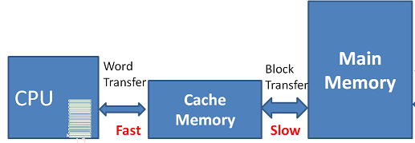
Cache Behavior Concepts
Cache Role
Design Factors
Emerging Challenges
Small, high-speed memory units
Bridge the speed gap between the processor and main memory
Stores frequently or recently accessed data
Notes:
Caches are small, high-speed memory units near the CPU that bridge the speed gap between the processor and main memory by storing frequently or recently accessed data, leveraging temporal and spatial locality.

Slide 6
Cache Behavior Concepts
Cache Role
Design Factors
Emerging Chalenges
Cache efficiency depends on factors such as hierarchy, data replacement and data mapping
Optimizing is challenging due to cache misses, coherence and trade-offs among size, speed and power
Notes:
Cache efficiency depends on factors such as hierarchy, data replacement and data mapping strategies, but optimizing these aspects is challenging due to cache misses, coherence in multicore systems and trade-offs among size, speed and power.

Slide 7
Cache Behavior Concepts
Cache Role
Design Factors
Emerging
Challenges
Security vulnerabilities
Efficient operation
Understandable cache behavior
Enhanced computational performance and system design
Notes:
Modern cache management must address security vulnerabilities while ensuring efficient operation, making understanding cache behavior crucial for enhancing computational performance and system design.

Slide 8
Types of cache misses
...
Compulsory misses
(Cold misses)
Capacity misses
Occur when the data is accessed for the first time
Prefetching techniques reduce them by loading the data into the cache before it is actually needed
Conflict misses (Collision misses)
Occur when the working set of data is larger than the cache size
Can be solved by optimizing loop structures and limiting the working set size
Occur when multiple memory blocks map to the same cache location
Can be reduced by reorganizing data access patterns or using more associative cache designs
Notes:
Compulsory misses, also known as cold misses, occur when the data is accessed for the first time. A good example of compulsory misses can be a large matrix, which is accessed for the first time, so its blocks must be fetched from the main memory. The mitigation of this problem can be prefetching techniques, which reduce compulsory misses by loading the data into the cache before it is actually needed.
Capacity misses occur when the working set of data is larger than the cache size. Even with optimal data placement, the cache cannot hold all the required information, leading to frequent evictions and reloads. A good example is a matrix multiplication’s performance, which can be improved when tile sizes are chosen to fit within the cache. Optimizing loop structures and limiting the working set size can solve some of these problems.
Conflict misses, also known as collision misses, occur when multiple memory blocks map to the same cache location, leading to unnecessary evictions despite available space. It's possible to reorganize data access patterns or use more associative cache designs to reduce conflict misses.

Slide 9
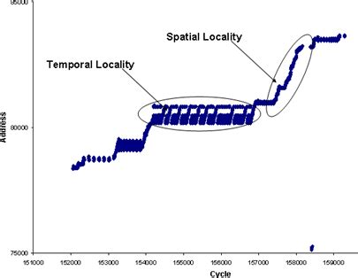
Temporal Locality
The reuse of the same data within a short period of time
Future misses reduction by keeping recently accessed data in cache
Spatial Locality
The access of data elements that are close to each other in memory
This principle works by prefetching nearby data, reducing misses in sequential data accesses
*
Notes:
Temporal locality means that a program reuses the same data within a short period of time. This process of keeping recently accessed data in the cache reduces future misses. (Talking about an example: repeatedly accessing the same rows of a matrix during computations, as seen in matrix multiplication, shows the meaning of temporal locality.)
Spatial locality is a principle that means the access of data elements that are close to each other in memory. This type of locality works by prefetching nearby data, reducing misses in sequential data accesses. (The example with the matrix is that the tiling of matrix operations enhances spatial locality by ensuring that adjacent rows and columns are processed together.)

Slide 10

Cache Coherency Challenges
{
> Frequent updates
> False sharing
> Performance impact
Memory Contention Challenges
{
> Bus saturation
> NUMA (Non- Uniform Memory Access) delays
> Performance impact
}
...
Notes:
Main cache coherency challenges are frequent updates, false sharing and performance impact. Frequent updates are about modifications to shared data that require updating or invalidating cached copies across all cores. False sharing means access to different variables within the same cache line by multiple cores that leads to unnecessary invalidations. And performance impact, which focuses on increased latency and reduced scalability due to delays in coherence mechanisms.
Main memory contention challenges are bus saturation, NUMA delays and performance impact. Bus saturation is responsible for multiple simultaneous memory requests that can overwhelm the memory bus, increasing latency. NUMA delays - which stands for Non-Uniform Memory Access delays - introduces delays when cores access remote memory regions.

Slide 11
Cache Optimization Techniques
Multicore Challenges
Performance Benefits
Leveraging Locality
& Multicore Efficiency
Cache misses classification
Temporal and spatial locality principles
Tiling
Cache coherency
Memory contention
Tiling
Loop transformations
Single-core performance boost
Near-linear scalability in multicore systems
Notes:
Classifying cache misses and applying temporal and spatial locality principles enable better memory hierarchy utilization. Techniques like tiling reduce cache misses and optimize performance, particularly in tasks like matrix operations and iterative solvers.
Cache coherency and memory contention are major bottlenecks for memory-intensive workloads. Tiling and loop transformations address these issues by improving data locality, reducing coherence traffic and optimizing memory bandwidth.
Cache optimizations boost single-core performance and enable near-linear scalability in multicore systems.

Slide 12
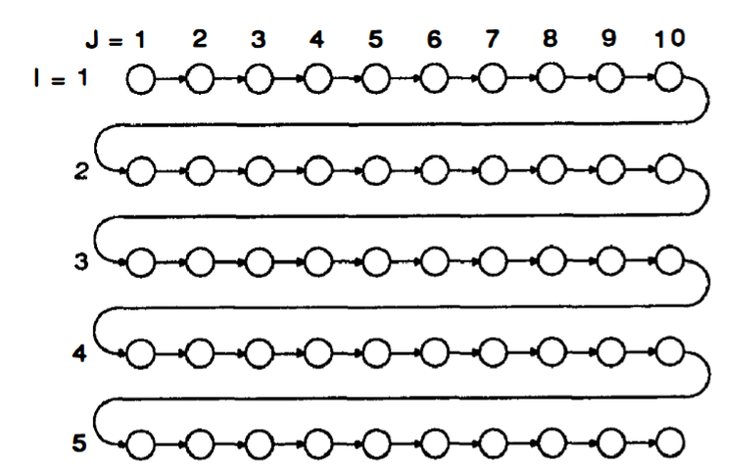
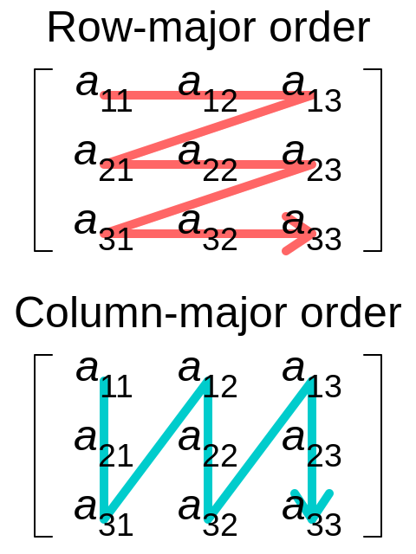
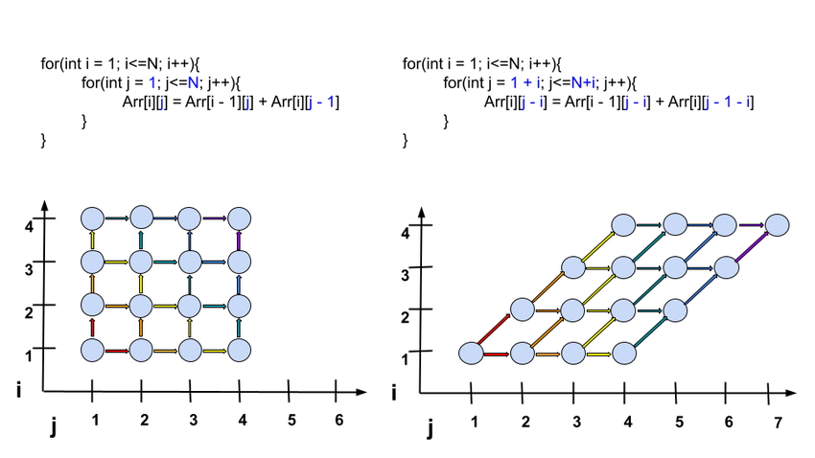
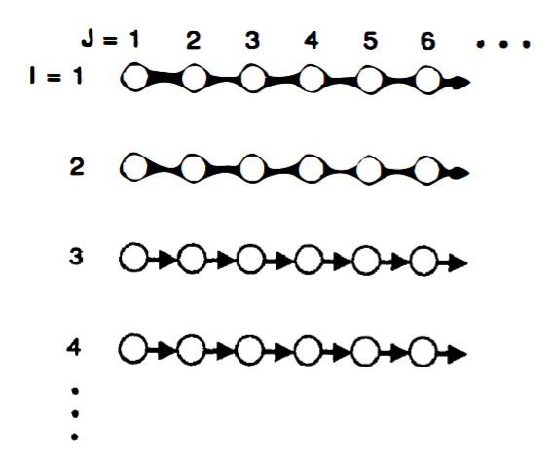
Do you remember these loop transformations? 1/2
{
Tiling
Interchange
Skewing
}
*
Notes:
Tiling: Divides the iteration space into smaller chunks (tiles) that fit in the cache
=> data is accessed multiple times from the cache rather than being repeatedly fetched from slower memory.
Interchange : It changes the order of loops so that the computer processes data in the same order it’s stored in memory.
Skewing : Shifts the way loops are processed to avoid two pieces of data fighting for the same spot in the cache

Slide 13
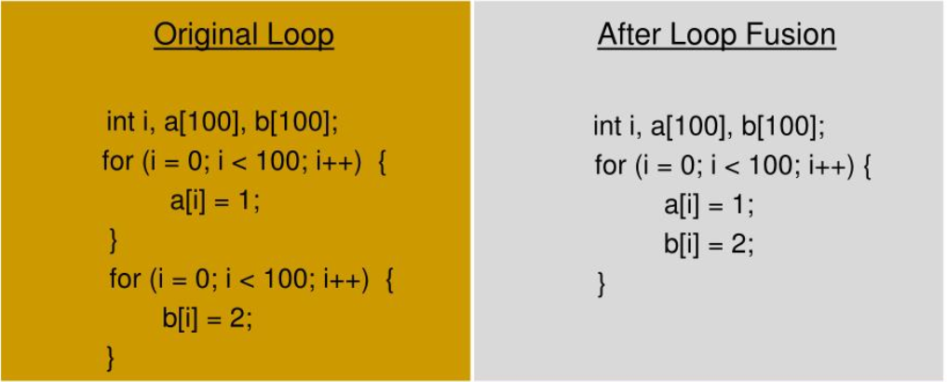
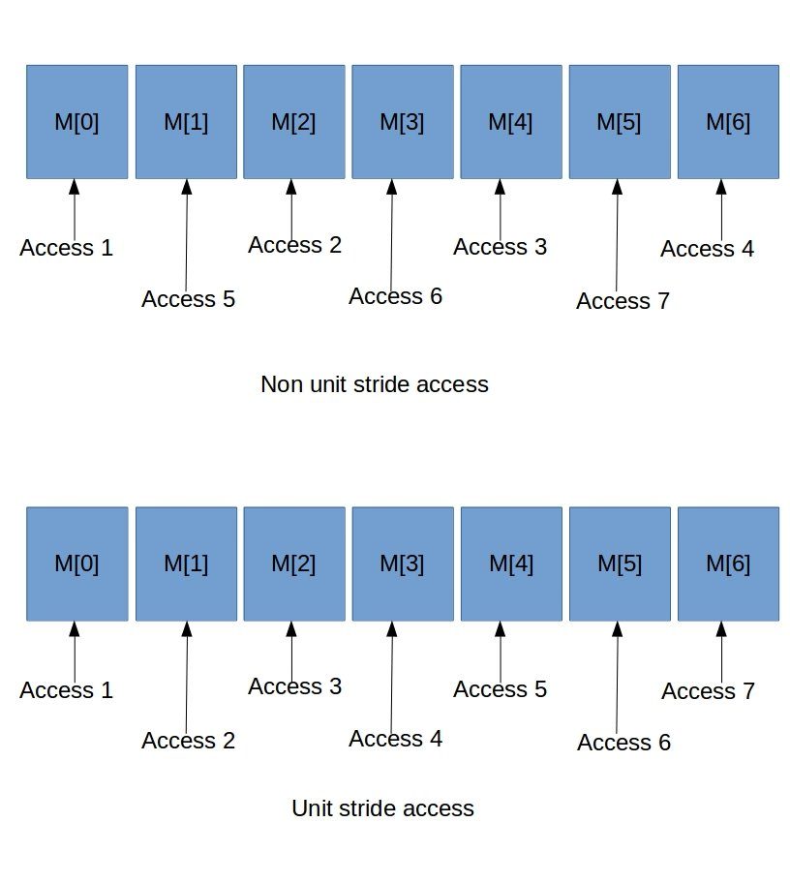
Do you remember these loop transformations? 2/2
{
Fusion
Non-Unit Strides
Data Alignment
}
Notes:
Loop Fusion : Combines loops that use the same data into one loop, so the computer doesn’t have to reload the same data multiple times.
Non-Unit Strides : Restructures the loop or transforms data layout to make strides (steps between consecutive memory accesses) align with the cache line size, optimizing memory utilization.
Data Alignment : Arranges data neatly in memory so the computer can grab all the needed information in one go, instead of splitting it across multiple trips to the cache.

Slide 14
Loop Transformation Combination
Combining Loop Transformations Considering Caches and Scheduling, E. Wolf (1996)
{
Loop Transformations | Fission, fusion, tiling, interchanging, and outer loop unrolling
Modeling Approach | Estimates total machine cycle time considering cache misses, software pipelining, register pressure, and loop overhead
Algorithm | Intelligently searches through possible transformations to select the best overall performance
Performance Improvement | Achieves an average geometric mean improvement of 50% with full optimizations on the MIPS R10000
Compilation Time | Reasonable, with modeling and optimizations taking up to 22% of total compile time
Conclusion | Effective and efficient algorithm for optimizing numerical programs, with a few exceptions.
}
Notes:
Today these loop transformations are orchestrated AI to minimise the cost function that we will present later

Slide 15
Compiler Support for Loop Transformations
Flags
Pragmas
{
Scope | Global (affects the entire codebase) | Localized (specific to code blocks)
Control | compiler-wide setting | Fine-tuned, per-loop or per-function
Example | -O3 (aggressive optimization) | #pragma omp parallel for (parallelism)
Use Case | General performance improvements | Specific optimizations for parallelism or vectorization
*
}
Notes:
1. Flags
Flags are options provided to the compiler through the command line to control the optimization level and behavior during the compilation process. They are typically global and affect the entire codebase, influencing how the compiler transforms the code for better performance, memory usage, and speed.
Key Points:
Global Settings: Applied to the entire program.
Impact: Directly affect how loops, functions, and other code constructs are optimized during compilation.
Level of Optimization: Flags can range from no optimization (e.g., -O0) to aggressive optimization (e.g., -O3).
Example:
-O3 (GCC/Clang):
Activates high-performance optimizations.
Includes loop unrolling, loop tiling, and loop fusion.
Improves performance by optimizing code for better data locality and reducing cache misses.
Commonly used in performance-critical applications like scientific computing and high-performance systems.
2. Pragmas
Pragmas Pragmas are special instructions you write inside your code to tell the compiler how to handle specific parts of it. They look like comments but start with #pragma, and they affect only certain parts of the code.
Localized Control: Applied to specific code blocks (e.g., loops).
Fine-grained Control: Allow precise optimization for performance-critical sections.
Compiler-Specific: Different compilers may support different pragmas.
Example:
#pragma omp parallel for (OpenMP):
Instructs the compiler to parallelize a loop.
Improves performance on multi-core processors by splitting loop iterations across multiple threads.

Slide 16
Cache-Aware Scheduling Algorithms
01
02
03
Cache and Scheduling
Tiling, unrolling and interchange improve cache behavior by keeping data accessible longer
The goal is to minimize performance bottlenecks caused by misses
Optimizing Loops for Cache
Tiling creates smaller, cache-friendly blocks
Loop interchange and unrolling enhance data locality and reuse
Cache Models in Scheduling
Cache models optimize tile sizes and transformations
The goal is to maximize data reuse and minimize misses for efficient scheduling
Notes:
Now, talking about cache-aware scheduling and memory management, data locality is key to optimizing program performance on modern microprocessors. Cache-aware scheduling algorithms play a crucial role in it.
Efficient cache usage is crucial for minimizing performance bottlenecks caused by misses. Techniques like tiling, unrolling, and loop interchange improve cache behavior by keeping data accessible for longer periods.
When it comes to optimizing loops for cache, tiling breaks computations into smaller, cache-friendly blocks, while loop interchange and unrolling improve data locality and reuse, significantly reducing cache misses.
Cache models in scheduling predict performance and optimize tile sizes and transformations. This ensures maximum data reuse and fewer misses, leading to more efficient scheduling overall.

Slide 17
Techniques for improving Instruction Level Parallelism
{
..
Cache Coherency Fundamentals
Advanced Techniques
Ensures data consistency across multiple processor caches
Main challenges are maintaining consistency with shared data and minimizing coherence traffic
Directory-based Cache Coherency: centralized or distributed directory to track data state
Prefetching with Locality Awareness: pre-load data into local caches to reduce misses
Cache Partitioning: ensures local access to frequently used data
Exploiting Data Locality
Minimizing False Sharing
Loop Permutation and Fusion: reduce cache line access, minimizing inter-processor communication
Temporal Reuse: reduces the need for frequent cache update
Loop Skewing: prevents concurrent access to the same cache line
Data Layout Transformations: avoid cache line sharing between processors
}
*
Notes:
Cache coherency is essential in multiprocessor systems, where each processor may have its own local cache of shared memory. To ensure everything runs correctly and efficiently, coherency protocols coordinate these caches to keep data consistent.
Cache coherency ensures data consistency across multiple processor caches, a critical aspect in multiprocessor systems. The main challenges are maintaining consistency when processors access shared data and minimizing coherence traffic.
Exploiting data locality is key to improving cache efficiency. Techniques like loop permutation and fusion help reduce cache line access and minimize inter-processor communication. Temporal reuse further reduces the need for frequent cache updates, keeping operations smooth.
Moving to advanced techniques, directory-based cache coherency uses centralized or distributed directories to track data states. Locality-aware prefetching preloads frequently used data into local caches to reduce misses, while cache partitioning ensures frequently accessed data stays local.
Lastly, minimizing false sharing is crucial. Loop skewing prevents processors from concurrently accessing the same cache line, and data layout transformations avoid sharing cache lines between processors.

Slide 18
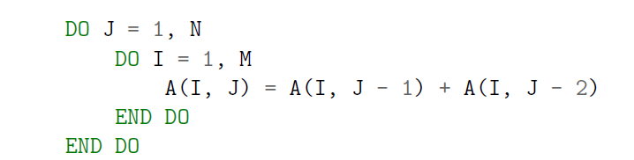
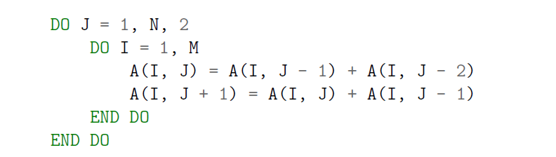
Unroll-And-Jam Transformation
Unrolls outer loops by a specified factor and fuses the unrolled iterations into the inner loop
Increased ILP - exposes additional parallelism in the loop body
Improved cache utilization - enhances cache locality and reduces cache misses
{
}
Notes:
So, this is the example code of the unroll-and-jam transformation.
This transformation involves unrolling the outer loops by a specific factor and fusing the unrolled iterations into the inner loop.
It delivers two key benefits:
-> Increased instruction-level parallelism: by creating more independent operations that can run concurrently, it exposes additional parallelism in the loop body.
-> Improved cache utilization: by concentrating memory accesses within smaller loop bodies, it boosts cache locality and reduces cache misses.

Slide 19
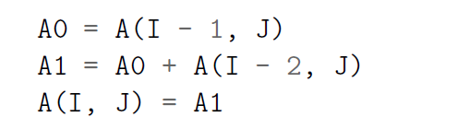
Scalar Replacement
{
Improves performance by replacing repeated memory references with register allocations
Reduces memory access costs
Lowers cache pressure
}
Notes:
And this is the example code of the scalar replacement transformation.
After unroll-and-jam, scalar replacement further improves performance by replacing repeated memory references with register allocations, reducing memory access costs. This approach ensures values are reused from registers, improving ILP and lowering cache pressure.

Slide 20

Objective of a Cost Function for Data Cache Optimization
Measure and improve the efficiency of memory accesses in a program
Well optimized cost function => reduce memory latency & improve performance
*
Notes:
The objective of a cost function in data cache optimization is to measure and improve the efficiency of memory accesses in a program. By calculating the cost of accessing data in the cache, we can understand how well the data is utilized and whether cache misses (delays when data is not found in the cache) can be minimized. A well-optimized cost function helps identify how to arrange loops and memory access patterns to reduce memory latency and improve performance by maximizing the use of data already loaded into the cache.

Slide 21

Cost function #1 : RefCost() Compiler optimizations for improving data locality, Carr 1994
Calculates the access cost for each memory reference based on its access pattern (loop-invariant, unit-stride, or non-unit stride) and the number of iterations in the loop.
• trip countl is the number of iterations for the loop;
• cls (cache line size) is the number of memory elements that fit in one cache line;
• stride(f1, il, l) is the memory access stride for the reference.
Notes:
Loop-invariant: The same data is reused in every loop iteration (easy for the computer).
Unit-stride: The data is accessed in order, one after another (fast for the computer).
Non-unit stride: The data is accessed with gaps or out of order (slower for the computer).

Slide 22
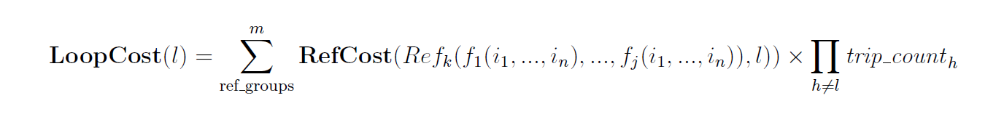
Cost function #2 : LoopCost() Compiler optimizations for improving data locality, Carr 1994
Quantifies the total memory access cost of a loop nest by summing the costs of all reference groups, adjusted for the trip counts of outer loop.
• ref groups is the set of reference groups in the loop nest, starting from k = 1
• trip counth is the number of iterations for loop h
• h ̸= l ensures that only outer loops are considered for the product
Notes:
This means figuring out how much "effort" it takes for the computer to access memory while running a loop with multiple levels (a loop nest). It works like this:
Break it down: Group all the places in the loop where memory is accessed (called reference groups).
Add the costs: Add up the cost of accessing memory for each group.
Adjust for loop size: Multiply the cost by how many times the outer loops run (because outer loops control how often the inner ones repeat).
The goal is to get a single number that shows how expensive the memory access is for the entire loop.

Slide 23
Practical Considerations and Trade-offs
Hardware Constraints
Performance Trade-offs
Scalability & Complexity
Cache hierarchy (L1, L2, L3) requires different optimization strategies for improved data locality
Multi-core and SIMD systems introduce challenges like cache contention and false sharing
Power efficiency must be balanced with performance, using techniques like dynamic voltage scaling
Notes:
SIMD (Single Instruction, Multiple Data) system processes multiple data points simultaneously using a single instruction, making it ideal for speeding up repetitive tasks like graphics processing and scientific computations
Cache contention occurs when multiple programs or threads compete to use the same cache space
False sharing is when multiple cores use different parts of the same memory block, causing slowdowns because they keep overwriting each other’s cache unnecessarily.
dynamic voltage scaling: lowering the power to the processor when it’s not working hard and raising it when more speed is needed.

Slide 24
Practical Considerations and Trade-offs
Hardware Constraints
Performance Trade-offs
Scalability & Complexity
Optimizations come with overheads & benefits must outweigh costs
Scaling issues arise in multi-core systems, where cache contention can reduce optimization effectiveness

Slide 25
Practical Considerations and Trade-offs
Hardware Constraints
Performance Trade-offs
Scalability & Complexity
Optimizations must be scalable, considering how memory access patterns change with larger systems
Excessive complexity in optimizations may lead to reduced returns and need careful evaluation

Slide 26
Machine Learning Applications in Cache Optimization
{
..
Cache behavior prediction
Adaptive Cache configuration
ML models predict cache accesses and optimize prefetching and replacement, reducing latency & energy use.
ML adapts cache parameters using clustering for workload-specific tuning and online learning for real-time adjustments.
Dynamic Cache replacement policies
ML-enhanced policies outperform traditional methods by using supervised learning and neural networks to improve real-time replacement decisions.
Prefetching optimization
ML improves prefetching strategies for spatial patterns and decision trees for workload-specific rules, reducing cache pollution.
Energy-efficient cache management
ML-driven regression optimizes energy usage while maintaining performance.
*
}
..
Notes:
Now let's explore some ways machine learning is transforming cache management.
Cache behavior prediction:
Machine learning models like Recurrent Neural Networks, Markov models and Reinforcement Learning predict cache accesses to optimize prefetching and replacement, decreasing latency and energy consumption.
Adaptive cache configuration:
Machine learning adjusts cache parameters like size and associativity through clustering for workload-specific tuning and online learning for real-time adaptation.
Prefetching optimization:
ML uses Convolutional Neural Networks to identify spatial patterns and decision trees for workload-specific rules, reducing cache pollution.
Energy-efficient cache management:
ML-driven regression and reinforcement learning models optimize energy usage without compromising performance, which is crucial for IoT devices.
Dynamic cache replacement policies:
ML-enhanced methods, using supervised learning and neural networks, outperform traditional policies like Least Recently Used by making smarter, real-time replacement decisions.

Slide 27
Hybrid and Dynamic Optimization Techniques
{
Hybrid Architectures
Dynamic Optimization
Combine SRAM and NVM for performance and energy efficiency.
Adjust cache parameters and replacement policies in real-time, using machine learning for self-optimization.
}
*
Notes:
Now I would like to mention basic information about hybrid and dynamic optimization techniques.
Hybrid cache architectures combine memory technologies like SRAM and NVM (volatile and non-volatile memory respectively) to optimize both performance and energy efficiency. SRAM offers high-speed access for latency-critical tasks, while NVM provides greater storage capacity and lower power consumption for larger datasets.
Dynamic reconfiguration adjusts cache parameters such as size, associativity and block size during runtime to match workload intensity. For example, higher associativity can reduce conflict misses during peak demand, while smaller configurations save energy during lighter workloads.

Slide 28
CONCLUSION
Data caches address bottlenecks like cache misses, coherency issues, and memory contention, bridging the gap between fast processors and slower memory systems.
Strategies such as tiling, unroll-and-jam and loop fusion improve data locality and minimize latency, enabling efficient memory-intensive computations.
Cache-aware scheduling, coherency protocols and hybrid approaches ensure scalability, energy efficiency, and adaptability to diverse workloads.
Emerging innovations in machine learning-driven cache management, NVM and in-memory processing prepare systems for increasingly complex data demands.
Notes:
And now it's time to shortly conclude the presentation.
Data caches play a crucial role in tackling bottlenecks like cache misses, coherency issues and memory contention, helping bridge the gap between fast processors and slower memory systems.
To improve performance, techniques like tiling, unroll-and-jam and loop fusion are used to enhance data locality and reduce latency, making memory-intensive computations more efficient.
Scalability and adaptability are achieved through cache-aware scheduling, coherency protocols and hybrid strategies, which also ensure energy efficiency across diverse workloads.
Looking ahead, innovations like machine learning-driven cache management, non-volatile memory and in-memory processing are preparing systems to handle the increasing complexity of data demands.

Slide 29
References
Michael E. Wolf and Monica S. Lam. 1991. “A data locality optimizing algorithm”. In Proceedings of the ACM SIGPLAN 1991 conference on Programming language design and implementation (PLDI '91). ACM, New York, NY, USA, 30-44.
Michael E. Wolf, Dror E. Maydan, and Ding-Kai Chen. 1996. “Combining loop transformations considering caches and scheduling”. In Proceedings of the 29th annual ACM/IEEE international symposium on Microarchitecture (MICRO 29). IEEE Computer Society, Washington, DC, USA, 274-286.
Kathryn S. McKinley, Steve Carr, and Chau-Wen Tseng. 1996. “Improving data locality with loop transformations”. ACM Trans. Program. Lang. Syst. 18, 4 (July 1996), 424-453.
Steve Carr and Ken Kennedy. 1994. “Improving the ratio of memory operations to floating-point operations in loops”. ACM Trans. Program. Lang. Syst. 16, 6 (November 1994), 1768-1810.
Steve Carr, Kathryn S. McKinley, and Chau-Wen Tseng. 1994. “Compiler optimizations for improving data locality”. SIGPLAN Not. 29, 11 (November 1994), 252-262.
Steve Carr. 1996. “Combining Optimization for Cache and Instruction-Level Parallelism”. In Proceedings of the 1996 Conference on Parallel Architectures and Compilation Techniques (PACT '96). IEEE Computer Society, Washington, DC, USA, 238-.

Slide 30
Thank your for your attention!
}
< Questions? >
*

