Slide 1
Advaned Computer Architecture: Basic Review
A Verilog Single-Cycle MIPS
Part I
Spring 2018
Jeong-Gun Lee
Dept. of Computer Engineering, Hallym University
Jeonggun.lee@hallym.ac.kr
Reference: http://cadapplets.lafayette.edu/ece313/
Notes:
1

Slide 2

Outline
MIPS Instruction Set
Registers and Memory 3
MIPS Instructions
A Single-Cycle MIPS in Verilog
Modeling basic datapath components
Modeling the datapath
Modeling the control unit
Notes:
4

Slide 3
MIPS Registers and Memory
32 bits
R0
0x00000000
R1
0x00000004
R2
0x00000008
0x0000000C
0x00000010
R30
0x00000014
R31
0x00000018
32 General Purpose Registers
0x0000001C
PC = 0x0000001C
0xfffffff4
0xfffffffc
0xfffffffc
Registers
Memory
4GB Max
(Typically 64MB-1GB)

Slide 4
MIPS Registers
Fast access to program data
Register R0/$0/$zero: hardwired to constant zero
Register names:
$0-$31 or R0-R31
Specialized names based on usage convention
$zero ($0) - always zero
$s0-$s7 ($16-$23) - “saved” registers
$t0-$t7 ($8-$15) - “temporary” registers
$sp - stack pointer
Other special-purpose registers

Slide 5
MIPS Registers and Usage

Slide 6
More about MIPS Memory Organization
Not all architectures require this
8 bits
32 bits
0x00000000
0x00000000
0
1
2
3
0x00000001
0x00000004
0x00000002
0x00000008
0x00000003
0x0000000C
*Word sizes vary in other architectures
Two views of memory:
2³² bytes with addresses 0, 1, 2, …, 2³²-1
2³⁰ 4-byte words* with addresses 0, 4, 8, …, 2³²-4
Both views use byte addresses
Word address must be multiple of 4 (aligned)

Slide 7
Outline - Instruction Sets
MIPS Instruction Set
Registers and Memory
MIPS Instructions 3
A Single-Cycle MIPS in Verilog
Modeling basic datapath components
Modeling the datapath
Modeling the control unit
Notes:
4

Slide 8
MIPS Instructions
All instructions exactly 32 bits wide
Different formats for different purposes
Similarities in formats ease implementation
6 bits
5 bits
5 bits
5 bits
5 bits
6 bits
op
rs
rt
rd
shamt
funct
R-Format
6 bits
5 bits
5 bits
16 bits
op
rs
rt
offset
I-Format
6 bits
26 bits
J-Format
op
address

Slide 9
MIPS Instruction Types
Arithmetic & Logical - manipulate data in registers add $s1, $s2, $s3 $s1 = $s2 + $s3 or $s3, $s4, $s5 $s3 = $s4 OR $s5
Data Transfer - move register data to/from memory lw $s1, 100($s2) $s1 = Memory[$s2 + 100] sw $s1, 100($s2) Memory[$s2 + 100] = $s1
Branch - alter program flow beq $s1, $s2, 25 if ($s1==$s1) PC = PC + 4 + 4*25

Slide 10
MIPS Arithmetic & Logical Instructions
Instruction usage (assembly) add dest, src1, src2 dest=src1 + src2 sub dest, src1, src2 dest=src1 - src2 and dest, src1, src2 dest=src1 AND src2
Instruction characteristics
Always 3 operands: destination + 2 sources
Operand order is fixed
Operands are always general purpose registers
Design Principles:
Design Principle 1: Simplicity favors regularity
Design Principle 2: Smaller is faster

Slide 11
Arithmetic Instruction Examples
C simple addition and assignment C code: A = B + C MIPS code: add $s0, $s1, $s2
Complex arithmetic assignment: C code: A = B + C + D; E = F - A; MIPS code: add $t0, $s1, $s2 add $s0, $t0, $s3 sub $s4, $s5, $s0
Compiler keeps track of mapping variables to registers (and, when necessary, memory)

Slide 12
Arithmetic & Logical Instructions - Binary Representation
6 bits
5 bits
5 bits
5 bits
5 bits
6 bits
op
rs
rt
rd
shamt
funct
Used for arithmetic, logical, shift instructions
op: Basic operation of the instruction (opcode)
rs: first register source operand
rt: second register source operand
rd: register destination operand
shamt: shift amount (more about this later)
funct: function - specific type of operation
Also called “R-Format” or “R-Type” Instructions

Slide 13
Arithmetic & Logical Instructions - Binary Representation Example
Machine language for add $8, $17, $18
See reference card for op, funct values
6 bits
5 bits
5 bits
5 bits
5 bits
6 bits
op
rs
rt
rd
shamt
funct
0
17
18
8
0
32
Decimal
000000
10001
10010
01000
00000
100000
Binary

Slide 14
MIPS Data Transfer Instructions
Transfer data between registers and memory
Instruction format (assembly) lw $dest, offset($addr) load word sw $src, offset($addr) store word
Uses:
Accessing a variable in main memory
Accessing an array element

Slide 15
Example - Loading a Simple Variable
8
R0=0 (constant)
0x00
R1
0x04
+
0x08
R2=0x10
R2=0x10
R3
0x0c
R4
0x10
Variable X
R5
0x14
R5
R5 = 629310
Variable Y
0x18
Variable Z = 692310
Variable Z = 692310
0x1c
R30
R31
Registers
lw R5,8(R2)
Memory

Slide 16
Data Transfer Example - Array Variable
12=0xc
Base Address
R0=0 (constant)
0x00
R1
0x04
+
0x08
R2=0x08
R2=0x08
a[0]
R3
0x0c
a[1]
R4
0x10
a[2]
R5=105
0x14
R5=105
a[3]
a[3]=105
0x18
a[4]
0x1c
R30
R31
Registers
C Program: int a[5];
a[3] = z;
Assembly: sw $5,12($2)
scaled offset
Memory

Slide 17
Data Transfer Instructions - Binary Representation
6 bits
5 bits
5 bits
16 bits
op
rs
rt
offset
Used for load, store instructions
op: Basic operation of the instruction (opcode)
rs: first register source operand
rt: second register source operand
offset: 16-bit signed address offset (-32,768 to +32,767)
Also called “I-Format” or “I-Type” instructions
Address
source for sw
destination for lw

Slide 18
I-Format vs. R-Format Instructions
Compare with R-Format
6 bits
5 bits
5 bits
5 bits
5 bits
6 bits
op
rs
rt
rd
shamt
funct
R-Format
6 bits
5 bits
5 bits
16 bits
op
rs
rt
offset
I-Format
Note similarity!

Slide 19
I-Format Example
Machine language for lw $9, 1200($8) == lw $t1, $1200($t0)
6 bits
5 bits
5 bits
16 bits
op
rs
rt
offset
35
8
9
1200
Decimal
100011
01000
01001
0000010010110000
Binary

Slide 20
MIPS Conditional Branch Instructions
Conditional branches allow decision making beq R1, R2, LABEL if R1==R2 goto LABEL bne R3, R4, LABEL if R3!=R4 goto LABEL
Example C Code if (i==j) goto L1; f = g + h; L1: f = f - i; Assembly beq $s3, $s4, L1 add $s0, $s1, $s2 L1: sub $s0, $s0, $s3

Slide 21
Example: Compiling C if-then-else
Example C Code if (i==j) f = g + h; else f = g - h; Assembly bne $s3, $s4, Else add $s0, $s1, $s2 j Exit; # new: unconditional jump Else: sub $s0, $s0, $s3 Exit:
New Instruction: Unconditional jump j LABEL # goto Label

Slide 22
Binary Representation - Branch
6 bits
5 bits
5 bits
16 bits
op
rs
rt
offset
Branch instructions use I-Format
offset is added to PC when branch is taken beq r0, r1, offset has the effect: if (r0==r1) pc = pc + 4 + (offset << 2) else pc = pc + 4;
Offset is specified in instruction words (why?)
What is the range of the branch target addresses?
Conversion to
word offset

Slide 23
Branch Example
Machine language for beq $s3, $s4, L1 add $s0, $s1, $s2 L1: sub $s0, $s0, $s3
$19
$20
PC
PC+4
1-instruction
offset
Target
of beq
6 bits
5 bits
5 bits
16 bits
op
rs
rt
offset
4
19
20
1
Decimal
000100
10011
10100
0000000000000001
Binary

Slide 24
Comparisons - What about <, <=, >, >=?
bne, beq provide equality comparison
slt provides magnitude comparison slt $t0,$s3,$s4 # if $s3<$s4 $t0=1; # else $t0=0;
Combine with bne or beq to branch: slt $t0,$s3,$s4 # if (a<b) bne $t0,$zero, Less # goto Less;
Why not include a blt instruction in hardware?
Supporting in hardware would lower performance
Assembler provides this function if desired (by generating the two instructions)
condition register

Slide 25
Binary Representation - Jump
6 bits
26 bits
op
address
Jump Instruction uses J-Format (op=2)
What happens during execution? PC = PC[31:28] : (IR[25:0] << 2)
Concatenate upper 4 bits
of PC to form complete
32-bit address
Conversion to
word offset

Slide 26
Jump Example
Machine language for j L5
Assume L5 is at address 0x00400020
and
PC <= 0x03FFFFFF
lower 28
bits
>>2
6 bits
26 bits
op
address
0x0100008
2
0x0100008
Decimal/Hex
000010
00000100000000000000001000
Binary

Slide 27
Constants / Immediate Instructions
Small constants are used quite frequently (50% of operands) e.g., A = A + 5; B = B + 1; C = C - 18;
MIPS Immediate Instructions (I-Format): addi $29, $29, 4 slti $8, $18, 10 andi $29, $29, 6 ori $29, $29, 4
Allows up to 16-bit constants
How do you load just a constant into a register?
Arithmetic instructions sign-extend immed.
Logical instructions don’t sign extend immed.
ori $5, $zero, 666

Slide 28
Why are Immediates only 16 bits?
Because 16 bits fits neatly in a 32-bit instruction
Because most constants are small (i.e. < 16 bits)
Design Principle 4: Make the Common Case Fast

Slide 29
MIPS Logical Instructions
and, andi - bitwise AND
or, ori - bitwise OR
Example
$s0
11011111010110100100100011110101
$s1
11110000111100001111000011110000
and $s2,$s0,$s1
$s2
11010000010100000100000011110000
ori $s3,$s2,252
00000000000000000000000011111100
(252₁₀)
$s3
11010000010100000100000011111100

Slide 30
Logical Operations - Applications
Masking - clear, set or test
Individual bits
Groups of bits

Slide 31
Larger Constants
Immediate operations provide for 16-bit constants
What about when we need larger constants?
Use "load upper immediate - lui” (I-Format) lui $t0, 1010101010101010
Then use ori to fill in lower 16 bits: ori $t0, $t0, 1010101010101010
filled with zeros
$t0
(original contents)
1010101010101010
0000000000000000
$t0
1010101010101010
0000000000000000
1010101010101010

Slide 32
MIPS Shift Instructions
MIPS Logical Shift Instructions
Shift left: sll (shift-left logical) instruction
Right shift: srl (shift-right logical) instruction
$s0
11011111010110100100100011110101
sll $s1,$s0,8
Zeros shift in
$s1
01011010010010001111010100000000
srl $s2,$s1,4
Zeros shift in
$s2
00000101101001001000111101010000

Slide 33
Shift Instruction Encodings
6 bits
5 bits
5 bits
5 bits
5 bits
6 bits
op
rs
rt
rd
shamt
funct
sll
0
rs
rt
rd
shamt
0
srl
0
rs
rt
rd
shamt
6
unused
Applications
Bitfield access (see book)
Multiplication / Division by power of 2
Example: array access sll $t0,$t1,2 # $t0=$t1*4 add $t3,$t1,$t2 lw $t3, 0($t0)

Slide 34
Summary - MIPS Instruction Set
Three instruction formats
Similarities in formats ease implementation
6 bits
5 bits
5 bits
5 bits
5 bits
6 bits
op
rs
rt
rd
shamt
funct
R-Format
6 bits
5 bits
5 bits
16 bits
op
rs
rt
offset
I-Format
6 bits
26 bits
J-Format
op
address

Slide 35
Advaned Computer Architecture: Basic Review with Verilog HDL
A Verilog Single-Cycle MIPS
Part 2
Spring 2018
Jeong-Gun Lee
Dept. of Computer Engineering, Hallym University
Jeonggun.lee@hallym.ac.kr
Reference: http://cadapplets.lafayette.edu/ece313/
Notes:
1

Slide 36
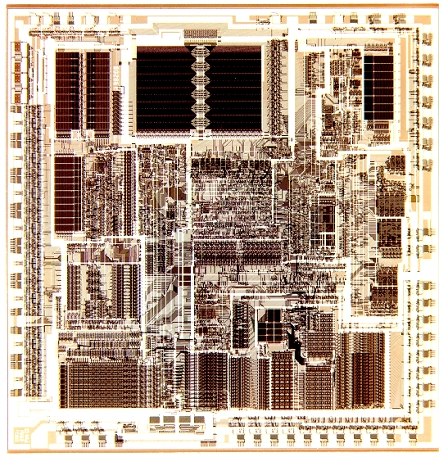
Outline - A Single-Cycle MIPS in Verilog
MIPS Instruction Set
Registers and Memory
MIPS Instructions
A Single-Cycle MIPS in Verilog
Modeling basic datapath components 3
Modeling the datapath
Modeling the control unit

Slide 37
Single-Cycle Datapath Components
32-bit adder add32
32-bit ALU alu32
Parameterized 2-1 Multiplexer mux2
32-bit Simple Register reg32
32-bit Idealized Read/Write Memory mem32
32-bit MIPS-Style Register File reg_file
32-bit Idealized Read-Only Memory rom32
ALU Control Unit alu_ctl
Control Unit control_single

Slide 38
32-Bit Adder
// Behavioral model of a 32-bit adder
module add32(a, b, result);
input [31:0] a, b;
output [31:0] result;
assign result = a + b;
endmodule
Adder

Slide 39
32-Bit ALU
module alu(ctl, a, b, result, zero);
input [2:0] ctl;
input [31:0] a, b;
output [31:0] result;
output zero;
reg [31:0] result;
reg zero;
always @(a or b or ctl)
begin
case (ctl)
3'b000 : result = a & b; // AND
3'b001 : result = a | b; // OR
3'b010 : result = a + b; // ADD
3'b110 : result = a - b; // SUBTRACT
3'b111 : if (a < b) result = 32'd1;
else result = 32'd0; //SLT
default : result = 32'hxxxxxxxx;
endcase
if (result == 32'd0) zero = 1;
else zero = 0;
end
endmodule
zero
ALU

Slide 40
2-1 Multiplexer (Parameterized)
module mux2( sel, a, b, y );
parameter bitwidth=32;
input sel;
input [bitwidth-1:0] a, b;
output [bitwidth-1:0] y;
assign y = sel ? b : a;
endmodule

Slide 41
32-Bit Register (e.g., PC)
// Simple 32-bit register
module reg32 (clk, reset, d_in, d_out);
input clk, reset;
input [31:0] d_in;
output [31:0] d_out;
reg [31:0] d_out;
always @(posedge clk)
begin
if (reset) d_out <= 0;
else d_out <= d_in;
end
endmodule
reset
REG
Data In
32
32
Data Out
CLK

Slide 42
Idealized Memory - Part 1
module mem32(clk, mem_read, mem_write, address, data_in, data_out);
input clk, mem_read, mem_write;
input [31:0] address, data_in;
output [31:0] data_out;
reg [31:0] data_out;
parameter BASE_ADDRESS = 25'd0;
reg [31:0] mem_array [0:31];
wire [4:0] mem_offset;
wire address_select;
assign mem_offset = address[6:2]
// address decoding
assign address_select = (address[31:7] == BASE_ADDRESS);

Slide 43

Idealized Memory - Part 2
// for READ operations
always @(mem_read or address_select or mem_offset or mem_array[mem_offset])
begin
if (mem_read == 1'b1 && address_select == 1'b1)
begin
if ((address % 4) != 0)
$display($time, " rom32 error: unaligned address %d", address);
data_out = mem_array[mem_offset];
$display($time, " reading data: Mem[%h] => %h", address, data_out);
end
else // 메모리의 주어진 범위를 넘어설 때
data_out = 32'hxxxxxxxx;
end

Slide 44
Idealized Memory - Part 3
// for WRITE operations
always @(posedge clk)
begin
if (mem_write == 1'b1 && address_select == 1'b1)
begin
$display($time, " writing data: Mem[%h] <= %h", address,data_in);
mem_array[mem_offset] <= data_in;
end
end
// initialize with some arbitrary values
integer i;
initial begin
for (i=0; i<7; i=i+1) mem_array[i] = i;
end
endmodule

Slide 45
Register File
module reg_file(clk, RegWrite, RN1, RN2, WN, RD1, RD2, WD);
input clk;
input RegWrite;
input [4:0] RN1, RN2, WN;
input [31:0] WD;
output [31:0] RD1, RD2;
reg [31:0] RD1, RD2;
reg [31:0] file_array [31:1];

Slide 46
Register File - Part 2
always @(RN1 or file_array[RN1])
begin
if (RN1 == 0) RD1 = 32'd0;
else RD1 = file_array[RN1];
$display($time, " reg_file[%d] => %d (Port 1)", RN1, RD1);
end
always @(RN2 or file_array[RN2])
begin
if (RN2 == 0) RD2 = 32'd0;
else RD2 = file_array[RN2];
$display($time, " reg_file[%d] => %d (Port 2)", RN2, RD2);
end
always @(posedge clk)
if (RegWrite && (WN != 0))
begin
file_array[WN] <= WD;
$display($time, " reg_file[%d] <= %d (Write)", WN, WD);
end
endmodule

Slide 47
32-Bit Idealized ROM
Input: 32-bit address
Output: 32-bit data
Use to model instruction memory

Slide 48
32-bit Idealized ROM - Part 1
// A simple 32-bit by 32-word read-only memory model
module rom32(address, data_out);
input [31:0] address;
output [31:0] data_out;
reg [31:0] data_out;
// address that applies to this memory
parameter BASE_ADDRESS = 25'd0;
reg [31:0] mem_arrray [0:31];
wire [4:0] mem_offset;
wire address_select;
// to get word offset
assign mem_offset = address[6:2];
// address decoding
assign address_select = (address[31:7] == BASE_ADDRESS);

Slide 49
32-bit Idealized ROM - Part 2
always @(address_select or mem_offset)
begin
if ((address % 4) != 0)
$display($time, " rom32 error: unaligned address %d", address);
if (address_select == 1)
begin
case (mem_offset)
5'd0 : data_out = { 6'd35, 5'd0, 5'd2, 16'd4 }; // 32bit
5'd1 : data_out = { 6'd35, 5'd0, 5'd3, 16'd8 };
5'd2 : data_out = { 6'd35, 5'd0, 5'd4, 16'd20 };
5'd3 : data_out = { 6'd0, 5'd0, 5'd0, 5'd5, 5'd0, 6'd32 };
5'd4 : data_out = { 6'd0, 5'd5, 5'd2, 5'd5, 5'd0, 6'd32 };
5'd5 : data_out = { 6'd0, 5'd4, 5'd5, 5'd6, 5'd0, 6'd42 };
5'd6 : data_out = { 6'd4, 5'd6, 5'd0, -16'd3 };
5'd7 : data_out = { 6'd43, 5'd0, 5'd5, 16'd0 };
default data_out = 32'hxxxx;
endcase
$display($time, " reading data: rom32[%h] => %h", address, data_out);
end
end
endmodule

Slide 50
32-bit Idealized ROM - case
case (mem_offset)
5'd0 : data_out = { 6'd35, 5'd0, 5'd2, 16'd4 };
// lw $2, 4($0) r2=1
5'd1 : data_out = { 6'd35, 5'd0, 5'd3, 16'd8 };
// lw $3, 8($0) r3=2
5'd2 : data_out = { 6'd35, 5'd0, 5'd4, 16'd20 };
// lw $4, 20($0) r4=5
5'd3 : data_out = { 6'd0, 5'd0, 5'd0, 5'd5, 5'd0, 6'd32 };
// add $5, $0, $0 r5=0
5'd4 : data_out = { 6'd0, 5'd5, 5'd2, 5'd5, 5'd0, 6'd32 };
// add $5, $5, $1 r5 = r5 + 1
5'd5 : data_out = { 6'd0, 5'd4, 5'd5, 5'd6, 5'd0, 6'd42 };
// slt $6, $4, $5 is r5 >= 5?
5'd6 : data_out = { 6'd4, 5'd6, 5'd0, -16'd3 };
// beq $6, $zero, -3 if not, go back 2
5'd7 : data_out = { 6'd43, 5'd0, 5'd5, 16'd0 };
// s2 $6, 0($zero) MEM[0] = $5
// add more cases here as desired
default data_out = 32'hxxxx;
endcase

Slide 51
ALU Control
Review - ALU Control Function
Instr. type
Operation
funct
Desired Action
ALU Ctl.
ALUOp
data transfer
lw
XXXXXX
add
010
00
data transfer
sw
XXXXXX
add
010
00
branch
beq
XXXXXX
subtract
110
01
r-type
add
100000
add
010
10
r-type
sub
100010
subtract
110
10
r-type
and
100100
and
000
10
r-type
or
100101
or
001
10
r-type
slt
101010
set on less than
111
10

Slide 52
ALU Control Unit - Part 1
module alu_ctl(ALUOp, Funct, ALUOperation);
input [1:0] ALUOp;
input [5:0] Funct;
output [2:0] ALUOperation;
reg [2:0] ALUOperation;
// symbolic constants for instruction function code
parameter F_add = 6'd32;
parameter F_sub = 6'd34;
parameter F_and = 6'd36;
parameter F_or = 6'd37;
parameter F_slt = 6'd42;
// symbolic constants for ALU Operations
parameter ALU_add = 3'b010;
parameter ALU_sub = 3'b110;
parameter ALU_and = 3'b000;
parameter ALU_or = 3'b001;
parameter ALU_slt = 3'b111;
Symbolic Constants -
MIPS Function Codes
Symbolic Constants -
ALU Operations

Slide 53
ALU Control Unit - Part 2
always @(ALUOp or Funct)
begin
case (ALUOp)
2'b00 : ALUOperation = ALU_add; // lw, sw
2'b01 : ALUOperation = ALU_sub; // beq
2'b10 : case (Funct)
F_add : ALUOperation = ALU_add;
F_sub : ALUOperation = ALU_sub;
F_and : ALUOperation = ALU_and;
F_or : ALUOperation = ALU_or;
F_slt : ALUOperation = ALU_slt;
default : ALUOperation = 3'bxxx;
endcase
default ALUOperation = 3'bxxx;
endcase
end
endmodule

Slide 54
Main Control Unit
Review - Control Unit Function
Input
Output
RegDst
ALUSrc
MemtoReg
RegWrite
MemRead
MemWrite
Branch
ALUOp1
ALUOp0
OP
Op5
Op4
Op3
Op2
Op1
Op0
RT
0
0
0
0
0
0
1
0
0
1
0
0
0
1
0
lw
1
0
0
0
1
1
0
1
1
1
1
0
0
0
0
sw
1
0
1
0
1
1
X
1
X
0
0
1
0
0
0
beq
0
0
0
1
0
0
X
0
X
0
0
0
1
0
1

Slide 55
Single-Cycle Control Unit - Part 1
module control_single(opcode, RegDst, ALUSrc, MemtoReg,
RegWrite, MemRead, MemWrite, Branch,
ALUOp);
input [5:0] opcode;
output RegDst, ALUSrc, MemtoReg, RegWrite, MemRead,
MemWrite, Branch;
output [1:0] ALUOp;
reg RegDst, ALUSrc, MemtoReg, RegWrite, MemRead,
MemWrite, Branch;
reg [1:0] ALUOp;
parameter R_FORMAT = 6'd0;
parameter LW = 6'd35;
parameter SW = 6'd43;
parameter BEQ = 6'd4;

Slide 56
Single-Cycle Control Unit - Part 2
always @(opcode)
begin
case (opcode)
R_FORMAT :
begin
RegDst=1'b1; ALUSrc=1'b0; MemtoReg=1'b0;
RegWrite=1'b1; MemRead=1'b0; MemWrite=1'b0;
Branch=1'b0; ALUOp = 2'b10;
end
LW :
begin
RegDst=1'b0; ALUSrc=1'b1; MemtoReg=1'b1;
RegWrite=1'b1; MemRead=1'b1;
MemWrite=1'b0; Branch=1'b0; ALUOp = 2'b00;
end
SW :
begin
RegDst=1'bx; ALUSrc=1'b1; MemtoReg=1'bx;
RegWrite=1'b0; MemRead=1'b0; MemWrite=1'b1;
Branch=1'b0; ALUOp = 2'b00;
end

Slide 57
Single-Cycle Control Unit - Part 3
case (opcode)
BEQ :
begin
RegDst=1'bx; ALUSrc=1'b0; MemtoReg=1'bx;
RegWrite=1'b0; MemRead=1'b0; MemWrite=1'b0;
Branch=1'b1; ALUOp = 2'b01;
end
default :
begin
$display("control_single unimplemented opcode %d",
opcode);
RegDst=1'bx; ALUSrc=1'bx; MemtoReg=1'bx;
RegWrite=1'bx; MemRead=1'bx; MemWrite=1'bx;
Branch=1'bx; ALUOp = 2'bxx;
end
endcase
end
endmodule

Slide 58
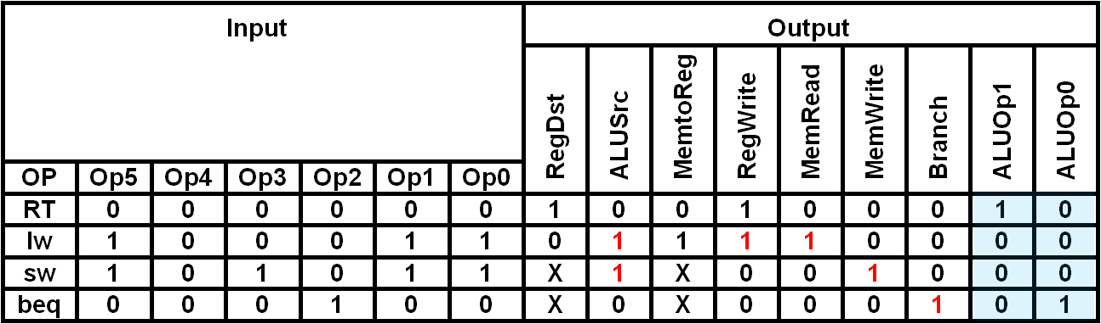
Single-Cycle Processor - Wires

Slide 59
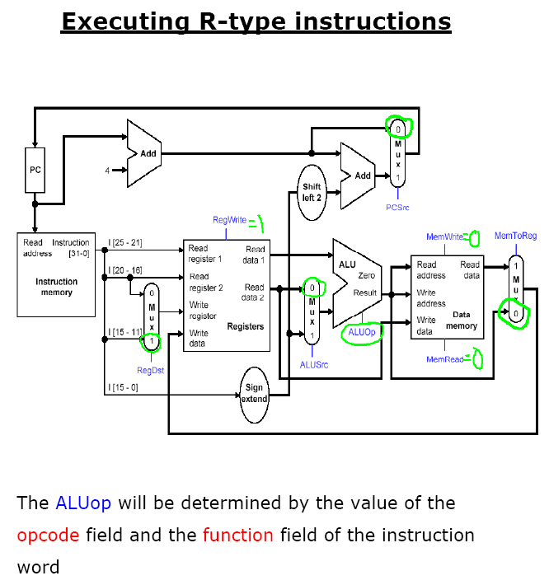

Slide 60
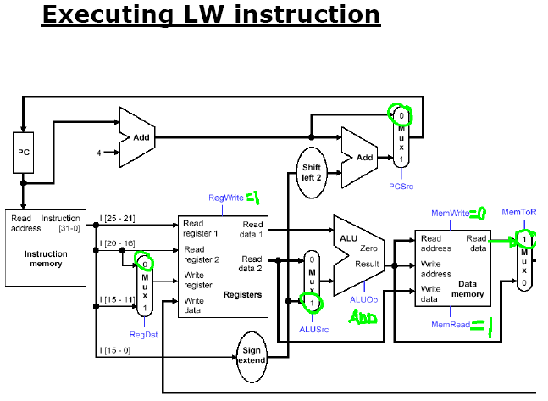

Slide 61
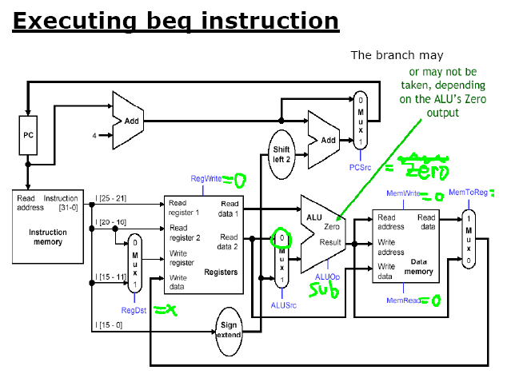

Slide 62
Control Unit Design for Single-Cycle CPU
http://cis.k.hosei.ac.jp/~yamin/lectures/organization/sccu.html

Slide 63
Single-Cycle Verilog - Part 1
module mips_single(clk, reset);
input clk, reset;
// instruction bus
wire [31:0] instr;
// break out important fields from instruction
wire [5:0] opcode, funct;
wire [4:0] rs, rt, rd, shamt;
wire [15:0] immed;
wire [31:0] extend_immed, b_offset;
wire [25:0] jumpoffset;
assign opcode = instr[31:26];
assign rs = instr[25:21];
assign rt = instr[20:16];
assign rd = instr[15:11];
assign shamt = instr[10:6];
assign funct = instr[5:0];
assign immed = instr[15:0];
assign jumpoffset = instr[25:0];

Slide 64
Single-Cycle Verilog - Part 2
// sign-extender
assign extend_immed = { {16{immed[15]}}, immed };
// branch offset shifter
assign b_offset = extend_immed << 2;
// datapath signals
wire [4:0] rfile_wn;
wire [31:0] rfile_rd1, rfile_rd2, rfile_wd, alu_b, alu_out,
b_tgt, pc_next, pc, pc_incr, br_add_out,
dmem_rdata;
// control signals
wire RegWrite, Branch, PCSrc, RegDst, MemtoReg, MemRead,
MemWrite, ALUSrc, Zero;
wire [1:0] ALUOp;
wire [2:0] Operation;

Slide 65
Single-Cycle Verilog - Part 3
// module instantiations
reg32 PC(clk, reset, pc_next, pc);
add32 PCADD(pc, 32'd4, pc_incr);
add32 BRADD(pc_incr, b_offset, b_tgt);
reg_file RFILE(clk, RegWrite, rs, rt, rfile_wn, rfile_rd1,
rfile_rd2, rfile_wd);
alu ALU(Operation, rfile_rd1, alu_b, alu_out, Zero);
rom32 IMEM(pc, instr);
mem32 DMEM(clk, MemRead, MemWrite, alu_out, rfile_rd2,
dmem_rdata);
and BR_AND(PCSrc, Branch, Zero);

Slide 66
Single-Cycle Verilog - Part 4
mux2 #(5) RFMUX(RegDst, rt, rd, rfile_wn);
mux2 #(32) PCMUX(PCSrc, pc_incr, b_tgt, pc_next);
mux2 #(32) ALUMUX(ALUSrc, rfile_rd2, extend_immed, alu_b);
mux2 #(32) WRMUX(MemtoReg, alu_out, dmem_rdata, rfile_wd);
control_single CTL(.opcode(opcode), .RegDst(RegDst),
.ALUSrc(ALUSrc), .MemtoReg(MemtoReg),
.RegWrite(RegWrite), .MemRead(MemRead),
.MemWrite(MemWrite), .Branch(Branch),
.ALUOp(ALUOp));
alu_ctl ALUCTL(ALUOp, funct, Operation);
endmodule

Slide 67
Project 2 - Extending the SC MIPS Model
Download files from Website
Simulate to gain familiarity with operation
Modify the design to support:
addi rd, rs, rt
bne rs, rt (in addition to beq)
j addr
Modify ROM to contain a test program
Write short assembly language to test all instructions
Include a loop that executes at least 4 times
Modify ROM code

Slide 68
Demo: Simulating mips_single
ROM Contains the following program
lw $2, 4($0) # r2=1
lw $3, 8($0) # r3=2
lw $4, 20($0) # r4=5
add $5, $0, $0 # r5=0
add $5, $5, $1 # r5 = r5 + 1
slt $6, $4, $5 # is $5 >= r4?
beq $6, $zero, -3 # if not, go back 2
sw $6, 0($zero) # MEM[0] = $5
Connections to watch:
PC, Instruction
Instruction fields: opcode, rs, rt, rd, immed, etc.
Register file: rfile_wn, regfile_rd1, regfile_rd2
ALU: alu_b, alu_out, Zero

Slide 69
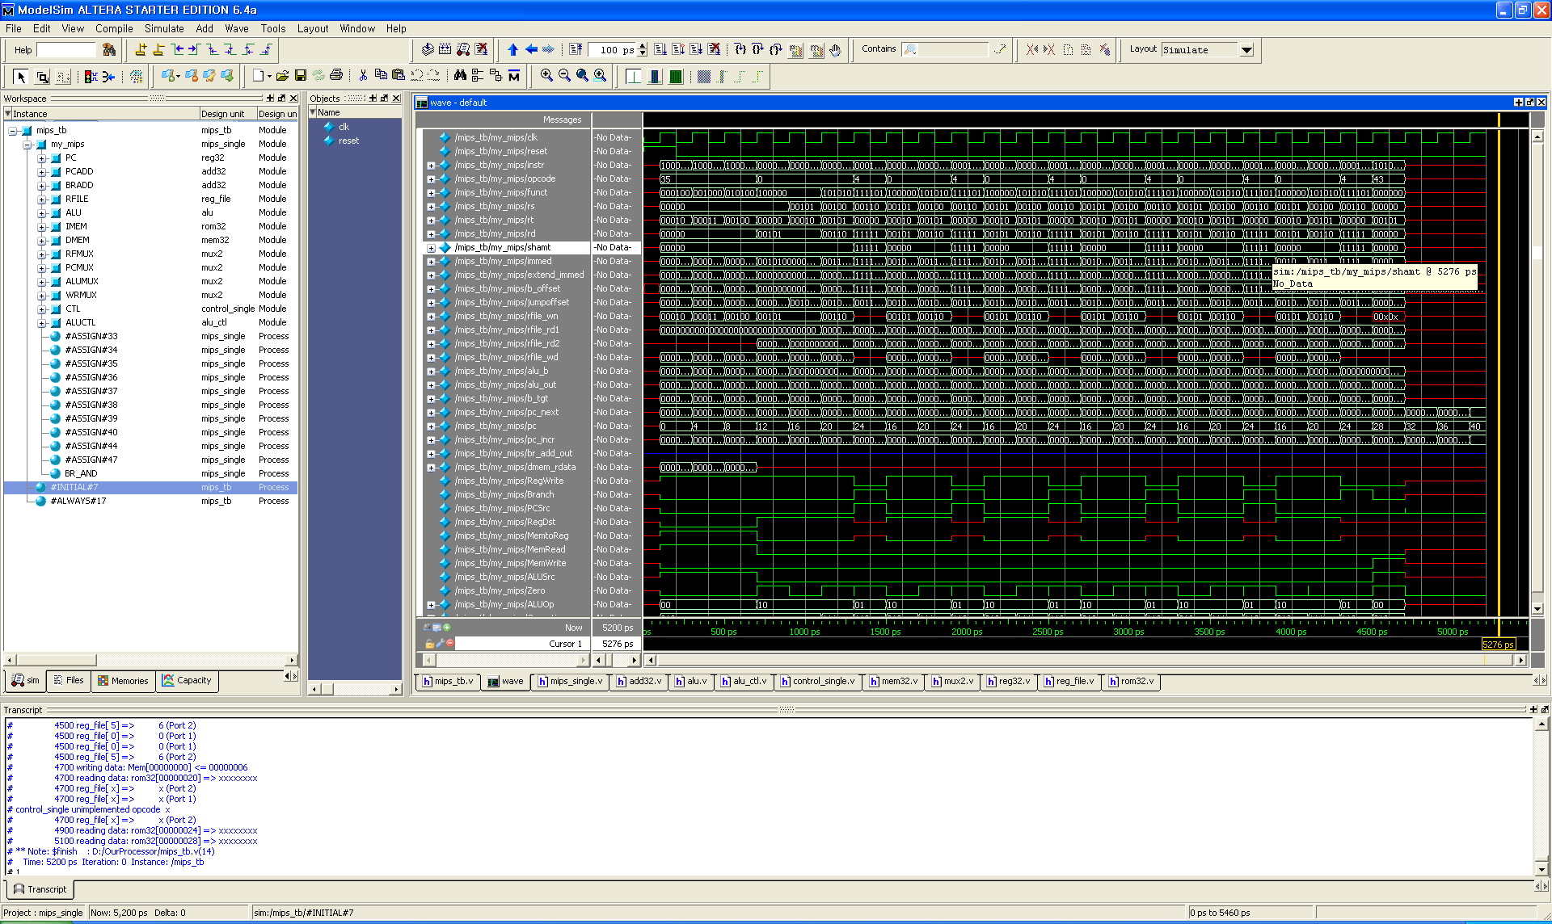
Demo: Simulating mips_single

