Slide 1
WAL
Suhwan Shin, Isu Kim, Seyeon Park
E-Mail: tlstnghks77@dankook.ac.kr

Slide 2
Content
WAL
Experiment
Disable_wal
Max_total_wal_size
Manual_wal_flush

Slide 3
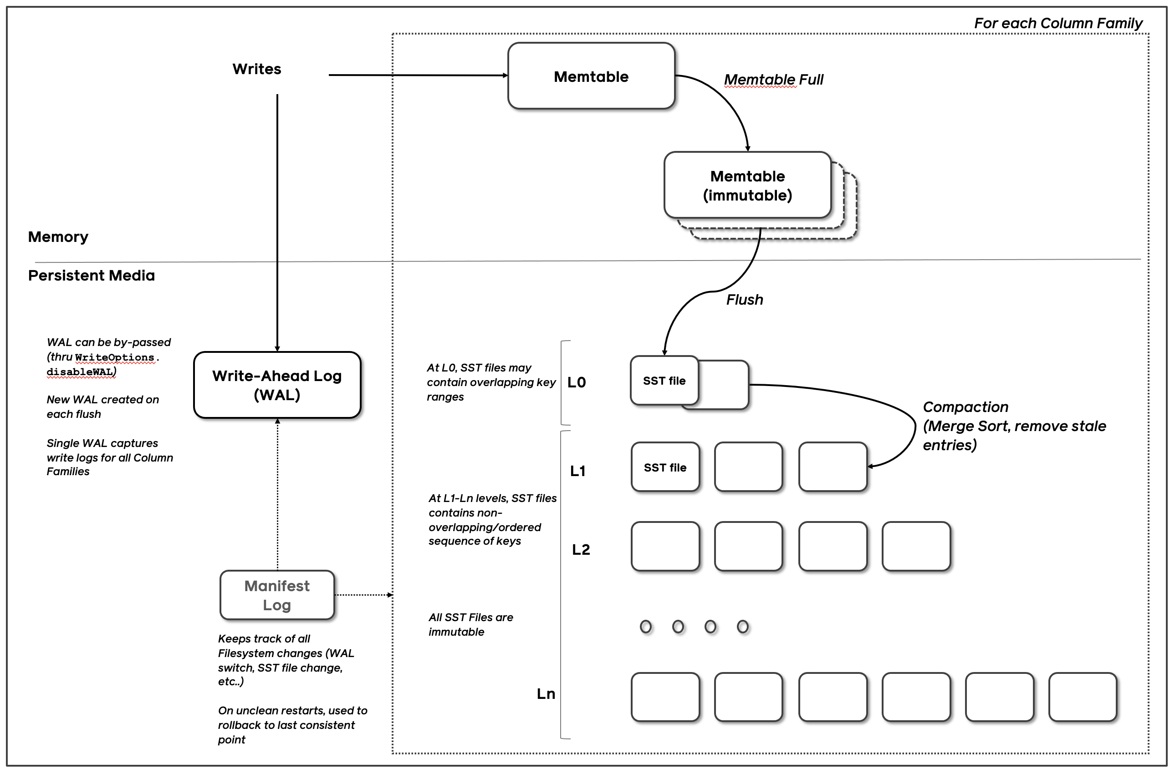
WAL
https://github-wiki-see.page/m/facebook/rocksdb/wiki/RocksDB-Overview

Slide 4
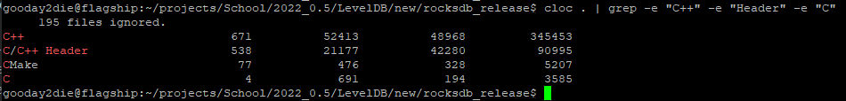
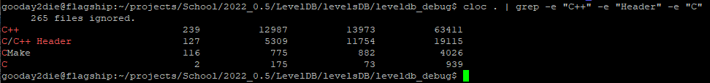
Before we start experiment…
LevelDB has no option of WAL for db_bench
Need to use RocksDB
How big is RocksDB?

Slide 5
Option : Disable_wal
Isu Kim

Slide 6
Disable_wal : Hypothesis
Disabling WAL will affect db_bench performance
WAL will use IO, thus will be slower if enabled
However, SAF and WAF will be the same
=> Disabling WAL will have better results in terms of throughput and latency

Slide 7
Disable_wal : Design
Independent Variable: --disable_wal (true or false)
Dependent Variable: SAF, WAF, Latency, Throughput
Controlled Variable:
1. --benchmarks=“fillseq,stats,levelstats,compact,stats,levelstats”
2. --num=10000000 (default)
3. Compiled option :

Slide 8

Disable_wal : Environment
Server Spec
OS: Ubuntu 22.04 LTS (Not VM)
CPU: Intel(R) Core(TM) i9-7940X CPU @ 3.10GHz
SSD: Samsung SSD 860 2TB
Test Environment
Python (IPython Script) using subprocess
Automatically runs fillseq, fillrandom, readrandom for designated times
Parses output from db_bench and generates a simple pandas.DataFrame
Does not use thread since it might affect output results.
All other processes were turned off as much as possible

Slide 9
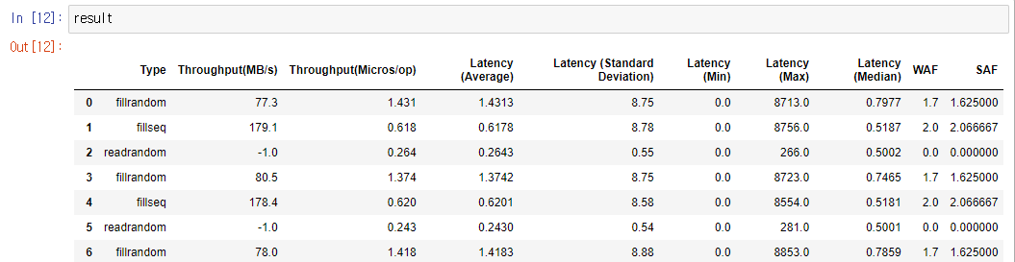
Disable_wal : Result
Results of fillseq, fillrandom, readrandom for 10 times each.

Slide 10
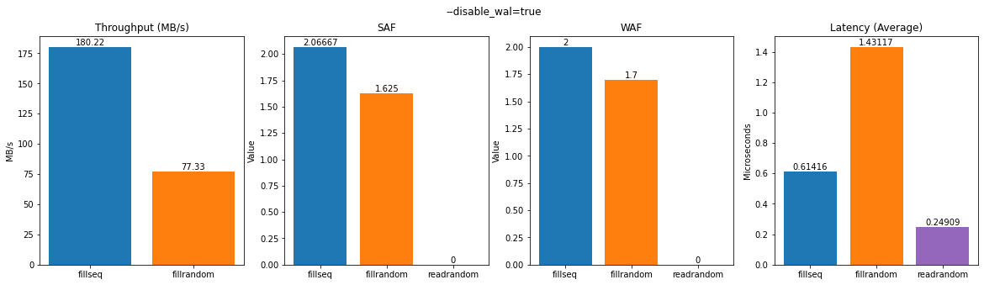
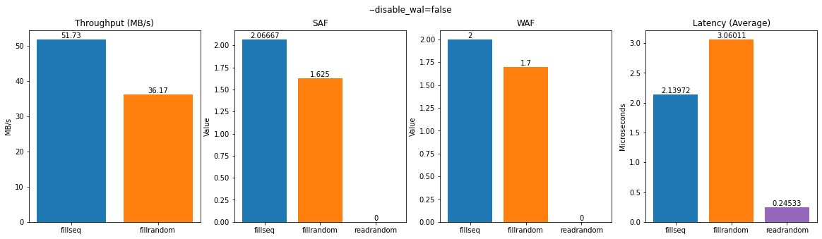
Disable_wal : Result
Average of 10 db_bench results

Slide 11
Disable_wal : Conclusion & Future Study
Enabling WAL will use IO, thus in terms of throughput and latency, it is slower than disabling it.
Future experiment ideas:
Use uftrace to analyze more about internal operations.
Disable WAL and shutdown abruptly.
Enable WAL and shutdown abruptly.
Find reasons for why SAF and WAF stays the same.
Test with wal_bytes_per_sync.

Slide 12
Option : Max_total_wal_size
Seyeon Park

Slide 13
Max_total_wal_size : Hypothesis
If there is no limit about the wal size, it cause slow deletion of wal in accor-dance with no flush for a while
In case of setting option ”max_total_wal_size”, if data satisfy the size, it’s going to be triggered
Then, will the performance deteriorate because the smaller the wal, the more often it flushes?

Slide 14
Max_total_wal_size : Design
Independent Variable: --max_total_wal_size = [int value]
Dependent Variable: SAF, WAF, Latency, Throughput
./db_bench --benchmarks="fillseq,stats,levelstats,compact,stats,levelstats,fillrandom,stats,levelstats,compact,stats,levelstats" --max_total_wal_size=[0,1,10,100,1000,10000,100000,1000000,10000000, 100000000]
--num=10000000 (default)

Slide 15
Max_total_wal_size : Environment
Server Spec • OS: macOS Monterey • Processor: 2.3 GHz 8코어 Intel Core i9 • SSD: APPLE SSD AP1024N 1TB

Slide 16
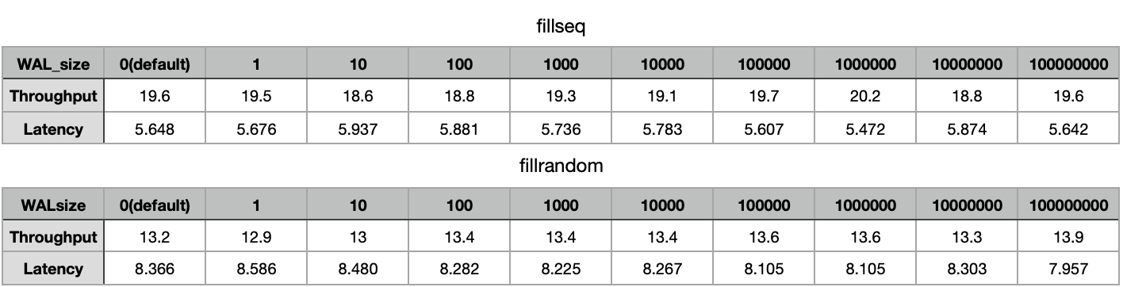
Max_total_wal_size : Result
I’d tried num, key_size, WALRecoveryMode…
I think there is no significant result..

Slide 17
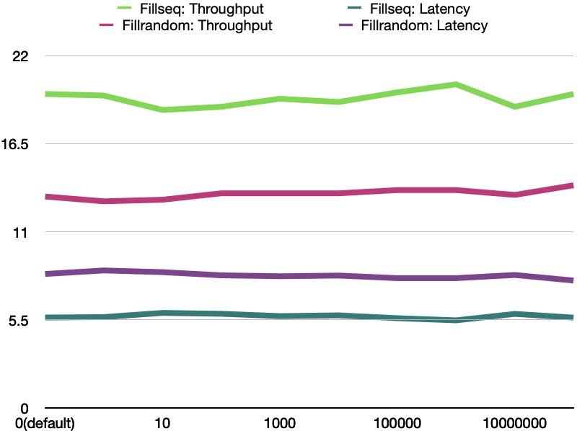
Max_total_wal_size : Result

Slide 18
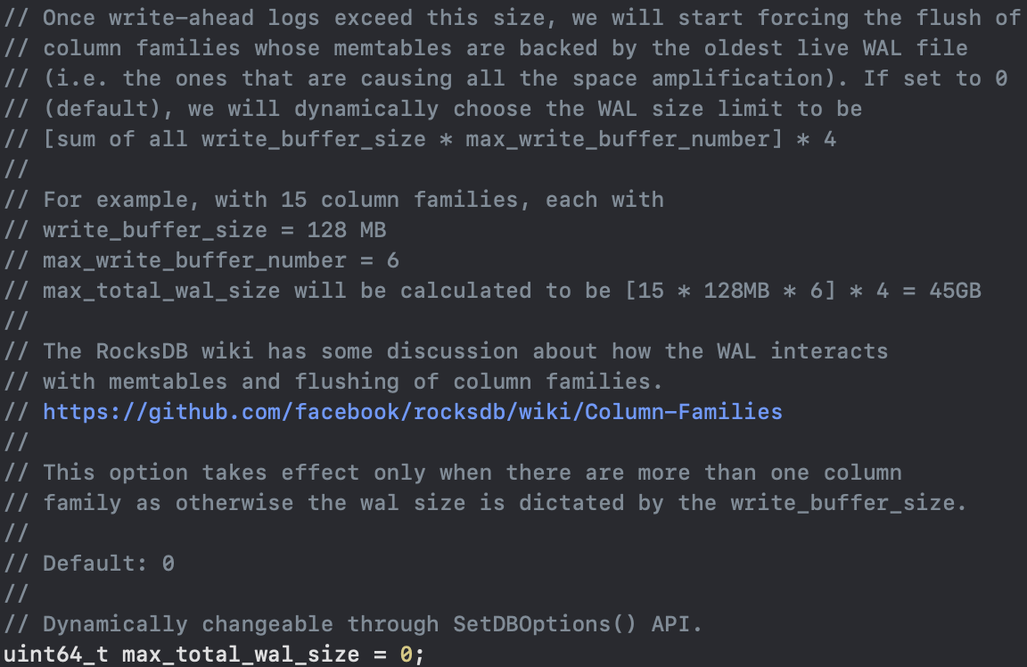
Max_total_wal_size : Conclusion
In fact, this option is valid when the value is 0 (default)
[sum of all write_buffer_size * max_write_buffer_number] * 4
For example, with 15 column families,
write_buffer_size = 128 MB
max_write_buffer_number = 6
max_total_wal_size
[15 * 128MB * 6] * 4 = 45GB

Slide 19
Max_total_wal_size : Conclusion
And It takes effect only when there are more than two column family.
Therefore, have to experiment with more than two column family again.

Slide 20
Option : Manual_wal_flush
Suhwan Shin

Slide 21
WAL_flush
Q: When will the WAL be written?
A: DB::put or DB::write.
WAL is first written to the application memory buffer.
And flushes the WAL from application memory to OS buffer.
OS buffer
(is synced to the persistent storage later)
Application memory buffer
Flush
(by fwrite syscall)

Slide 22
Manual_wal_flush : Hypothesis
Many flush = Overhead
=> Affect the performance
Test – Option: manual_wal_flush
Manual_wal_flush can be changed flush from automatically to manually after an explicit call to ::FlushWAL.
Tradeoff between reliability and write latency.

Slide 23
Manual_wal_flush : Design
Independent Variable: --manual_wal_flush (true or false)
Dependent Variable: Latency, Throughput
Controlled Variable : Sync mode (Sync or Async)
--sync=false(default) : Async
--sync=true : Sync

Slide 24
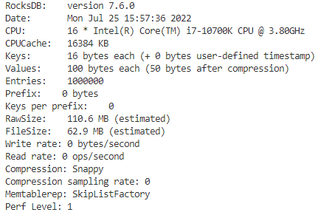
Manual_wal_flush : Environment

Slide 25
Manual_wal_flush : Result
 | Async |  |  |  | Sync
Benchmark /Manual | Seq/True | Seq/False | Ran/True | Ran/False | Seq/True | Seq/False | Ran/True | Ran/False
Latency (micros/op) | 1.004 | 2.019 | 2.358 | 3.498 | 3029 | 3041 | 3047 | 3035
Throughput (MB/s) | 113.1 | 54.8 | 46.9 | 31.6 | 0 | 0 | 0 | 0

Slide 26
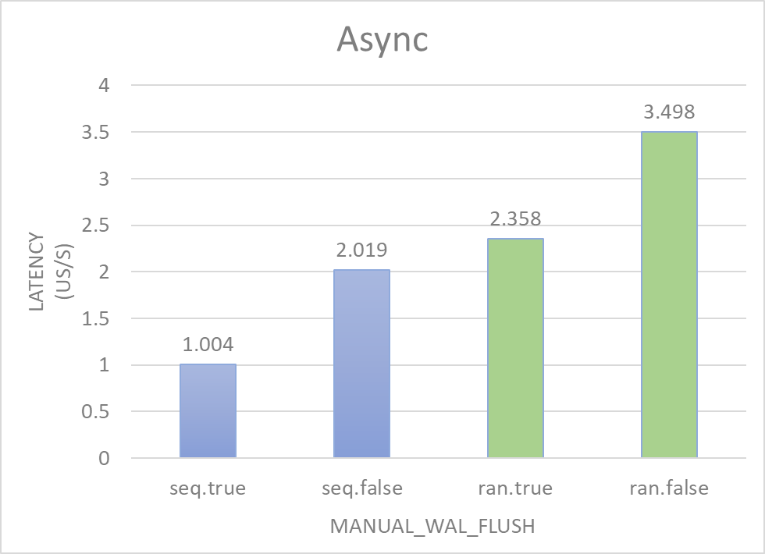
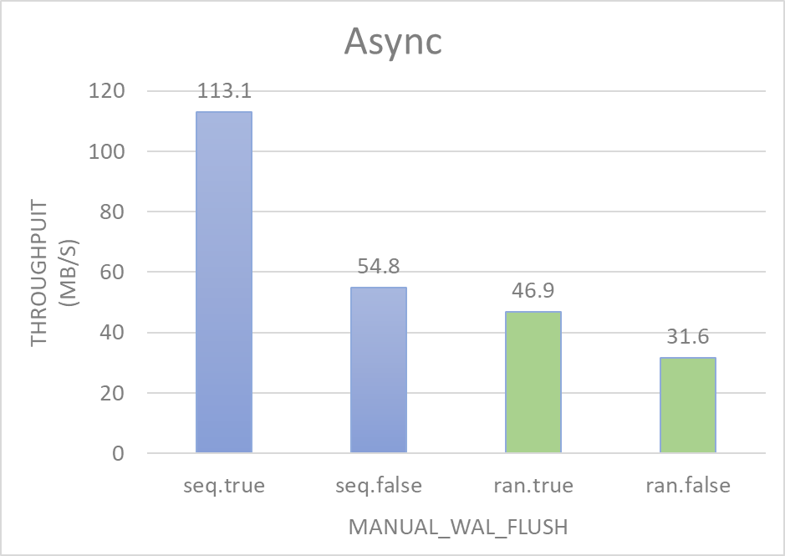
Manual_wal_flush : Result
Async (Latency / Throughput)
manual_wal_flush (True/False)
fillseq / fillrandom

Slide 27
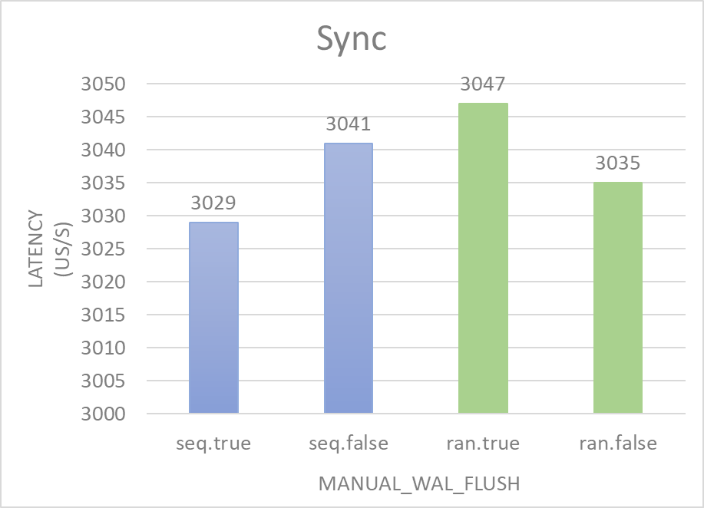
Manual_wal_flush : Result
Sync (Latency)
manual_wal_flush (True/False)
fillseq / fillrandom

Slide 28
Manual_wal_flush : Conclusion
Async mode
An ideal result :
fillseq > fillrandom
Manual > Automatic
+ new fact : Benchmark affects more than Option:manual_wal_flush
Sync mode
An unideal result :
(fillseq > fillrandom) & (fillseq < fillrandom)
(Manual > Automatic) & (Manual < Automatic)

Slide 29
Manual_wal_flush : Future Study
Why Sync’s result is informal?
Manifest

Slide 30

Question

