Slide 1
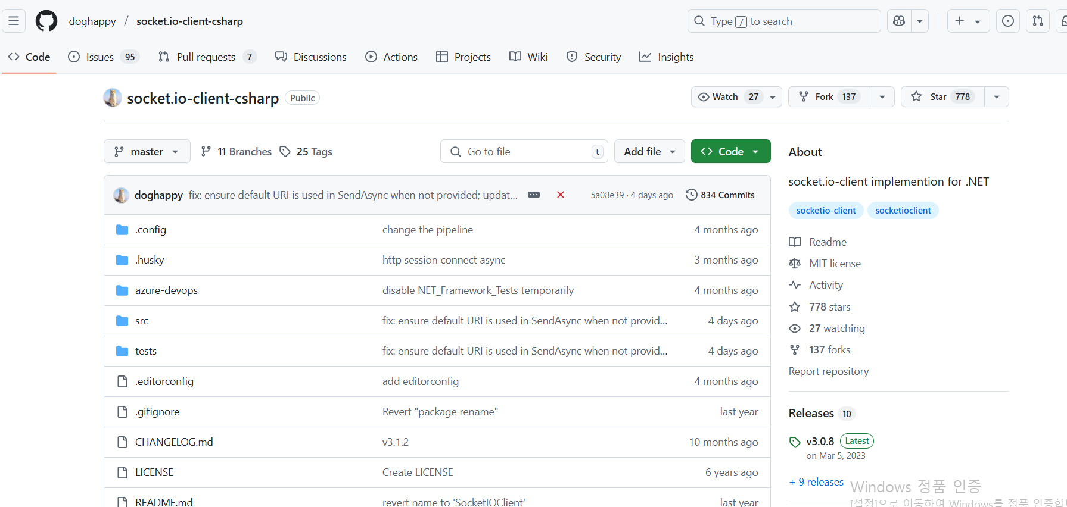
씬(Scene) 전환
웹소켓(socket.io)
https://github.com/doghappy/socket.io-client-csharp
Src/SocketIOClient
v3.0.8
Assets/Plugins

