Slide 1
Video classification with keras
딥러닝스터디
2020-10-21
이 예 림

Slide 2
Video classification vs. Image classification
Video? A series of individual images!
Video classification = N images classification
( N = # of frames)
Notes:
비디오에서는 연속적인 frame들이 semantic contents와 연관이 있다는 가정이 있는 건데, 그래서 만약 시간적인 요소를 고려할 수 있다면..

Slide 3
Video classification vs. Image classification
Video? A series of individual images!
Video classification = N images classification
( N = # of frames)
Notes:
비디오에서는 연속적인 frame들이 semantic contents와 연관이 있다는 가정이 있는 건데, 그래서 만약 시간적인 요소를 고려할 수 있다면..

Slide 4
Video classification vs. Image classification
Video? A series of individual images!
Video classification = N images classification
( N = # of frames)
Subsequent frames are correlated with semantic contents.
> Temporal dimension > video classification results improval
(i.e., LSTM, RNN …)
Notes:
비디오에서는 연속적인 frame들이 semantic contents와 연관이 있다는 가정이 있는 건데, 그래서 만약 시간적인 요소를 고려할 수 있다면..

Slide 5
Video classification vs. Image classification
Video? A series of individual images!
Video classification = N images classification
( N = # of frames)
Subsequent frames are correlated with semantic contents.
> Temporal dimension > video classification results improval
(i.e., LSTM, RNN …)
Rolling prediction averaging!
Image classification (CNN) > Video classification (Rolling averaging)
Notes:
비디오에서는 연속적인 frame들이 semantic contents와 연관이 있다는 가정이 있는 건데, 그래서 만약 시간적인 요소를 고려할 수 있다면..

Slide 6
Video classification vs. Image classification
Image classification
Input : Image
Prediction
The largest corresponding probability >> The label
Video classification
Input : Frame
Loop over all frames
Prediction individually and independently
The largest corresponding probability >> The label
“Prediction flickering”

Slide 7
Video classification vs. Image classification
Image classification
Input : Image
Prediction
The largest corresponding probability >> The label
Video classification
Input : Frame
Loop over all frames
Prediction individually and independently
A list of the last K predictions
The average of the last K predictions
The largest corresponding probability >> The label
“Smooting out”

Slide 8
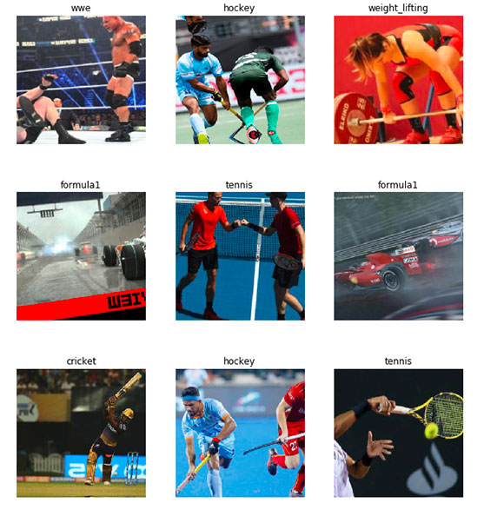
The sports classification dataset
Swimming
Badminton
Wrestling
Olympic Shooting
Cricket
Football
Tennis
Hockey
Ice Hockey
Kabaddi
WWE
Gymnasium
Weight lifting
Volleyball
Table tennis
Baseball
Formula 1
Moto GP
Chess
Boxing
Fencing
Basketba
https://github.com/anubhavmaity

Slide 9
The sports classification dataset
Swimming
Badminton
Wrestling
Olympic Shooting
Cricket
Football
Tennis
Hockey
Ice Hockey
Kabaddi
WWE
Gymnasium
Weight lifting
Volleyball
Table tennis
Baseball
Formula 1
Moto GP
Chess
Boxing
Fencing
Basketba
https://github.com/anubhavmaity

Slide 10
Transfer learning
1. Take a network pre-trained on a dataset.
2. Utilize the network to recognize image/object categories it was not trained on.
Advantages?
Train a network with a new dataset > Cost + time loss, Not working
Hundred of parameters
Two steps of transfer learning
Via feature extraction
Pre-trained network = Feature extractor
2. Via fine-tuning
무조건 좋을까?
김도형 선생님의 답 : Feature extraction이 어떻게 되는 것에 따라 다르다. 데이터의 분포(특성)이 다를 경우
Notes:
When performing feature extraction, we treat the pre-trained network as an arbitrary feature extractor, allowing the input image to propagate forward, stopping at pre-specified layer, and taking the outputs of that layer as our features.
Fine-tuning, on the other hand, requires that we update the model architecture itself by removing the previous fully-connected layer heads, providing new, freshly initialized ones, and then training the new FC layers to predict our input classes.

Slide 11
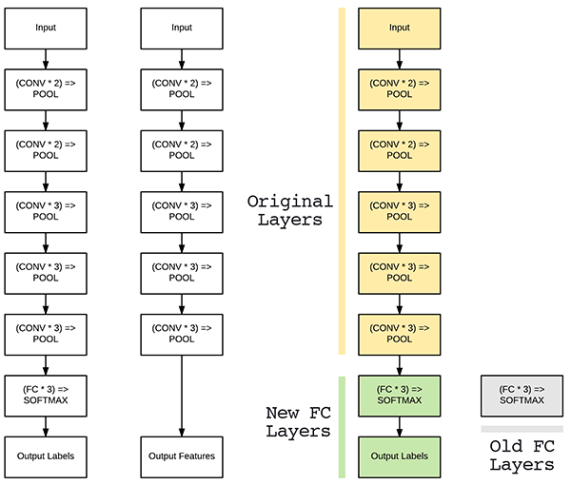
Transfer learning
VGG16
“Freeze”

Slide 12
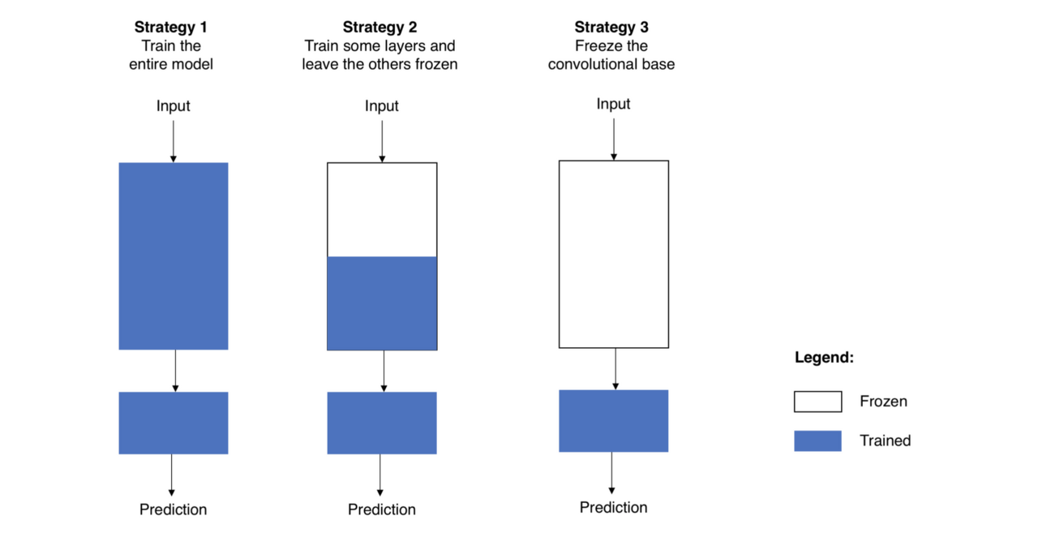
Transfer learning

Slide 13
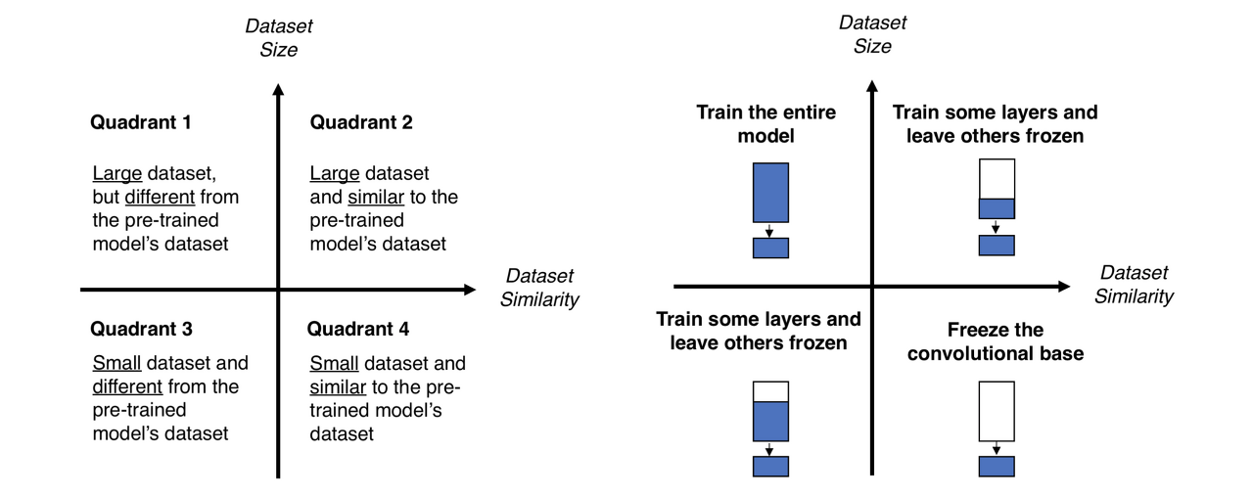
Transfer learning

Slide 14
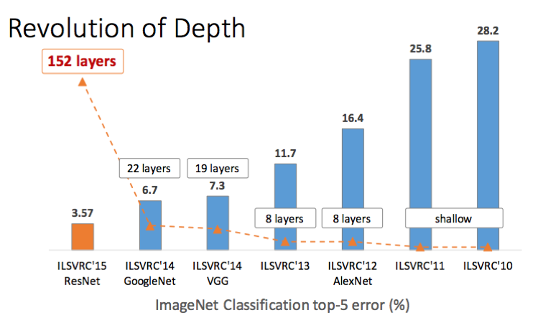
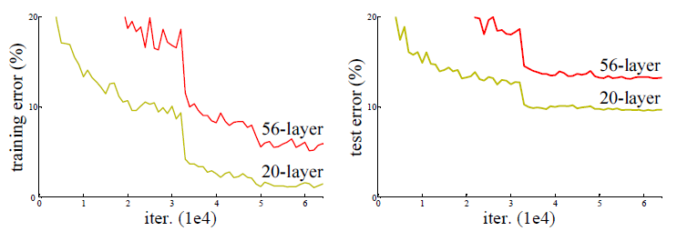
ResNet-50
2015 ImageNet Large Scale Visual Recognition Challenge(ILSVRC) winner.
Developed by Microsoft
"Deep Residual Learning for Image Recognition“ (Kaiming He et al.,)
Gradient vanishing >> Residual block (skip connection)

Slide 15
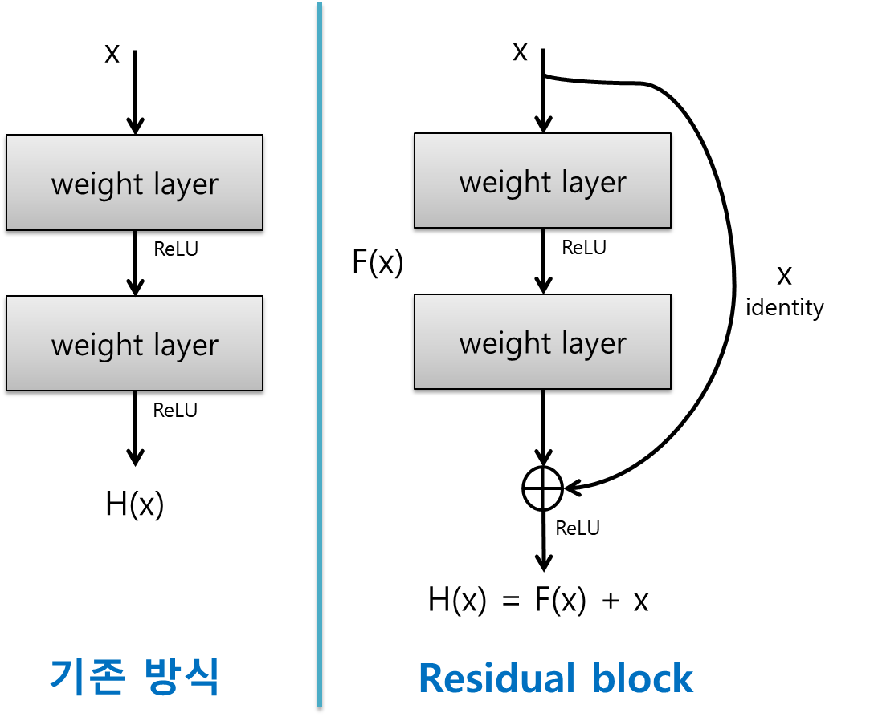
ResNet-50
2015 ImageNet Large Scale Visual Recognition Challenge(ILSVRC) winner.
Developed by Microsoft
"Deep Residual Learning for Image Recognition“ (Kaiming He et al.,)
Gradient vanishing >> Residual block (skip connection)
Notes:
Skip connection : forget gate 등을 도입해 이전 스텝의 그래디언트(정보)를 좀 더 잘 흐르게 만드려는 Long Term Short Memory(LSTM)의 철학과 본질적으로 유사.
Identity block : Shortcut 의 channel 과 main path 의 channel 이 일치할 경우 단순 add 연산만 진행하는 블록을 identity block 이라고 합니다.
Vs. convolution block (conv2d+batch norm)

Slide 16
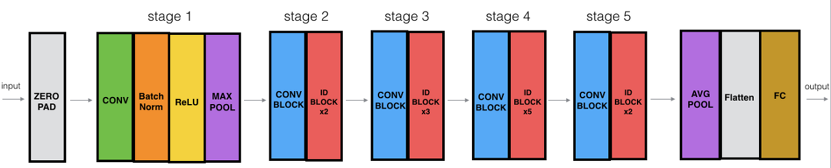
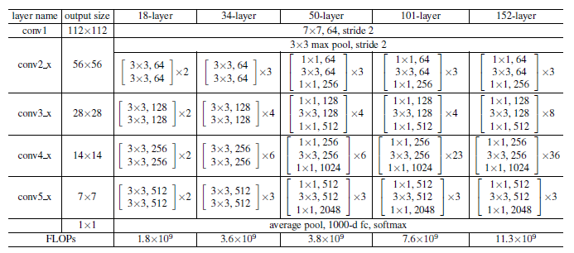
ResNet-50

Slide 19
Video classification with Keras and rolling prediction averaging
To create this script we’ll take advantage of the temporal nature of videos, specifically the assumption that subsequent frames in a video will have similar semantic contents.
By performing rolling prediction accuracy we’ll be able to “smoothen out” the predictions and avoid “prediction flickering”.

Slide 20
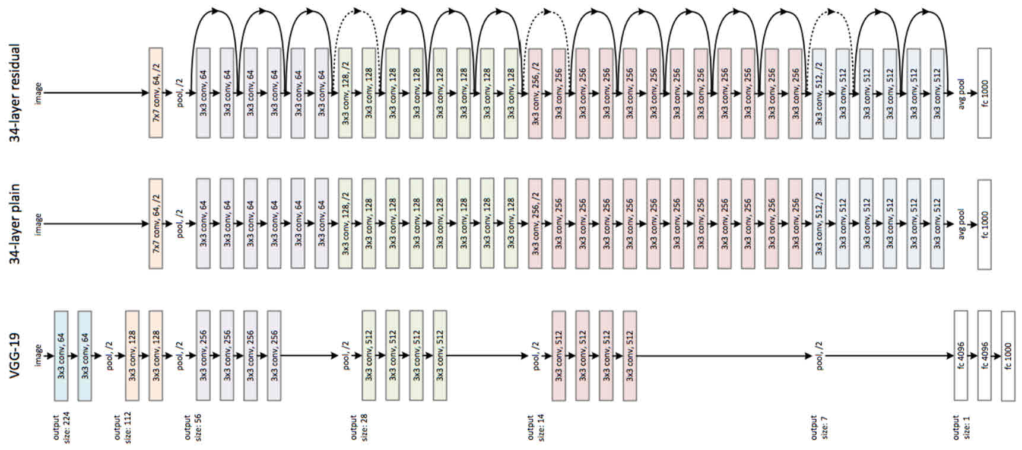
ResNet-50

