Slide 1
Street Fighter x TinyML
CE4172 Tiny ML
Chockalingam Kasi

Slide 2
Street Fighter x Tiny ML Overview
Data Collection
Model Training
Street Fighter Gameplay
Gesture Recognition

Slide 3
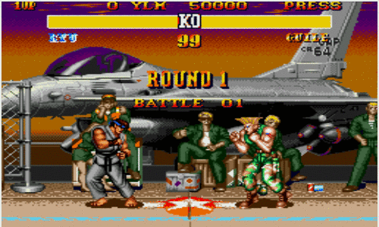
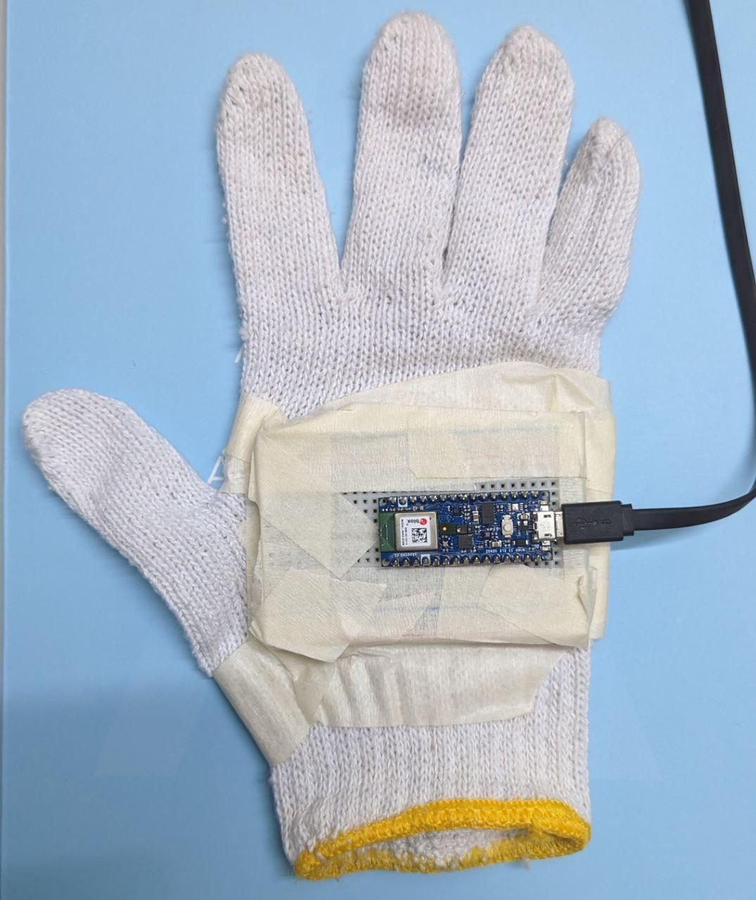
Street Fighter Gameplay

Slide 4



Slide 5
Data Collection

Slide 6
Data
12 Gestures
150 samples per gesture
Left
Right
Jump
Crouch
Hard Punch
Crouch Punch
Uppercut
High Kick
Crouch Slide
Hadoken
Tatsumaki
Normal

Slide 7
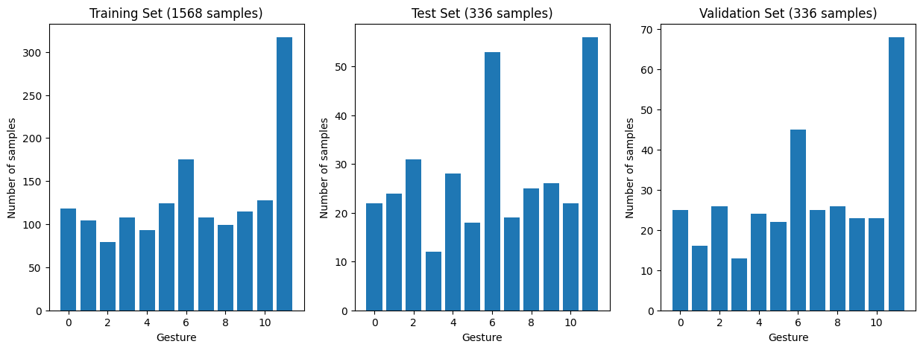
Splitting of Data

Slide 8
Model Training

Slide 9
Model Architecture
Layer Number | Layer | Number of Units | Dropout Size | Activation
1 | Dense | 64 | - | ReLU
2 | Dense | 64 | - | ReLU
3 | Dropout | - | 0.1 | -
4 | Dense | 32 | - | ReLU
5 | Dense | 32 | - | ReLU
6 | Dropout | - | 0.1 | -
7 | Dense | NUM_GESTURES | - | Softmax

Slide 10
Model Training Hyperparameters
Loss Function
Adam Optimizer
Learning Rate
0.0001
Early Stopping
20 Epochs

Slide 11
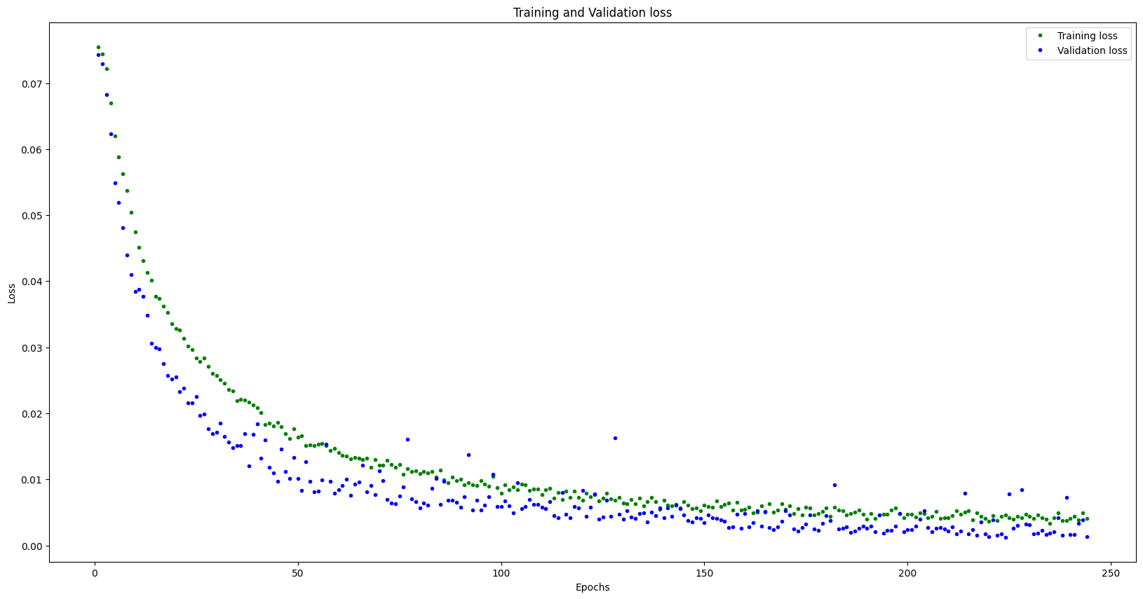

Slide 12
Gesture Recognition

Slide 13
Test Data Performance
Gesture Name | Accuracy (%)
left | 90.91
right | 100.00
jump | 90.32
crouch | 100.00
hardpunch | 100.00
crouchpunch | 94.44
crouchslide | 96.23
highkick | 94.74
uppercut | 92.00
tatsumaki | 96.15
hadoken | 100.00
normal | 91.07
Total | 94.94
Notes:
319 17 336

Slide 14
Demo
Mercury is the closest planet to the Sun and the smallest
LEVEL 1
LEVEL 3
Venus has a beautiful name and is the second from the Sun
Jupiter is a gas giant and the biggest planet in the Solar System
LEVEL 2
LEVEL 4
Saturn is a gas giant, composed mostly of hydrogen and helium

Slide 15
Optimization Techniques

Slide 16
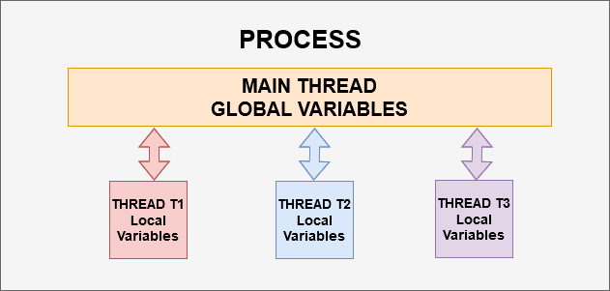
Model Quantization
Threading
216 812 Bytes
58 016 Bytes

Slide 17
Thank You

