Slide 1

KEYLOGGER
DONE BY : S.RM.CHOCKALINGAM
COLLEGE NAME : AALIM MUHAMMED SALEGH
COLLEGE OF ENGINEEERING

Slide 2
OUTLINE :
Problem statement
Proposed solution
System development approach
Algorithm & deployment
Result
Conclusion
Future scope

Slide 3
Problem statement : Now a days, in cyber security era the growth of cyber crime rate has been increased constantly. We can see them in the following areas such as banking, many unwanted websites, etc. What happens is thief tries to stole the various credentials such as password, personal identification number(aka PIN), and other details in order to stole the money. Many unwanted websites have also been searched.

Slide 4
Proposed solution: The proposed solution is to use the virtual keyboard or on screen keyboard and recognition systems while entering sensitive information like passwords and other things in atm. Additionally, the regular software updates is required in order to avoid this attacks.

Slide 5

Systematic approach: Here, this topic tells about the how can we develop the keylogger system via software and the implementation of the code part using programing languages. We can approach this via both means of hardware and the software.

Slide 6
Algorithm and deployment: The string based matching algorithms can be used here in order to record all the input via the keyboard. The data can be detected via the users input or any typing things made manually. The deployment can be done via hardware by using physical components such as pendrives and or via software can be coded by developers.

Slide 7
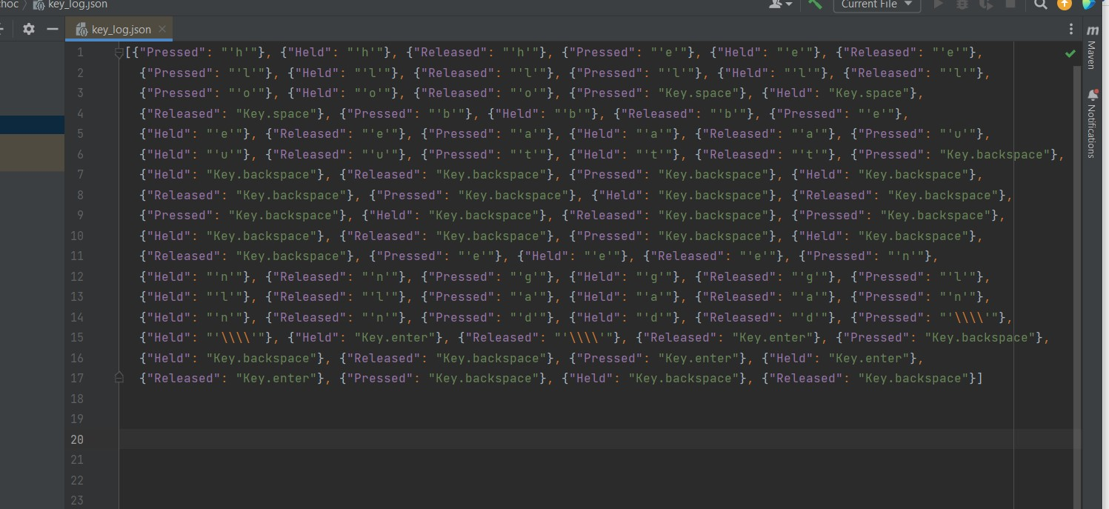
Output in json format:

Slide 8
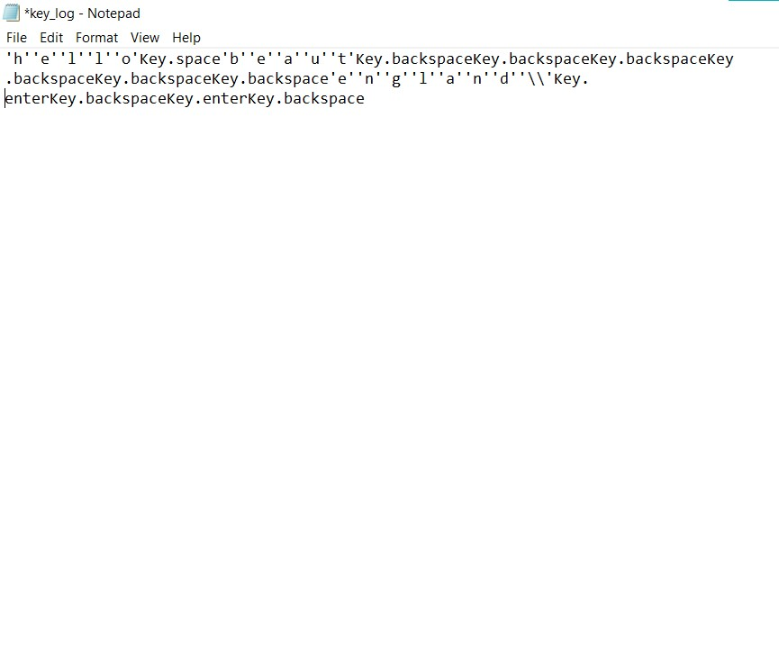
Output in text format:

Slide 9
Conclusion: Thus by using the keyloggers, we can able to detect what are all the things that can be searched anywhere in the internet and it can be used as parental controls and like surveillance and in other areas where we use the sensitive information, we can follow the touch pad like machines and voice recognition system where we can avoid this.In future it have many scopes in the it field and data areas where many important things are being processed.

Slide 10
Thank You.

