Slide 1
Four-Phases Segmentation for Bullpen Pitching Motion Analysis
Student: 楊乃諺
Advisor: 連震杰 教授
Robotics Lab, CSIE NCKU

Slide 2
Content
  1. Introduction
    1.1 Motivation, Objective and Global Framework
    1.2 Related Works
    1.3 Contribution
  2. System Setup and Hardware Specification
  3. Framework
    3.1.1 Training Framework
    3.1.2 Inference Framework
    3.1.3 Loss Function
  4. Experimental Results
  4.1.1 Data Collection
  5. Conclusion and Future Work
    6. Reference

Slide 3
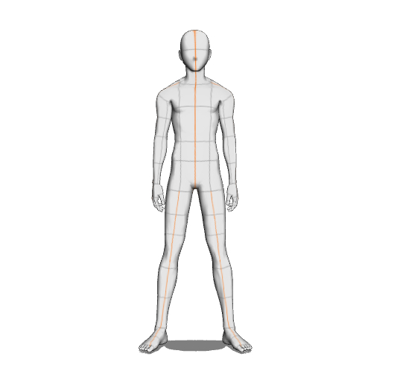
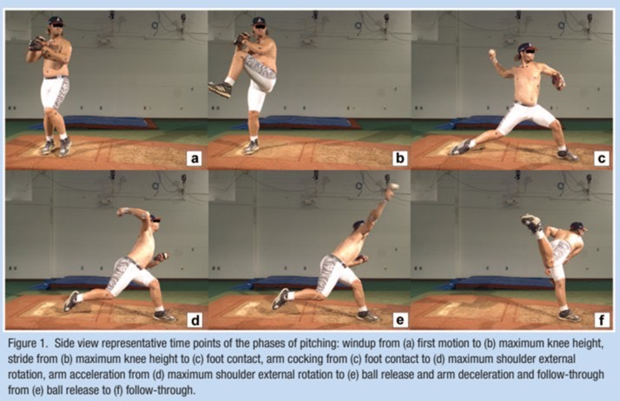
0.1 Definition
Keyframe Definitions & Detection Logic
Skeleton Keypoints of Right-Handed Pitcher
Index | Joints Name
0 | 鼻子
1 | 左眼
2 | 右眼
3 | 左耳
4 | 右耳
5 | 頭
6 | 左肩
7 | 右肩
8 | 左手肘
9 | 右手肘
10 | 左手腕
11 | 右手腕
12 | 脖子
13 | 髖重心
14 | 左髖
15 | 右髖
16 | 左膝
17 | 右膝
18 | 左踝
19 | 右踝
20 | 左大腳趾
21 | 右大腳趾
22 | 左小腳趾
23 | 右小腳趾
24 | 左腳跟
25 | 右腳跟
Keyframe | Ground Truth | Proposed
Foot Contact (FC) | The lead foot touches ground. | Lead foot settles stably at ground height.
Max External Rotation (MER) | The moment of maximum forearm layback. | Peak forearm layback angle with the arm raised.
Ball Release (BR) | The ball leaves the fingertips. | Peak wrist speed ≤ 0.3 s after MER.
頭 6 點
5
3
1
0
2
4
12
肩
7
6
上肢 6 點
9
8
髖
11
15
13
14
10
軀幹 2 點
Foot Contact
下肢-腿 6 點
17
16
Max External Rotation
Ball Release
19
18
下肢-足 6 點
23
25
24
22
21
20
[Ref] A. Diffendaffer, M. Bagwell, G. Fleisig, Y. Yanagita, M. Stewart, E. Cain, J. Dugas, and K. Wilk, “The Clinician‘s Guide to Baseball Pitching Biomechanics,” Sports Health, vol. 15, 2022.

Slide 4
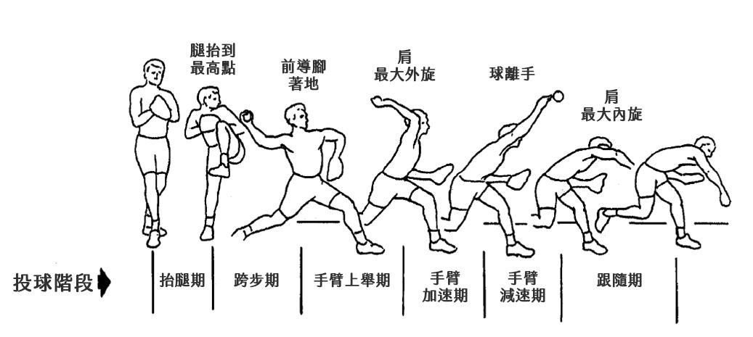
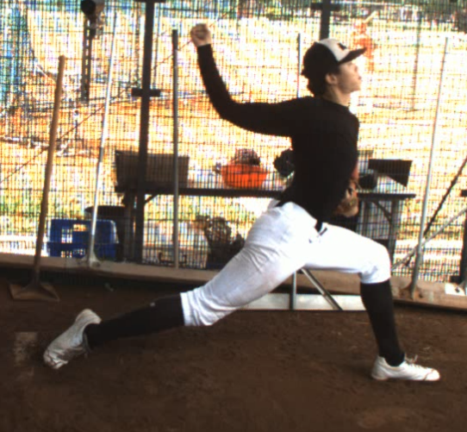
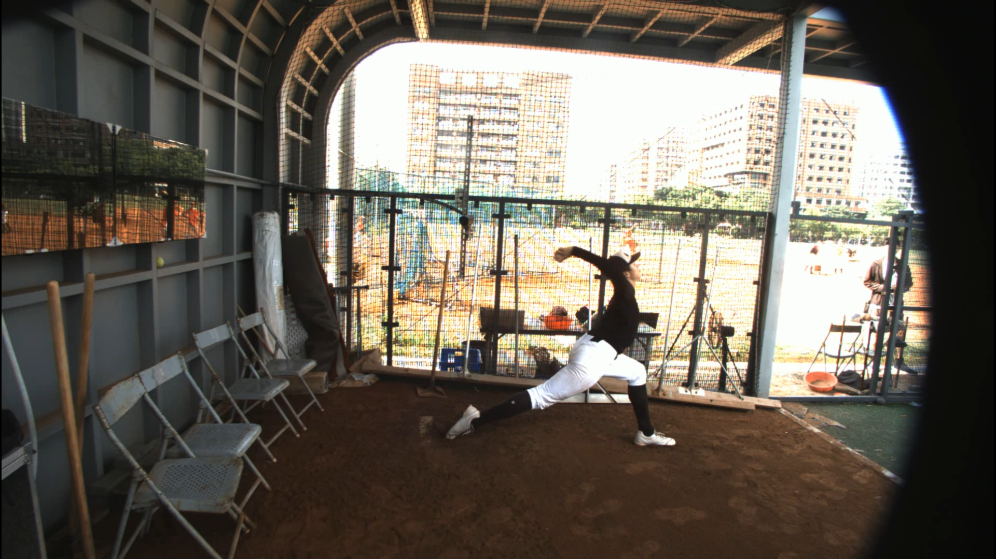
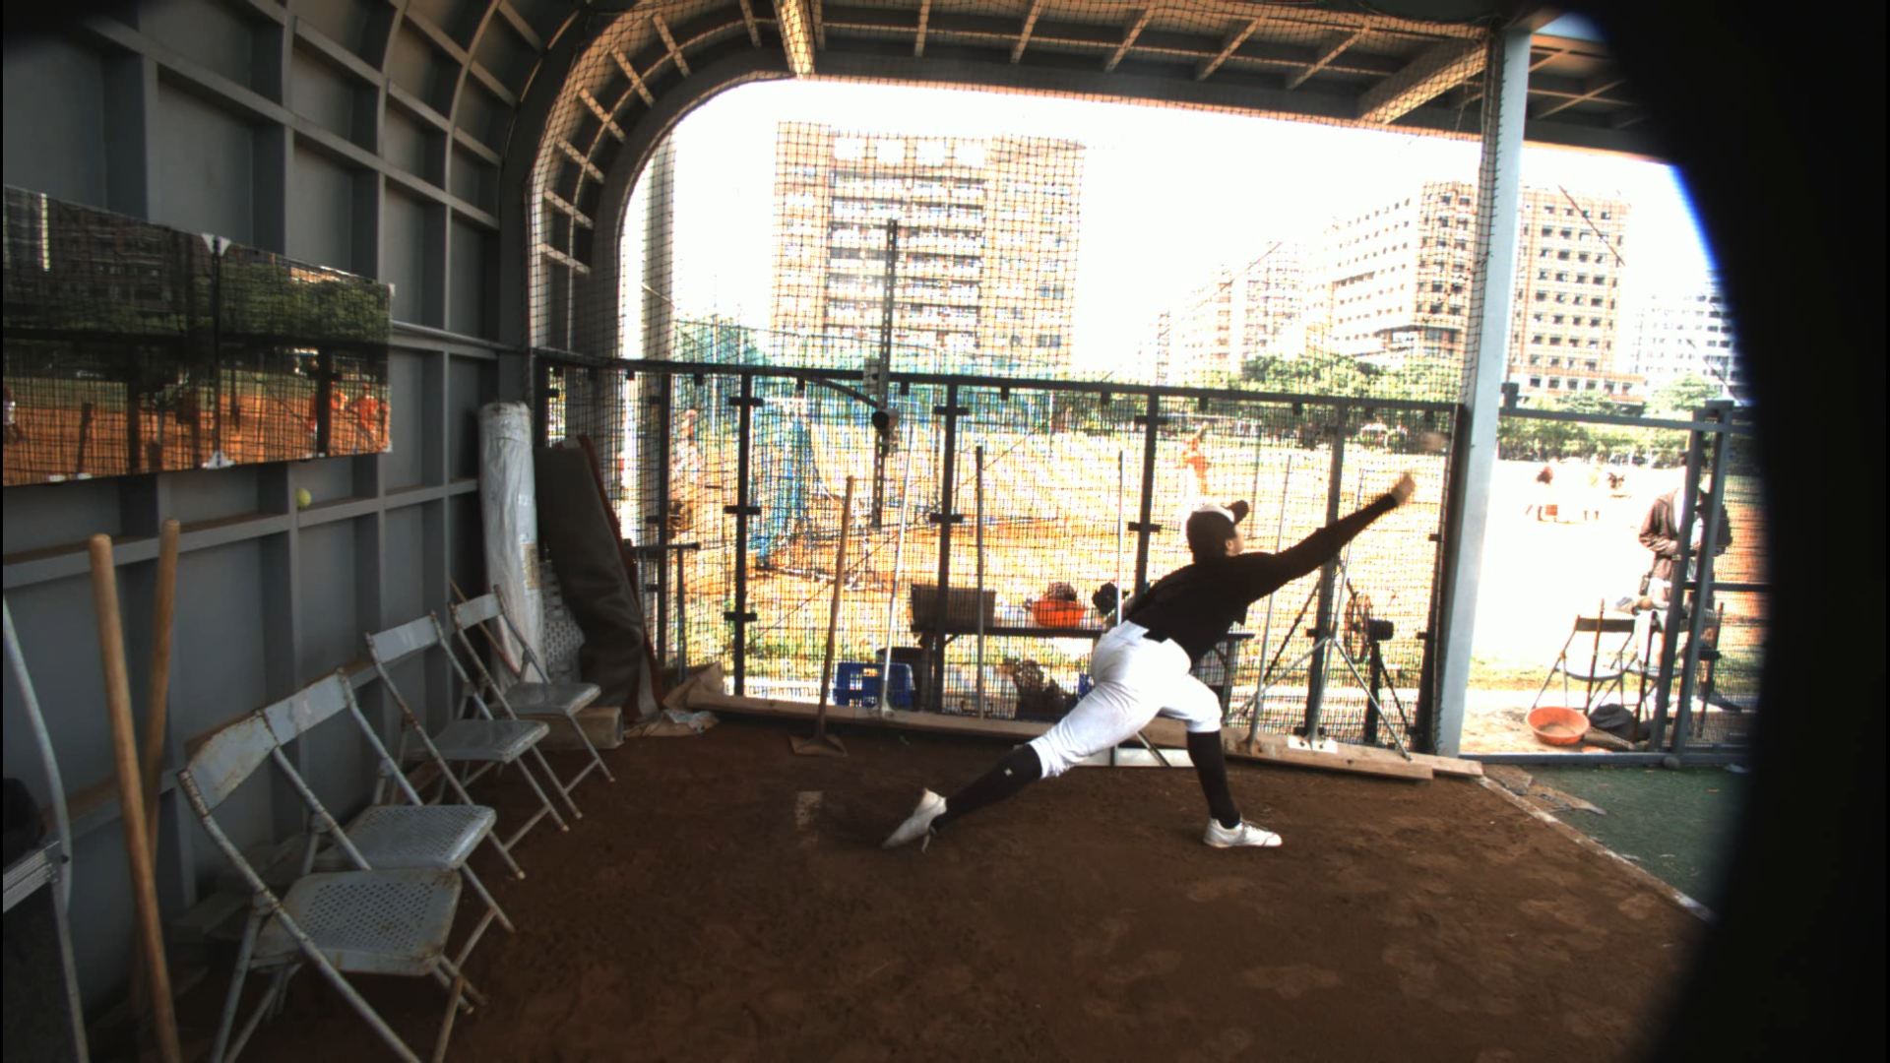
1.1 Introduction: Motivation and Objective
1. Motivation:
1) Improve player performance
2) Prevent sports injuries
2. Objective:
1) Develop 4 Phases Segmentation Based on 3 Key Frames (Foot Contact, MER, Ball Release)
MER: Maximum External Rotation
a. Foot Contact
b. Shoulder MER
c. Ball Release
3個分割關鍵點
4 階段
1) 準備期
Preparation
2) 手臂上舉期
Arm cocking
3) 手臂加速期
Arm acceleration
4) 跟隨期
Follow-through
功能：
1）費時：4個分段動作費時及百分比 (%)，
2）距離：跨步距離、出手點距離，
3）速度：手腕速度變化，
4）角度：前導腳膝蓋角度變化、肩外旋角度變化、肩髖分離角度變化

Slide 5
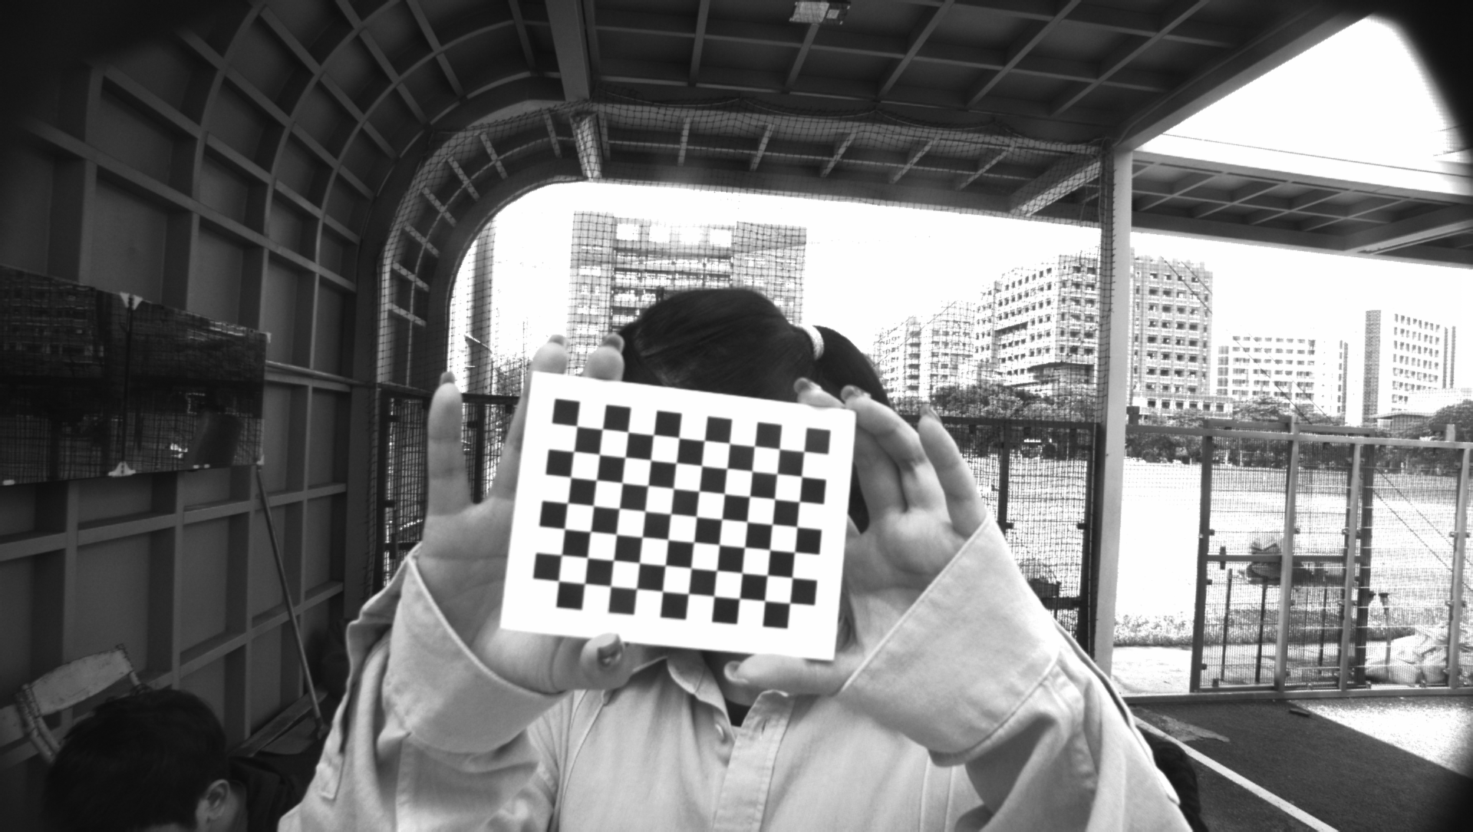
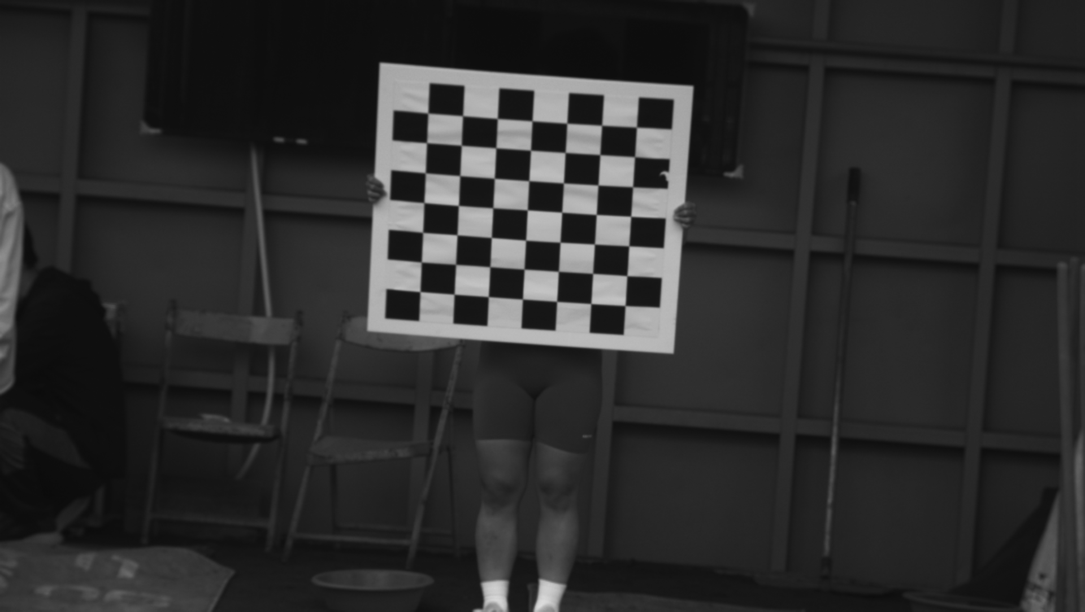
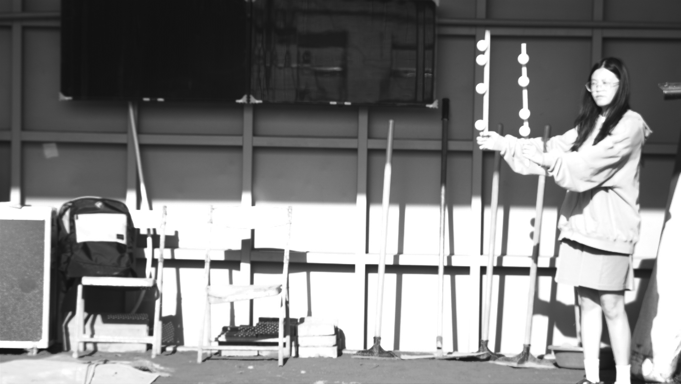
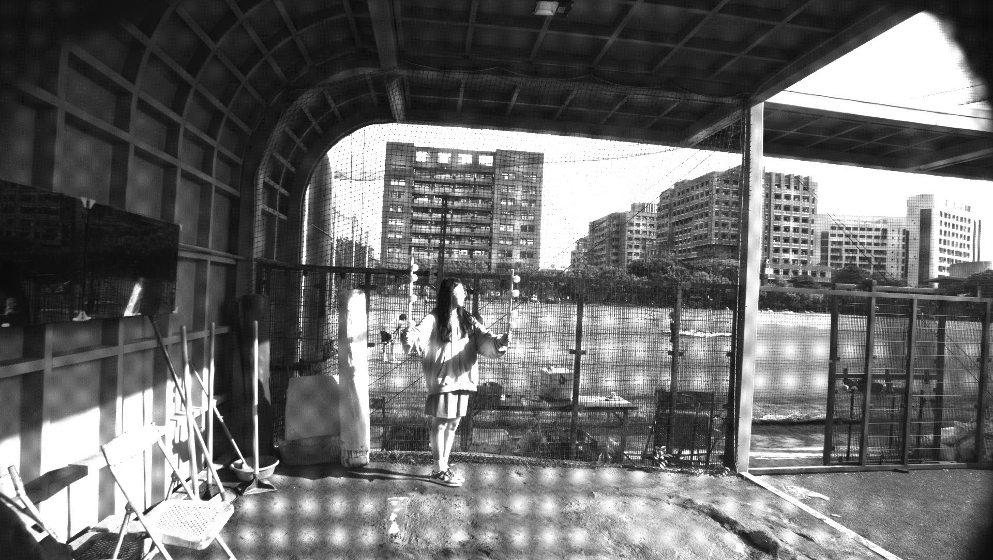





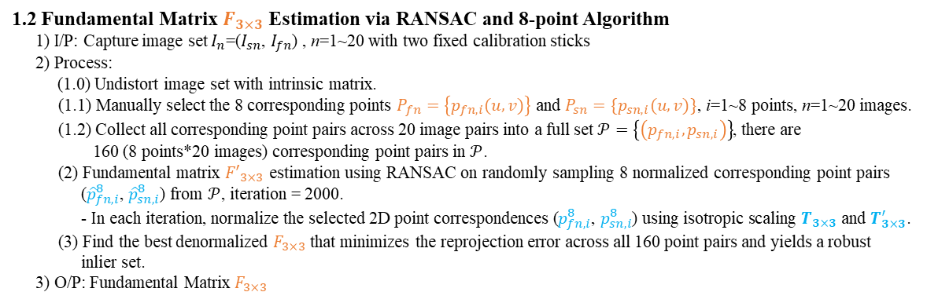














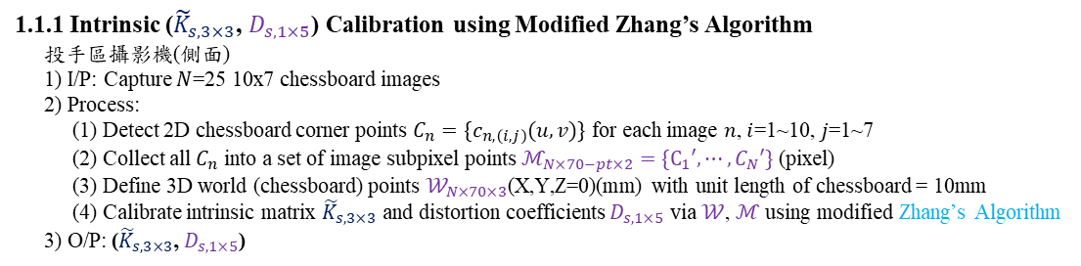






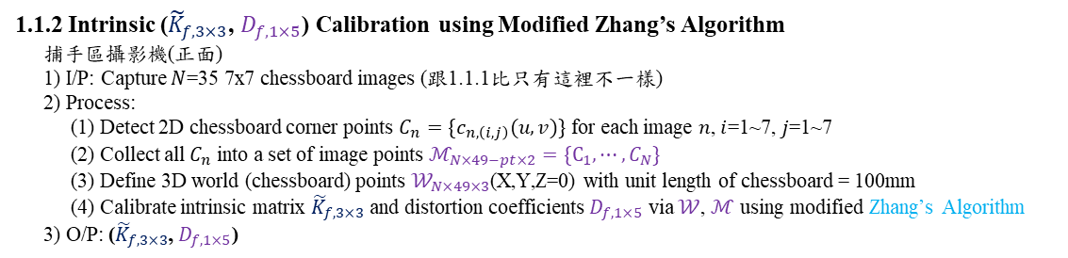

1.1 Introduction: Global Framework - Invariant Pattern Calibration
1. Intrinsic (${\tilde{K}}_{s, 3×3}$, $D_{s,1×5}$), (${\tilde{K}}_{f, 3×3}$, $D_{f,1×5}$) and Fundamental Matrix ($F_{3×3}$) Calibrations of Two Cameras
1.1.1 Intrinsic (${\tilde{K}}_{s, 3×3}$, $D_{s,1×5}$) Calibration using Modified Zhang’s Algorithm
投手區攝影機(側面)
1) I/P: Capture $N$≥15 8x7 chessboard images
2) Process:
(1) Detect 2D chessboard corner points $C_{n}=\{c_{n,\left(i,j\right)}(u,v)\}$ for each image $n$, $i$=1~8, $j$=1~7
(2) Collect all $C_{n}$ into a set of image subpixel points $ℳ_{N×56−pt×2}=\{C_{1}′, ⋯, C_{N}′\}$ (pixel)
(3) Define 3D world (chessboard) points $𝒲_{N×56×3}$(X,Y,Z=0)(mm) with unit length of chessboard = 100mm
(4) Calibrate intrinsic matrix ${\tilde{K}}_{s, 3×3}$ and distortion coefficients $D_{s,1×5}$ via $𝒲$, $ℳ$ using modified Zhang’s Algorithm
3) O/P: (${\tilde{K}}_{s, 3×3}$, $D_{s,1×5}$)
$(u,v)$=$(0,0)$
(1) $C_{n} =$ cv2.findChessboardCorners(image, (8, 7))
(2) $C_{n}′=$cv2.cornerSubPix(image, $C_{n}$) optical flow
(4) ${\tilde{K}}_{s, 3×3},D_{s,1×5}=$cv2.calibrateCamera(𝒲, ℳ, (1920, 1080))
$$Y$$
(${\tilde{K}}_{s, 3×3}\text{, }D_{s,1×5}$)
$$(0,0,0)$$
as G.T.
$$X$$
$$Z$$
(向下)
${\tilde{K}}_{s, 3×3}=\left[\begin{matrix}f_{x} & 0 & c_{x} \\ 0 & f_{y} & c_{y} \\ 0 & 0 & 1\end{matrix}\right]$, $D_{s,1×5}=\left[\begin{matrix}k_{1} & k_{2} & p_{1}\end{matrix} \begin{matrix}p_{2} & k_{3}\end{matrix}\right]$
Image size: $(1920, 1080)$
每個黑格/白格邊長: 100mmx100mm
1.1.2 Intrinsic (${\tilde{K}}_{f, 3×3}$, $D_{f,1×5}$) Calibration using Modified Zhang’s Algorithm
捕手區攝影機(正面)
1) I/P: Capture $N$≥15 8x7 chessboard images (跟1.1.1相同)
2) Process:
(1) Detect 2D chessboard corner points $C_{n}=\{c_{n,\left(i,j\right)}(u,v)\}$ for each image $n$, $i$=1~8, $j$=1~7
(2) Collect all $C_{n}$ into a set of image points $ℳ_{N×56−pt×2}=\{C_{1}, ⋯, C_{N}\}$
(3) Define 3D world (chessboard) points $𝒲_{N×56×3}$(X,Y,Z=0) with unit length of chessboard = 100mm
(4) Calibrate intrinsic matrix ${\tilde{K}}_{f, 3×3}$ and distortion coefficients $D_{f,1×5}$ via $𝒲$, $ℳ$ using modified Zhang’s Algorithm
3) O/P: (${\tilde{K}}_{f, 3×3}$, $D_{f,1×5}$)
$(u,v)$=$(0,0)$
$$Y$$
(1) $C_{n} =$ cv2.findChessboardCorners(image, (8, 7))
(2) $C_{n}′=$cv2.cornerSubPix(image, $C_{n}$) optical flow
(4) ${\tilde{K}}_{f, 3×3},D_{f,1×5}=$cv2.calibrateCamera(𝒲, ℳ, (1920, 1080))
$$(0,0,0)$$
(${\tilde{K}}_{f, 3×3}\text{,} D_{f,1×5}$)
$$X$$
$$Z$$
(向下)
as G.T.
Image size: $(1920, 1080)$
每個黑格/白格邊長: 100mmx100mm
${\tilde{K}}_{f, 3×3}=\left[\begin{matrix}f_{x} & 0 & c_{x} \\ 0 & f_{y} & c_{y} \\ 0 & 0 & 1\end{matrix}\right]$, $D_{f,1×5}=\left[\begin{matrix}k_{1} & k_{2} & p_{1}\end{matrix} \begin{matrix}p_{2} & k_{3}\end{matrix}\right]$
1.2 Fundamental Matrix $F_{3×3}$ Estimation via RANSAC and 8-point Algorithm
1) I/P: Capture image set $I_{n}$=($I_{sn}$, $I_{fn}$) , n=1~15 with two 4-ball calibration rods
2) Process:
(1.0) Undistort image set with intrinsic matrix.
(1.1) Detect and confirm the 8 ball centers $P_{fn}=\left\{p_{fn,i}(u,v)\right\}$ and $P_{sn}=\{p_{sn,i}(u,v)\}$, i=1~8 points, n=1~15 images.
(1.2) Collect all corresponding point pairs across 15 image pairs into a full set $𝒫=\left\{\left(p_{fn,i},p_{sn,i}\right)\right\}$, there are
120 (8 points*15 images) corresponding point pairs in $𝒫$.
(2) Fundamental matrix ${F′}_{3×3}$ estimation using RANSAC on randomly sampling 8 normalized corresponding point pairs (${\hat{p}}_{fn,i}^{8}$, ${\hat{p}}_{sn,i}^{8}$) from $𝒫$, iteration = 10000, threshold = 2 px.
- In each iteration, normalize the selected 2D point correspondences ($p_{fn,i}^{8}$, $p_{sn,i}^{8}$) using isotropic scaling $T_{3×3}$ and $T_{3×3}^{′}$.
(3) Refit the denormalized $F_{3×3}$ that uses the 8-point algorithm on all RANSAC inliers (near-planar data is rejected).
3) O/P: R, t (mm) and Fundamental Matrix $F_{3×3}$
.
$(u,v)$=$(0,0)$
$$p_{ℓn,1}$$
.
.
$$p_{ℓn,5}$$
fix 2 cameras
$$p_{ℓn,4}$$
.
$$p_{ℓn,8}$$
$$I_{fn}$$
$$I_{sn}$$
?
?
${{\hat{p}}_{fn,i}^{8}}_{3×1}=T_{3×3}∙{p_{fn,i}^{8}}_{3×1}$ and ${{\hat{p}}_{sn,i}^{8}}_{3×1}=T_{3×3}^{′}∙{p_{sn,i}^{8}}_{3×1}$
?
$${{{\hat{p}}_{fn,i}^{8}}_{3×1}}^{T}∙{F^{′}}_{3×3}∙{{\hat{p}}_{sn,i}^{8}}_{3×1}=0$$
?
$$F_{3×3}=T_{3×3}^{ T}∙{F^{′}}_{3×3}∙{T′}_{3×3}$$
Front cam
(捕手側)
Side cam
(投手側)
$$F_{3×3}$$
(${\tilde{K}}_{f, 3×3}\text{,} D_{f,1×5}$)
(${\tilde{K}}_{s, 3×3}\text{, }D_{s,1×5}$)

Slide 6
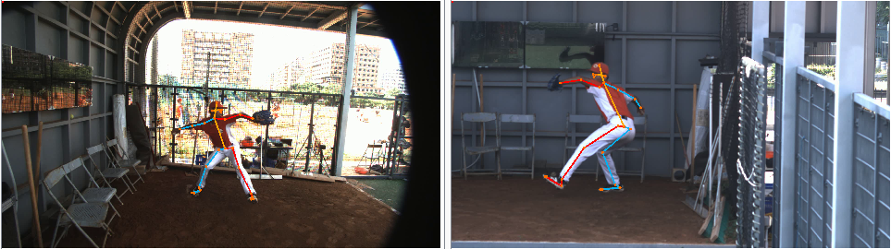
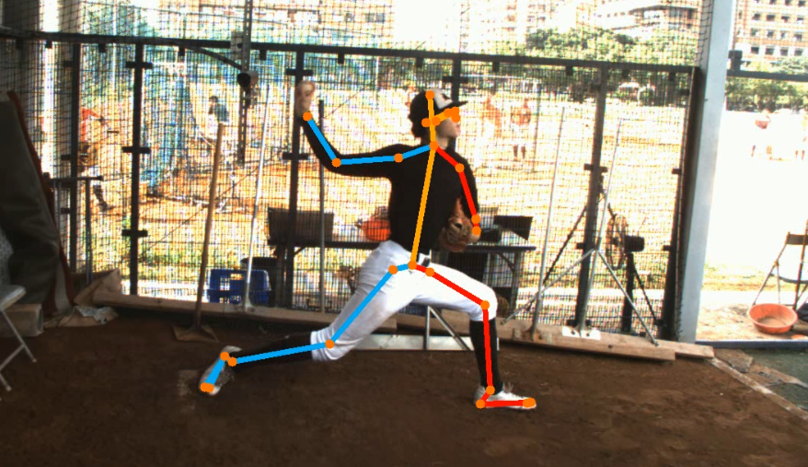
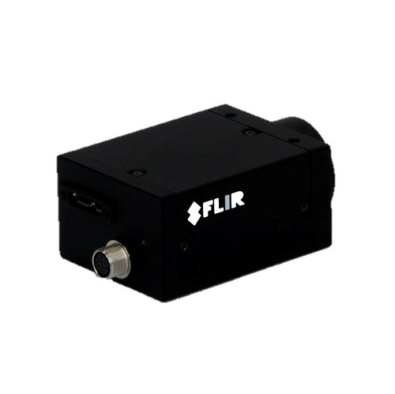
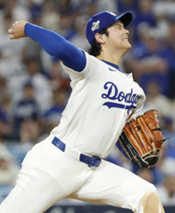








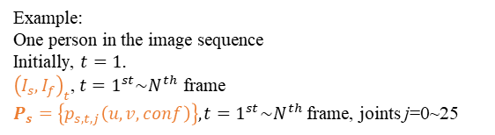
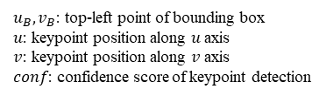

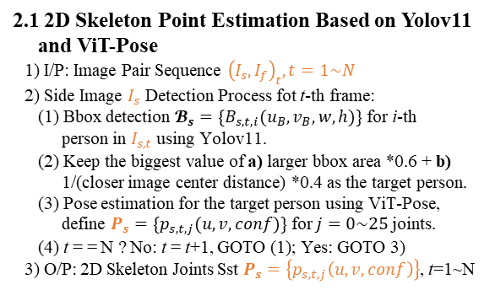








1.1 Introduction: Global Framework - 2D Phase Segmentation
$k_{fc}$: Foot Contact
$k_{mer}$: Maximum External Rotation
$k_{br}$: Ball Release
2. 2D Phase Segmentation Based on The Lead-Foot Height & Stride, The Maximum Shoulder External Rotation Angle, and Wrist Speed.
$$(0,0)$$
$$u$$
s: side
f: front
t: frame number
2.2 2D Phase Segmentation via 3 Keyframes Detection Based on 2D Skeleton Joint Motion
1) I/P: 2D skeleton joint coordinates $P_{s}=\left\{p_{s,t,j}\left(u,v,conf\right)\right\}$
2) Computation process (Right-Handed shown; left-handed uses mirrored joints):
2.1) $k_{fc}$: Identified via lead-foot ground height and stride length $y_{foot,t}, s_{t}$,
$L, conf≥0.6$.
(1) Find the knee-lift peak k_prep (max hip–knee height) and the median leg length L.
$k_{prep}=argmax(v_{t,14}−v_{t,16})$➔ $L=med(‖P_{14}−P_{16}‖+‖P_{16}−P_{18}‖)$ for $t=1\sim N$ frames
(2) After k_prep, keep stride frames where the ankles are more than 0.55 L apart horizontally.
$s_{t}=u_{t,18}−u_{t,19}$，$\frac{|s_{t}|}{L}>0.55$
(3) Lead-foot height = lowest toe/heel point; in a ~45 ms window ankle-u and foot-v vary ≤ 0.04 L.
$y_{foot,t}=max(v_{t,20}, v_{t,22}, v_{t,24})$
(4) Identify $k_{fc}$ as the first frame where $y_{foot}≥y_{gnd}−0.025L$ and stays stable, $k_{prep}<t≤k_{mer}$.
2.2) $k_{mer}$: Identified via right forearm layback angle (arm raised) $θ_{ser}=\left\{θ_{ser,1},…,θ_{ser,t},…,θ_{ser,N}\right\}$.
(1) Calculate the angle $θ_{ser,t}$ between the forearm (wrist-elbow) vector ${\overset{⃑}{V}}_{we,t}$ and the horizontal vector ${\overset{⃑}{V}}_{u}$ (u-axis).
$θ_{ser,t}=\cos^{−1}{\frac{{\overset{⃑}{V}}_{we,t}\left(u,v\right)∙{\overset{⃑}{V}}_{u}\left(1,0\right)}{\left\|{\overset{⃑}{V}}_{we,t}\left(u,v\right)\right\|\left\|{\overset{⃑}{V}}_{u}\left(1,0\right)\right\|}}$where ${\overset{⃑}{V}}_{we,t}\left(u,v\right)=P_{s,t,11}^{}\left(u,v\right)−P_{s,t,9}^{}\left(u,v\right)$
(2) Identify $k_{mer}$ as the frame with the maximum value of $θ_{ser,t}$ and t > $k_{fc}$.
2.3) $k_{br}$: Identified via right wrist speed $𝒱_{11}=\left\{𝓋_{11,1},…,𝓋_{11,t},…,𝓋_{11,N}\right\}$.
(1) Use the wrist positions directly (conf ≥ 0.6, consecutive frames only).
$P_{s,t,11}(u,v)$➔ $\text{(no extra smoothing)}$ for $t=1\sim N$ frames
(2) Compute the speed by the backward difference of consecutive frames.
$v_{11,t}=\frac{‖P_{s,t,11}−P_{s,t−1,11}‖}{Δt}$
$Δt=\frac{1}{FPS}, \text{ only if t−1 and t are valid}$
(3) Identify $k_{br}$ as the frame with the maximum value of $v_{11,t}$ and t > $k_{mer}$ (≤ 0.3 s).
3) O/P: 3 keyframes ($k_{fc}$, $k_{mer}$, $k_{br}$)
$$v$$
$$I_{s,t}$$
$u_{B}, v_{B}$: top-left point of bounding box
$u$: keypoint position along $u$ axis
$v$: keypoint position along $v$ axis
$conf$: confidence score of keypoint detection
z
$$u$$
y
x
$$d_{a,t}$$
$$(0,0)$$
$$v$$
$$I_{f,t}$$
$${\left(I_{s}, I_{f}\right)}_{t}$$
a: ankle
18: left ankle
19: right ankle
2.1 2D Skeleton Point Estimation Based on YOLOv8 and ViT-Pose
1) I/P: Image Pair Sequence ${\left(I_{s}, I_{f}\right)}_{t}, t=1\sim N$
2) Side Image $I_{s}$ Detection Process fot t-th frame:
  (1) Bbox detection $𝓑_{s}=\{B_{s,t,i}(u_{B},v_{B},w,h)\}$ for i-th person in $I_{s,t}$ using YOLOv8.
  (2) Lock the bbox nearest the image center (central ROI) as the pitcher; track it by IoU / center distance.
  (3) Pose estimation for the target person using ViT-Pose, define $P_{s}=\{p_{s,t,j}(u,v,conf)\}$ for $j=0\sim 25$ joints.
  (4) t = = N ? No: t = t+1, GOTO (1); Yes: GOTO 3)
3) O/P: 2D Skeleton Joints Sst $P_{s}=\left\{p_{s,t,j}\left(u,v,conf\right)\right\}$, t=1~N
$P_{s}=\left\{p_{s,t,j}\left(u,v,conf\right)\right\}$ $t=1^{st}\sim N^{th}$ frame, joints j=0~25
3D較準
7: right shoulder
9: right elbow
11: right wrist
Vwe: forearm vector
$$θ_{ser,t}$$
Example:
One person in the image sequence
Initially, $t=1$.
${\left(I_{s}, I_{f}\right)}_{t}$, $t=1^{st}\sim N^{th}$ frame
$P_{s}=\left\{p_{s,t,j}\left(u,v,conf\right)\right\}, t=1^{st}\sim N^{th}$ frame, joints j=0~25
11
$${\overset{⃑}{V}}_{we,t}$$
$${\overset{⃑}{V}}_{u}$$
11: right wrist
9
($k_{fc}$, $k_{mer}$, $k_{br}$)
Keypoints are smoothed online by a One Euro filter during inference. Event detection uses keypoints with confidence ≥ 0.6; all thresholds scale with leg length L and FPS.

Slide 7
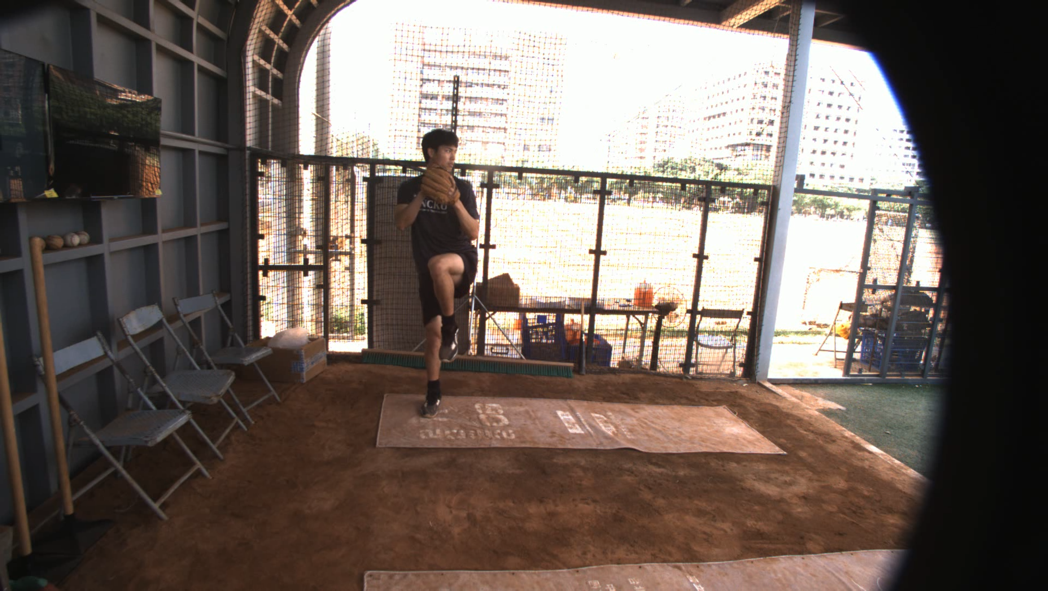
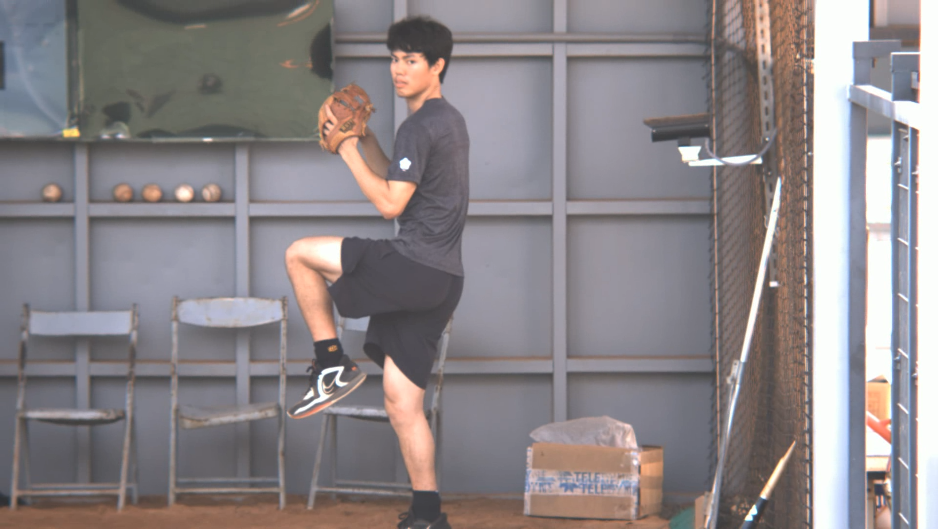
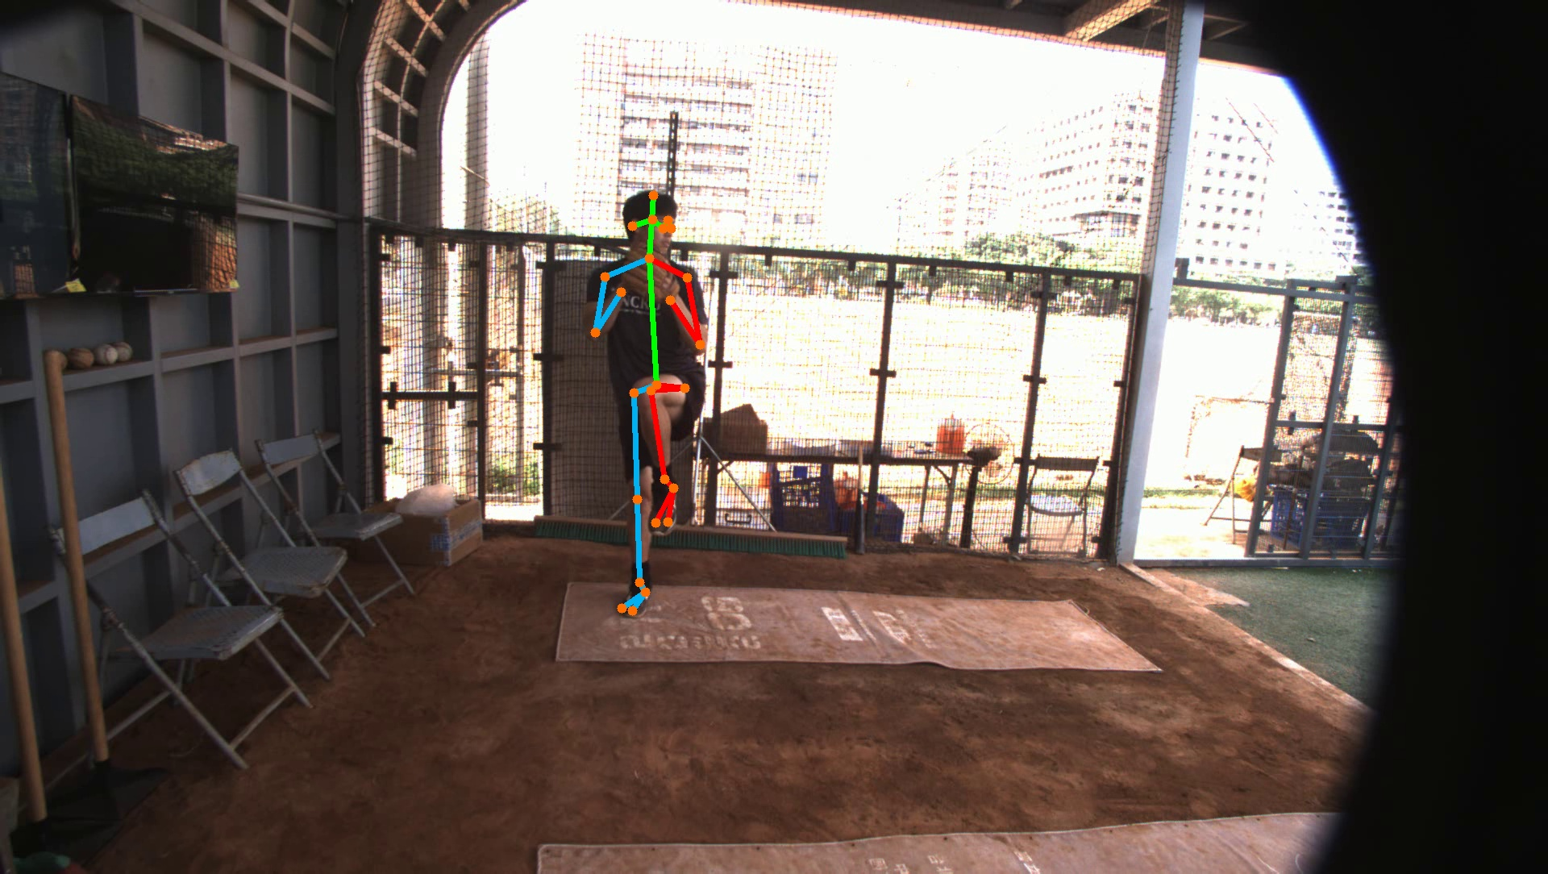
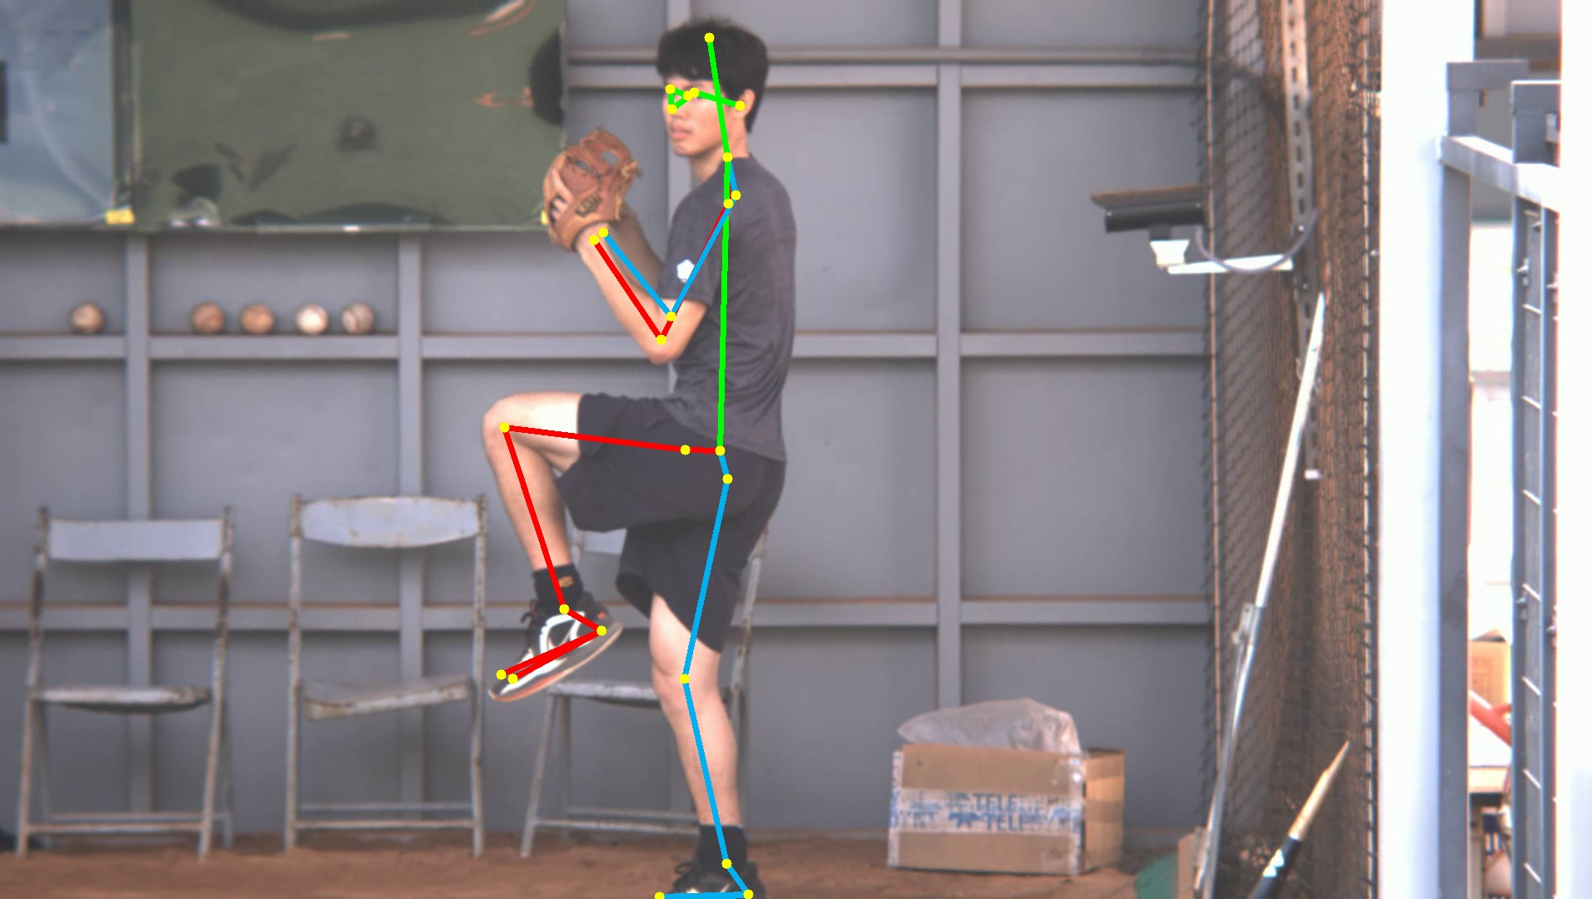
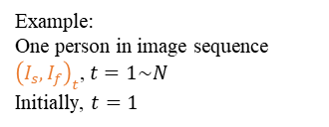
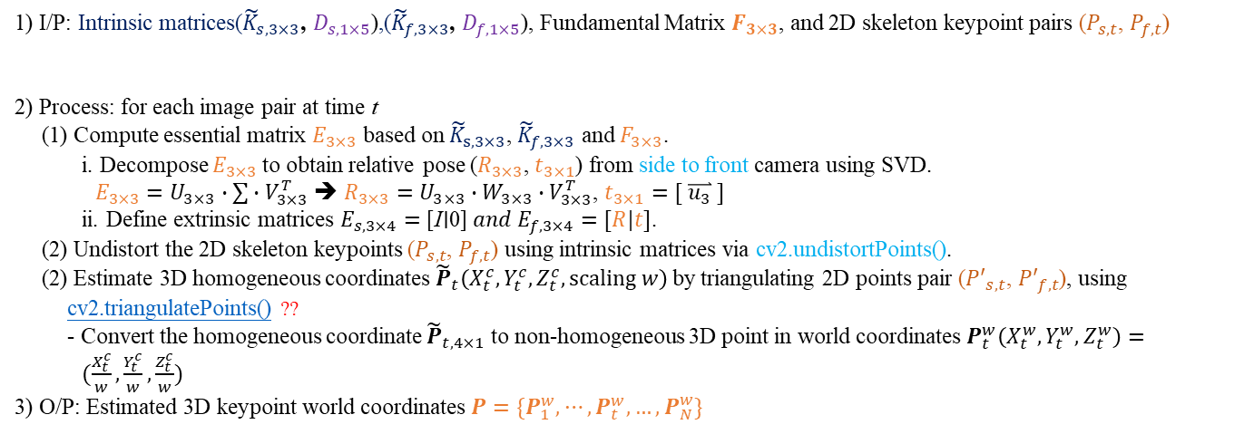






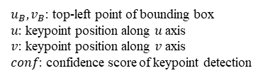
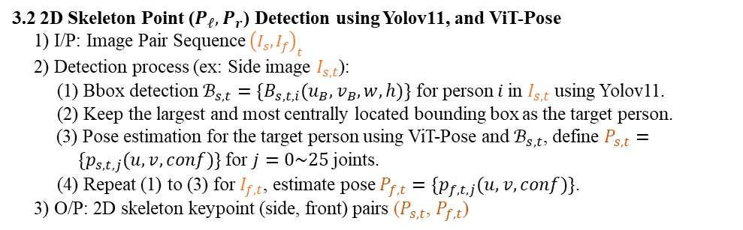



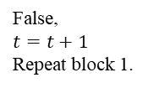












1.1 Introduction: Global Framework - 3D Skeleton
Block 1.1) (${\tilde{K}}_{s, 3×3}$, $D_{s,1×5}$)
Block 1.1) (${\tilde{K}}_{f, 3×3}$, $D_{f,1×5}$)
Block 1.2) $R, t$
3. 3D Skeleton Point Estimation Based on Calibrated Stereo (K, D, R, t)
$$u_{ }$$
3.2 2D Skeleton Point ($P_{ℓ}, P_{r}$) Detection using YOLOv8, and ViT-Pose
1) I/P: Image Pair Sequence ${\left(I_{s}, I_{f}\right)}_{t}$
2) Detection process (ex: Side image $I_{s,t}$):
  (1) Bbox detection $ℬ_{s,t}=\{B_{s,t,i}(u_{B},v_{B},w,h)\}$ for person $i$in $I_{s,t}$ using YOLOv8.
  (2) Lock the most central bbox (central ROI) as the pitcher and track it.
  (3) Pose estimation for the target person using ViT-Pose and $ℬ_{s,t}$, define $P_{s,t}=\{p_{s,t,j}(u,v,conf)\}$ for $j=0\sim 25$ joints.
  (4) Repeat (1) to (3) for $I_{f,t}$, estimate pose $P_{f,t}=\{p_{f,t,j}(u,v,conf)\}$.
3) O/P: 2D skeleton keypoint (side, front) pairs ($P_{s,t}$, $P_{f,t}$)
$u_{B}, v_{B}$: top-left point of bounding box
$u$: keypoint position along $u$ axis
$v$: keypoint position along $v$ axis
$conf$: confidence score of keypoint detection
(0,0)
$${\left(I_{s}, I_{f}\right)}_{t}$$
$$v_{ }$$
$$I_{s,t}$$
$$u_{ }$$
$$u_{ }$$
$$u_{ }$$
(0,0)
(0,0)
(0,0)
$$v_{ }$$
$$I_{f,t}$$
$$v_{ }$$
$$I_{s,t}$$
$$v_{ }$$
$$I_{f,t}$$
3.1 I/P: Image Pair Sequence ${\left(I_{s}, I_{f}\right)}_{t}$
Example:
One person in image sequence
${\left(I_{s}, I_{f}\right)}_{t}$, $t=1\sim N$
Initially, $t=1$
($P_{s,t}$, $P_{f,t}$)
3.3 3D Skeleton Estimation using Triangulation
1) I/P: Intrinsic matrices(${\tilde{K}}_{s, 3×3}$, $D_{s,1×5}$),(${\tilde{K}}_{f, 3×3}$, $D_{f,1×5}$), Extrinsics $R, t \text{(mm)}$, and 2D skeleton keypoint pairs ($P_{s,t}$, $P_{f,t}$)
2) Process: for each image pair at time t
(1) Calib.: essential matrix $E_{3×3}$ based on ${\tilde{K}}_{s, 3×3}$, ${\tilde{K}}_{f, 3×3}$ and $F_{3×3}$.
i. Decompose $E_{3×3}$to obtain relative pose ($R_{3×3}$, $t_{3×1}$) from CF to CS camera using SVD.
$E_{3×3}=U_{3×3}∙∑∙V_{3×3}^{T}$ ➔ $R_{3×3}=U_{3×3}∙W_{3×3}∙V_{3×3}^{T}$, $t_{3×1}=[ \overset{⃑}{u_{3}} ]$
ii. Define extrinsic matrices $E_{f,3×4}=[I∣0] \text{ and } E_{s,3×4}=[R|t]$.
(2) Undistort the 2D skeleton keypoints ($P_{s,t}$, $P_{f,t}$) using intrinsic matrices via cv2.undistortPoints().
(3) Estimate 3D homogeneous coordinates ${\tilde{P}}_{t}\left(X_{t}^{c}, Y_{t}^{c},Z_{t}^{c},scaling w\right)$by triangulating 2D points pair (${P′}_{s,t}$, ${P′}_{f,t}$), using cv2.triangulatePoints()
- Convert the homogeneous coordinate ${\tilde{P}}_{t,4×1}$ to non-homogeneous 3D point in world coordinates $P_{t}^{w}\left(X_{t}^{w}, Y_{t}^{w},Z_{t}^{w}\right)=(\frac{X_{t}^{c}}{w}, \frac{Y_{t}^{c}}{w},\frac{Z_{t}^{c}}{w})$
3) O/P: Estimated 3D keypoint world coordinates $P=\{P_{1}^{w},⋯,P_{t}^{w},…,P_{N}^{w}\}$
$P_{s,t}=\{p_{s,t,j}(u,v,conf)\}$ for $j=0\sim 25$ joints
$$P_{f,t}=\{p_{f,t,j}(u,v,conf)\}$$
補: Triangulated points will be in CF camera coordinate system
Origin point: Front camera (捕手區攝影機)
False,
$t=t+1$
Repeat block 1.
?
$$E_{3×3}={\tilde{K}}_{f,3×3}^{T}∙F_{3×3}∙{\tilde{K}}_{s,3×3}$$
$P=\{P_{1}^{w},⋯,P_{t}^{w}\}$
$t=1\sim N$
$U_{3×3}=\left[\begin{matrix}\overset{⃑}{u_{1}} & \overset{⃑}{u_{2}} & \overset{⃑}{u_{3}}\end{matrix}\right]$ , $W=\left[\begin{matrix}0 & −1 & 0 \\ 1 & 0 & 0 \\ 0 & 0 & 0\end{matrix}\right]$
$t==N$ ?
$U_{3×3}$ is an orthogonal matrix, $U^{T}U=I$
${p′}_{s,t}$= cv2.undistortPoints($p_{s,t}$,${\tilde{K}}_{s, 3×3}$, $D_{s,1×5}$)
True, O/P:
$P=\{P_{1}^{w},⋯,P_{t}^{w}\}$
$t=1\sim N$
?
${\tilde{P}}_{t}\left(X_{t}^{c}, Y_{t}^{c},Z_{t}^{c},w\right)$ = cv2.triangulatePoints($[I|0]$, $[R|t]$, ${p′}_{f,t}$, ${p′}_{s,t}$)

Slide 8
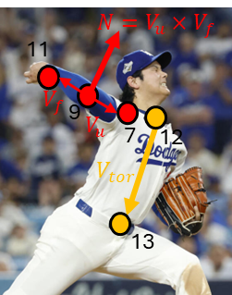


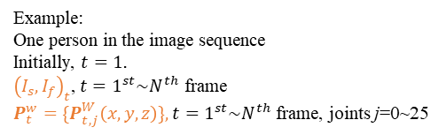
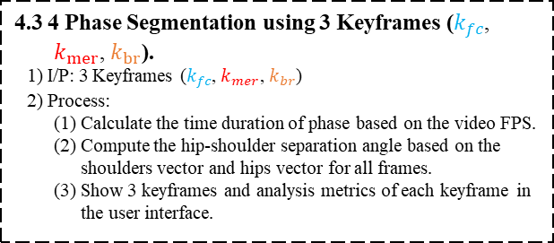
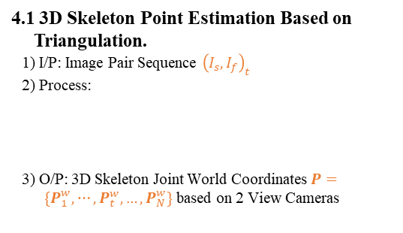





1.1 Introduction: Global Framework - 3D Phase Segmentation
$k_{fc}$: Foot Contact
$k_{mer}$: Maximum external rotation
$k_{br}$: Ball Release
4. 3D Phase Segmentation Based on The Lead-Foot Height & Stride, The Maximum Shoulder External Rotation Angle, and Wrist Speed.
$$(0,0)$$
$$u$$
s: side
f: front
t: frame number
4.2 3D Phase Segmentation: 2D Keyframes + 3D Skeleton Metrics.
1) I/P: 3D skeleton joint coordinates $P=\{P_{1}^{w},⋯,P_{t}^{w},…,P_{N}^{w}\}$
- $P_{t}^{W}=\left\{P_{t,j}^{W}\left(x,y,z\right)\right\}$ for j = 0~25, total 26 joints, t = 1st~N^{th} frame
2) Computation process (Right-Handed shown; left-handed uses mirrored joints):
2.1) $k_{fc}$: Identified via FC frame of the 2D rule and 3D stride $d_{stride}$,
$k_{0}\text{: initial standing frame}$.
(1) Take k_fc from the CS 2D event detector (same rule as the 2D slide, 2.1).
$k_{fc}=k_{fc,2D}$➔ $\text{(CS view)}$ for $t=1\sim N$ frames
(2) Triangulate each joint; keep it only if conf ≥ 0.5 in both views, reproj. ≤ 3 px and ray angle ≥ 1°.
$P_{t,j}^{W}=\frac{(X_{t}, Y_{t}, Z_{t})}{w}$，$\text{(m); null if rejected}$
(3) Stride = 3D distance of the rear heel from frame k0 to k_fc (not projected to the ground).
$d_{stride}=‖P_{k_{fc},25}^{W}−P_{k_{0},25}^{W}‖$
(4) Show $k_{fc}$ with $d_{stride} \text{(cm)}$ and $k_{fc}<k_{mer}<k_{br}$.
2.2) $k_{mer}$: Identified via right arm-plane angle vs torso $θ_{ser}=\left\{θ_{ser,1},…,θ_{ser,t},…,θ_{ser,N}\right\}$.
(1) Compute the upper arm (shoulder-elbow) ${\overset{⃑}{V}}_{u,t}\left(x,y,z\right)$ and forearm (wrist-elbow) ${\overset{⃑}{V}}_{f,t}\left(x,y,z\right)$ vectors and use their cross product to obtain the plane normal ${\overset{⃑}{N}}_{uf,t}$.
$${\overset{⃑}{N}}_{uf,t}\left(x,y,z\right)={\overset{⃑}{V}}_{u,t}\left(x,y,z\right)×{\overset{⃑}{V}}_{f,t}\left(x,y,z\right)$$
$${\overset{⃑}{V}}_{u,t}\left(x,y,z\right)=P_{t,7}^{W}\left(x,y,z\right)−P_{t,9}^{W}\left(x,y,z\right)\text{，}{\overset{⃑}{V}}_{f,t}\left(x,y,z\right)=P_{t,11}^{W}\left(x, y,z\right)−P_{t,9}^{W}\left(x,y,z\right)$$
(2) Compare this plane normal ${\overset{⃑}{N}}_{uf,t}$ with the torso vector (hip-neck) ${\overset{⃑}{V}}_{tor,t}\left(x,y,z\right)$ using the dot product to calculate the angle $θ_{ser,t}$.
$$θ_{ser,t}=\cos^{−1}{\frac{{\overset{⃑}{N}}_{uf,t}\left(x,y,z\right)∙{\overset{⃑}{V}}_{tor,t}\left(x,y,z\right)}{\left\|{\overset{⃑}{N}}_{uf,t}\left(x,y,z\right)\right\|\left\|{\overset{⃑}{V}}_{tor,t}\left(x,y,z\right)\right\|}}$$
$${\overset{⃑}{V}}_{tor,t}\left(x,y,z\right)=P_{t,13}^{W}\left(x,y,z\right)−P_{t,12}^{W}\left(x,y,z\right)$$
(3) Take $k_{mer}$ from the CS 2D detector; show $θ_{ser,t}$ and t > $k_{fc}$.
2.3) $k_{br}$: Identified via right wrist speed $𝒱_{11}=\left\{𝓋_{11,1},…,𝓋_{11,t},…,𝓋_{11,N}\right\}$.
(1) Take k_br from the CS 2D event detector; use the valid 3D wrist points.
$P_{t,11}^{W}(x,y,z)$➔ $\text{(valid points only)}$ for $t=1\sim N$ frames
(2) 3D wrist speed = backward difference of consecutive valid frames (m/s).
$v_{11,t}=\frac{‖P_{t,11}^{W}−P_{t−1,11}^{W}‖}{Δt}$
$Δt=\frac{1}{FPS}, \text{ no bridging over missing frames}$
(3) Show $k_{br}$ with $v_{11,t}$ and t > $k_{mer}$.
3) O/P: 3 keyframes ($k_{fc}$, $k_{mer}$, $k_{br}$)
$$v$$
$$I_{s,t}$$
z
y
x
$$(0,0)$$
$$u$$
$$v$$
$$I_{f,t}$$
$${\left(I_{s}, I_{f}\right)}_{t}$$
4.1 3D Skeleton Point Estimation Based on Triangulation.
1) I/P: Image Pair Sequence ${\left(I_{s}, I_{f}\right)}_{t}$
2) Process:
3) O/P: 3D Skeleton Joint World Coordinates $P=\{P_{1}^{w},⋯,P_{t}^{w},…,P_{N}^{w}\}$ based on 2 View Cameras
$$P=\{P_{1}^{w},⋯,P_{t}^{w},…,P_{N}^{w}\}$$
$t=1^{st}\sim N^{th}$ frame
a: ankle
18: left ankle
19: right ankle
$${\left(I_{s}, I_{f}\right)}_{t}$$
2D Skeleton Point Detection using YOLOv8 and ViT-Pose
($P_{s,t}(u,v)$, $P_{f,t}(u,v)$)
3D Skeleton Estimation using Triangulation
$$P_{t}^{w}(x,y,z)$$
7: right shoulder
9: right elbow
11: right wrist
uf: upper arm & forearm
Example:
One person in the image sequence
Initially, $t=1$.
${\left(I_{s}, I_{f}\right)}_{t}$, $t=1^{st}\sim N^{th}$ frame
$P_{t}^{w}=\{P_{t,j}^{W}\left(x,y,z\right)\}, t=1^{st}\sim N^{th}$ frame, joints j=0~25
12: neck
13: hip center
4.3 4 Phase Segmentation using 3 Keyframes ($k_{fc}$, $k_{mer}$, $k_{br}$).
1) I/P: 3 Keyframes ($k_{fc}$, $k_{mer}$, $k_{br}$)
2) Process:
(1) Calculate the time duration of phase based on the video FPS.
(2) Compute the signed hip-shoulder separation angle on the plane perpendicular to the torso axis, for all frames.
(3) Show 3 keyframes and metrics in the UI; save the 3D / analysis / keyframes JSON.
($k_{fc}$, $k_{mer}$, $k_{br}$)
11: right wrist
Keypoints are smoothed online by a One Euro filter during inference. 3D distances are 3D Euclidean (no ground plane); invalid joints give null instead of a rescaled value.

Slide 9

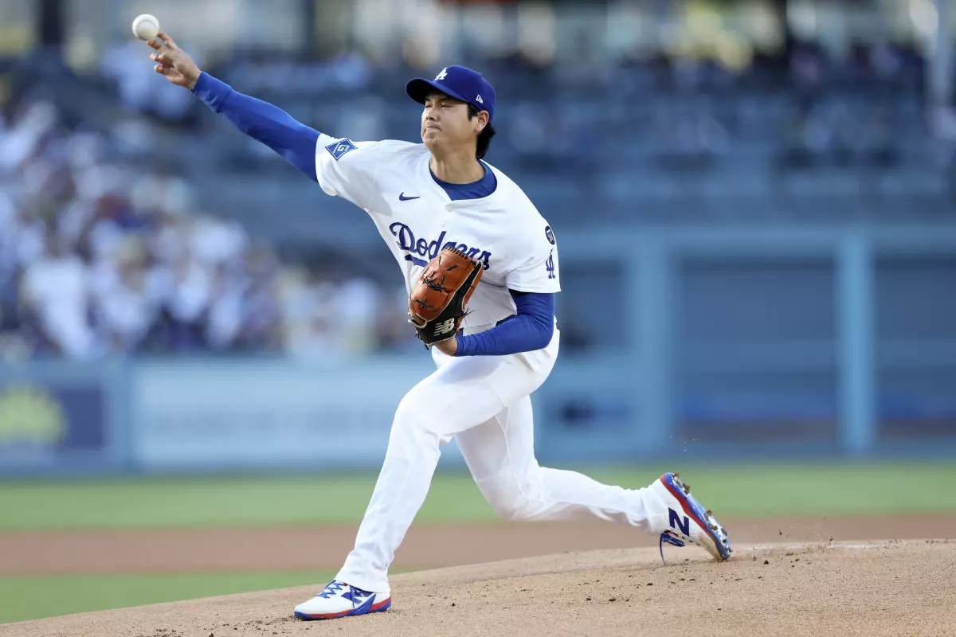

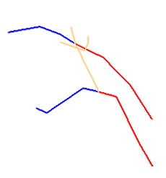














1.2 Related Works: 投手動作功能定義（1/2）
跨步距離
$$N=V_{u}×V_{f}$$
11
7
$$V_{f}$$
9
$$N$$
6
$$V_{u}$$
7
12
$$V_{s}$$
z
$$θ_{er}$$
15
$$V_{tor}$$
14
$$V_{tor}$$
$$V_{h}$$
13
$$θ_{sh}$$
$$V_{s}$$
投手板
x
$$V_{h}$$
肩最大外旋
(External Rotation)
出手點距離
y
肩髖分離角度
(shoulder-Hip)
$$θ_{er}$$
$$θ_{sh}$$

Slide 10
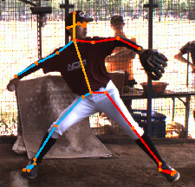
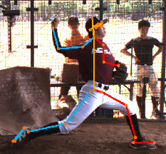
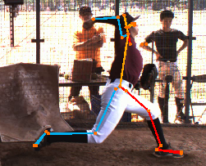
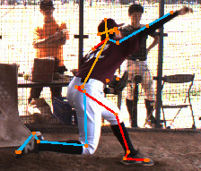
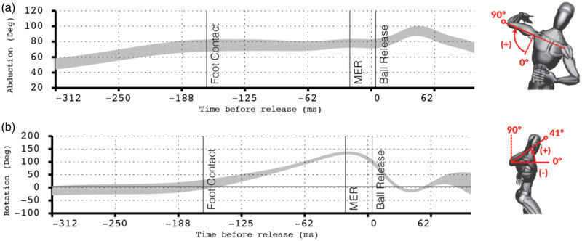
1.2 Related Works: 投手動作功能定義（2/2）
z
肩峰連線向量
髖部連線向量（基準）
地面
x
肩髖分離角度
(shoulder-Hip)
5°
地面
最大正角度14°
地面
-6°
地面
-25°
地面
147°
99°
肩外旋角度
47°
Ref: Manzi, Joseph E et al. “The influence of shoulder abduction and external rotation on throwing arm kinetics in professional baseball pitchers.” Shoulder & elbow vol. 14,1 Suppl (2022): 90-98. doi:10.1177/17585732211010300

Slide 11



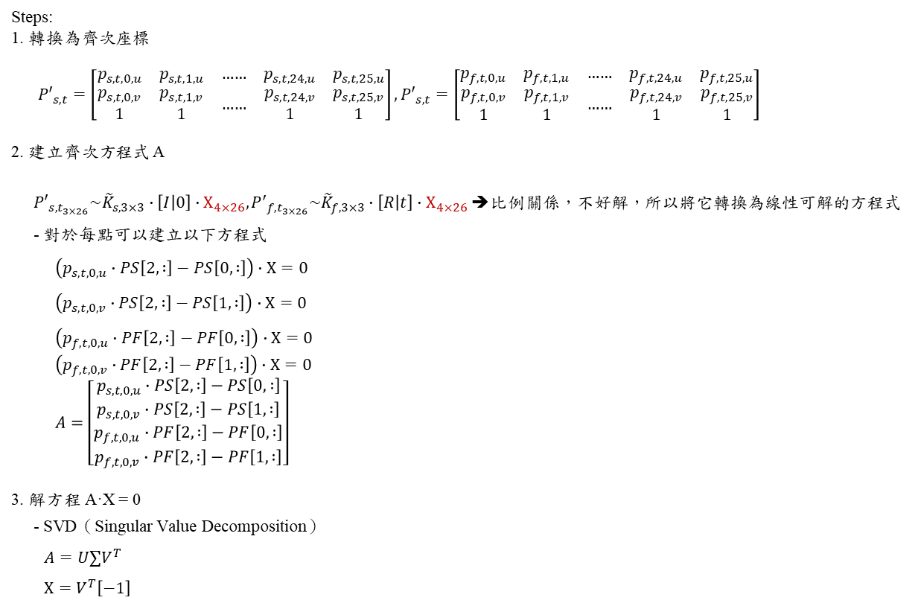
1.2 Related Work: cv2.triangulatePoints( )
$$Χ_{4×26}$$
cv2.triangulatePoints(projMat1, projMat2, points1, points2) → points4D
cv2.triangulatePoints(${\tilde{K}}_{s,3×3}∙[I|0]$, ${\tilde{K}}_{f,3×3}∙[R|t]$, $P_{s,t}$, $P_{f,t}$) = ${\tilde{P}}_{t}\left(X_{t}^{c}, Y_{t}^{c},Z_{t}^{c},w\right)$
$P_{s,t}=\left[\begin{matrix}p_{s,1,u} & p_{s,2,u} & … \\ p_{s,1,v} & p_{s,2,v} & …\end{matrix}\begin{matrix}… & p_{s,N−1,u} & p_{s,N,u} \\ … & p_{s,N−1,v} & p_{s,N,v}\end{matrix}\right],P_{s,t}=\left[\begin{matrix}p_{f,1,u} & p_{f,2,u} & … \\ p_{f,1,v} & p_{f,2,v} & …\end{matrix}\begin{matrix}… & p_{f,N−1,u} & p_{f,N,u} \\ … & p_{f,N−1,v} & p_{f,N,v}\end{matrix}\right]$, N = total frames
Steps:
1. 轉換為齊次座標
${P′}_{s,t}=\left[\begin{matrix}p_{s,t,0,u} & p_{s,t,1,u} & … \\ \begin{matrix}p_{s,t,0,v} \\ 1\end{matrix} & \begin{matrix}p_{s,t,1,v} \\ 1\end{matrix} & …\end{matrix}\begin{matrix}… & p_{s,t,24,u} & p_{s,t,25,u} \\ … & \begin{matrix}p_{s,t,24,v} \\ 1\end{matrix} & \begin{matrix}p_{s,t,25,v} \\ 1\end{matrix}\end{matrix}\right],{P′}_{s,t}=\left[\begin{matrix}p_{f,t,0,u} & p_{f,t,1,u} & … \\ \begin{matrix}p_{f,t,0,v} \\ 1\end{matrix} & \begin{matrix}p_{f,t,1,v} \\ 1\end{matrix} & …\end{matrix}\begin{matrix}… & p_{f,t,24,u} & p_{f,t,25,u} \\ … & \begin{matrix}p_{f,t,24,v} \\ 1\end{matrix} & \begin{matrix}p_{f,t,25,v} \\ 1\end{matrix}\end{matrix}\right]$
2. 建立齊次方程式 A
${P′}_{s,t_{3×26}}\sim {\tilde{K}}_{s,3×3}∙\left[I | 0\right]∙Χ_{4×26},{P^{′}}_{f,t_{3×26}}\sim {\tilde{K}}_{f,3×3}∙\left[R | t\right]∙Χ_{4×26}$ ➔比例關係，不好解，所以將它轉換為線性可解的方程式
- 對於每點可以建立以下方程式
$$\left(p_{s,t,0,u}∙PS\left[2, :\right]−PS\left[0, :\right]\right)∙Χ=0$$
$$\left(p_{s,t,0,v}∙PS\left[2, :\right]−PS\left[1, :\right]\right)∙Χ=0$$
$$\left(p_{f,t,0,u}∙PF\left[2, :\right]−PF\left[0, :\right]\right)∙Χ=0$$
$$\left(p_{f,t,0,v}∙PF\left[2, :\right]−PF\left[1, :\right]\right)∙Χ=0$$
$$A=\left[\begin{matrix}p_{s,t,0,u}∙PS\left[2, :\right]−PS\left[0, :\right] \\ \begin{matrix}p_{s,t,0,v}∙PS\left[2, :\right]−PS\left[1, :\right] \\ \begin{matrix}p_{f,t,0,u}∙PF\left[2, :\right]−PF\left[0, :\right] \\ p_{f,t,0,v}∙PF\left[2, :\right]−PF\left[1, :\right]\end{matrix}\end{matrix}\end{matrix}\right]$$
3. 解方程 A·X = 0
- SVD（Singular Value Decomposition）
$$A=U∑V^{T}$$
$$Χ=V^{T}\left[−1\right]$$
26 joints
26 joints
$$PS_{3×4}$$
$$PF_{3×4}$$

Slide 12

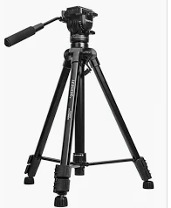
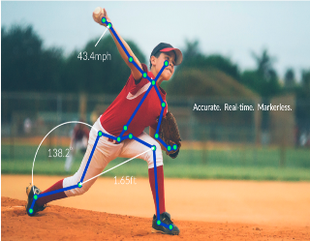


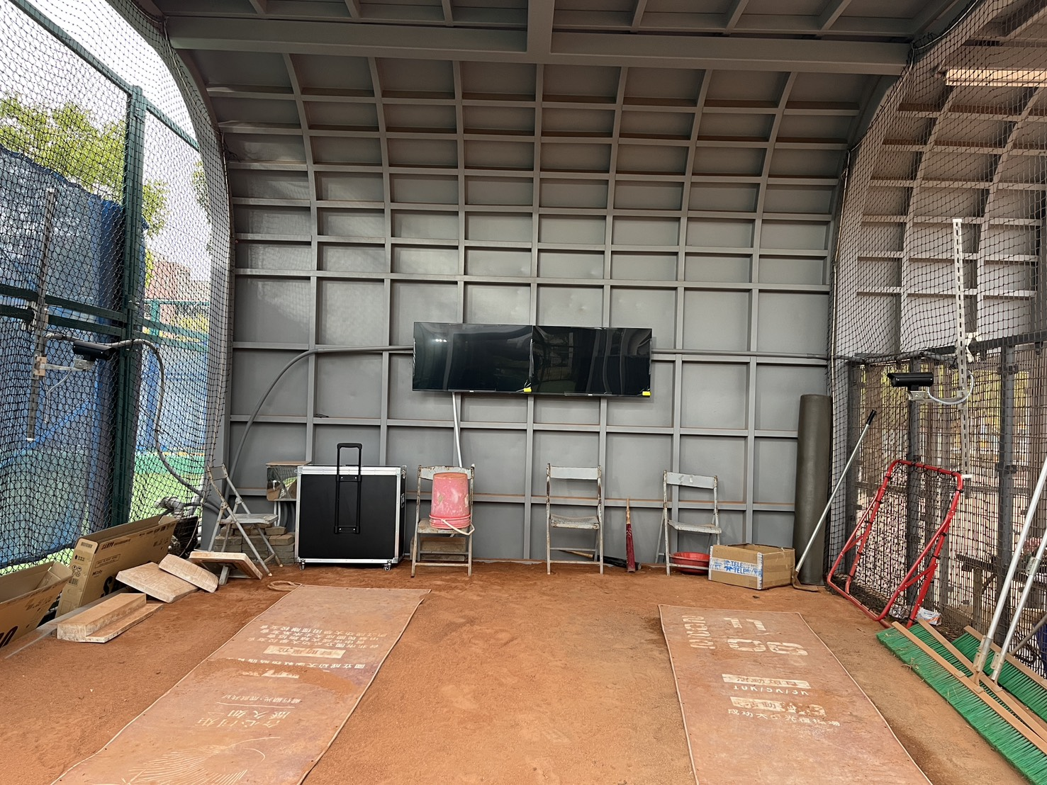
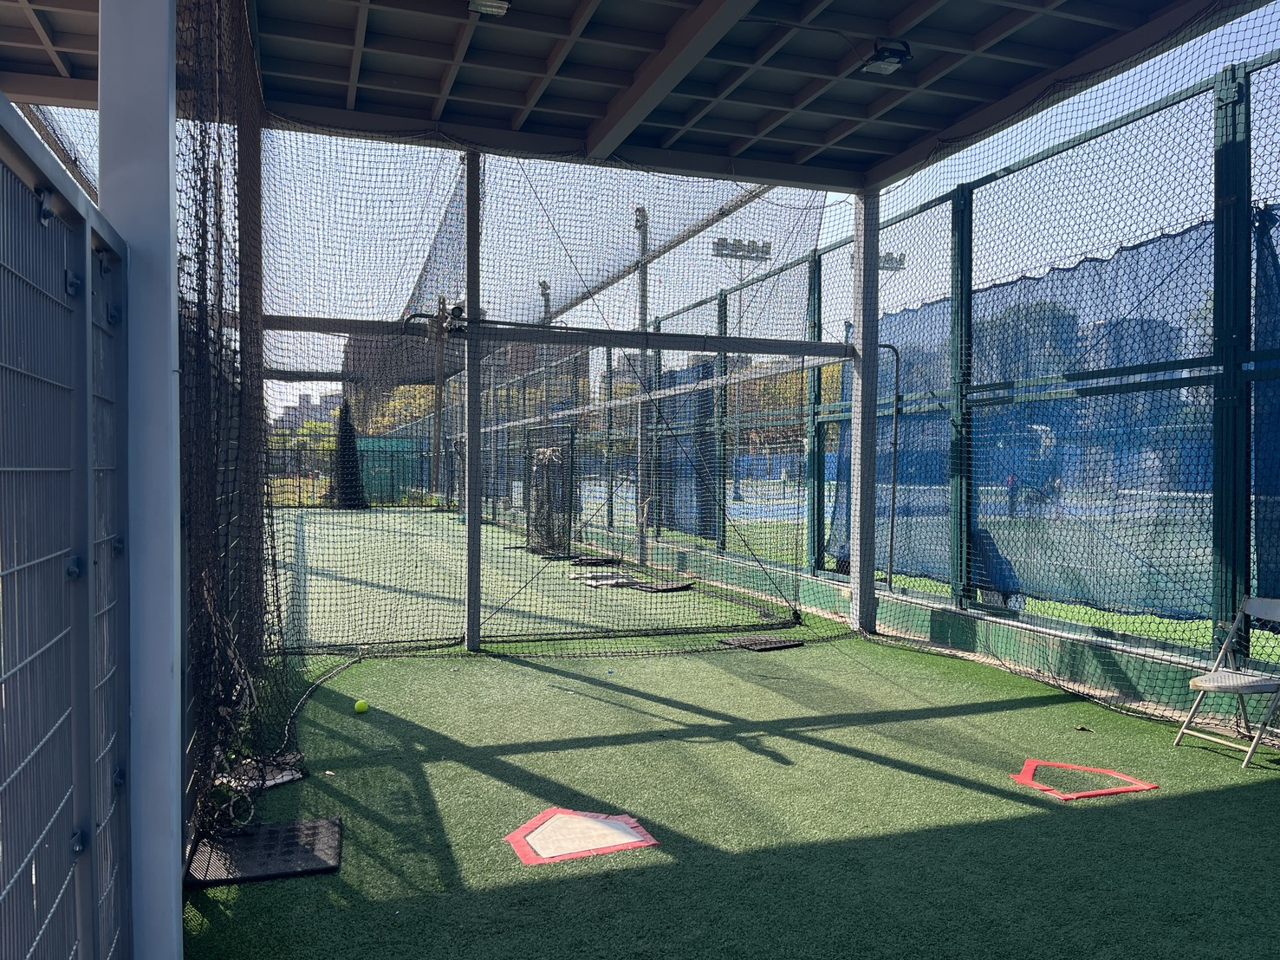
2. System Setup and Hardware Specification
c2
架高 1.6 m
c3
架高 2.0 m
world coordinates
投手丘
Y’
Z
X’
本壘板
Rapsodo
20 ft
Y
Z’
c1
X
架高 1.6 m
攝影機跟投手板距離 22 m
距離投手板
3 m
設備
1.0）Rapsodo 2.0 pro x1
2.1）攝影機 (179FPS) x3 (c1~c3)
- 179FPS, 1920x1080解析度
2.2) 鏡頭 x3
2.3）三腳架 x3
2.4）線材
3.1) 電腦-PC x1
3.2) 螢幕（43”） x1
3.3) 折疊桌 x2
c3
c1
c2

Slide 13
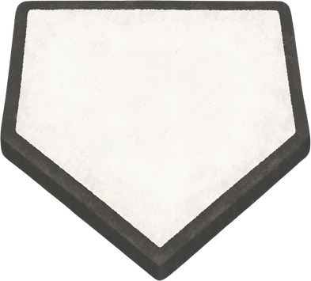
2. System Setup and Hardware Specification
CP：投手區攝影機
：收線箱
：相機架設位置
CP4：左投手側面
高度：1.6m
角度：?
傾斜度：?
*高度未加入投手丘高度，投手丘高度約30公分。
?
master
CP1：右投手前方
高度：2.20m
角度：?
傾斜度：?
3m
20 ft
x 軸
（0,0）
2D 座標原點 =
投手區的參考點
22.05m
Rapsodo
y軸
x 軸
22.05m
master
3.25m
y軸
CP3：左投手前方
高度：2.20m
角度：?
傾斜度：?
CP桌
牆壁
?
CP2：右投手側面
高度：1.6m
角度：?
傾斜度：?
*高度未加入投手丘高度，投手丘高度約30公分。
牆壁
CP1：右投手前方
位置：
x軸：+22.05m, y軸：0m, z軸：4.40m
左右角度： ??
上下傾斜角度： ??
補充說明：
CP2：右投手側面
位置：
x軸：??m, y軸：-3.25m, z軸：2.20m
左右角度： ??
上下傾斜角度： ??
補充說明：
1）此高度未加入投手丘高度。
CP3：左投手前方
位置：
x軸：+22.05m, y軸： ??m, 高度：4.40m
左右角度： ??
上下傾斜角度： ??
補充說明：
1）此高度未加入投手丘高度。
CP4：左投手側面
位置：
x軸：??m, y軸： ??m, 高度：2.20m
左右角度： ??
上下傾斜角度： ??
補充說明：
1）此高度未加入投手丘高度。

Slide 14
2. System Setup and Hardware Specification
PC:
CPU | RAM | Disk | GPU | Platform
Intel i7-14700K | 64GB DDR5 | 2TB SSD | RTX 4090 | Windows 11
  2. Cameras:
Number | Camera Model | Lens Model | Focal Length (mm) | Max Resolution (pixels) | Max Frame Rate
CP1(Right Front) | FLIR GS3-U3-23S6C-C | KOWA LM50HC | 50 | 1920x1200 (2M) 1920x1080 (ROI) | 163 FPS 179 FPS (Real)
CP2(Right Side) | FLIR GS3-U3-23S6C-C | KOWA LM8HC | 8 | 1920x1200 (2M) 1920x1080 (ROI) | 163 FPS 179 FPS (Real)
CP3(Left Front) | FLIR GS3-U3-23S6C-C | KOWA LM50HC | 50 | 1920x1200 (2M) 1920x1080 (ROI) | 163 FPS 179 FPS (Real)
CP4(Left Side) | FLIR GS3-U3-23S6C-C | KOWA LM8HC | 8 | 1920x1200 (2M) 1920x1080 (ROI) | 163 FPS 179 FPS (Real)

Slide 15
3. System Framework
Live
60 fps ➔ 30 fps
180 fps ➔ 60 fps
ViT-Pose
1 | 2 | 3 | 4 | 5 | 6 | 7 | 8 | 9 | 10 | 11 | ……
1 | 3 | 5 | 7 | 9 | 11 | ……
DRAM: 45 frames
Queue (len = 45)
Trigger t’
t’-45 | t’ | t’+135
Knee Lift
SSD (w/o skeleton)
180 frames
Replay
Replay
SSD
1 | 2 | 3 | 4 | 5 | 6 | 7 | 8 | 9 | 10 | 11 | …… | 180
ViT-Pose
Image + Skeleton
Skeleton.json
Segment
3 Keyframes
Analysis.json
SSD

Slide 16


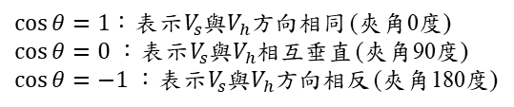





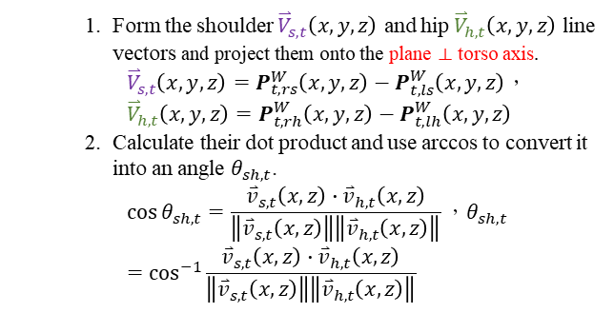
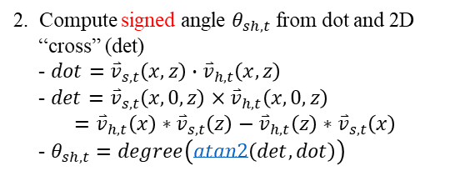









3. System Framework: Shoulder–Hip Separation Angle
1. Form the shoulder ${\overset{⃑}{V}}_{s,t}\left(x,y,z\right)$ and hip ${\overset{⃑}{V}}_{h,t}\left(x,y,z\right)$ line vectors and project them onto the plane ⟂ torso axis.
${\overset{⃑}{V}}_{s,t}\left(x,y,z\right)=P_{t,rs}^{W}\left(x,y,z\right)−P_{t,ls}^{W}\left(x,y,z\right)$，${\overset{⃑}{V}}_{h,t}\left(x,y,z\right)=P_{t,rh}^{W}\left(x, y,z\right)−P_{t,lh}^{W}\left(x,y,z\right)$
2. Calculate their dot product and use arccos to convert it into an angle $θ_{sh,t}$.
$$\cos{θ_{sh,t}}=\frac{{\overset{⃑}{v}}_{s,t}\left(x,z\right)∙{\overset{⃑}{v}}_{h,t}\left(x,z\right)}{\left\|{\overset{⃑}{v}}_{s,t}\left(x,z\right)\right\|\left\|{\overset{⃑}{v}}_{h,t}\left(x,z\right)\right\|}，θ_{sh,t}=\cos^{−1}{\frac{{\overset{⃑}{v}}_{s,t}\left(x,z\right)∙{\overset{⃑}{v}}_{h,t}\left(x,z\right)}{\left\|{\overset{⃑}{v}}_{s,t}\left(x,z\right)\right\|\left\|{\overset{⃑}{v}}_{h,t}\left(x,z\right)\right\|}}$$
$$P_{t,rs}^{W}$$
$$V_{s}$$
$$P_{t,ls}^{W}$$
$$P_{t,rh}^{W}$$
z
$$P_{t,lh}^{W}$$
$$V_{h}$$
rs: right shoulder
ls: left shoulder
rh: right hip
lh: left hip
$$−1<\cos{θ}<1$$
$\cos{θ}=1$：表示$V_{s}$與$V_{h}$方向相同 (夾角0度)
$\cos{θ}=0$：表示$V_{s}$與$V_{h}$相互垂直 (夾角90度)
$\cos{θ}=−1$：表示$V_{s}$與$V_{h}$方向相反 (夾角180度)
x
y
project $V_{s}, V_{h}$ onto the plane ⟂ torso axis
2. Compute signed angle $θ_{sh,t}$ from dot and cross product along the torso axis
- $dot={\overset{⃑}{v}}_{s,t}\left(x,z\right)∙{\overset{⃑}{v}}_{h,t}\left(x,z\right)$
- $det={\overset{⃑}{v}}_{s,t}\left(x,0,z\right)×{\overset{⃑}{v}}_{h,t}\left(x,0,z\right)$
$={\overset{⃑}{v}}_{h,t}\left(x\right)∗{\overset{⃑}{v}}_{s,t}\left(z\right)−{\overset{⃑}{v}}_{h,t}\left(z\right)∗{\overset{⃑}{v}}_{s,t}\left(x\right)$
- $θ_{sh,t}=degree\left(atan2\left(det,dot\right)\right)$
z
$$−180°<θ_{sh,t}<180°$$
z
$$θ_{sh}$$
$$V_{s}$$
$${\overset{⃑}{v}}_{s,t}$$
$$V_{h}$$
$θ_{sh,t}$ 為正
$${\overset{⃑}{v}}_{h,t}$$
$θ_{sh,t}$ 為負
x
$${\overset{⃑}{v}}_{s,t}$$
x

Slide 17
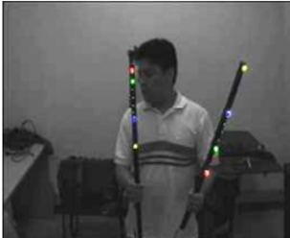
























3. System Framework: Fundamental matrix estimation $F_{3×3}^{′}$ using RANSAC
Camera i ➔ image i,
Camera i’ ➔ image i’
8 points s⁸_{ij} , pt j=1~4
-Pair (i,i’)
8 Point pair (s⁸_{ij},s⁸_{i’j})
4 Point pair (s⁴_{ij},s⁴_{i’j})
使用RANSAC求 6 fundamental matrix R_{mn}, m=1~4, n=1~4, n!=m, m>n, 以R12為例
0. Input 8 Point Pair (s⁸_{ij},s⁸_{i’j})
1. 4 point pair: Randomly Select 4-Corresponding Features (s⁴_{ij}, s⁴_{i’j}) from 8 points:
-Randomly select 4 pair points s⁴_{ij} and s⁴_{i’j}, s⁴_{ij} $ε$ s⁸_{ij} , s⁴_{i’j}$ε$s⁸_{i’j}, respectively
??
4 point pair (s⁴_{ij}, s⁴_{i’j})
Fundamental Matrix $Rmn$ (3x3) Estimation using 8-point algorithm
Normalize (s⁴_{ij} and s⁴_{i’j}) to ($\hat{s}4ij and \hat{s}4i^{′}j$) using Hartley’s algorithm [2]
Estimate closed-form linear solution Af=0,
- 4 pair pt matrix
A [$\hat{s}4ij$, $\hat{s}4i^{′}j$ , 1],
- Perspective projection
vector f=
3) Solve orthonormal matrix F_{3x3}(=expand of f) by SVD(Singular Value Decomposition)
4) De-normalize F_{3x3} as R_{mn} (3x3) using Hartley’s algorithm
8 point pair
($s8ij, s8i^{′}j$)
I$i$
$$Ii′$$
$${s4i′j,3x1}^{T}R\text{mn,}\text{ 3x3}s4ij,3x1=0$$
8 points $\text{s}\text{8}\text{ij}$, at image I_{i,} i=1~4,
Pt j=1~4
8 points $\text{s}\text{8}\text{i}’\text{j}$, at image I_{i’}, i’=1~4, i’ != i, i’>i, Pt j=1~4
I$i$
$$Ii′$$
6. Output Fundamental Matrix R_{mn} with Max N^{c}
5. c = 10?
(循環次數)
$A_{n(=4)x9}f_{9x1}$=0
yes
no
c++;
s⁸_{ij} at image Ii
$$[\begin{matrix}f_{11} & f_{21} & f_{31} & f_{12} & f_{22} & f_{32} & f_{13} & f_{23} & f_{33}]T\end{matrix}$$
N^{c}
s⁸_{i’j}
8 point pair: Calculate Inlier Number N^{c} According to Euclidean Distance
For k = 1 ,… , 8
If $\left(d\left(skij, {sk}^{′}i^{′}j\right)<ε\left(=15\right)\right)$
then N^{C} ++
3. 8 point pair: Transform s⁸$i′j at$ I$i′$to $s^{8′}i^{′}j$ at I$i$ Using Perspective Transform with Fundamental R_{mn}
s⁸’$i′j=R_{mn}s8i′j$
$$Rmn$$
n⬅m
I ⬅ I’
$$Euclidean distance d\left(skij,sk^{′}i^{′}j\right) at image Ii=\sqrt{{\left(skij\left[x\right]−sk^{′}i^{′}j\left[x\right]\right)}^{2}+{\left(skij\left[y\right]−sk^{′}i^{′}j\left[y\right]\right)}^{2}}$$
s^{8’}_{i’j} at Image Ii
s^{8’}_{i’j}
at I$i$
s⁸_{i’j}
at I$i′$
s^{8’}_{ij} : Transformed
from s⁸_{i’j}
s⁸_{i’j} : Points
at image I_{i’}
$Rmn$: 3x3 Fundamental between image m of I’ and image n of I
s^{k}_{ij}: k-th point in s⁸_{ij}
s^{k}_{ij}[x]: s^{k}_{ij}的x座標， s^{k}_{ij}[y]: s^{k}_{ij}的y座標
N^{c}: Inlier Number of c-th point set, c is the iteration times, c=1~10
s⁸’$i′j=R_{mn}s8i′j$
s⁸’$i′j=R_{mn}s8i′j$
$${\left[\begin{matrix}x′ \\ y′ \\ 1\end{matrix}\right]}_{3 x 8}=\left[\begin{matrix}\begin{matrix}r_{11} & r_{12} & r_{13}\end{matrix} \\ \begin{matrix}r_{21} & r_{22} & r_{23}\end{matrix} \\ \begin{matrix}r_{31} & r_{32} & r_{33}\end{matrix}\end{matrix}\right]{\left[\begin{matrix}x \\ y \\ 1\end{matrix}\right]}_{3 x 8}$$
$${\left[\begin{matrix}x′ \\ y′ \\ 1\end{matrix}\right]}_{3 x 8}=\left[\begin{matrix}\begin{matrix}r_{11} & r_{12} & r_{13}\end{matrix} \\ \begin{matrix}r_{21} & r_{22} & r_{23}\end{matrix} \\ \begin{matrix}r_{31} & r_{32} & r_{33}\end{matrix}\end{matrix}\right]{\left[\begin{matrix}x \\ y \\ 1\end{matrix}\right]}_{3 x 8}$$
Notes:
[1] Pano_Stitch_SiftTreeRansacBundleAdjBlend_ThesisMs_Rl_20140729_V1HuangSp_Oral.pptx
[2] R. I. Hartley, "In defense of the eight-point algorithm," IEEE Transactions on pattern analysis and machine intelligence, pp. 580-593, 1997

Slide 18


















3. System Framework: 8-point algorithm
J: 2Dto2D Perspective projection – fundamental matrix R_{mn}
?
Objective: Given n ≥ 8 image point correspondences $\left\{s4ij,3x1↔s4i′j,3x1\right\}$, determine the fundamental matrix $R$_{mn, 3x3} such that ${s4i′j,3x1}^{T}R\text{mn}\text{, 3x3}s4ij,3x1=0$. $i=1…n$ points (n=4 corresponding point pairs)
at I$i$
at I$i′$
1. Pt Pair Normalization by Intrinsic Para$({s4}_{ij, 3x1}⇒{\hat{s}4}_{i,j,3x1})$: Transform the image coordinates according to ${\hat{s}4}_{i,j,3x1}=T_{3x3}{s4}_{ij, 3x1}$ and ${\hat{s}4}_{i′,j,3x1}=T_{3x3}^{′}{s4}_{i′j, 3x1}$, where $T_{3x3}$ and $T_{3x3}^{′}$ are normalizing transformations matrix (intrinsic para) consisting of a translation ($\overline{u}$/d, $\overline{v}$/d ) and scaling d.
Origin (0,0) at centroid of image
After the normalization step the points will be:
  The points are translated so that their centroid is at the origin (0, 0).
  The points are then scaled isotropically or non-isotropically so that the average distance from the origin is equal to $\sqrt{2}$.
1.1 Intrinsic para - Isotropic Scaling (OpenCV)??
$T_{3x3}=\left[\begin{matrix}\frac{1}{d} & 0 & −\frac{\overline{u}}{d} \\ 0 & \frac{1}{d} & −\frac{\overline{v}}{d} \\ 0 & 0 & 1\end{matrix}\right]$
$\overline{u}=\sum_{n=1}^{4}{\frac{u_{n}}{4}}, un=x coordinate in s4ij$
$\overline{v}=\sum_{n=1}^{4}{\frac{v_{n}}{4}}, vn=y coordinate in s4ij, d=\frac{1}{4}\sum_{n=1}^{4}{\frac{\sqrt{{(u_{n}−\overline{u})}^{2}+{(v_{n}−\overline{v})}^{2}}}{\sqrt{2}}}$
1.2 Intrinsic para - Non-isotropic Scaling
$T_{3x3}=\left[\begin{matrix}\frac{1}{d_{x}} & 0 & −\frac{\overline{x}}{d_{x}} \\ 0 & \frac{1}{d_{y}} & −\frac{\overline{y}}{d_{y}} \\ 0 & 0 & 1\end{matrix}\right]$
$\overline{u}=\sum_{n=1}^{4}{\frac{u_{n}}{4}}$ , $un=x coordinate in s4ij$
$\overline{v}=\sum_{n=1}^{4}{\frac{v_{n}}{4}},vn=y coordinate in s4ij{ d}_{x}=\sum_{n=1}^{4}{\frac{\sqrt{{(u_{n}−\overline{u})}^{2}}}{4}},d_{y}=\sum_{n=1}^{4}{\frac{\sqrt{{(v_{n}−\overline{v})}^{2}}}{4}}$
Such a transformation is applied to each of the two images independently.
➔ as intrinsic para.
has the same scaling d in x and y direction
➔ as intrinsic para.
➔ Scaling term as focal length of intrinsic para.
The Generation process of $T^{′}$ is the same
has different scaling in x and y direction
$${\hat{s}4}_{ij,3x1}↔{\hat{s}}_{i′j,3x1}^{4}$$
Estimate Fundamental Matrix ${\hat{F′}}_{mn,3x3}$ by Linear Solution: Given point matches ${\hat{s}4}_{ij,3x1}⟷{\hat{s}}_{i^{′}j,3x1}^{4}$,
solve the equations ${{\hat{s}}_{i′j,3x1 }^{4}}^{T}{\hat{F′}mn,}_{3x3}{\hat{s}4}_{ij,3x1}=0$to find ${\hat{F′}}_{mn,3x3}$.
  1) The fundamental matrix ${\hat{F′}}_{mn,3x3}$ is defined by the equation ➔ ${{\hat{s}}_{i′j,3x1 }^{4}}^{T}{\hat{F′}mn,}_{3x3}{\hat{s}4}_{ij,3x1}=0$
2) Specifically, the equation corresponding to a pair of points have the form ($u$, $v$, 1) and ($u^{′}$, $v^{′}$, 1) will be
$$u^{′}uf_{11}+u^{′}vf_{12}+u^{′}f_{13}+v^{′}uf_{21}+v^{′}vf_{22}+v^{′}f_{23}+uf_{31}+vf_{32}+f_{33}=0$$
u: x coordinate of ${\hat{s}4}_{ij,3x1},$v: y coordinate of ${\hat{s}4}_{ij,3x1},$u’: x coordinate of ${\hat{s}4}_{i′j,3x1},$v’: y coordinate of ${\hat{s}4}_{i′j,3x1},$
3) Denote by $f_{9x1}$ the 9-vector made up of the entries of ${\hat{F′}}_{mn,3x3}$ in row-major order.
$$\left[\begin{matrix}u^{′}u & u^{′}v & u^{′} & v^{′}u & v^{′}v & v^{′} & u & v & 1\end{matrix}\right]{\left[\begin{matrix}f_{11} & f_{21} & f_{31} & f_{12} & f_{22} & f_{32} & f_{13} & f_{23} & f_{33}\end{matrix}\right]}^{T}=0$$
4) From all the n point matches, we obtain a set of linear equations of the form
$$A_{nx9}f_{9x1}=\left[\begin{matrix}u_{1}^{′}u_{1} & u_{1}^{′}v_{1} & u_{1}^{′} & v_{1}^{′}u_{1} & v_{1}^{′}v_{1} & v_{1}^{′} & u_{1} & v_{1} & 1 \\ ⋮ & ⋮ & ⋮ & ⋮ & ⋮ & ⋮ & ⋮ & ⋮ & ⋮ \\ u_{n}^{′}u_{n} & u_{n}^{′}v_{n} & u_{n}^{′} & v_{n}^{′}u_{n} & v_{n}^{′}v_{n} & v_{n}^{′} & u_{n} & v_{n} & 1\end{matrix}\right]f_{9x1}=0$$
The solution for $f_{9x1}$ is the least eigenvalue corresponding to that eigenvector of $A_{nx9}^{T}A_{nx9}$ , where $A_{nx9}$ is the equation matrix.
Math Proof : The relation between $R$ and ${\hat{F}}^{′}$
➔ $Rmn={T^{′}}^{T}{\hat{F}}^{′}T$
${s_{i^{′}j}^{4}}^{T}Rmn{s4}_{ij}=0$, ${\hat{s}4}_{ij}=T{s4}_{ij}$, and ${\hat{s}}_{i′j}^{4}=T^{′}s_{i^{′}j}^{4}$
${{\hat{s}}_{i^{′}j}^{4}}^{T}{T^{′}}^{−T}RmnT^{−1}{\hat{s}4}_{ij}={{\hat{s}}_{i^{′}j}^{4}}^{T}{\hat{F}}^{′}{\hat{s}4}_{ij}=0$
This relation implies that ${T^{′}}^{−T}RmnT^{−1}$ is the fundamental matrix corresponding to the point correspondences${\hat{s}4}_{ij}↔{\hat{s}}_{i^{′}j}^{4}$.
?
${s_{i^{′}j}^{4}}^{T}Rmn{s4}_{ij}=0$,
?
?
$${\hat{F}}^{′}$$
$${\hat{F}}^{′}$$
?
We can write the above equation in $Af =0$closed-form solution.
Here, n=4 corresponding point pairs
?
$$f,T_{3x3}\text{ ,}T_{3x3}^{′}$$
3. Constraint Enforcement: Estimate ${\hat{F}}_{3x3}^{′}$the closest singular matrix to F_{3x3}(=Expand of f) under Frobenius norm.
1) The matrix $F_{3x3}$ found by solving the set of linear equations $A_{nx9}f_{9x1}=0$ will not in general have rank 2, Thus, let $F_{3x3}$= $U_{3x3}D_{3x3}V_{3x3}^{T}$ be the Singular Value Decomposition of $F_{3x3}$
$$F_{3x3}=U_{3x3}\left[\begin{matrix}σ_{1} & 0 & 0 \\ 0 & σ_{2} & 0 \\ 0 & 0 & σ_{3}\end{matrix}\right]V_{3x3}^{T}=U_{1}σ_{1}V_{1}+U_{2}σ_{2}V_{2}+U_{3}σ_{3}V_{3}$$
2) Replace $F_{3x3}$ with ${\hat{F}}_{3x3}^{′}$that minimizes Forbenius norm || ${\hat{F}}_{3x3}$– ${\hat{F}}_{3x3}^{′}$ || subject to det(${\hat{F}}_{3x3}^{′}$) = 0
$${\hat{F}}_{3x3}^{′}=U_{3x3}\left[\begin{matrix}σ_{1} & 0 & 0 \\ 0 & σ_{2} & 0 \\ 0 & 0 & 0\end{matrix}\right]V_{3x3}^{T}=U_{1}σ_{1}V_{1}+U_{2}σ_{2}V_{2}$$
$$σ_{1}≥σ_{2}≥σ_{3}$$
Important property of the fundamental matrix:
  It is singular, in fact of rank 2.
  ?? The left and right nullspaces of F are generated by the vectors representing (in homogeneous coordinates) the two epipoles in the two images.
$${\hat{F}}_{3x3}^{′},T_{3x3}\text{ ,}T_{3x3}^{′}$$
18
4. Pt Pair Denormalization: Set $Rmn,3x3{{=T}^{′}}_{3x3}^{T}{\hat{F}}_{3x3}^{′}T_{3x3}$. Matrix $Rmn,3x3$ is the fundamental matrix corresponding to the original data $s_{ij,3x1}^{4}⟷{s4}_{i′j,3x1}$.

Slide 19


































3. System Framework: $I_{ℓ}$ 2D Skeleton Framework
Total time cost: 33ms
$I^{t=T}$ t $∈\{1, …, T\}$
1. Human Detection and Identification Using YOLOv8-s and Pitcher Lock, Respectively
$$I^{t}$$
1) Human bounding box $B_{t}$ detection using YOLOv8-s
  (1) Human bounding box $B^{t}$ detection using YOLOv8-s
  - $B^{t}$ = {$b_{1}^{t}$, …$b_{n}^{t}$, …$,b_{N}^{t}$}: Set of bbox at frame t
  - N: Total number of bbox $b^{t}$ at frame t
  - n-th detected bbox $b^{t}$(x, y, w, h, c, cls):
  (x, y): Bbox upper-left corner position in image.
  wxh: Bbox width x height
  FG/BG bbox confidence c:
  Confidence value of bbox, threshold = 0.3
  Class confidence prediction cls (total 80 classes):
  Which category the object belongs to, cls = 0 (human)
…
$$I^{t=1}$$
1080 x 720 pixels
- T: Total number of frame
Time cost: 21ms at GPU??
O/P:
$$B^{t}$$
Time cost: 17ms
O/P:
$$Tracklets$$
$$B^{′t}$$
2) Human Identification (IDs) ${B′}_{t}$ using Pitcher Lock
  (1) If t = 1, give $b_{n}^{t}$a fixed id (nearest center).
  (2) If t $≥$ 1, for each $b_{n}^{t}$ match the last $b_{id}^{′t}$ using IoU / center distance.
  - ${B′}^{t}$ = {$b_{id=1}^{′t}$, $b_{id=2}^{′t}$, …$,b_{id=M}^{′t}$}: Set of tracked bbox at frame t
  - M: Total number of tracked bbox $b^{′t}$ at frame t
  id-th tracked bbox with ids $b_{id}^{′t}$(x, y, w, h):
  (x, y): Bbox upper-left corner position in image.
  wxh: Bbox width x height
  id: (1) If $b_{n}^{t}$ is not matched, assign a new id.
  (2) If $b_{n}^{t}$ and $b_{id}^{′t}$ is matched, keep their existing id.
$$b_{id=3}^{′t}$$
$$b_{id=2}^{′t}$$
$$B^{′t−1}$$
I/P:
Match with the last pitcher bbox
$$B^{′t}$$
$$b_{id=1}^{′t}$$
Lost 15 frames → reset
Time cost: 12ms at CPU??
O/P:
$$B^{′t}$$
3) Pitcher bbox $b_{id}^{′t}$
  (1) Calculate each of $b_{id}^{′t}$ area from $B^{′t}$
  Area($b_{id}^{′t}$) = $b_{id}^{′t}$(w) x $b_{id}^{′t}$(h)
  (2) Assume: The locked bbox in $B^{′t}$ is the pitcher’s bbox
  Ex: $b_{id=1}^{′t}$ is the pitcher’s bbox
  - Pitcher bbox with id $b_{id=1}^{′t}$(x, y, w, h):
  (x, y): Bbox upper-left corner position in image.
  wxh: Bbox width x height
  id: Bbox id
$$b_{id=1}^{′t}$$
Q: 1. Human area resolution ??
2. Precision of joint??
O/P:
$$b_{id=1}^{′t}$$
2. 2D Human Skeleton using Vision Transformer (ViT) Model
Time cost: 9ms at GPU??
  1) For bbox ${b^{′}}_{id=1}^{t}$ crop one region $c_{id}^{t}$ from $I^{t}$
  $c_{id}^{t}$(${b^{′}}_{id=1}^{t}$(w) x ${b^{′}}_{id=1}^{t}$(h) x 3c): Cropped id-th bbox at color image $I^{t}$
  2) For $c_{id}^{t}$, 26 2D joints estimation $p_{id}^{t}$(j), j = 1~26 using ViTPose model.
- $p_{id=1}^{t}\left(j\right)\left(x,y,conf.\right)$: $j_{th}$ joint of person at frame t, j $∈${1~J=26}
  - $P^{t}$={ }: Sets of person$p_{id=1}^{t}$ at frame t
26 2D 關節點
$$c_{id=1}^{t}$$
ViTPose
$p_{id=1}^{t} \text{(j), j}$ = 1~26
ViTPose
Time cost: 9ms at GPU??
O/P:
$$P^{t}$$
$$c_{id=1}^{t}$$
$$p_{id=1}^{t} \text{(j), j=1\sim 26}$$
  1) Manually select a joint $p_{id=1}^{t}$(default j = 10 (right wrist)) from $P^{t}$to display its trajectory
  2) Manually select a joint $p_{id=1}^{t}$(default j = 8(right elbow)) from $P^{t}$ to display its angle in 2D image
  Ex: $θ_{right elbow}=arccos⁡(\frac{\overset{⃑}{j_{10}j_{8}}∙\overset{⃑}{j_{8}j_{6}}}{\left|j_{10}j_{8}\right|\left|j_{8}j_{6}\right|})$
- Green line: Joint (right wrist) trajectory
- Green number: Joint (right elbow) angle
$$θ_{right elbow}$$
[0~180]
$$j_{10(right wrist)}$$
$$j_{6(right shoudler)}$$
$$j_{8(right elbow)}$$

Slide 20
4.1 Data Collection
1.骨架
Category | Location | Train | Validation | Test | Total
Gait | 成功大學 |  |  | 10 | 935
Baseball | 高雄長庚 |  |  | 10 | 74
Baseball | 成大牛棚 |  |  | 10 | 389
Baseball | 台鋼牛棚 |  |  | 10 | 105
2.球員
Category | Location | Train | Validation | Test | Total (CS only) | Total pairs (CF+CS)
Baseball | 高雄長庚 |  |  |  | 0 | 74
Baseball | 成大牛棚 |  |  |  | 181 | 208
Baseball | 台鋼牛棚 |  |  |  | 3 | 102

Slide 21
棒球投手人體骨架偵測系統優化規劃
一、目前架構:
YOLOv8-s (mmyolo) + ViTPose-B + epoch_210.pth
YOLOv8-s：負責人體偵測（score ≥ 0.3、NMS 0.3）。
ViTPose-B：負責人體骨架估測。
epoch_210.pth：目前使用的姿態估測權重，輸出 Halpe-26（config：ViTPose_base_simple_halpe_256x192）。
環境：NVIDIA RTX 4090（24GB VRAM）。
資料：現有投手影片、大量 ViTPose JSON，以及可重新執行 ViTPose 產生骨架資料的程式。
二、目前問題與改善方向
Q1：多人場景時，可能選到旁邊的人，而不是投手
A：優先改善目標選擇與追蹤，再比較 YOLO26 的偵測能力。
比較 YOLO26m、YOLO26l、YOLO26x 的人體偵測準確度與速度。
目標選擇已改為：中央 ROI 內最靠近畫面中心者為投手，再以 IoU／中心距離／面積比連續追蹤。
加入固定 ROI（Region of Interest），降低周圍球員與教練的干擾。
加入 ByteTrack、BoT-SORT 等追蹤方法，維持投手的 Tracking ID。
如果仍需使用 Instance Mask，則改用 YOLO26-Seg，而不是一般 Detection 模型。
預期效益： 降低選錯人物、切換 Tracking ID 和遺失目標投手的情況。
Q2：人體骨架不穩定，部分關節會抖動或偵測錯誤
A：從模型能力、訓練資料及時間連續性三個方向改善。
方案 A：升級 ViTPose
比較 ViTPose-B、ViTPose-L、ViTPose-H。
優先尋找已訓練為 Halpe-26 的權重。
若只有 COCO-17 預訓練權重，需要修改 Pose Head 的輸出關節數，並使用 Halpe-26 資料進行 Fine-tuning。
更換 L/H 時，需要對應尺寸的 Backbone 權重，不能直接把 ViTPose-B 的權重當成 L/H 使用。
方案 B：使用 YOLO26-Pose 取代 YOLO + ViTPose
測試 YOLO26m-Pose、YOLO26l-Pose、YOLO26x-Pose。
官方預訓練模型輸出 COCO-17。
如果需要保留 Halpe-26，須使用 26 點資料集 Fine-tuning。
優點是單階段偵測，可減少模型串接與推論成本。
方案 C：加入 Temporal Refinement
利用關節 Confidence Score 判斷偵測品質。
使用 Savitzky–Golay、Kalman Filter 等方法改善關節抖動。
加入人體骨長一致性及前後影格資訊，修正短暫遮擋造成的錯誤。
注意不能過度平滑高速投球動作，以免影響 Wrist Velocity、MER 和 BR 的計算。
方案 D：增加比較基準
使用 RTMPose-L／X 的 Body8-Halpe26 預訓練模型。
比較 ViTPose、RTMPose、YOLO26-Pose 在投球場景的準確度與推論效率。
討論:
「YOLO26x-Pose 經過 Halpe-26 Fine-tuning 後，是否能在保持原本 26 點骨架分析能力的同時，達到比 YOLO + ViTPose 更好的速度與精度平衡？」

Slide 22
利用現有 JSON + 公開資料集重新訓練
實驗 | 模型 | 關節數 | 目的
A | YOLOv8-s + ViTPose-B | 26 | 原始 Baseline
B | YOLO26m + ViTPose-B | 26 | 比較 Detector 升級
C | YOLO26m + ViTPose-L/H | 26 | 比較 Pose Backbone
D | RTMPose-L/X Halpe-26 | 26 | 比較其他姿態估測模型
E | YOLO26m/l/x-Pose | 17 | 比較原生單階段模型
F | Fine-tuned YOLO26-Pose | 26 | 研究主要改良方法
G | Fine-tuned YOLO26-Pose + Temporal | 26 | 研究骨架穩定性改善
目標：Fine-tuning YOLO26-Pose，使其直接輸出 Halpe-26 骨架。
資料來源
1. 公開資料集
Halpe FullBody Dataset：包含人體、腳部等關節標註，可取前 26 個關節。
使用公開資料作為基礎訓練資料，提升一般人體姿態估測能力。
確認資料集授權、圖片來源及關節順序。
2. 現有投手影片與 ViTPose JSON
使用目前 ViTPose-B + epoch_210.pth 產生 Halpe-26 Pseudo Labels。
保留原始影片影格、人物 Bounding Box、26 個關節座標及 Confidence Score。
優先挑選不同投手、拍攝角度、遮擋程度，以及 FC、MER、BR 附近的影格。
過濾低信心關節，人工修正部分錯誤標註。
將資料轉換成 Ultralytics YOLO Pose 格式。
訓練方法
使用公開 Halpe-26 標註資料建立基礎模型。
載入 YOLO26m/l/x-Pose 預訓練權重，設定 kpt_shape: [26, 3]。
使用公開資料集進行 Fine-tuning，建立一般 Halpe-26 Pose 模型。
加入現有投手的 ViTPose Pseudo Labels，進一步進行棒球專用 Domain Adaptation。
使用人工標註、未參與訓練的投手資料，驗證真實精度。
這個流程屬於 Teacher–Student Learning / Pseudo-Label Fine-tuning，不需要從隨機權重開始重新訓練整個 YOLO26。
四、實驗設計
評估指標
2D Keypoint Error / PCK / OKS-mAP： 評估關節定位準確度。
Inference Latency / Throughput： 評估 RTX 4090 上的模型效能。
Tracking Accuracy： 評估是否能持續選到正確投手。
Temporal Stability： 評估骨架抖動及異常跳點。
FC / MER / BR Error： 評估投球關鍵事件的時間誤差。
3D Reconstruction Error： 評估對 Triangulation 和實際生物力學分析的影響。
驗證集及測試集應以投手或獨立投球片段分組，避免相鄰影格出現在訓練集與測試集中。

Slide 23

4.2 Experimental Results - 2D Phase Segmentation

Slide 24

4.2 Experimental Results - 3D Phase Segmentation

Slide 25

4.2 Experimental Results - 3D Replay Compare

Slide 26
5. Conclusion and Future Work

