Slide 1
Sorting plan v.2
Weijia

Slide 2
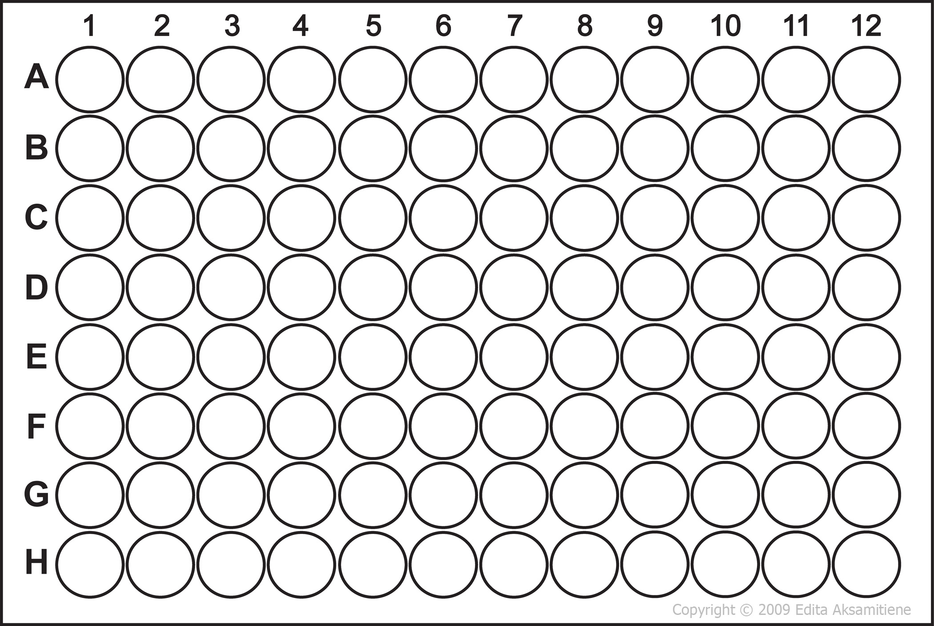
rep1
rep2
rep3
Sorting order overall:
Bulk rep1 -> single cells rep1
-> Bulk rep2
Sorting of bulk:
6000 for neg/atto,
5800 for mscarlet in rep 1.
6000 for neg/atto,
ca. 4300 for mscarlet in rep 3.
Might be due to the time loss during single cell sorting.
After sorting, spin down properly (2-3min at 1000 rpm) and store at -80°C.
atto
atto
atto
atto
neg
neg
atto
neg
mscarlet
mscarlet
sort out 40000 for these for titration
mscarlet
LV
Sorted into PCR tubes instead
Bulk
Notes:
5800, 2000.

Slide 3
Bulk
Put in 100ul (50ul for the two tubes for titration with 40k cells) of water in the PCR tube before sorting. Cell lysis was thru centrifugation later.
After sorting, spin down with adaptor 2-3min at 1000 rpm and store at -80°C.
Lysis buffer will be added later during sample prep for MS.
1 Hela cell = 50 ~ 60pg. 6000 cells = 300 ~ 400ng. Trypsin 1 in 50~100 to protein amount (we used approx. double in pilot and want to adhere to this). For 6000 cells, use 1ul from 50ng/ul source
cond | rep1 | rep2 | rep3
neg | 6000 | 6000 | 7000
atto | 6000 | 6000 | 7000
ms | 5800 | 4300 | 7000
LV | 6000 | 6000 | 3000
lyse in 20ul of 0.1% DDM, TEAB buffer, pipette up and down
heat 10’ at 95C, lid at 105C
cool down briefly in LN
sonicate?
Add 1ul trypsin, digest overnight at 27C, lid at 105C.

Slide 4
Do not sort into the first lane and last lane!
ATTO
80 * 1 cells
8 rows, 10 columns
4 * 10 cells + 4 * 50 cells
into 8 rows, 1 column
Neg
80 * 1 cells
8 rows, 10 columns
4 * 10 cells + 4 * 50 cells
into 8 rows, 1 column
8 rows
mScarlet
80 * 1 cells
8 rows, 10 columns
11 columns
4 * 10 cells + 4 * 50 cells
into 8 rows, 1 column
8 rows
Plan
11 columns
single cells, rep 1

Slide 5
ATTO
80 * 1 cells
8 rows, 10 columns
4 * 50 cells + 4 * 100 cells
into 8 rows, 1 column
Neg
80 * 1 cells
8 rows, 10 columns
4 * 50 cells + 4 * 100 cells
into 8 rows, 1 column
8 rows
mScarlet
80 * 1 cells
8 rows, 10 columns
11 columns
8 rows
11 columns
single cells, rep 1 sorted

Slide 6
4 * 10 cells + 4 * 50 cells
into 8 rows, 1 column
ATTO
80 * 1 cells
8 rows, 10 columns
8 rows
4 * 100 cells + 4 * 500 cells
into 8 rows, 1 column
12 columns
single cells, for Sibylle

Slide 7
ATTO
80 * 1 cells
8 rows, 10 columns
4 * 10 cells + 4 * 50 cells
into 8 rows, 1 column
Neg
80 * 1 cells
8 rows, 10 columns
8 rows
LV_red
72 * 1 cells
8 rows, 9 columns
4 * 10 cells + 4 * 50 cells
into 8 rows, 1 column
mScarlet
50 * 1 cells
5 rows, 10 columns
8 rows
4 * 100 cells + 4 * 500 cells
into 8 rows, 1 column
11 columns
11 columns
single cells, rep 2 sorted

