Slide 1
Lab 4
Dr. Weitao Xu
weitaoxu@cityu.edu.hk

Slide 2
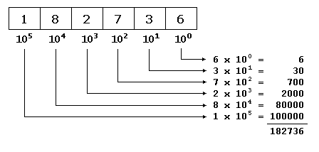
How decimal works?

Slide 3
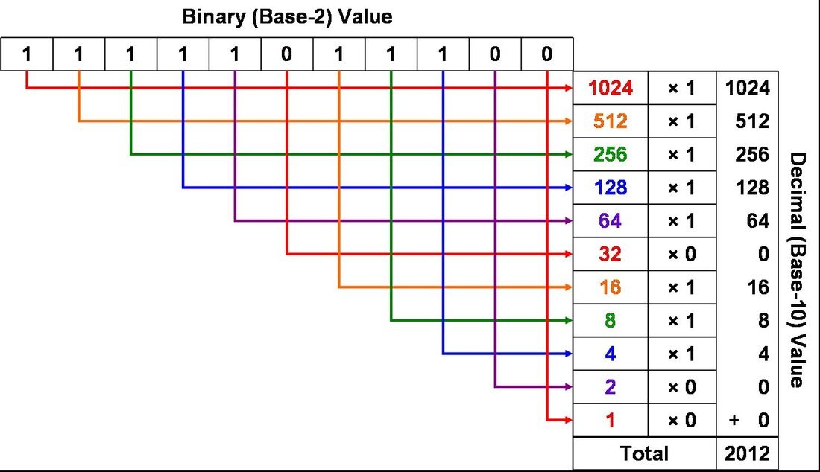
How binary works?

Slide 4
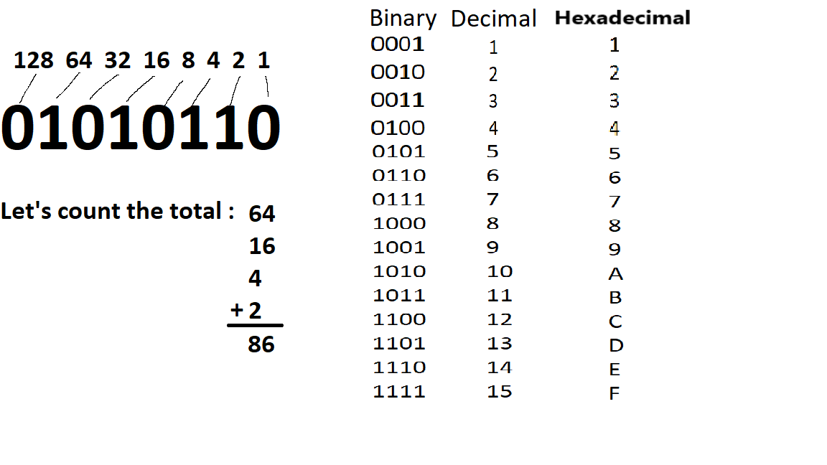
Binary-to-decimal

Slide 5
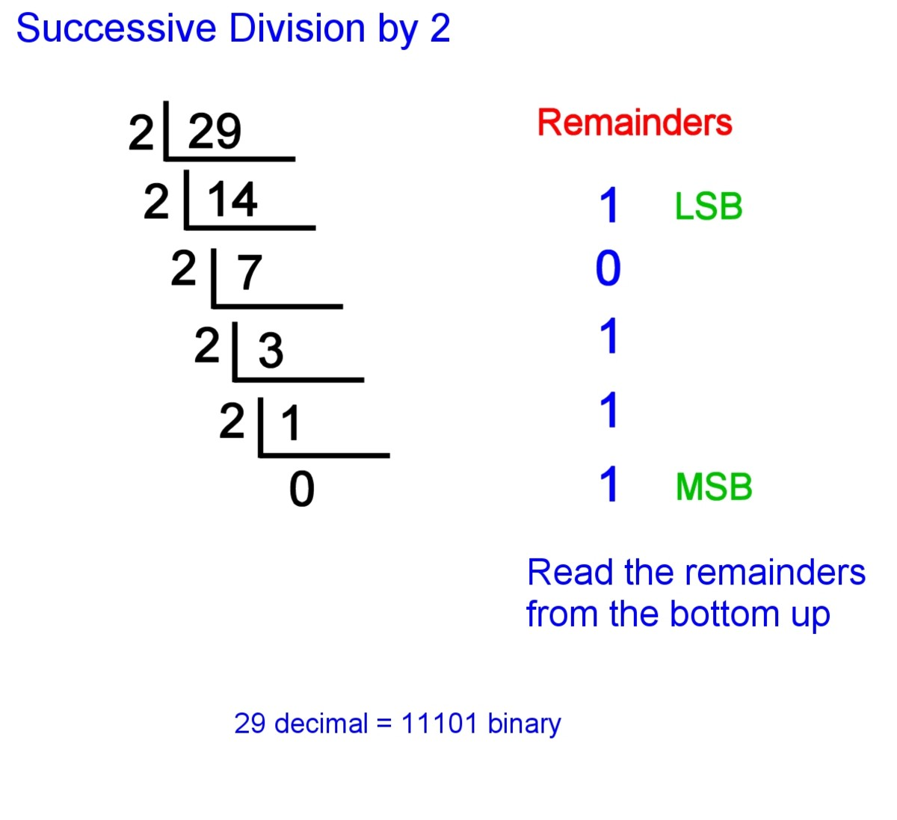
Decimal-to-binary
Least significant bit
Most significant bit

Slide 6
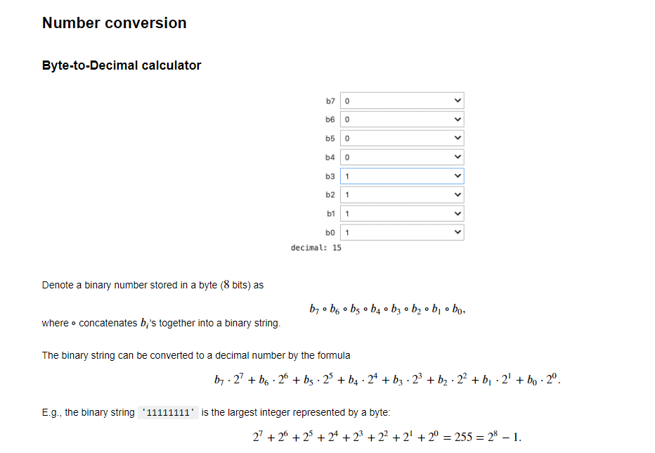
In lab2, we solve number conversion, but only consider 8 bits. We can solve it by defining 8 variables where each variable represent 1 bit.

Slide 7
But the binary string may be in arbitrary length -“010” -“101011” -“1010111110001010100001001” We need to use while loop or for loop

Slide 8
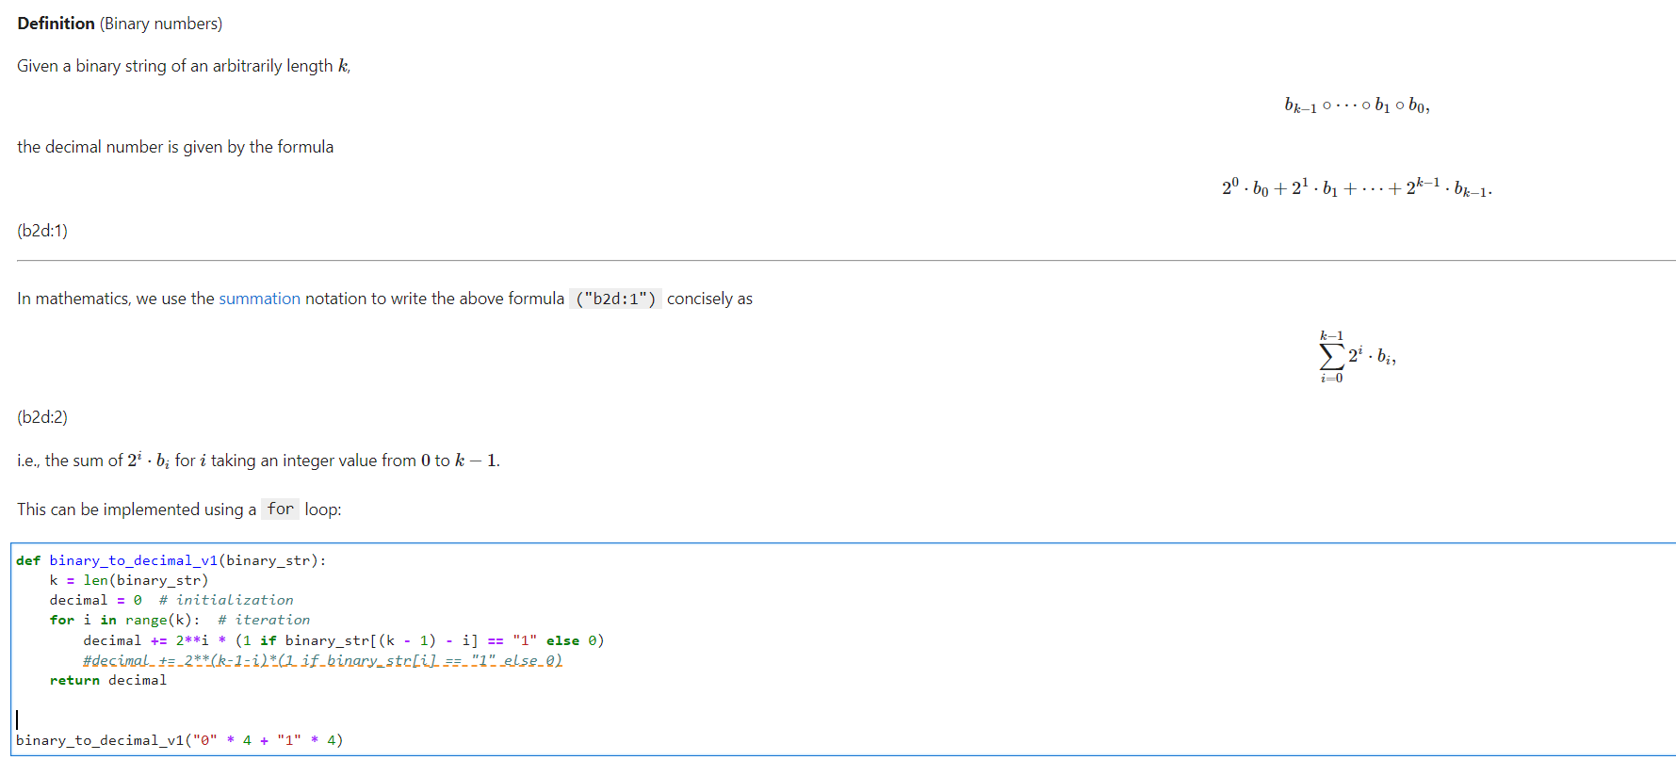
Get the length of the binary string, so we know how many loop to run
Initialize a variable decimal to be 0
Use a for loop to iterate over all the bits
in the string and calculate the summation
based on the equation above.
You need to be careful about the index
This line is added by me: it’s another solution

Slide 9
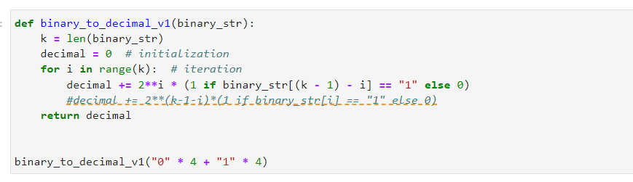
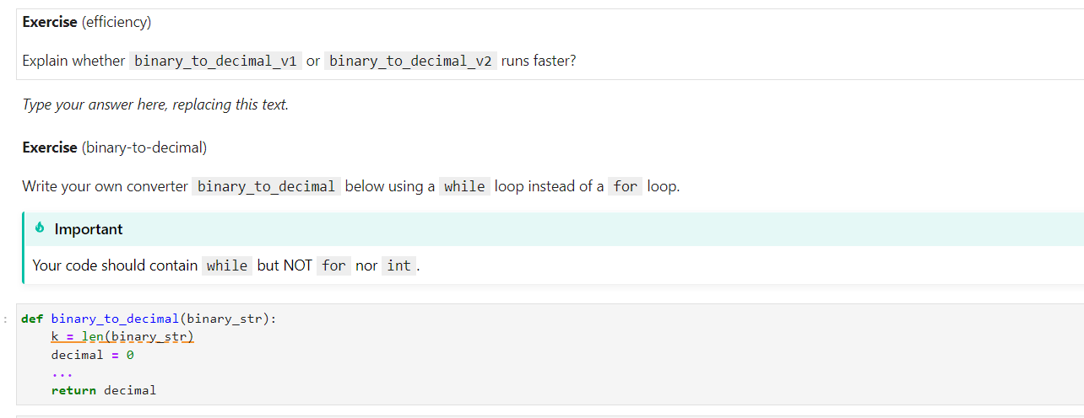
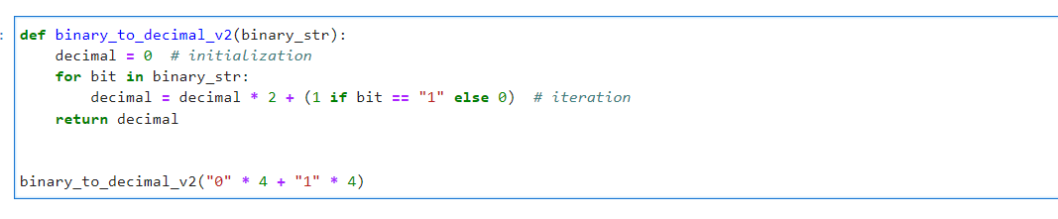

Slide 10
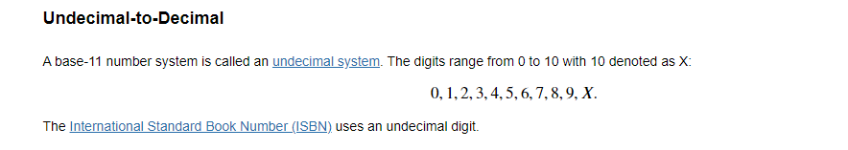
Why we need ‘X’?
-for binary number, we use 0 and 1 (2 digits)
-for octal number, we use 0,1,2,3,4,5,6,7 (8 digits)
-for decimal number, we use 0,1,2,3,4,5,6,7,8,9 (10 digits)
-for undecimal number, we should use 11 digits, but we only have 10 digits-→we use a letter to represent a digit
Why we can’t just use ‘10’ to represent 10?
If we see a base-11 number ‘101’, we don’t know whether it represents ‘10’, ’1’ or ‘1’-’0’-’1’
If we use ‘X’, then ‘101’ means ‘1’-’0’-’1’. ‘X1’ means ‘10’-’1’
The most important thing: how to handle ‘X’?
- Use if statement to convert the digit to integer 10 if the current character is ‘X’

Slide 11
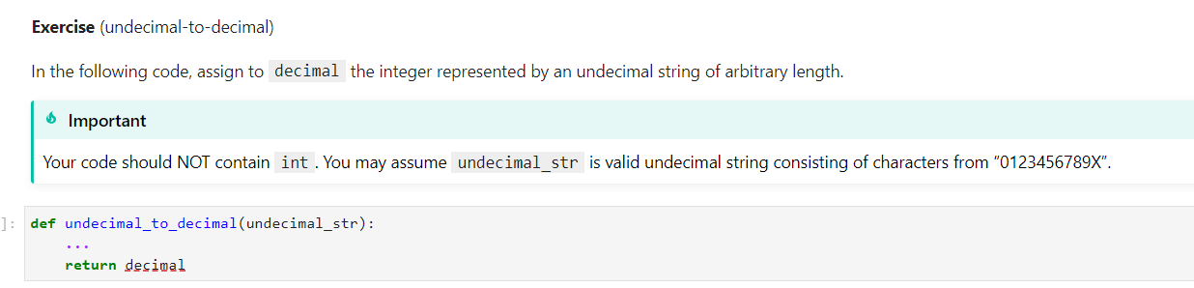
Hint: use function enumerate()

Slide 12
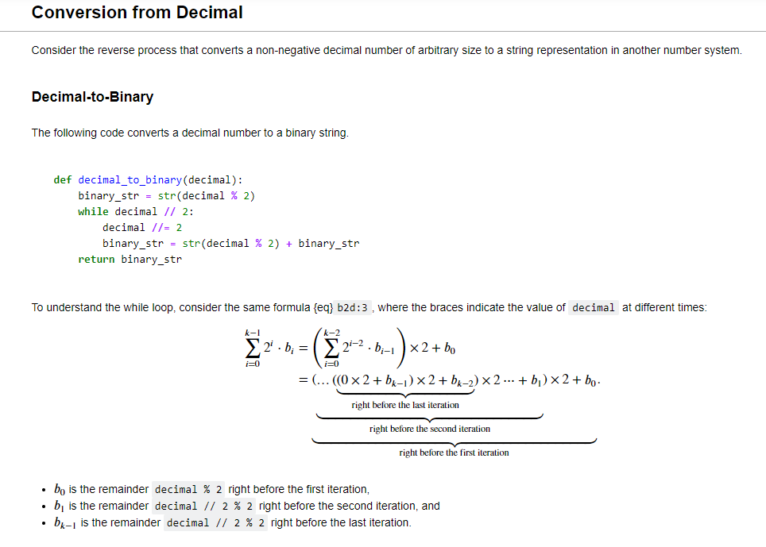
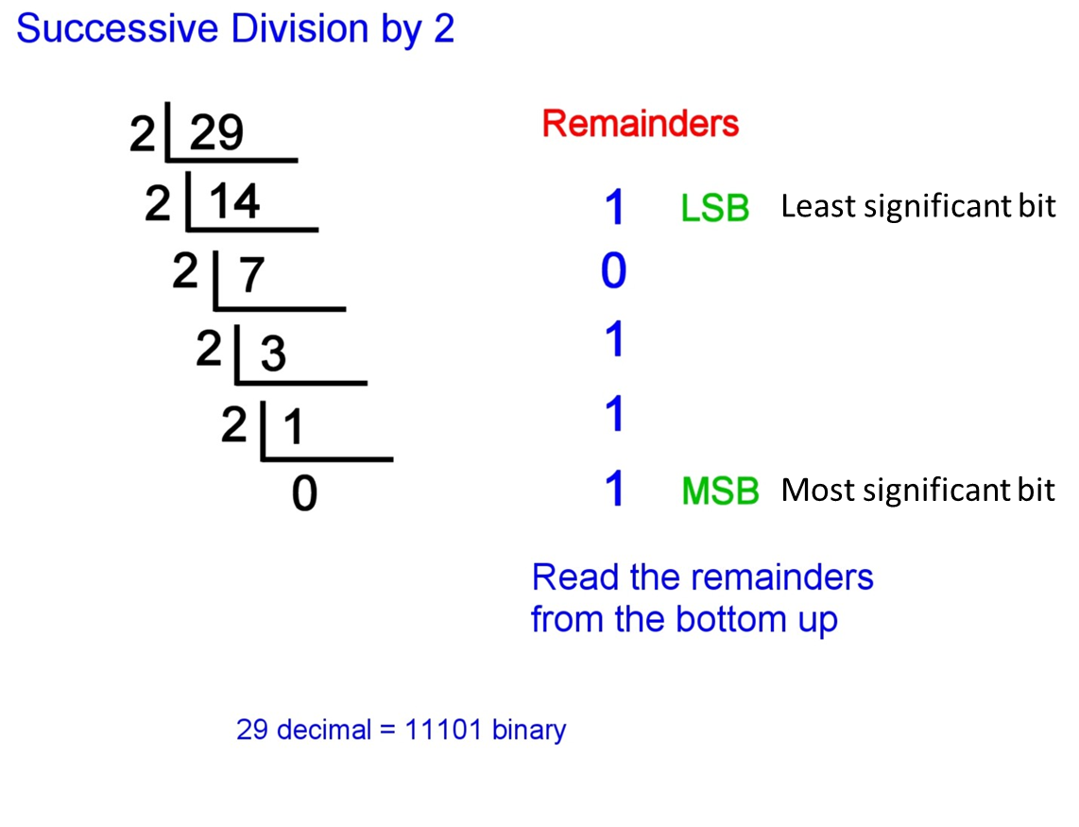
Calculate the first binary bit by modulo operator %
As long as we don’t reach the end of calculation, we keep dividing by 2
Calculate the quotient after division by 2
Concatenate all the bits together to a binary string

Slide 13
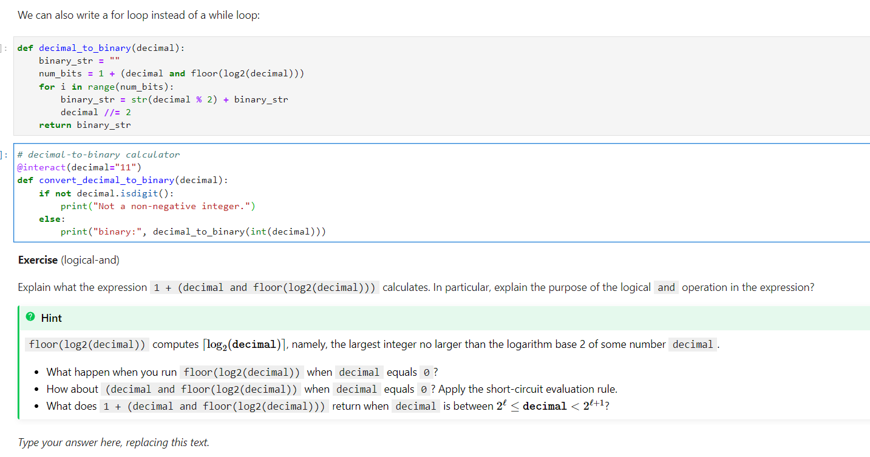
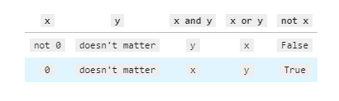
If decimal is not 0, the expression returns floor(log2(decimal))
1+floor(log2(decimal)) represents the number of bits to represent decimal
E.g., 1+floor(log2(10)) is 4 because we need 4 bits to represent 10
1+floor(log2(5)) is 3 because we need 3 bits to represent 5
If decimal is 0, it returns 0
- Why we need this condition? Because log2(0) is illegal

Slide 14
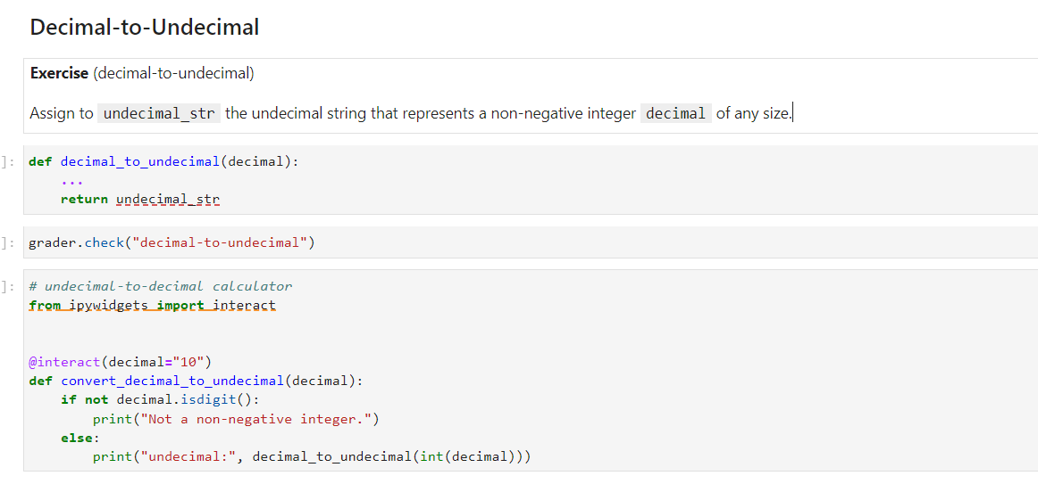
This question is a bit challenging, try to solve it by yourself.

