Slide 1
Lab 5 Complementary materials
Dr. Weitao Xu
weitaoxu@cityu.edu.hk

Slide 2
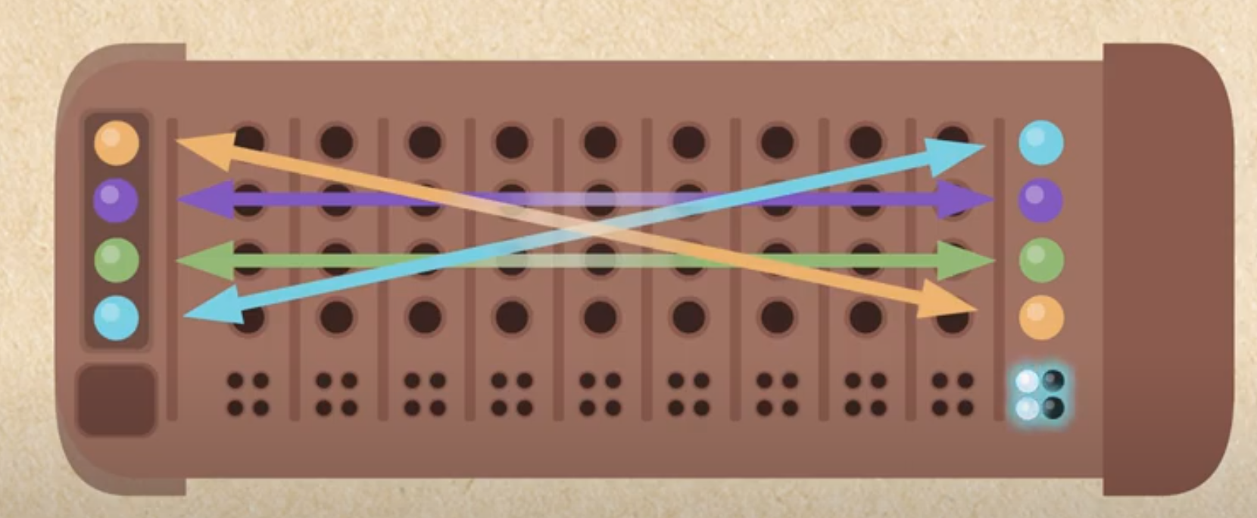
This lab is challenging, pls try your best
code: it’s a string, it represents the correct answer, in this example it’s “YPGB” (yellow-purple-green-blue)
code_length: the length of this string,
guess: it’s user’s input, it’s also a string.
In this example, it’s “BPGY” (blue-purple-green-yellow)
In this example, the feedback is bbww, meaning 2 black_key+2 white_key
Purple and green are correct color in correct positions->2 black
Yellow and blue are correct color in incorrect positions->2 white
feedback: every time, the system generates a feedback for user’s guess.
black_key_pegs_count is the number of code pegs that are the correct colors in the correct positions
white_key_pegs_count is the number of code pegs that are the correct colors but in incorrect positions

Slide 3
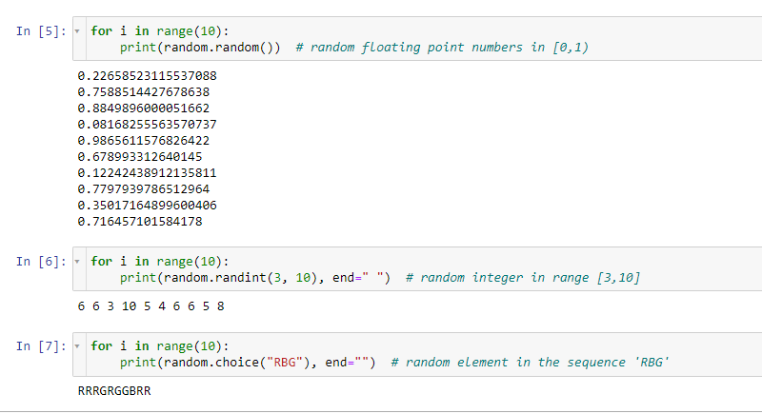
Random Code Generation
import random
random.random()→# random floating point numbers in [0,1)
random.randint(3,10)→# random integer in range [3,10]
random.choice('RBG')→# random element in the sequence 'RBG'

Slide 4
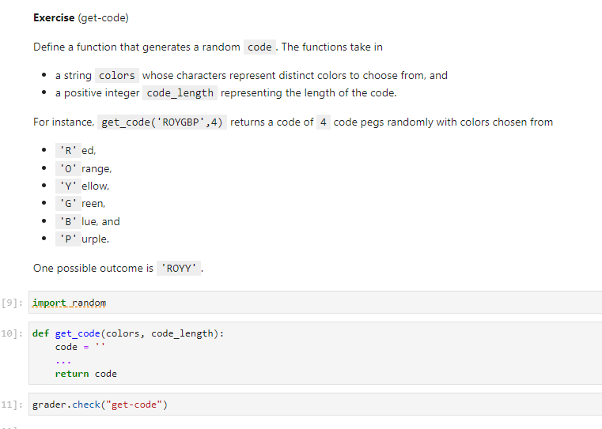
Solution 1: use random.randint()
use a for loop to generate some random numbers
use the random numbers as index to generate random colors
concatenate these colors together
Solution 2: use random.choice()
use a for loop to generate some random characters from colors
concatenate these colors together

Slide 5
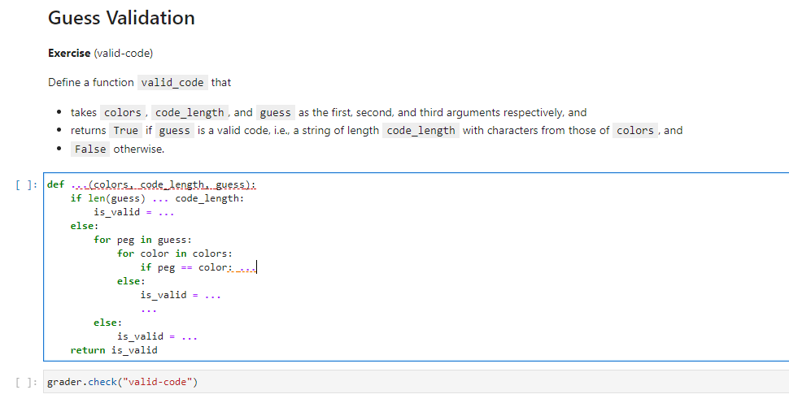
2 Guess Validation: used to validate if user’s input is valid or not

Slide 6
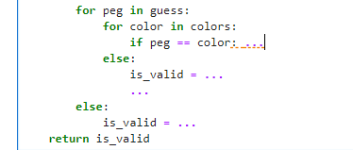
If you don't understand while/else and for/else, pls go to Chapter 5.6 of our reference book.
This function is used to check whether user's input is correct or not. There're two types of invalid input, first the user inputs the wrong number of colors, for example, user should enter 3 colors, but he enters 2. This possibility is checked by the first if statement.
if len(guess) __ code_length:
is_valid = ____
If the length of user's input is equal to the correct code_length, another possible type of invalid input is he enters some colors we don't have, for example, we only have three possible colors, say "RGB", but users may input "RGY". So the code below checks whether user's input color is what we expect. To do so, we need to check each letter in user's input "guess", compare it with each letter in our defined "colors", to see if it belong to our defined colors or not. If one letter doesn't match, we can terminate immediately because we know it's invalid. Let's use the above example again, we define colors be "RGB", and user enters "RGY",
1) we check the first letter in guess "R", to see if any letters in colors is equal to it or not, we find that there's a "R" in colors,
2) so we move to the next letter "G", we compare each letter in "RGB" to see if G exist or not, and we find there's a "G" in "RGB",
3) so we move to the last letter "Y", we iterate all the letters in "RGB", and we find that there's no letter equal to "Y", so we know it's invalid. That's the logic to solve this problem, you don't need to strictly follow the hints below, cause it's just one way to do so. If you understand this logic, you can write your own code, no need to follow this template strictly.
Hints:
as long as we find user’s input is invalid, we can terminate immediately, how?
the value of is_valid can only be True or False

Slide 7
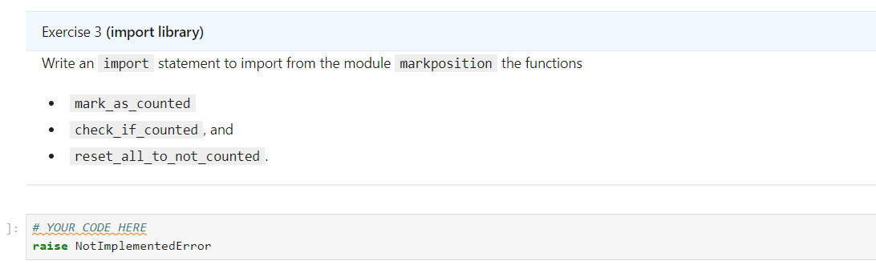
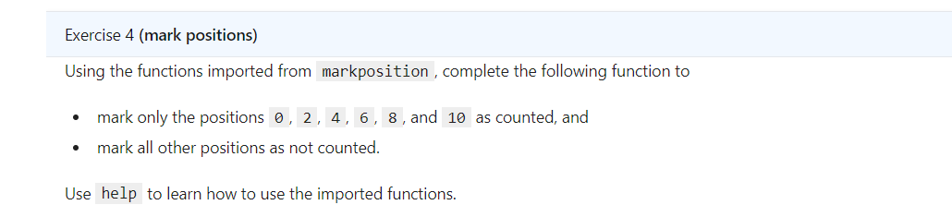
3 Feedback Generation
"Hint: Use help to learn how to use the imported functions.", that means you can type
help(mark_as_counted)
help(check_if_counted)
help(reset_all_to_not_counted)
to get information of these three functions.
As I said in the first question, for each of user's input, we need to check whether it's correct or not.
Suppose the correct color is "RGB", and user enters "BGR", we need to check whether the first letter is correct or not, the second letter "G" is correct or not, and the third letter "R" is correct or not.
After we check the first letter, we mark the first letter is counted, we use mark_as_counted(1) to represent this operation.
If we want to check if the second letter has been counted or not, we use check_if_counted(2), if it's true, it means we already checked it's correctness. Otherwise, if it's false, meaning we haven't checked it's correctness.
reset_all_to_not_counted() means we reset the boolean value of each letter to false, meaning we reset to the default condition: all the letters have not been verified.

Slide 8

Why we need these three functions? -To avoid double count
black_key_pegs_count is the number of code pegs that are the correct colors in the correct positions
white_key_pegs_count is the number of code pegs that are the correct colors but in incorrect positions
Give a user’s input color, it has three posibilitties:
If it is wrong color→we do nothing
If it is correct color and in the correct position-> we add black_key_pegs_count by 1
If it is correct color but in the wrong position->we add white_key_pegs_count by 1
It is possible that you count a correct color in both white_key_pegs_count and black_key_pegs_count
So every time after you determine whether a color is case 2) black_key or case or 3) white_key, we need to mark this position as counted. Otherwise, we may count it again →to mark the i-th color, we use mark_as_counted(i)
To check whether i-th color is counted or not, we use check_if_counted(i), and it’s return value is True or False
True means it’s counted and False means it’s not counted.

Slide 9
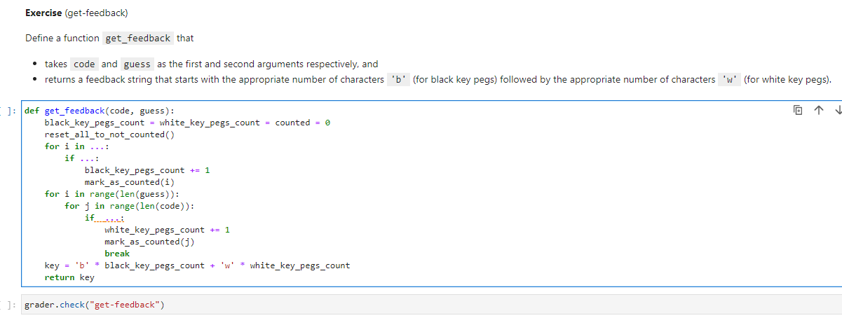
This is the most difficult question
This function will generate the number of black_key_pegs
and the number of white_key_pegs.
The idea is : iterate each letter in “guess”, and compare
It’s color and location with colors in “code” to determine
The number of black_key_pegs and white_key_pegs.
Black_key_pegs_count: the total number of black_key_pegs
White_key_pegs_count: the total number of white_key_pegs

Slide 10
Test example for get_feedback()
get_feedback(“RRRRGGG","RRRGGGR") will return 5*'b'+’w’*2, why?
bbbwbbw → 5*’b’+ ‘w’*2
RRRRGGG
RRRGGGR
get_feedback("RRRRGGG","GGGGRRR") will return 0*'b'+'w’*6, why?
www www → 0*’b’+ ‘w’*6
RRRRGGG
GGGGRRR
Code:
Guess:
Code:
Note: the length of code is 7 but the
length of the feedback is only 6!
Do not double count!
Guess:

