Slide 1
Lab 6
Dr. Weitao Xu
weitaoxu@cityu.edu.hk

Slide 2
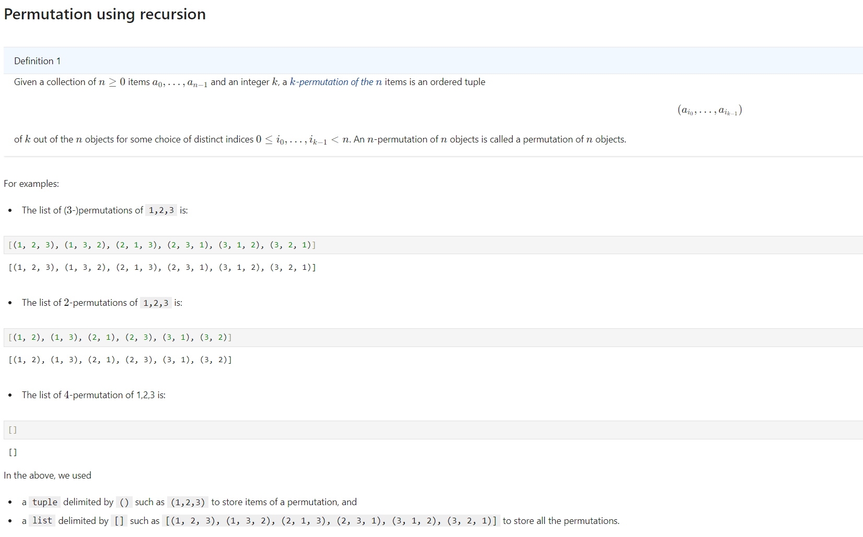

Slide 3
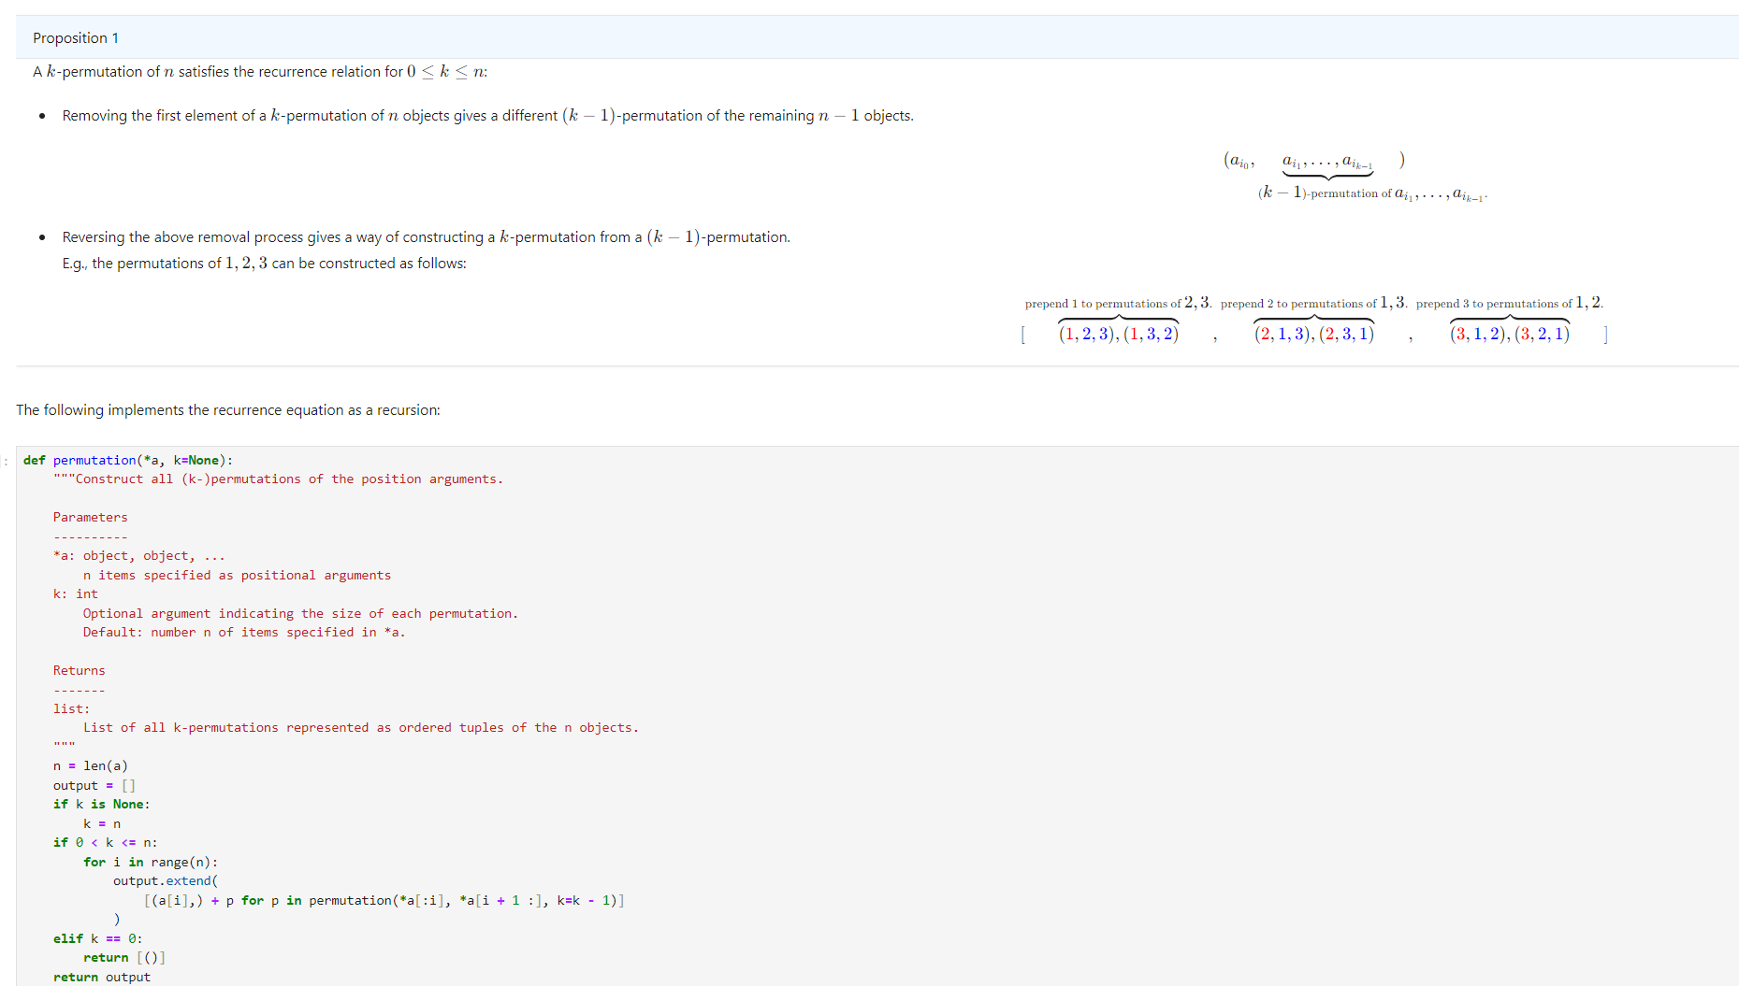

The element took out, i.e., a[i]
Permutation of rest k-1 elements

Slide 4
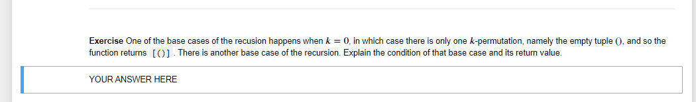
Hint: In mathematics, there is no k-permutation when k<0 or k>n. Therefore, if k<0 or k>n, the function returns
an empty list [].

Slide 5
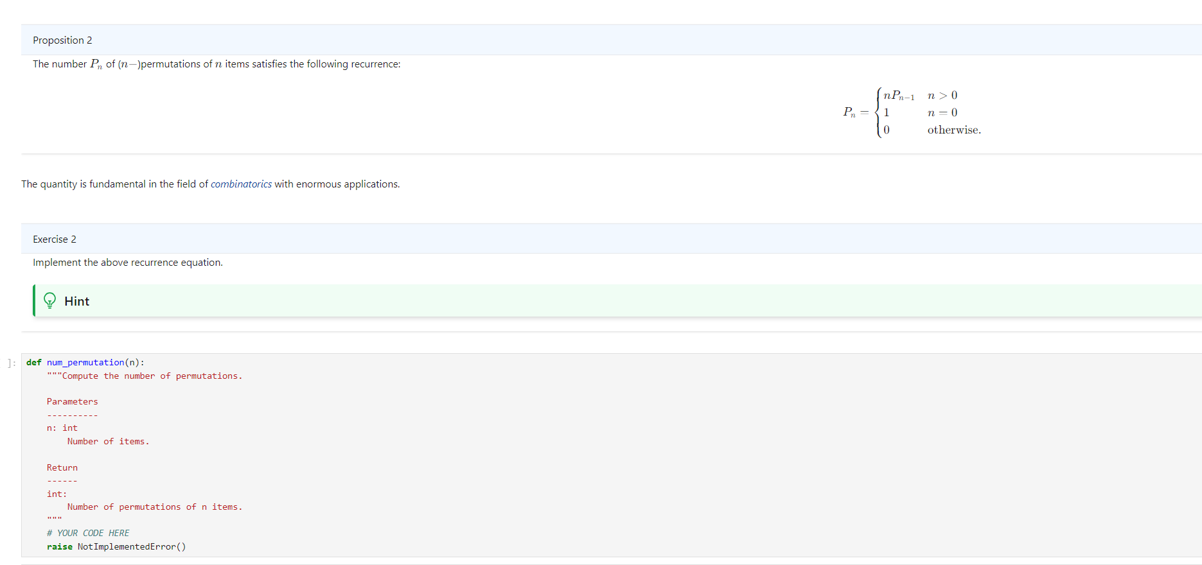
Use recursion to complete this function

Slide 6
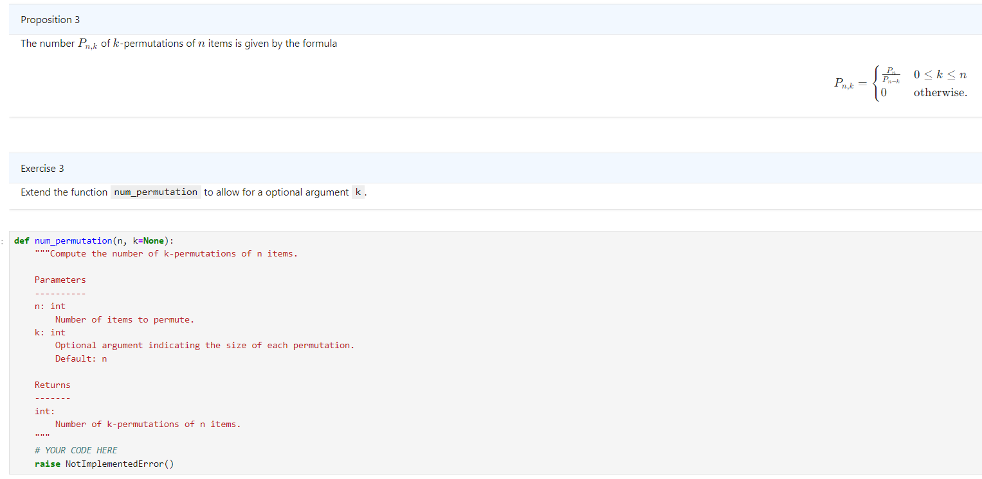
Introduce k in your previous implementation
To check if k =None, you need to use “k is None” but not “k == None”

Slide 7
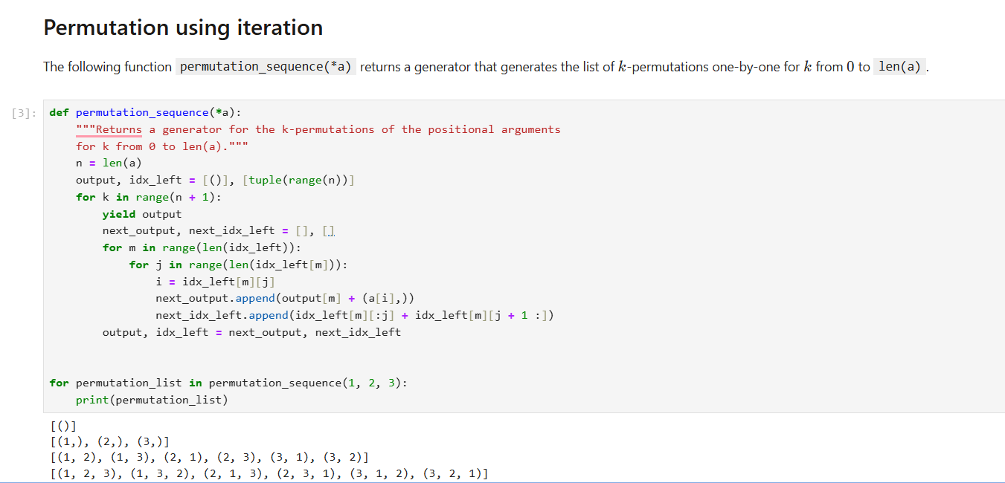
0-permutation
1-permutation
2-permutation
3-permutation
This example prints all the 0-permutation, 1-permutation, 2-permutation, 3-permutation of (1,2,3)
At first glance, this example is hard to understand. We can analyse this example by adding some code by ourselves

Slide 8
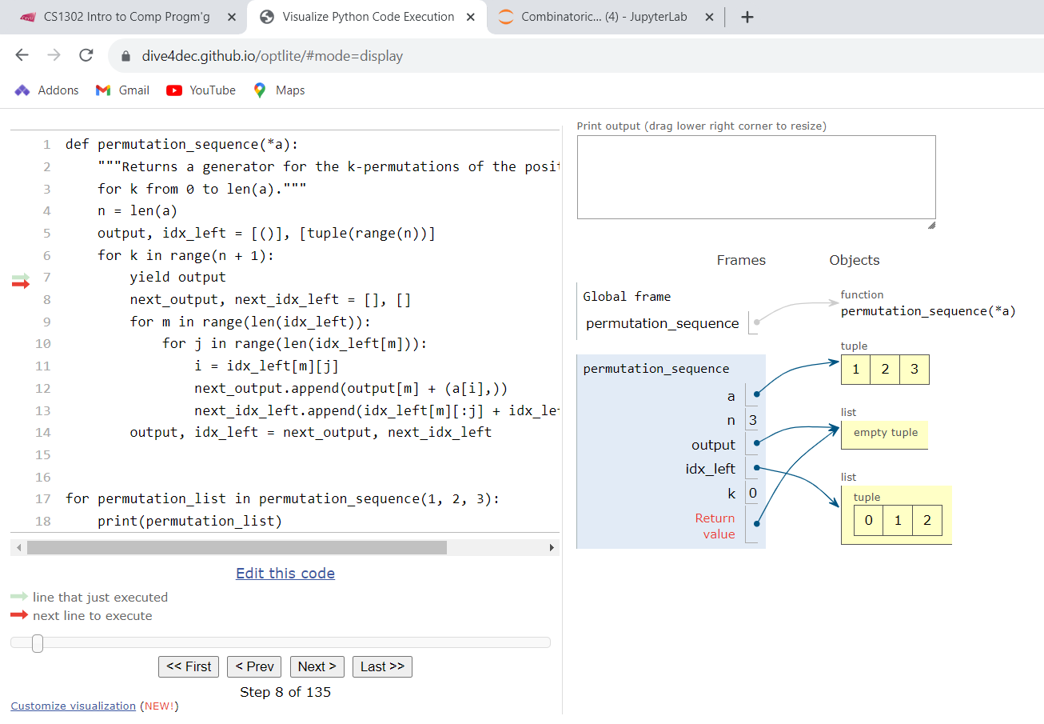
Visualize the process by running the code in online Python tutor

Slide 9
What does this example mean?
First, we generate all the 0-permutations
Then, based on the 0-permutations, we generate 1-permutations.
Then, based on the 1-permutation, we generate 2-permutations.
Then, based on the 2-permutation, we generate 3-permutations.

Slide 10
We use a b c to replace 1, 2, 3, in case you mix up element 1, 2, 3 and index 0, 1, 2
a | b | c
0 | 1 | 2
Red color: current output
Black color: element_left
0-permutation
[]
[(a, b, c)]
If we take a out, (b,c) will be left
1-permutation
[(a)]
[(b, c)]
[(b)]
[(a, c)]
[(c)]
[(a, b)]
If we take b out, c will be left
2-permutation
[(a,b)]
[(c)]
[(a, c)]
[(b)]
[(b,a)]
[(c)]
[(b, c)]
[(a)]
[(c,a)]
[(b)]
[(c, b)]
[(a)]
3-permutation
[(a,b,c)]
[]
[(a, c,b)]
[]
[(b,a,c)]
[]
[(b, c,a)]
[]
[(c,a,b)]
[]
[(c, b,a)]
[]

Slide 11
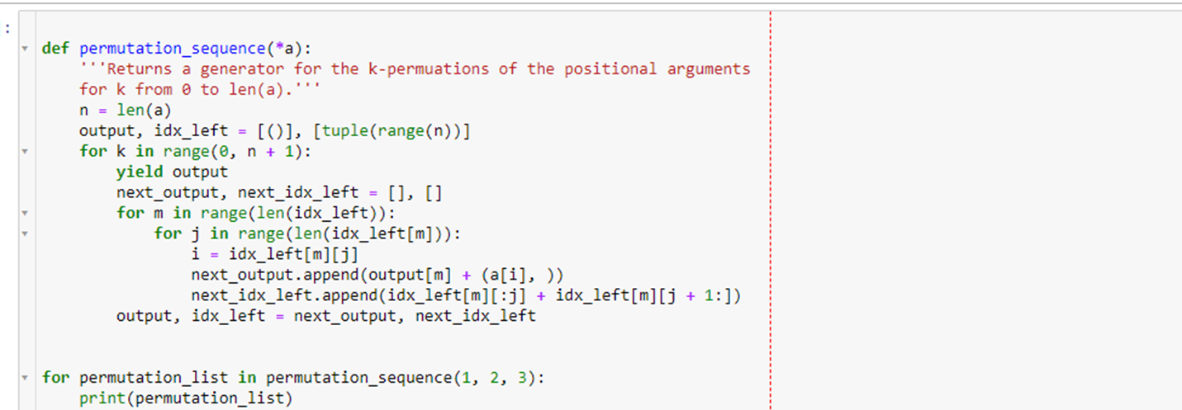
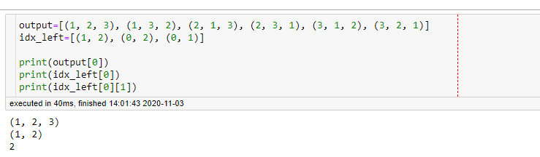
Note: output and idx_left are list, but their elements are tuples.
So, you need to understand the meaning of
output[i], idx_left[i], idx_left[i][j]

Slide 12
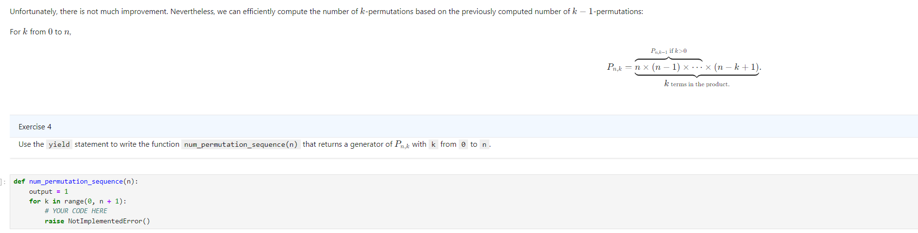
Analyse the equation and think about how to calculate Pn,k from Pn,k-1

Slide 13
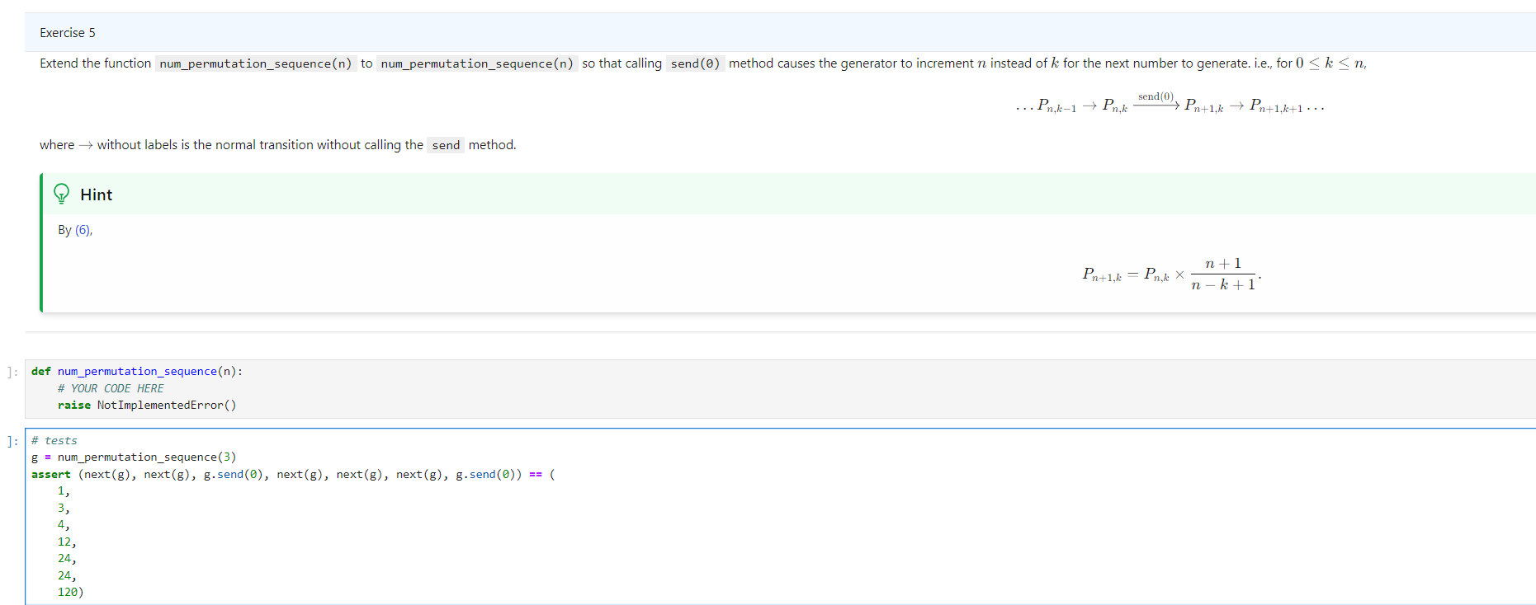
You need to understand how send() and next() works
Understand the test code, what happens if we call next(g) and what happens if we call g.send(0)

Slide 14
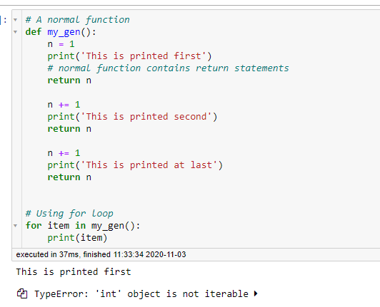
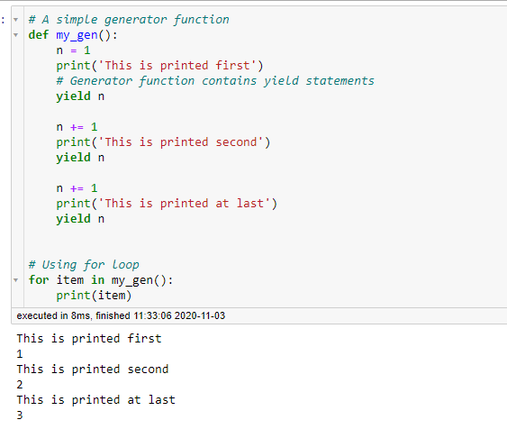
Let’s recall how to generate a generator - we use yield statement
Return will return the data and terminate a function immediately
But yield just pauses the function, and will continue from there in next function call
difference

Slide 15
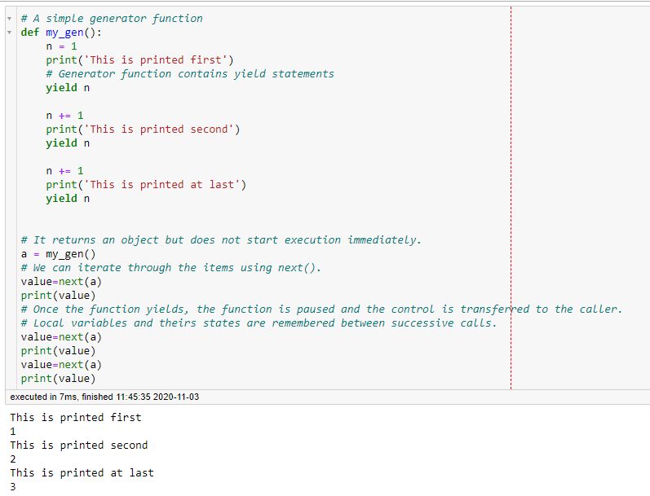
Usually we use for loop to generate a generator. We can also use next() to replace for loop to continue to the next yield expression - the return data of next() is the generated value by yield statement
Automatically run the next iteration
Run the next iteration by calling next() manually
Same result

Slide 16
So far, a generator can only generate some data, can it receive data? Yes, we can use send() function
send() function can send a value to a generator
The send() method returns the next value yielded by the generator, or raises StopIteration if the generator exits without yielding another value.
When send() is called to start the generator, it must be called with None as the argument, because there is no yield expression that could receive the value.

Slide 17
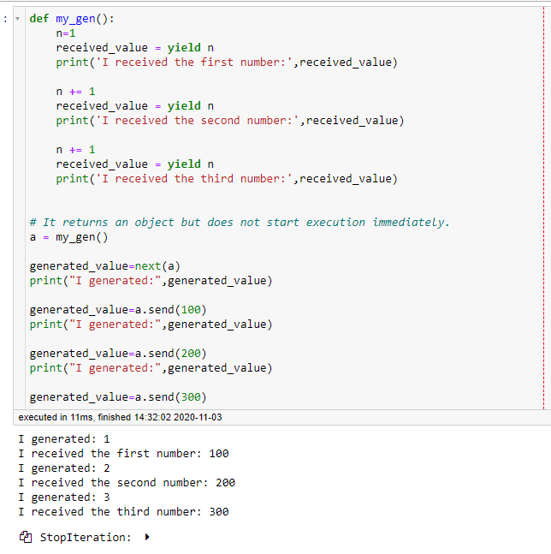
This is how we receive the data
Call next() to execute the next yield statement
The return value of send() is the generated value
The last send() causes error cause there’s no more yield
statement

Slide 18
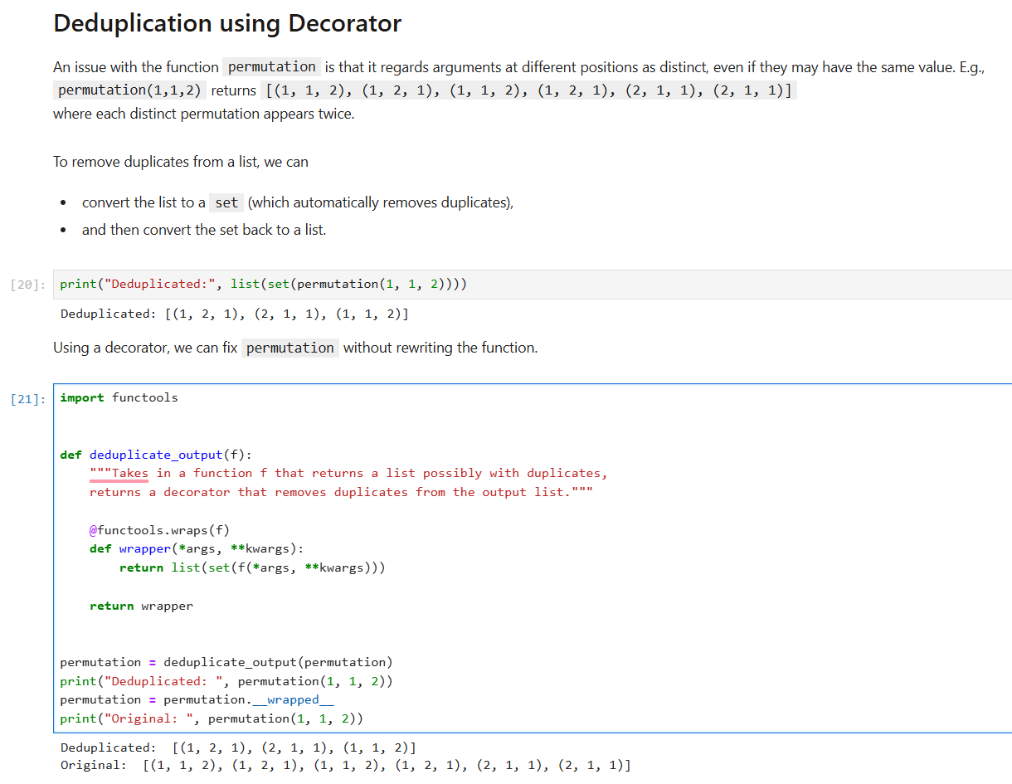
set will be introduced in next lecture
this is how we decorate a function
this is how we remove the decoration, i.e., use
the original function

Slide 19
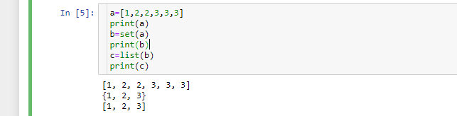
set is a composite data type that doesn’t allow duplicated items https://www.w3schools.com/python/python_sets.asp
How to delete duplicates in a list?

Slide 20
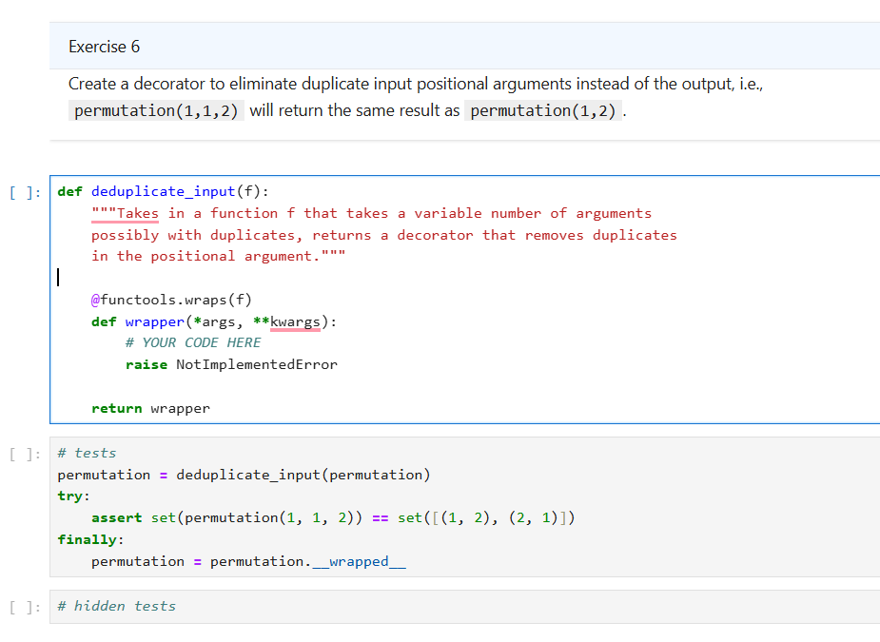
refer to the above example to see how to use set() to
solve this problem

Slide 21
Tips
In Exercise 3:
To check whether k is None or not, you need to use if k is None
(refer to function def permutation(*a, k=None))
if k==None →wrong because None is a keyword, it’s not the same as 0/False
Based on proposition 3, we need to calculate Pn and Pn-k, there two values can be calculated by the function in Exercise 2. However, since function name of exercise 2 and exercise 3 are both num_permutation(n), you may copy your solution of Exercise 2 into the cell of Exercise 3 and rename num_permutation(n) to another name, such as p(n), so you can use p(n) and p(n-k) directly in def num_permutation(n, k=None).

