Slide 1
Lab 7
Dr. Weitao Xu

Slide 2
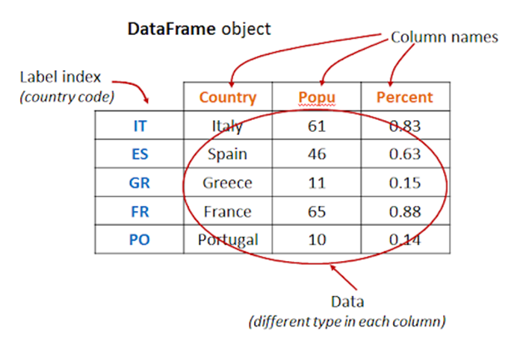
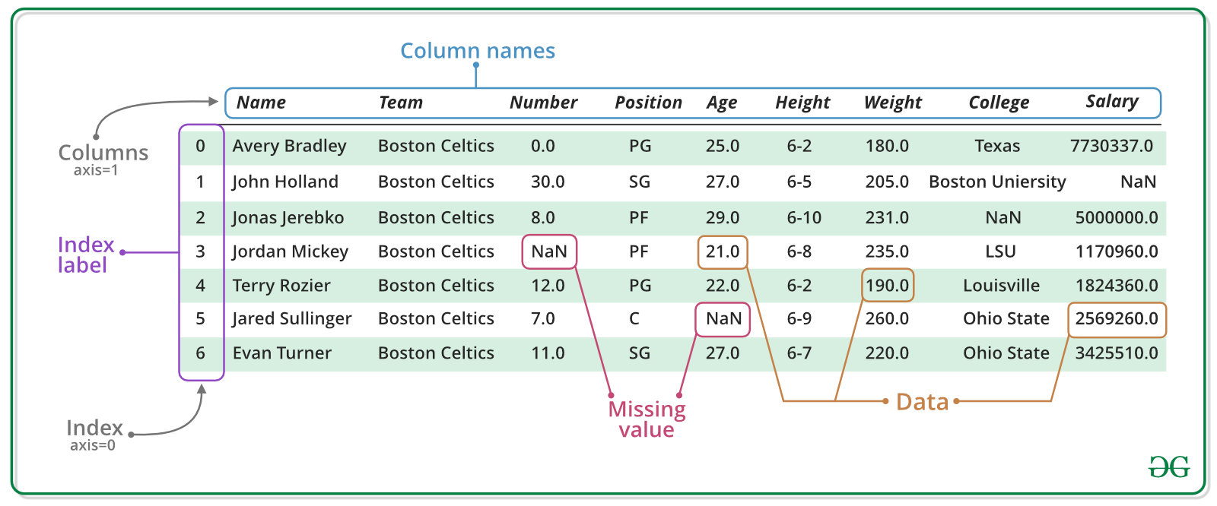
In this lab, you will analyze COVID19 data using a powerful package called pandas.
- pandas is a Python package providing fast, flexible, and expressive data structures designed to make working with “relational” or “labeled” data both easy and intuitive.

Slide 3
Data source
https://data.gov.hk/en-data/dataset/hk-dh-chpsebcddr-novel-infectious-agent
How to use it? https://data.gov.hk/en/help/api-spec#historicalAPI
enhanced_sur_covid_19_eng.csv
Download url_covid: https://api.data.gov.hk/v1/historical-archive/get-file?url=http%3A%2F%2Fwww.chp.gov.hk%2Ffiles%2Fmisc%2Fenhanced_sur_covid_19_eng.csv&time=20200801-1204
building_list_eng.csv
Download url_building: https://api.data.gov.hk/v1/historical-archive/get-file?url=http%3A%2F%2Fwww.chp.gov.hk%2Ffiles%2Fmisc%2Fbuilding_list_eng.csv&time=20200801-1203

Slide 4
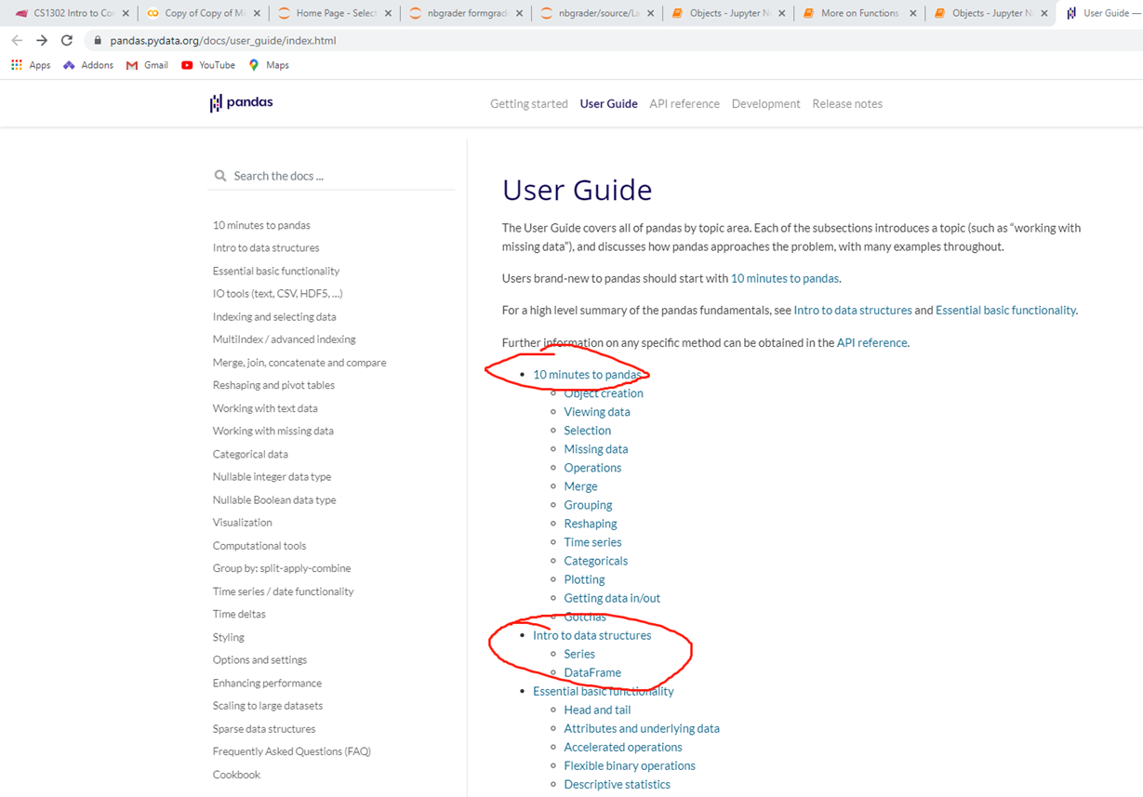
Before you start, we suggest you read a 10 minutes introduction to pandas https://pandas.pydata.org/docs/user_guide/index.html
Pandas

Slide 5
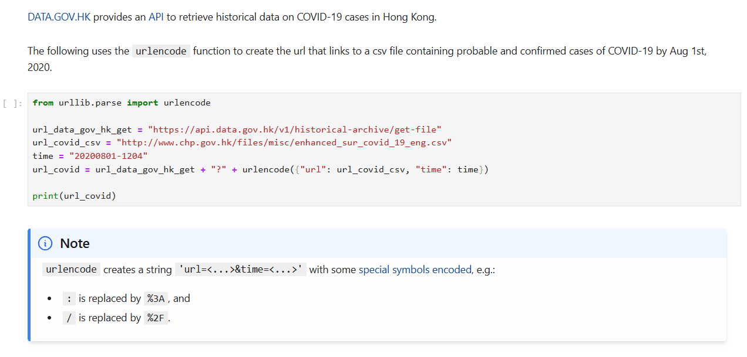
1 Loading CSV Files with Pandas
This example shows how to create a URL link to download a file.
In this example, it has a urlencode() function, which is used to convert strings to a URL.
URL means Uniform Resource Locator, it is the address of online resources such as webpage, image and files

Slide 6
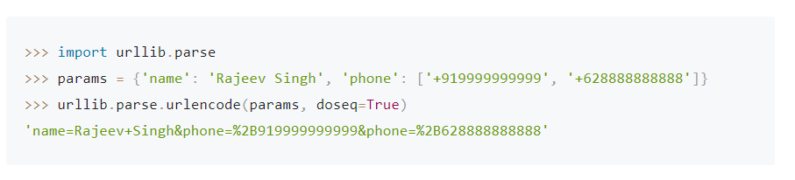
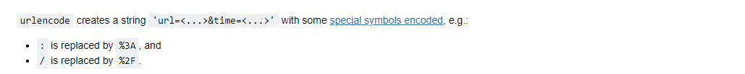
Urlencode() is used to encode strings to a webpage link
The example below shows how it works
During encoding/conversion, it will replace : with %3A, replace / with %2F

Slide 7
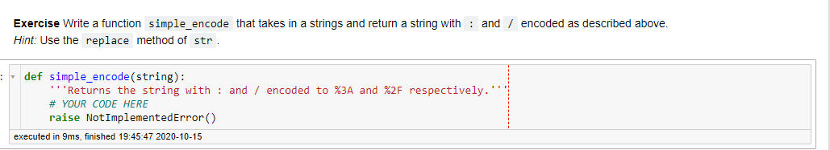
So, now you need to write a function simple_encode() to implement the simple version of urlencode()
Write your code here

Slide 8
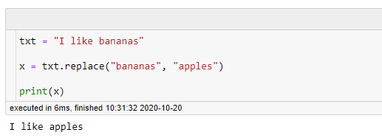
In this question, you need to use function replace() - replace(str1,str2) will replace str1 with str2 - see example below

Slide 9
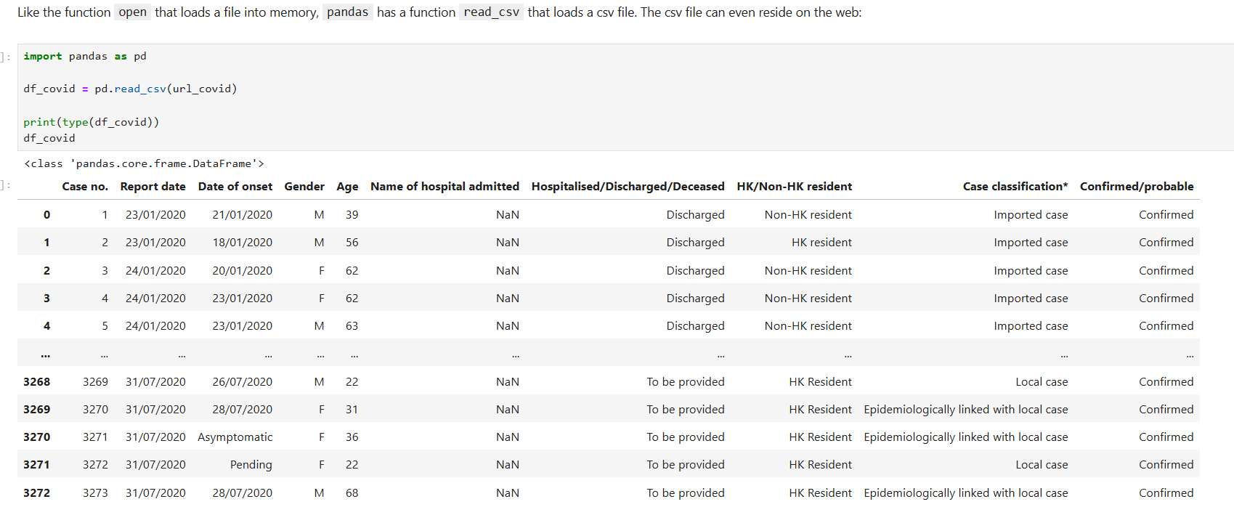
Next, we can read data using pd.read_csv()
Read data
Get data type
Display data

Slide 10
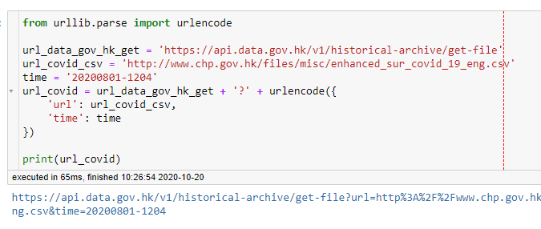
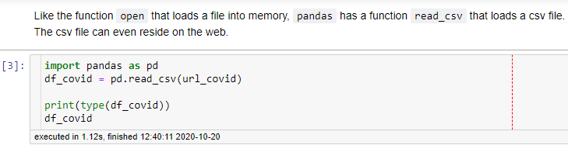
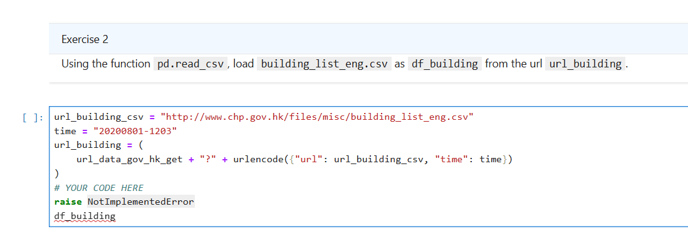
Based on examples we show to you, complete the code below to read another file from url_building.
The data should be assigned to a variable df_building

Slide 11
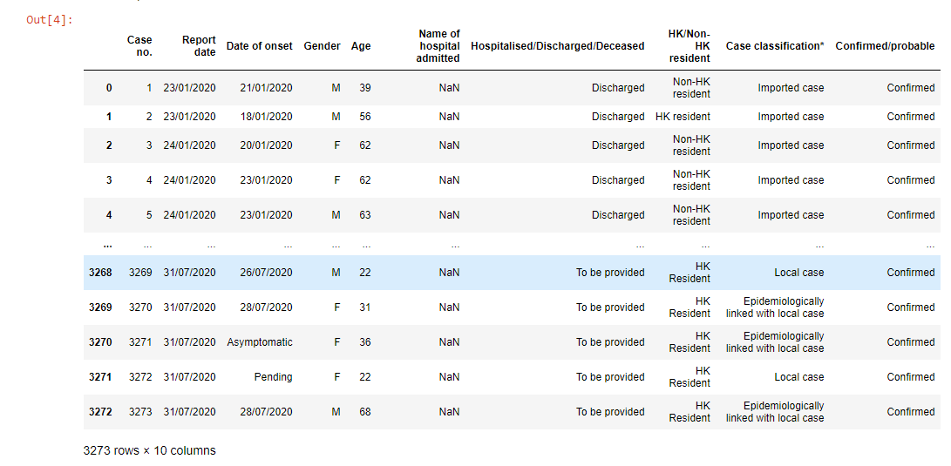
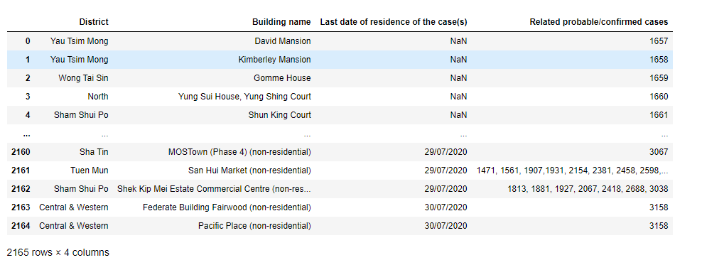
Now we have two data source. So be careful which data source you should use when you complete the questions below.
df_covid
df_building

Slide 12
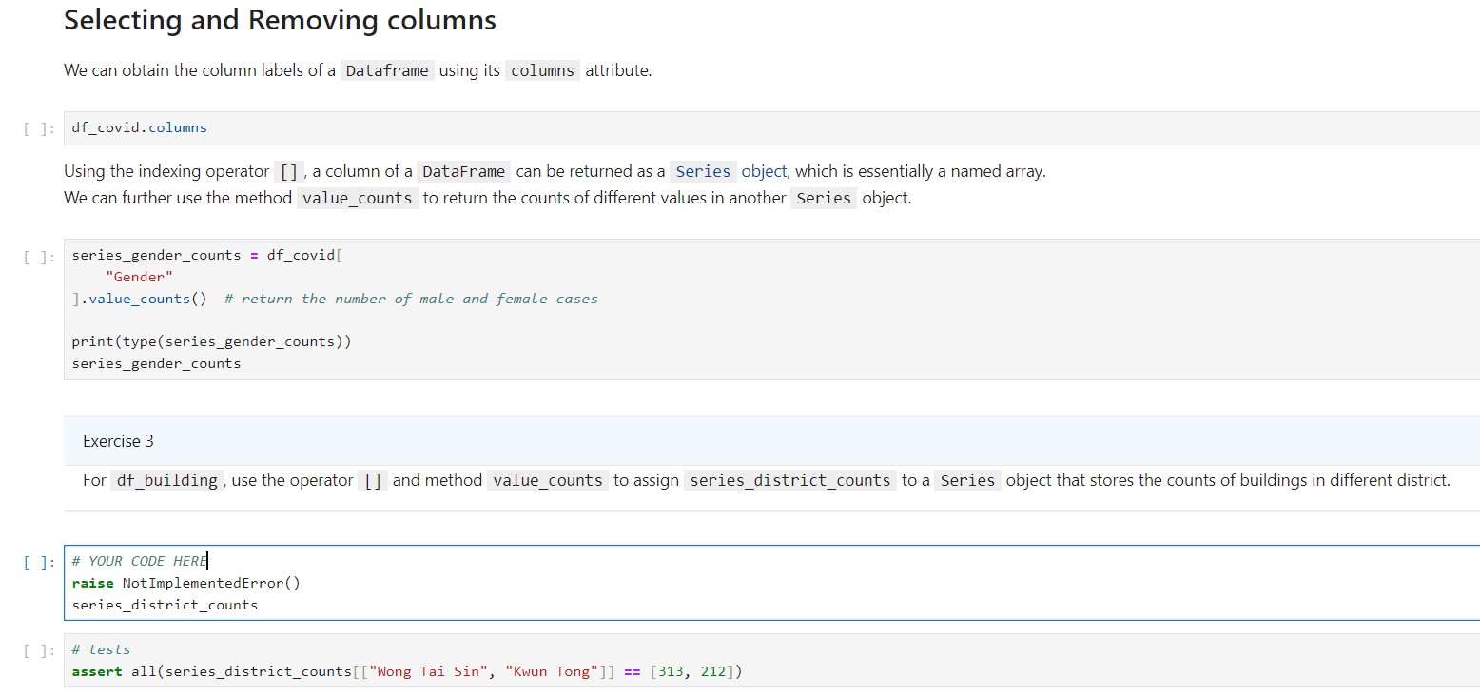
In Question 2, you will learn how to select and remove columns
In this example, we show how to get the number of male and female cases
from df_covid
Now, you need to use similar method to get the number of buildings from df_building

Slide 13
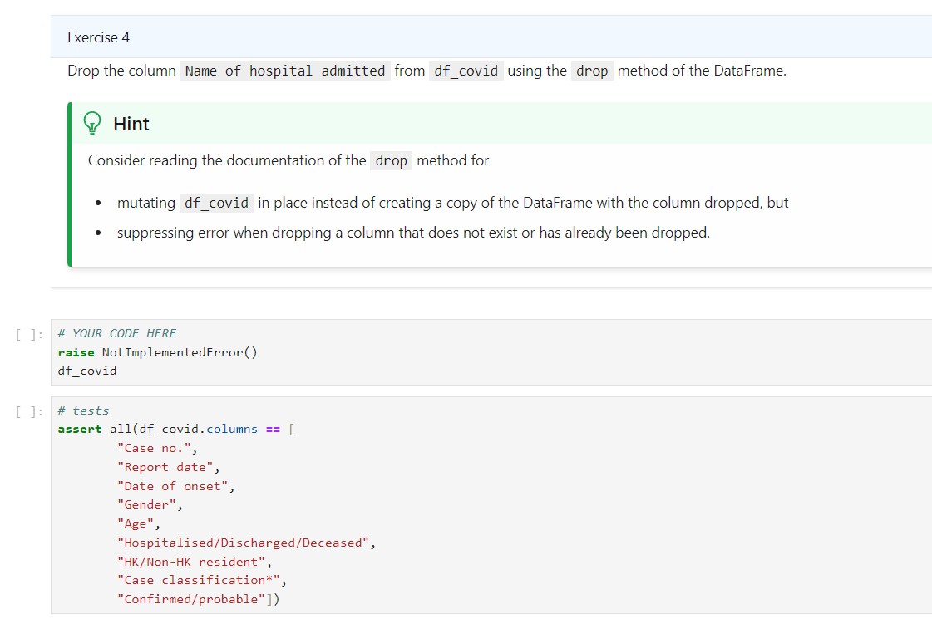
Name of hospital admitted is empty, you need to learn how to delete it. You need to understand how to use drop() by yourself
https://pandas.pydata.org/pandas-docs/stable/reference/api/pandas.DataFrame.drop.html
Use drop() to solve this question
Empty

Slide 14
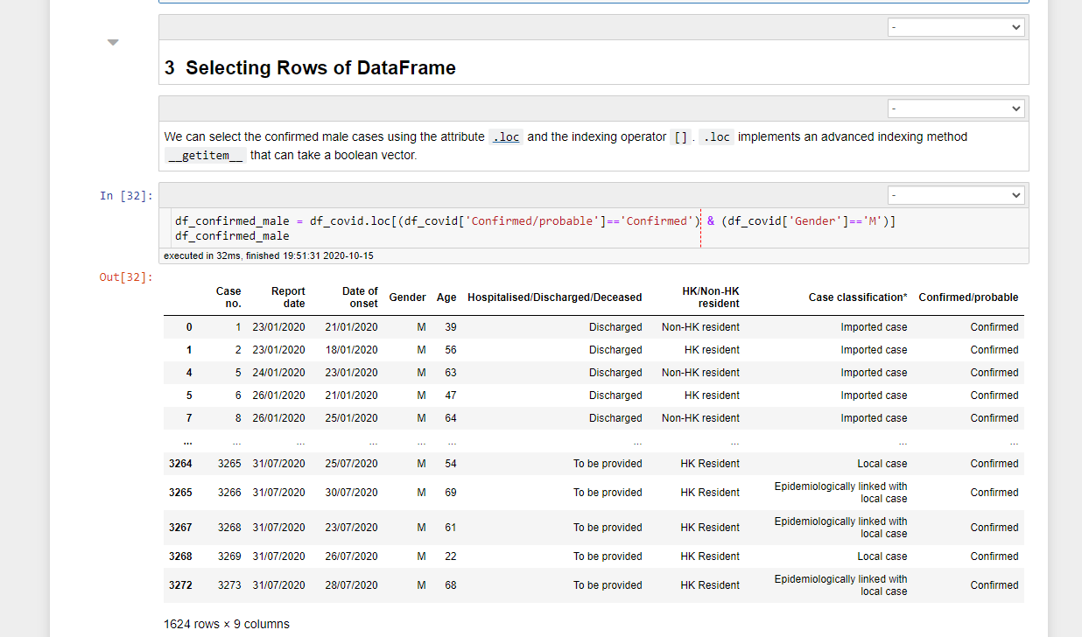
In question 3, you will learn how to select rows of DataFrame. You need to learn how to use DataFrame.loc[] by yourself https://pandas.pydata.org/pandas-docs/stable/reference/api/pandas.DataFrame.loc.html
Condition 1: confirmed
Condition 2: male
This example shows how to select all the rows who are confirmed and male

Slide 15
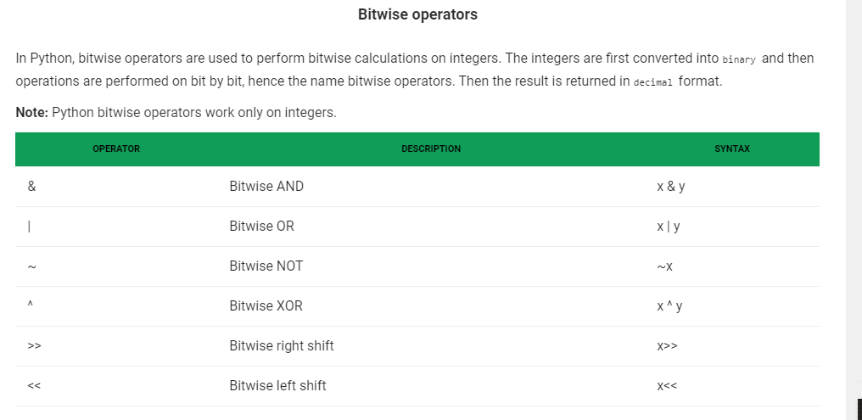
To solve this problem, we need to introduce bitwise operators https://www.geeksforgeeks.org/python-bitwise-operators/
Only need to know these three: note that they’re different from logical operator and, or, not

Slide 16
How to select rows based on multiple conditions
We need to use &, |, ~ to link conditions together
For example, if we want to select rows that meeting condition 1 and condition2
DataFrame.loc[(condition 1) & (condition 2)]
DataFrame is the name of the object, in the previous example, it is df_covid
we want to select rows meet condition 1 or condition2
DataFrame.loc[(condition 1) | (condition 2)]
More information
https://www.kite.com/python/answers/how-to-select-rows-by-multiple-label-conditions-with-pandas-loc-in-python
https://stackoverflow.com/questions/15315452/selecting-with-complex-criteria-from-pandas-dataframe

Slide 17
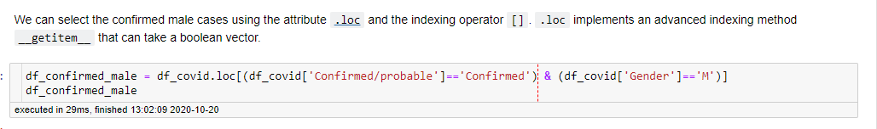
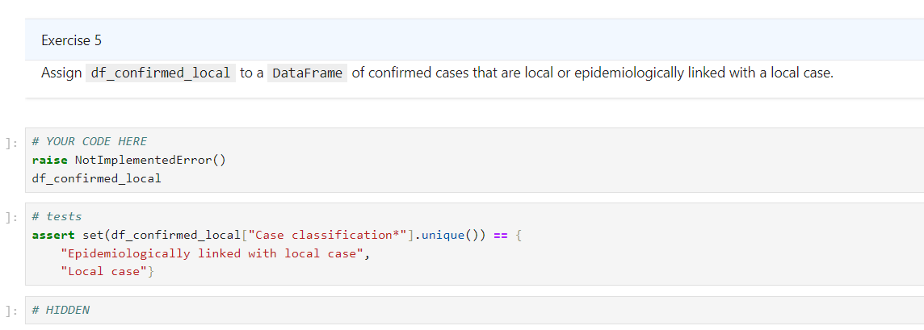
Now you need to finish the exercise by yourself based on example provided to you.
Condition 1
Condition 2
Condition 3
Note the relationship between condition 2 and condition 3 is or

Slide 18
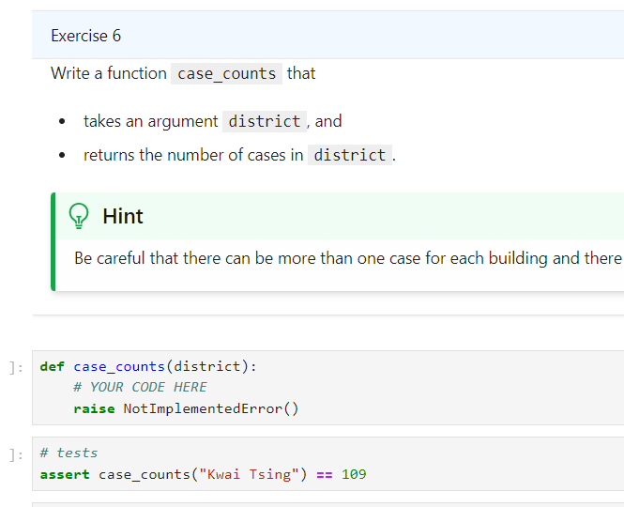
Note that the data you use in this example is df_building

Slide 19
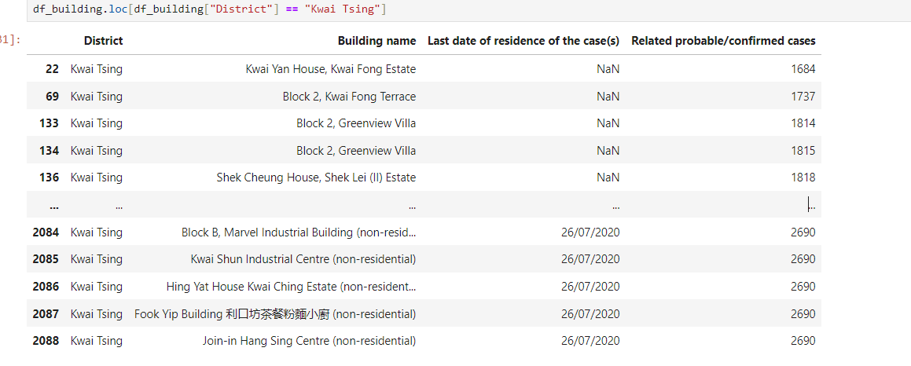
Be careful:
(1) The same case ID may go to multiple buildings, see example below
The case ID 2690 went to 5 buildings

Slide 20
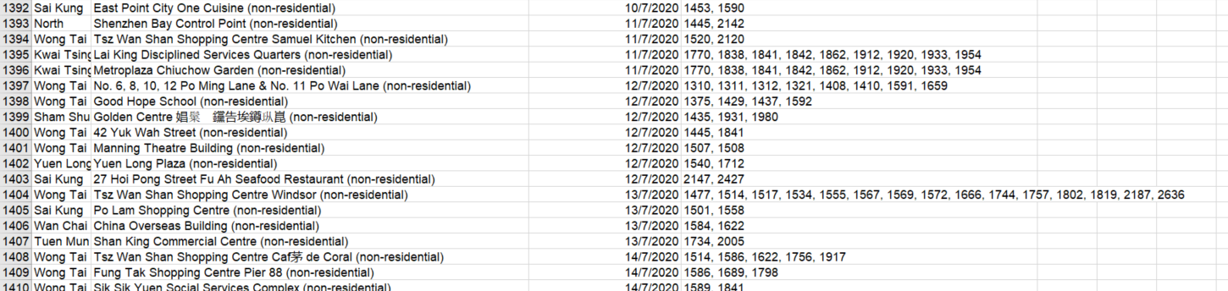
Be careful:
(2) The same building may have multiple cases
The same person may go to different buildings. The case ID 1586 went to 2 buildings
There may be multiple cases in the same building. Take row 1409 as an example, the same building has 3 cases: 1586 1689 1798
So suppose there’re 5 rows in a csv file, it doesn’t mean there’re 5 confirmed cases, for example the case are [1501, 1501, 1501, 1935, 1935], then
It means there’re only 2 cases.
Likewise, if there’re 4 buildings in a csv file, it doesn’t mean there’re 4 confirmed cases.
Each unique ID means a case, so the idea is 1) to extract all the case IDs in one district, for example, all the cases in “Sai Kung” is x=[1501, 1501, 1935], 2) remove all the duplicates by converting this list to a set: x=set(x)→you get x={1501, 1935} 3) finally, calculate the number of elements in the set (you get 2 in this example, so it means there’re 2 cases in Sai Kung).

Slide 21
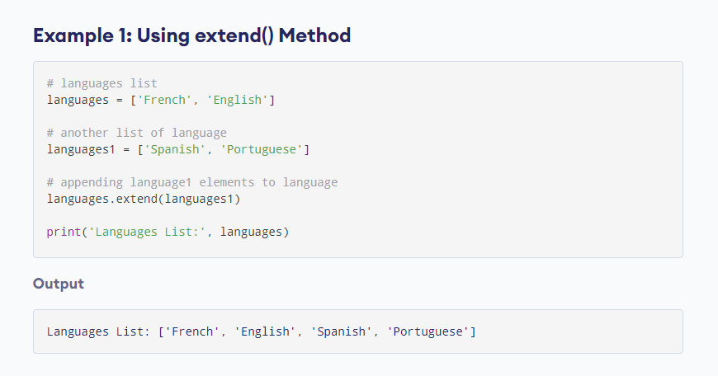
To solve the last question, you need to use extend() and set()
List: extend() ttps://www.programiz.com/python-programming/methods/list/extendh
set() https://www.w3schools.com/python/python_sets.asp

