Slide 1
INWK-6112 COURSE PROJECT
ATLANTIC CONNECTIFY SOLUTIONS
HARIJI MURARI PADMALATHA
SAI BHARATH REDDY CHODAVARAM
KATHIRESAN SONAIMUTHU

Slide 2
Company overview:
ATLANTIC CONNECTIFY SOLUTIONS:
Atlantic Connectify Solutions is service based company consists around 50 to 60 employees who delivers technology related solutions to their clients.
They take projects from the client and understand their need and then provide the proper solutions to them which includes managing the IT infrastructure, development of custom software based on their needs, migration of data centers from on premise to cloud platforms, implement and maintain security of the data etc.….
The company consists of many departments like development, management, delivery and so on.

Slide 3
Network Requirements:
The company consists of 50 employees which has nearly 45 workstations and 3 servers.
It consists of four departments Management, Development, Delivery and Client.
Layer 1 Requirement:
All the PC’s and servers need to be connected with wired connections with ethernet cables and the network needs high performance and efficiency.
Layer 2 Requirements:
The management team consists of 15 workstations and 3 servers, Development team consists of 20 workstations and the delivery team has around 15 PC’s and these four departments need to be separated by using the VLAN’s as a layer 2 requirement.
Then there should be a communication between every VLAN.

Slide 4
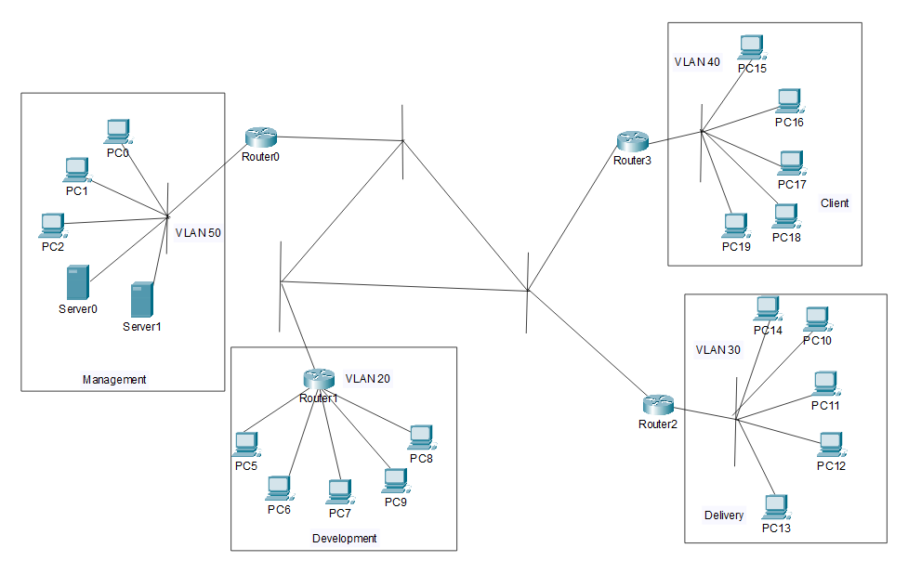
Logical Topology:

Slide 5
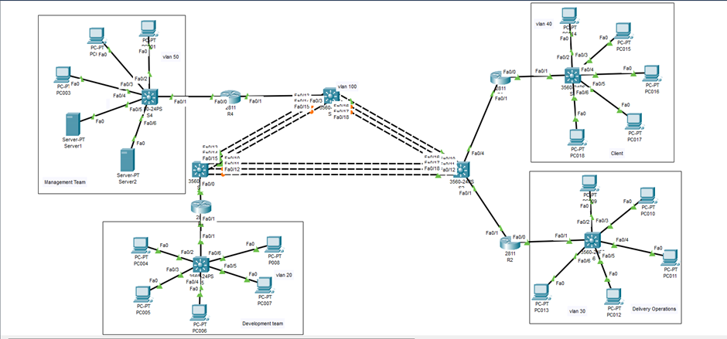
Physical Topology:

Slide 6
Fourier Transform and uses in this topology:
Usually the communication between the PC, Switch and server is in the form of signals in modern communication most of data transmission in digital signals.
By using the Fourier Transform we can analyze and represent these digital signals in the frequency domain. Subsequently, the digital signal is converted to analog form for transmission.
For the transmission there are several fundamental processes happens (Fourier Transform, Modulation, Demodulation, Quantization…).

Slide 7
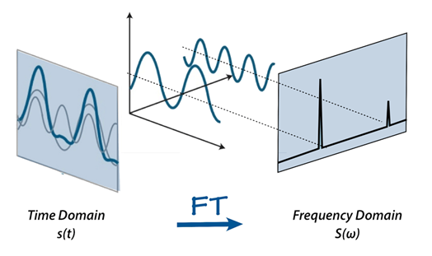
At the receiving end, sampling occurs the process to convert the analog signal to digital signal, this involves taking samples of the analog signal to retrieve the original data sent by the sender.
Then the quantization occurs which matches the height of the samples to certain levels.

Slide 8
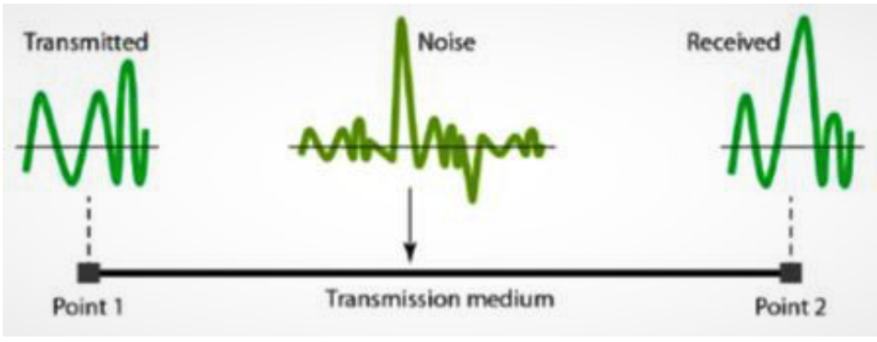
IMPAIRMENTS:
When the data is transmitted through the transmission medium the it may encounter some impairments like,
Noise
Some interruption or disturbance which reduces quality of the data being conveyed is known as noise.
Attenuation
In the physical topology at the time of data transmitted from PC to router or switch through the transmission medium there is some gradual decrease in signal strength which makes the signal weaker.

Slide 9
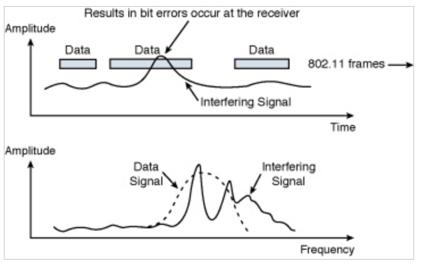
Delay
The time of data transmitted from the source to the destination.
Jitter
At the time of signal transmitted through the medium there should be a jitter which is the difference in the time it takes for data packets to get from their source to their destination.
Interference
When the signal is transmitted from one PC to another PC through the wired medium in this network topology there will be some other signal will overlap with the original signal which results that the receiver will get the output signal will some changes leads an error in the output.

Slide 10
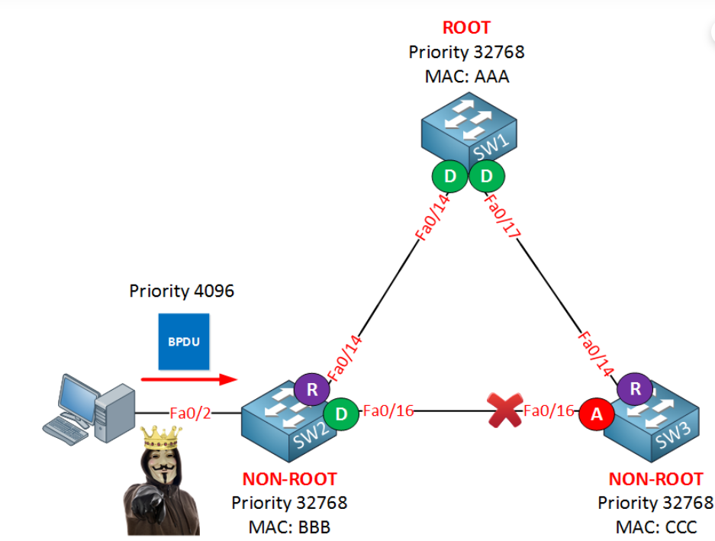
BPDU:
Bridge Protocol Data Unit is the packet frame which helps the switches to enable STP (Spanning Tree Protocol) by collecting the information about the each bridges in our topology.
It prevents the looping of data frames transmitted through multiple paths.

Slide 11
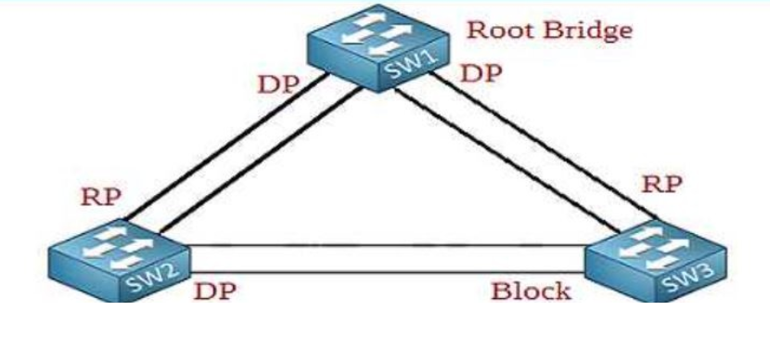
STP (Spanning Tree Protocol):
In our topology STP is used to keep enable only the root port and designated and blocking the redundant ports in order to prevent the looping of the data packets in the network.
For implementing STP, BPDU is the initial frame from which the switch gathers the information about the bridges available in the network.

Slide 12
CONFIGURATION OF VLAN, INTER VLAN ROUTING, VTP
Network topology:

Slide 13
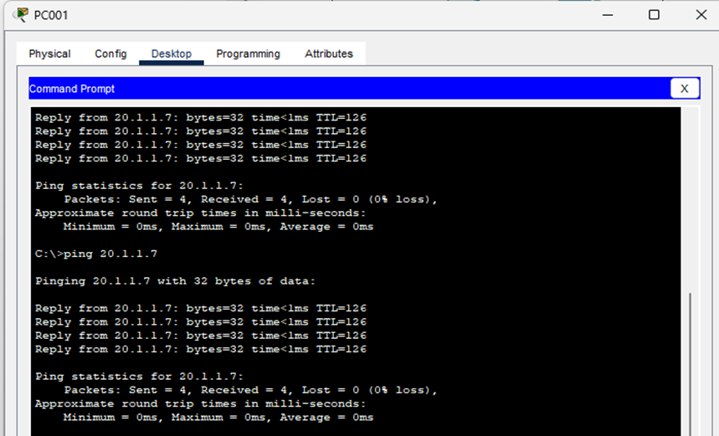
Result and Test cases:
Test case 1: Ping form PC001(vlan 50) to PC008(vlan 20):

Slide 14
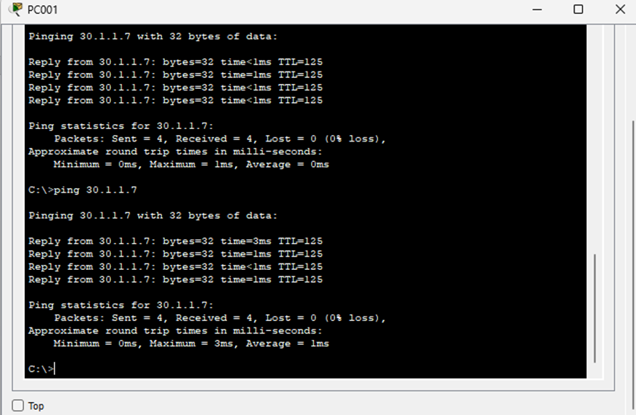
Testcase 002: Ping from PC001(Vlan 50) to PC0013(Vlan 30):

Slide 15
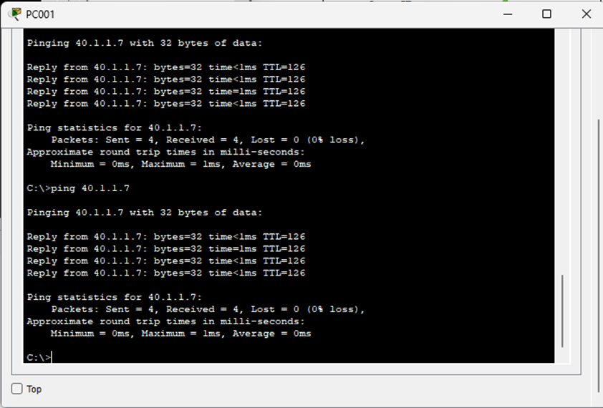
Testcase 003: Ping from PC001(Vlan 50) to PC0018(Vlan 40):

Slide 16
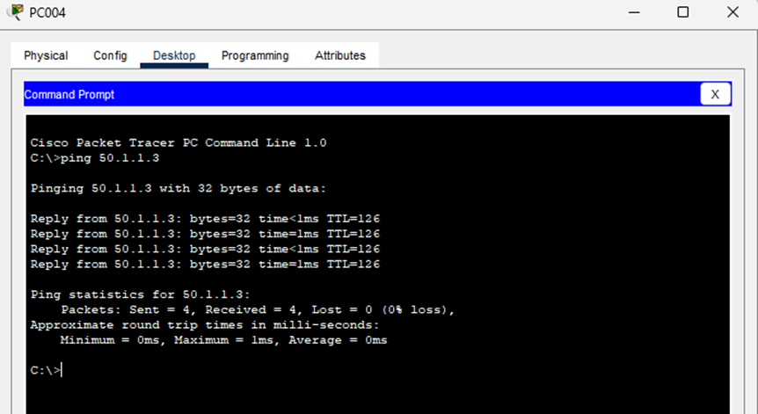
Testcase 004: Ping from PC004(Vlan 20) to PC001(Vlan 50):

Slide 17
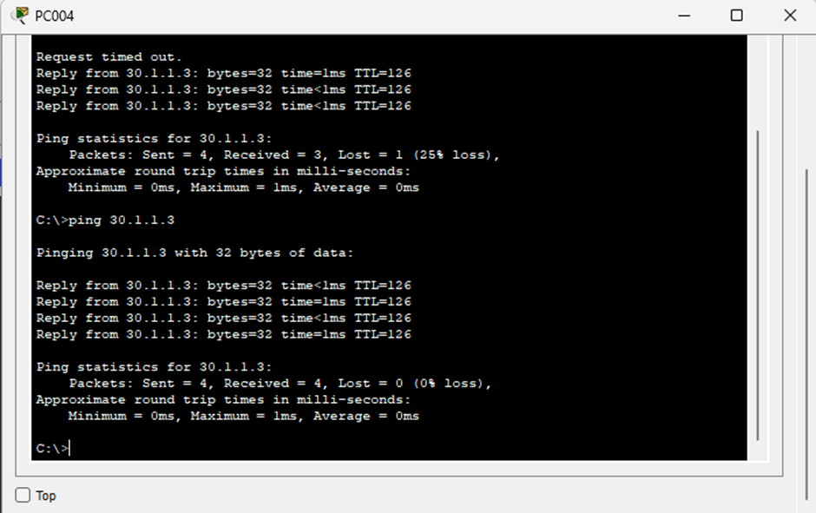
Testcase 005: Ping from PC004(Vlan 20) to PC009(Vlan 30):

Slide 18
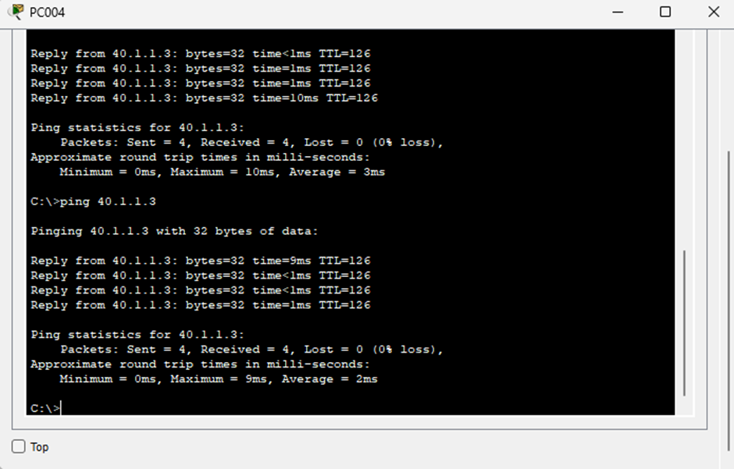
Testcase 006: Ping from PC004(Vlan 20) to PC014(Vlan 40):

Slide 19
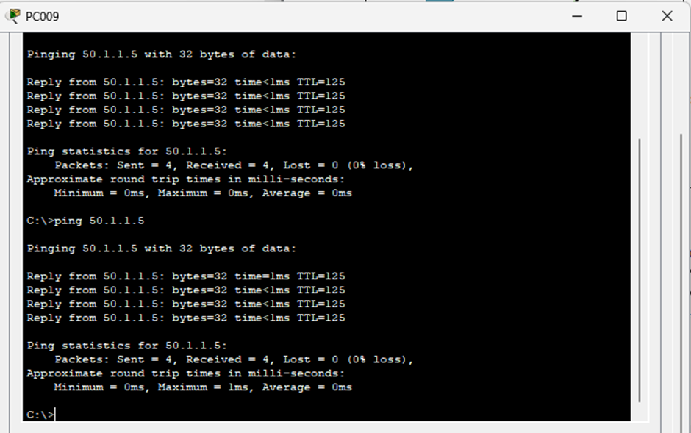
Testcase 007: Ping from PC009(Vlan 30) to PC003(Vlan 50):

Slide 20
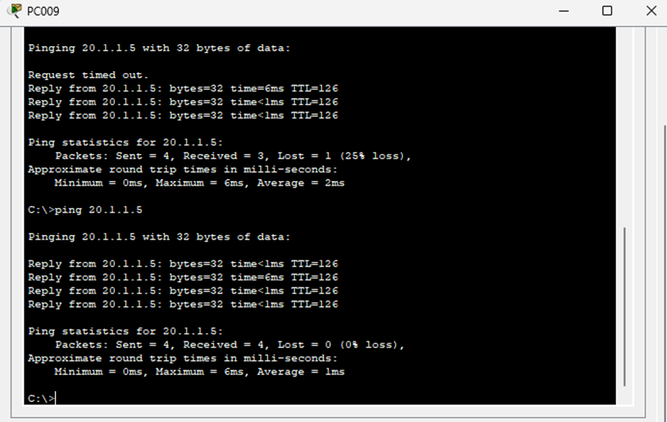
Testcase 008: Ping from PC009(Vlan 30) to PC006(Vlan 20):

Slide 21
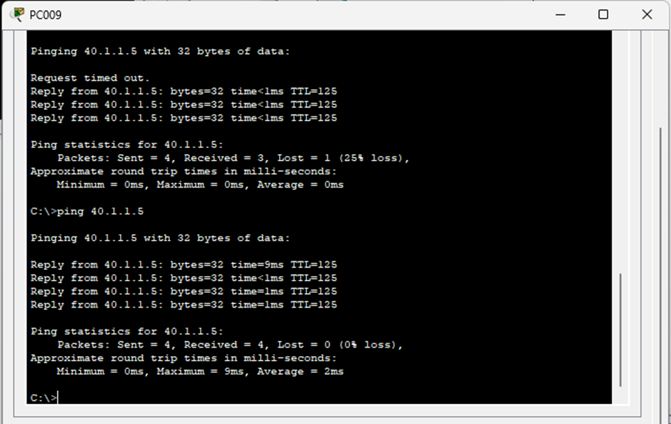
Testcase 009: Ping from PC009(Vlan 30) to PC016(Vlan 40):

Slide 22
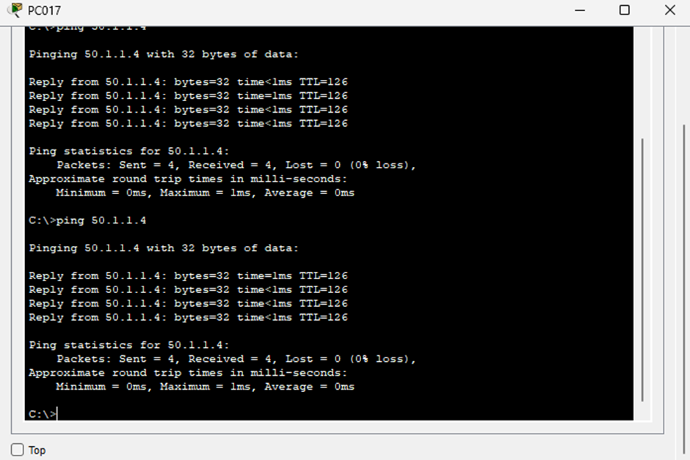
Testcase 010: Ping from PC017(Vlan 40) to PC002(Vlan 50):

Slide 23
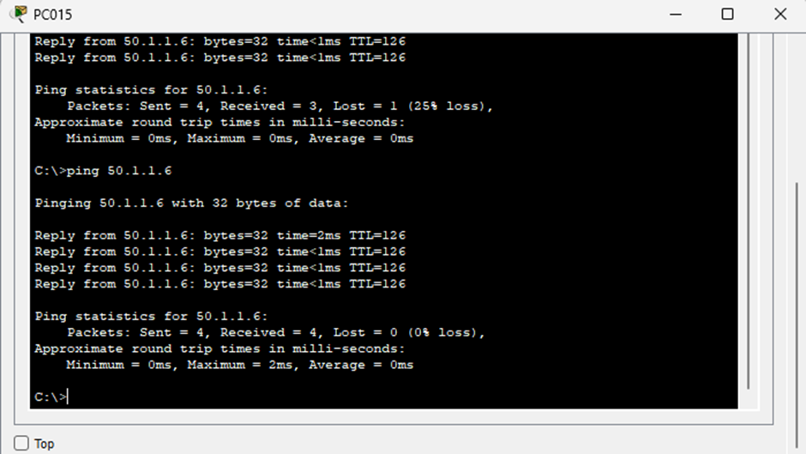
Testcase 011: Ping from PC0015 to Server1:

Slide 24
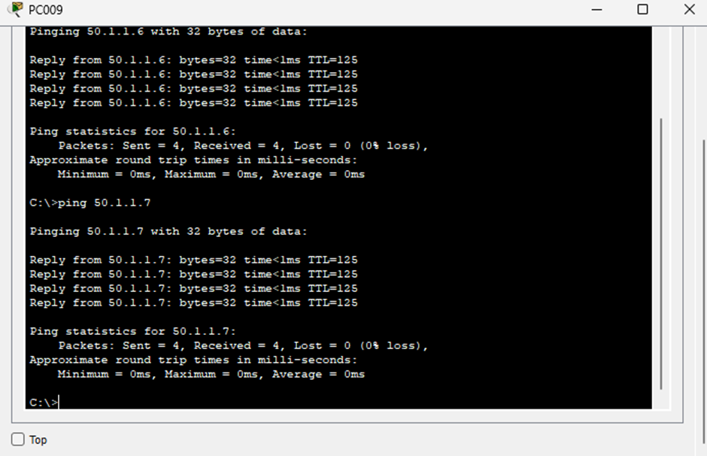
Testcase 019: Ping from PC009 to Server2:

Slide 25
CONCLUSION:
As per the requirement given by the company named Atlantic Connectify Solutions the network topology is created with four VLAN’S each assigned to various department and the inter VLAN routing is enabled.
The final output is verified by checking the connectivity of PC and servers from one VLAN to another VLAN using the Cisco Packet Tracer simulation tool and the output is verified by receiving successful ping response from the destination devices.

Slide 26
ANY QUESTIONS ??

Slide 27


