Slide 1

Team name : Byunggeon
Department : Sejong University
Major : Information Security

Slide 2
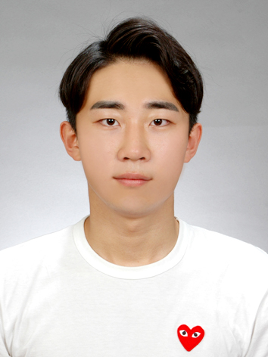
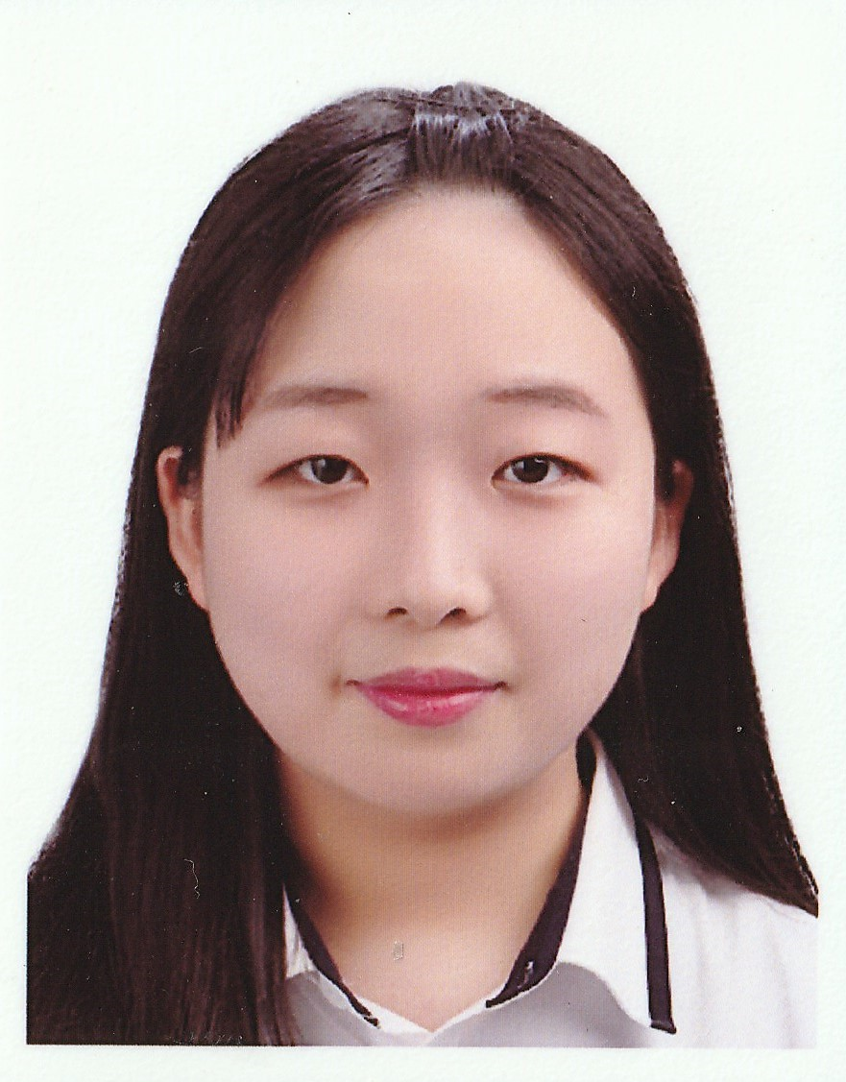
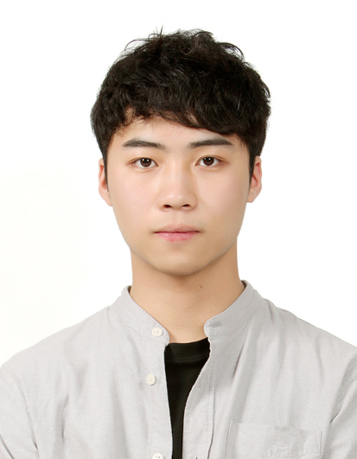
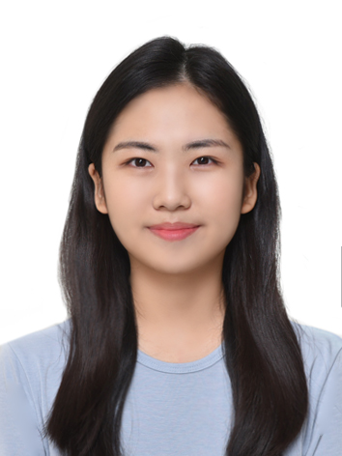
Name : Byunggeon-Choi
Role : Team leader,
App development
Name : Jieun-Park
Role : Hardware development
Name : Jeongwoo-Seong
Role : Server development,
Software development
Name : Yewon-Park
Role : Hardware development

