Slide 1
Posey Analysis Group-15
MEMBERS :
Choice Ugwuede Gilton Mujivane Zain Ul Abideen Alvi

Slide 2
INTRODUCTION
Posey is a company that specializes in the sales of goods and services. To help the Core Data Engineering (CDE) team gain a deeper understanding of their competitor, Parch & Posey, we conducted an exploratory analysis of Posey’s database tables.
This analysis provides insights into their market operations, sales performance, and customer behavior, serving as a foundation for informed decision-making

Slide 3
Project analysis slide 3
Project Analysis
HIGHEST SPENDINGS
MOST SALES_REPS(REGION BASED
CHANNELS USED
Top Region with the Highest Revenue
The sales rep with the highest account

Slide 4
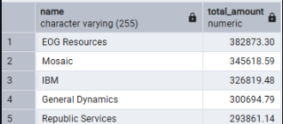
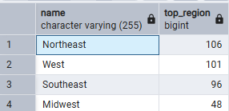
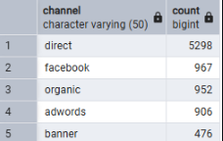
Project analysis slide 5
Project Analysis
TOP ACCOUNT WITH HIGHEST AMOUNT
REGION CONTAINING TOP ACCOUNTS
Top Channel used to place orders
382,873.30
106
DIRECT ORDER
Highest Amount Spender Company was EOG Resources
NORTH EAST.
Mostly orders are done by direct without using any channel

Slide 5
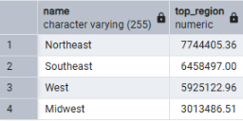
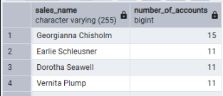
Project analysis slide 5
Project Analysis
TOP REGION WITH THE HIGHEST REVENUE
TOP SALES-REP WITH THE MOST ACCOUNT
7744405.36
GEORGIANNA

Slide 6
CONCLUSION
The analysis of Posey's accounts, revenue distribution, sales channels and the top performers shows the strengths and opportunities of the market to the CDE team.
The insights enable strategic decision-making by emphasizing on lucrative territories, customer needs, and growth leverages.
This gives the team the capacity to maximize on resources and foresee the strategies of the competitors.

Slide 7
Thank You

