Slide 1

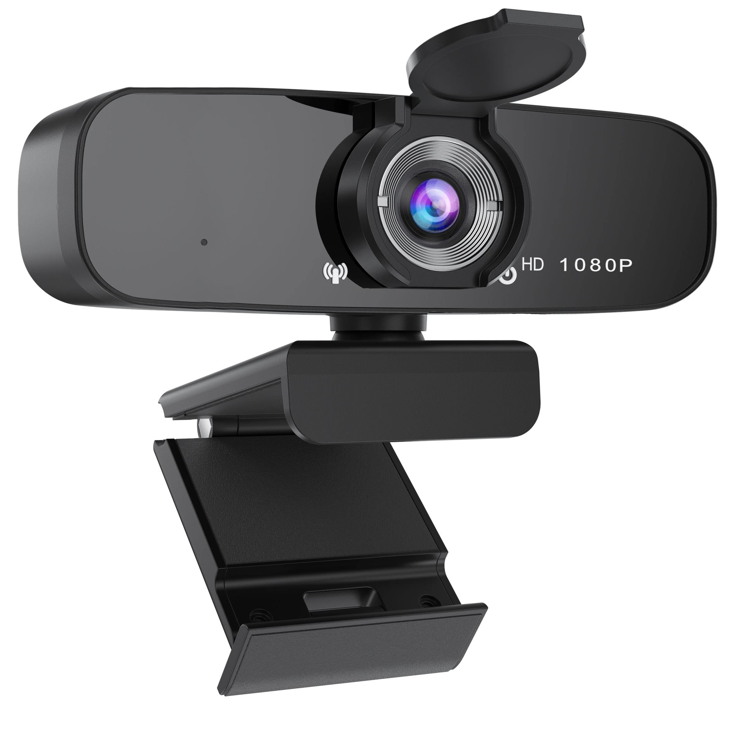
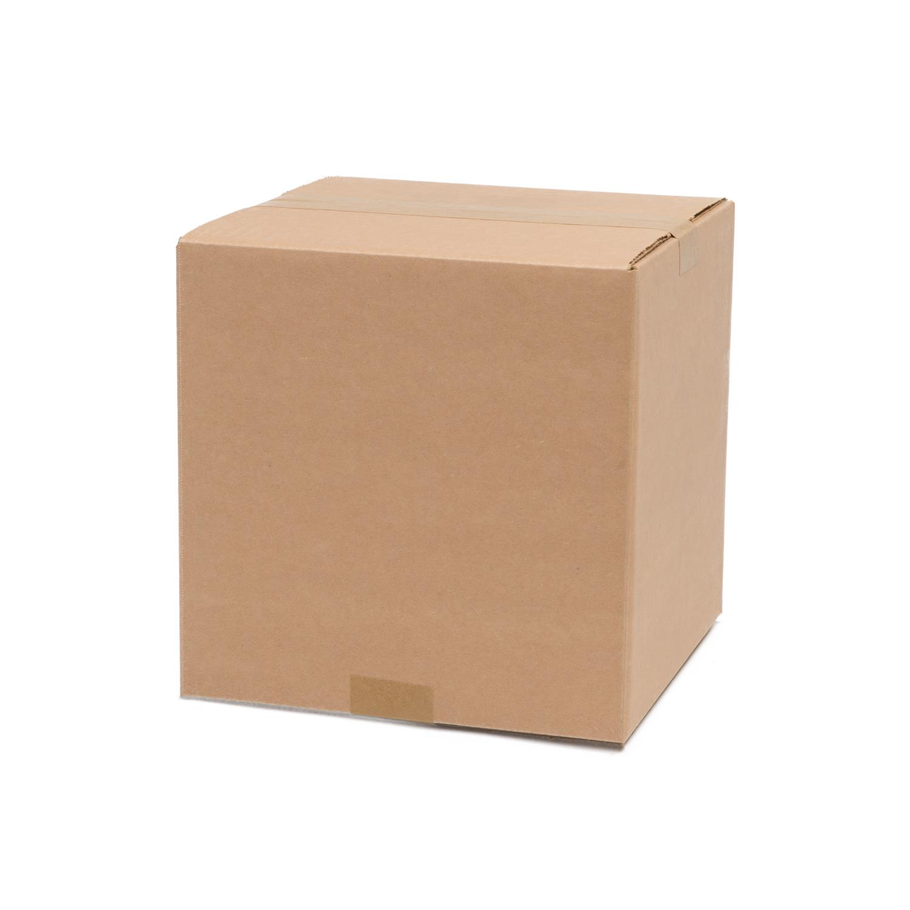
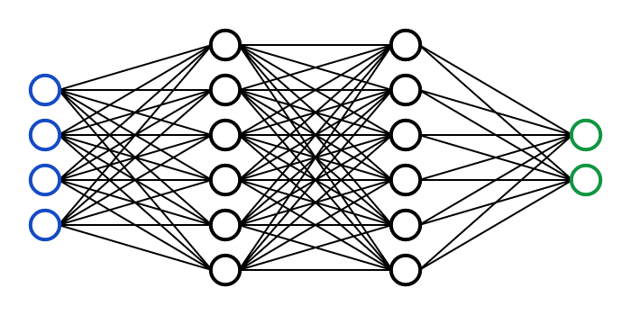
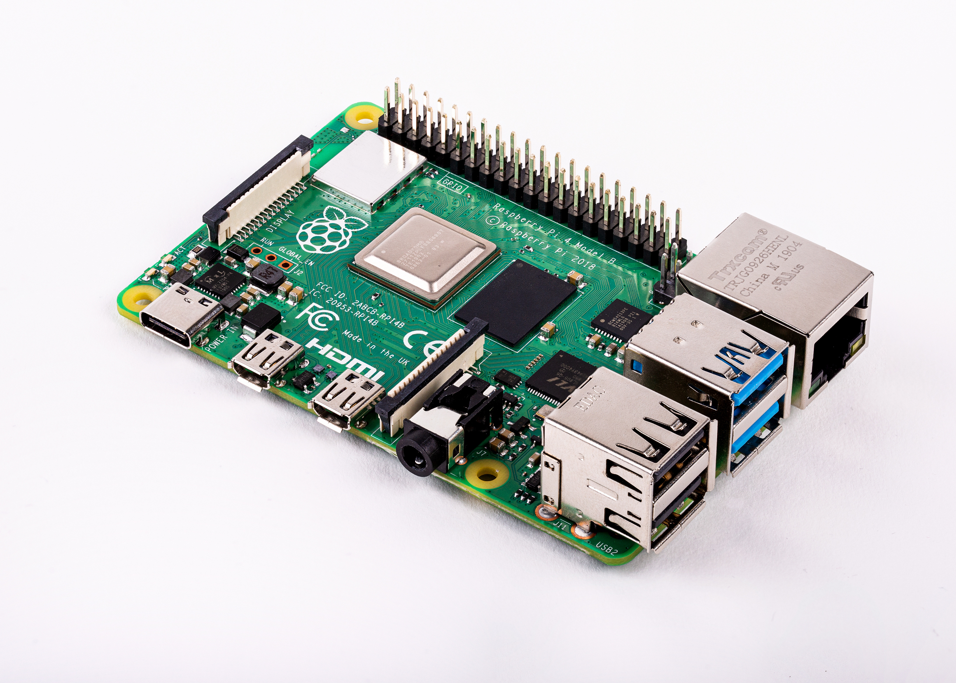
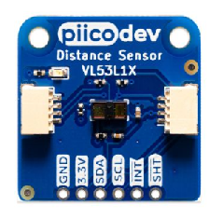
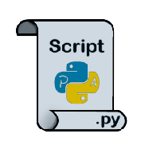
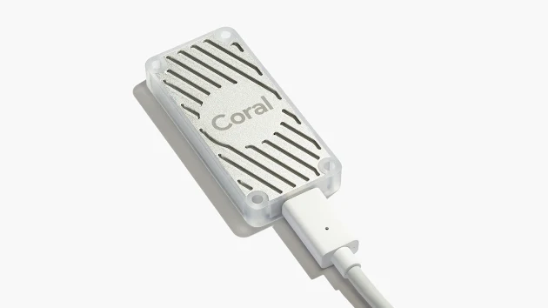
ERU High-Level Processing – Object Detection
Hardware/Software tools utilized
Raspberry Pi 4, HD USB webcam (CV2), Google coral edge TPU
Ubuntu 20.04, Google Colab, TFLite, LabelIMG, Python3.8
PiicoDev Laser Distance Sensor
Network
Efficientdet_lite_0(current), possibly 0~2 can be used.
Originally trained on COCO(Common Objects in Context) 2017 dataset, optimized for TFLite, designed for performance on mobile CPU, GPU, and EdgeTPU.
Retrained through Google Colab using custom dataset (hiker, package, cone, and box).
Implementation
Upon detecting obstacle, I/O signal is sent from inference python script
FPS(Frames per second) and Distance (in mm) printed on live camera screen
Signals will be packaged and interpreted via ROS

Slide 2
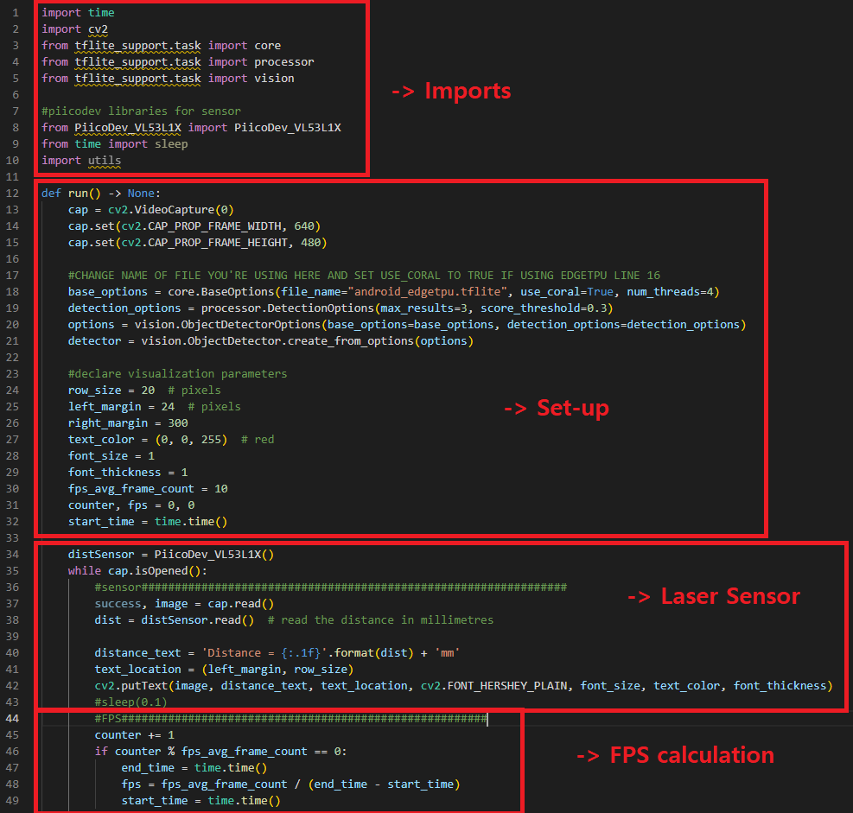
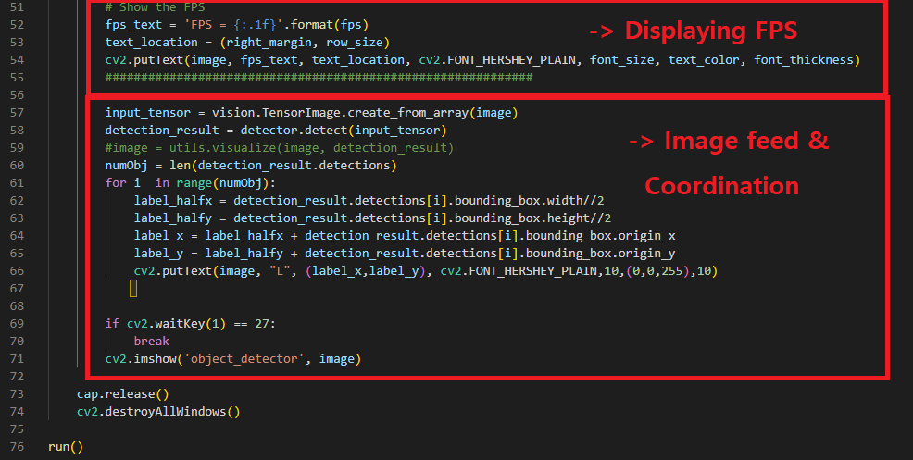
ERU High-Level Processing – Object Detection

Slide 3
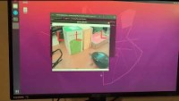
ERU High-Level Processing – Object Detection
Wireless Video Transmission using NDI
FPS measured: About 15~17, max 20
NDI Protocol Specifications
By default, it transmits using UDP
Many endpoints can watch the video source on the network
Utilizes mDNS (multicast Domain Name System) to allow for zero configuration discovery
Demo video Link:
https://youtu.be/-JaYwJnfG48

