Slide 1
Real-Time Detection and Tracking for Augmented Reality on Mobile Phones 应用于移动设备上的增强现实的实时监测与跟踪方法改进
常惠源 21551058

Slide 2
Outlines
Introduction
Nature Feature Tracking System
FAST detector
Adopted Trackers
Performance & Analysis
Conclusion

Slide 3
Introduction
Reason:
Limited performance on phones
(limited computational resources)
Leads to:
Natural feature tracking not feasible
(Needs long waiting time for large computation)
Goal:
Speed improvement
(enough speed for AR processing & displaying)

Slide 4
Natural Feature Tracking System
SIFT
Ferns
Both are accurate but not fast enough for phones
Need faster approach
New approaches are called:
PhonySIFT
PhonyFerns
Notes:
SIFT（scale invariant feature transform）: 尺度不变特征变换 一种检测图像关键点（key points , 或者称为图像的interest points(兴趣点) )， 并对关键点提取其局部尺度不变特征的描绘子， 采用这个描绘子进行用于对两幅相关的图像进行匹配（matching）。 目前， SIFT可以说是所有图像局部特征描述特征子 中最火的一个了。

Slide 5
Ferns
An keypoint tracker using statistical algorithm
and can be trained to get higher matching rate
As good as SIFT, or even better performance

Slide 6
Adopted Trackers
PhonySIFT (Refined from SIFT)
PhonyFerns (Refined from Ferns)
Patch Tracker (developed by authors)
Combined Tracking
PhonySIFT + PatchTracker
PhonyFerns + PatchTracker

Slide 7
SIFT to PhonySIFT
Changes:
Uses FAST corner detector to all scaled images to detect feature points instead of DoG
Only 3x3 subregions, 4bins each , creates 36 elements
Notes:
feature detection,
feature description and matching,
outlier removal, and
pose estimation.
特征点检测的一种方法——FAST（features from accelerated segment test）。很多传统的算法都很耗时，而且特征点检测算法只是很多复杂图像处理里中的第一步，得不偿失。FAST特征点检测是公认的比较快速的特征点检测方法，只利用周围像素比较的信息就可以得到特征点，简单，有效。

Slide 8
Ferns to PhonyFerns
Changes:
Uses FAST detector to increase detection speed
Uses 8-bit size to store probability instead of using 4 bytes float point value
Notes:
Feature Detection |Feature Classification and Training |Matching | Outlier Rejection
features from accelerated segment test FAST特征点检测是公认的比较快速的特征点检测方法，只利用周围像素比较的信息就可以得到特征点，简单，有效

Slide 9
PatchTracker
Both the scene and the camera pose change only slightly between two successive frames
New feature positions can be successfully predicted by old one.
Do not require a keypoint detection step. This makes the tracker faster.

Slide 10
Performance & Analysis
Platform:Asus P552W (Cellphone)
624Mhz CPU
240x320 screen resolution
No float point unit
No 3D acceleration
Platform:Dell Notebook (PC)
2.5Ghz , limited to use single core
With float point support

Slide 11
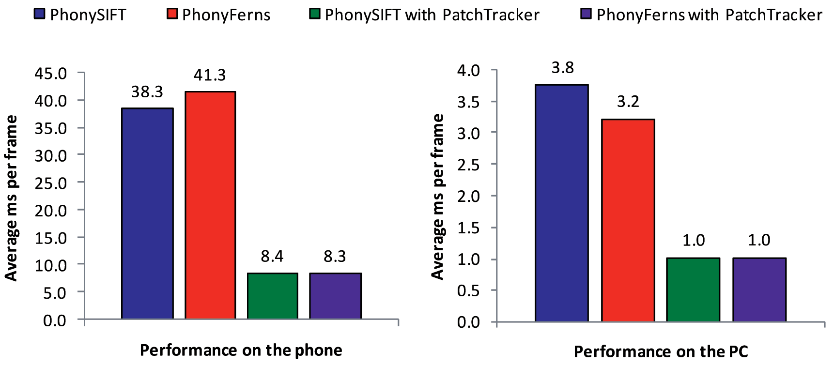
Performance & Analysis

Slide 12
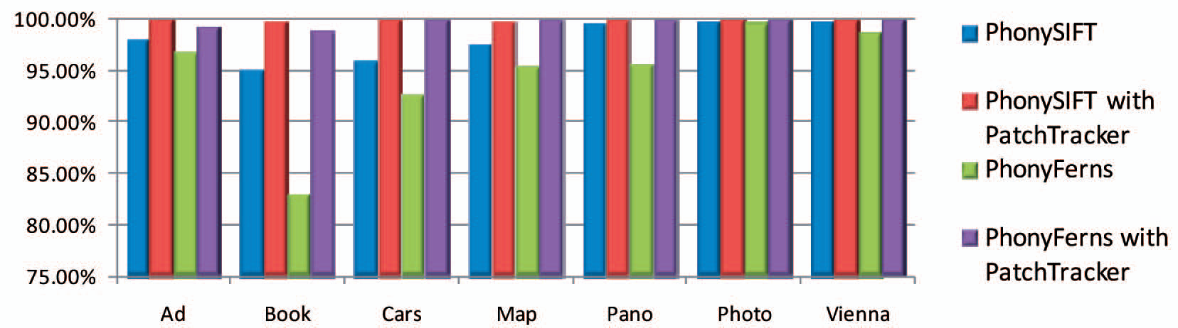
Performance & Analysis
Robustness results over different tracking targets

Slide 13
Conclusion
Successfully worked with tracking system on phones
In the future, faster CPUs could come, and the choice of next generation of tracking technique may be different, and may enable more expensive per-pixel processing

Slide 14
The End
Thank you

