Slide 1


Team 2
Job hunting Website----JobDB.com
Jivant
Annie
Jason
Cindy

Slide 2

Our Aims ---What are we going to do?
FOCUS ON IT Sector
We are the members in a research company
Our main clients : someone who would like to get into the IT sector
Our main goal : helping students to get into the IT sector
Looking for the demand for entry level job in the IT market
Looking for the qualification for landing an entry level job
Find the highest paid job in IT Sector
Notes:
We are the members in a research company and our main goal is to help our clients to get into the IT sector, especially for the fresh grad students who lack IT experience. We are also looking for the demand for entry level job, qualification and the highest paid job in IT Sector, to name but a few.

Slide 3

2. Business Value - How?
Provide information to University
info to government to help fresh grad and unemployees
e.g. Cyberport & Science park
info to Training Center
e.g. Xccelerate
info to Manpower Agents
info to Internships hunters
Notes:
Jason
As we’re mainly helping fresh grads and people who are unemployed want to get into IT sector, we provide information to different organisations like university and government to help the fresh grads and unemployees ,training center (e.g. Xccelerate), manpower agents, as well as internships hunters.

Slide 4
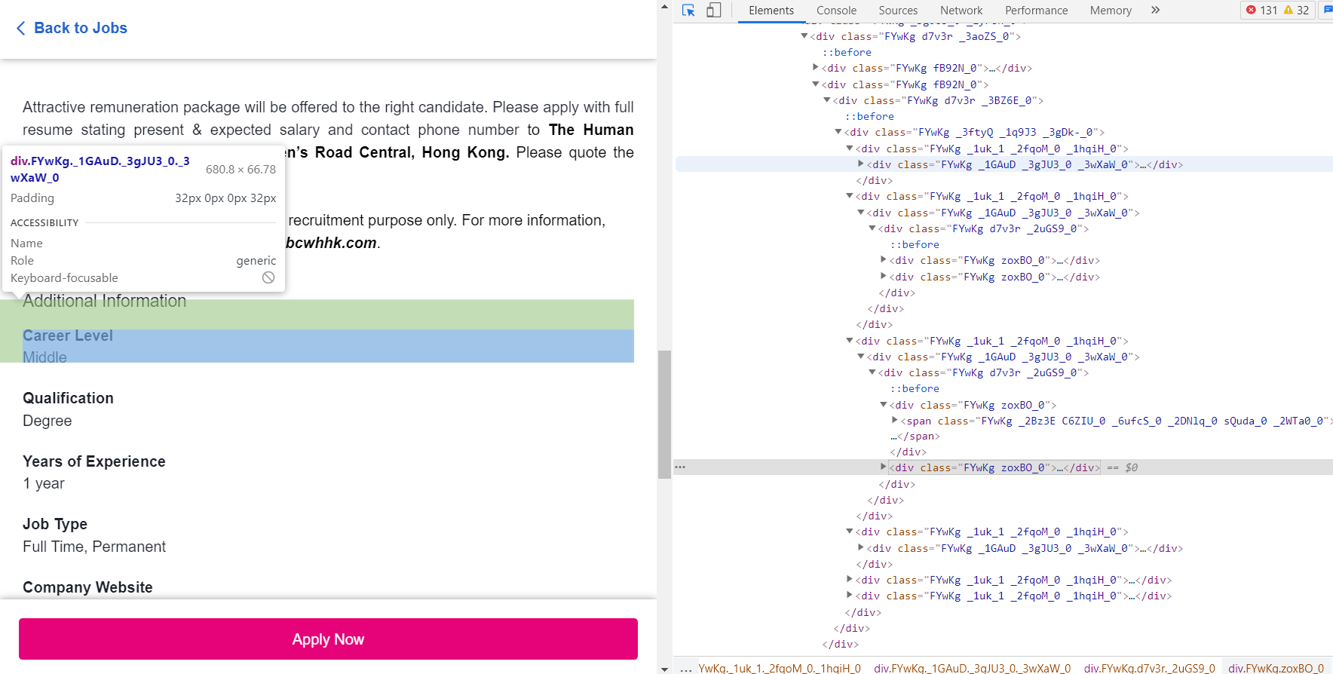
3. Data Collection
- Collecting the data by using web scraping, Beautiful Soup on the website on JobsDB.com
Notes:
Jivant

Slide 5
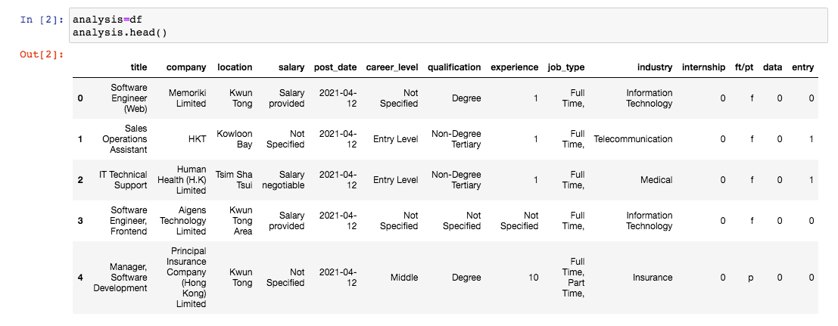
4.Data Cleaning/Preprocessing
Industry:
Eg, from (Education > Teacher, Education > Tutor / Instructor, Information Technology (IT) > Technical / Functional Consulting)
To (Education)
salary: extract only the numbers and find the average
Notes:
Annie: Regex,

Slide 6
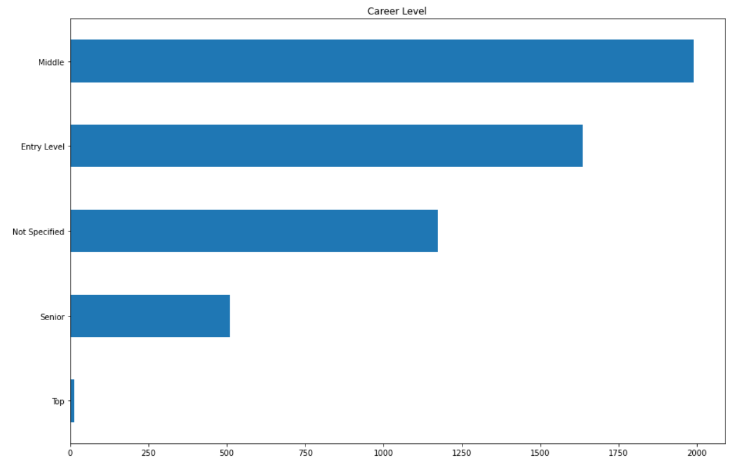
Q1. Find the job opening for different career level
Key point: middle level has the most openings but we should focus on the entry level
Carer level Findings:
Middle level jobs are highly advertised followed by Entry level
Top Level very few jobs
Notes:
Here's a bar chart, it shows all career levels that we can find in the website. For the "Not Specified" one, we could just ignore it because it couldn't provide us any information about the level. So we found that about 2000 of openings are in the middle level, which is the most. But as our objective is to nurture early talents, we have to focus on entry level itself.

Slide 7
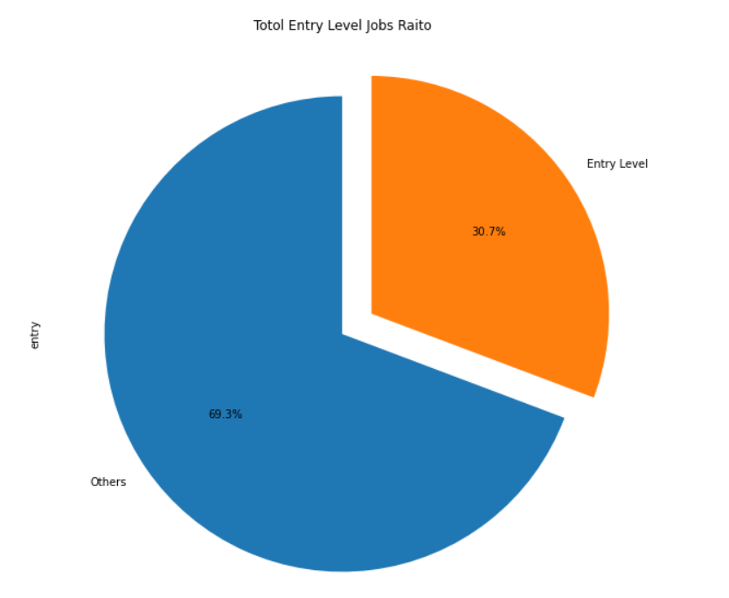
Q1. Find the job opening --- only for entry level
Entry level Jobs Findings:
entry level openings account for ⅓ out of the whole pool
Notes:
If we compare it with the whole pool, we would find that one-third of the openings are entry level, which is not bad and means that the business opportunities for us are still considerable.

Slide 8
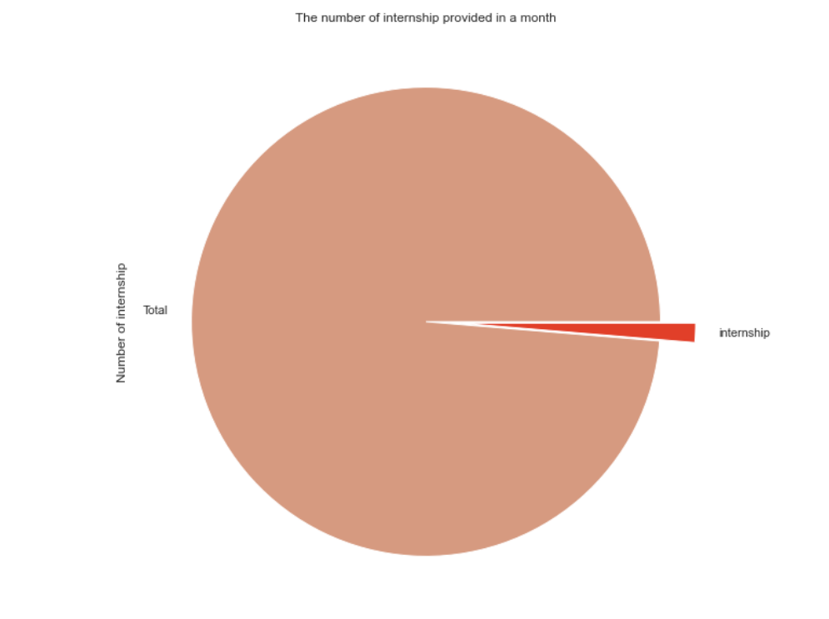
Q2. Find the number of internship
Internship Findings:
Companies post around 70 internship jobs in a month.
Notes:
IT sector provides ard 70 internship posts in 1 month.This is shown that IT sector provided internship opportunities for fresh grad and someone who are new to the IT sector.
This can help our clients (students in UNI and training centre) to have more practical opportunities before getting a full-time job.

Slide 9
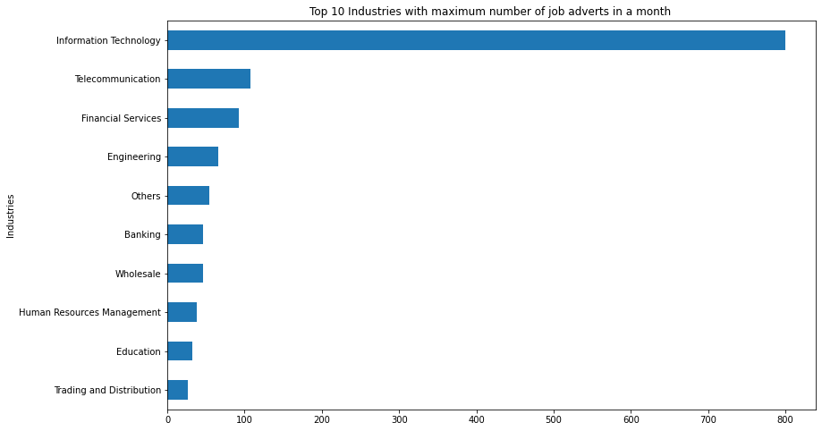
Q3. Find the Top 10 industries with maximum number of job adverts in a month
Hiring Industries Findings:
Maximum jobs advertised by I.T followed by Telecom, Education & Engineering
Notes:
Here's a bar chart, it shows that IT industry has the most job openings, which makes sense by nature, so we decide to focus on the top 10 industries which have high demand for IT talents except for IT industry. Then, we have Telecommunication, Financial Services, Engineering and so on, they're all posting more than 60 job ads related to IT within 30 days, which probably imply that these industries are facing not only digital transformation, but also IT talents shortage. Whatever the reason is, the fact remains that those 3 industries need early talent, and this is an opportunity for us to provide related job trainings or bootcamps.

Slide 10
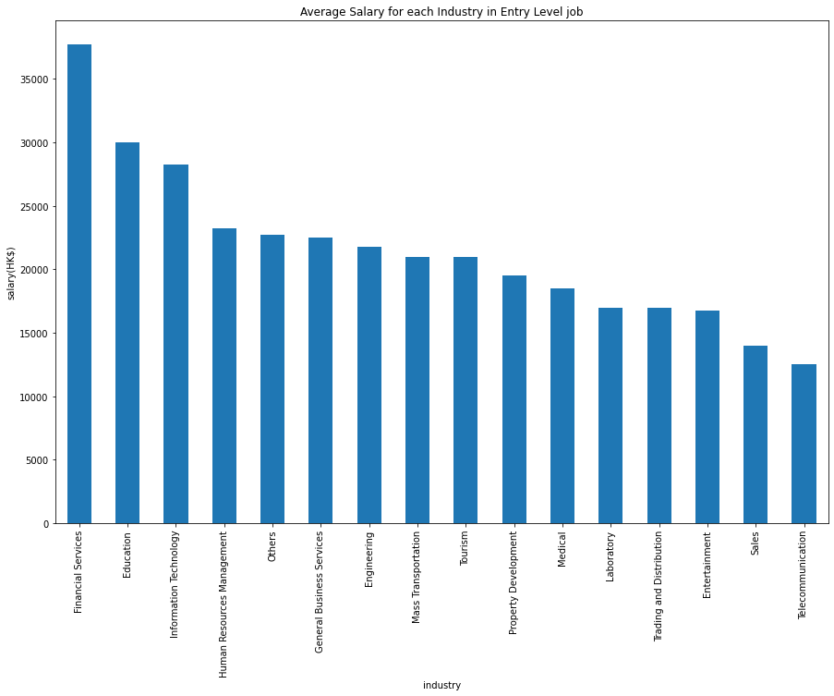
Q4. Average salary of entry level jobs in each industry
Salary Findings:
Financial services has the highest salary in entry level jobs
Followed by Education & IT

Slide 11
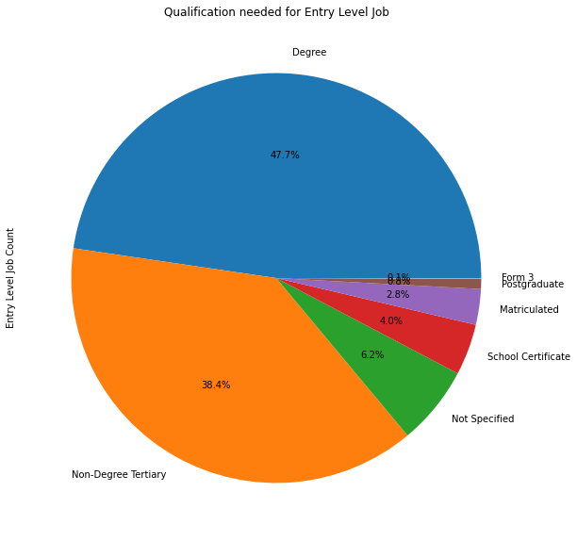
Q5. Find the qualifications requirement in an entry level job
Qualification Findings:
Having a degree is not a must , but training or education above diploma is required
Notes:
I may conclude, it is not a must to have a degree. Over 50% of jobs do not require the applicants to have a degree, having a diploma or training can help increase chance to be hired.

Slide 12
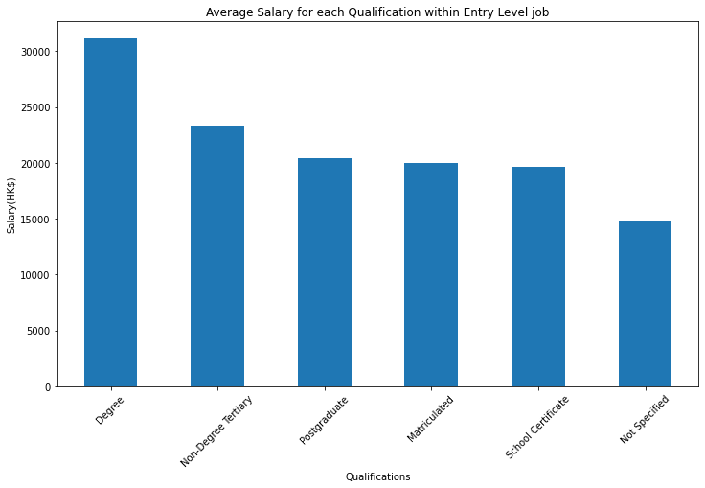
Q6. Average Salary of entry level jobs with different qualifications
Salary Findings:
Entry level jobs that require a degree tends to have higher salary
Notes:
Mainly compare degree and non-degree

Slide 13
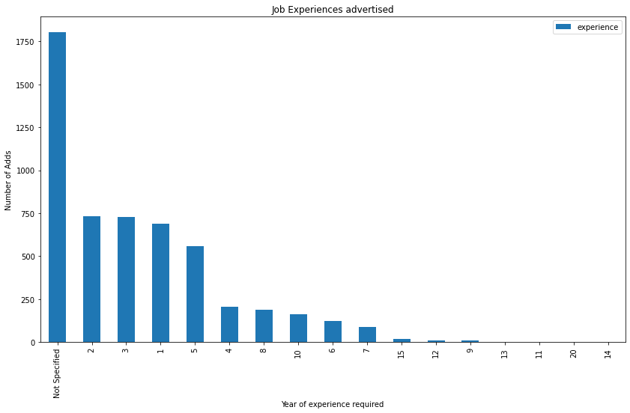
Q7. What is job market is looking for regarding experience?
Experience Findings:
Many companies don't specify
Very few jobs requiring experience above 10 years
Most jobs require 1-3 years experience

Slide 14
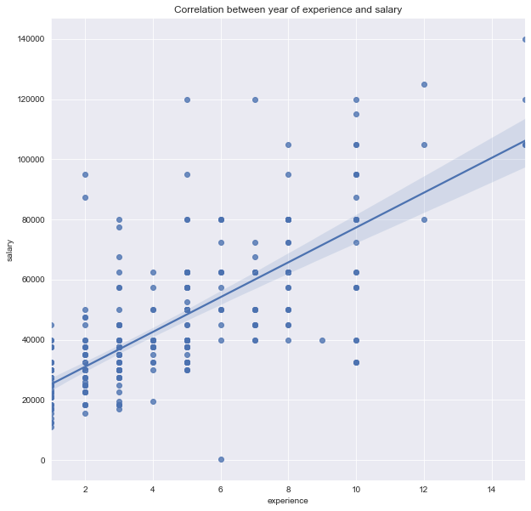
Q8. The correlation between year of experience and salary
Findings:
Growth of salary is directly related to experience.
We have 2 jobs that require 20 years of experience.
Chief Tech officers in financial services.

Slide 15
6. Challenges & Next steps
Not accessible to API for many websites
Some Values are missing or not specified
Values are not same eg. integers and Text in some columns
The result may not be representable as the sample size is small
Our next steps:
To find out more jobs in different websites
Improve our codes and analysis
Notes:
When we were doing the data collection, it is hard to find the complete data since we were not able to access the API of many websites, especially for JobsDB.com. During the data cleaning process, many values are missing and not the same. The result will be not really representable sometime.

Slide 16
7. Conclusion
For Entry level job in the IT sector we found out that Trainings or education above diploma is recommended
Information Technology, Telecommunication, Financial Services are the Top 3 industries with most of the entry level jobs opening
Financial Services, Education, IT are Top 3 industries that have the highest salaries in entry level
Candidates with a degree tends to have higher salary
Most entry level jobs requiring 1-3 years of experience

