Slide 1
Detecting Environmental Noise and Mapping
by Team G College of Information Science and Engineering Ritsumeikan University

Slide 2
Agenda
Problem formulation
Suggested approach
Project Schedule

Slide 3
Problem formulation
What is noise pollution?
The severity of noise pollution in Japan
Current market structure and problem

Slide 4
Suggested approach 01
Target customer
Policy makers, city architects
Measurement range
Road traffic noise and Railway noise
Measurement method
Use object’s phones to collect sound and location data
Use sound sensors and GPS module to feed data to a microcontroller
Measurement indicator
Noise indicators (L_{den} and L_{night})
Data processing method
Collect data via object’s phones, micro computer
Data transfer via Cloud computing
Data analyzation and visualization using GIS program

Slide 5
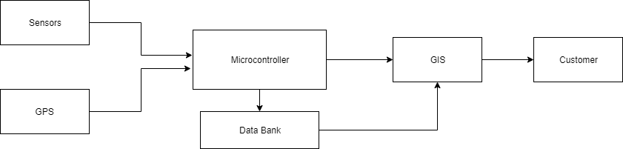
Suggested approach 02
System diagram

Slide 6
Suggested approach 03
Use case diagram

Slide 7
Suggested approach 04
Context diagram

Slide 8
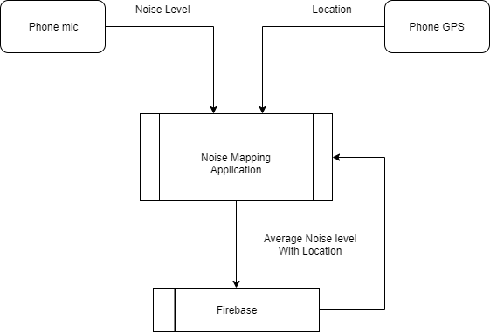
Suggested approach 05
Prototype A (application)
Notes:
Records sound over a period of time
Get average in decibels
Save location
Data saved in firebase
Display the sound levels at a particular location

Slide 9
Suggested approach 06
Prototype B (Microcontroller)
Raspberry pi collects data from sound sensors and GPS module
Latitude, longitude and loudness in decibels is exported to a csv file

Slide 10
Suggested approach 07
Prototype C (Mapping software)
A geographic information system software is used for mapping
Produce maps and graphically displays geographic information
Uses the csv file to map the data collected

Slide 11
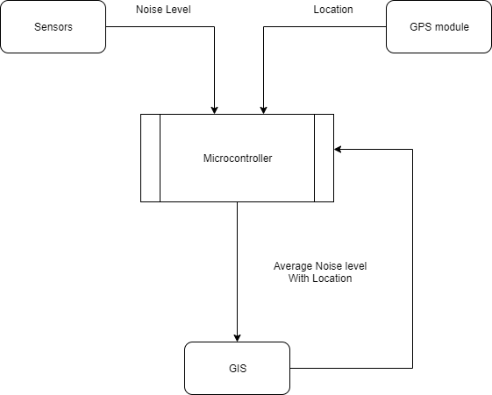
Suggested approach 06 & 07

Slide 12
Project Schedule
 | WEEK 12 | WEEK 13 | WEEK 14 | WEEK 15
Prototype B (Micro computer)
Prototype C (Mapping)
Documentation
Poster
Presentation

Slide 13
Thank you
Q & A -
College of Information Science and Engineering Ritsumeikan University

