Slide 1
Project 3: Cache Design
[SCE212]
Dec 6, 2018
CSL @ AU
Wonkyo Choe

Slide 2
Cache
What is a cache?
https://lwn.net/Articles/252125/

Slide 3
Cache
Tag: used to compare with the value of the tag field of the cache
Associativity: A cache that has fixed number of locations
Block: Cache block

Slide 4
Policy
Write Back
Writing is done only to the cache. The write to the backing store is postponed until the modified content is about to be replaced by another cache block.
Write-allocate
Data at the missed-write location is loaded to cache, followed by a write-hit operation.
LRU (Least Recently Used)
Replace the oldest entry

Slide 5
Example
Capacity: 8KB (8192B)
Associativity: 2 way
Block size: 32B
Set?
128 sets = 8192 / (32B * 2 way)
Block offset: 5bits (2^5 = 32)
Index: 7bits (2^7 = 128)
Tag: 20bits = 32 - (5 + 7)

Slide 6

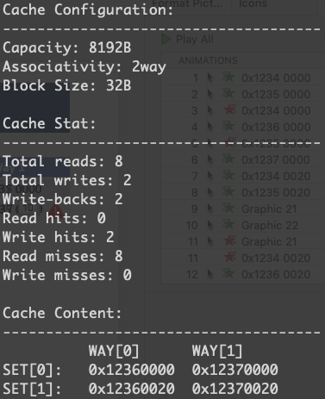
Example
Operation | Address
Read | 0x1234 0000
Read | 0x1235 0000
Read | 0x1236 0000
Read | 0x1237 0000
Read | 0x1234 0020
Read | 0x1235 0020
Write | 0x1234 0020
Write | 0x1235 0020
Read | 0x1236 0020
Read | 0x1237 0020
Set | Way 0 | Way 1
0
1
0x1236 0000
0x1237 0000
0x1234 0000
0x1235 0000
0x1234 0020
0x1237 0020
0x1236 0020
0x1235 0020

Slide 7
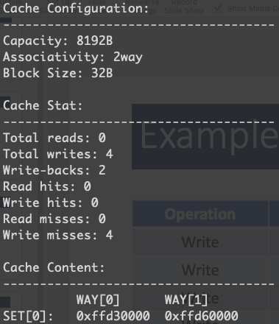
Example – Only Write
Operation | Address
Write | 0xFFC1 0000
Write | 0xFFC2 0000
Write | 0xFFD3 0000
Write | 0xFFD6 0000
Set | Way 0 | Way 1
0
1
0xFFD3 0000
0xFFC1 0000
0xFFC2 0000
0xFFD6 0000

