Slide 1
#GOALS
Tacofest
Okori Sanipe 100884359
Tahani Alharbi 100878661
Chola Chikolwa 100985505
Ugochinyere Okehi 100906729

Slide 2
The Goal
To allow students to be able to visualize their progress in all their courses
Have students manage their time better
Tell students what is required of them to reach their goals
How?
Students enter class times, office hours and passing/desired grade
We set alerts, calculate how well students are achieving their goals and manage the changes that they make to their account

Slide 3
Functional Requirements
Students must be able to:
Add course profile (add course info and desired/passing grade)
Remove course profile
Manage course profile (add/edit/delete grades)
View their progress and what grade must be achieved on future coursework to reach their goal
Manage their schedule (add/edit/delete different school related events)

Slide 4
Non-functional Requirements
Usability
Clear naming convention
Visually appealing and clutter-free design
Provide help/about tabs
Efficiency
Make calculations quickly
Show views quickly

Slide 5
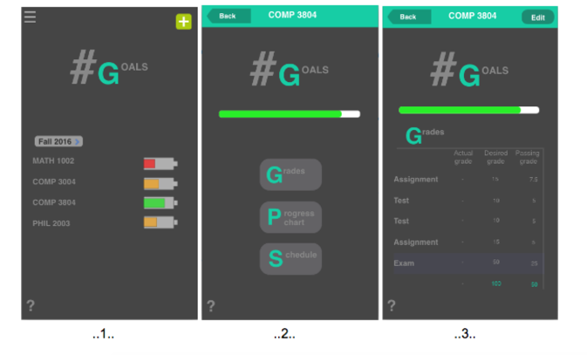
Use Case

Slide 6
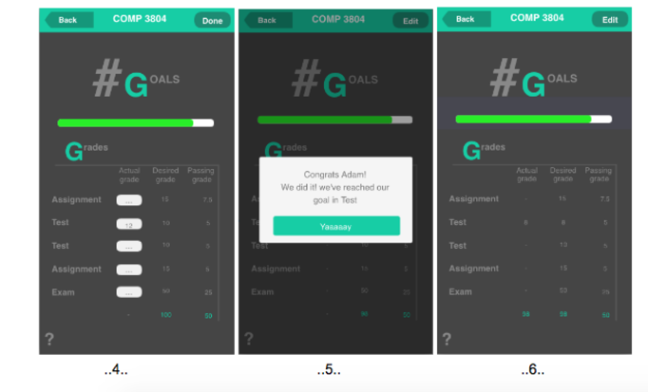
Ruby Notification

Slide 7
System Architecture
Where Architecture is in the Development life cycle
First step after thorough requirements document
Difference between style and pattern
Style: language, Pattern: class arrangement
Distinction between prescriptive and descriptive
Prescriptive: Object-oriented
Descriptive: Implicit Invocation - Events based & Blackboard
Process of discovering style
Clustering finding interactions between components

Slide 8
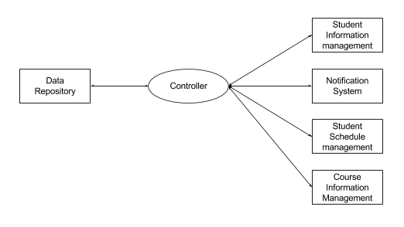
Blackboard Architectural Style
Data-driven
Components are separate and access data source individually are all connected through controller

Slide 9
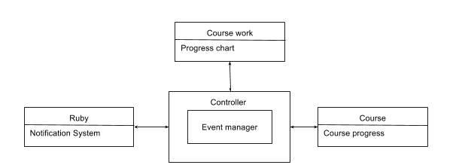
Events-Based Architectural Style
Motivated by all events that are not initiated by the user but are handled by the app in the background through the controller
Explain what components do

Slide 10
Design Pattern
SINGLETON:
Used with the database.
one consistent copy of all the database.
ensures that no extra space is used.

Slide 11
Design Pattern
BLACKBOARD:
allows us to validate and update our database as the student enters their personal and course information.
coupling is minimized.
will be beneficial when making future adjustments.

Slide 12
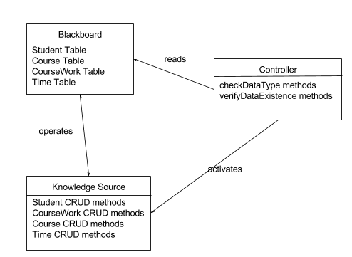
Design Pattern
BLACKBOARD:

Slide 13
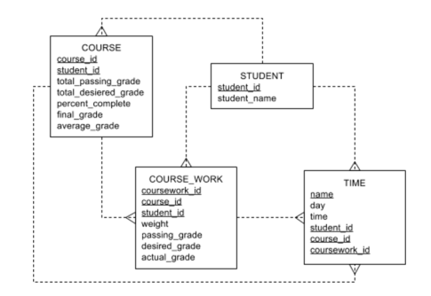
Database Schema
Android built in SQLite

Slide 14
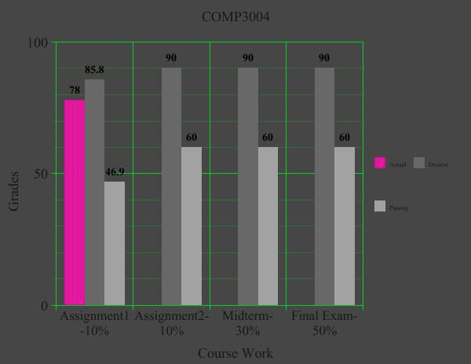
External API
Graph MPAndroidChart by PhilJay

Slide 15
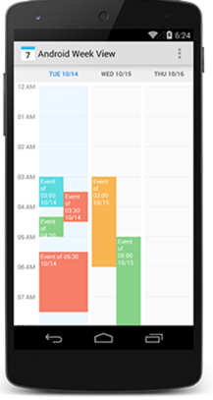
Schedule
alamkanak/Android-Week-View

Slide 16
Difficulties/ Challenges: Things you should know
Choosing between observer design pattern and blackboard design pattern
All data/code is on the client, we have no server code
Lack of mobile app experience

Slide 17
Possible additions to #Goals
Ability for students; who use the app, to view other students courses and grades
Ability to add Professors as the Admin managers who manage the courses in the system
Ability for students to add a more flexible schedule

Slide 18
ROLES
Tahani
Design interface, grades detail, edit grades, Ruby (notification system), LaTeX document editing, and creating diagrams.
Chola
Strategy, presentation preparation, code checks/debugging, refactoring, naming, student profile, battery, finding resources to further knowledge of android studio and mobile development
Ugochi
Database, Progress report showing the graphs, the course, enter actual grade, course Profile, logic of displaying and editing the grades, edit and delete student, course and course work
Okori
Strategy, presentation preparation, EnterAssign, EnterOffice, Course, LaTeX document editing, schedule.

