Slide 1
Poster presentation
Dr. purna gamage

Slide 2


Slide 3
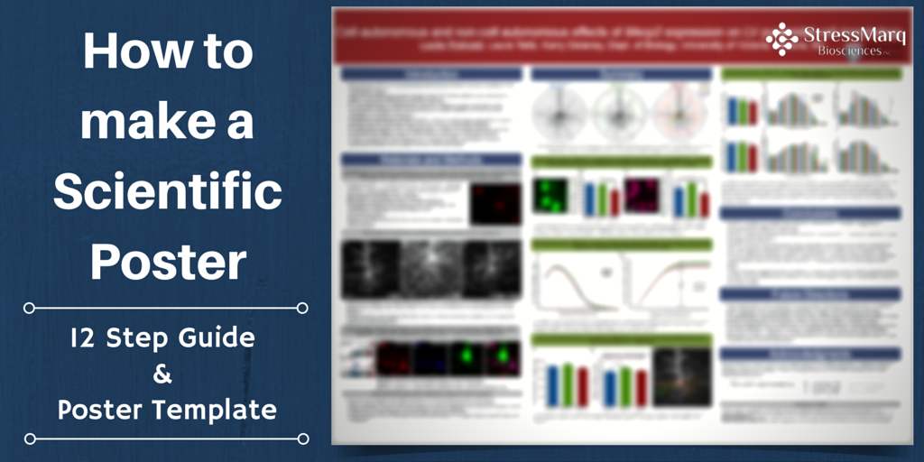

Slide 4
Good example

Slide 5
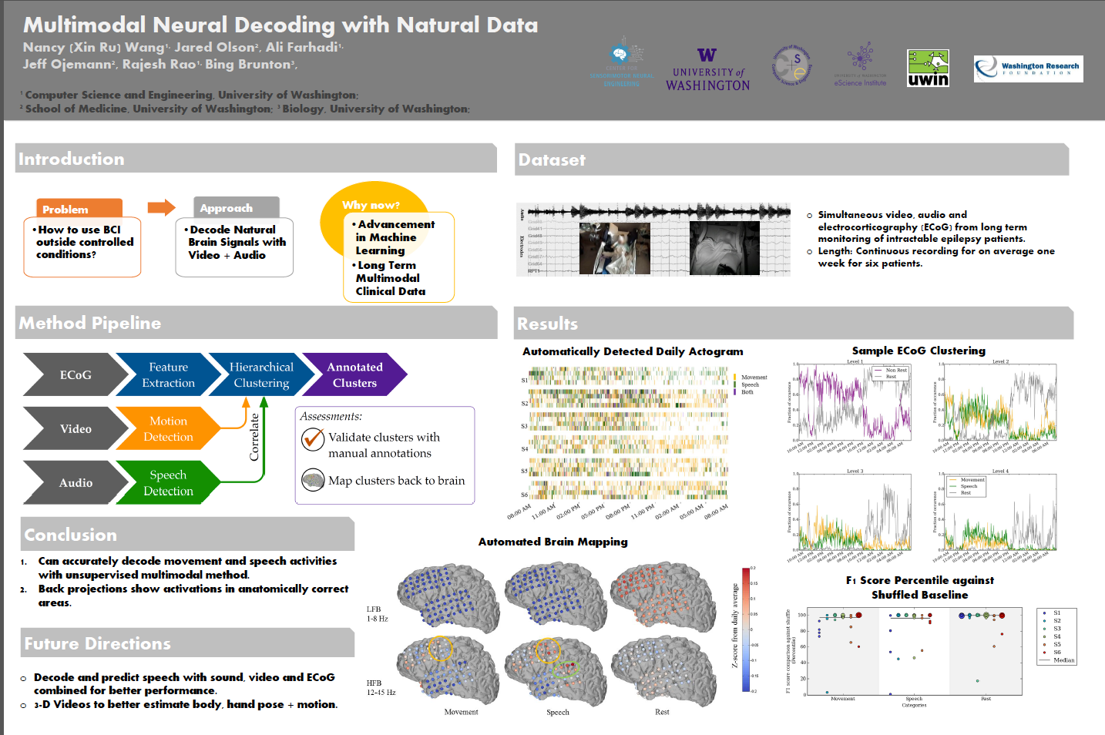

Slide 6
bad example

Slide 7
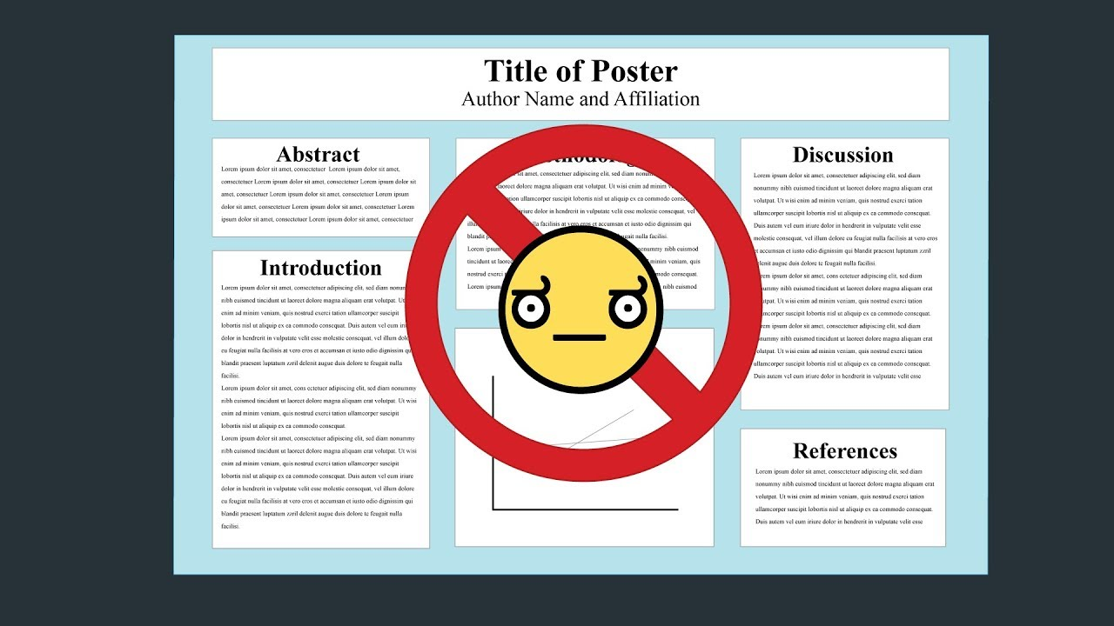

Slide 8
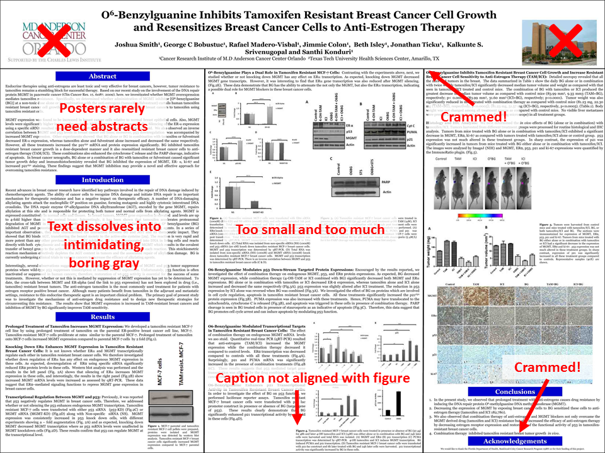

Slide 9
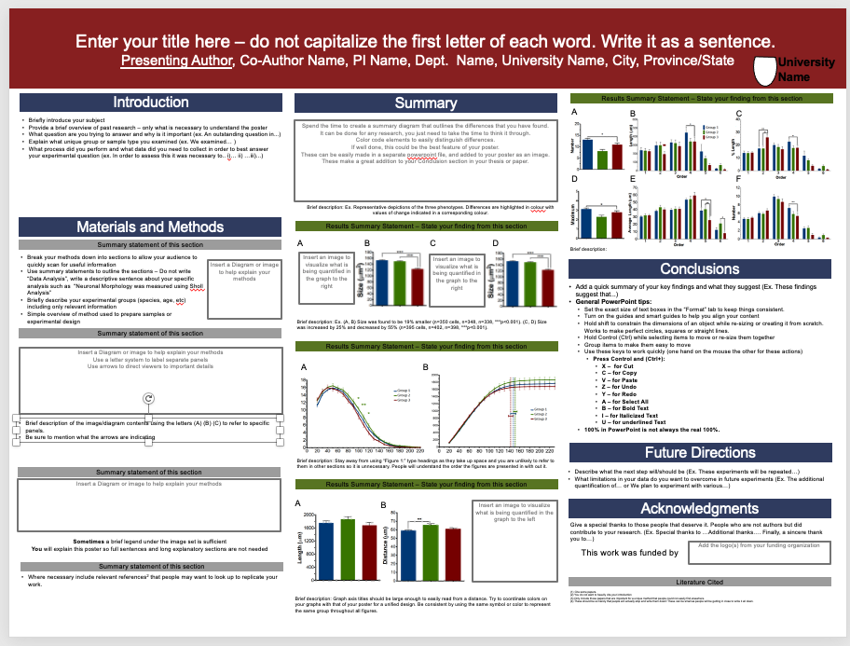

Slide 10
guidelines

Slide 11
Scientific Poster Guidelines
A. Title – Write It As A Sentence. Do Not Capitalize The First Letter Of Each Word.
B. Introduction – Be Brief And Only Include Essential Information. C. Methods – Break It Into Subsections With Vizs Or Diagrams. Or Use A Flow-chart. D. Results – Break It Into Subsections With Headers - Summarizing The Key Findings E. Discussion/Summary – Make A Diagram Outlining The Major findings
F. Conclusions/Future Directions – A Few Brief Bullet Points Will Bring Home Your Message. G. Literature Cited – Only Include A Few Key Citations From Your Introduction Or Methods. H. Acknowledgements – Thank The People That Deserve Thanking. Include Funding Agency Logos Here.
Reference

Slide 12
Scientific Poster Guidelines
2. Create a title that can be easily read from a few feet away.
Use A Sans-serif Font (Arial, Calibri) In Bold. These Are Easier To Read For Large Titles.
3. Use columns to organize your information, not rows.
Depending On The Size Of Your Final Poster, You May Want 3-4 Columns.
4. Use large headers to outline sections and break-up text.
Reference

Slide 13
Scientific Poster Guidelines
5. Use bullet points.
Be Brief With Your Text. Less Is More. Bullets Should Not Run More Than 2-3 Lines.
6. Do not use a busy background.
Stick With A Simple White Or Solid Color Background. You Do Not Want To Distract From Your Data.
7. Use black or dark font.
Stay Away From Colored Text As It Is Difficult To Read.
8. Add lots of images/ data Visualizations.
If You Are Getting Into More Than 4-5 Lines Of Solid Text, Stop And Think About How You Could Summarize This Better With A Diagram Or Image.
Reference

Slide 14
Scientific Poster Guidelines
9. Your graphs should be simple,
With Axis Titles That Are Legible From A Reasonable Distance (Ie. 2-3 Feet). Remove Any Background Or Gridlines As They Obscure The Data.
10. Export your images as png files and at the desired resolution.
Do Not Resize Them Drastically Inside Your Poster Making Program.
11. View your poster at fullsize on your screen,
Carefully Checking Out All Images And Text Regions To Make Sure They Are Not Pixelated.
12. Have a quick summary ready for when people ask “so what did you do here?”
Reference

Slide 15
The poster design needs to be attractive, uncluttered and easy to read for this to work.
Reference

Slide 17
Please Watch this nice video!!!!
Click here

Slide 18
Free templates
https://www.posterpresentations.com/free-poster-templates.html

Slide 19
Case study
https://towardsdatascience.com/spotifys-this-is-playlists-the-ultimate-song-analysis-for-50-mainstream-artists-c569e41f8118

