Slide 1
De Bruijn Sequences
Define an alphabet A consisting of k elements
E.g. A={0,1} , A={a,b,c}, A= {图，论，很，好，玩}
K=2，K=3，and K=5 in the preceding example
Consider the possible subsequences of length n that can be created using the defined alphabet
E.g. Let n=2 A={0,1}
We have 4 possible subsequences
10,01,11, and 00

Slide 2
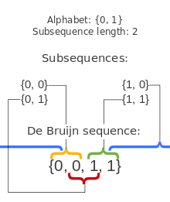
De Bruijn Sequences
A De Bruijn Sequence B(k,n) is a cylic sequence of an alphabet A (that consists of k elements ) in which EVERY possible subsequence of length n appears as a sequence of consecutive letters EXACTLY once.

Slide 3
De Bruijn Sequences
Note that these sequences are cyclic and hence {0011}= {1001} = {1100} = {0110}. Hence we consider the sequence as a loop and it doesn’t matter which element of the loop we consider to be the first one
This does not mean that De Bruijn sequences are unique in fact there can be numerous De Bruijn sequence B(n,k), but none of which are created by picking a different starting element in a loop of an existing one

Slide 4

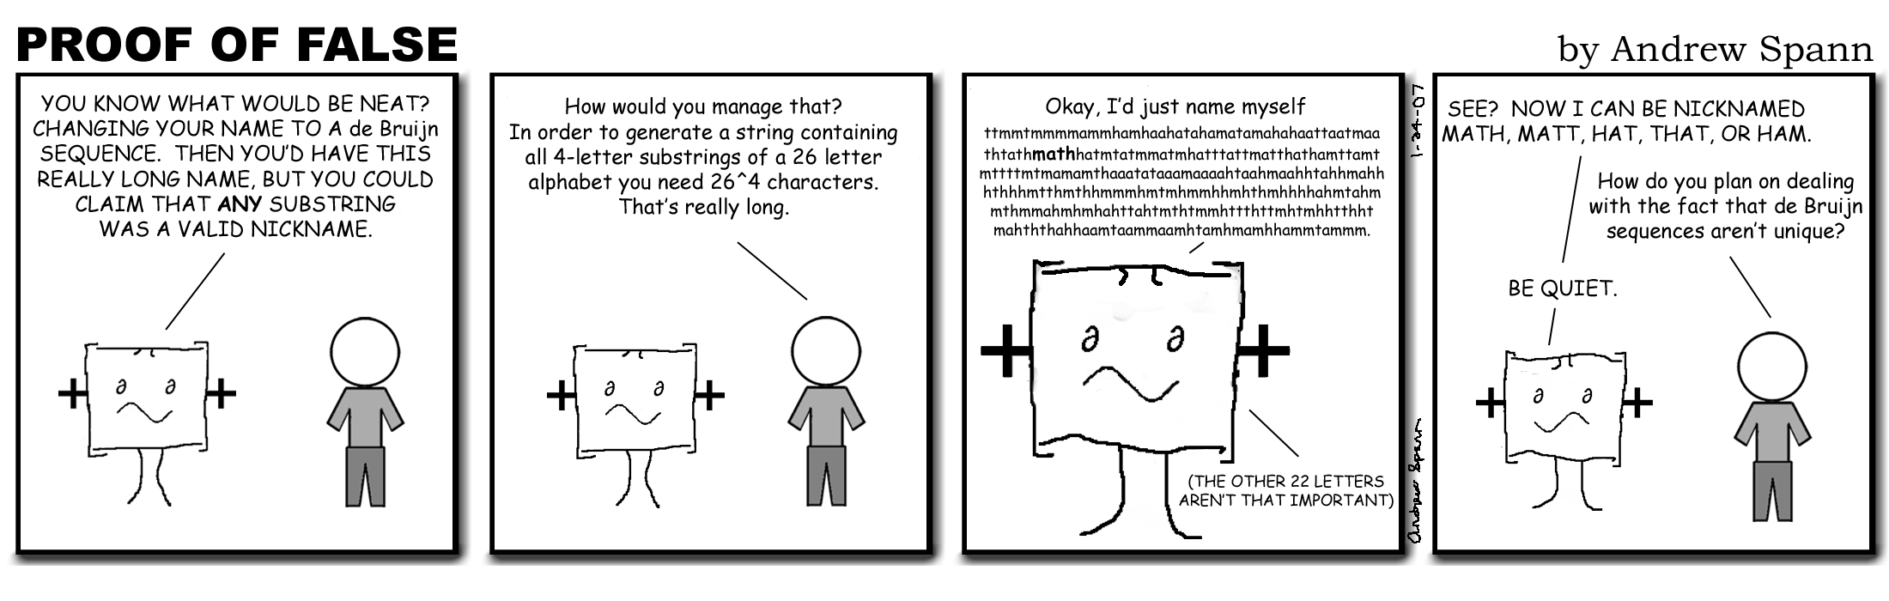

Slide 5
De Bruijn Sequences
The earliest examples of De Bruijn sequences appear in Sanskirt prosody
They were used by the prosodists to memorize the names of three letter patterns of long and short letters in “Pingala’s Chandah Shaastra”
Hence they were studying a De Brujin sequence B(2,3) with A={L,S} (long and short)
Note: prosodists were those who studied the metrical structure of verse
Pingala’s Chandah Shaastra was a famous book on prosody

Slide 6
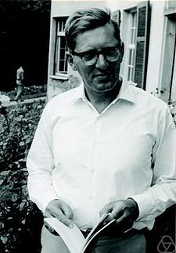
De Bruijn Sequences
Though the name De Bruijn is attached to these sequences due to his proof of K. Posthumus' conjecture in 1946, in 1975 he acknowledged that priority in this proof belonged to C. Flye Sainte-Marie, who had independently published it in 1894

Slide 7
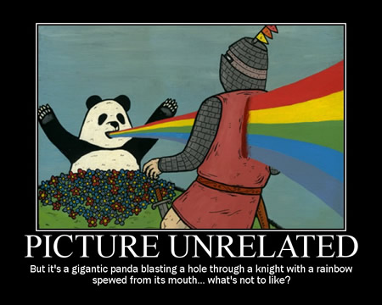
De Brujin Sequences
Important Theorems:
Each De Brujin sequence B(k,n) has length K^{n}.
There are K!^{k^(n-1)}/K^{n} distinct De Brujin sequences B(k,n)

Slide 8
De Bruijn Sequences
A De Bruijn Sequence can be constructed by taking an Eulerian Cycle of a (n-1) dimensional directed De Bruijn Graph.
An Eulerian cycle is a cycle that starts and ends on the same vertex and visits every edge exactly once
Hence each vertex would represent a different (n-1) sequence of the k elements and each edge would represent one of the k elements in the alphabet. The set of all vertices represent all (n-1) combinations of the k elements, and each vertex has in degree and out degree equal to k.

Slide 9
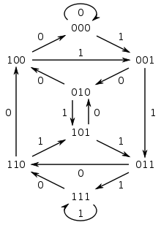
De Bruijn Sequences
Consider constructing a B(2,4) De Bruijn sequence of length 2^4=16. Let A={0,1}. Suppose we take the Eulerian path (000, 000, 001, 011, 111, 111, 110, 101, 011, 110, 100, 001, 010, 101, 010, 100, 000)

Slide 10
De Bruijn Sequence
Finding the De Bruijn Sequence:
Taking the loop from 000 to 000 =>0000 is in the sequence
Taking the 1 edge from 000 to 001 => 0001 is in the sequence => sequence hence far=00001
Taking the 1 edge from 001 to 011 => 0011 is in the sequence => sequence hence far= 000011
Taking the 1 edge from 011 to 111 => 0111 is in the sequence => sequence hence far = 0000111

Slide 11
De Bruijn Sequences
Continuing with this process until we come back to 000 we end up with the De Bruijn sequence 0 0 0 0 1 1 1 1 0 1 1 0 0 1 0 1. Finding all Eulerian cycles in this graph and applying this method will find us all De Bruijn Sequences

Slide 12

De Bruijn Sequences
De Bruijn sequences have many real world applications including:
Digital door locks
Used in neuroscience
Chess Programming
Laser Technologies

