Slide 1
DP
DevPulse
Version 1 project presentation
IT diagnostics, testing, and developer focus in one web workspace
V1
Built with .NET 9 and Blazor Server
Notes:
Open by introducing DevPulse as a personal IT operations workspace. Version 1 combines system diagnostics, network tools, website testing, API checks, and a developer wellness area. Source: project README and running application.

Slide 2
CREDITS
Project creators
DevPulse Version 1
Student team
Project advisor
Student 1
________________________________
Advisor
________________________
Student 2
________________________________
Replace each blank line with the correct name before presenting.
Student 3
________________________________
DevPulse Version 1
02
Notes:
Replace the three student blanks and the advisor blank before presenting. In PowerPoint, open slide 2, click a blank line, and type the name over the underscores.

Slide 3
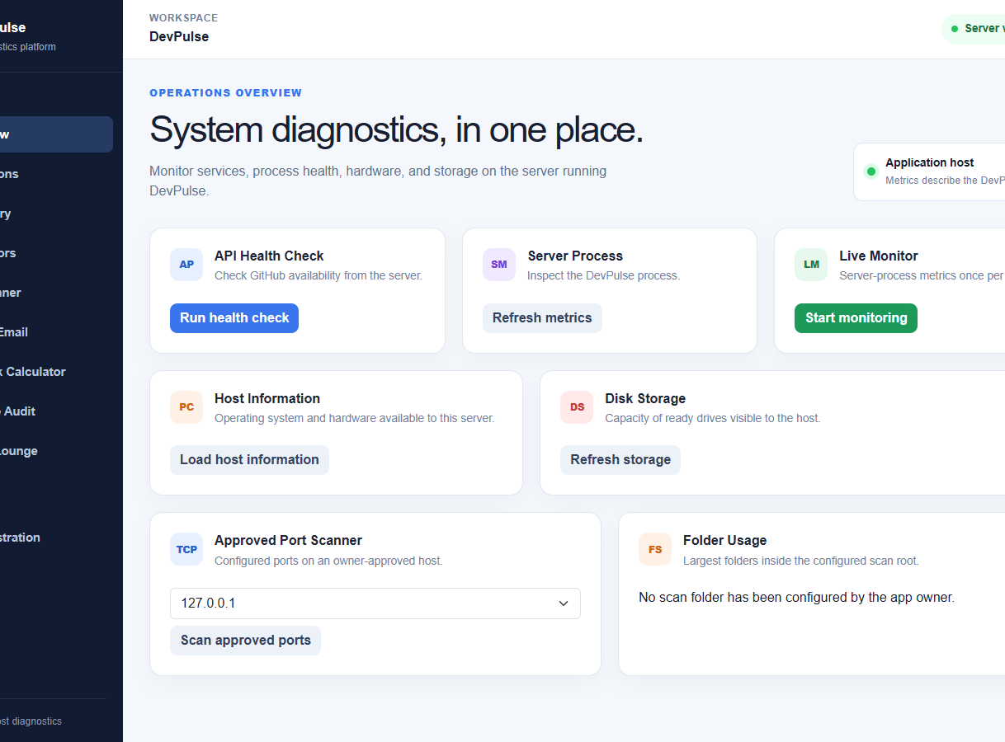
PURPOSE
The project goal
Developers often switch between operating system tools, network calculators, API clients, website auditors, and music applications.
DevPulse brings these tasks into one controlled browser workspace. The application emphasizes bounded tests, clear ownership checks, and results that are easy to demonstrate.
One workspace for day-to-day IT checks
DevPulse Version 1
03
Notes:
Frame the problem as tool switching and fragmented evidence. DevPulse does not replace enterprise monitoring. It gives students, developers, and small teams one place to run bounded checks and understand what the server sees.

Slide 4
PRODUCT
Version 1 scope
OBSERVE
Host metrics, storage, processes, telemetry, incidents
TEST
Ping, DNS, TLS, ports, databases, websites, APIs
INSPECT
JSON, JWT, SHA-256, encrypted files, DNS email policy
PLAN
IPv4, IPv6, VLSM, routes, bandwidth, MTU and MSS
FOCUS
Timer, breathing, ambient sound, reflection, Spotify
The same navigation supports technical demonstrations and daily use.
DevPulse Version 1
04
Notes:
Use this slide as the feature map. Avoid reading every item. Pick one example from each row, then transition into the architecture and live screens.

Slide 5
DESIGN
Application architecture
System and storage
.NET 9 Blazor Server
Runtime metrics
Processes and files
Browser
Interactive Blazor circuit
User actions and live updates
Razor components
Application services
Safety validation
Approved services
Websites, APIs, DNS
Spotify and OTLP
Encrypted session state and bounded telemetry journals use the configured data directory.
DevPulse Version 1
05
Notes:
Explain that Blazor Server executes diagnostics on the machine hosting DevPulse. A Render deployment therefore reports Render's container, not the visitor's computer. External requests pass through validation and bounded HTTP clients. Sources: Program.cs, PublicHttpTarget.cs, TelemetryService.cs.

Slide 6
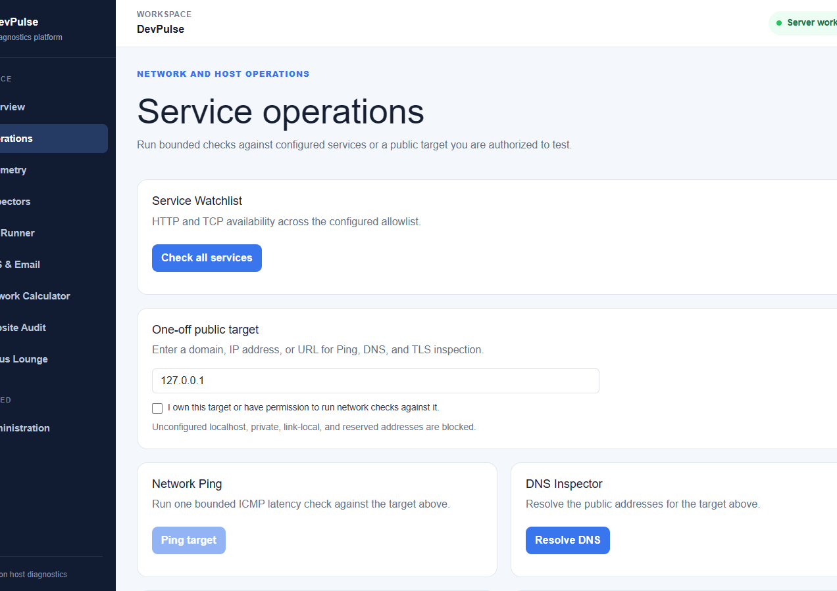
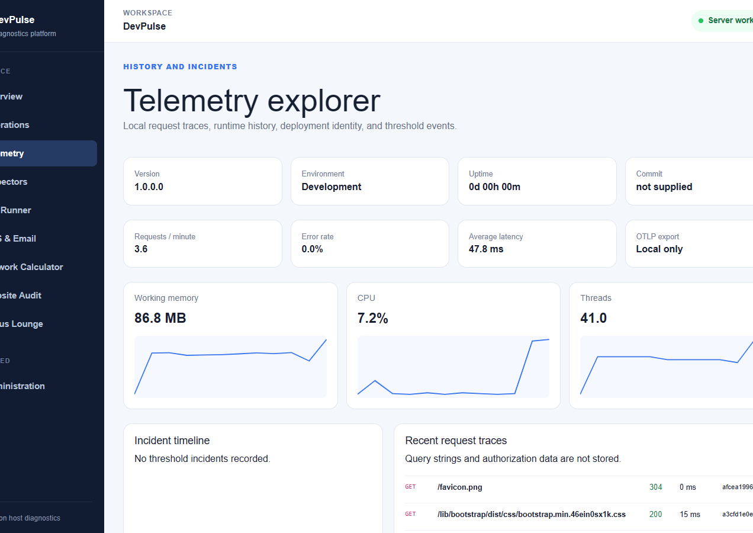
OBSERVE
Operations and telemetry
Bounded checks
Evidence over time
HTTP, TCP, ping, DNS, TLS, database connectivity, and approved log files
Runtime metrics, request traces, deployment identity, threshold incidents, and optional OTLP export
DevPulse Version 1
06
Notes:
Demonstrate that Operations answers whether a service can be reached now, while Telemetry preserves evidence about application behavior over time. Clarify that private addresses need explicit owner configuration.

Slide 7
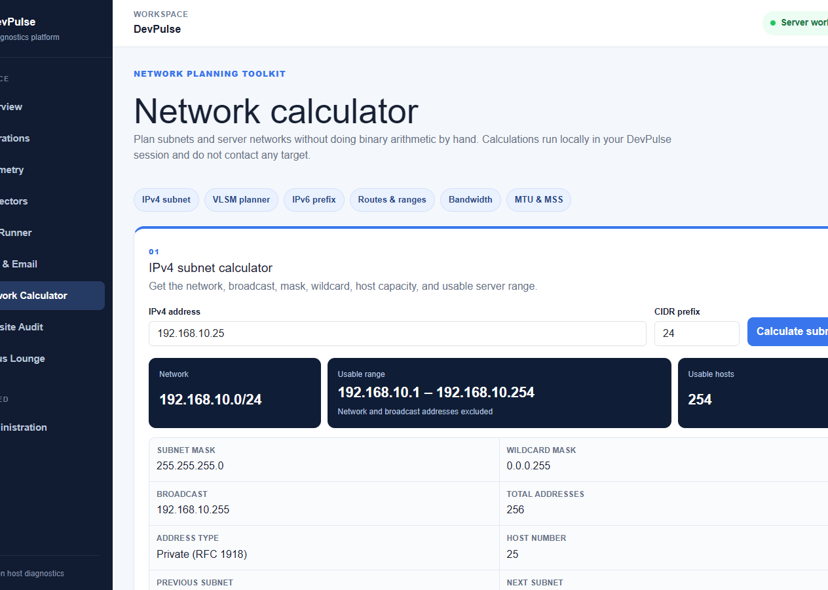
PLAN AND INSPECT
Network planning and local inspectors
Network calculations
IPv4 and IPv6 subnet details
VLSM allocation and route summaries
Bandwidth, transfer time, MTU, and MSS
Local data inspection
JSON tree and JWT payload decoding
SHA-256 integrity checks
AES-256-GCM file encryption and decryption
DevPulse Version 1
07
Notes:
The calculator performs local arithmetic and contacts no target. Uploaded inspector files stay in memory and are not stored. SHA-256 proves integrity but cannot be decoded, while AES encryption can be reversed only with the password.

Slide 8
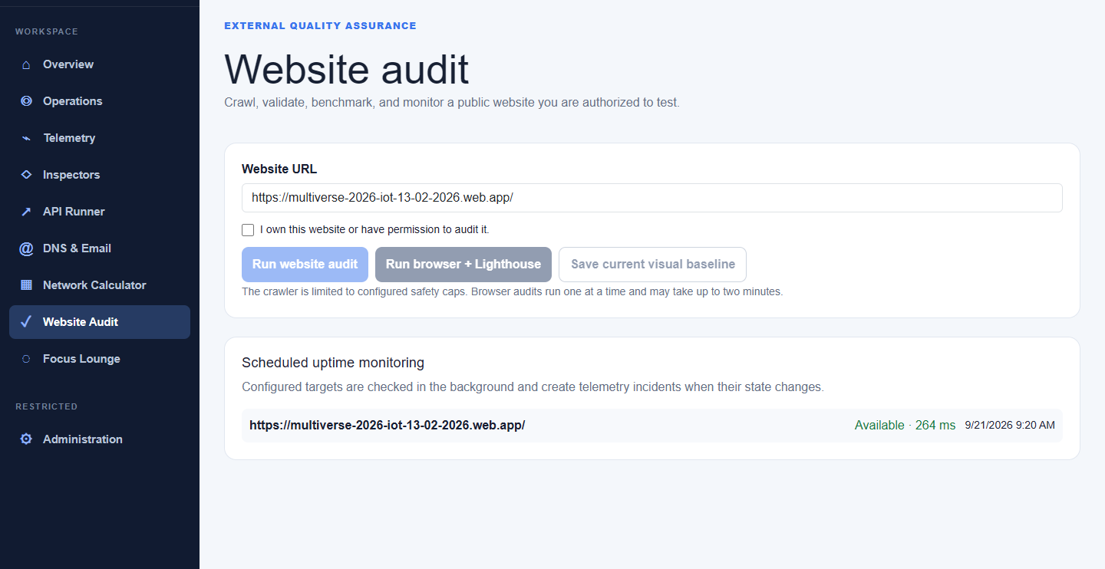
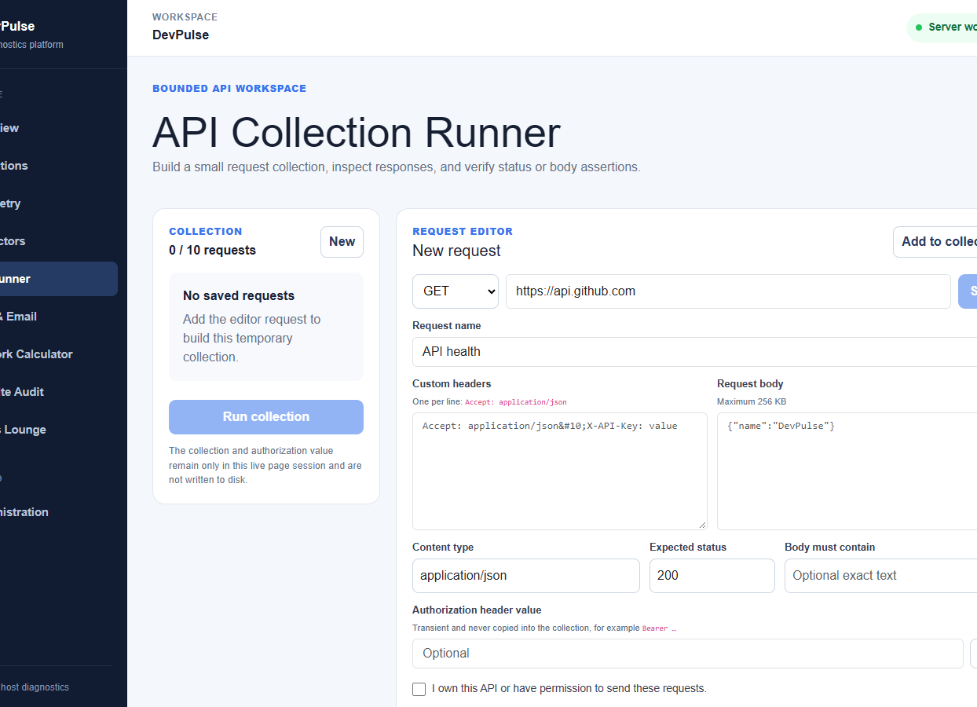
TEST
Website and API assurance
Website Audit
API and DNS
Crawl checks, headers, JSON validation, Lighthouse, accessibility, screenshots, visual baselines, and scheduled uptime
Temporary request collections, assertions, response previews, and public DNS email-policy inspection
DevPulse Version 1
08
Notes:
The Website Audit combines a bounded crawler with an optional browser worker. The API Runner supports read-only public requests and restricts write methods to exact approved URLs. The DNS inspector checks MX, SPF, DMARC, DKIM, CAA, and addressing records.

Slide 9
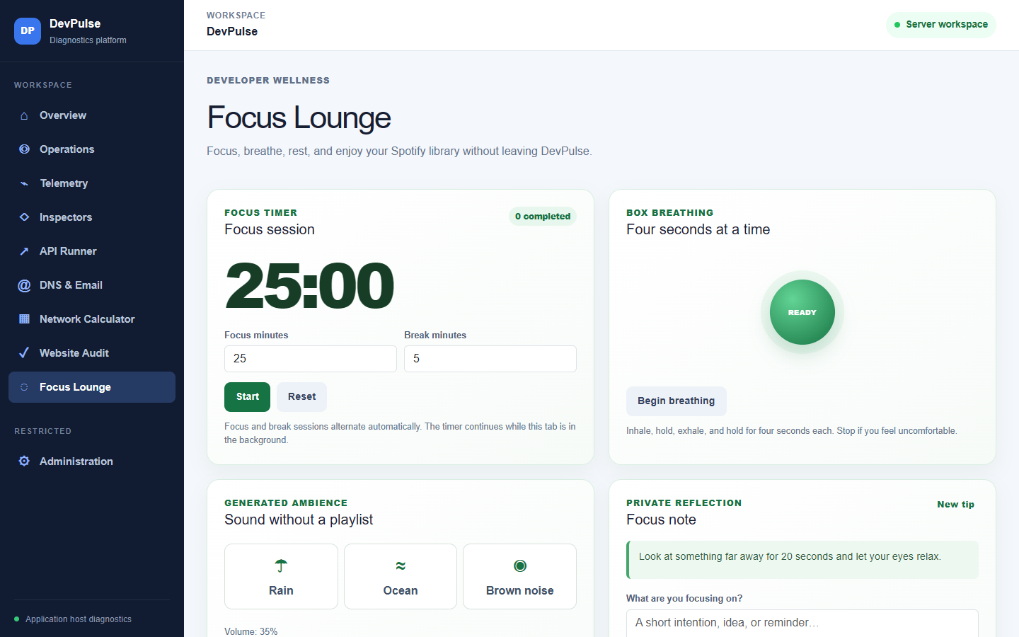
DEVELOPER WELLNESS
Focus Lounge and Spotify
A quieter workspace
Focus and break timer
Guided box breathing
Generated ambient sound
Private browser-local notes
Spotify Connect and optional browser playback
Spotify credentials remain server-side. OAuth sessions use encrypted storage and opaque cookies.
DevPulse Version 1
09
Notes:
This module gives the presentation a human side. Explain that Spotify playback can remain on the user's phone or computer through Spotify Connect. Browser playback requires Premium and an explicit user action.

Slide 10
SECURITY
Safety boundaries in Version 1
Network controls
Secrets and sessions
Administrative actions
Private and reserved targets blocked by default
Redirects disabled for diagnostic clients
Owner allowlists permit intentional private checks
Strict request, response, timeout, and concurrency caps
Environment variables or external secret files
Encrypted Spotify token storage
No credentials committed to appsettings.json
Authorization values stay transient in the API Runner
Separate administrator authentication
Rate limits and antiforgery protection
Process termination disabled unless explicitly enabled
Production diagnostics can be hidden completely
Public deployments should place diagnostic pages behind authenticated access.
DevPulse Version 1
10
Notes:
Version 1 has strong request-level boundaries, but the current public Render deployment exposes diagnostic pages anonymously. Before a public launch, require administrator authentication or a private access gateway. This also supports the ongoing Google Safe Browsing review.

Slide 11
OPERATE
Deployment and configuration
Local development
Docker image
Render service
.NET 9 SDK
User Secrets
Published application
Non-root container user
HTTPS proxy
Persistent data volume
Configuration that must stay outside Git
Deployment checks
Spotify client ID and secret
Administrator password
SMTP credentials and webhook destinations
External secrets file and persistent encryption keys
Health endpoint at /healthz
Correct Spotify callback URL
Trusted reverse proxy configuration
Diagnostics exposure reviewed before launch
DevPulse Version 1
11
Notes:
Local credentials use .NET User Secrets. Render credentials use environment variables or a mounted secret file. Persistent storage keeps data-protection keys and encrypted sessions across container replacement.

Slide 12
QUALITY
Verification and release status
79 / 79
Release build
0 warnings, 0 errors
automated regression checks passed
Code formatting
Verified
Coverage includes Spotify parsing and sessions, cryptography, network safety, website audit behavior, telemetry persistence, API boundaries, and DNS email-policy analysis.
Published HTTP smoke suite
Passed
Public launch checkpoint
Complete Google Search Console review and protect public diagnostic pages before broad promotion.
DevPulse Version 1
12
Notes:
The test count reflects the custom regression executable run for this release. The build, formatter, publish, and production HTTP smoke checks also passed. The Chrome Safe Browsing warning remains a launch blocker until Google identifies or clears the reported issue.

Slide 13
NEXT STEPS
Presentation route and Version 2
Suggested live demonstration
Version 2 candidates
01
Overview
SQL Server health and performance monitor
IT asset inventory with IP address management
Authenticated remote monitoring agent
Incident response and backup verification
Role-based access for every diagnostic tool
02
Network Calculator
03
Website Audit
04
API Runner
05
Focus Lounge
Version 1 establishes the platform and the safety model needed for these additions.
DevPulse Version 1
DevPulse Version 1
13
Notes:
Close with a short live demonstration. The roadmap extends DevPulse from a single-host diagnostics workspace into a small IT operations platform. Do not promise a delivery date for Version 2 until scope and access controls are agreed.

