Slide 1
PaaS Message Communication Middleware

Slide 2
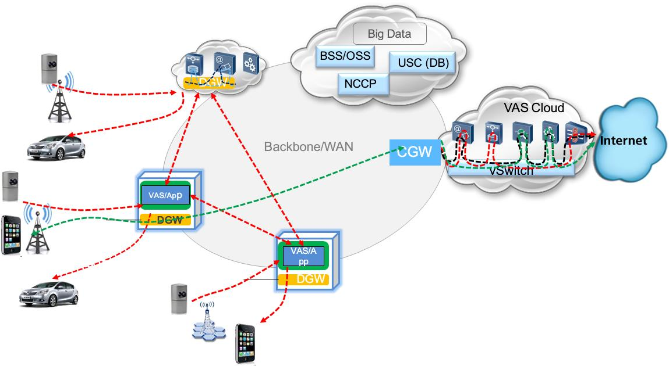
A Typical Scenario in 5G Network
Distributed gateways (VNFs) and APPs are deployed at the edge
Shorten transmission path to mobile users → lower latency
Architecture: micro-services
Applications/services (distributed on edge servers) coordinate with each other through messages
Need a low-latency & light-weight messaging middleware
The middleware provides a PaaS messaging service
Normal traffic to Internet
Traffic at edge

Slide 3
Requirements
Messaging middleware is independently deployed
As an independent PaaS service
Low-latency
End-to-end transmissions achieve millisecond level
Upper bounded by 10 ms
Scalability
Middleware should support high connection concurrency
Workload and connections can be distributed on cluster
Reliability
Reliable message delivery
Message persistency: it has two levels
Store messages to disk so that data can be recovered after crash
Enable message survive more severe failure; Redundancy (e.g., RAID) is required
Light-weight
Low resource consumption: on a single node, < 10% of a CPU core, < 100 MB memory

Slide 4
Pub/Sub Architecture
Apps communicate using publish/subscribe mode
Publishers: publish msgs on topics
Subscribers: receive msgs on topics of interest
There are two design choices for middleware architecture
Broker-based: every app connect to a central broker (or a broker cluster)
Broker-less: publishers directly send messages to subscribers
Message flow of topic A
Message flow of topic B
Subscriber A
Publisher B
Subscriber B
Publisher A
Messaging Middleware Layer
Server 2
Broker
Subscriber A
Publisher B
Messaging Middleware Layer
Server 1
Server 3
Messaging Middleware Layer

Slide 5
Latency Consideration
Latency is the focus of this project
Latency performance of broker-based messaging middleware is worse than that of brokerless one ^{[1] [2] [3] [4]}
Every message goes through one more hop → long latency
Broker is responsible for many functionalities
Message filtering, routing, persistency
Large resource (CPU, memory, bandwidth) consumption potentially makes the broker server the bottleneck
Brokerless messaging middleware
Direct message transmission between publisher and subscriber
Lower latency is expected
Reference
[1] Dissecting Message Queues
[2] RabbitMQ Performance Measurements
[3] A Quick Message Queue Benchmark
[4] Middleware Trends and Market Leaders, CERN

Slide 6
Latency Test – Broker-based
Testbed setup:
One broker server, RabbitMQ installed
One server for publishers, one server for subscribers
Each connection means one publisher and one subscriber
10K msgs/s for each connection; Msg_size =1024 bytes
Findings: long latency and high CPU utilization as workload scales up
Broker-based middleware appears unable to meet our latency requirements
Broker:
Intel i7-980, 6-core CPU
Intel 82567 Gigabit NIC
RabbitMQ-3.6.0 installed
Disable persistency and auto-ack (a reliability mechanism of AMQP)

Slide 7
Design Choice: Brokerless
Compared to broker-based middleware, brokerless has better latency performance
Year 1 will focus on pushing the limit of latency
Additional features will be developed in future years
Middleware candidates:
ZeroMQ, Aeron: both are brokerless middleware
NSQ: has a very flexible architecture. Every message transmission in NSQ goes through a daemon process. When daemon is deployed at a remote server other than the servers where publishers and subscribers locate, NSQ is more like a broker-based middleware. Otherwise, NSQ is a brokerless middleware.
Features to consider in finding the best design:
Support micro-service architecture
Best latency performance and scalability

Slide 8
Candidates
ZeroMQ
Socket abstraction library in C++, providing BSD-like API
Support multiple transport protocols:
TCP
PGM (Pragmatic General Multicast)
Reliable multicast protocol, directly on top of IP
EPGM (Encapsulated PGM)
PGM datagrams are encapsulated in UDP datagrams
NSQ:
Written in Go
Support distributed deployment and persistency
Leverage TCP for reliable delivery
Aeron:
Written in Java
Reliable UDP unicast, multicast, and IPC message transport
Claims very low and predictable latency

Slide 9
ZeroMQ vs NSQ vs Aeron
Feature | Ideal Middleware | ZeroMQ | NSQ | Aeron
Communication between application and middleware | Remote: socket Local: shared-memory [1] | Intra-process function call [2] | RESTful or TCP socket | Ring buffers (shared-memory) [3]
Transport Protocol | Reliable UDP | TCP | TCP | “Reliable” UDP [4]
 | Low-latency TCP
 | Multicast[7] | PGM/EPGM |  | Custom UDP-Multicast
Architecture | Micro-service [5] | App and middleware in one process | Separate daemon process [6] | Separate daemon process
Decentralization | Distribute workload among daemons | NA | Support distributed topology | NA
[1] Ideal middleware should have uniform APIs but different underlying mechanisms for remote and local communication. If application and middleware service are deployed on different servers, socket is used. Otherwise, the same APIs are implemented by shared-memory, because of lower latency.
[2] Because ZeroMQ middleware and user code are compiled together.
[3] Aeron- Design Overview
[4] The reliability is claimed at Aeron- Protocol Specification, but it is still questionable.
[5] Messaging middleware should be deployed independently from applications, running as a messaging service
[6] Daemon receives, queues, and delivers messages to clients
[7] Multicast is good for certain cases, e.g., large number of subscribers to one topic.

Slide 10
ZeroMQ vs NSQ vs Aeron Contd.
Feature | Ideal Middleware | ZeroMQ | NSQ | Aeron
QoS [1] | Latency differentiation | NA | NA | NA
 | Persistency differentiation [2] | NA | Support message backup in disk [5] | NA
 | Reliability differentiation | NA | NA | NA
Scalability | Low resource consumption; Support large numbers of topics and connections | Fair [3] | Fair | Poor [4]
Language | Little or no GarBage Collection (GBC) pauses | C/C++ | GO Language | Java
 |  | GBC Manually | GBC handled by GO runtime | Garbage free in steady-state running
Maturity | Mature Large community | Stable, mature, large community | Stable, mature, large community | Unstable, immature, inactive community
[1] QoS: Differentiated services for different applications depending on their declared requirements.
[2] Persistency differentiation: Allows explicit tradeoff between persistency and performance.
[3] No shared ZeroMQ component among applications. The resource consumption could be high as number of applications scales up.
[4] Every connection requires fixed amount of buffer
[5] Persistency in NSQ relies on a length limit for message queues. Messages over this limit are backed-up to disk

Slide 11
Comparison Summary
Suitability for micro-service architecture
ZeroMQ provides low-latency, but requires middleware and applications to be compiled into one process, making it unsuitable for micro-service architecture.
NSQ and Aeron support micro-service architecture
NSQ supports decentralization, which can help scalability
Another candidate is NATS^{[1]}, which is also written in Go language and has architecture and features similar to NSQ (but without persistency support).
Aeron leverages shared-memory^{[2]} and its own reliable UDP to achieve low-latency message communication
Next steps:
ZeroMQ is eliminated because of its incompatibility with micro-service architecture
Aeron, NSQ and NATS have complementary features. To find the best one among these three candidates, additional evaluation is required.
[1] NATS- Official Website
[2] While Aeron’s shared memory architecture has benefits for latency, it makes decentralization infeasible

Slide 12
Evaluation
Compare latency performance of Aeron, NSQ^{[1]}, NATS
Two different experimental scenarios
Scenario 1: scale up the number of concurrent connections
Scenario 1a: publishers and subscribers are deployed on separate hosts: involve remote communication
Scenario 1b: publishers and subscribers are deployed on the same host ^{[2]}: local communication only
Scenario 2: tradeoff between persistency and latency; publisher and subscriber are deployed on separate hosts
[1] To make the comparison fair, persistency in NSQ is disabled. The NSQ daemon co-locates with publisher
[2] In this scenario, without network involved, an ideal middleware should consider more dedicated transport protocol (such as the IPC support in Aeron), instead of TCP or UDP

Slide 13
Testbed
Our testbed includes two machines.
One for publisher(s). Intel i5-3330, 4-core
One for subscriber(s). Intel i7-980, 6-core
In scenario 1b, both publisher(s) and subscriber(s) are deployed on this server
Connected by Gigabit Ethernet
Use PTP to synchronize the clocks on two machines
So we can get end-to-end (one-way) latency

Slide 14
Experiment Setup
In Scenarios 1a and 1b, two communication models are evaluated:
Fanout:
One publisher, one topic, multiple subscribers (consumers)
Inter-msg gap = 5 ms, Msg_size =1024 bytes
Each subscriber (consumer) handled by one concurrent entity
Aeron (Java): Java thread
NSQ & NATS (Go): go routine
Fanin:
Multiple publishers (producers), multiple topics, one subscriber
In each experiment (e.g., NSQ, fanout, 128 subscribers):
Record CPU utilization at pub server and sub server (kernel CPU utilization is omitted as it is negligible in all cases, <2% of single core)
Record the end-to-end latency over 10K messages
Every subscriber (consumer) receives 10K messages. In each of our experiments, we randomly chose one subscriber and recorded the end-to-end latency results of all its messages.

Slide 15
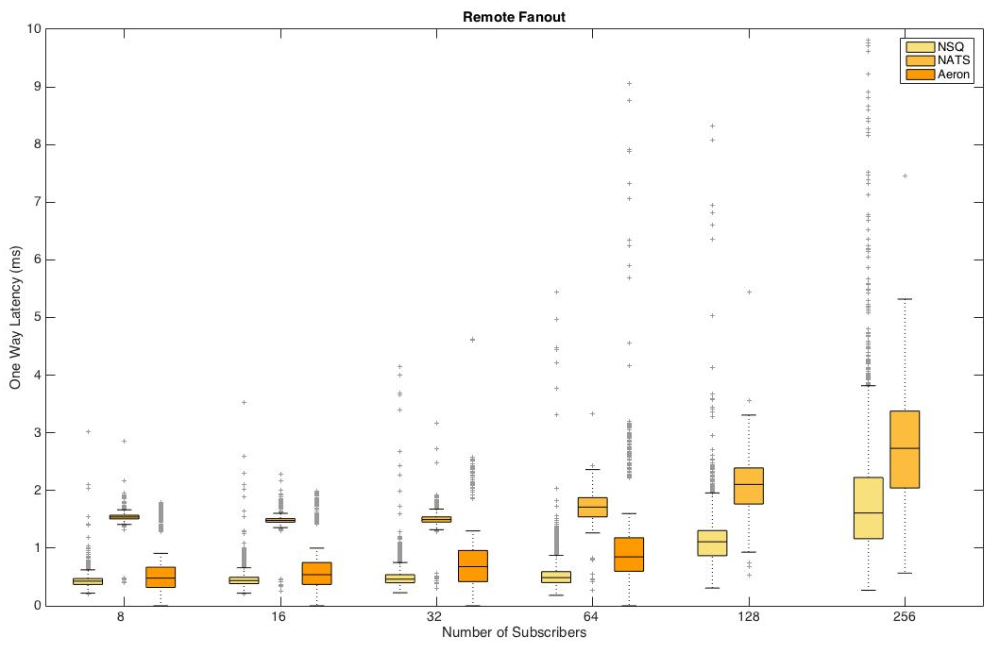
Scenario 1a: Remote Fanout
The boxplot shows the end-to-end latency with different numbers of subscribers
NSQ has the best latency performance in all cases
There is no latency result for Aeron when the number of subscribers =128 or 256, because Aeron can not support > 80 connections, which is due to
Aeron daemon consumes too much CPU resource
Each connection consumes fixed amount of memory (64 MB * 3)

Slide 16
Scenario 1a: Remote Fanout
The figure below shows the breakdown of the CPU utilization on both pub and sub server
Pub server has 4 cores, so the upper bound of its CPU utilization is 400%
Sub server has 6 cores, so the upper bound of its CPU utilization is 600%
In Aeron, daemon consumes too much CPU cycles, limiting its scalability in the number of connections.
NSQ consumes high CPU utilization with increasing concurrency. We plan to address this inefficiency in the next phase.

Slide 17
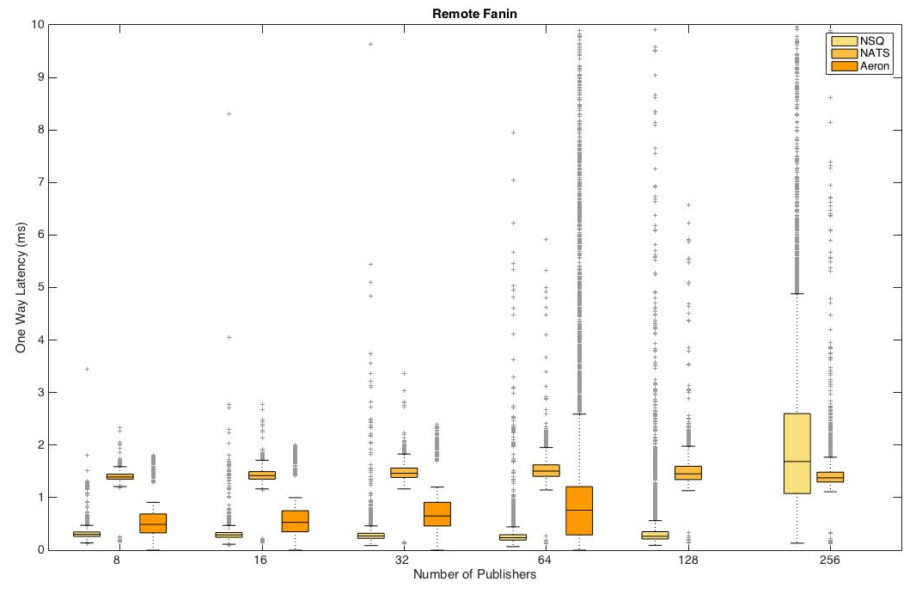
Scenario 1a: Remote Fanin
NSQ has the best latency performance in most cases
Long latency is found in NSQ with 256 publishers
Because CPU at the pub server is overloaded
This can be fixed through workload balancing (shown later)

Slide 18
Scenario 1a: Remote Fanin
Aeron has very high CPU utilization in all cases
When number of publishers (topics) goes up to 256, the NSQ daemon (at pub server) consumes too much CPU, becoming the bottleneck

Slide 19
NSQ - Decentralization
The decentralized architecture of NSQ enables load distribution among multiple daemons.
Distribute topics to nsq daemons on pub and sub servers.
Fanin experiment with 256 topics and subscribers
128 topics are handled by the nsq daemon at pub server, while all remaining topics are handled by the nsq daemon at sub server
Publisher
Subscriber
Topic 1~128
NSQ Daemon
NSQ Daemon
Topic 129 ~ 256

Slide 20
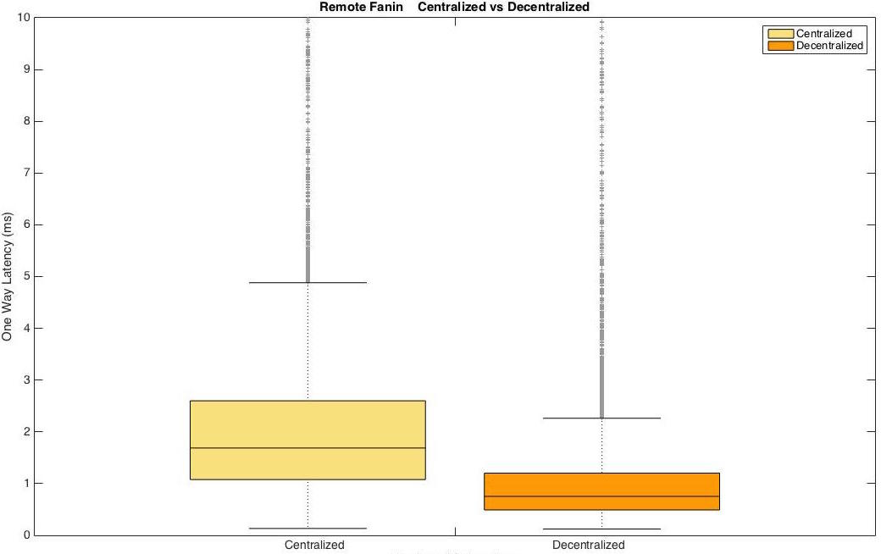
NSQ - Decentralization
When workload is balanced among two daemons, system bottleneck (NSQ daemon at pub server) is mitigated
Latency is greatly reduced (see figure below)
CPU utilization at pub server: 327% → 245%
CPU utilization at sub server: 235% → 350%

Slide 21
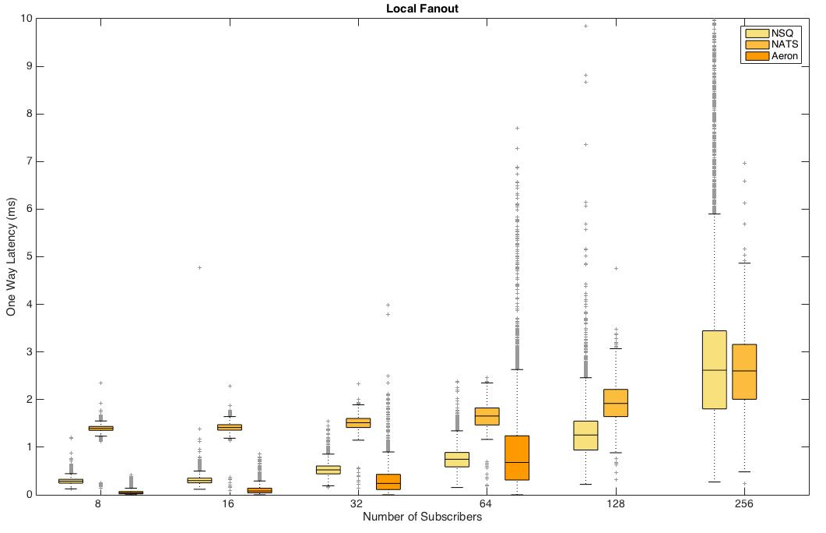
Scenario 1b: Local Fanout
In scenario 1b (publishers and subscribers co-located at one server), Aeron uses IPC as the transport protocol, instead of UDP
When the number of connections is low, Aeron has better latency performance
But Aeron is unable to support high concurrency, due to its high resource consumption
NSQ has good latency performance throughout different setups

Slide 22
Scenario 1b: Local Fanout
Aeron has very high CPU utilization in all cases
NSQ has high CPU utilization when the number of connections scales up.

Slide 23
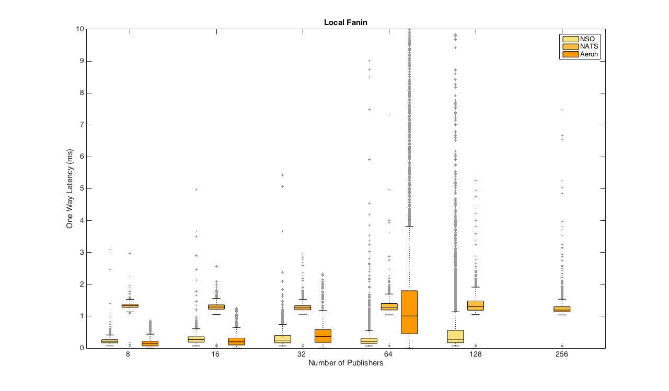
Scenario 1b: Local Fanin
NSQ has good latency performance in most cases
When number of publishers is 256, the latency in NSQ is higher than 1 second (due to the high CPU utilization) - not shown in the figure.

Slide 24
Scenario 1b: Local Fanin
Aeron has the highest CPU utilization in all cases
NSQ has high CPU utilization when concurrency scales up
CPU utilization → 600% (upper bound) when #publishers = 256

Slide 25
Scenario #2: Tradeoff between Persistency and Latency
In this scenario, we evaluate the tradeoff persistency and latency
All experiments conducted with NSQ, because it’s the only candidate supporting persistency
Create one connection
Publisher and subscriber are deployed on separate servers
Msg_size = 1024 bytes
Test end-to-end latency, along with the increase of message sending rate
Sending rate is adjusted by tuning the inter-msg gap
We compare the latency performance with and without NSQ persistency
Persistency in NSQ: when the in-memory queue is full under high message sending rate, the NSQ daemon backs up all following messages in disk. In our experiments, when we enable persistency, we limit the max in-memory queue length = 0, which means whenever there is one message pending in the queue, all the following messages are backed up. This setup maximizes the impact of NSQ persistency
When disabling NSQ persistency, we give the max in-memory queue length an unrealistically large value, in order to make sure no message is dropped
This setup shows the latency when every message is handled in memory, which gives us the best-case performance

Slide 26
Scenario #2: Tradeoff between Persistency and Latency
The left below figure shows the latency without persistency (blue box) and the one with persistency (red box), along with different inter-message gap
Throughput is 580Mbits/s when there is no inter-msg gap
When persistency is disabled, latency is very low (less than 8 ms even when there is no inter-msg gap)
When persistency is enabled
When sending rate is low (inter-msg gap = 100, 70, 40 us), there is not much message backup. Therefore, we can see low impact of persistency in the right below figure
As the sending rate increases (inter-msg gap = 10, 0 us), more messages have to be backed up into disk, which significantly increases the latency
Note that to maximize the impact of persistency, we set max in-memory queue length = 0, which is an unrealistic value. In normal use cases, properly setting the in-memory queue length would decrease the persistency load and improve the latency performance

Slide 27
Our proposed choice: NSQ
We choose NSQ as the code base for future work, because:
Good latency performance compared to Aeron and NATS.
Support decentralization, which helps load balancing and scalability
System may potentially support more concurrent connections
It is the only candidate that supports persistency
The product and community of NSQ are more mature than those of Aeron and NATS
NSQ Limitations
NSQ does not support several high-performance and low-latency communication mechanisms, e.g., shared-memory, reliable UDP, multicast
NSQ does not support QoS provisioning
NSQ daemon consumes too much CPU resources when scaling the number of publishers/subscribers/topics
NSQ persistency is unable to handle the daemon failure
Messages in the memory of NSQ daemon is lost
Redundancy backup ^{[1]} solves this problem, but it is important to guarantee the data consistency
We plan to address these limitations in the next phase of this project.
[1] One of the future work

Slide 28
Go Language Background
NSQ is written in Go language created by Google in 2007. Go is in the tradition of C, but with garbage collection.
Go routine is the basic concurrent entity in Go
It has a tiny stack which grows as needed, which leads to good scalability
Go runtime schedules go routines ^{[1][2]}
Multiple goroutines can be multiplexed to a OS thread
Every OS thread has a local scheduler and runqueue
When the currently running goroutine blocks on network input, channel operations, sleep, or primitives in sync package, the local scheduler picks one goroutine from runqueue to run on the corresponding OS thread
When currently running goroutine blocks on syscall, the corresponding OS thread is blocked as well, but the other goroutines (in the corresponding runqueue) can be migrated to another OS thread.
Go runtime also supports work stealing for load balancing. When an OS thread is idle, the local scheduler steals goroutines from other busy threads
Inter-goroutine communication is implemented based on go channel
Only works for communication between goroutines within one process
[1] The go-scheduler
[2] Scalable Go Scheduler Design Doc

Slide 29
NSQ – Architecture Overview
NSQ daemon receives, queues and delivers messages to clients, which is the most essential component in NSQ
In the example below,
Subscriber 1 subscribes to topic 1, subscriber 2 subscribes to topic 1 and topic 2
Producer and consumer are provided by NSQ client library
One producer can publish msgs of any topics; one consumer subscribes to only one topic
TCP connection between application and daemon
IO Loop delivers messages to different topics; every topic has multiple channels; each channel corresponds to one consumer
Publisher 1
Transmission via TCP connection
Transmission via Go channel
Subscriber 1
User Code
User Code
Msg1 (T1)
Msg2 (T2)
Msg1 (T1)
Msg3 (T1)
Producer
NSQ Daemon process
Consumer
Channel 1-A
Publisher 2
IO Loop
Msg1 (T1)
Topic 1
Subscriber 2
User Code
Msg2 (T2)
Channel 1-B
User Code
Msg3 (T1)
Msg4(T2)
Msg3 (T1)
Msg1(T1)
Msg3 (T1)
Msg2(T2)
Msg4(T2)
Producer
IO Loop
Topic 2
Channel 2-A
Consumer
Consumer
Msg4 (T2)

Slide 30
NSQ - Goroutines
Every goroutine runs a for loop
Read msgs from (incoming) channel, write msgs to (outgoing) channel
When a goroutine blocks on channel read/write, its corresponding OS thread can run other goroutines
Transmission via TCP connection
Transmission via Go channel
Go routine
NSQ Daemon
Channel.messagePump()
….
User Code
User Code
Topic.messagePump()
Msg
Channel.messagePump()
Consumer.handlerLoop()
Producer
PublishAsyn(msg)
Msg
Msg
Producer.router()
Prot.IOLoop()
Prot.messagePump()
Conn.readLoop
Cmd=params+msg
Write cmd to Conn
Read cmd
Conn
Conn
Conn
Conn

Slide 31
Research: Latency Improvement
The message communication mechanisms in our middleware should support runtime transport adaptation to optimize latency.
For local communication (between publishers/subscribers and daemon that co-locate at one server)
Current NSQ design: communication based on TCP connection(s) between pub/sub and daemon introduces unnecessary latency
Our design: keep the API uniform. But underneath the API, when the middleware detects local communications, messages are delivered via shared-memory instead of TCP
For remote (unicast) communication, TCP may not always be the best transport protocol for latency.
Explore replacement by reliable UDP (build reliability mechanisms on top of UDP^{[1]})
When multiple subscribers subscribe to a common topic, multicast, e.g., PIM^{[2]} is more efficient than unicast. However, TCP does not work over multicast, so another mechanism is needed to support reliability over multicast. Related research questions include:
Explore the trade-off between better scalability and higher latency overhead for reliability between multicast and multiple unicast TCP (or reliable UDP) connections
Multicast: Low latency and scalability as # connections , but high latency for reliability
TCP: Low latency for reliability, but poor scalability as # connections 
Explore whether we can develop a light weight reliability mechanism for multicast, and evaluate when using multicasts pays off
Note: UDP and multicast can also improve scalability, because of lower connection overhead than TCP
[1] Aeron- Protocol Specification
[2] Protocol Independent Multicast

Slide 32
Research: QoS
Provide differentiated services for different applications depending on their declared requirements.
Our middleware will provide API for QoS specification (service level agreement), including different attributes and granularity.
QoS specifications
Traffic contract: To what volume of messages does SLA apply?
QoS attributes
Latency: messages that have higher latency requirement should be scheduled and transmitted at higher priority.
Messages are handled by goroutines, but go runtime does not support real-time goroutine scheduling. To implement latency differentiation on top of go runtime, we propose two solutions, which are shown later.
Persistency: Applications may demand different degrees of persistency. Persistency may be implemented through disk backup or redundant memory copies.
Reliability: messages may demand different levels of reliability, e.g., in terms of in-order, no-loss, no-dup delivery guarantees.

Slide 33
Research: QoS Granularity
Topic-level (coarse-grained): messages are differentiated based on which topic they belong to
Subscriber-level (fine-grained): messages are differentiated based on which subscriber they are delivered to
Hierarchical: combines the above two levels
Example: Latency differentiation across topics (1, 2) and subscribers (1, 2). Assume subscriber1 subscribes to topic1 and 2, while subscriber2 subscribes to topic2. Hierarchical differentiation implies:
Topic-level: priority (topic1) > priority (topic2) (“>” means higher priority)
Subscriber-level: priority (subscriber1) > priority (subscriber2)
Resulting message differentiation:
Topic-level: all messages of topic1 scheduled prior to those of topic2
Subscriber-level (after topic-level differentiation is enforced): both subscribers subscribe to topic2, but messages (of topic2) are first delivered to subscriber1

Slide 34
Research: Scalability
NSQ daemon consumes large amount of CPU cycles when workload and connections scale up
We need to further look into the message handling in NSQ daemon and improve its efficiency
E.g., adaptive message batching as load increases can improve scalability without significantly affecting latency
Leveraging design ideas from NATS daemon may help with this research task
Decentralization: workload balancing on daemon cluster (future work)
Notes:
In Golang, the select in for loop is very resource consuming: in each iteration, we have to re-create a select struct and release it.

Slide 35
Real-Time Messaging Middleware
To optimize latency, our middleware will have self-configuration and runtime transport adaptation
To build QoS provisioning (on top of go runtime), there are two architectures (shown in following slides):
Create multiple daemons on a physical host, each daemon dedicated for one service class
Leverage Linux real-time scheduler (underlying middleware) to prioritize daemons
Due to the fact that the resource consumption highly depends on the number of daemons (which we will quantify), this architecture may only support coarse-grained (topic-level) service differentiation.
One daemon on a physical host, but we will implement traffic control mechanism inside the daemon to regulate traffic of every service class
When traffic controller detects long delay on high-priority (which means higher QoS requirements) service classes, it throttles/backpressures the traffic rate of low-priority service classes

Slide 36
Architecture-A: Per-Service-Class Daemon
Publisher 1
Host 1
Subscriber 1
Host 2
Subscriber 2
User Code
User Code
UserCode
Msg1 (T1)
Msg2 (T2)
Msg1(T1)
Msg2(T2)
Msg1(T1)
Msg2(T2)
Producer
Consumer
Consumer
Consumer
Consumer
High-prio Daemon
Low-prio Daemon
Channel 1-A
Channel 2-A
Transmission via Shared Memory
Transmission via Go channel
Transmission via Lightweight TCP, or Reliable UDP, or Multicast
IO Loop
Topic 1
IO Loop
Topic 2
Channel 1-B
Channel 2-B
Linux RT scheduling
Linux Push/Pull scheduling
on multicore
Linux RT scheduling
Priority (T1) > Priority (T2)
Priority (subscriber1) > Priority (subscriber2)
See footnote for details
….
Core
Core
Core
Notes:
Middleware SDK should be able to differentiate the messages of different service classes, and forward them to the corresponding daemons.

Slide 37
Architecture-B: Traffic Control inside Daemon
Publisher 1
Host 1
Subscriber 1
Host 2
Subscriber 2
User Code
User Code
User Code
Msg1 (T1)
Msg2 (T2)
Msg1(T1)
Msg2(T2)
Msg1(T1)
Msg2(T2)
Producer
Consumer
Consumer
Consumer
Consumer
Daemon
…
Channel 1-A
TC
Transmission via Shared Memory
Transmission via Go channel
Transmission via Lightweight TCP, or Reliable UDP, or Multicast
Topic-level traffic control:
Group topics based on their service class
Throttle the traffic rate of low-priority service class when TC detects long delay in high-priority service class
Subscriber-level Traffic control
…
…
Channel 1-B
Topic 1
TC
TC
…
…
Channel 2-A
TC
TC
IO Loop
…
Channel 2-B
Priority (T1) > Priority (T2)
Priority (subscriber1) > Priority (subscriber2)
See footnote for details
Topic 2
Notes:
If hierarchical QoS granularity is used, there will be two types of traffic controllers: topic-level and subscriber-level.
Traffic control details:
Topic-level traffic controller can estimate delay by checking the queue size (in Topic component)in two successive times. The change of the queue size actually implies the delay.
Subscriber-level traffic controller does this by checking Channel components.
2. We are going to find an adaptive way to throttle the traffic rate of low-priority service class. Latency should be guaranteed without the starvation of some service classes.

Slide 38
Risk Factors
Some of the research tasks we are proposing are non-trivial, and we may not be able to find good solutions quickly. For example:
Improving the CPU usage efficiency of NSQ may require fundamental changes to the architecture of NSQ daemon
NSQ persistency increases latency. NSQ backs-up messages to disk when the in-memory queue is full. The longer latency caused by persistency may be caused by NSQ’s strategy for when deciding when to fetch message from disk and transmit them. Optimizing this strategy involves a complex trade-off between disk access, memory utilization, and CPU resources.

Slide 39
Summary
NSQ is the most appropriate code base, because it
Supports micro-service architecture
Offers good latency performance
Achieves good scalability through its decentralized architecture
Accommodates persistency
Our design tasks for the next phase:
Add a runtime adaptation (uniform API, different underlying mechanisms) to improve latency
Leverage shared-memory for local communication
Implement reliable UDP and multicast for remote communication
Add service differentiation capabilities (QoS), which supports
Service specification (to what traffic does QoS apply)
Different attributes: latency, persistency and reliability
Different granularities: application-level, topic-level
Scalability improvements:
Improve the CPU usage efficiency of NSQ daemon
Leverage decentralization for load balancing (future work)

