Slide 1
Evaluation of Architecture-1

Slide 2
Architecture-1: Per-Service-Class Daemon
Publisher 1
Host 1
Subscriber 1
Host 2
Subscriber 2
User Code
User Code
UserCode
Msg1 (T1)
Msg2 (T2)
Msg1(T1)
Msg2(T2)
Msg1(T1)
Msg2(T2)
Producer
Consumer
Consumer
Consumer
Consumer
High-prio Daemon
Low-prio Daemon
Channel 1-A
Channel 2-A
Transmission via Shared Memory
Transmission via Go channel
Transmission via Lightweight TCP, or Reliable UDP, or Multicast
IO Loop
Topic 1
IO Loop
Topic 2
Channel 1-B
Channel 2-B
Linux RT scheduling
Linux Push/Pull scheduling
on multicore
Linux RT scheduling
Priority (T1) > Priority (T2)
Priority (subscriber1) > Priority (subscriber2)
Middleware SDK will differentiate the messages of different service classes, and forward them to the corresponding daemons.
….
Core
Core
Core

Slide 3
Outline
Latency evaluation
Goal: how real-time scheduler and architecture-1 improve latency and implement topic-level differentiation
Different daemon configurations
Key parameters: OutputBufferSize, Max-In-Flight, OutputBufferTimeout, etc.
Big impact on overall latency and CPU consumption
Can be used for service differentiation
Overhead of Architecture-1
Quantify the extra CPU consumption

Slide 4
Latency Evaluation
A prototype of Architecture-1
Topic-level differentiation
2 daemons (given different priorities)
Daemon-1 (with high scheduling priority) dedicated for msgs of high-prio topics; daemon-2 (with low scheduling priority) dedicated for msgs of low-prio topics
Baseline: one daemon handles all the topics
Goal:
Compare latency and resource consumption between architecture-1 (2 prioritized daemons) and baseline
Evaluate the impact of different parameters (e.g., MaxBufferSize, MaxInFlight)

Slide 5
Latency Evaluation
Testbed setup:
Two publishers, two subscribers ^{[1]}
Publisher-1 publishes high-priority topics; publisher-2 publishes low-priority topics
Subscriber-1 subscribes to high-priority topics; subscriber-2 subscribes to low-priority topics
Each producer^{[2]} sends 10,000 msgs with inter-msg gap = 4096 us, msg_size=1024 bytes; Every producer publishes a unique topic
Publisher-1 (latency-sensitive) has one producer/topic, while publisher-2 has 256, 320, 384, 448 producers/topics
Publishers and subscribers are separately deployed at two servers; servers connected by gigabit network (WashU testbed)
Daemon(s) co-locate with publishers
MaxInFlight =1000, MaxBufferSize =-1
See later slides for detailed explanation
Provide good overall latency performance
In 1-daemon setup:
Daemon, publishers and subscribers are all regular processes (SCHED_NORMAL) or given same priority (using SCHED_RR)
In 2-daemon setup:
Prio(daemon-1) = Prio(publisher-1) = Prio (subscriber-1) =95; Prio(daemon-2) = Prio(publisher-2) = Prio (subscriber-2) =94
Scheduling policy = SCHED_FIFO or SCHED_RR
Notes:
[1] One publisher or subscriber means a separate application (process). In our experiments, we assume publisher only publishes msgs, subscriber only subscribes to topics and receives corresponding msgs. But in our real scenario, any application can do both of the two.
[2] Each producer is a concurrent entity inside a publisher application. On the other hand, each consumer is a concurrent entity inside a subscriber application

Slide 6
Latency of Topics
Publisher-1: 1 producers/topic
Publisher-2: 256 producers/topics
Real-time scheduler reduces overall latency
CPU contention is not severe, no obvious improvement in architecture-1
Notes:
Black box: end-to-end latency of high-priority topic
Blue box: end-to-end latency of low-priority topics
1-d, normal: one daemon handles all the topics; publishers, daemon and subscribers are scheduled by SCHED_NORMAL
1-d, rr: one daemon handles all the topics; publishers, daemon and subscribers are scheduled by SCHED_RR
2-d, fifo: one high-priority daemon (process) for high-priority topic, one low-priority daemon (process) for low-priority topics; daemon and subscribers are scheduled by SCHED_FIFO
2-d, rr: one high-priority daemon (process) for high-priority topic, one low-priority daemon (process) for low-priority topics; daemon and subscribers are scheduled by SCHED_RR

Slide 7
Latency of Topics
Publisher-1: 1 producers/topic
Publisher-2: 320 producers/topics
As number of topics increases, CPU contention becomes severer → (1-d, normal/rr) can not guarantee low latency for high-priority topic, but architecture-1 (2-d, fifo/rr) differentiates topics well

Slide 8
Latency of Topics
Publisher-1: 1 producers/topic
Publisher-2: 384 producers/topics
Architecture-1 differentiates topics well

Slide 9
Latency of Topics
Publisher-1: 1 producers/topic
Publisher-2: 448 producers/topics
Architecture-1 differentiates topics well

Slide 10
Daemon Configurations
Users can configuration some key parameters to control latency performance and resource consumption
Max-In-Flight
Mem-queue-size
OutputBufferSize
OutputBufferTimeout
Ephemeral Tag
All the parameters are used to configure components inside daemon
Experiments run at Huawei testbed

Slide 11
Configuration Specifications #1
Max-in-Flight:
Description:
Per-connection (between daemon and consumer) parameter
How many messages are allowed to be sent by daemon before receiving acknowledgement from consumer
How to configure:
Default value is set to 1
Setting a big Max-in-Flight would improve latency as daemon does not have to wait for “ack”

Slide 12
Configuration Specifications #2
Mem-Queue-Size
Description:
The size of the buffer for each topic and each channel
Setting a really small Mem-Queue-Size would make daemon write messages to the disk as there is not enough room to hold incoming messages for the topic from the producers
Setting a really big Mem-Queue-Size would cause huge memory footprint as daemon has to allocate large chunk of memory
How to configure:
Mem-Queue-Size should always be large enough for high priority traffic
Mem-Queue-Size should be moderate for low priority traffic

Slide 13
Configuration Specifications #3
OutputBufferSize:
Description:
The size of the buffer for each TCP connection
Messages that are passed to the TCP handler are stored in this buffer
OutputBufferSize sets the size of the buffer in the Golang bufio library
When the buffer is full, messages would be flushed to the TCP stack
The default size is 16 * 1024 bytes
The max size is 128 * 1024 bytes
Set to -1 or 0 to disable buffering
Tradeoff between CPU util & latency
Setting a large size would facilitate batching, thus increasing latency as messages spend more time in the bufio buffer before they are sent
Setting a small size would lower latency, yet it would increase CPU utilizations
How to configure
For high priority traffic, set to -1 to disable buffering
For low priority traffic, use the default value or a relatively large OutputBufferSize to reduce CPU utilization

Slide 14
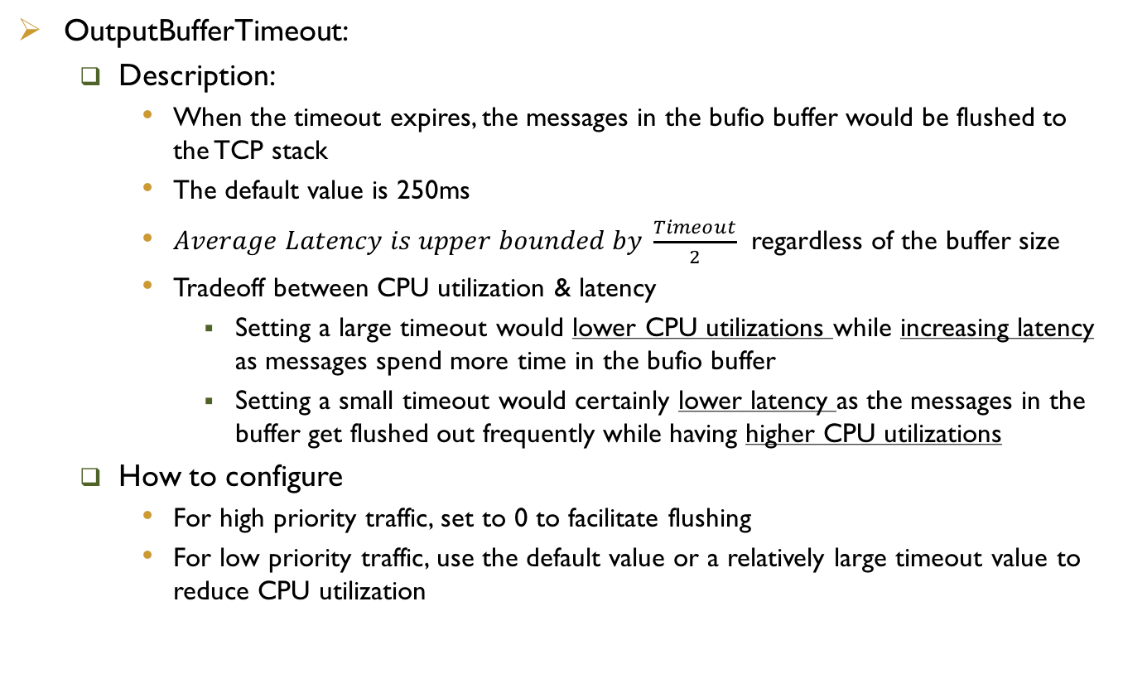
Configuration Specifications #4
OutputBufferTimeout:
Description:
When the timeout expires, the messages in the bufio buffer would be flushed to the TCP stack
The default value is 250ms
$Average Latency is upper bounded by \frac{Timeout}{2}$ regardless of the buffer size
Tradeoff between CPU utilization & latency
Setting a large timeout would lower CPU utilizations while increasing latency as messages spend more time in the bufio buffer
Setting a small timeout would certainly lower latency as the messages in the buffer get flushed out frequently while having higher CPU utilizations
How to configure
For high priority traffic, set to 0 to facilitate flushing
For low priority traffic, use the default value or a relatively large timeout value to reduce CPU utilization

Slide 15
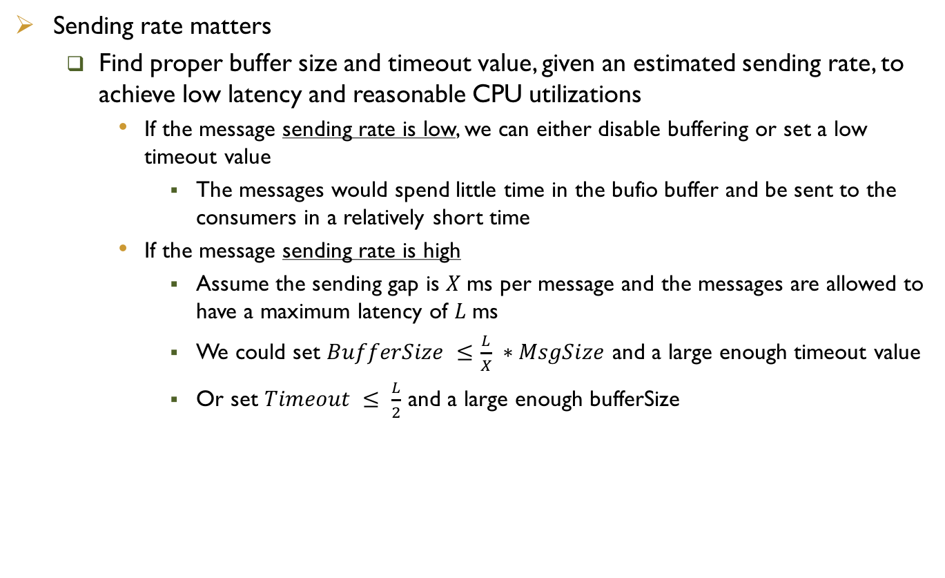
More About Buffer Size & Timeout
Sending rate matters
Find proper buffer size and timeout value, given an estimated sending rate, to achieve low latency and reasonable CPU utilizations
If the message sending rate is low, we can either disable buffering or set a low timeout value
The messages would spend little time in the bufio buffer and be sent to the consumers in a relatively short time
If the message sending rate is high
Assume the sending gap is $X$ms per message and the messages are allowed to have a maximum latency of $L$ms
We could set $BufferSize ≤\frac{L}{X} ∗MsgSize$ and a large enough timeout value
Or set $Timeout ≤ \frac{L}{2}$ and a large enough bufferSize

Slide 16
Configuration Specification #5
Ephemeral Tag
Description:
By appending “#ephemeral” tag behind the topic and channel name, we can prevent the message from being written to the disk when the messages overflows the Mem-Queue-Size.
For messages that belongs to an ephemeral topic, it will never be written the disk
How to configure:
For high priority traffic, we should allocate a large enough Mem-Queue-Size to its specific topic/channel so that the messages would not have the chance to be written to the disk.
However, if the queue size is not big enough, by appending the ”ephemeral” tag, the message would not be written to disk, enabling the “ephemeral” tag would potentially cause message losses.
For low priority traffic that tolerates long delay and requires high reliability, we can disable “ephemeral” tag.

Slide 17
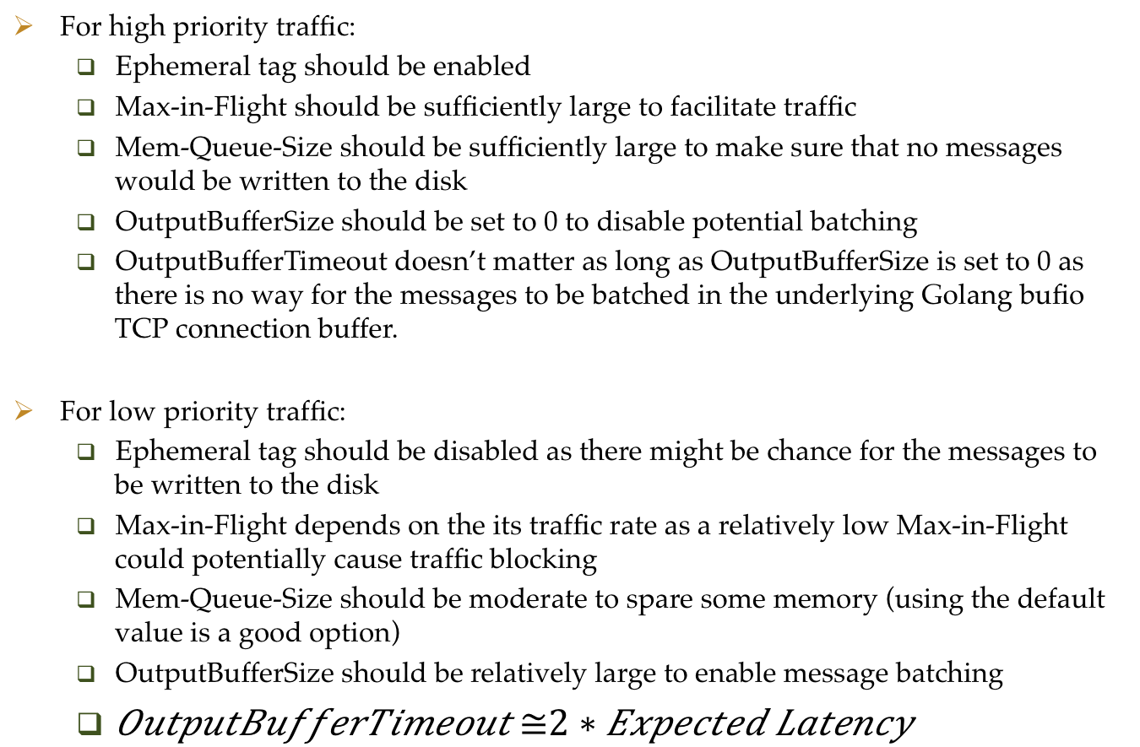
Configuration Summarizations
For high priority traffic:
Ephemeral tag should be enabled
Max-in-Flight should be sufficiently large to facilitate traffic
Mem-Queue-Size should be sufficiently large to make sure that no messages would be written to the disk
OutputBufferSize should be set to 0 to disable potential batching
OutputBufferTimeout doesn’t matter as long as OutputBufferSize is set to 0 as there is no way for the messages to be batched in the underlying Golang bufio TCP connection buffer.
For low priority traffic:
Ephemeral tag should be disabled as there might be chance for the messages to be written to the disk
Max-in-Flight depends on the its traffic rate as a relatively low Max-in-Flight could potentially cause traffic blocking
Mem-Queue-Size should be moderate to spare some memory (using the default value is a good option)
OutputBufferSize should be relatively large to enable message batching
$OutputBufferTimeout ≅2 ∗ Expected Latency$

Slide 18
How Timeout & Buffer Size matters
Experiment Specifications
Pub and subs are on two separate machines (40 cores) and communicating via VLan
Fanout model, 256 subscribers
Sending gap is 10ms
All subs are run as independent processes (one sub one process)
Max-in-Flight =1000 && OutputBufferTimeout = 80ms
Examine how latency changes with different OutputBufferSize

Slide 19
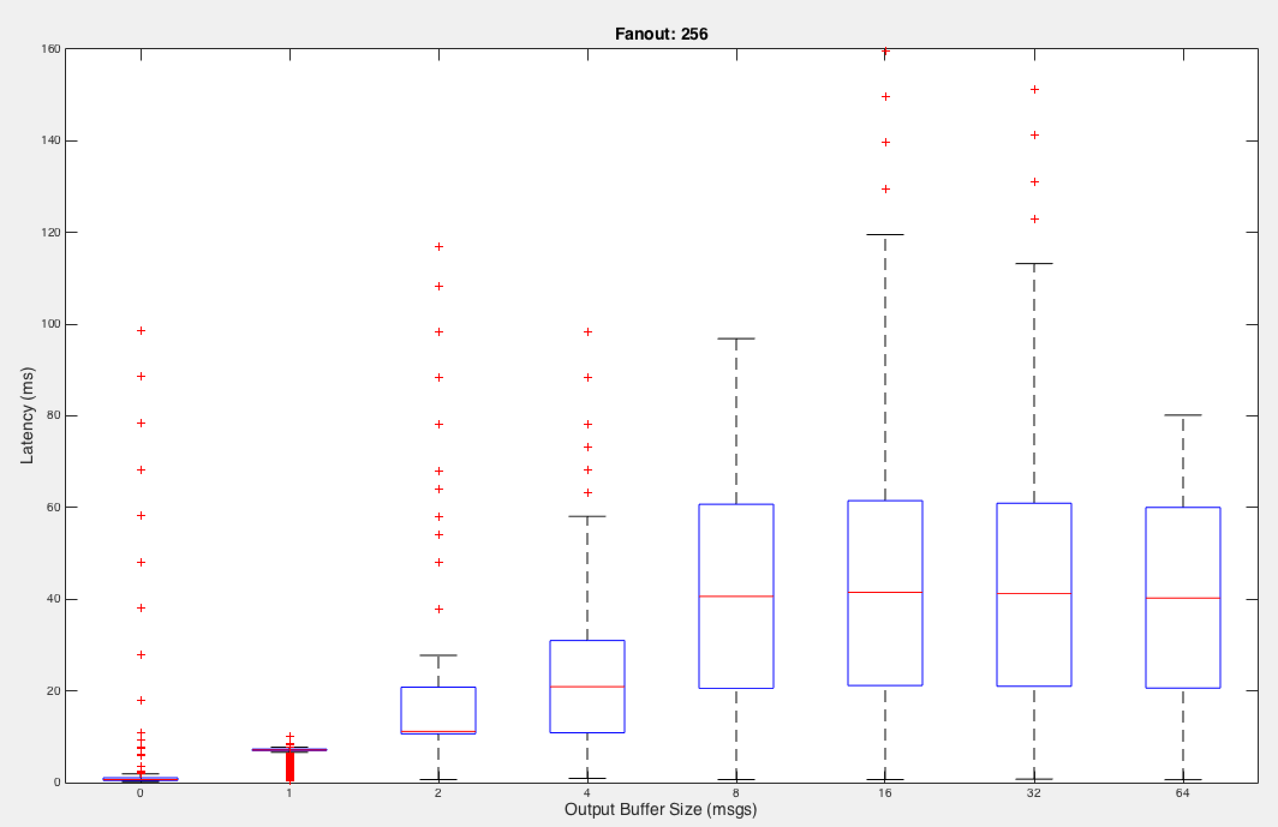
Latency (Timeout 80ms)

Slide 20
CPU Utilization

Slide 21
Cross Comparison
Output Buffer Size = 8 msgs
Sending Gap = 10ms
Max-in-Flight = 1000
Fanout Model: 256 Subscribers
Tune the OutputBufferTimeout to see how latency changes

Slide 22
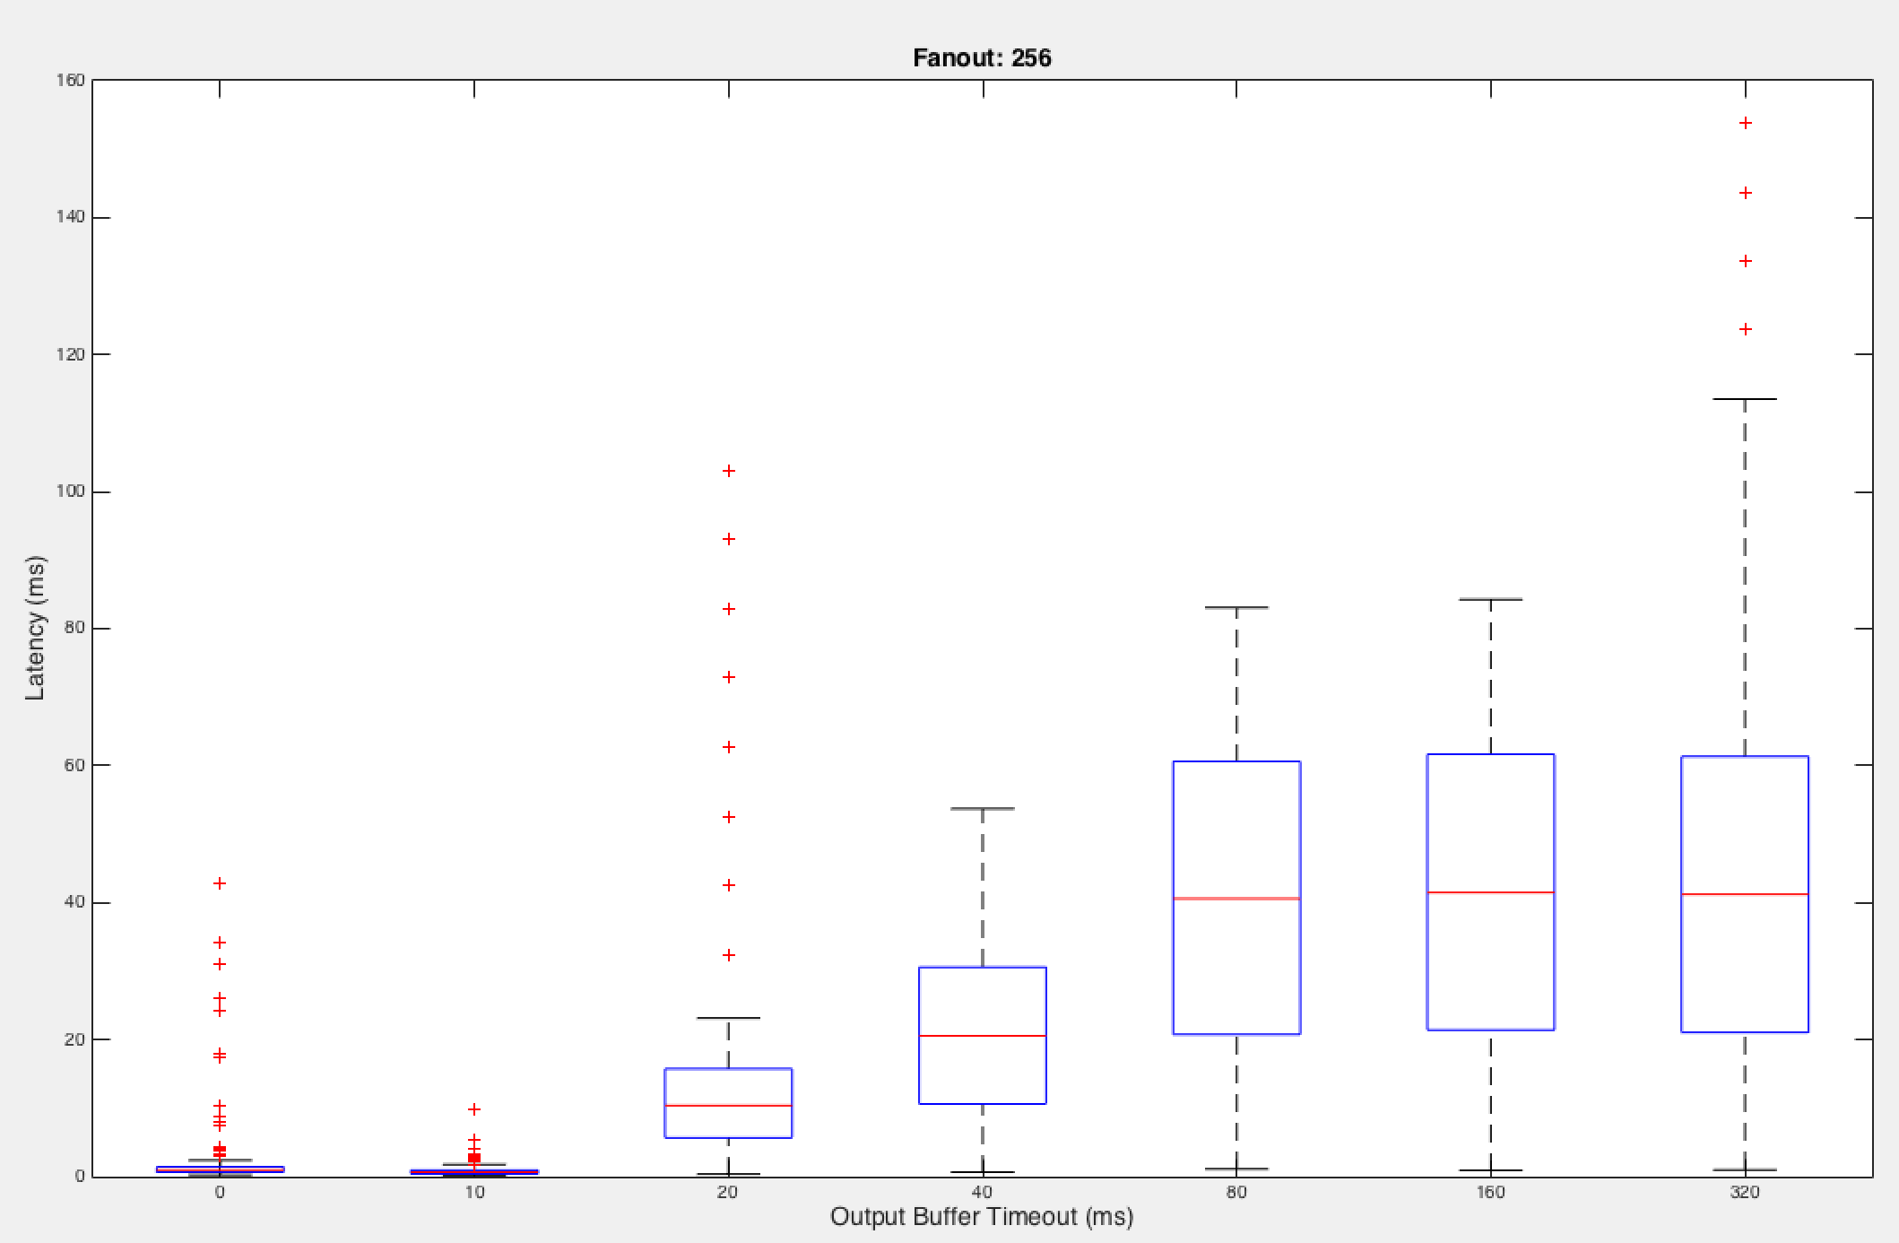
Cross Comparison Latency BufferSize 8msgs

Slide 23
Cross Comparison CPU BufferSize 8msgs
Notes:
307%, 278%, 178%, 150%, 133%, 132%, 147%

Slide 24
Configuration for Differentiation
Compare three different cases:
Base Case:
No difference of priority among pubs and subs;
All pubs and subs connect to the same daemon
All pubs and subs use the default configurations
OutputBufferSize = 16KB, Max-in-Flight = 1, OutputBufferTimeout = 250ms
Case 2:
One dedicated high priority daemon to handle high priority messages
(OutputBufferSize = -1, Max-in-Flight = 1000)
One low priority daemon to handle other messages
OutputBufferSize = -1, Max-in-Flight = 1000, OutputBufferTimeout = 250ms
Case 3
One dedicated high priority daemon to handle high priority messages
(OutputBufferSize = -1, Max-in-Flight = 1000)
One low priority daemon to handle other messages
OutputBufferSize = 16KB, Max-in-Flight = 1, OutputBufferTimeout = 250ms

Slide 25
Experiment Specifications
Multiple Sub applications
Each sub app has 1 consumer (1 Go Routine)
Two Pub applications
Pub_1 only has 1 high priority producer (1 Go Routine)
Pub_2 has multiple low priority producers (multiple Go Routines)
Two Daemons
NSQd_1 is a high priority daemon which is dedicated to the high priority messages
NSQd_2 is a low priority daemon which is responsible for the rest of the traffic

Slide 26
Experiment Specifications
Unicast Model
Multiple Topics
Each consumer is only interested in one topic
Each producer publishes one unique topic
Specifications:
Msg size 1KB
Sending gap is 4ms
Scale up the number of topics to see how latency changes

Slide 27
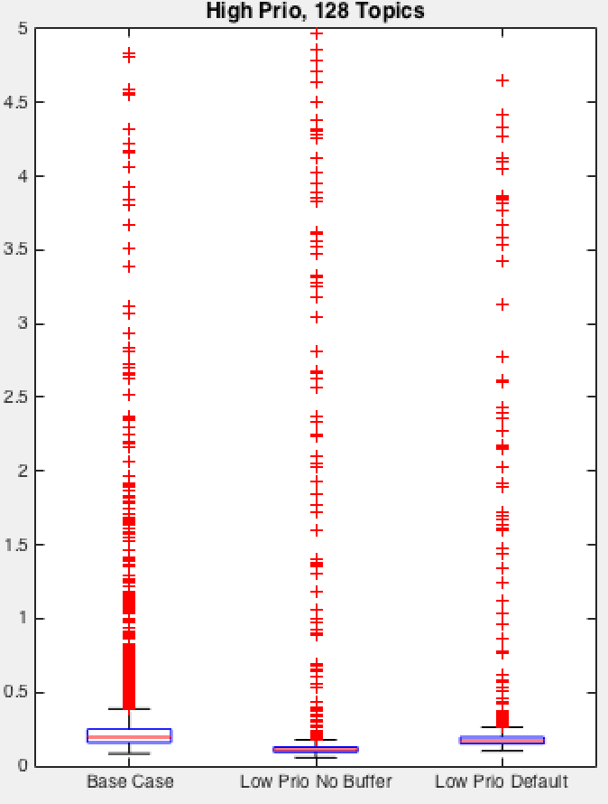
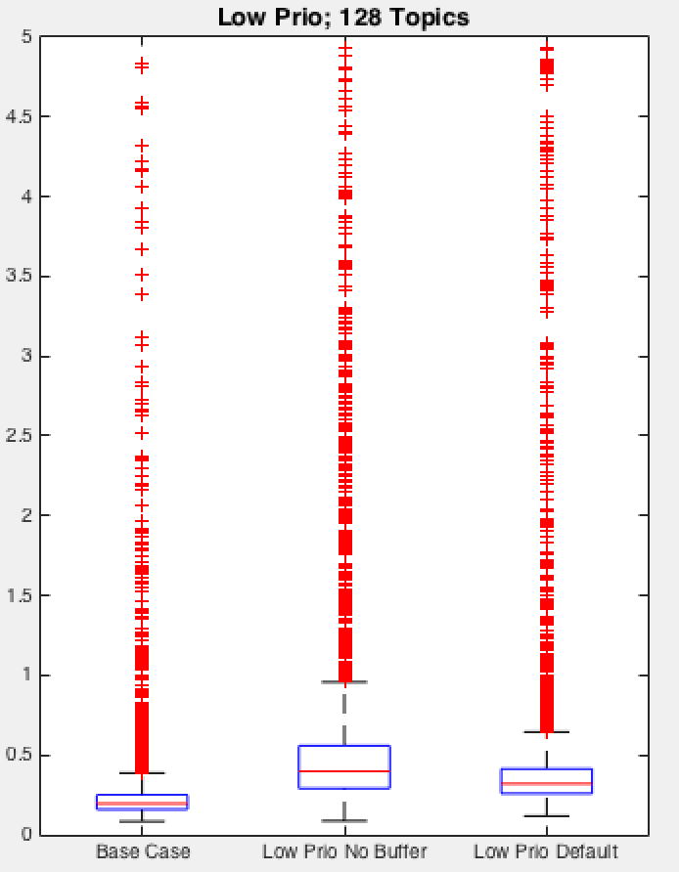
Latency Comparison; 128 Topics
Left figure: latency of high-priority messages
Right figure: latency of low-priority messages
Base Case: 1d, No Prioritization
Low Prio No Buffer: case 2, The low prio subs OutputBufferSize is 0
Low Prio Default: case 3, The low prio subs use default settings

Slide 28
CPU Utilization; 128 Topics

Slide 29
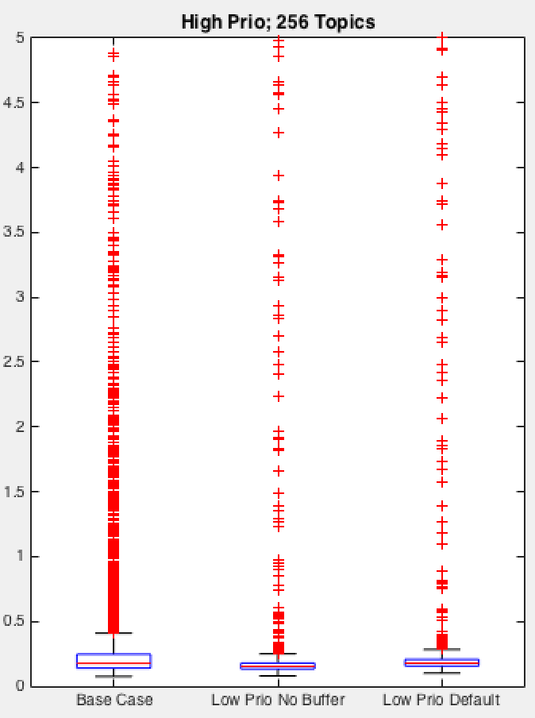
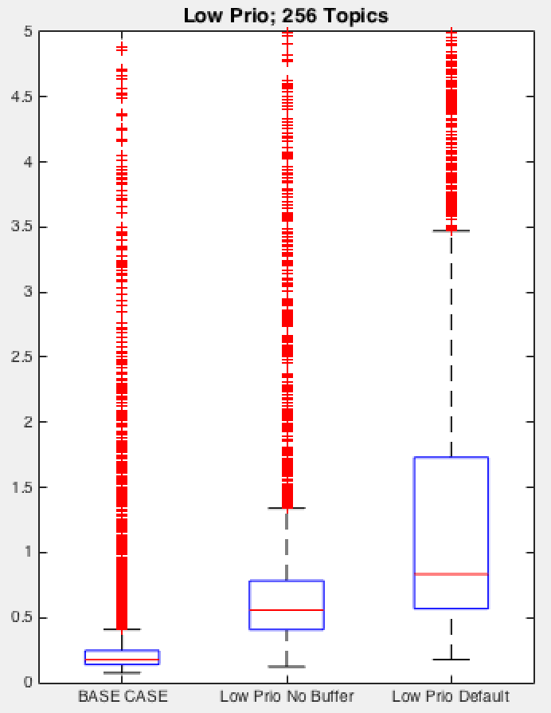
Latency Comparison; 256 Topics
Base Case: case 1, No Prioritization
Low Prio No Buffer: case 2, The low prio subs OutputBufferSize is 0
Low Prio Default: case 3, The low prio subs use default settings
Low-priority messages have even longer latency than that in case 2, due to the large outputbuffersize and small max-in-flight

Slide 30
CPU Utilization; 256 Topics

Slide 31
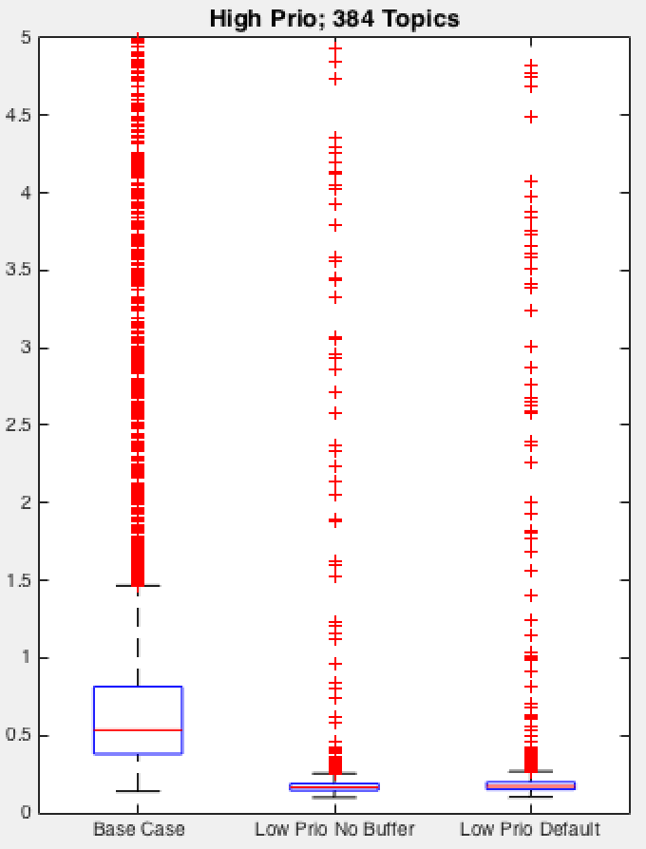
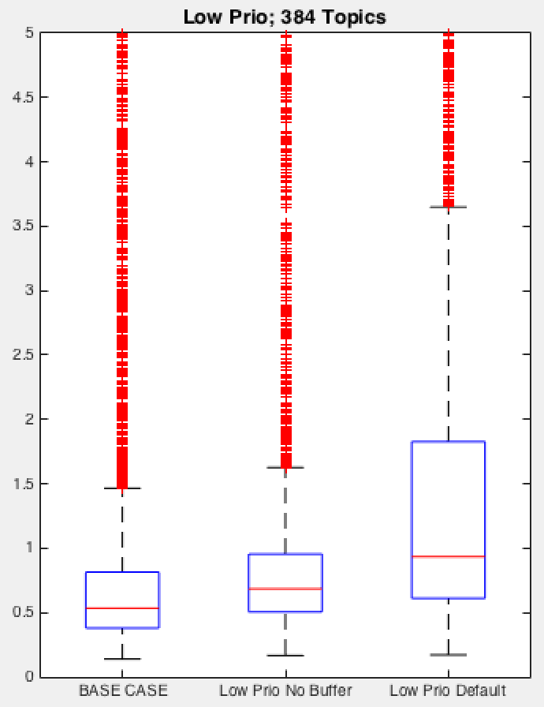
Latency Comparison; 384 Topics
Base Case: case 1, No Prioritization
Low Prio No Buffer: case 2, The low prio subs OutputBufferSize is 0
Low Prio Default: case 3, The low prio subs use default settings

Slide 32
CPU Utilization; 384 Topics

Slide 33
Overhead of Architecture-1
In architecture-1, there are multiple daemon processes
Context switch between daemons generates overhead
To quantify overhead of Arch-1
Experiment setup is similar to what shown in page 4, except:
Publisher-1: 16/32/64 producers/topic
Publisher-2: 128 producers/topics
CPU is mildly used

Slide 34
Overhead of Architecture-1
Showing the CPU utilization of daemons
CPU of high-prio daemon increases as # of high-prio topics scales up
Total CPU utilization of architecture-1 > total CPU of baseline (1 daemon)
Notes:
Figure Explanation:
X-axis label: For example, (2d-32,128) means that architecture-1 is used (2 daemons), publisher-1 has 32 producers and subscriber-1 has 128 producers
Legend:
Dark blue: %user of daemon-2 (low-priority daemon)
Light blue: %system of daemon-2
Yellow: %user of daemon-1
Brown: %system of daemon-1

