Slide 1
EHealth Care System with
SOS Mobile App
CMPE 285 Team Project

Slide 2
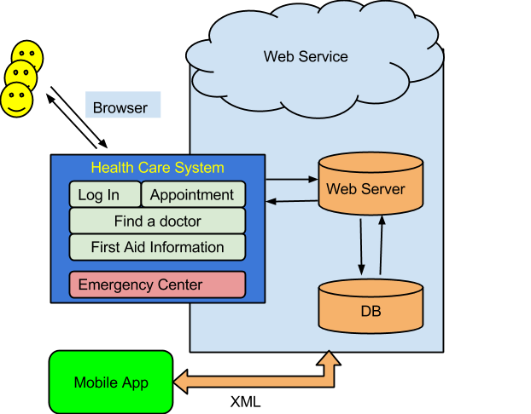
System Architecture
Typical 3 tiers architecture

Slide 3

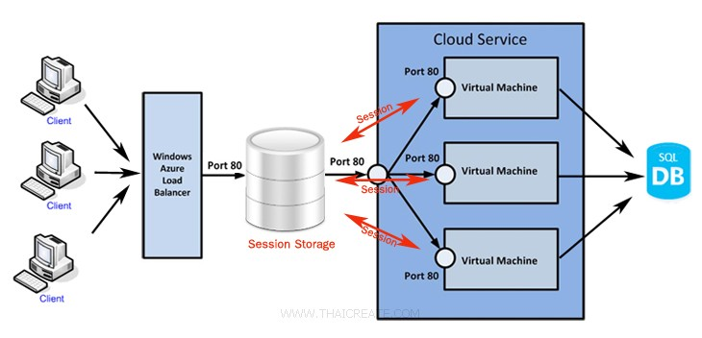
Web Server - Load Balance
In disaster context, the access to server may soar to a high level. We use Azure cloud service to implement load balance.
http://104.209.40.90/ehealth/

Slide 4
Web Server - DataBase Independence
Change DataBase with only one-line configuration code.
Application
Web.config
Provider Manager
SQL Server
Provider
My SQL
Provider
Oracle
Provider
ODBC
Provider
SQL Server
My SQL
Oracle
ODBC

Slide 5
Web Client - Features
Hospital Information and Search
Hospital Navigation
Find a Doctor and View the Doctor Profile
Make an Appointment
First Aid Knowledge
Message Center
SOS APP Download

Slide 6

Web Client - Homepage

Slide 7
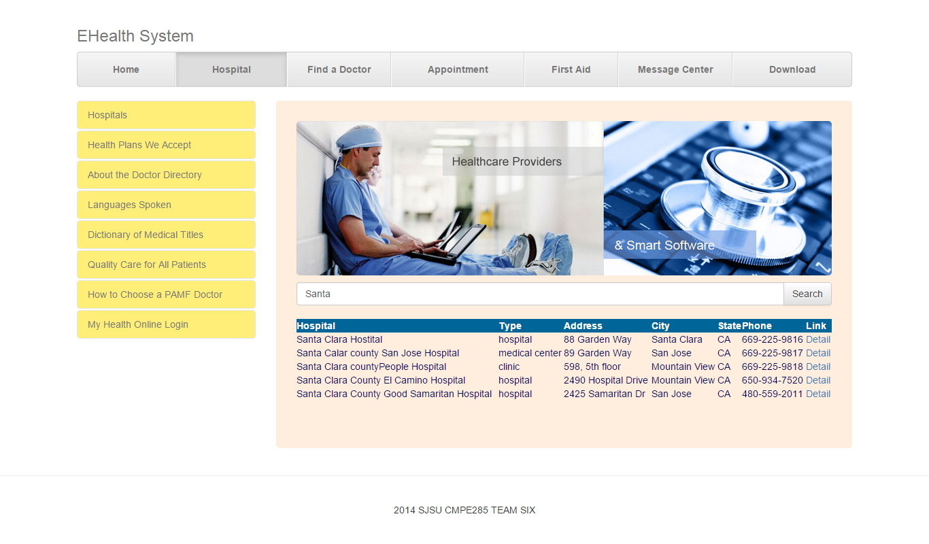
Web Client - Hospital Search

Slide 8
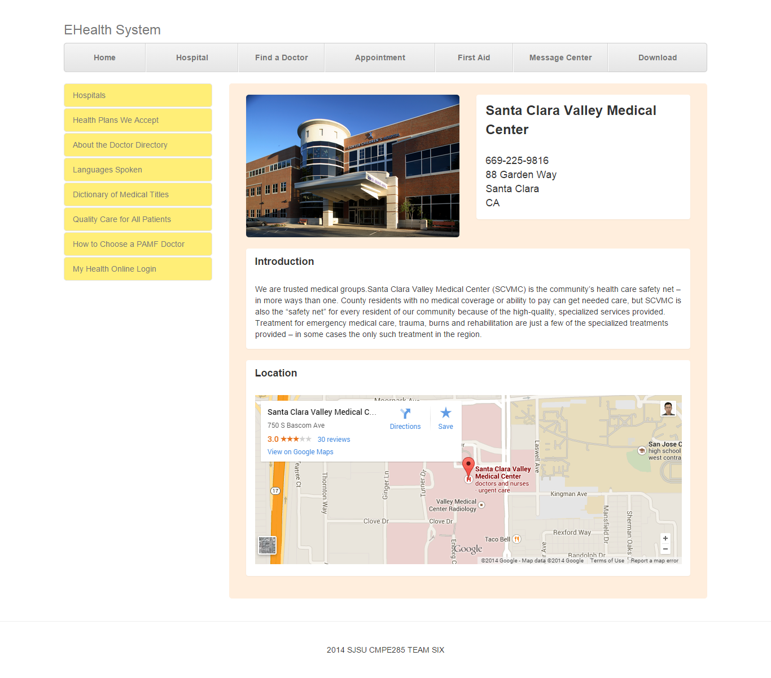
Web Client - Hospital Detailed Information

Slide 9
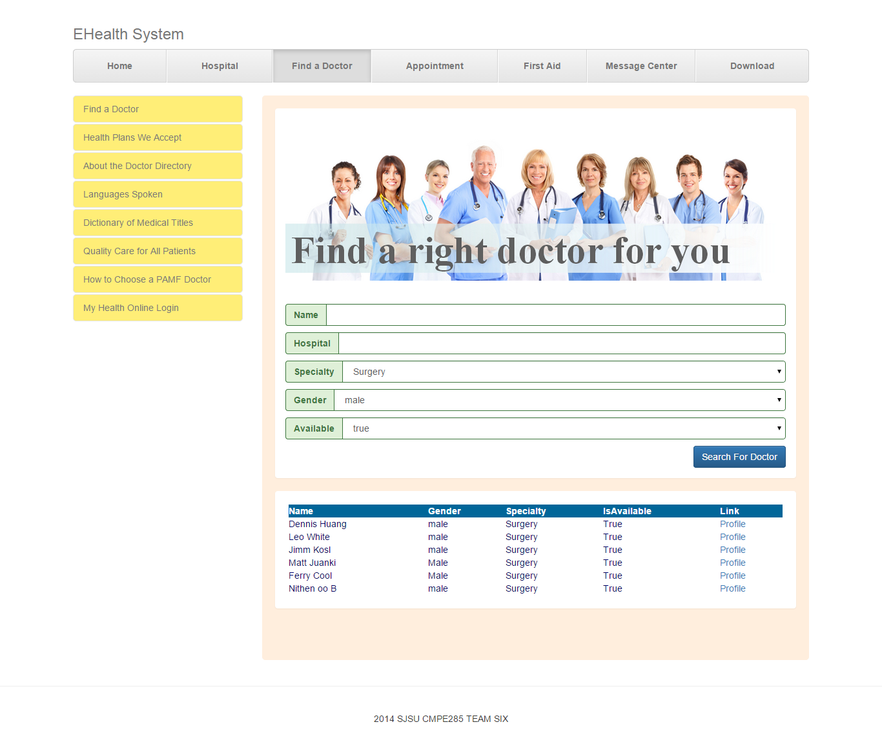
Web Client - Find a doctor

Slide 10
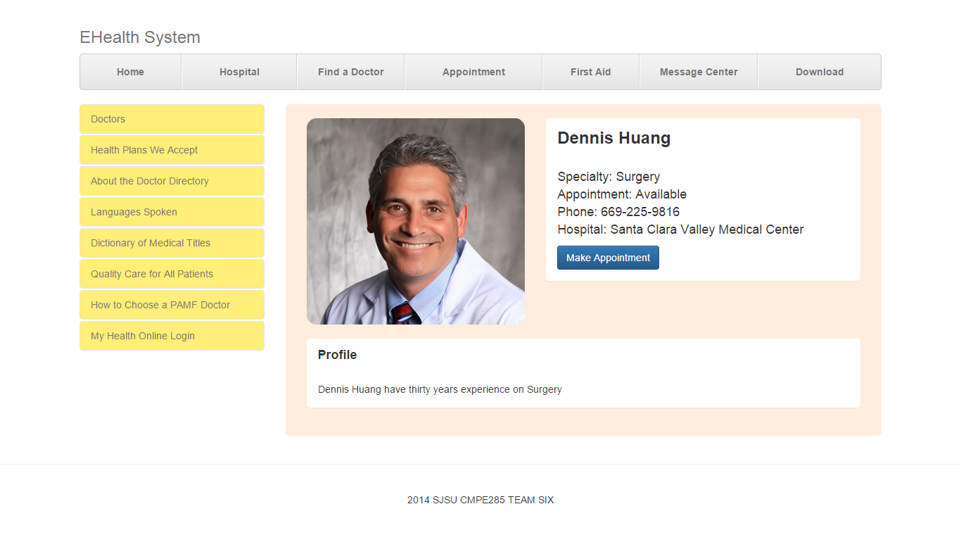
Web Client - Doctor Profile

Slide 11
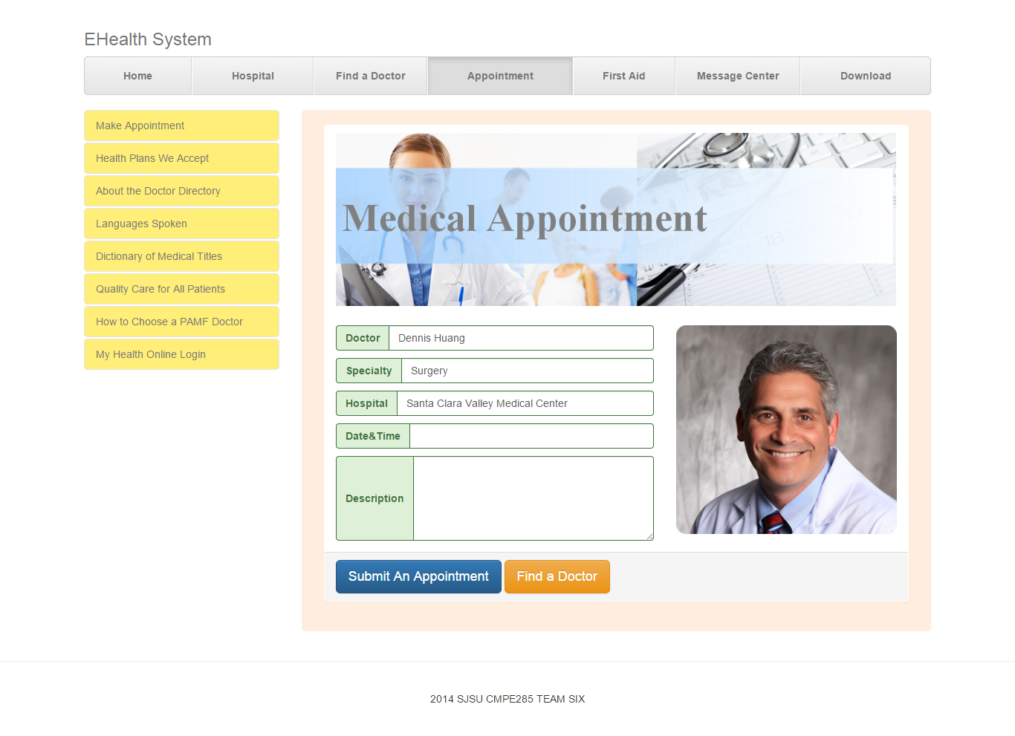
Web Client - Make Appointment

Slide 12
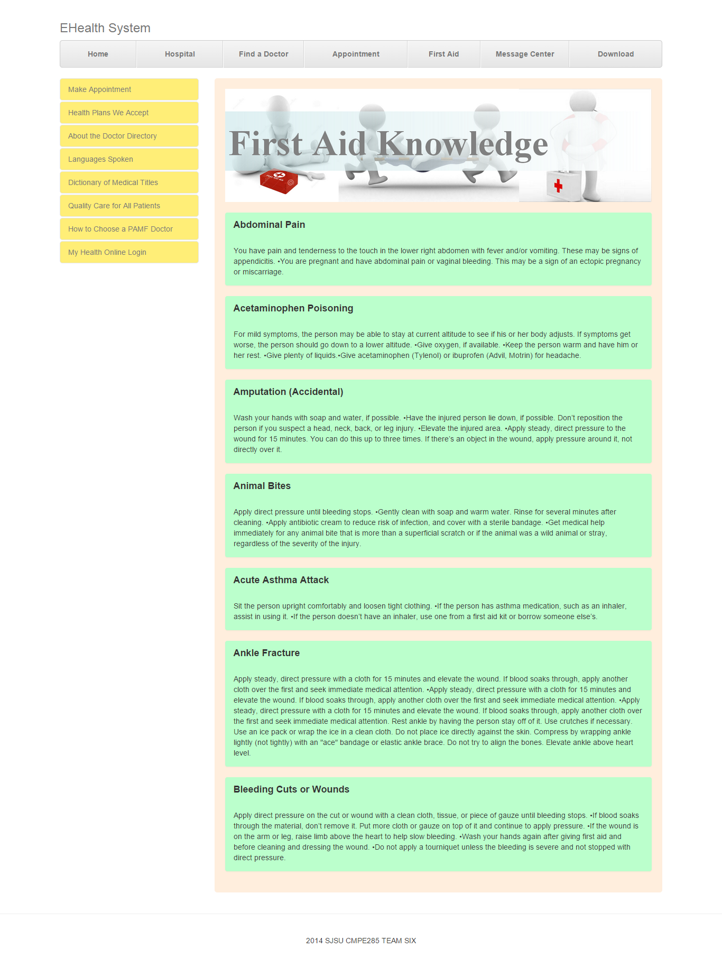
Web Client - First Aid

Slide 13
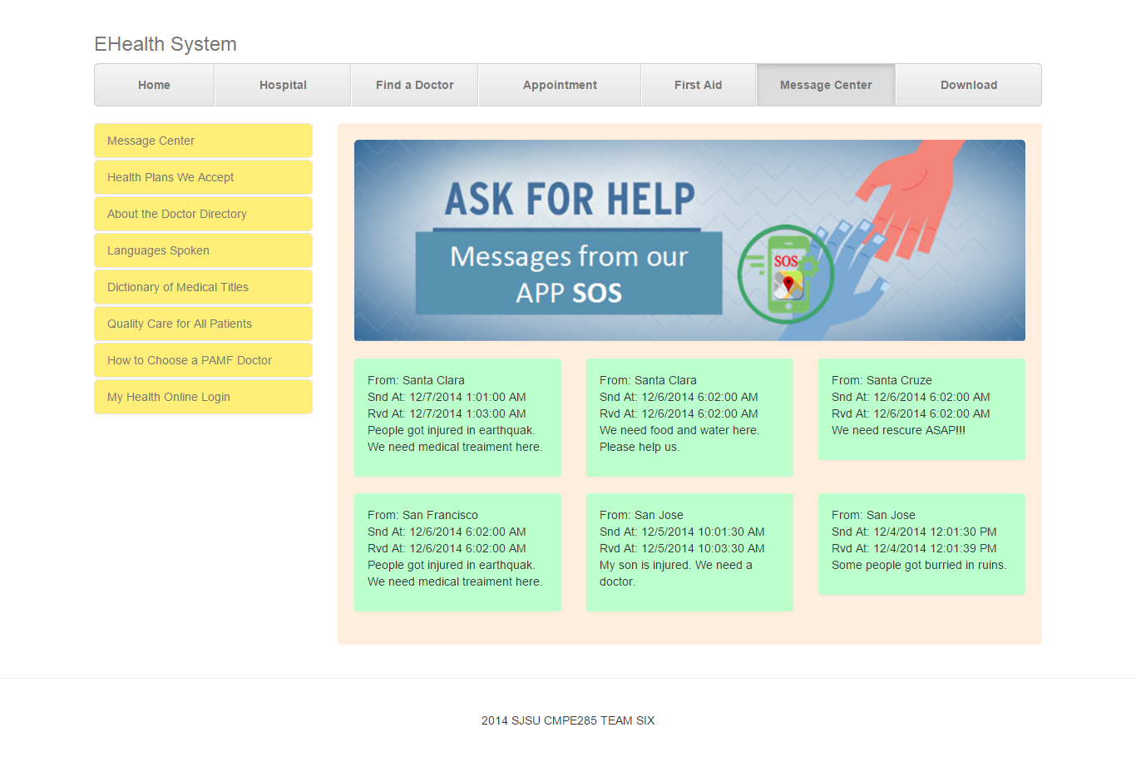
Web Client - Message Center for Emergency

Slide 14
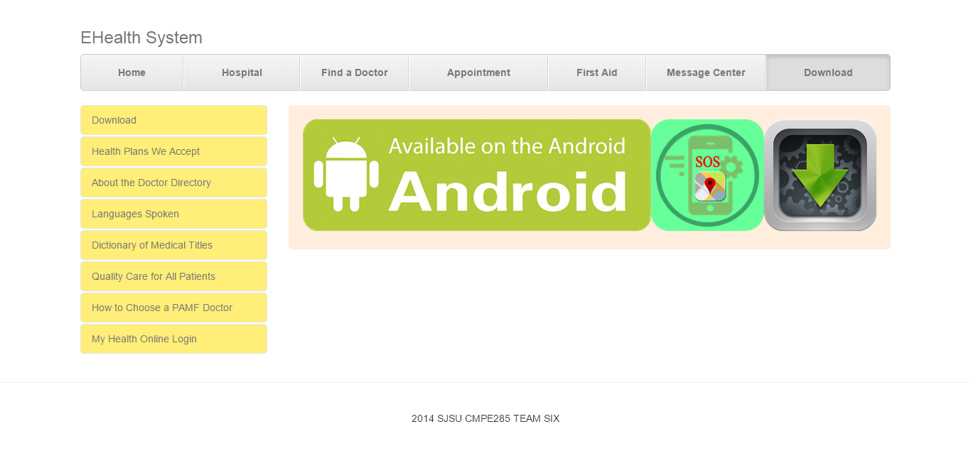
Web Client - APP Download

Slide 15
Web System - Technology Employed
Web Server
Web Service
Azure Cloud Service
SQL Server
ASP.NET
Google Map API
Web Client
Bootstrap
JQuery
ASP.NET

Slide 16
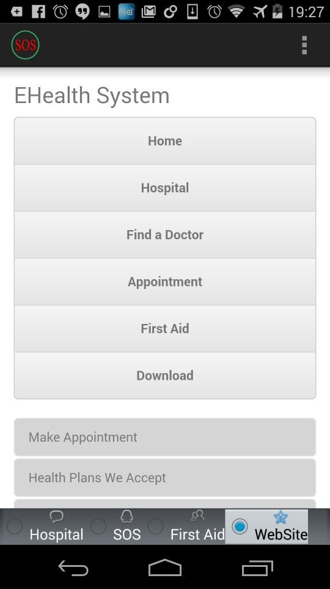
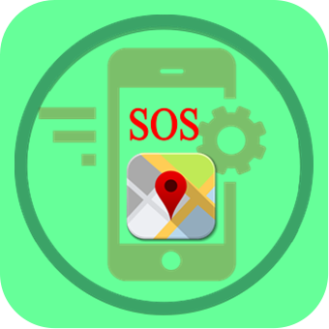
SOS Mobile APP

Slide 17


SOS - Features
P2P Communication
Communication Relay
Cache System

Slide 18
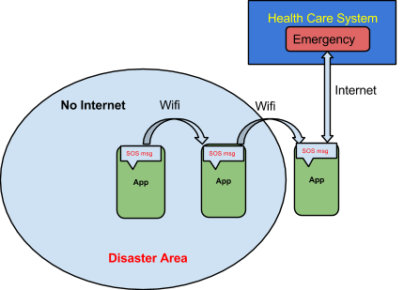
SOS - P2P Communication & Relay
In no-cellullar context, P2P Communication is possible between Apps.
App also can send SOS message to server through communication relay.

Slide 19
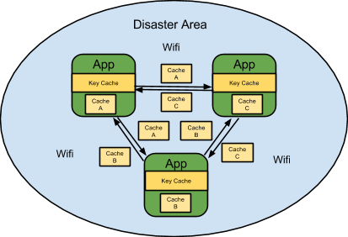
SOS - Cache System
Server will push updated data to APP in designated time.
App cache data in Sqlite.
Caching data could be exchanged between Apps.
through P2P communication in no-cellular context.
Server
Mobile
Sqlite

Slide 20
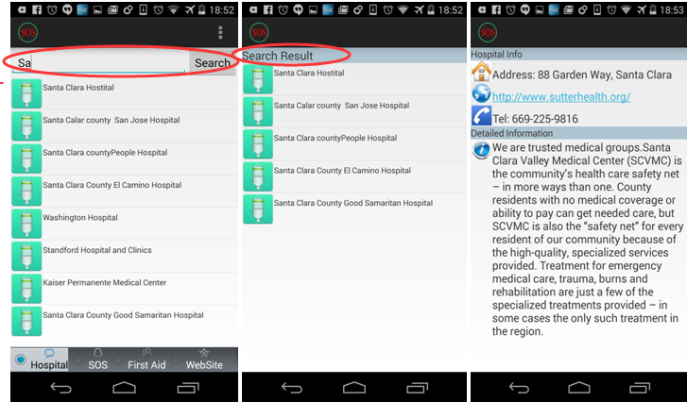
SOS - Hospital Search

Slide 21
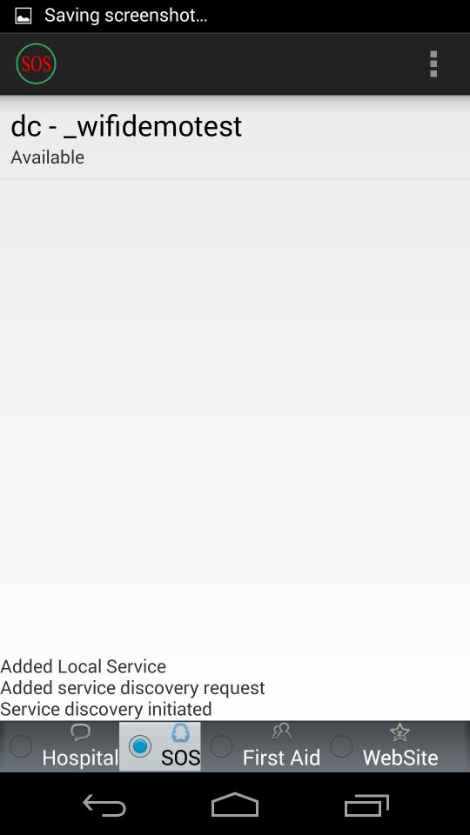
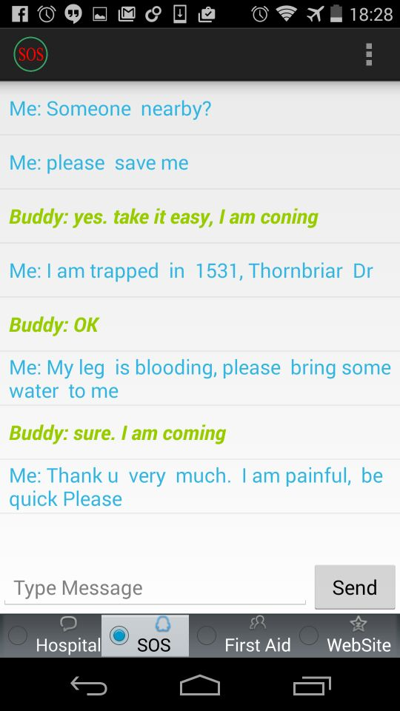
SOS - SOS Message

Slide 22
SOS - Technology Employed
P2P Connection
Wifi Discovery
Web Service
Sqlite
Android

Slide 23

Thank You！

