Slide 1


FPT SOFTWARE HO CHI MINH CITY VIET NAM NATIONAL UNIVERSITY HO CHI MINH CITY UNIVERSITY OF SCIENCE
REPORT MOCK PROJECT
WHEELCHAIR ACCIDENT DETECTOR
WAD
Group 4
Ho Chi Minh City, August 3, 2018.

Slide 2
CONTENT
1. PROBLEM
2. OVERVIEW PROJECT
3. OPERATING PRINCIPLE
4. DEMO
5. CONCLUSION

Slide 3
CONTENT
1. PROBLEM
2. OVERVIEW PROJECT
3. OPERATING PRINCIPLE
4. DEMO
5. CONCLUSION

Slide 4


1. PROBLEM
Supervising and supporting on time

Slide 5
CONTENT
1. PROBLEM
2. OVERVIEW PROJECT
3. OPERATING PRINCIPLE
4. DEMO
5. CONCLUSION

Slide 6
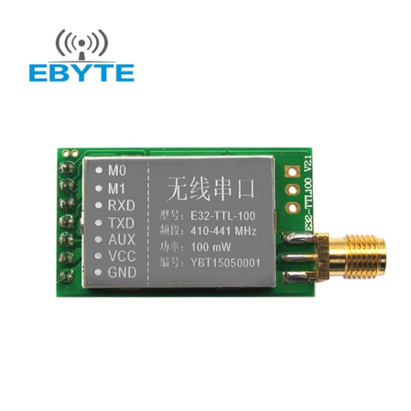
2. OVERVIEW PROJECT
HARDWARE
Module Lora SX1278
Module size:21*36mm
Antenna type: Standard SMA antenna (FREE)
Power supply:2.3V-5.5V DC
Communication level:5.2V(max)
Transmission distance:3000m(max)
Maximum powAer:2dB(100mW)
Air rates:2.4Kbps
Emission current:130mA @ 100mW
Receiving current:13.5mA @ Mode 0, Mode 1
Sleep Current:2.0uA(M1=1,M1=0)
Emission length:256 Byte
Receive length:256 Byte
Communication Interface: UART
RSSI support: Yes
Working frequency:410MHz-441MHz(Default 433MHz)
Operating temperature:-30?~+85?
Receiver sensitivity:-130dBm @ 1.2Kbps

Slide 7
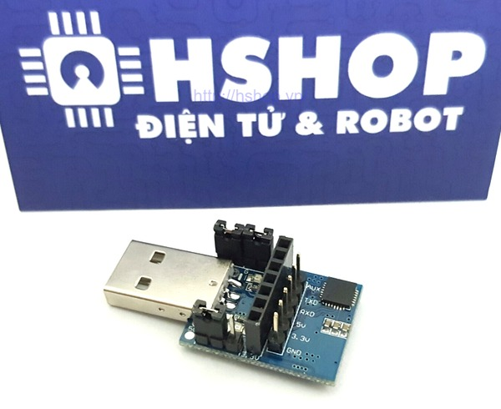
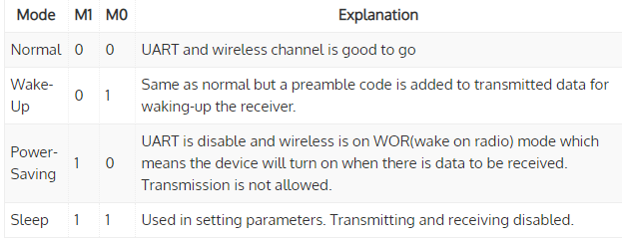
2. OVERVIEW PROJECT
HARDWARE
USB UART Lora SX1278 Transmission
Modes of the module

Slide 8
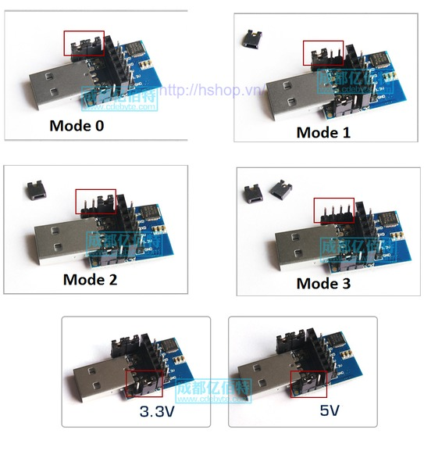
2. OVERVIEW PROJECT
HARDWARE
Configuring Modes

Slide 9
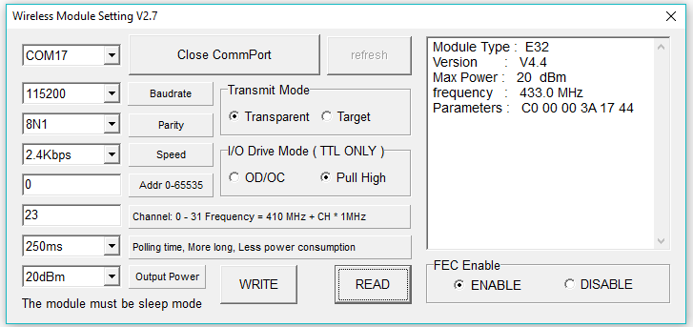
2. OVERVIEW PROJECT
HARDWARE
Connection Lora with PC and microcontroller

Slide 10
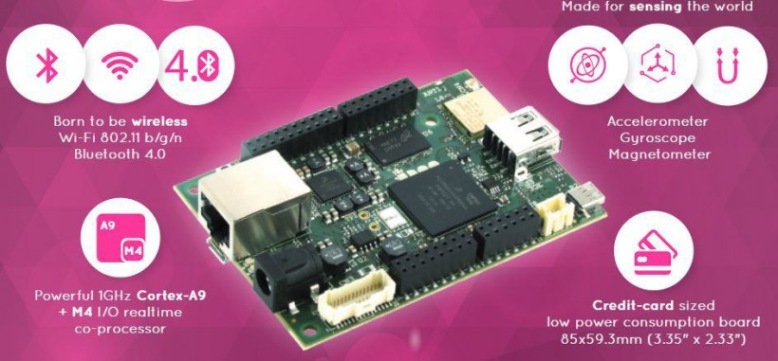
2. OVERVIEW PROJECT
HARDWARE
https://www.udoo.org/docs-neo/Introduction/Introduction.html

Slide 11
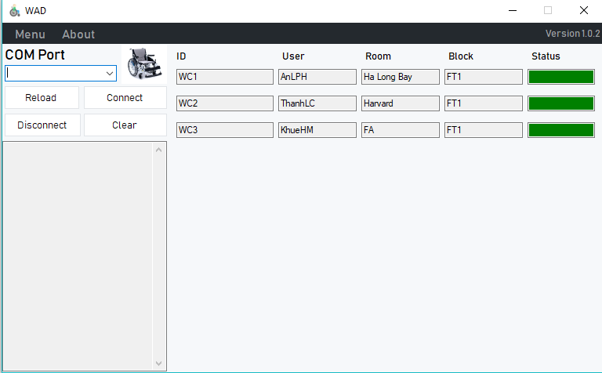
2. OVERVIEW PROJECT
SOFTWARE

Slide 12
CONTENT
1. PROBLEM
2. OVERVIEW PROJECT
3. OPERATING PRINCIPLE
4. DEMO
5. CONCLUSION

Slide 13
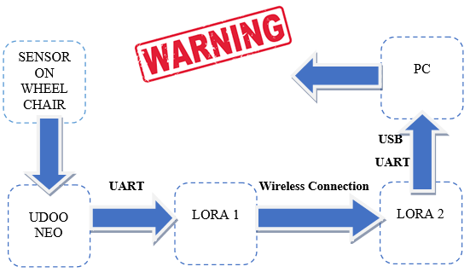
3. OPERATING PRINCIPLE

Slide 14
CONTENT
1. PROBLEM
2. OVERVIEW PROJECT
3. OPERATING PRINCIPLE
4. DEMO
5. CONCLUSION

Slide 15
4. DEMO

Slide 16
CONTENT
1. PROBLEM
2. OVERVIEW PROJECT
3. OPERATING PRINCIPLE
4. DEMO
5. CONCLUSION

Slide 17
5. conclusion
ADVANTAGES
Light weigth
Saving Energy
Easy to use
Wide range
DIFFICULTIES
High price
Accuracy is not high

Slide 18
THANKs FOR LISTENING

