Slide 1

Integrating eQTL data with GWAS summary statistics identifies novel genes and pathways associated with schizophrenia
Chong Wu and Wei Pan
Division of Biostatistics, University of Minnesota
Oct. 17, 2017

Slide 2
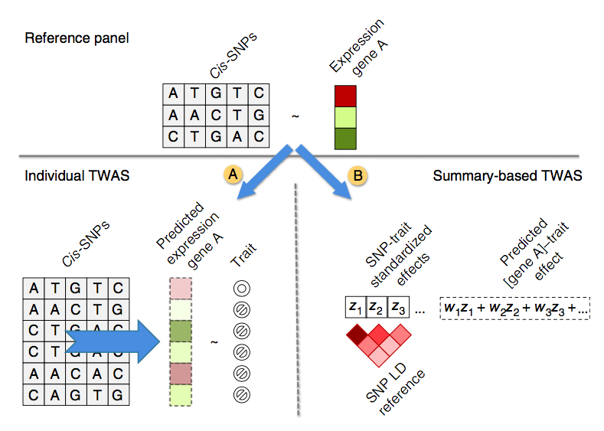
PrediXcan
copyright @ Gusev et. al. (2016)

Slide 3
Novel reformulation
PrediXcan = TWAS = (weighted) Sum test;
Sum test will lose statistical power under many situations;
More powerful tests, such as SSU and aSPU, can be applied.

Slide 4
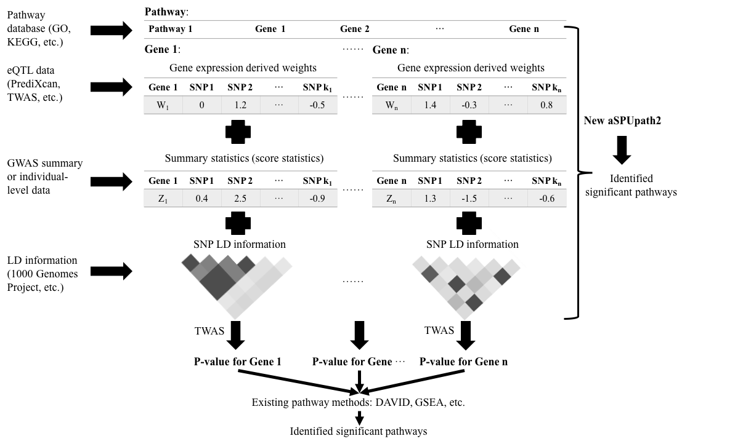
Pathway-based analysis

Slide 5
Gene-based analysis results
Table: The numbers of the significant genes identified by analyzing the SCZ data. The numbers a/b in each cell indicate the numbers of (a) the significant genes; (b) the significant genes covering at least one genome-wide significant SNP within 500 kb in the SCZ data.
 | YFS | NTR | METSIM | CMC | Combined
TWAS | 63/46 | 49/39 | 4332 | 69/50 | 202/142
SSU | 127/94 | 78/59 | 108/76 | 124/85 | 381/255
aSPU | 105/83 | 69/60 | 87/72 | 110/82 | 314/235

Slide 6
Pathway-based analysis results
Table: The significant and novel gene sets containing no significant genes as identified by a new pathway-based method.
ID | Description | P-value
GO:1902710 | GABA receptor complex | 0.0E+00
GO:1901661 | quinone metabolic process | 2.0E-08
GO:0016339 | calcium-dependent cell-cell adhesion | 2.2E-07
GO:0030315 | T-tubule | 2.3E-07
GO:0007528 | neuromuscular junction development | 5.7E-07
GO:0003143 | embryonic heart tube morphogenesis | 9.5E-07
GO:0007569 | cell aging | 1.6E-06
GO:0035050 | embryonic heart tube development | 1.8E-06

Slide 7
Summary
We have developed a powerful adaptive test (aSPU) to integrate GWAS and eQTL data;
PrediXcan and TWAS, can be regarded as a special case of our proposed test;
Extend TWAS from gene-based analysis to pathway-based analysis can identify new pathways that may be missed by gene-based analysis
Chong Wu (a biostatistics Ph.D. candidate at the University of Minnesota, chongwu@umn.edu) is looking for an Assistant Professor or Research Scientist position.

