Slide 1
EmoGenius Crew
An Innovative Android Appication
TEAM MUMBERS: WangYifan, LuYuhao, WangYanbo, ZhengBinyue
Zhangxindan, ZhengHaoyuan, Wuguohua, LiGuandong, ShiTianjun, FanJinzhen, WangZhaoyou
Software Engineering

Slide 2
2.4
Functions
PART TWO

Slide 3
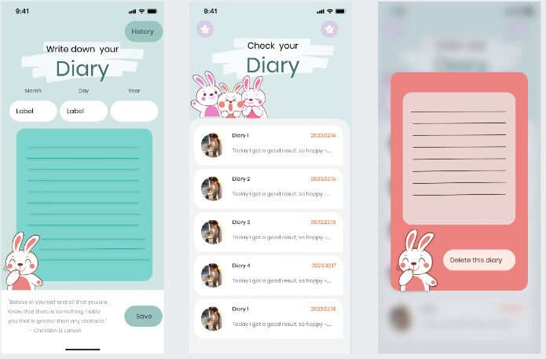
2.4.1 Emotional diary interface
2.4.1.1 Result
Our group plans to make the emotional diary module a separate interface, which can be entered after the "Emotional Diary" button on the homepage.
In this diary module, users can choose to create and save a new emotional diary or review the history by clicking one of the buttons at the very beginning page.

Slide 4



2.4.1.2 Process
Difficulty description:
Difficulties in finding material : including how to find the right pattern and background.
1.We need to determine what kind of patterns to look for can meet the overall design of the APP, and whether different styles of patterns are needed in different modules and how many patterns to look for.
2.The need to determine the source of the pattern prototype, that is : in what website can find the right pattern prototype.
3.Copyright and compliance issues

Slide 5




2.4.1.2 Process
Solution attempts and Whether solved:
1.Our group held an online meeting separately at the beginning of the project, and each member expressed his views and decided the most appropriate plan. Finally, we decided to find some lovely rabbit patterns.
2.According to the results of the above meeting, everyone went to find several sets of materials and shared them. Finally, it was determined that our pattern prototype mainly came from ink knife, instant design and Xiaohongshu materials.
3. In order to ensure that the selected material does not infringe any copyright or intellectual property rights, so as not to cause legal problems. We carefully review the copyright of each material before use, and avoid using resources that clearly mark ' uncommercial '.

Slide 6
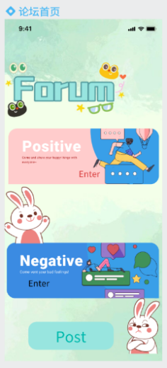
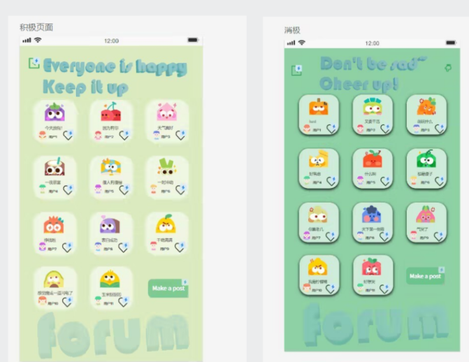
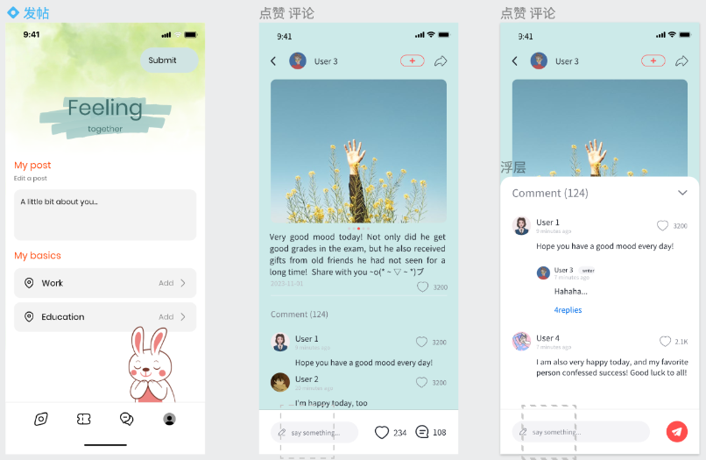
2.4.2 Forum
2.4.2.1 Result
Our group plans to divide the forum into 4 interfaces, namely: main interface, specific partition interface, posting interface, likes, comments, and reply interfaces for each post.

Slide 7

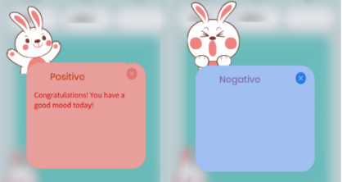
2.4.2.2 Process
Difficulty description:
1.How to choose a main framework that can adapt to the remaining functions and conform to the function. Because this part of the UI design volume is the largest, so this part of the design style, framework, etc.on the overall UI effect has a negligible impact ( forum home page design, for example ).
2.Font design and click effect of positive and negative pages. We have tried to use the font that can be modified in the ink knife, but the effect is not ideal. Our group hopes that these two partitions in the emotional forum can have a prominent sense of design.

Slide 8


2.4.2.2 Process
Solution attempts and Whether solved:
1.Through the red book search, the green tie-dye background that meets the theme is first determined, and then the art words and two maps corresponding to the entrance of positive and negative emotions are added. With cute and vivid rabbit, add a sense of lively.
2.The font part is modeled using blender software, and the head-up and ' forum ' words are designed through an online search tutorial. Add ' add component status ' to the page, so that the like function in the lower right corner of each mood realizes the function of clicking once ( single click ) as a like and then clicking ( double click ) as a cancellation.

Slide 9
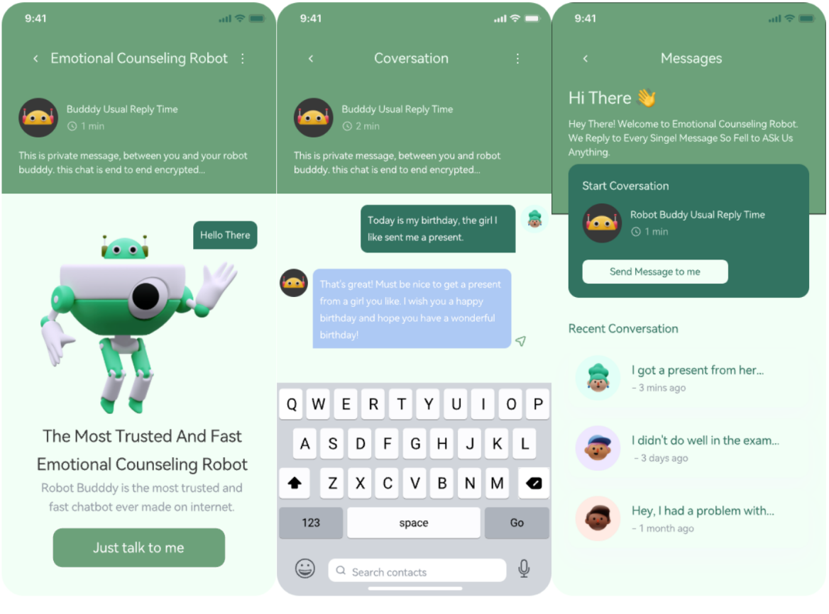
2.4.3 Emotional counseling robot
2.4.3.1 Result
The function of emotional counseling robot is divided into two interfaces: main interface and conversation interface.
The main interface consists of: emotional counseling robot function introduction, emotional counseling robot cartoon image display and chat start button (Just talk to me).
In the conversation page, users can click the text input field at the bottom to enter text to talk with the robot buddy, or click the voice recognition button at the lower right corner to convert the user's voice into text information.

Slide 10
2.5
Individual pages
PART TWO

Slide 11




2.5.1 Result
2.5.1.1 Individual center
Individual center has four functions: checking the numbers of follows and followers, looking the browsing history, looking user’s all diary and comments, and setting personal information.

Slide 12
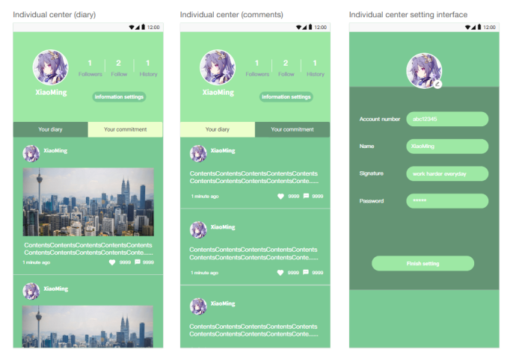
2.5.1.2 Individual center setting interface
Individual center setting interface provides the function of modifying user information. A user can change profile pictures, account number, name signature and password. These changes would be saved when the user presses' Finish setting '.

Slide 13




2.5.2 process
Difficulty description:
When designing the three pages of login, registration ( 2.2 ) and personal information setting, it is necessary to avoid homogenization, which makes it difficult for users to distinguish the situation of each page.
Solution attempts and Whether solved:
Solution attempts and Whether solved:
Through different design styles, typesetting, background color distinction, and text prompts, users can clearly identify different pages.

Slide 14
Thank You
Software Engineering

