Slide 1
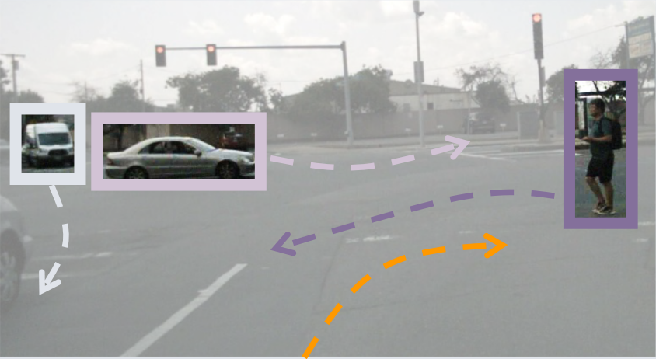
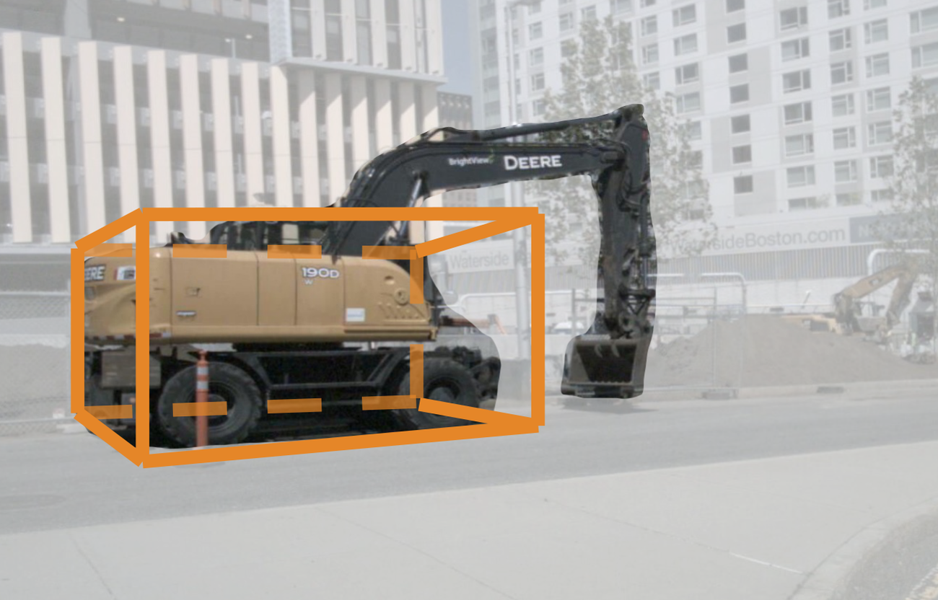
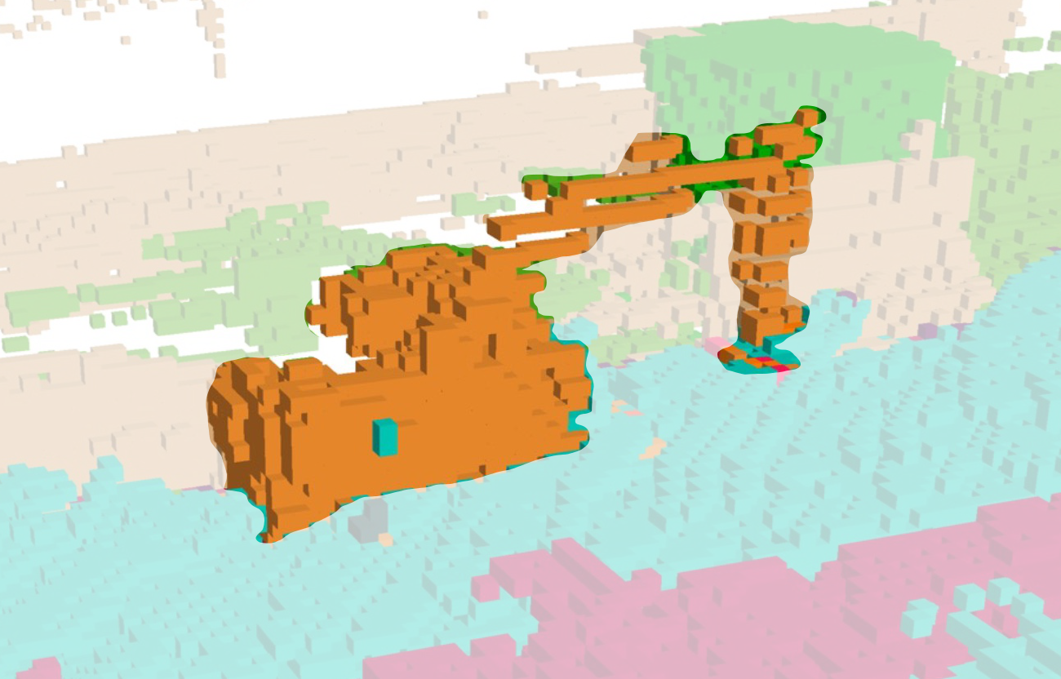
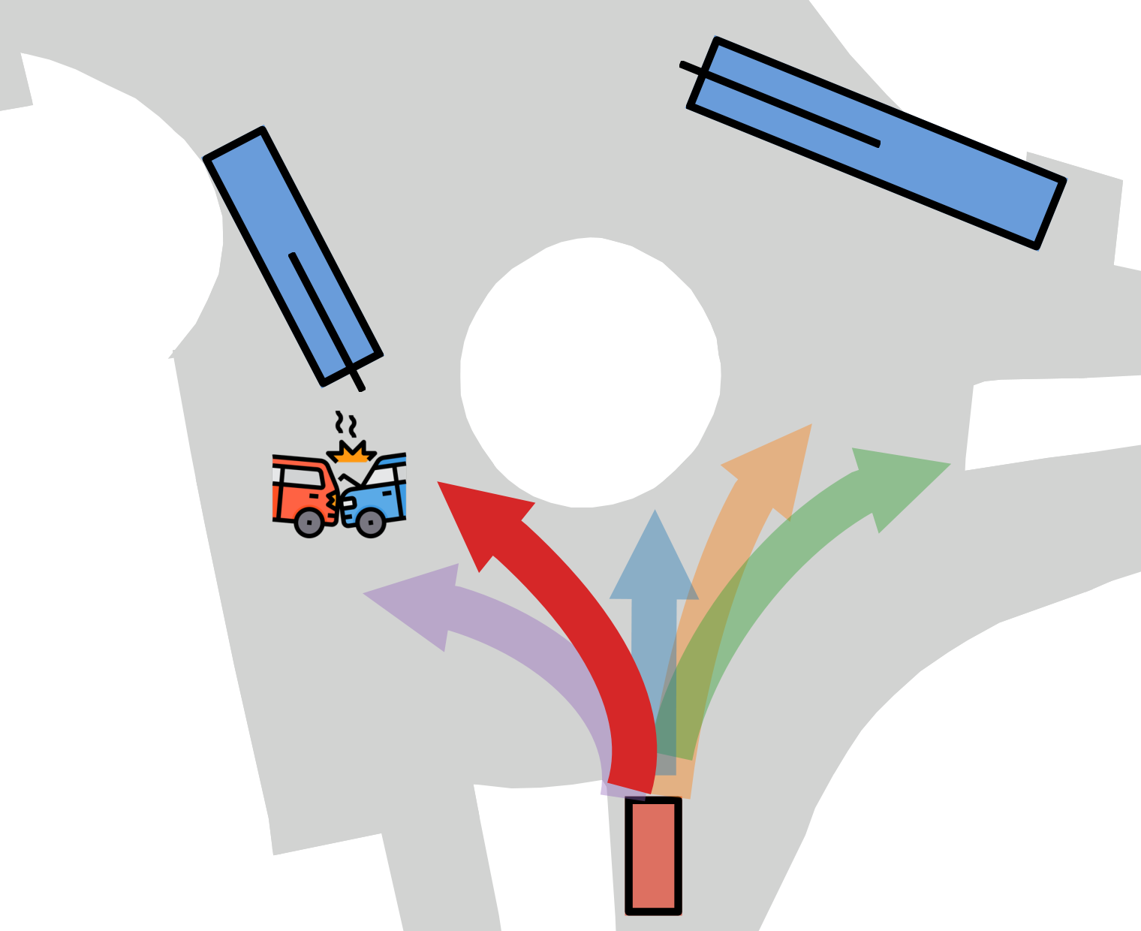
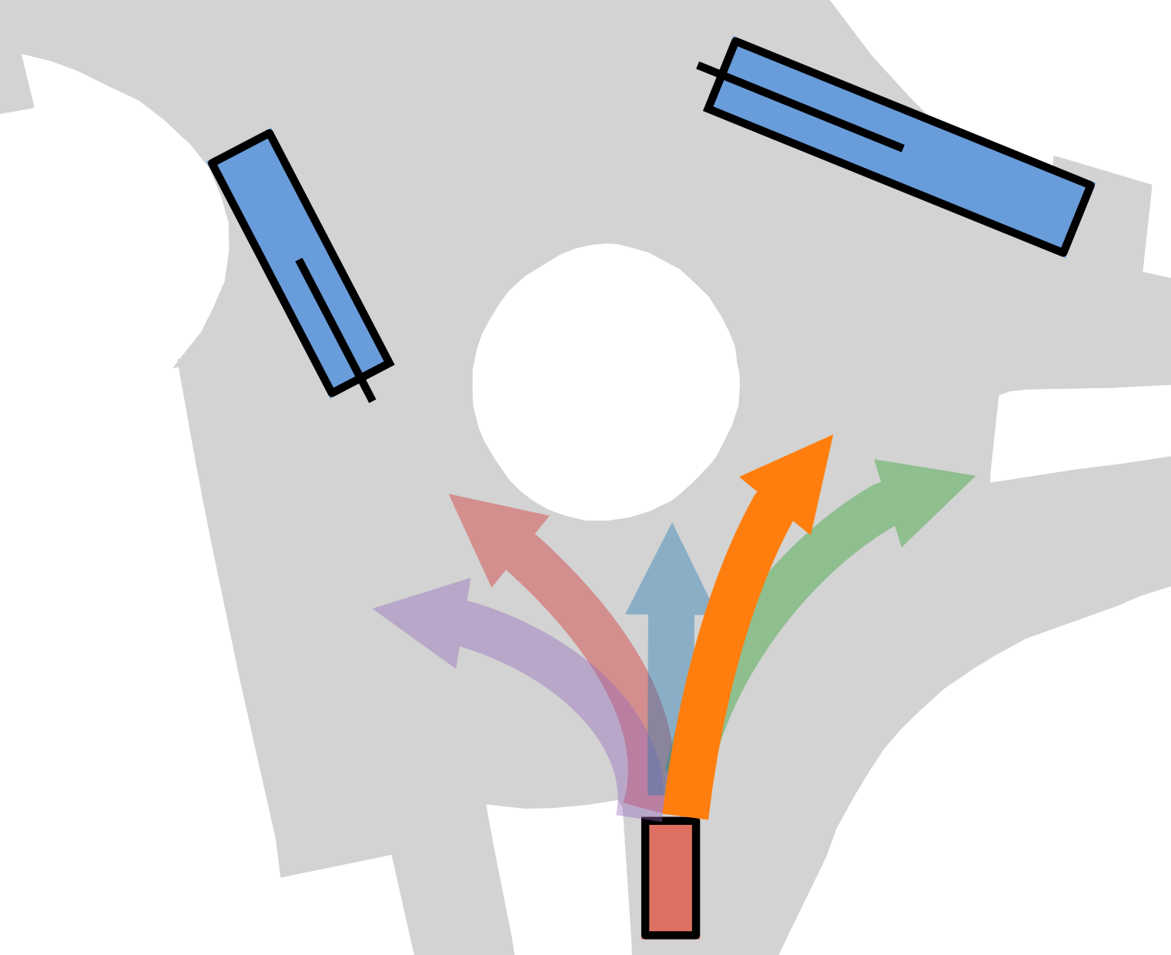
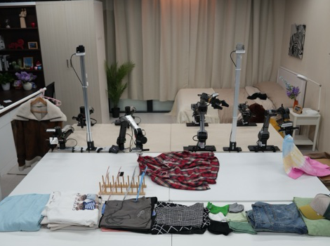
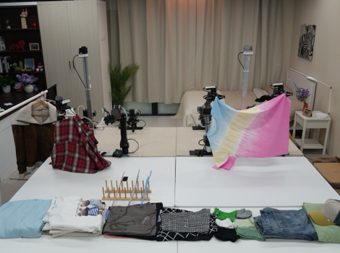
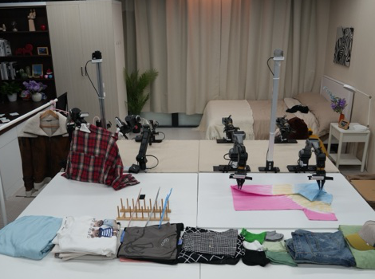
The real world (the curse of reality): irregular objects · long-tail scenarios · closed-loop shift · train–deploy gaps
observations
actions
Stage 1 · Perceive
Stage 2 · Reason
Stage 3 · Act
RQ1
RQ2
RQ3
Chapter 2
OccNet, OpenOcc,
OpenScene
Chapter 3
DriveLM-Agent,
DriveLM-Data
Chapter 4
Centaur,
test-time training
Chapter 5
χ₀,
resource-aware manipulation
rigid 3D box
3D occupancy
flattening
hanging
folding
w/o TTT
with TTT
P₁
P₂
P₃
B
M
Voxels capture what rigid boxes miss; OpenOcc and OpenScene benchmark occupancy at scale
Graph-structured VQA grounds a VLM from key objects to behaviour and motion
A test-time training step on Cluster Entropy removes the colliding plan (NAVSIM)
Train–deploy alignment for bimanual garment manipulation on real robots
Unified Perspective
Chapter 6 (RQ4)
Five elements of a self-correcting physical agent: (1) an open, queryable 3D representation · (2) fast and slow decisions (ETA*, FLARE*) · (3) a competence monitor · (4) adaptation at deployment · (5) a learning loop (PerturBot*, self-directed learning*)

