Slide 1
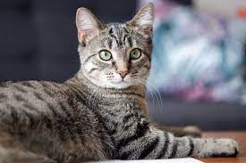

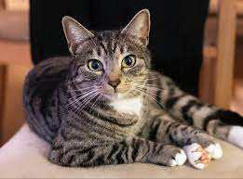
Fake
Real
Fake
Real
Real
Real

Slide 2
Sample
Real World
Images
Real
Discriminator
Discriminator Loss
Random/Conditional
Input
Generator
Generator Loss
Sample
Fake

Slide 3
Sample
Real World
Images
Discriminator Loss
Real
Discriminator
Random/Conditional
Input
Generator
Generator Loss
Sample
Fake
Gloss-Backpropagation

Slide 4
Dloss-Backpropagation
Sample
Real
Real World
Images
Discriminator
Discriminator Loss
Fake
Random/Conditional
Input
Generator
Generator Loss
Sample

