Slide 1
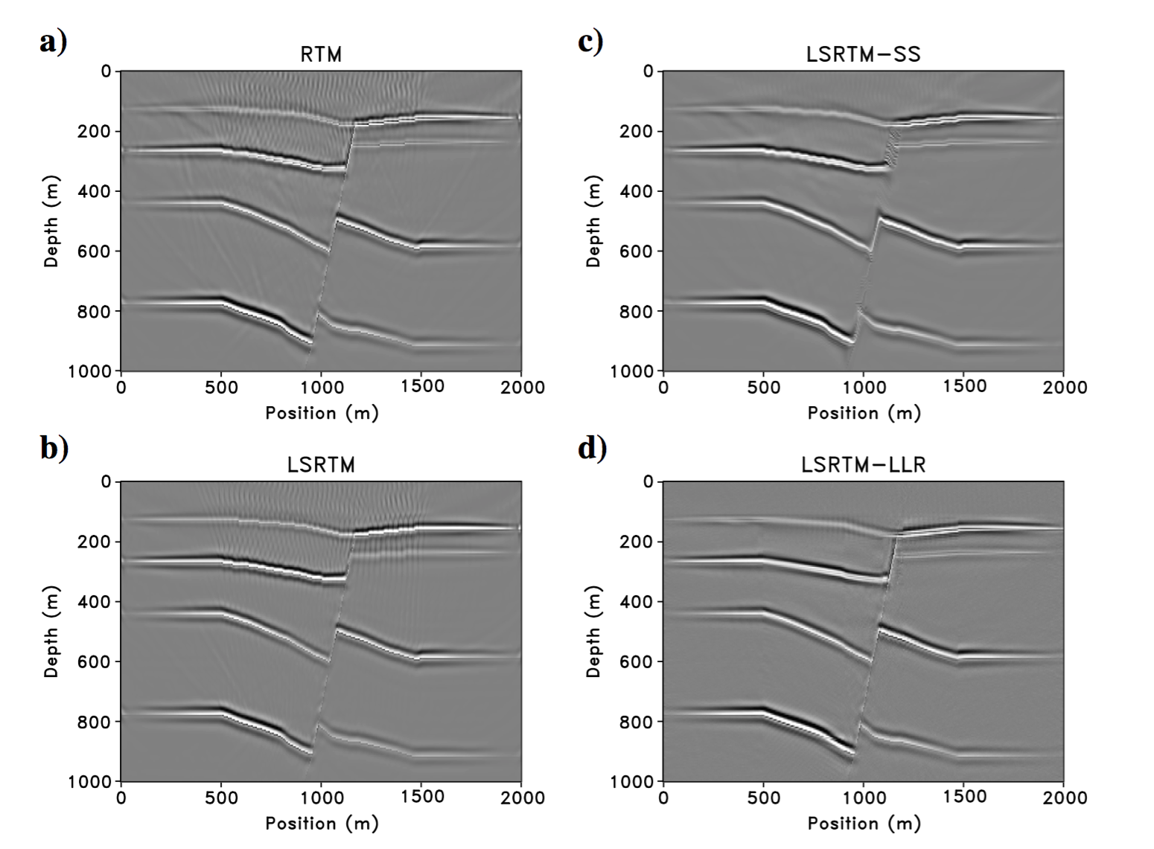
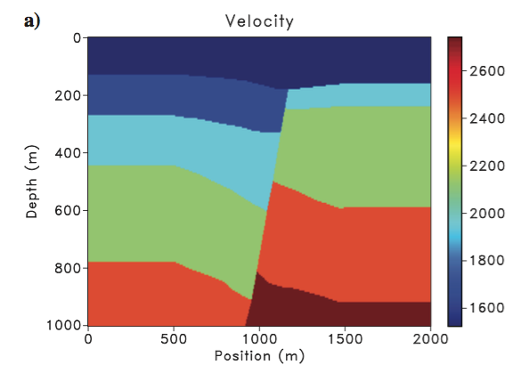
RTM result
LSRTM result
LSRTM with structural smoothness constraint
LSRTM with local low rank constraint

