Slide 1
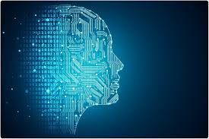

Slide 2
作者简介：
姓名：王冲野
部门：公安事业部
出生日期：1998-08-20
学历：现就读于美国伊利诺伊大学香槟分校
专业：计算机&统计
研究领域：人工智能，机器学习，文本挖掘，推荐系统,数值分析
邮箱：wangchongye@hikvision.com.cn

Slide 3
Artificial Intelligence and Data Science
人工智能和数据科学

Slide 4
What is artificial Intelligence 什么是人工智能？
Artificial intelligence (AI), sometimes called machine intelligence, is intelligence demonstrated by machines in contrast to the natural intelligence displayed by humans and other animals.
---wikipedia
人工智能（英语：artificial intelligence，缩写为 AI）亦稱機器智能，指由人製造出來的機器所表現出來的智能。通常人工智能是指通過普通電腦程式的手段實現的人類智能技術。該詞也指出研究這樣的智能系統是否能夠實現，以及如何實現科學領域。同時如此，人類的數量開始收斂及功能逐漸被其取代。
---维基百科

Slide 5
detailed Definition of Artificial intelligence
The theory and development of computer systems able to perform tasks that normally require human intelligence, such as visual perception, speech recognition, decision-making, and translation between languages.

Slide 6
Why AI ?

Slide 7
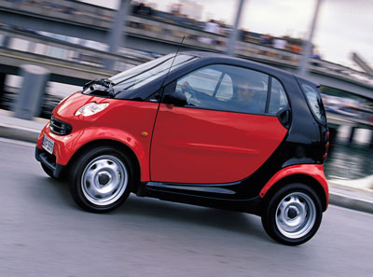

Slide 8
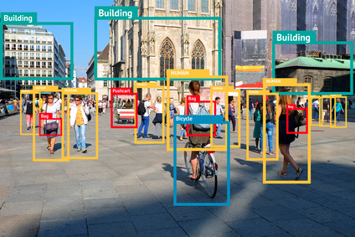

Slide 9
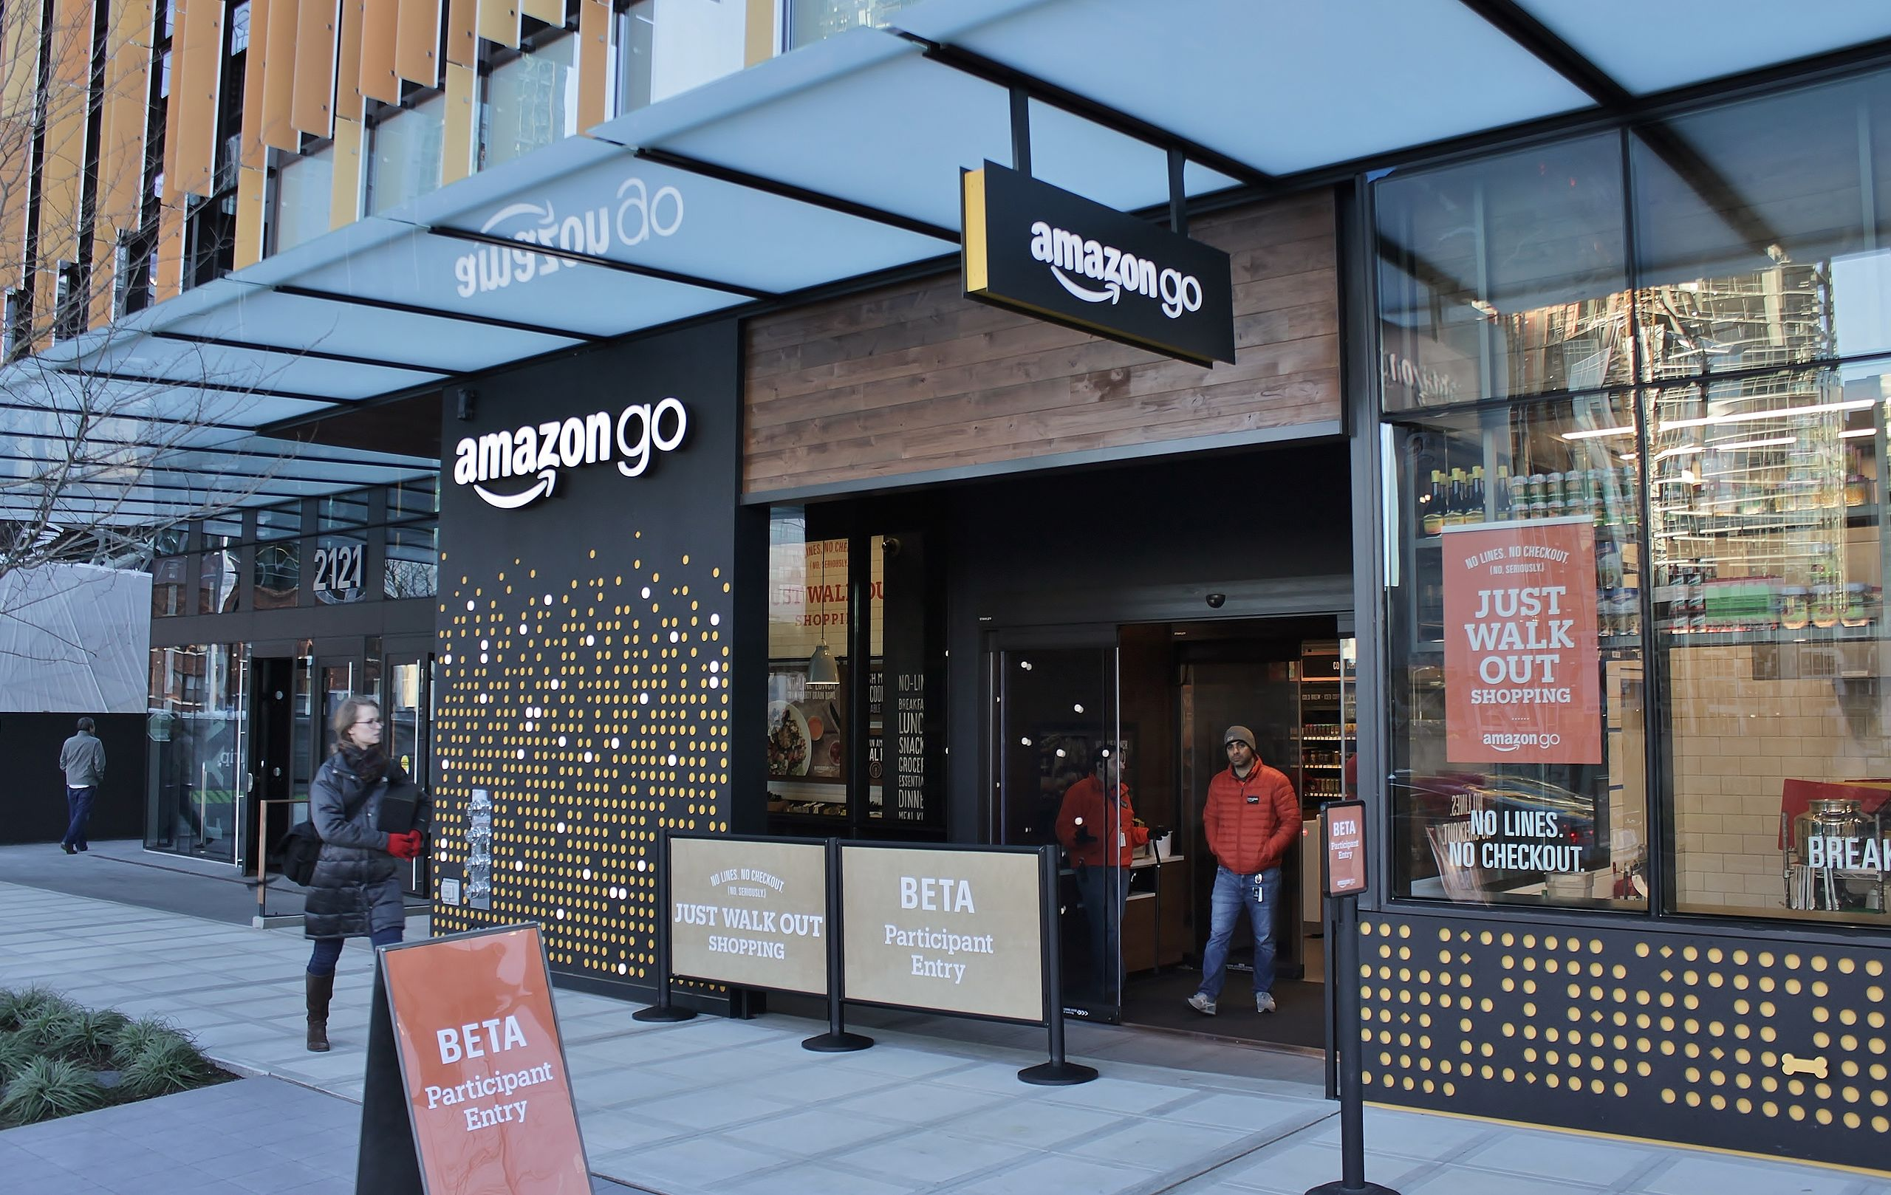

Slide 10


Slide 11


Slide 12
What is Data Science 什么是数据科学
Data science is an interdisciplinary field that uses scientific methods, processes, algorithms and systems to extract knowledge and insights from data in various forms, both structured and unstructured, similar to data mining.
---wikipedia

Slide 13
Relation between artificial intelligence and data science 人工智能和数据科学的关系

Slide 14
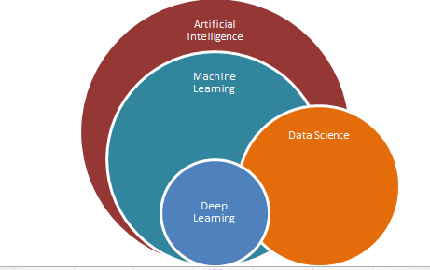

Slide 15
Machine Learning 机器学习
Text Retrieval 文本检索
Natural Language Processing 自然语言处理
Voice Recognition 语音识别
Data Mining 数据挖掘
Computer Vision 计算机视觉
Reinforcement Learning 强化学习
Recommender System 推荐系统
Deep Learning and Neural Network 深度学习和神经网络

Slide 16
What is machine learning 什么是机器学习
Machine learning is a subset of artificial intelligence in the field of computer science that often uses statistical techniques to give computers the ability to “learn” (i.e., progressively improve performance on a specific task) with data, without being explicitly programmed.
---wikipedia

Slide 18
机器学习和人工智能的关系： 机器学习是实现人工智能的一种方法

