Slide 1

INFO90002冲刺班
DueApe
导师：Alex
Notes:
版权声明：300套精品模板商业授权，请联系【锐旗设计】:https://9ppt.taobao.com，专业PPT老师为你解决所有PPT问题！

Slide 2
Past Exam 分析
16年试卷分析
试卷问题答疑

Slide 3
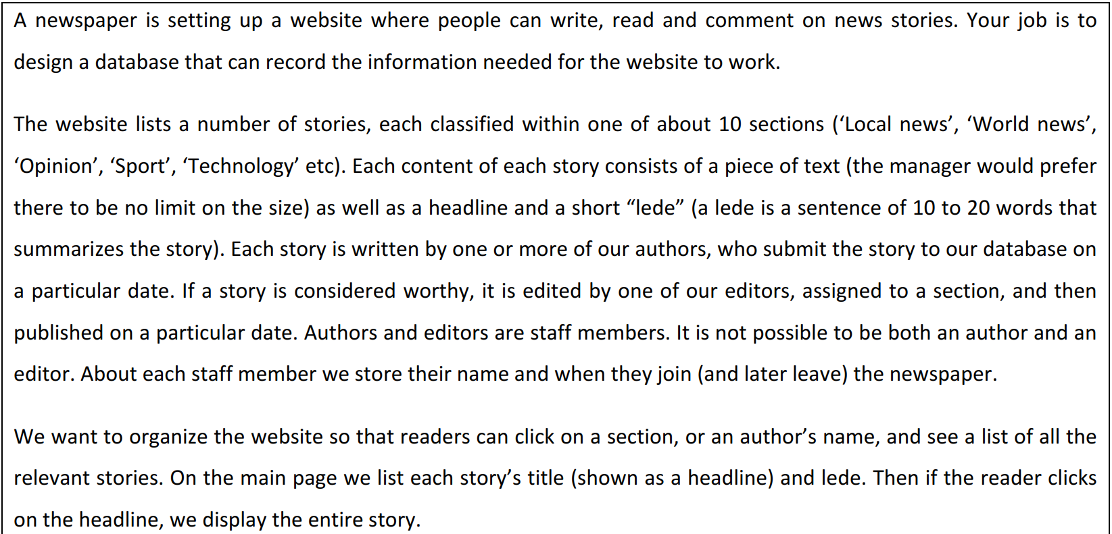
16年试卷

Slide 4
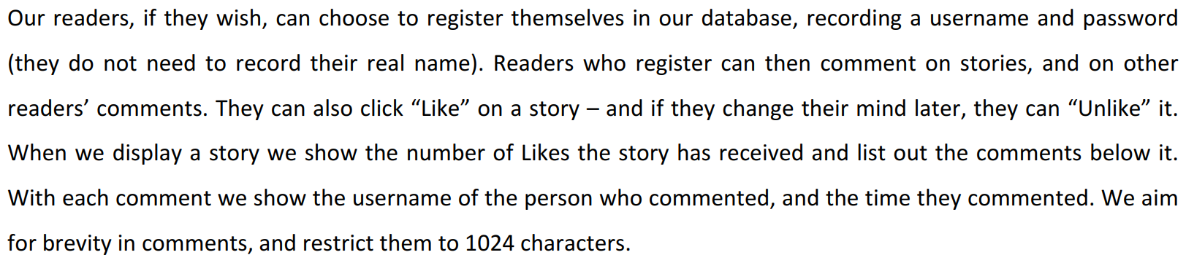
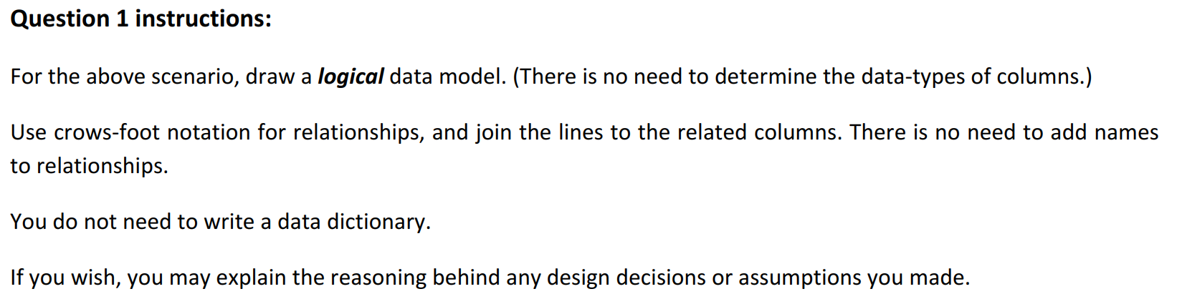

Slide 5
第一步：大致确定涉及到的实体Entities:
STORY, SECTION,DRAFT, AUTHOR DRAFT, EMPLOYEE, COMMENT, LIKE, READER
第二步：大致把每个实体所需要记录的attributes写下来。
STORY(ID, editor, section, headline, content, lede, select, publish),
SECTION(ID, name),
DRAFT(ID, headline, content, lede, submit),
AUTHOR DRAFT(AuthorID, DraftID),
EMPLOYEE(ID, Name, join date, leave date, role),
COMMENT(ID, content, storyID, readerID, parentComment, submit),
LIKE(readerID, storyID),
READER(ID, username,pw)

Slide 6
第三步：梳理表格之间大致的关系(1-多，多-多……)
记得标出PK,FK以及将多对多拆解成一对多
考logical data model 的概率会比physical data model更大，一般数据类型会放在后面单独考察。

Slide 7
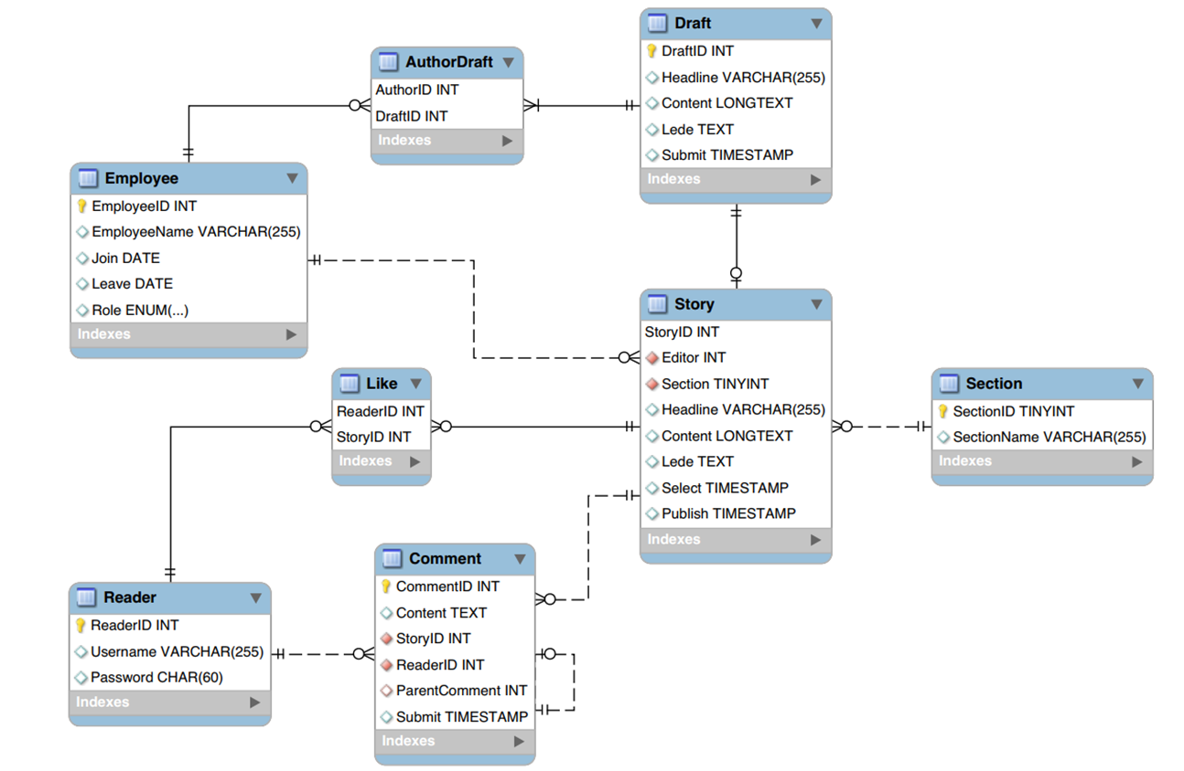

Slide 8
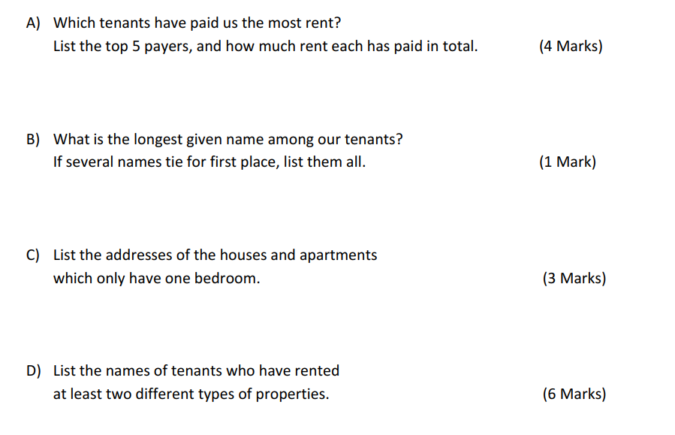
Q2

Slide 9
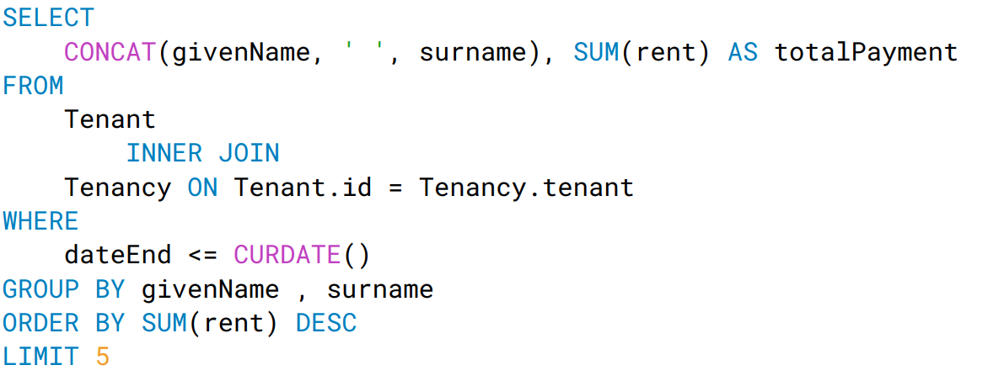
1.

Slide 10
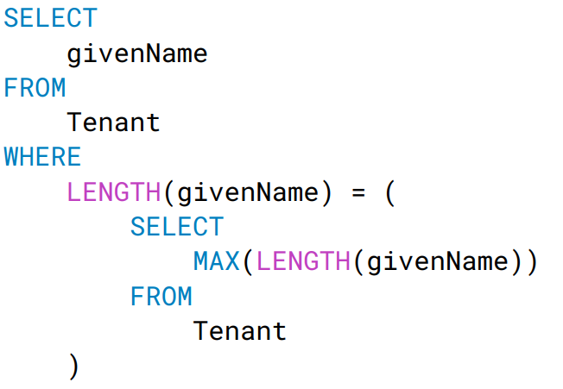
2.

Slide 11
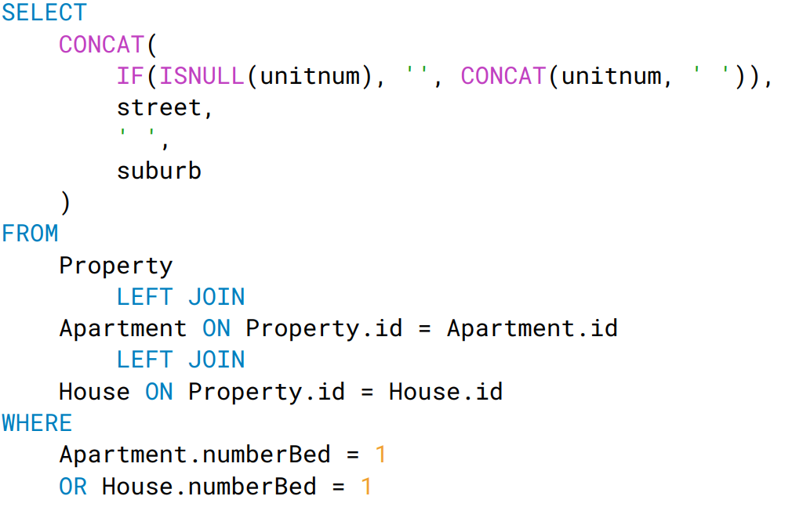
3.

Slide 12
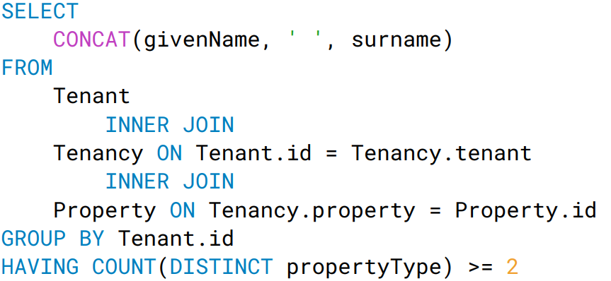
4.

Slide 13
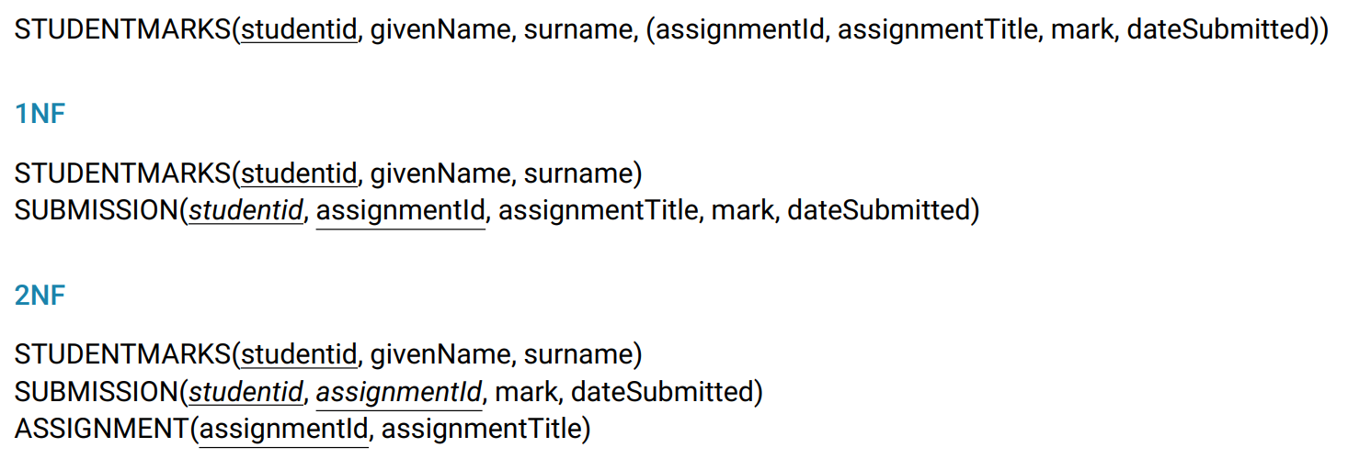
Q3

Slide 14
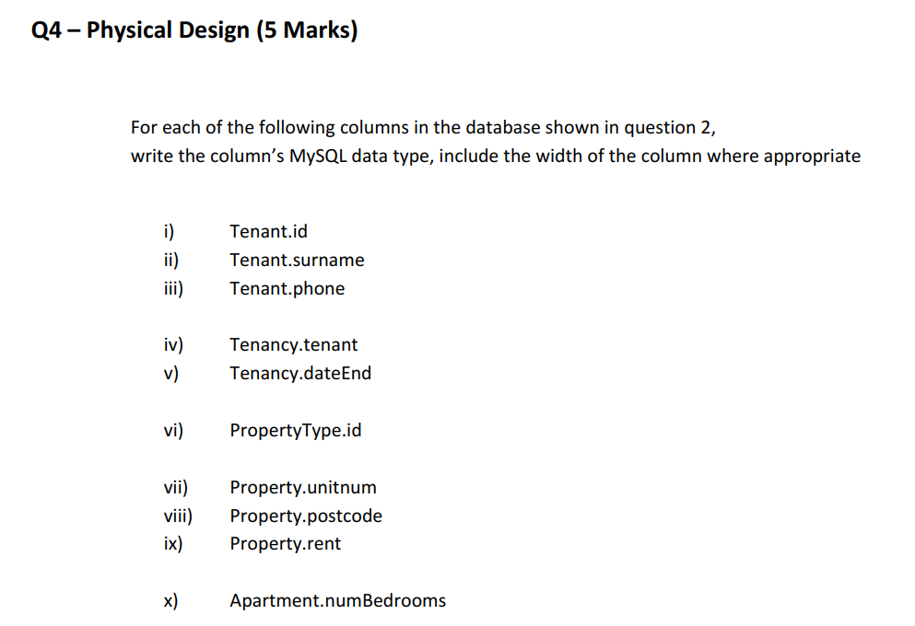

Slide 15
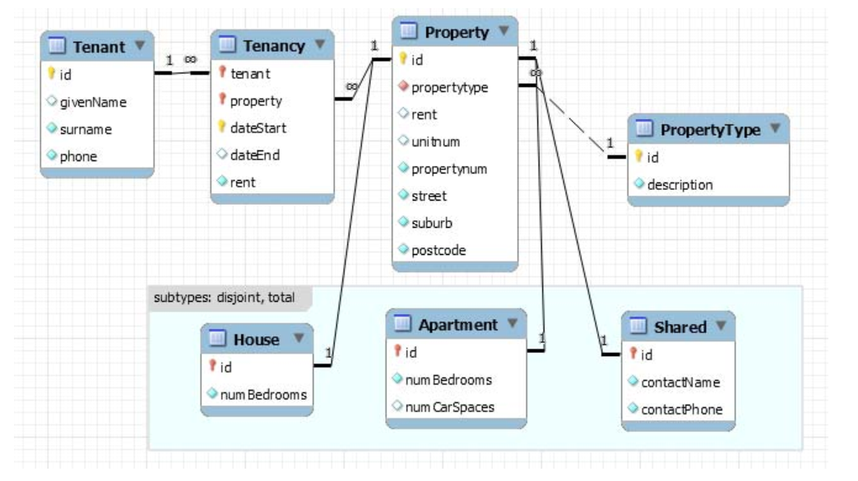

Slide 16
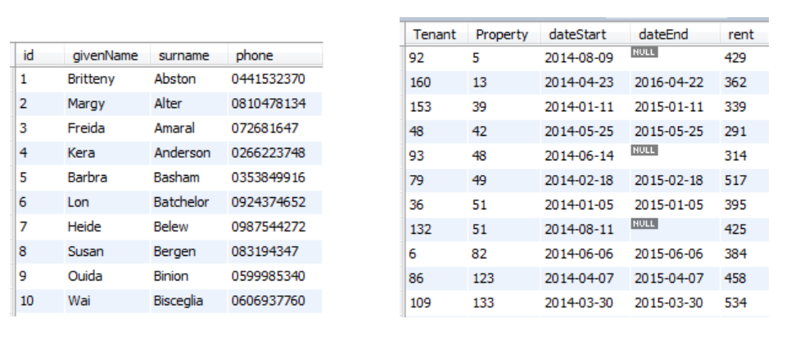

Slide 17
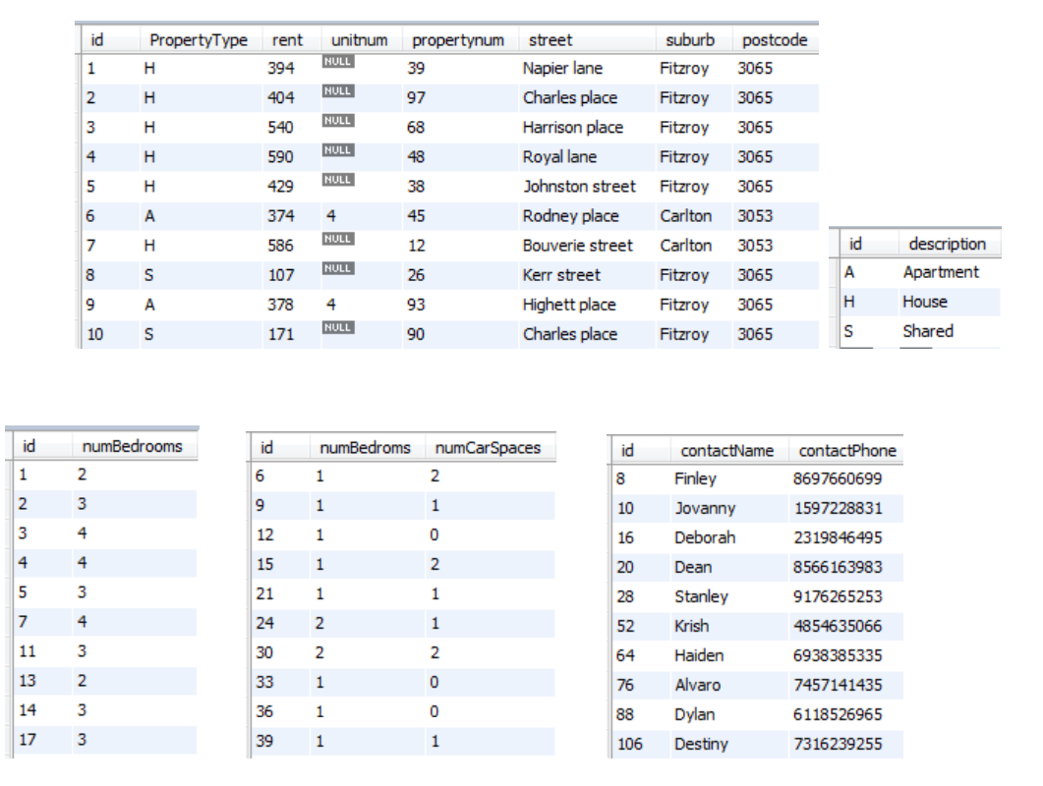

Slide 18
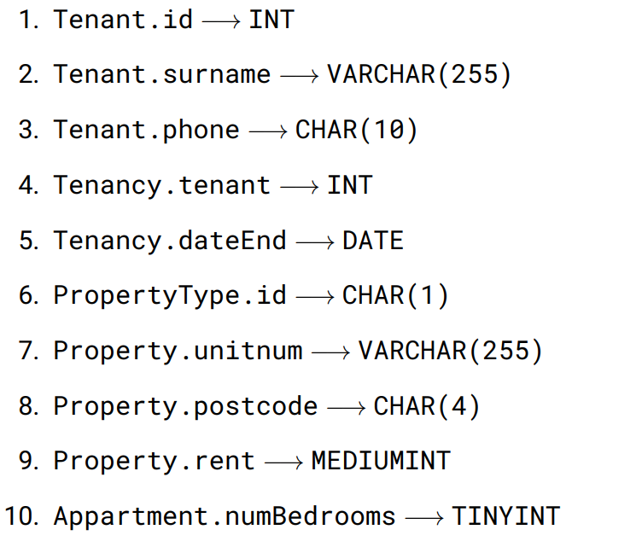

Slide 19
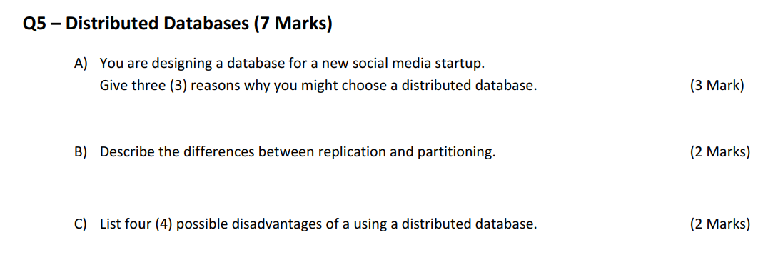

Slide 20
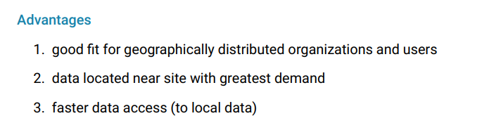
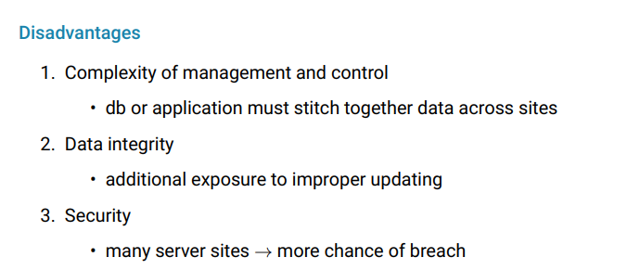

Slide 21
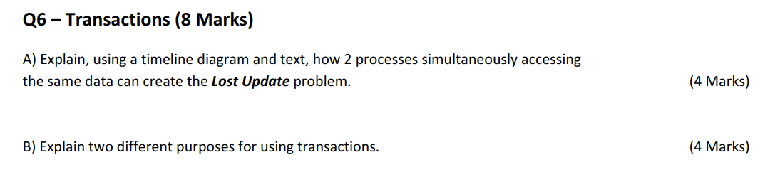

Slide 22
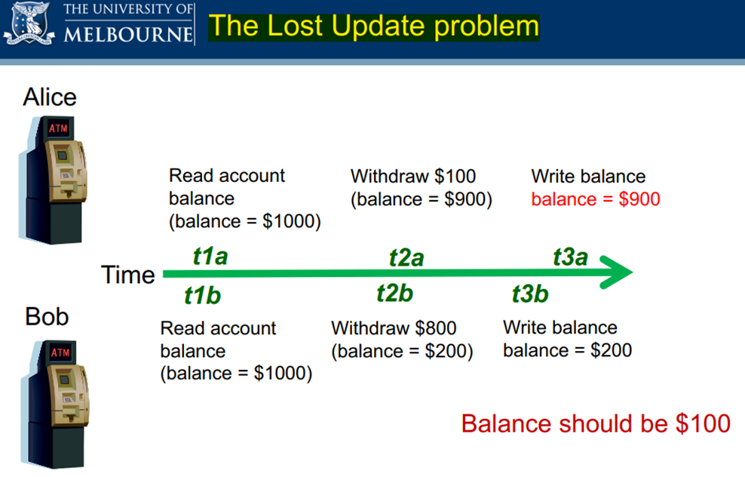

Slide 23
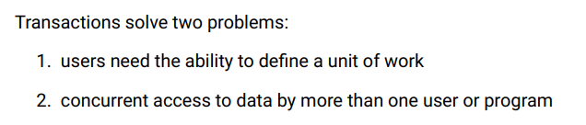

Slide 24
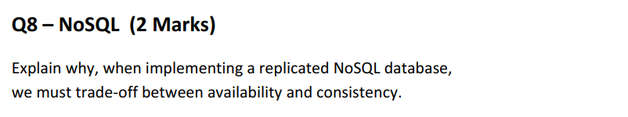

Slide 25
In the context of replicated (NoSQL) databases, this means there is always going to be a trade-off between consistency and availability.
This is because replicated systems are always necessarily partition tolerant (ie. it simply wouldn't be a distributed database if it wasn't partition tolerant.)

Slide 26
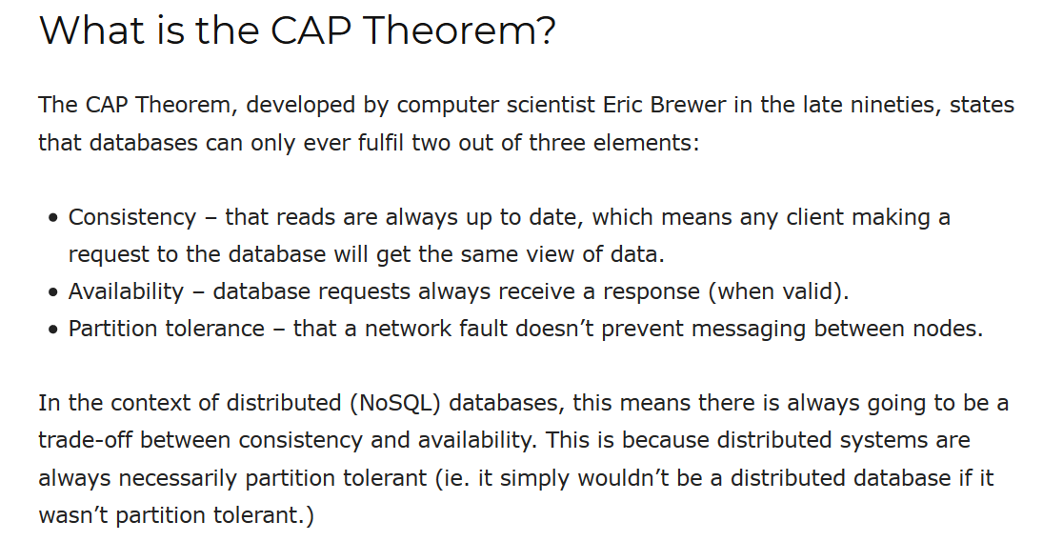

Slide 27
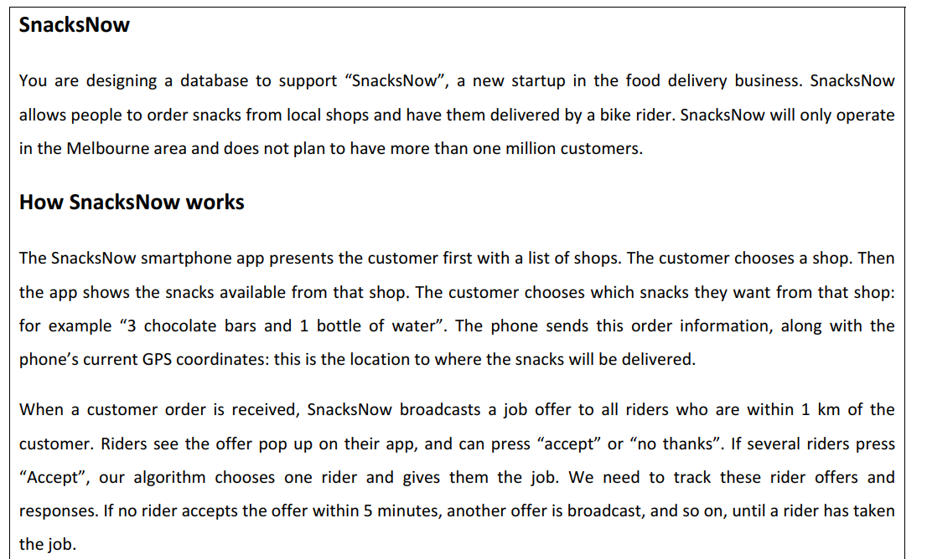
17年试卷

Slide 28
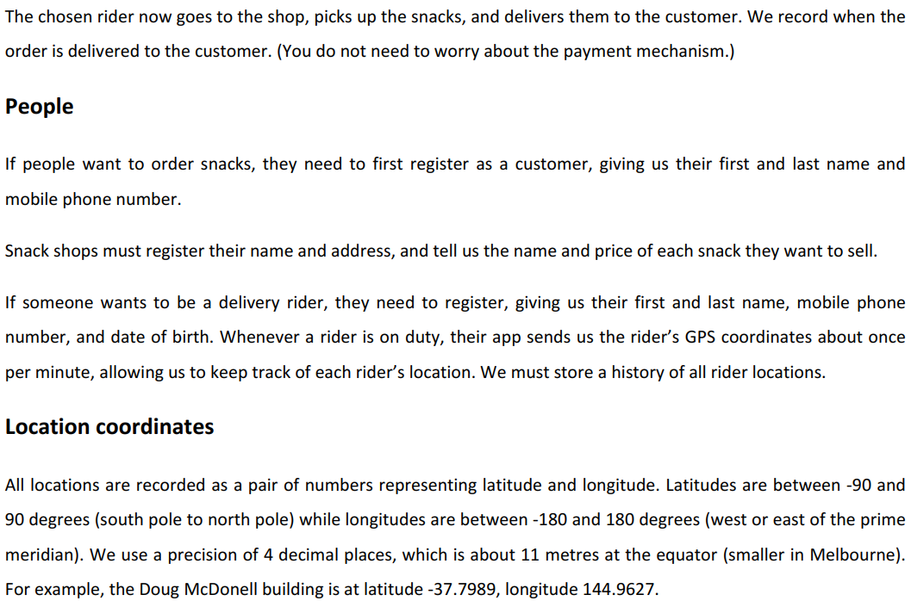

Slide 29
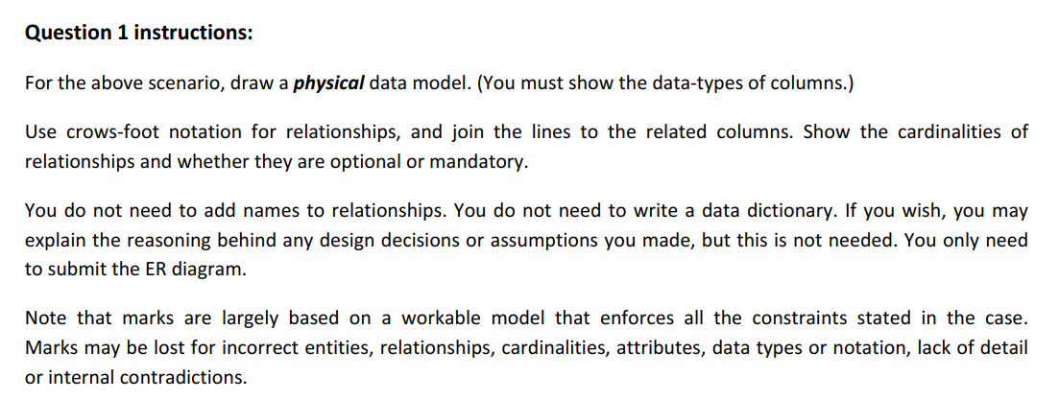

Slide 30
第一步：大致确定涉及到的实体Entities:
SHOP, SNACK,ORDER, RIDER, DELIVERYINFO, CUSTOMER
第二步：大致把每个实体所需要记录的attributes写下来。
SHOP(Name,Add), SNACK(Name, Price),ORDER(GPS坐标), RIDER(FN,LN,DOB,Phone), DELIVERYINFO(GPS坐标), CUSTOMER(FN,LN,DOB,Phone)
第三步：梳理表格之间大致的关系(1-多，多-多……)

Slide 31
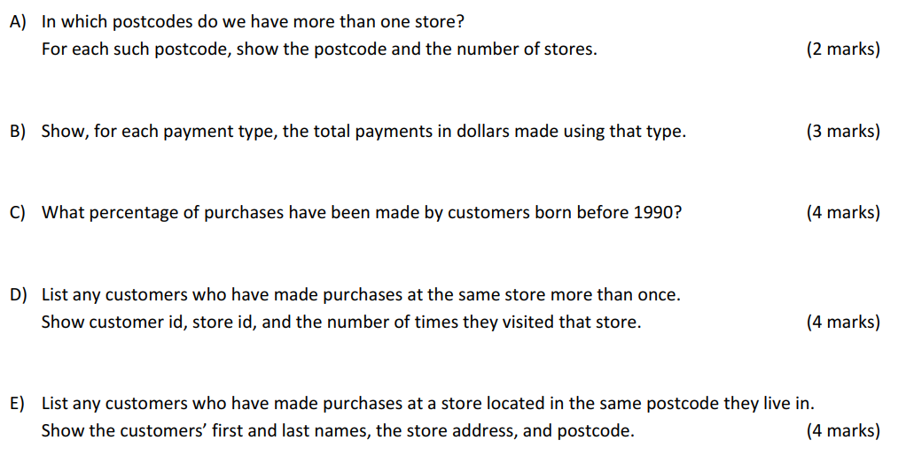

Slide 32
谢谢观看
THANK YOU FOR WATCHING
导师：xxxxxx
Notes:
版权声明：300套精品模板商业授权，请联系【锐旗设计】:https://9ppt.taobao.com，专业PPT老师为你解决所有PPT问题！

