Slide 1

Group 2
CE 72.12 Finite Element Methods in Engineering
Prepared by Mr. Tanakit Kertsap st124841
Mr. Sikared Nuchnueng st124929
Mr. Suyam Man Pradhan st125149
Ms. Moragoda Liyanage Tharumini Abeysingha st125456
Ms. Saraswati Bhandari st125502
Present on 14th May 2025
FEM implementation for structural analysis

Slide 2
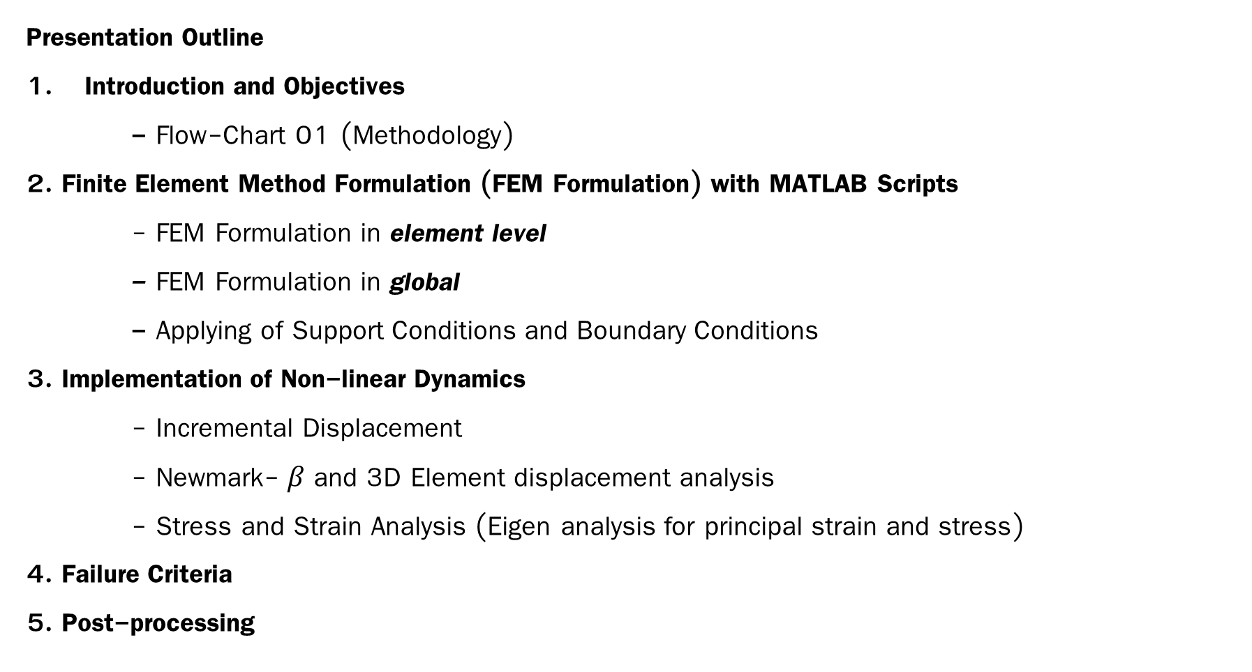
Outline
Presentation Outline
Introduction and Objectives
- Flow-Chart 01 (Methodology)
2. Finite Element Method Formulation (FEM Formulation) with MATLAB Scripts
- FEM Formulation in element level
- FEM Formulation in global
- Applying of Support Conditions and Boundary Conditions
3. Implementation of Non-linear Dynamics
- Incremental Displacement
- Newmark- $β$ and 3D Element displacement analysis
- Stress and Strain Analysis (Eigen analysis for principal strain and stress)
4. Failure Criteria
5. Post-processing

Slide 3
Introduction and Objective

Slide 4

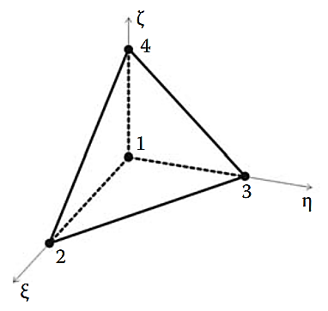
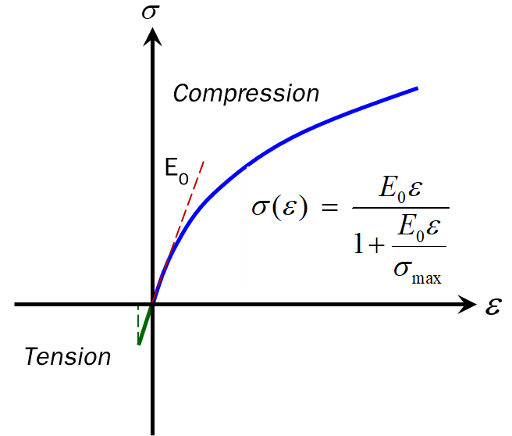
Objectives
Objectives
1. Develop FEM implementation for structural analysis by applying the knowledge of:
- Dynamics analysis
- Material non-linearity
- Interpretation of results
2. FEM Formulation with TET4
- Mass matrix formulation
- Material non-linearity
- Dynamics displacement incremental
Meshing
Dynamics displacement incremental
Material nonlinearity
3.0 m
//////
0.25 m
////////
0.25 m

Slide 5

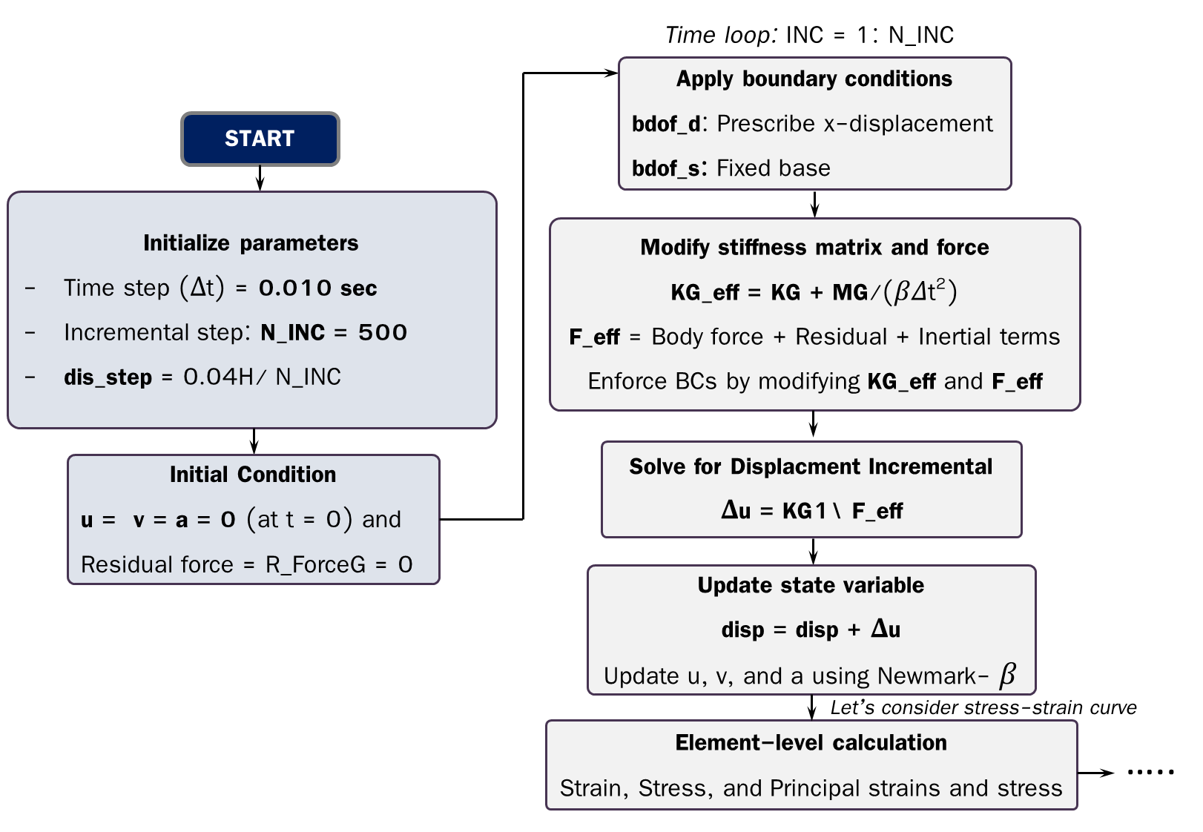

Non-linearity section
Meshing
(Gmsh)
Pre-processing
Load vector
(displacement at top)
Local mass matrices
Global mass matrix
Local stiffness matrices
Non-linearity
Global stiffness matrix
Solve dynamics equation using Newmark
Strain ($ε$)
Stress ($σ$)
Principal strain and Stress
Failure Criteria
Residual Force (R)
Eigen Analysis

Slide 6
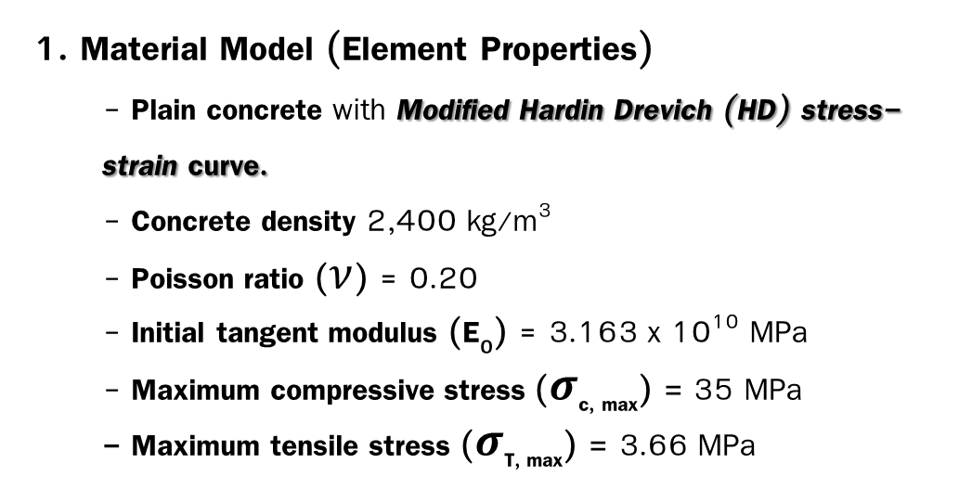
Introduction
Introduction
1. Material Model (Element Properties)
- Plain concrete with Modified Hardin Drevich (HD) stress-strain curve.
- Concrete density 2,400 kg/m³
- Poisson ratio ($ν$) = 0.20
- Initial tangent modulus (E₀) = 3.163 x 10¹⁰ MPa
- Maximum compressive stress ($σ$_{c, max}) = 35 MPa
- Maximum tensile stress ($σ$_{T, max}) = 3.66 MPa
Modified Hardin Drevich stress-strain curve.
Compression
E₀
MATLAB: G2.m
(Line 10-16 )
Tension
Material Assumptions:
1. Isotropic Materials
2. Homogenous
3. Incompressible
E=3.163e10; %Young Modulus
nu=0.2; %Poisson ratio
rho = 2400; %Density of concrete kg/m³
g = 9.81; %Acceleration due to gravity, m/s²
SigmaMax_C = 35*e6 ; % max. compressive stress N/m²
SigmaMax_T = 10*e6*0.62*sqrt(SigmaMax_C/10^6);

Slide 7
Introduction
Introduction
2. Meshing
- Four-Node Tetrahedral Elements (TET4)
- Import gmsh to MATLAB then we get
Number of TET4 element = 122 elements
Number of node (nNode) = 54 nodes
Element connectivity (ELEMCon)
MATLAB: G2.m
(Line 19-25 )
%% Run mesh file to get the node coordinates and nodes:
MeshG2
nodeCoordinates = msh.POS; % Node Coordinates of each node
ELEMCon = msh.TETS(:,1:4); % Element Connectivity
NE=length(ELEMCon); % Number of Elements
nNode=length(nodeCoordinates); % Number of Nodes
nDOF = nNode*3; % 1 node = 3DOFs
Mesh size = 0.25 m (122 elements)

Slide 8
FEM Formulation

Slide 9
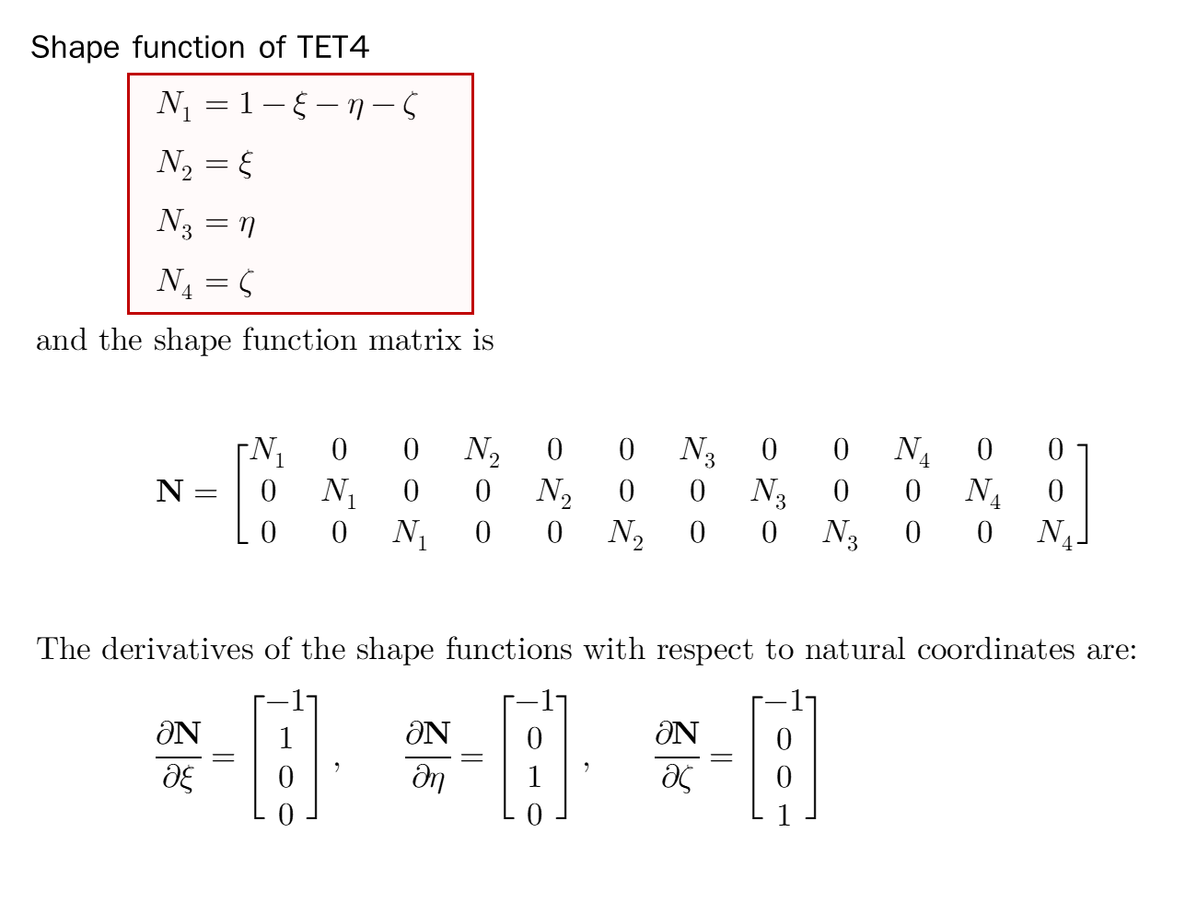

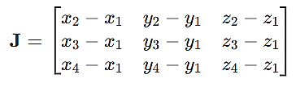
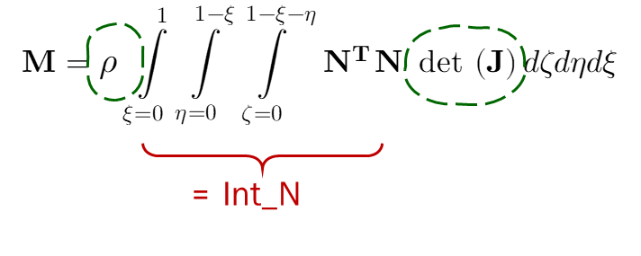
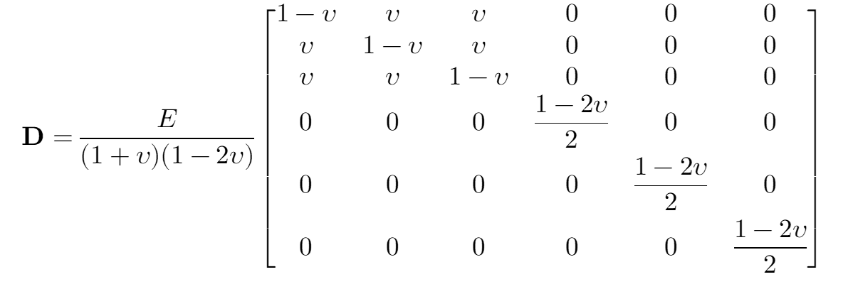
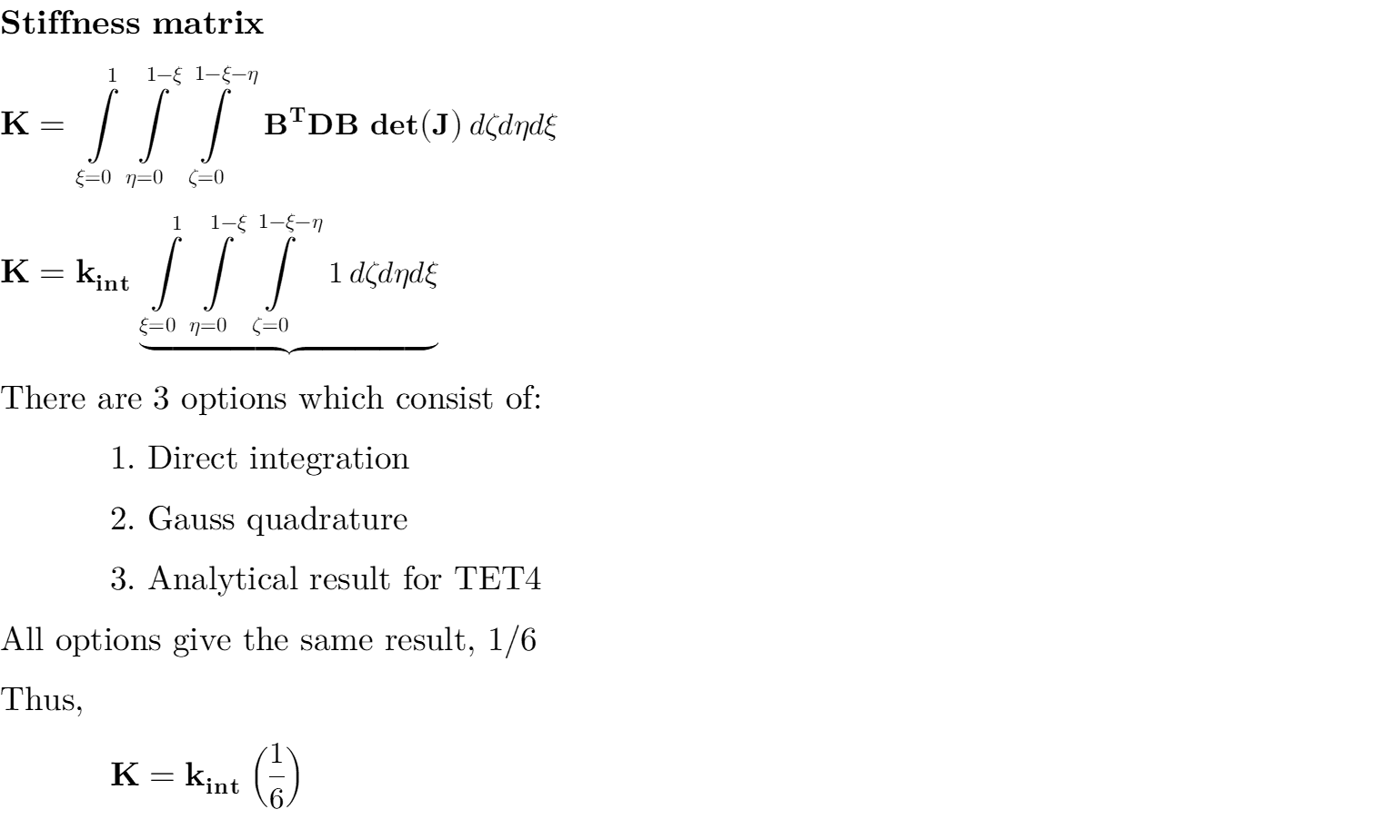

Overview of FEM Formulation
Element level
Global
Mapping
B = LN

Slide 10
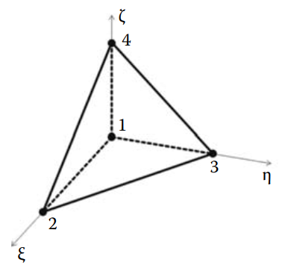

FEM Formulation: Shape function (N)
Shape function (N)
MATLAB: G2.m
% Shape Function % x= xi ; y=eta ; z=zeta
syms xi eta zeta
N(1)=1-xi-eta-zeta;
N(2)= xi;
N(3)= eta;
N(4)= zeta;
nN=length(N);
%for TET4
N_matrix = [N(1) 0 0 N(2) 0 0 N(3) 0 0 N(4) 0 0;
0 N(1) 0 0 N(2) 0 0 N(3) 0 0 N(4) 0;
0 0 N(1) 0 0 N(2) 0 0 N(3) 0 0 N(4)];
% Int_N for mass matrix M
int_N = double(int(int(int(N_matrix'*N_matrix, zeta, 0, 1 - xi - eta), eta, 0, 1 - xi), xi, 0, 1));
To determine the mass matrix, we have to know
Appendix A (Derivation of FEM formulation)
Notes:
double converts the symbolic result to a numerical value

Slide 11

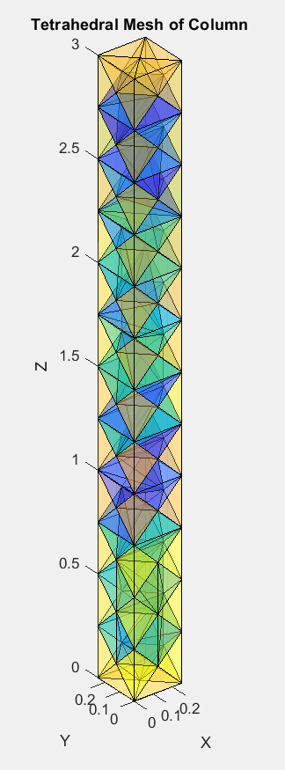

FEM Formulation: Shape function (N)
Body force vector (b)
The body force also called the consistent nodal force vector) due to a distributed body force like gravity
Body force vector (b) per unit volume:
To integral of the body force distributed to the nodes of a finite element, the consistent nodal force vector due to body force is
MATLAB: G2.m
% for body force
b = [0; 0; -rho*g];
int_Nb = double(int(int(int(N_matrix'*b, zeta, 0, 1 - xi - eta), eta, 0, 1 - xi), xi, 0, 1));
z
MATLAB: G2.m
Element body force
x
%% -----Element body force (Constant for each element)------
ELEMENT(eNo).BodyForce = int_Nb*double(det(J));
y
-z is direction of body force

Slide 12
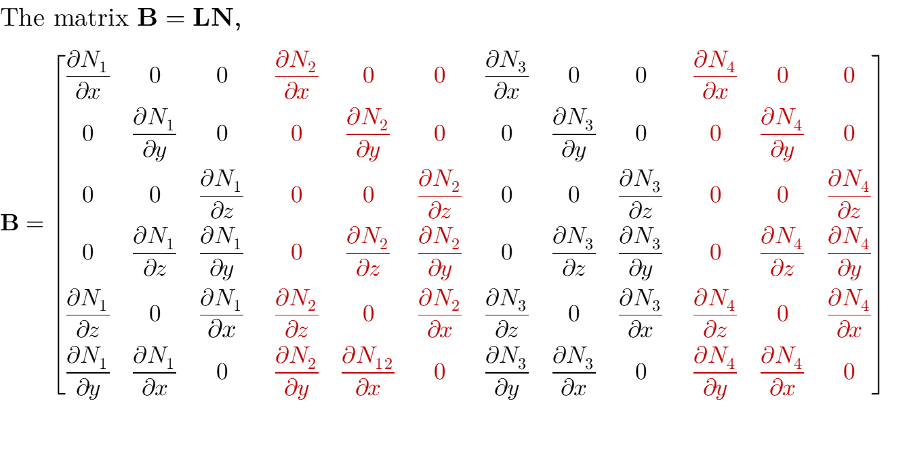
Forming the element-level matrices (M, K, b) and Assembling then into global matrices
B matrix and Constitutive D matrix
The matrix B = LN,
MATLAB: G2.m
%% -------------B matrix and D matrix-------------
%B=zeros(6,3*length(N));
B = zeros(6, 3*nN);
for i = 1:nN
j = 3*i - 2;
k = 3*i - 1;
l = 3*i;
B(:, [j, k, l]) = [dN(1,i), 0, 0;
0, dN(2,i), 0;
0, 0, dN(3,i);
dN(2,i), dN(1,i), 0;
0, dN(3,i), dN(2,i);
dN(3,i), 0, dN(1,i)];
end
ELEMENT(eNo).B=B;
% Define constitutive matrix (D)
D = E / ((1+nu)*(1-2*nu)) * [1-nu, nu, nu, 0, 0, 0;
nu, 1-nu, nu, 0, 0, 0;
nu, nu, 1-nu, 0, 0, 0;
0, 0, 0, (1 - 2*nu)/2, 0, 0;
0, 0, 0, 0, (1-2*nu)/2, 0;
0, 0, 0, 0, 0, (1-2*nu)/2];
ELEMENT(eNo).D = D;
Constitutive matrix (D)

Slide 13
Forming the element-level matrices (M, K, b) and Assembling then into global matrices
Element Stiffness (K^{e})
MATLAB: G2.m
(Line 97-107)
%% ---------------------Element Stiffness Matrix------------------------
%Integrand is
k_int = double(B'*D*B*det(J));
% %Direct Integration option 1: Direct Stiffness method
% ELEMENT(eNo).stiffness=double(int(int(int(f, zeta, 0, 1 - xi - eta), eta, 0, 1 - xi), xi, 0, 1));
%Gauss Points option 2: Gauss Points mehtod
ELEMENT(eNo).stiffness=wg(2)*wg(2)*subs(f,[xi,eta,zeta],[xg(2),xg(2)])+wg(1)*wg(2)*subs(f,[xi,eta,zeta],[xg(1),xg(2)])+wg(1)*wg(1)*subs(f,[xi,eta,zeta],[xg(1),xg(1)])+wg(2)*wg(1)*subs(f,[xi,eta,zeta],[xg(2),xg(1)]);
%Option 3: only fo TET4 elements
%For Tetrahedral element with 4 nodes (linear element), there are no
%variables in integral. So, for faster computation, we are using the
%constant value i.e.
% int(int(int(1, zeta, 0, 1 - xi - eta), eta, 0, 1 -xi), xi, 0, 1) = 1/6
ELEMENT(eNo).stiffness = 1/6*k_int;

Slide 14
Forming the element-level matrices (M, K, b) and Assembling then into global matrices
Jacobian (J)
MATLAB: G2.m
(Line 84-96)
%% -------------------------Jacobian-----------------------------------
% J=[diff(x,xi) diff(y,xi) diff(z,xi);
% diff(x,eta) diff(y,eta) diff(z,eta);
% diff(x,zeta) diff(y,zeta) diff(z,zeta)];
%Constant for an element(for TET4 only)
J = [ELEMENT(eNo).X(2)-ELEMENT(eNo).X(1) ELEMENT(eNo).Y(2)-ELEMENT(eNo).Y(1) ELEMENT(eNo).Z(2)-ELEMENT(eNo).Z(1);
ELEMENT(eNo).X(3)-ELEMENT(eNo).X(1) ELEMENT(eNo).Y(3)-ELEMENT(eNo).Y(1) ELEMENT(eNo).Z(3)-ELEMENT(eNo).Z(1);
ELEMENT(eNo).X(4)-ELEMENT(eNo).X(1) ELEMENT(eNo).Y(4)-ELEMENT(eNo).Y(1) ELEMENT(eNo).Z(4)-ELEMENT(eNo).Z(1)];
ELEMENT(eNo).det_J = det(J);
ELEMENT(eNo).J = J;

Slide 15
Forming the element-level matrices (M, K, b) and Assembling then into global matrices
Element mass matrix (Me)
= constant for each element
MATLAB: G2.m
(Line 55-56)
% Prepare for mass matrix M
int_N = double(int(int(int(N_matrix’*N_matrix, zeta, 0, 1 - xi - eta), eta, 0, 1 - xi), xi, 0, 1));
MATLAB: G2.m
(Line 108-110)
% Mass Matrix
ELEMENT(eNo).Mass = rho*int_N*double(det(J));

Slide 16
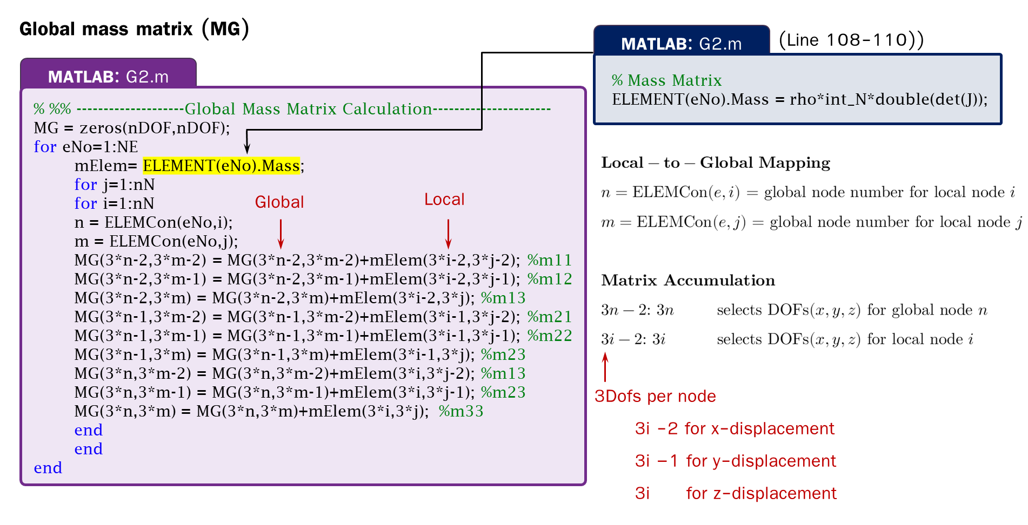
Start
Inputs structural properties
Run Mesh Generation
TET4
Shape function (N_{i})
Local coordinate
Form element matrices
N, J, f_{b}, B, D, M, K
Assemble Global Matrices
MG, KG, and Body_ForceG
e.g.
Global coordinate
Apply Support Conditions
Non-linear dynamics process

Slide 17
Applying of Support Conditions
Applying Support Condition
The particular nodes at z = 3 are applied displacement u in x-direction
MATLAB: G2.m
%% ------------------------Apply Support Conditions------------------------
%Identifying nodes for boundary conditions
% Nodes where z =0 (zero displacement in all directions)
nodes_z0 = find(nodeCoordinates(:,3) == 0);
% Nodes where x == 0.25 and z == 3 (displacement u in x-direction only)
nodes_x025_z3 = find(nodeCoordinates(:,1) == breadth & nodeCoordinates(:,3) == height);
bdof_s = []; %Boundary Degrees Of Freedom - Support
bddis_s = []; %Boundary Displacements - Support
% Zero displacement at nodes_z0 (x,y,z)---> same for every iteration
for i = 1:length(nodes_z0)
node = nodes_z0(i);
dofs = 3*(node-1) + (1:3); % DOFs for x,y, and z respectively
bdof_s = [bdof_s, dofs]; % Append DOFs to constrained list
bddis_s = [bddis_s, zeros(1,3)]; % Set all displacements to zero
end
keyboard;
Dynamics displacement incremental
3.0 m
//////
////////
The nodes at z = 0 are zero displacement in all directions

Slide 18
Incremental with equilibrium correction

Slide 19
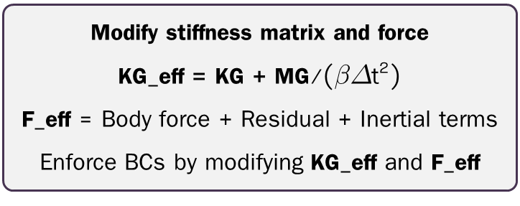
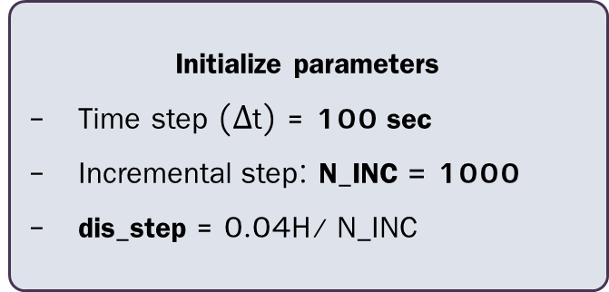
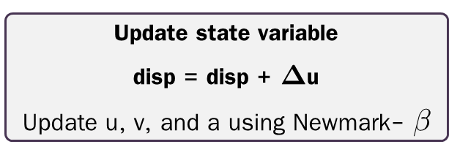
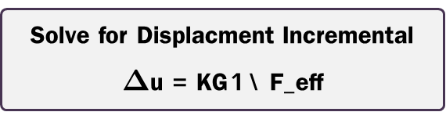
Time loop: INC = 1: N_INC
Apply boundary conditions
bdof_d: Prescribe x-displacement
bdof_s: Fixed base
START
Initialize parameters
Time step ($Δ$t) = 100 sec
Incremental step: N_INC = 1000
dis_step = 0.04H/ N_INC
Modify stiffness matrix and force
KG_eff = KG + MG/($βΔ$t²)
F_eff = Body force + Residual + Inertial terms
Enforce BCs by modifying KG_eff and F_eff
Initial Condition
u = v = a = 0 (at t = 0) and
Residual force = R_ForceG = 0
Solve for Displacment Incremental
$Δ$u = KG1\ F_eff
Update state variable
disp = disp + $Δ$u
Update u, v, and a using Newmark- $β$
Let’s consider stress-strain curve
Element-level calculation
Strain, Stress, and Principal strains and stress
…..

Slide 20

Incremental Method with Equilibrium Correction
Incremental Method with Equilibrium Correction
In this study, we use the incremental analysis with constant stiffness for each iteration only if no element fails.
E₀
K_{G, eff}
E₀
$$R_{σ}=σ_{cal}−σ_{act}$$

Slide 21
Nonlinear Dynamics Process: Initialize parameters
Step 1 Initialize parameters
MATLAB: G2.m
%% -------------------Incremental Displacement Vector----------------------
Totaltime = 100; %Gradual application of load during total time, seconds
N_INC = 1000;
del_t = Totaltime/N_INC; %time interval for each step, seconds
disp_top = 4/100*height; %Given, displacement at top 4% of height
disp_step = disp_top/N_INC; %Linear Increment of displacment at top of column
applied_d = disp_step*ones(N_INC,1);
R_ForceG = zeros(nDOF,1); %initially, no residual force
displ = zeros(nDOF,1);
vel = zeros(nDOF,1);
acc = zeros(nDOF,1);
output_disp = [zeros(nDOF,1)];
fail = [];
Go to Iteration

Slide 22
Nonlinear Dynamics Process: Apply Boundary Conditions
Step 2 Iteration: Apply boundary conditions and conduct KG_eff and F_eff (for Newmark-$β$ method)
MATLAB: G2.m
%% -----------------------Iteration starts---------------------------------
for INC = 1: N_INC
%Displacement Bounary condition
bdof_d = [];
bddis_d = [];
% Displacement u at nodes_x025_z3 (only x axis)
for i = 1:length(nodes_x025_z3)
node = nodes_x025_z3(i);
dof_x = 3*(node-1) + 1; % x-direction DOF only
bdof_d = [bdof_d, dof_x];
bddis_d = [bddis_d, applied_d(INC)];
end
bdof = [bdof_d bdof_s];
bddis =[ bddis_d bddis_s];
% Modify force vector to account for prescribed displacement
F_eff = Body_ForceG + R_ForceG + MG*vel/(beta*del_t) + MG*acc*(1-2*beta)/(2*beta);
KG_eff = KG + MG/(beta*del_t*del_t);
KG1 = KG_eff;
Prepare to Newmark-beta method

Slide 23


Nonlinear Dynamics Process: Newmark-$β$
Step 2 Iteration: Appy support condition and displacement (for Newmark-$β$ method)
MATLAB: G2.m
%% --------------Applying Boundary conditions--------------------
for i = 1:length(bdof)
dof = bdof(i);
known_disp = bddis(i);
KG_dof = KG1(:, dof);
KG_dof(dof) = -1;
F_eff(dof) = 0;
F_eff = F_eff - KG_dof * known_disp;
% Zero out row and column in stiffness matrix
KG1(:, dof) = 0;
KG1(dof, :) = 0;
% Set diagonal to 1 to enforce displacement
KG1(dof, dof) = 1;
end
del_u = KG1\F_eff; %in each iteration
%store the total displacement at each iteration
output_disp = [output_disp output_disp(:,INC)+del_u];
%Element Displacement, Strains and Dispalcement
disp = disp + del_u; %displacement increases at time step
Newmark- $β$
Updating total displacement

Slide 24
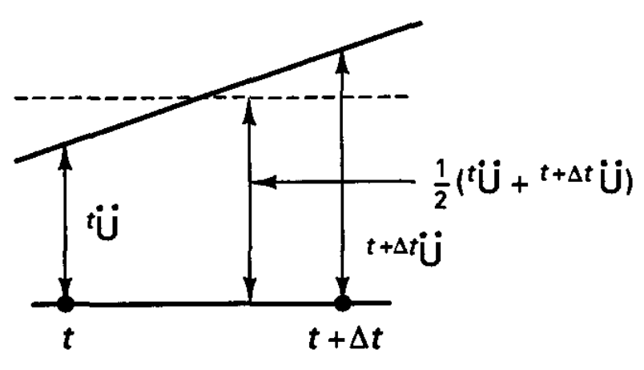
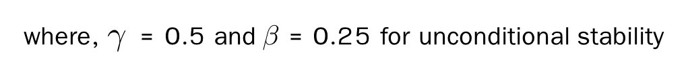
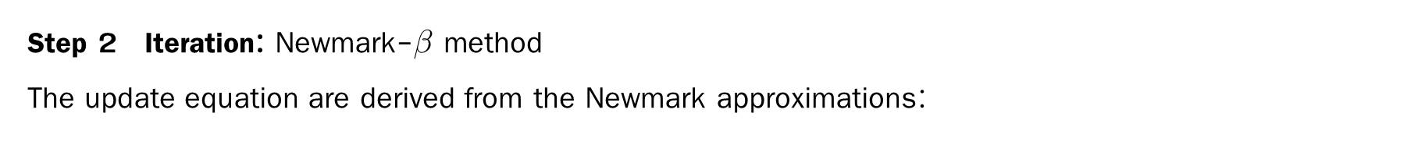

Nonlinear Dynamics Process: Newmark-$β$
Step 2 Iteration: Newmark-$β$ method
The update equation are derived from the Newmark approximations:
Newmark- $β$ constant-average acceleration
Adjust the previous velocity
where, $γ$ = 0.5 and $β$ = 0.25 for unconditional stability
MATLAB: G2.m
%% ------------------------Newmark Beta----------------------------
% It is used to get the velocity and acceleration for next time step
acc_next = 1/(beta*del_t*del_t)*del_u - 1/(beta*del_t)*vel - (1-2*beta)/(2*beta)*acc;
vel_next = gamma/(beta*del_t)*del_u - (gamma-beta)/(beta)*vel - del_t*(gamma-2*beta)/(2*beta)*acc;
acc = acc_next;
vel = vel_next;
% Dispalcement vector
for i = 1:nNode
u(:,i)=[displ(3*i-2);displ(3*i-1); displ(3*i)];
NODE(i).u = [displ(3*i-2);displ(3*i-1); displ(3*i)];
end
Notes:
/

Slide 25
Failure Criteria

Slide 26
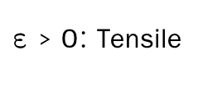
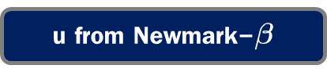
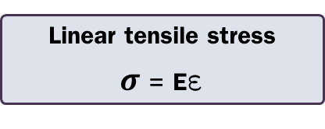
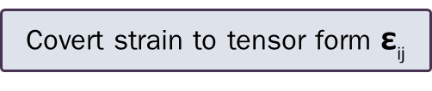
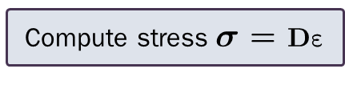
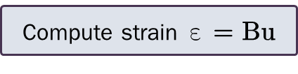
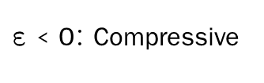
Eigen analysis
Principal strain/ directions (R)
u from Newmark-$β$
Loop over element: eNo = 1:NE
$\text{ε}$ < 0: Compressive
$\text{ε}$ > 0: Tensile
Check sign of strain
Assemble nodal displacements u for element eNo
Nonlinear stress
GetStressHDCompression.m
Linear tensile stress
$σ$ = E$\text{ε}$
Compute strain $\text{ε}\text{ = }\text{Bu}$
Failure Criteria
Compute stress$σ \text{=} D\text{ε}$
All of them are presented in the iteration loop
Compute residual stress
Covert strain to tensor form $\text{ε}$_{ij}
Transform stresses to Cartesian coordinates
Rotational matrix
Assemble global stiffness matrix KG
Assemble global residual force_R_ForceG
Principle coordinate
Cartesian coordinate
End loop
Output KG and R_ForceG

Slide 27

Nonlinear Dynamics Process: 3D Element Displacement Calculation
MATLAB: G2.m
(Line 315-339)
%% --------------3D Element Displacements Calculation---------------------
for eNo = 1:NE
temp = [];
for j = 1:nN
temp = [temp; NODE(ELEMCon(eNo,j)).u];
end
ELEMENT(eNo).u = temp;
Strain = ELEMENT(eNo).B*ELEMENT(eNo).u;
StressCal = ELEMENT(eNo).D*Strain;
%Tensor form:
Strain_Tensor = [Strain(1) Strain(4)/2 Strain(6)/2;
Strain(4)/2 Strain(2) Strain(5)/2;
Strain(6)/2 Strain(5)/2 Strain(3)];
ELEMENT(eNo).Strain_Tensor = Strain_Tensor;
%% ---------Eigen analysis for principal strains---------------
% Calculating Principal strains and Rotation vector by solving Eigen Equations
% R = Rotation Vector and P_Strain = Principal Strains
[V, P_S] = eig(Strain_Tensor);
R = V;
P_Strain = [P_S(1,1);
P_S(2,2);
P_S(3,3)];
Strain tensor construction
Eigen analysis for principal strains
V = R = Rotation matrix
P_S = Principal strains in diagonal

Slide 28
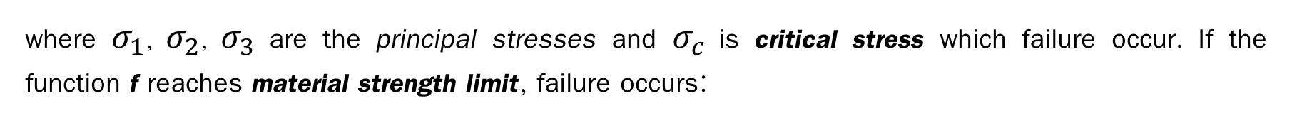
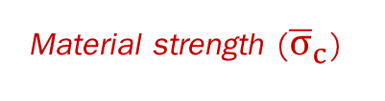
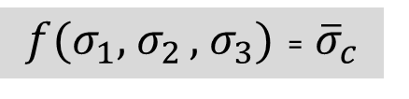
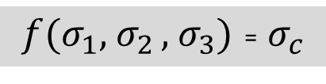
Failure Criteria for Brittle Materials
Brittle Materials (Fracture Mechanics)
Assumption
1. Isotropic : The material’s properties (e.g., strength, stiffness) are the same in all directions.
2. Homogeneous : The material’s properties are uniform throughout its volume.
Therefore, the failure criteria for isotropic materials is:
$f(σ_{1},$ $σ_{2 },$ $σ_{3})$ = $σ_{c}$
where $σ_{1}$, $σ_{2}$, $σ_{3}$ are the principal stresses and $σ_{c}$ is critical stress which failure occur. If the function f reaches material strength limit, failure occurs:
$f(σ_{1},$ $σ_{2 },$ $σ_{3})$ = ${\overline{σ}}_{c}$
Material strength (${\overline{σ}}_{c}$)
(Reference: Mechanical_Behavior_of_Materials_5th_Edition_Dowling_Kampe_Kral)

Slide 29
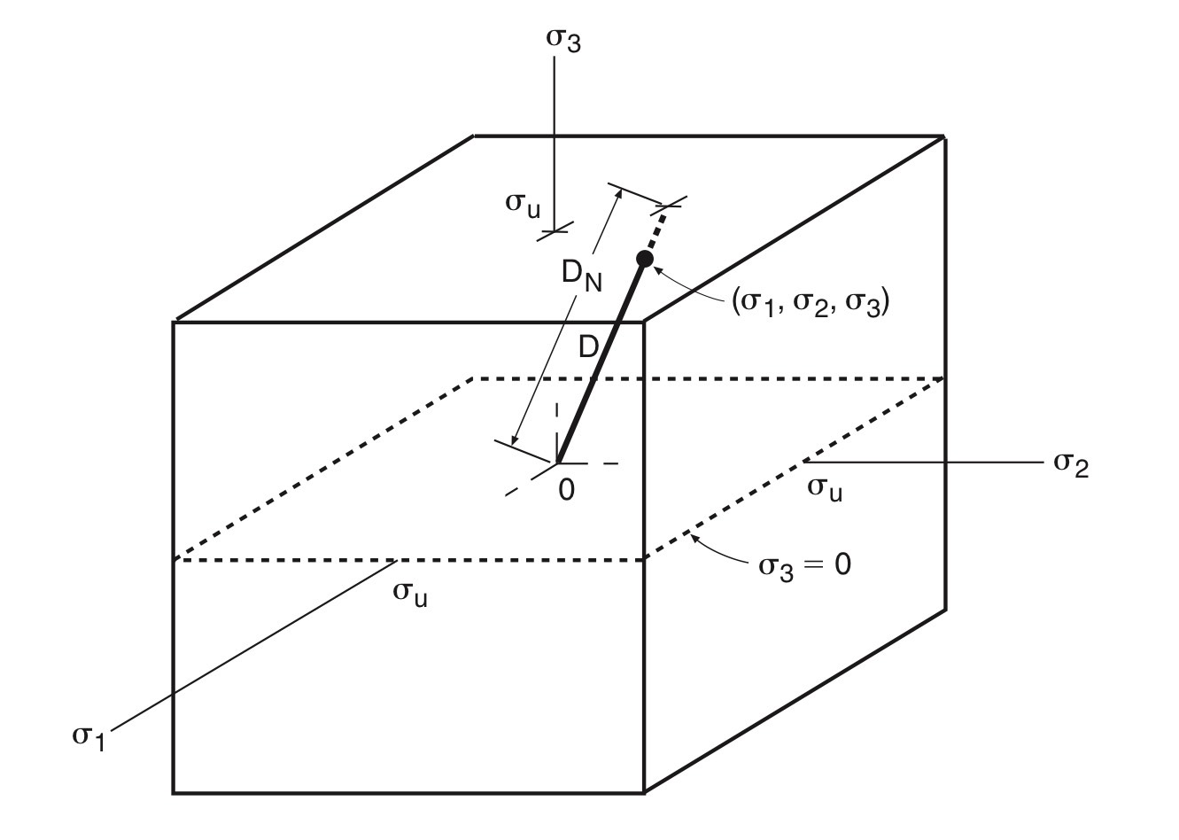
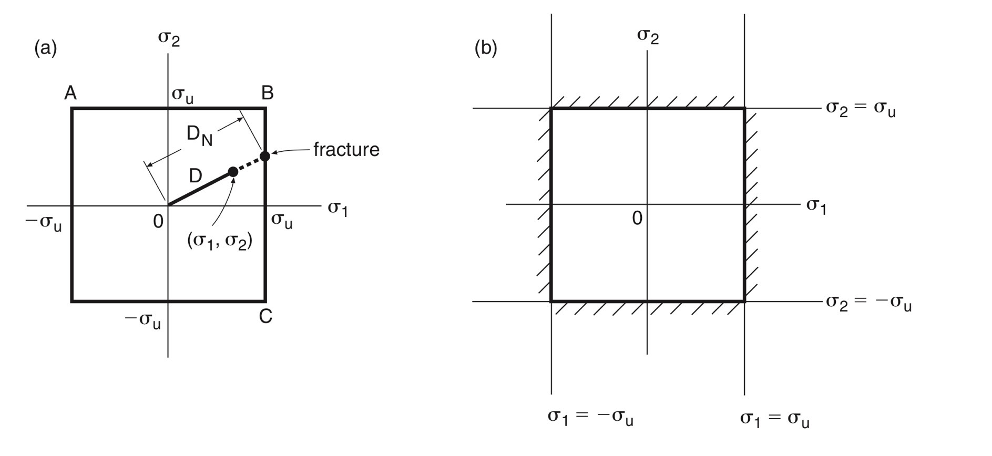
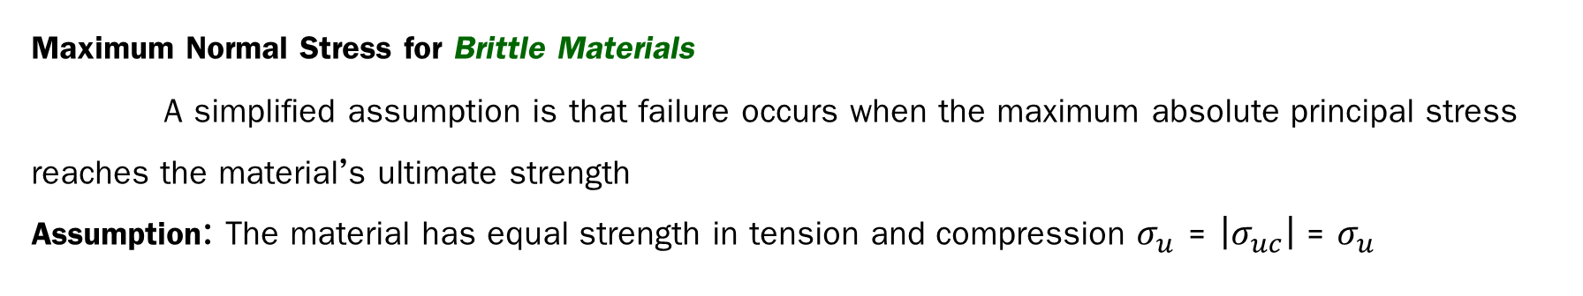
Failure Criteria for Brittle Materials Maximum Normal Stress Fracture Criterion
Maximum Normal Stress for Brittle Materials
A simplified assumption is that failure occurs when the maximum absolute principal stress reaches the material’s ultimate strength
Assumption: The material has equal strength in tension and compression $σ_{u}$ = $\left|σ_{uc}\right|$ = $σ_{u}$
Used in this project
Unqualified for concrete

Slide 30
Nonlinear Dynamics Process: Actual Principal Strains and Stresses
MATLAB: G2.m
%% ---Actual Principal strains, stresses for each element-------
for j = 1:3
if P_Strain(j)< 0
[P_Stress(j)] = GetStressHDCompression(ELEMENT(eNo).E, SigmaMax_C, abs(P_Strain(j))); % Compression stress
else
[P_Stress(j)] = ELEMENT(eNo).E*P_Strain(j); %tension
end
Act_P_Stress(j) = P_Stress(j) * sign(P_Strain(j)); % Apply sign convention for stress
%% ------------------Failure criteria-----------------------
ELEMENT(eNo).Act_P_Stress = Act_P_Stress';
end
%for the HD model, the concrete stress will not reach maximum compressive stress level so, only checking for tension
if any(Act_P_Stress >= SigmaMax_T)
fail = [fail; eNo INC];
disp("Element "+num2str(eNo)+" failed in tension at prescribed displacment of "+num2str(applied_d(INC)*INC)+" at step "+num2str(INC)+ ".");
%1. Remove the element 2. Reduce the stiffness (we use this approach)
ELEMENT(eNo).E = ELEMENT(eNo).E/10000000;
ELEMENT(eNo).stiffness = ELEMENT(eNo).stiffness/10000000;
End
ELEMENT(eNo).Residual_P_Stress = ELEMENT(eNo).Cal_P_Stress - ELEMENT(eNo).Act_P_Stress;
Reducing the stiffness
for failed elements

Slide 31
Nonlinear Dynamics Process: Residual Stress in Cartesian Coordinates
MATLAB: G2.m
(Line 342-350)
Rotational matrix
%% -------------Residual Stress in Cartesian Coordinates-----------
% diag---> diagonal matrix
R_tensor = R*diag(ELEMENT(eNo).Residual_P_Stress)*R’;
%Residual stress tensor in Cartesian planes
ELEMENT(eNo).R_Stress = [R_tensor(1,1);
R_tensor(2,2);
R_tensor(3,3);
R_tensor(1,2);
R_tensor(2,3);
R_tensor(1,3)];
%% -----Residual force for an element in Cartesian Coordinates-----
f= (ELEMENT(eNo).B)'*ELEMENT(eNo).R_Stress*ELEMENT(eNo).det_J;
%For Tetrahedral element with 4 nodes (linear element), there are no
%variables in integral. So, for faster computation, we are using the
%constant value i.e.
% int(int(int(1, zeta, 0, 1 - xi - eta), eta, 0, 1 -xi), xi, 0, 1) = 1/6
ELEMENT(eNo).R_Force = 1/6*f;
end
Principle coordinate
Cartesian coordinate
Notes:
%Direct Integration option 1:
% ELEMENT(eNo).R_Force=double(int(int(int(f, zeta, 0, 1 - xi - eta), eta, 0, 1 - xi), xi, 0, 1));
%Gauss Points option 2: Gauss Points mehtod
%Option 3: only fo TET4 elements

Slide 32
Results

Slide 33
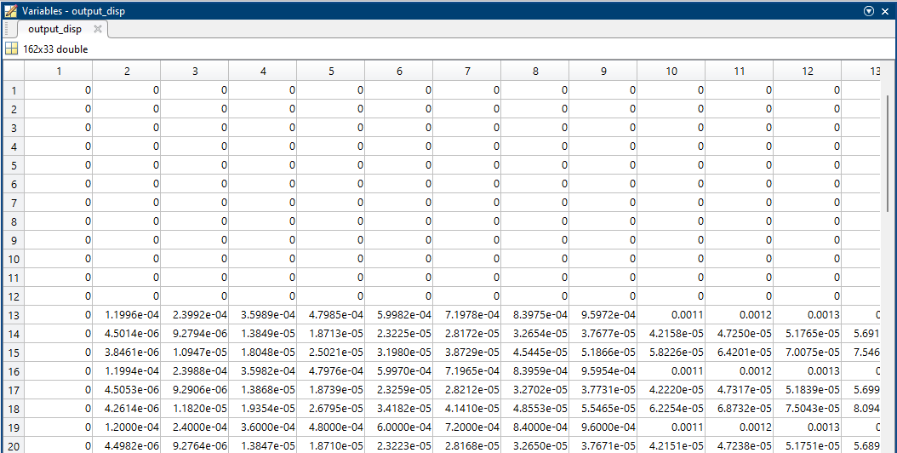
Displacement Outputs
(output_disp)
N_INC
Displacement out-put of the 1st increment step

Slide 34
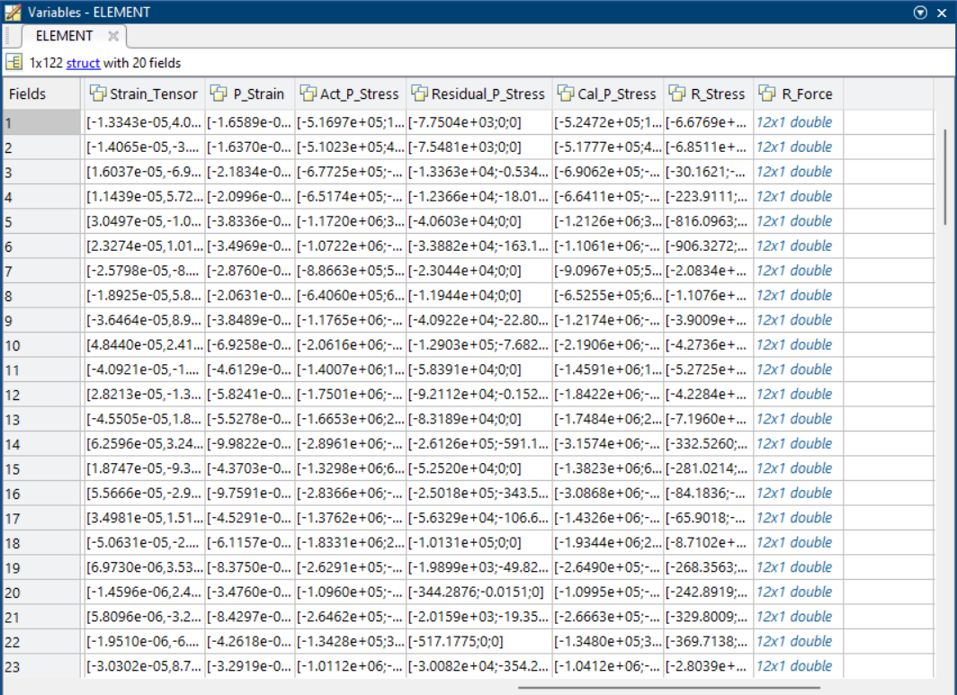
Element Outputs
Element No.

Slide 35
Post Processing

Slide 36
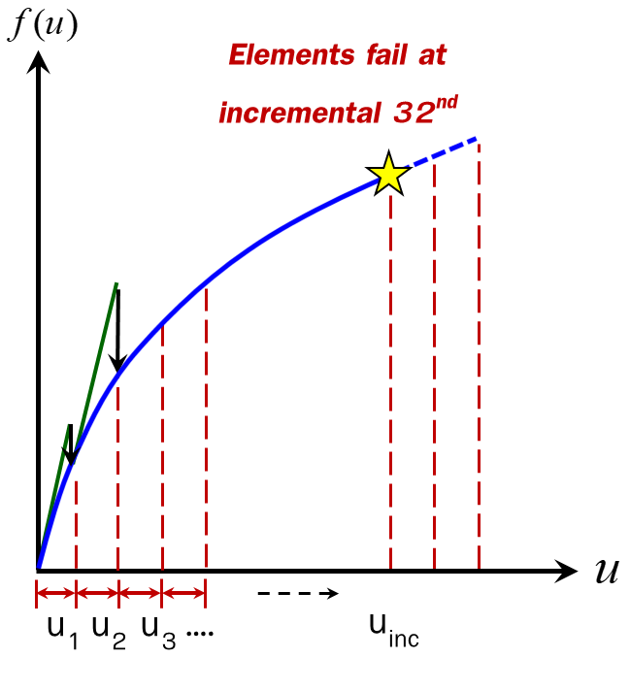
Deflected Shape
Post-processing (Deflected Shape)
Applied disp.
amplified animation

Slide 37
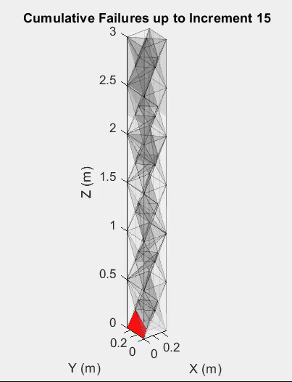
Failed Elements
Element No. | Incremental step
108 | 15
81 | 24
109 | 24
114 | 24
14 | 25
79 | 25
16 | 28
26 | 29
107 | 29
53 | 30
77 | 30
80 | 30
115 | 30
117 | 30
13 | 31
25 | 31
82 | 31
93 | 31
94 | 31
118 | 31
Post-processing (Failed Elements): Cumulative Failures
Applied disp.
Cumulate failure in tension

Slide 38
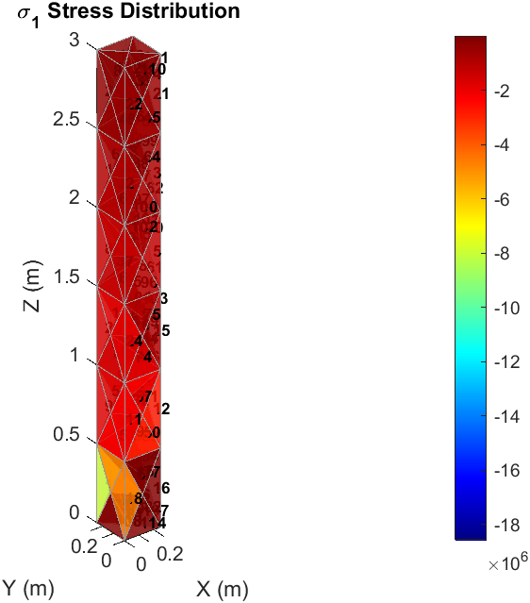
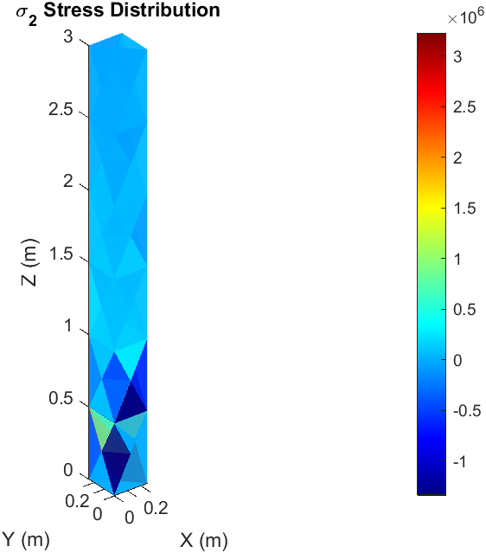
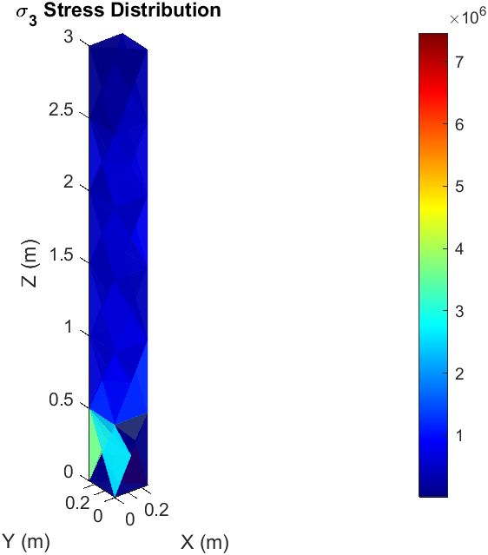
Principal Stresses Distribution
s
Largest principal stress
Intermediate principal stress
Smallest principal stress
Notes:
σ₁ (sigma11): Dictates tensile fracture (e.g., cracking perpendicular to σ₁).
σ₃ (sigma33): Governs compressive failure (e.g., buckling or crushing).
σ₂ (sigma22): Often ignored in 2D problems but critical in 3D (e.g., triaxial loading).

Slide 39
Limitation

Slide 40
Limitation
Limitation
1. Limitation of TET4 (Linear displacement interpolation)
Volume Locking in Bending
Under flexural behavior, TET4 elements may exhibit artificial shear stiffness, distorting the true response. Results in underpredicted displacements and overestimated bending stiffness.
Concrete cracking and crushing require high-resolution strain fields, which TET4 struggles to capture.
Notes:
Higer-order element (TET10) can reduce the effect of shear locking

Slide 41
Limitation
Limitation
2. Incremental Method with Equilibrium Correction
Convergence Issues in Brittle Failure
Since concrete exhibits sudden stiffness loss. The method may fail to track post-peak softening, small step size shall be used.
3. Failure Criterion using Maximum Normal Stress
Asymmetry of tension and compression
Concrete has different strengths in tension and compression which is not truly satisfy the assumption.
A single max-stress threshold ignores this, leading to unrealistic failure predictions (e.g., overestimating tensile capacity).
Notes:
The incremental approach assumes piecewise linearity within small steps. If equilibrium corrections (e.g., Newton-Raphson iterations) are insufficient, errors can accumulate, leading to divergence or false convergence.

Slide 42
Thank you

Slide 43
Comments
1. Time –step should be smaller enough to capture non-linear behavior
2. Post-processing
- Displacement response-time curve should be used to used to visualize the results.
- Crack propagation should be displayed
3. Further study
- Compare the results obtained using TET4 and TET10 elements
- Observe the effect of volumetric locking
- Extend the failure criteria to more realistic principles, such as Coulomb-Mohr criterion
From G2_2025

