Slide 1
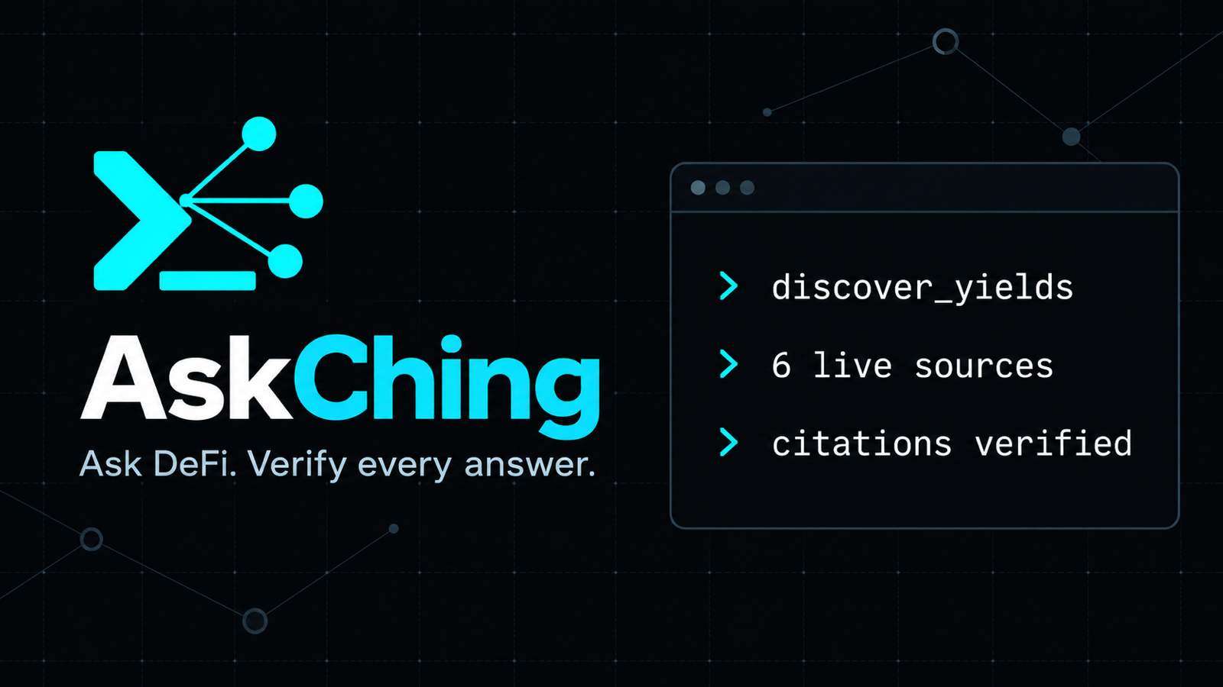
ONE QUESTION · MULTIPLE LIVE SUBGRAPHS · EVERY NUMBER CITED
Notes:
[0:00–0:15] AskChing turns a natural-language DeFi question into a cited answer across multiple live subgraphs. The promise is simple: one question, multiple live sources, and every number carries its evidence. AskChing is research software built for ETHOnline 2026.

Slide 2
01 / PROBLEM
A DeFi number without evidence is impossible to trust
“USDC APY is 4.2%”
AskChing requires
SUBGRAPH ID
where the value came from
Which protocol? Which block? Which definition? When was it observed?
BLOCK
which chain state it reflects
UNSUPPORTED
TIMESTAMP
when the source observed it
QUERY HASH
which query produced it
Evidence travels with the number.
ASKCHING · ETHONLINE 2026
02
Notes:
[0:15–0:35] Ask an AI which lending market has the best USDC rate and it may give you one confident number. But without the protocol, block, definition, or observation time, that number is difficult to trust. AskChing attaches the evidence to each figure: its subgraph, block, timestamp, and query hash.

Slide 3

02 / ARCHITECTURE
One MCP research layer connects agents to live subgraphs
ANY MCP CLIENT
ASKCHING
THE GRAPH
6 LIVE SOURCES
›
›
›
Claude · Cursor · VS Code
Codex · Gemini · ChatGPT
7 tools
normalization + evidence gates
Gateway
Messari subgraph schemas
4 lending + 2 DEX
Ethereum mainnet
GROK DEMO CLI
Grok interprets the question and selects an AskChing tool.
The MCP server remains model-independent.
ASKCHING · ETHONLINE 2026
03
Notes:
[0:35–0:55] AskChing is a model-independent MCP server. Any compatible client can call the same seven tools. For our featured CLI demo, Grok interprets the question, selects a tool, and explains the cited result. AskChing then fans out through The Graph Gateway to four lending and two DEX subgraphs on Ethereum mainnet.

Slide 4
03 / DEMO
Live comparison: one question, three cited markets
Switch to the deployed app after reading the prompt
● ● ● askching · grok tool loop
> compare_markets
Compare live USDC supply APY across Aave V3, Compound V3, and Spark Lend right now. Rank the results, cite each source, and state the as-of time.
selected tool
compare_markets
query fan-out
3 live lending subgraphs
sources
Aave V3 · Compound V3 · Spark Lend
✓ ranked values ✓ citations ✓ asOf
▶ SWITCH TO LIVE APP
Point out
rank · asOf · subgraph ID · block · query hash
ASKCHING · ETHONLINE 2026
04
Notes:
[0:55–1:45] Here is the live question. Compare USDC supply APY across Aave V3, Compound V3, and Spark Lend, rank the result, and cite every source. [SWITCH TO LIVE APP.] Show the selected tool and the three-source fan-out. Then point to the ranking, the as-of time, and one citation with its subgraph ID, block, and query hash. [RETURN TO SLIDES. Source: live AskChing MCP endpoint.]

Slide 5
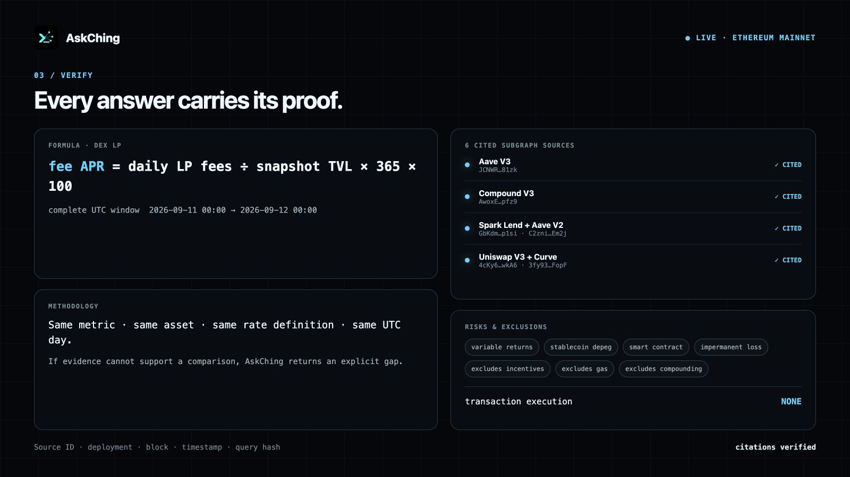
04 / TRUST
AskChing reports gaps instead of inventing evidence
≥ 2
independently cited sources
or no quantitative comparison
MISSING HISTORY
The answer carries an explicit gap. A spot value never pretends to be a trend.
source ID · deployment · block · timestamp · query hash
ASKCHING · ETHONLINE 2026
05
Notes:
[1:45–2:15] The trust rule is enforced in code. A quantitative comparison needs at least two independently cited sources. If only one survives, AskChing returns no comparison. Missing historical coverage also becomes an explicit gap, so a current snapshot never masquerades as a seven-day trend. This behavior matters more than producing an answer at any cost.

Slide 6
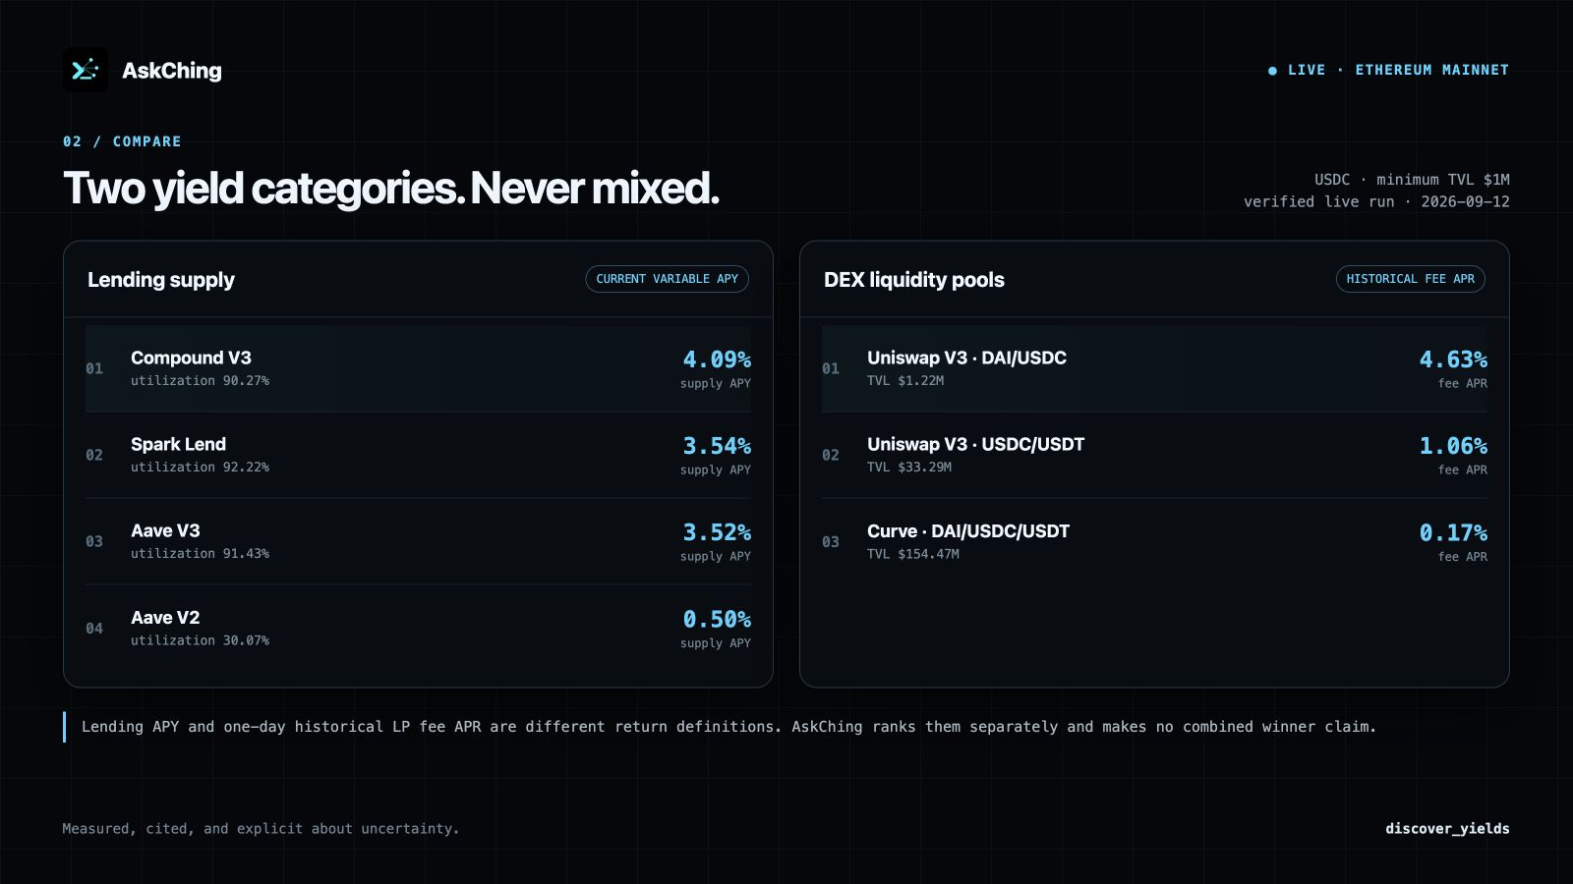
05 / RESEARCH
Seven tools cover spot research, history, and yield discovery
compare_markets
rank comparable metrics
research_brief
summarize cited findings
risk_scan
peer-relative spot signals
analyze_markets
explain calculations and confidence
analyze_trends
7d / 30d cited daily history
discover_yields
separate lending and DEX LP rankings
get_info
describe capabilities and examples
LENDING SUPPLY APY
≠
HISTORICAL LP FEE APR
ASKCHING · ETHONLINE 2026
06
Notes:
[2:15–2:45] The project now exposes seven MCP tools. It can compare current markets, create research briefs, scan peer-relative risk, explain calculations, and analyze cited daily history over seven or thirty days. Yield discovery covers lending, Uniswap V3, and Curve while keeping current lending APY separate from historical LP fee APR because they describe different products and risks.

Slide 7
One evidence layer for many agents
AskChing would rather report a gap than invent a number.
REMOTE MCP
https://ask-ching-agent.vercel.app/api/mcp
COMPATIBLE CLIENTS
Claude Cursor VS Code Codex Gemini ChatGPT
PUBLIC CODE
github.com/Chonwai/AskChing_Agent
GROK CLI · FEATURED ORCHESTRATION DEMO
ASKCHING · ETHONLINE 2026
07
Notes:
[2:45–3:15] AskChing exposes one remote MCP endpoint that compatible agents can call directly. Our Grok CLI demonstrates the orchestration path, but the research layer stays model-independent. The Graph supplies the live, verifiable market history, and AskChing adds normalization, evidence gates, and transparent analysis. The code is public. AskChing would rather report a gap than invent a number. Thank you.

