Slide 1
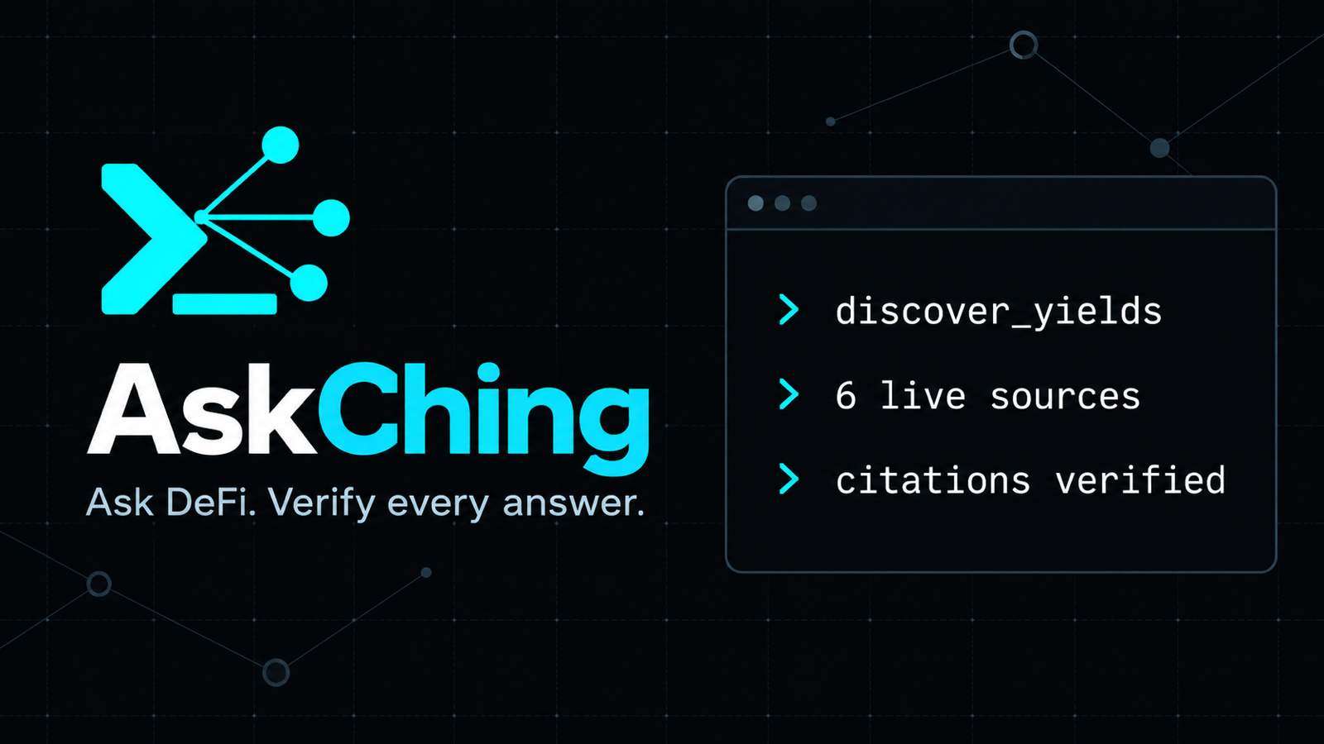
ONE QUESTION · MULTIPLE LIVE SUBGRAPHS · EVERY NUMBER CITED
Notes:
[0:00–0:15] AskChing turns a natural-language DeFi question into a cited answer across multiple live subgraphs. The promise is simple: one question, multiple live sources, and every number carries its evidence. AskChing is research software built for ETHOnline 2026.

Slide 2
01 / PROBLEM
The Graph supplies data. AskChing builds the comparison.
DIRECT SUBGRAPH RESEARCH
ASKCHING RESEARCH LAYER
The researcher must
The user asks one question
01 find the active deployments
01 fan out across live subgraphs
02 inspect each protocol schema
02 normalize comparable definitions
03 write GraphQL for every source
03 rank only valid observations
04 reconcile APY definitions and units
04 attach block-level provenance
05 assemble citations and gaps
05 fail closed or report explicit gaps
ASKCHING · ETHONLINE 2026
02
Notes:
[0:15–0:40] A user can query The Graph directly, and The Graph gives us the verifiable on-chain data. But answering a cross-protocol research question still means finding the correct deployments, inspecting different schemas, writing several queries, reconciling rate definitions, and assembling the evidence by hand. AskChing automates that research workflow. The user asks one question, and the system returns only comparable observations with citations or explicit gaps.

Slide 3
02 / ARCHITECTURE
AskChing turns Graph access into comparable research
ANY MCP CLIENT
ASKCHING
THE GRAPH
6 LIVE SOURCES
›
›
›
Claude · Cursor · VS Code
Codex · Gemini · ChatGPT
7 tools
normalization + evidence gates
Gateway
Messari subgraph schemas
4 lending + 2 DEX
Ethereum mainnet
THE GRAPH
queryable protocol data + block provenance
ASKCHING
fan-out + normalization + ranking + evidence gates
GROK DEMO CLI
Grok routes the demo. Other MCP clients call AskChing directly.
ASKCHING · ETHONLINE 2026
03
Notes:
[0:40–1:00] The Graph is the load-bearing data layer: it gives AskChing queryable protocol data with block provenance. AskChing adds the research logic above that access. It fans out across sources, normalizes comparable definitions, ranks valid observations, and enforces evidence gates. The MCP server remains model-independent. Grok routes questions in our demo CLI, while other MCP clients can call AskChing directly.

Slide 4
03 / DEMO
Live comparison: one question, three cited markets
Switch to the deployed app after reading the prompt
● ● ● askching · grok tool loop
> compare_markets
Compare live USDC supply APY across Aave V3, Compound V3, and Spark Lend right now. Rank the results, cite each source, and state the as-of time.
selected tool
compare_markets
query fan-out
3 live lending subgraphs
sources
Aave V3 · Compound V3 · Spark Lend
✓ ranked values ✓ citations ✓ asOf
▶ SWITCH TO LIVE APP
Point out
rank · asOf · subgraph ID · block · query hash
ASKCHING · ETHONLINE 2026
04
Notes:
[0:55–1:45] Here is the live question. Compare USDC supply APY across Aave V3, Compound V3, and Spark Lend, rank the result, and cite every source. [SWITCH TO LIVE APP.] Show the selected tool and the three-source fan-out. Then point to the ranking, the as-of time, and one citation with its subgraph ID, block, and query hash. [RETURN TO SLIDES. Source: live AskChing MCP endpoint.]

Slide 5
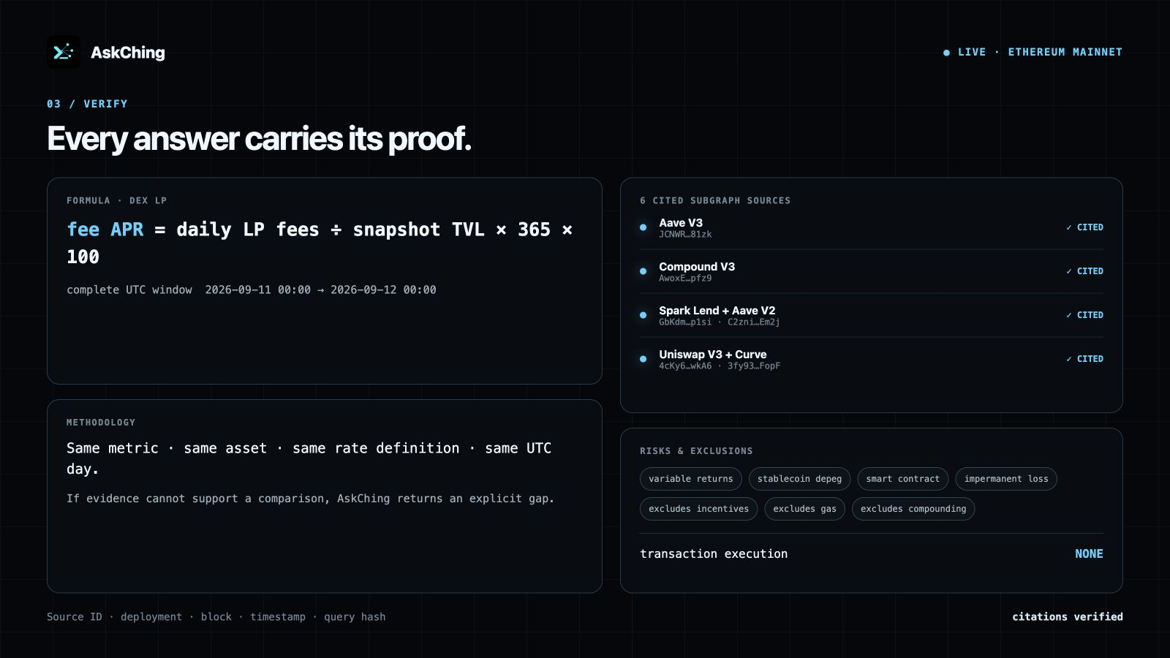
04 / TRUST
AskChing reports gaps instead of inventing evidence
≥ 2
independently cited sources
or no quantitative comparison
MISSING HISTORY
The answer carries an explicit gap. A spot value never pretends to be a trend.
source ID · deployment · block · timestamp · query hash
ASKCHING · ETHONLINE 2026
05
Notes:
[1:45–2:15] The trust rule is enforced in code. A quantitative comparison needs at least two independently cited sources. If only one survives, AskChing returns no comparison. Missing historical coverage also becomes an explicit gap, so a current snapshot never masquerades as a seven-day trend. This behavior matters more than producing an answer at any cost.

Slide 6
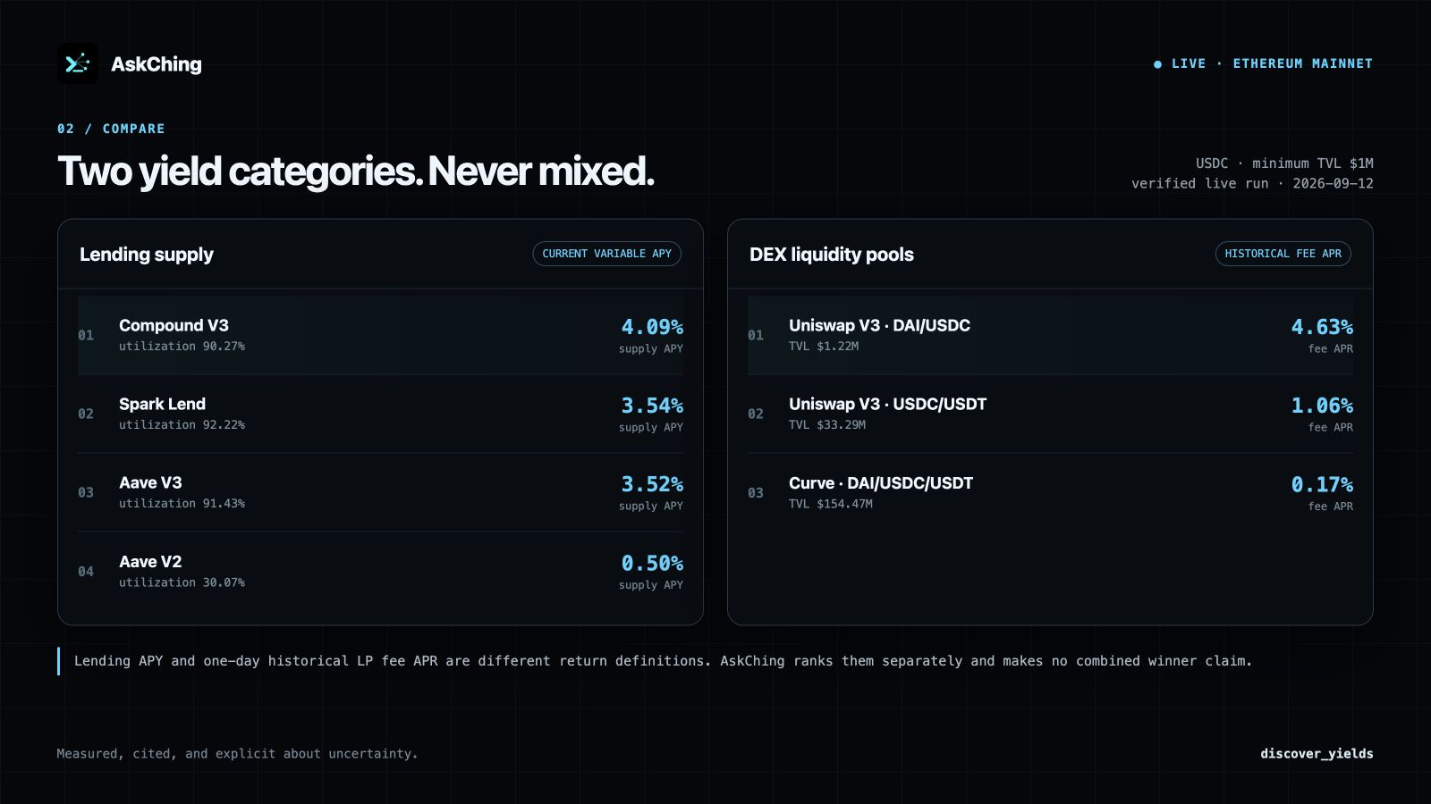
05 / RESEARCH
Seven tools cover spot research, history, and yield discovery
compare_markets
rank comparable metrics
research_brief
summarize cited findings
risk_scan
peer-relative spot signals
analyze_markets
explain calculations and confidence
analyze_trends
7d / 30d cited daily history
discover_yields
separate lending and DEX LP rankings
get_info
describe capabilities and examples
LENDING SUPPLY APY
≠
HISTORICAL LP FEE APR
ASKCHING · ETHONLINE 2026
06
Notes:
[2:15–2:45] The project now exposes seven MCP tools. It can compare current markets, create research briefs, scan peer-relative risk, explain calculations, and analyze cited daily history over seven or thirty days. Yield discovery covers lending, Uniswap V3, and Curve while keeping current lending APY separate from historical LP fee APR because they describe different products and risks.

Slide 7

One evidence layer for many agents
AskChing would rather report a gap than invent a number.
REMOTE MCP
https://ask-ching-agent.vercel.app/api/mcp
COMPATIBLE CLIENTS
Claude Cursor VS Code Codex Gemini ChatGPT
PUBLIC CODE
github.com/Chonwai/AskChing_Agent
GROK CLI · FEATURED ORCHESTRATION DEMO
ASKCHING · ETHONLINE 2026
07
Notes:
[2:45–3:15] AskChing exposes one remote MCP endpoint that compatible agents can call directly. Our Grok CLI demonstrates the orchestration path, but the research layer stays model-independent. The Graph supplies the live, verifiable market history, and AskChing adds normalization, evidence gates, and transparent analysis. The code is public. AskChing would rather report a gap than invent a number. Thank you.

