Slide 1
segmentation

Slide 2
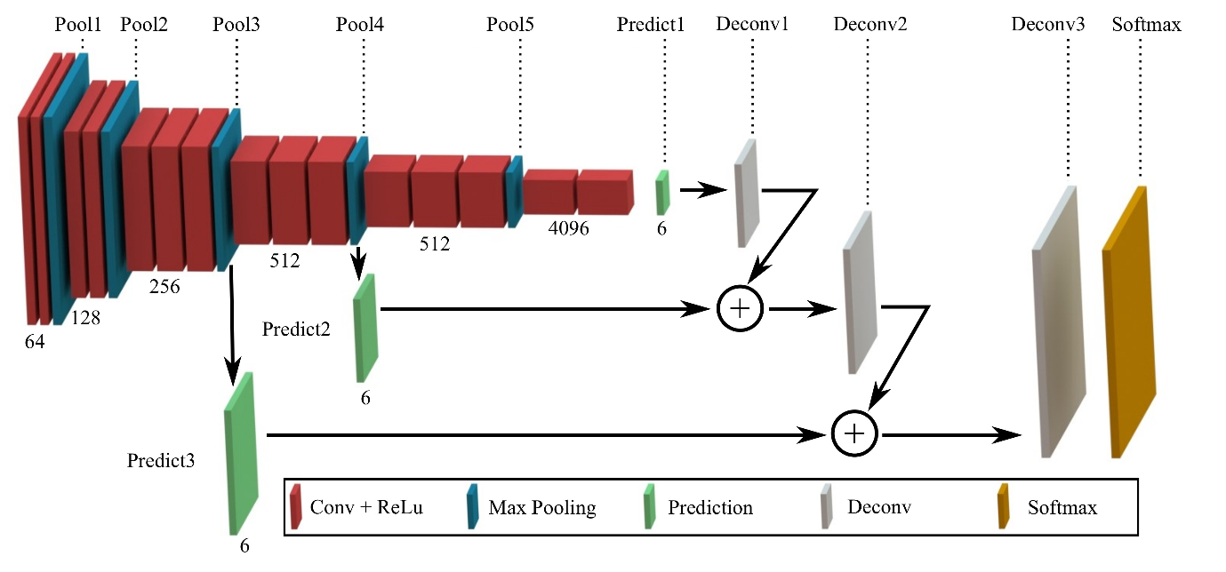
수업 시간에 다룬 모델

Slide 3

U-NET + VGG-16 Transfer-learning

Slide 4
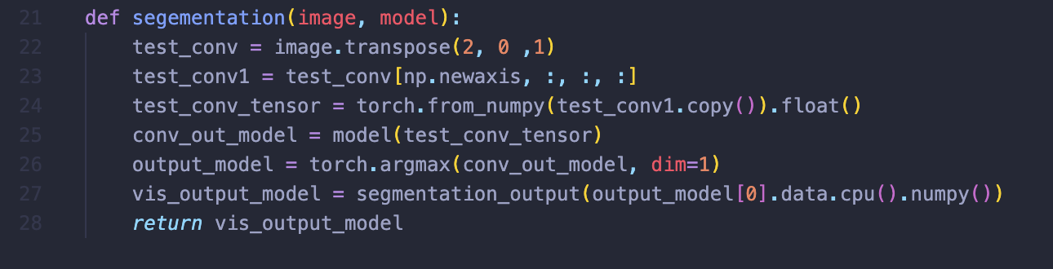
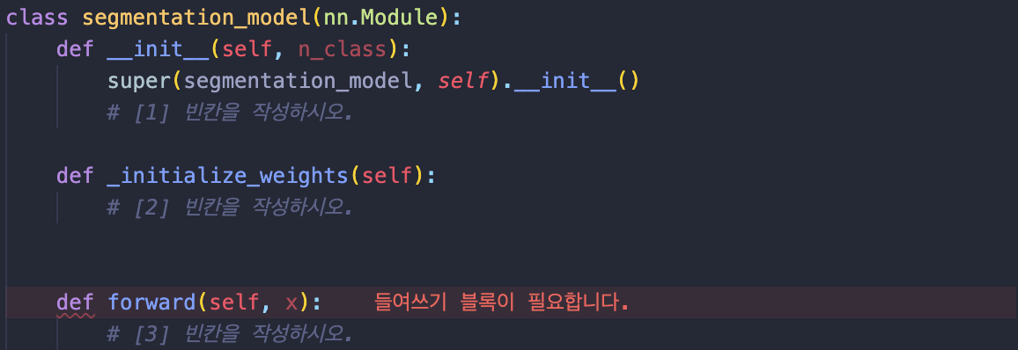






segmentation.py → def segmentation(image, model)
$$I∈ ℝ^{H × W × C}$$
$$I^{T}∈ ℝ^{C × H × W}$$
$$𝕀∈ ℝ^{N × C × H × W}$$
(type = torch.tensor)
$$N=1$$
model
model.py → class segmentation_model(nn.Module):
$$𝕆∈ ℝ^{N × H × W}$$
segmentation.py →
def segmentation_output(mask, num_classes = 7)
$$𝕆∈ ℝ^{H × W ×3}$$

Slide 5
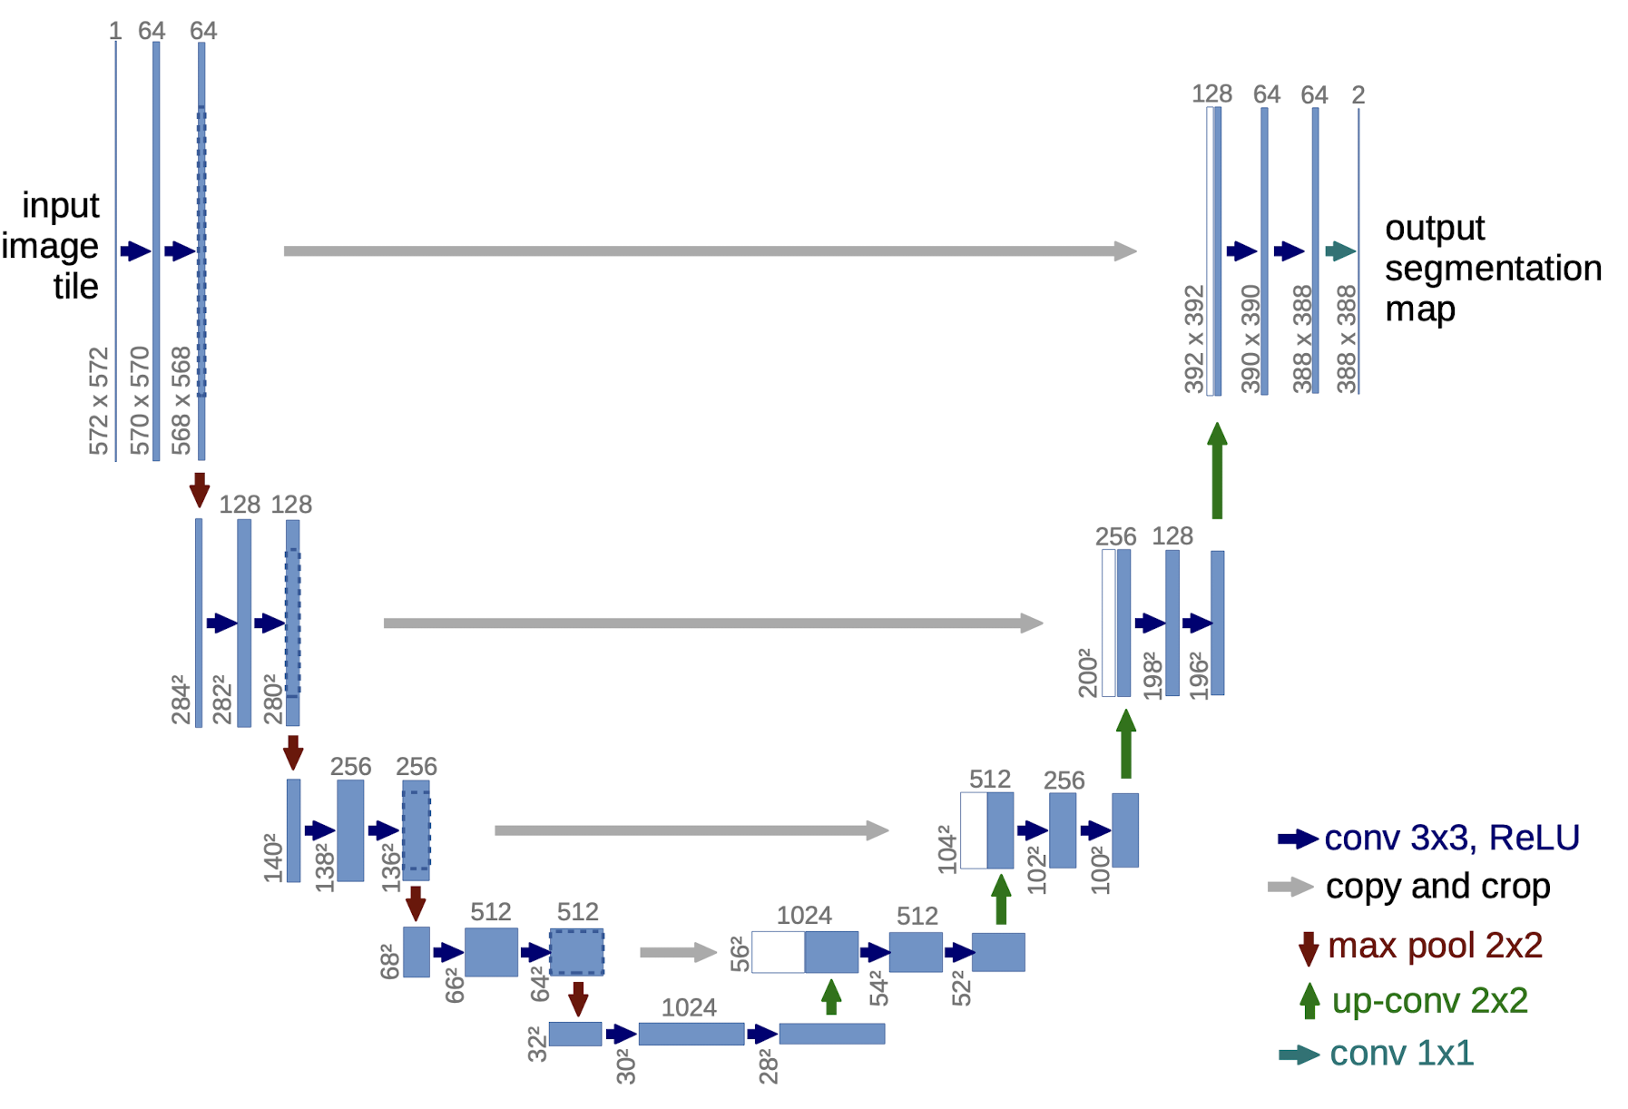

model.py
$$𝕀∈ ℝ^{N × C × H × W}$$
FCN8
UNET

Slide 6
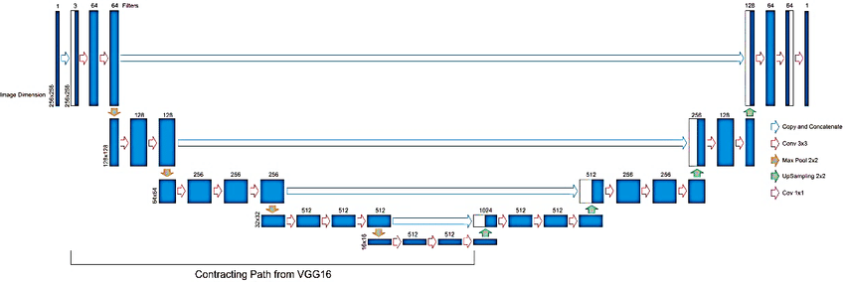
model.py
$$𝕀∈ ℝ^{N × C × H × W}$$
UNET + VGG16

Slide 7
model.py
(0): Conv2d(in_channel, 64, kernel_size=(3, 3), stride=(1, 1), padding=(1, 1))
(1): ReLU(inplace=True)
(2): Conv2d(64, 64, kernel_size=(3, 3), stride=(1, 1), padding=(1, 1))
(3): ReLU(inplace=True)
(4): MaxPool2d(kernel_size=2, stride=2, padding=0, dilation=1, ceil_mode=False)
(5): Conv2d(64, 128, kernel_size=(3, 3), stride=(1, 1), padding=(1, 1))
(6): ReLU(inplace=True)
(7): Conv2d(128, 128, kernel_size=(3, 3), stride=(1, 1), padding=(1, 1))
(8): ReLU(inplace=True)
(9): MaxPool2d(kernel_size=2, stride=2, padding=0, dilation=1, ceil_mode=False)
(10): Conv2d(128, 256, kernel_size=(3, 3), stride=(1, 1), padding=(1, 1))
(11): ReLU(inplace=True)
(12): Conv2d(256, 256, kernel_size=(3, 3), stride=(1, 1), padding=(1, 1))
(13): ReLU(inplace=True)
(14): Conv2d(256, 256, kernel_size=(3, 3), stride=(1, 1), padding=(1, 1))
(15): ReLU(inplace=True)
(16): MaxPool2d(kernel_size=2, stride=2, padding=0, dilation=1, ceil_mode=False)
(17): Conv2d(256, 512, kernel_size=(3, 3), stride=(1, 1), padding=(1, 1))
(18): ReLU(inplace=True)
(19): Conv2d(512, 512, kernel_size=(3, 3), stride=(1, 1), padding=(1, 1))
(20): ReLU(inplace=True)
(21): Conv2d(512, 512, kernel_size=(3, 3), stride=(1, 1), padding=(1, 1))
(22): ReLU(inplace=True)
(23): MaxPool2d(kernel_size=2, stride=2, padding=0, dilation=1, ceil_mode=False)
$$𝕀∈ ℝ^{N × C × H × W}$$
pass_through = []

Slide 8

model.py
(24): Conv2d(512, 512, kernel_size=(3, 3), stride=(1, 1), padding=(1, 1))
(25): ReLU(inplace=True)
(26): Conv2d(512, 512, kernel_size=(3, 3), stride=(1, 1), padding=(1, 1))
(27): ReLU(inplace=True)
(28): Conv2d(512, 512, kernel_size=(3, 3), stride=(1, 1), padding=(1, 1))
(29): ReLU(inplace=True)
$$𝕀∈ ℝ^{N × C × H × W}$$

Slide 9
Encoder Method
(feature extraction)
Decoder → HOW??

Slide 10
Pros: better result than FCN8 (VGG+UNET > UNET)
Cons: takes extreme amount of time for training (est. 7hr) → might need colab pro…

