Slide 1
DSCI 222: Python Code Collaboration, List Comprehension and Memory Management
Ignacio Segovia-Dominguez
West Virginia University
www.IgnacioSD.com
*Disclaimer. Slides may contain a mix of material from multiple authors: Ignacio Segovia-Dominguez (WVU), AWS, Anaconda, Google Colab, Microsoft, Medium.com, GeeksForGeeks.org, RealPython.com, Simplilearn.com, SaturnCloud, DigitalOcean, Python Docs.

Slide 2
Collaboration while writing Python code
One of the most important features of Google Colab is the ability to share your work with others in real-time. You can collaborate with your team members, colleagues, or friends by sharing your Google Colab notebook with them.
Sometimes you may need to share a Google Drive with all the members of Google Colab, especially if you are working on a group project where data needs to be shared among team members.
SaturnCloud
Other tools: Visual Studio Live Share, Code With Me (JetBrains),
CodeTogether, GitLive, Github (Code versions), and much more…

Slide 3
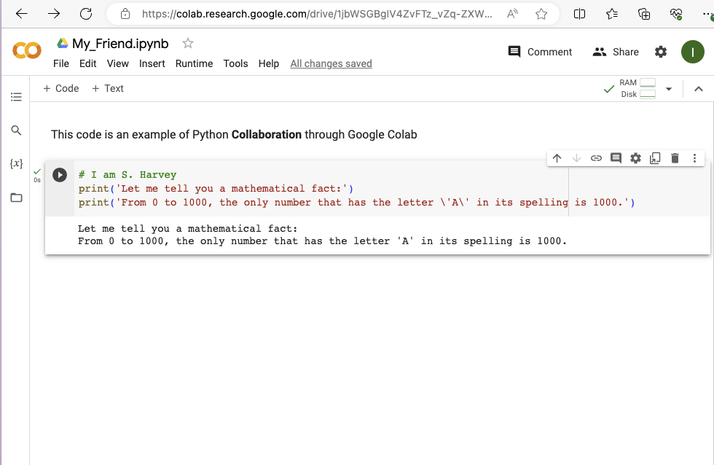

Slide 4
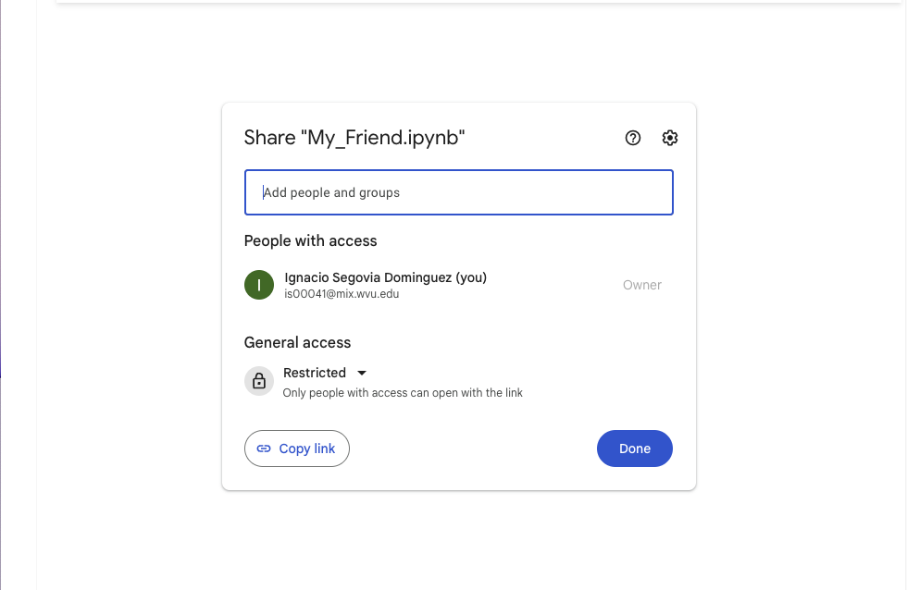

Slide 5
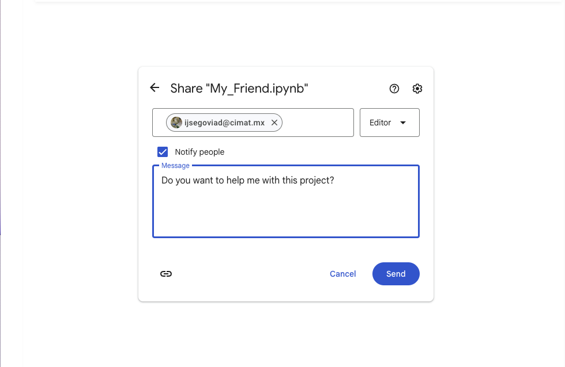

Slide 6
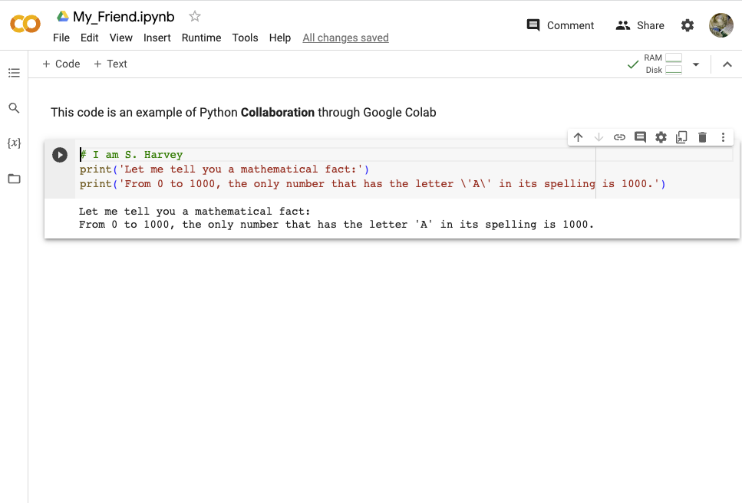

Slide 7
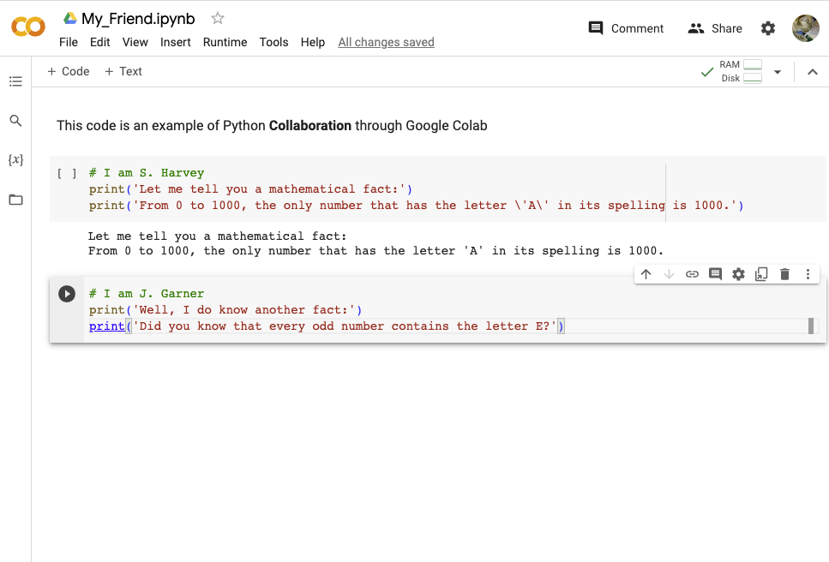

Slide 8
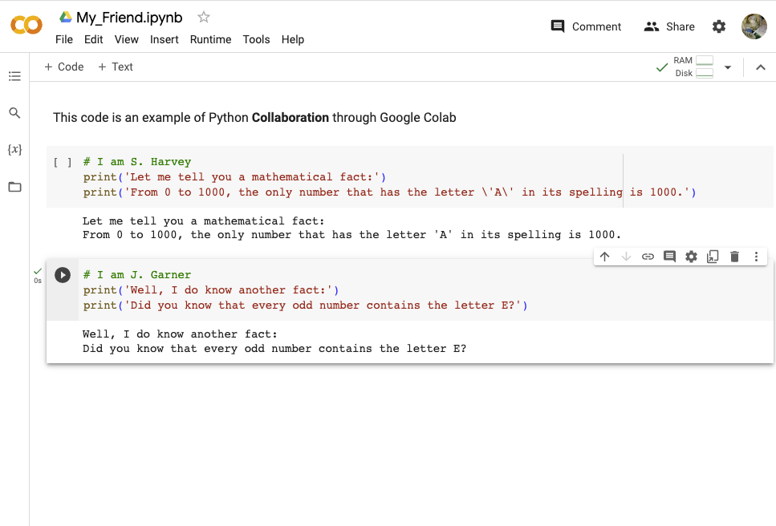

Slide 9
Collaboration while writing Python code
One of the most important features of Google Colab is the ability to share your work with others in real-time. You can collaborate with your team members, colleagues, or friends by sharing your Google Colab notebook with them.
Sometimes you may need to share a Google Drive with all the members of Google Colab, especially if you are working on a group project where data needs to be shared among team members.
SaturnCloud
Other tools: Visual Studio Live Share, Code With Me (JetBrains),
CodeTogether, GitLive, Github (Code versions), and much more…

Slide 10
Any ideas to solve this problem?
Let’s move to another subject…
Create a list of 10 numbers and compute their square value:
1, 2, 3, 4, 5, 6, 7, 8, 9, 10

Slide 11
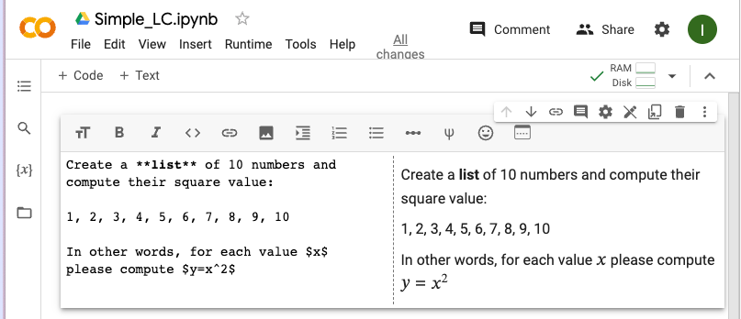
Note that Google Colab, GitHub and other platforms uses Markdown code for texts formatting.
https://colab.research.google.com/notebooks/markdown_guide.ipynb#scrollTo=Lhfnlq1Surtk
https://docs.github.com/en/get-started/writing-on-github/getting-started-with-writing-and-formatting-on-github/basic-writing-and-formatting-syntax

Slide 12
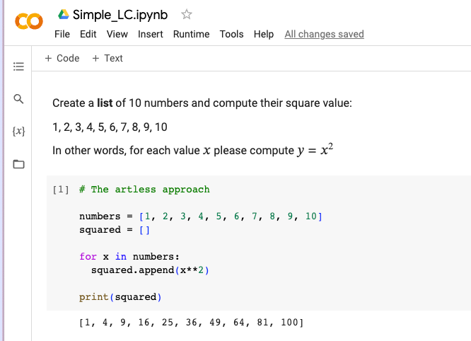

Slide 13
List Comprehension
List comprehensions offer a succinct way to create lists based on existing lists. When using list comprehensions, lists can be built by leveraging any iterable, including strings and tuples.
Syntactically, list comprehensions consist of an iterable containing an expression followed by a for clause. This can be followed by additional for or if clauses, so familiarity with for loops and conditional statements will help you understand list comprehensions better.
List comprehensions provide an alternative syntax to creating lists and other sequential data types. While other methods of iteration, such as for loops, can also be used to create lists, list comprehensions may be preferred because they can limit the number of lines used in your program.
DigitalOcean

Slide 14
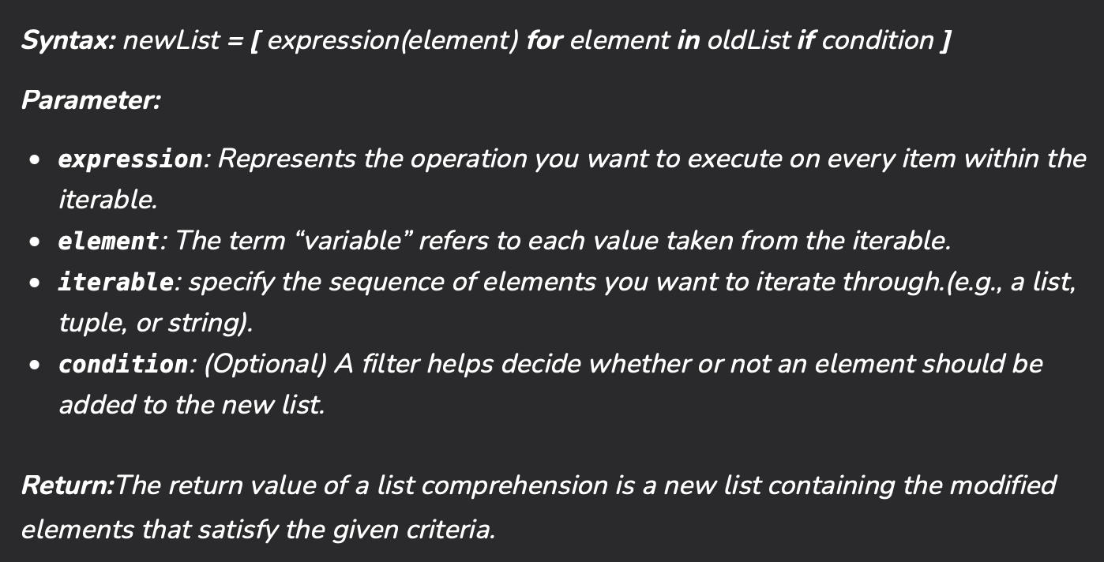
List Comprehension
Python List comprehension provides a much more short syntax for creating a new list based on the values of an existing list.

Slide 15
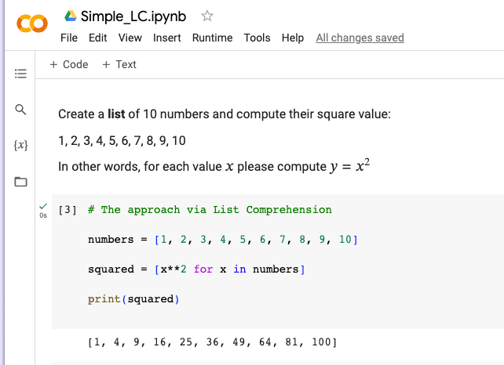

Slide 16
List Comprehension
Let’s explore more sophisticated constructions…

Slide 17
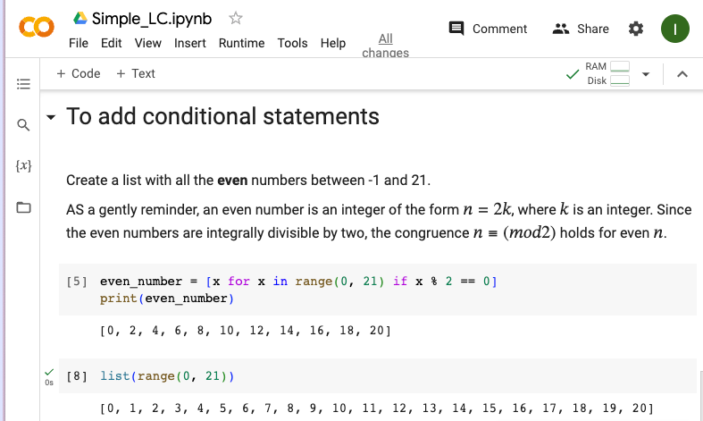

Slide 18


Slide 21
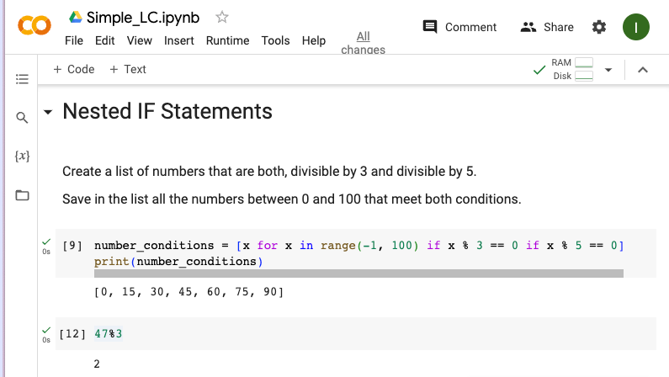

Slide 24
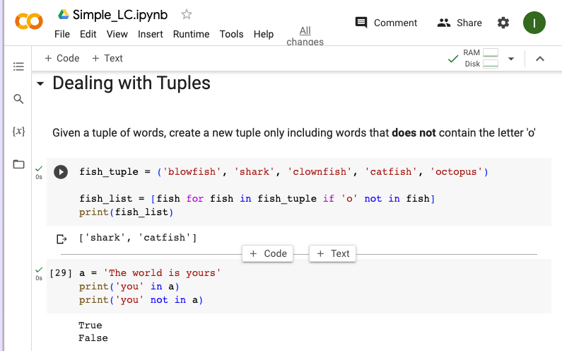

Slide 27
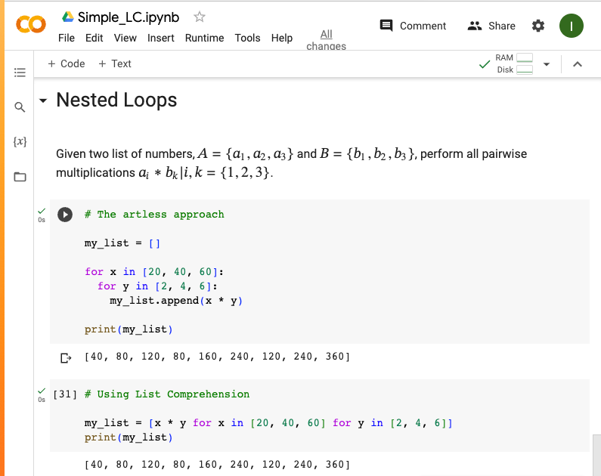

Slide 30

List Comprehension
Why do we care about writing code via List Comprehension if at the end we got the same answer? right?

Slide 31
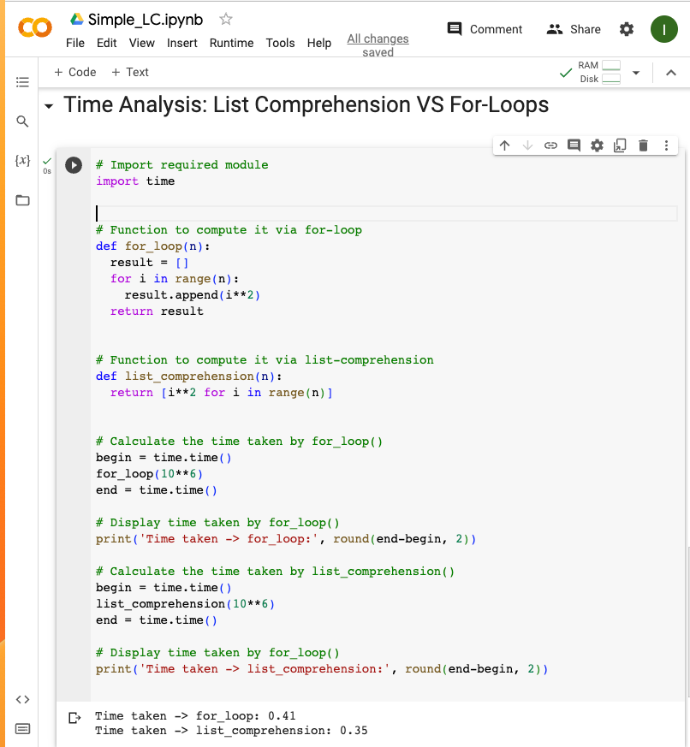
For the Unix system,
January 1, 1970, 00:00:00
at UTC is epoch.

Slide 35
List Comprehension
Why do we care about writing code via List Comprehension if at the end we got the same answer? right?
In general, list comprehensions are faster than for-loops.

Slide 36
How data-storage is managed while working on Python?
Let’s move to another subject…
As Data Scientist, we care about writing efficient code that runs fast.
But also…
writing efficient code means writing a memory-efficient code

Slide 37
Memory Management in Python
Memory management in Python involves a private heap containing all Python objects and data structures. The management of this private heap is ensured internally by the Python memory manager. The Python memory manager has different components which deal with various dynamic storage management aspects, like sharing, segmentation, preallocation or caching.
At the lowest level, a raw memory allocator ensures that there is enough room in the private heap for storing all Python-related data by interacting with the memory manager of the operating system. On top of the raw memory allocator, several object-specific allocators operate on the same heap and implement distinct memory management policies adapted to the peculiarities of every object type. For example, integer objects are managed differently within the heap than strings, tuples or dictionaries because integers imply different storage requirements and speed/space tradeoffs. The Python memory manager thus delegates some of the work to the object-specific allocators, but ensures that the latter operate within the bounds of the private heap.
Python.org

Slide 38

Memory Management in Python
Memory management in Python involves a private heap containing all Python objects and data structures. The management of this private heap is ensured internally by the Python memory manager. The Python memory manager has different components which deal with various dynamic storage management aspects, like sharing, segmentation, preallocation or caching.
At the lowest level, a raw memory allocator ensures that there is enough room in the private heap for storing all Python-related data by interacting with the memory manager of the operating system. On top of the raw memory allocator, several object-specific allocators operate on the same heap and implement distinct memory management policies adapted to the peculiarities of every object type. For example, integer objects are managed differently within the heap than strings, tuples or dictionaries because integers imply different storage requirements and speed/space tradeoffs. The Python memory manager thus delegates some of the work to the object-specific allocators, but ensures that the latter operate within the bounds of the private heap.
Python.org
This topic is very technical…

Slide 39
Memory Management in Python
Key points:
Garbage collection is a process in which the interpreter frees up the memory when not in use to make it available for other objects.
Reference counting works by counting the number of times an object is referenced by other objects in the system. When references to an object are removed, the reference count for an object is decremented. When the reference count becomes zero, the object is deallocated.
CPython is the default and most widely used implementation of the Python language. Since CPython is the reference implementation, all new rules and specifications of the Python language are first implemented by CPython.

Slide 40
Memory Management in Python
Key points:
It’s important to note that there are implementations other than CPython. IronPython compiles down to run on Microsoft’s Common Language Runtime. Jython compiles down to Java bytecode to run on the Java Virtual Machine. PyPy claims to run faster for particular applications.
Each object has its own object-specific memory allocator that knows how to get the memory to store that object. Each object also has an object-specific memory deallocator that “frees” the memory once it’s no longer needed.
The Global Interpreter Lock (GIL) performs a single global lock on the interpreter when a thread is interacting with shared resources. In other words, only one thread can write at a time.
If you want to get deep into memory management in Python:
https://docs.python.org/3/c-api/memory.html
https://www.honeybadger.io/blog/memory-management-in-python/

Slide 41
Memory Management in Python
How Python make efficient use of memory allocation?
Let’s remember the Phyton function id()
Python id() function returns the “identity” of the object. The identity of an object is an integer, which is guaranteed to be unique and constant for this object during its lifetime. Two objects with non-overlapping lifetimes may have the same id() value.
In CPython implementation, this is the address of the object in memory.
DigitalOcean

Slide 42
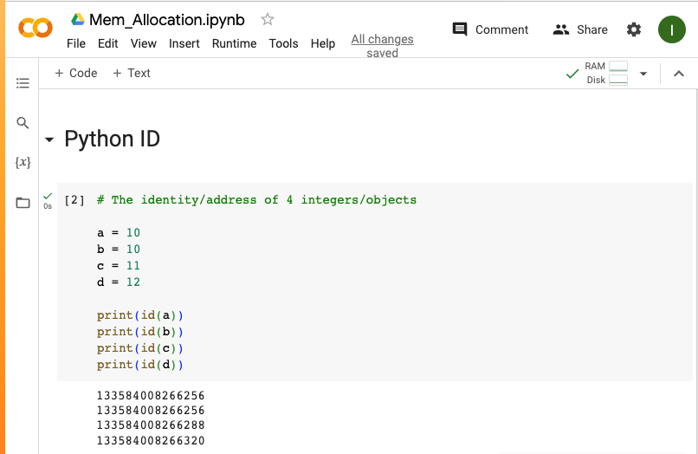

Slide 44
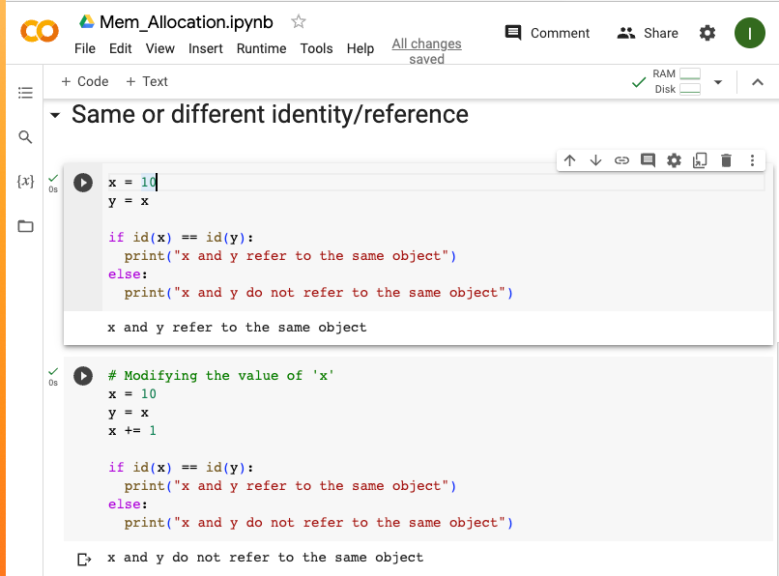

Slide 48
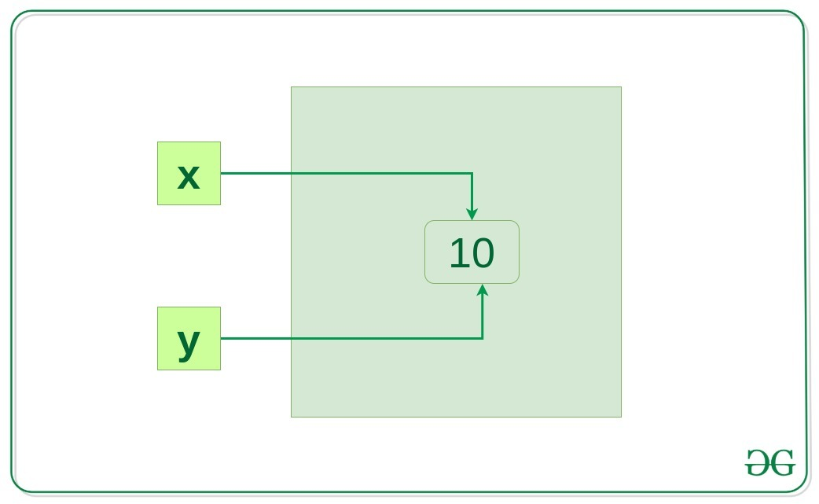
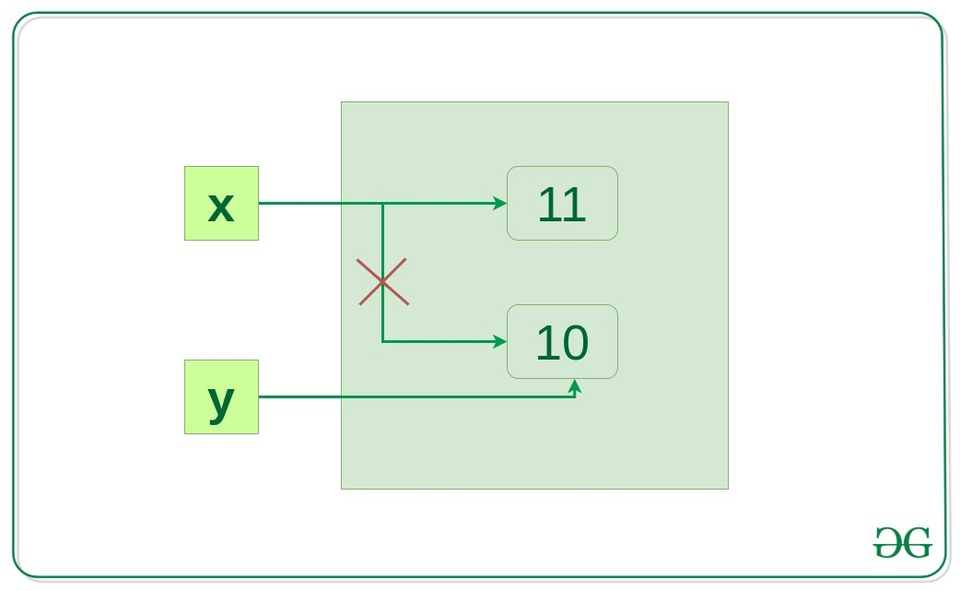

Slide 49
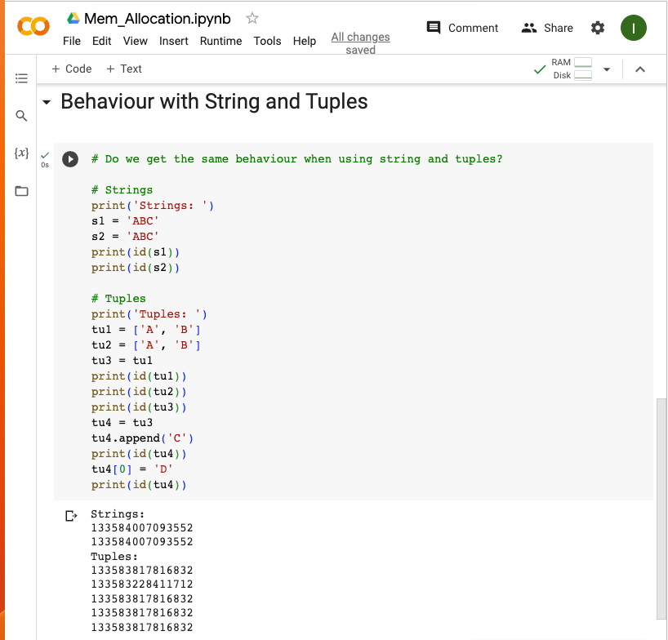

Slide 51
Summary
Code collaboration in real-time among data scientists is crucial to speed-up results and to be part of an efficient teamwork.
Techniques, such as list comprehension, help us to write faster code.
Understanding memory allocation and management help us to write efficient code.

Slide 52

Stay Safe & Healthy

