Slide 1
Advanced machine learning: Boosting
Austin SIGKDD 8/3/2016

Slide 2
Executive Summary
Boosting
Ensemble method
Basic concept
Multiple weak learners combined algorithmically to form a strong model
Primary implementation is decision trees
Inherits best qualities, fixes the worst
Best off the shelf algorithm for transactional data
Popular in competitions & real-world modeling
Variance in implementations (GBM)
R, Sci-kit, H2O, XGBoost, Salford (MART)

Slide 3
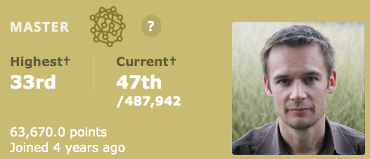
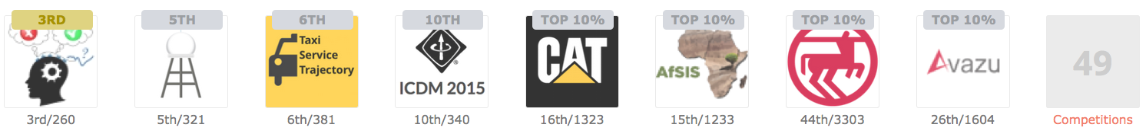
Background
Lead Data Scientist, H2O
BS, computer science
Additional roles: data warehousing, BI, analytics

Slide 4
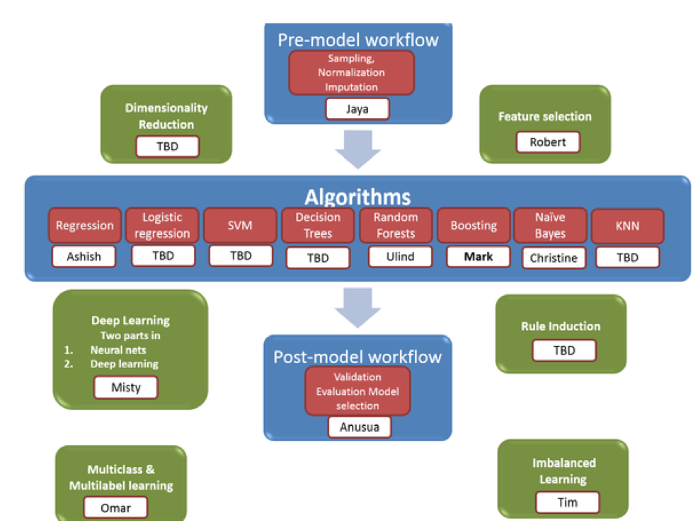
Advanced ML Topics

Slide 5
Predictive Modeling Landscape: General Purpose Algorithms (for illustrative purposes only, not to scale, precise, or comprehensive; author’s perspective)
Random Forest
Gradient Boosted Machines
Neural Networks & Deep Learning
Support Vector Machines
Regularized
Linear
Models
Splines
complexity
Generalized Linear Models
Classification
And Regression Trees
Naïve Bayes
Nearest Neighbor
Linear Models
Linear Models
Decision Trees
Others
More Comprehensive List: http://caret.r-forge.r-project.org/modelList.html

Slide 6
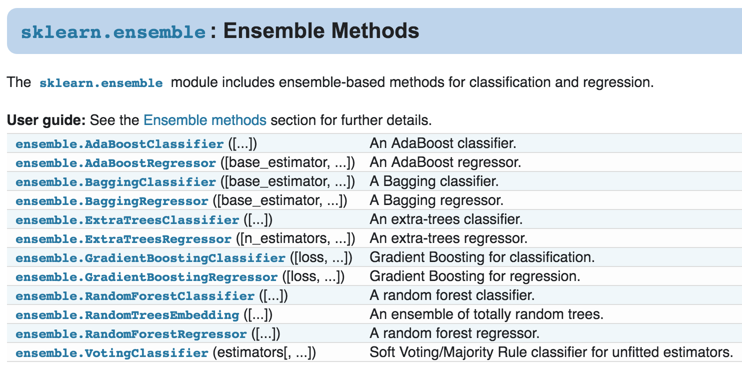
Ensembles in Sci-Kit Learn

Slide 7
Ensembles in Sci-Kit Learn
Source: http://scikit-learn.org/stable/modules/classes.html#module-sklearn.ensemble

Slide 8
Boosting
Common definition
Multiple weak learners combined algorithmically to form a strong model
Weak learner examples
Single-featured predictions
Small decision trees
No definition of weak
Combined algorithmically
Sequential fits focusing on the training cases with highest error
Adaboost: reweighting at each iteration based on misclassification error
GBM: new target = gradient loss of model as of prior iterations, stochastic with regularization

Slide 9
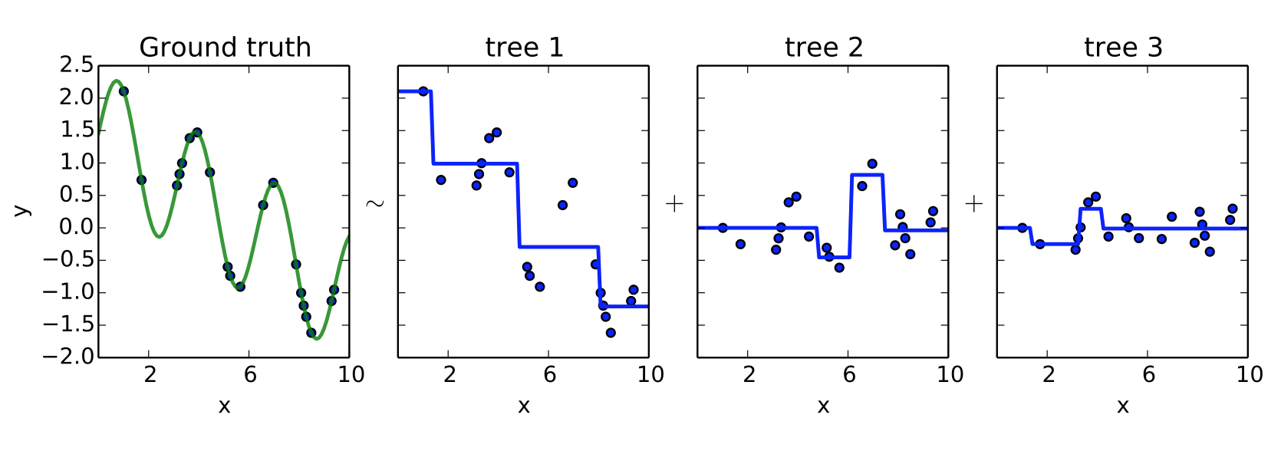
Revisit Sequential Tree Building
Source: http://www.slideshare.net/DataRobot/gradient-boosted-regression-trees-in-scikitlearn

Slide 10
Boosting: Brief History
1988: original concept in Kearns/Valiant paper
1990: original Freund & Schapire
1997: Adaboost, by Freund & Schapire
1999: Friedman - Stochastic Gradient Boosting
2002: Friedman – Gradient Boosted Machines
2014: Extreme gradient boosting (XGBoost) T. Chen
Interesting how few developments existed between 2002 and 2014

Slide 11
Decision Trees

Slide 12
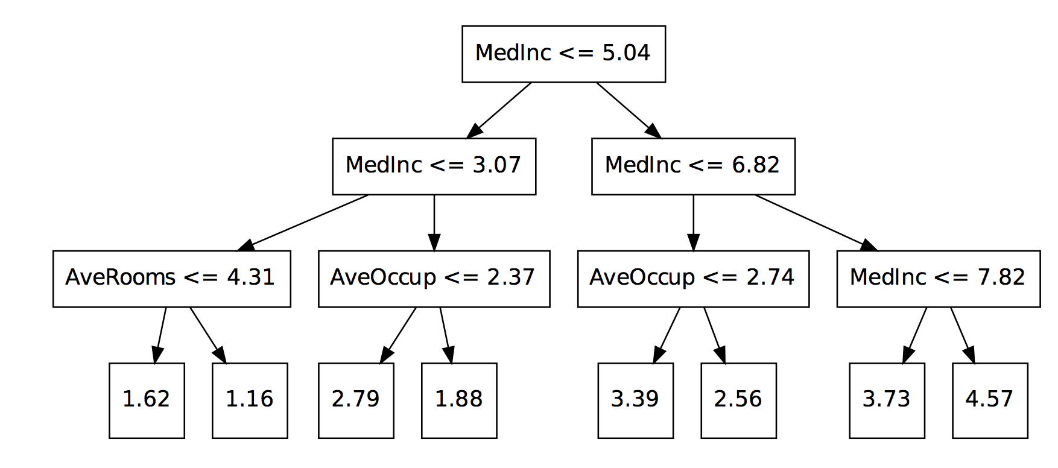
Decision Tree Overview
Source: http://www.slideshare.net/DataRobot/gradient-boosted-regression-trees-in-scikitlearn

Slide 13
Decision Trees: Practical Use
Strengths
Weaknesses
Non linear
Robust to correlated features
Robust to feature distributions
Robust to missing values
Simple to comprehend
Fast to train
Fast to score
Poor accuracy
Cannot project
Inefficiently fits linear relationships

Slide 14
Boosting Decision Trees
Strengths
Inherits strengths of decision trees
Often best possible model
Dominant in Kaggle
Increasing adoption in production use cases
Robust
Directly optimizes cost function
Weaknesses
Overfits
Need to find proper stopping point
Sensitive to noise and extreme values
Several hyper-parameters
Lack of transparency

Slide 15
Basic GBM Parameters
Number of iterations
Learning rate
Tree depth
Minimum number of observations
Observation sampling
Column sampling (multiple methods)
Minimum split gain requirement
Regularization strength

Slide 16
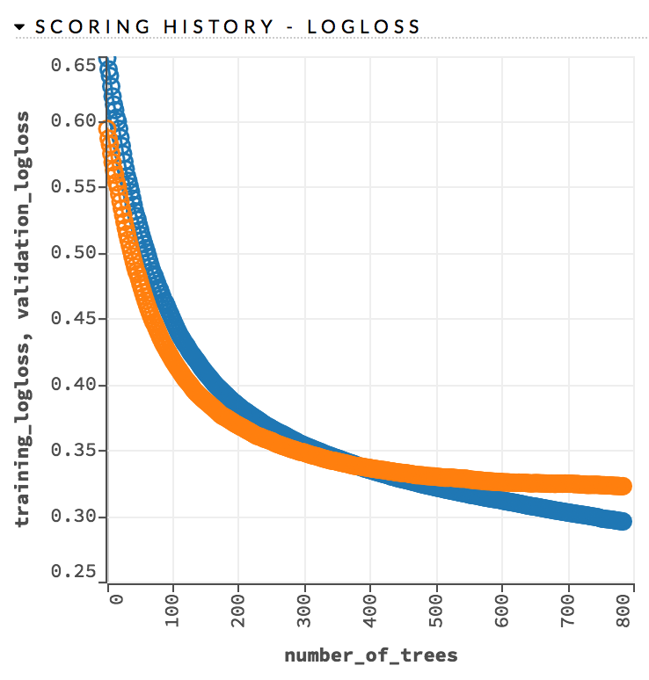
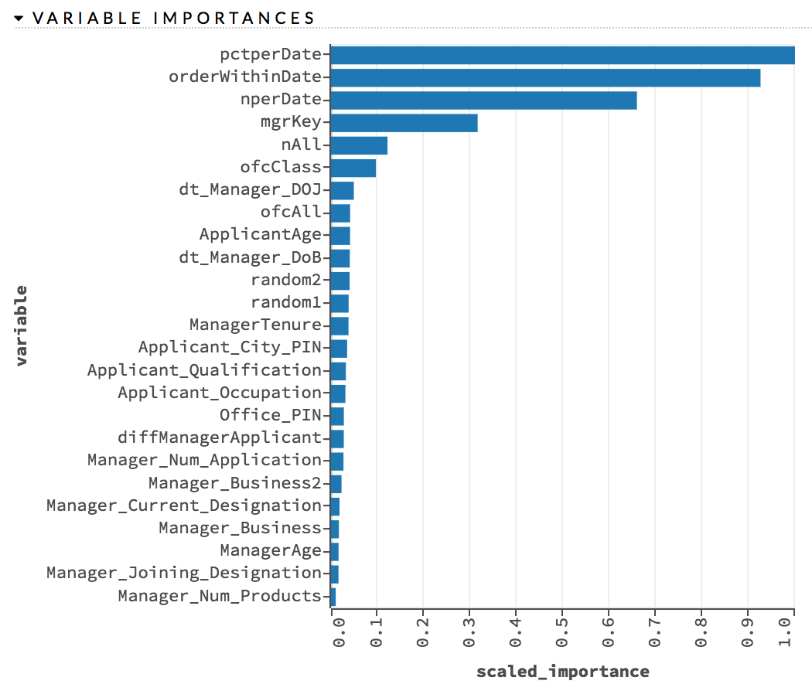
GBM In Action

