Slide 1




Specialty Fiber
Photothermal Spectroscopy
for Trace Gas Detection
Sixiang Ran
2025.10.11

Slide 2


Content
Background
Methodology
Recent progress
Conclusion
1
2
3
4
2

Slide 3

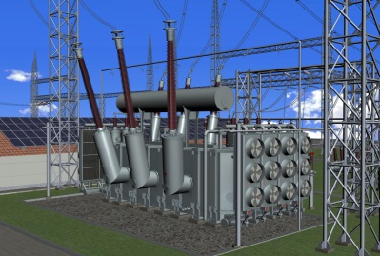
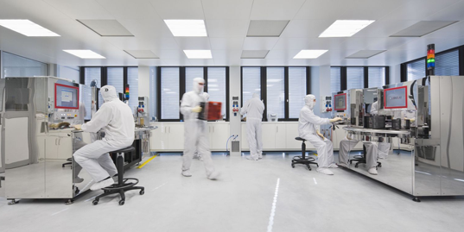
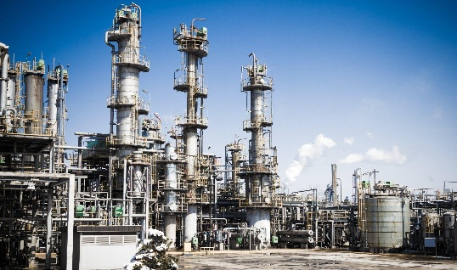
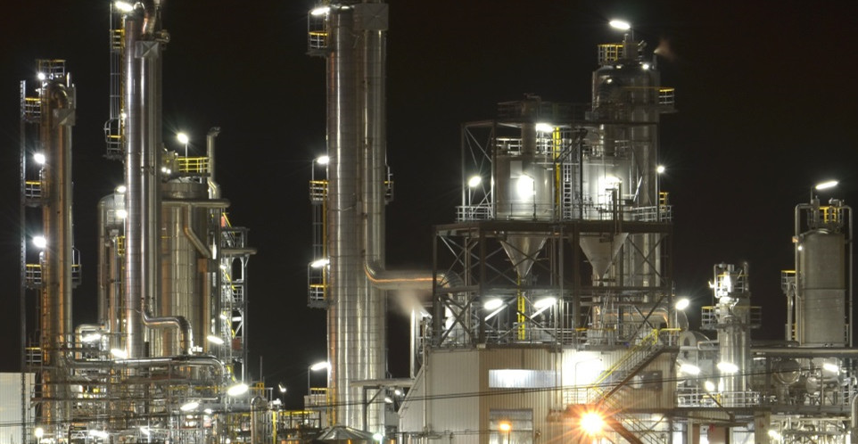


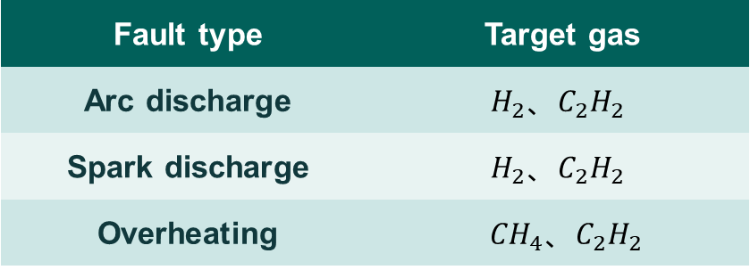
Background
Typical application of trace gas detection
Electrical grid monitoring
Other application scenarios
Fault type | Target gas
Arc discharge | $$H_{2}{、C}_{2}H_{2}$$
Spark discharge | $$H_{2}{、C}_{2}H_{2}$$
Overheating | ${CH}_{4}{、C}_{2}H_{2}$
Scenarios | Target gas
Semiconductor clean room | NF₃
Grain storage facility | PH₃（磷化氢）
Customs | SO₂F₂（硫酰氟）
3

Slide 4
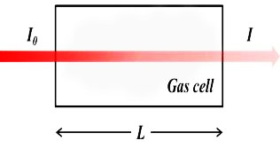
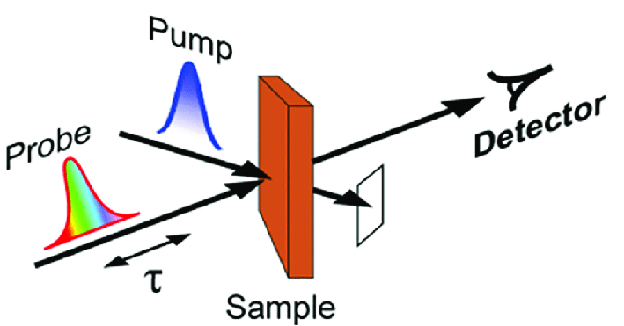
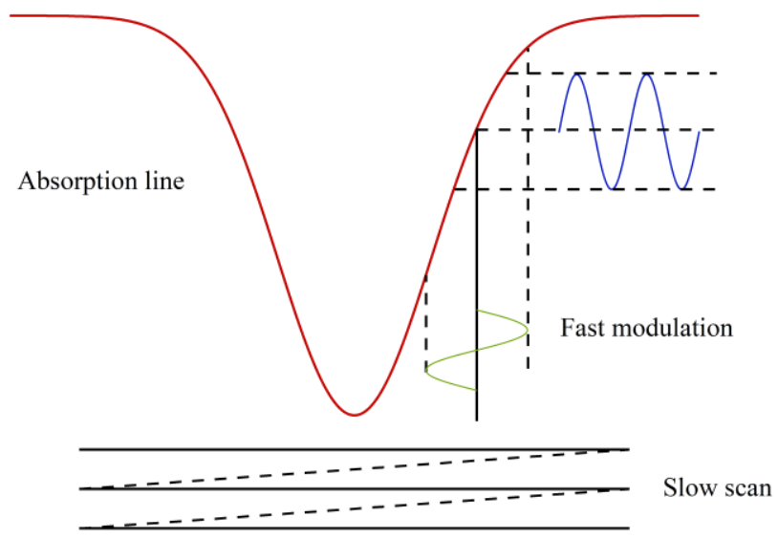
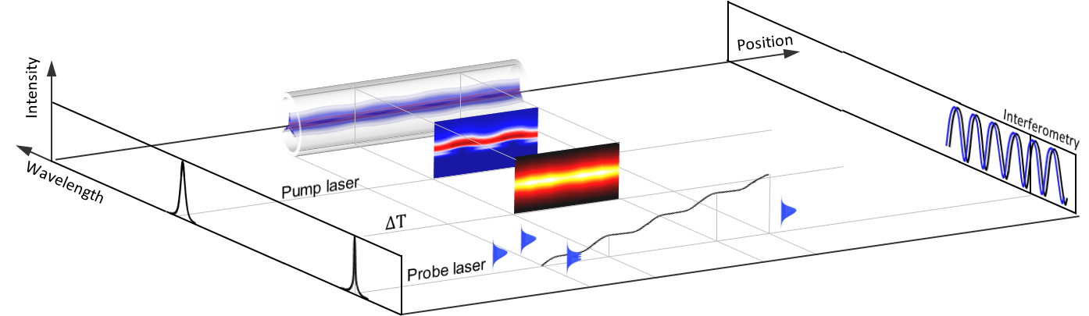
Background：
Laser absorption spectroscopy
LAS principle
Wavelength modulation technique
Direct absorption type
Absorption coefficient
Modulation wave number
Pump-probe type
Probe laser output
Gas absorption line
Pump light fast modulation
Pump laser slow tuning
Gas detection with micro- and nano-engineered optical fibers. Opt. Fiber Technol 2013, 19, 741.
4

Slide 5
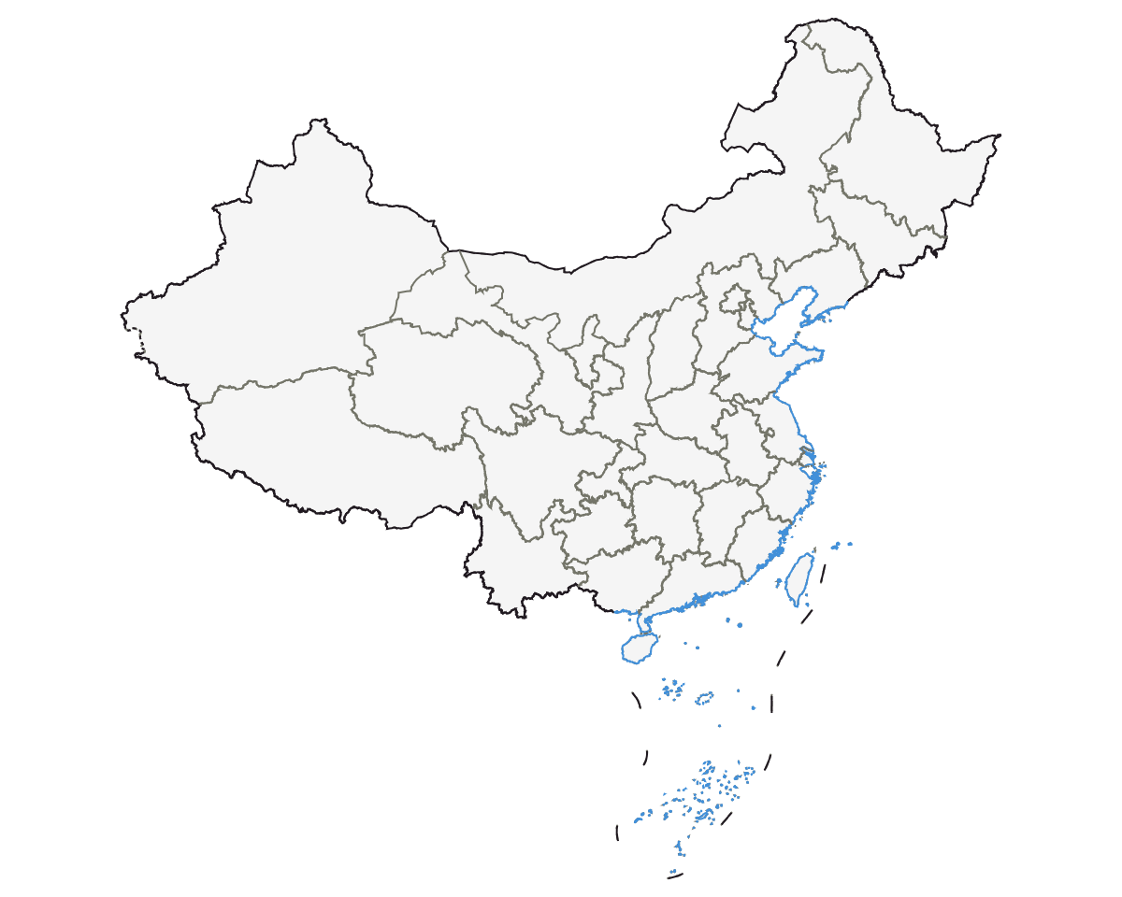
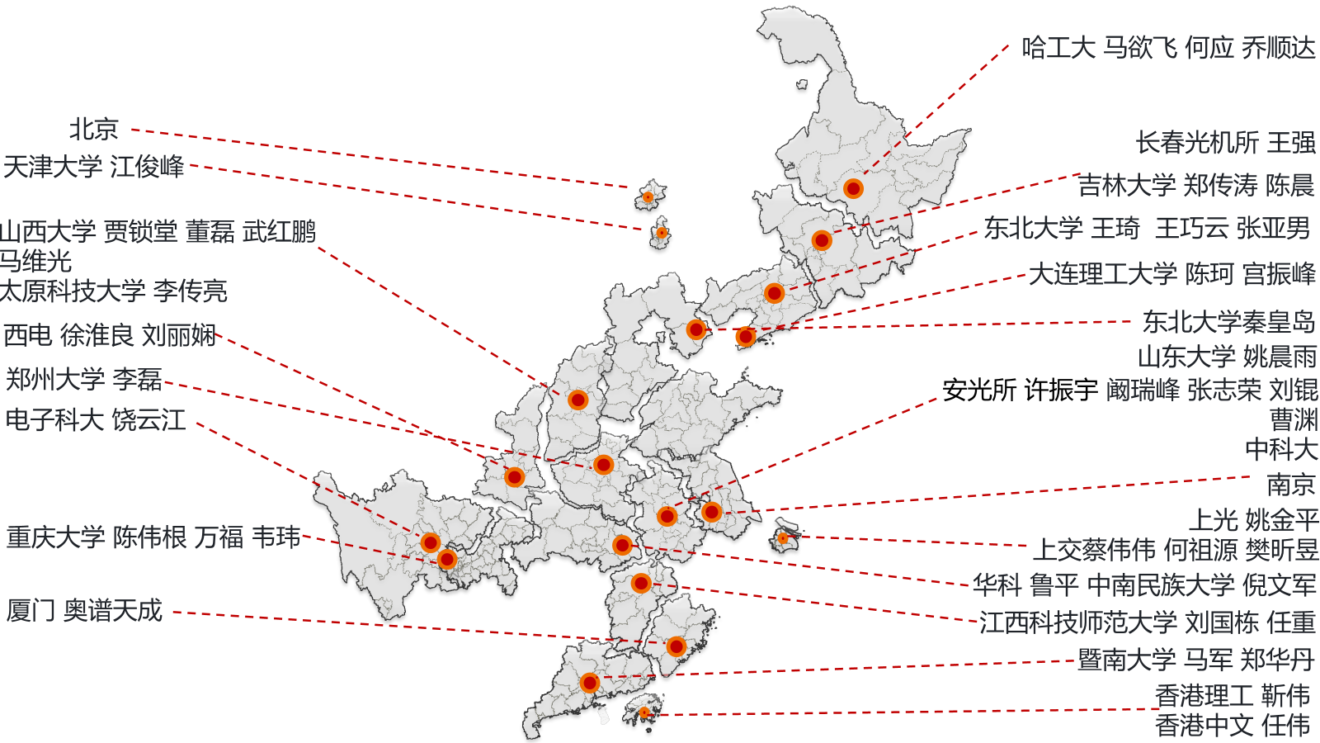
Background
5

Slide 6
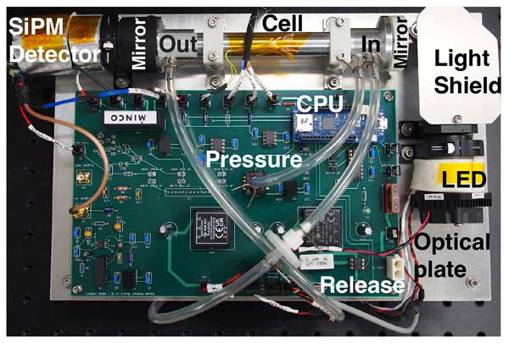
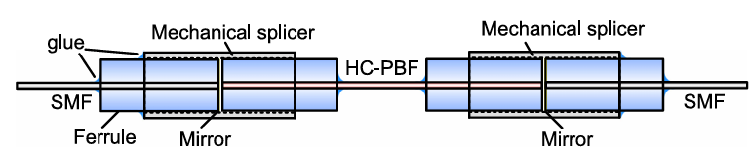
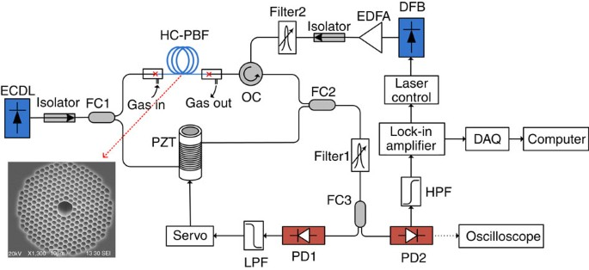
Background
All-fiber photothermal spectroscopy (Common advantages)
Spatial optical cavity enhanced gas detection
Specialty fiber enhanced spectral gas detection
Atmos. Meas. Tech. 2024, 17, 5903
Nat Commun, 2015, 6, 6767.
J. Lightwave Technol. 2019, 37, 4222.
Sensitivity：Low light energy density and short distance
High light energy density and long distance
Integration：large volume、complex reflection will drift
smaller volume、compact all-fiber system
6

Slide 7
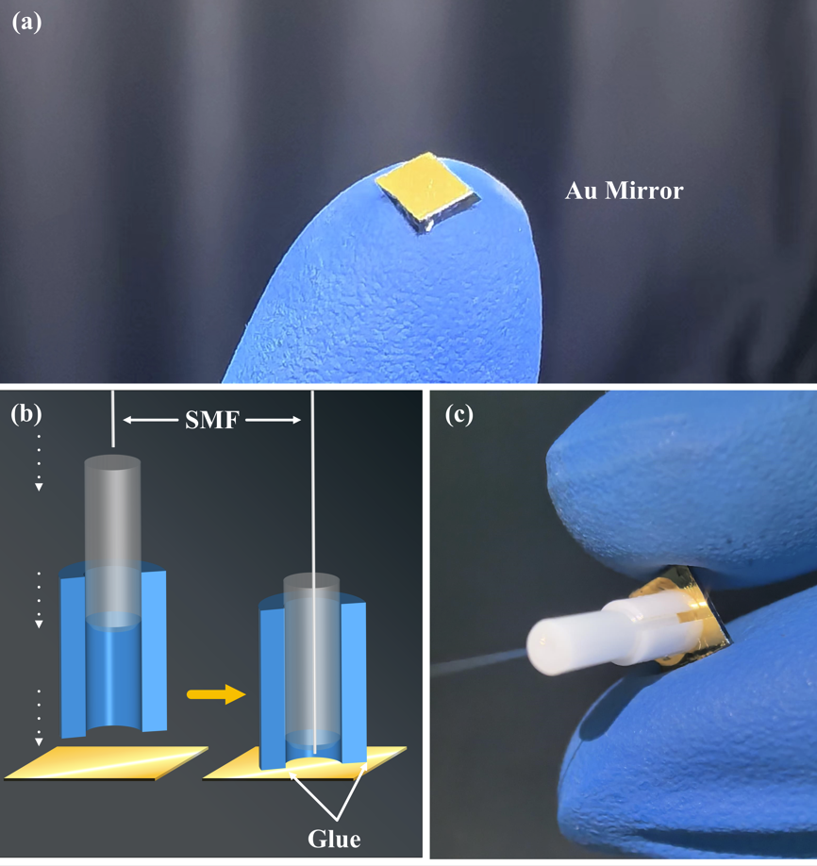
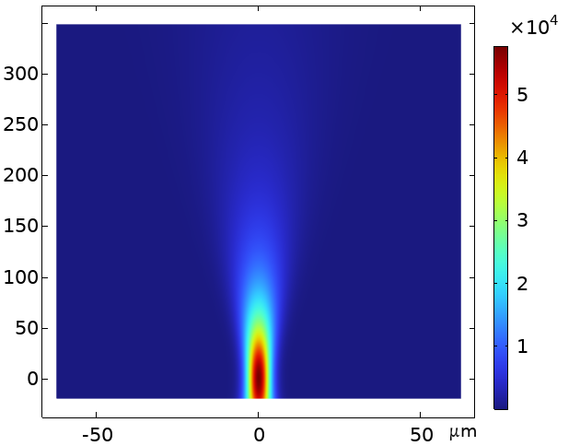
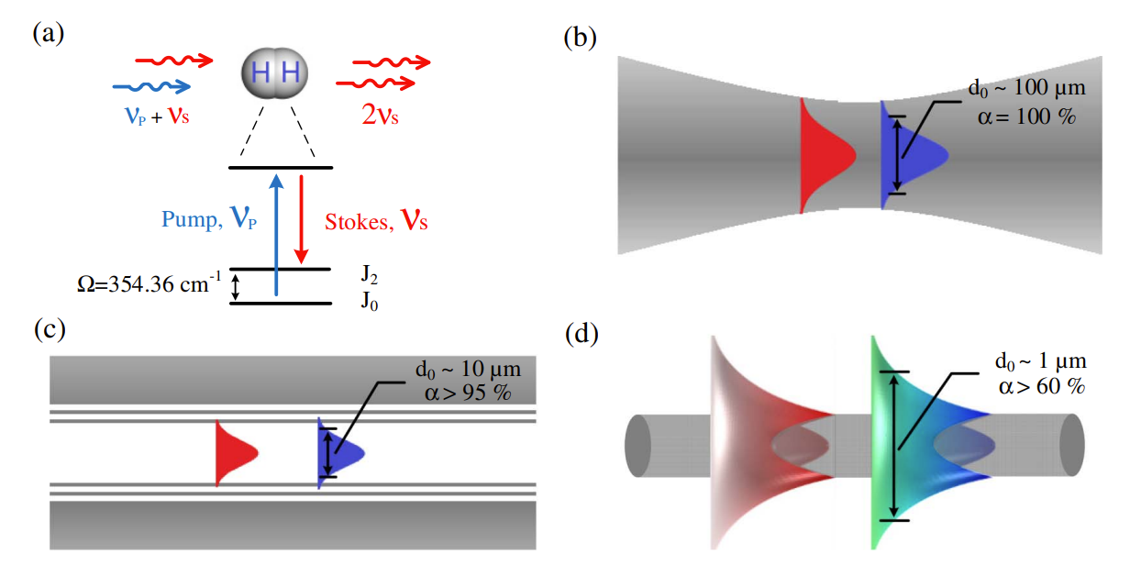
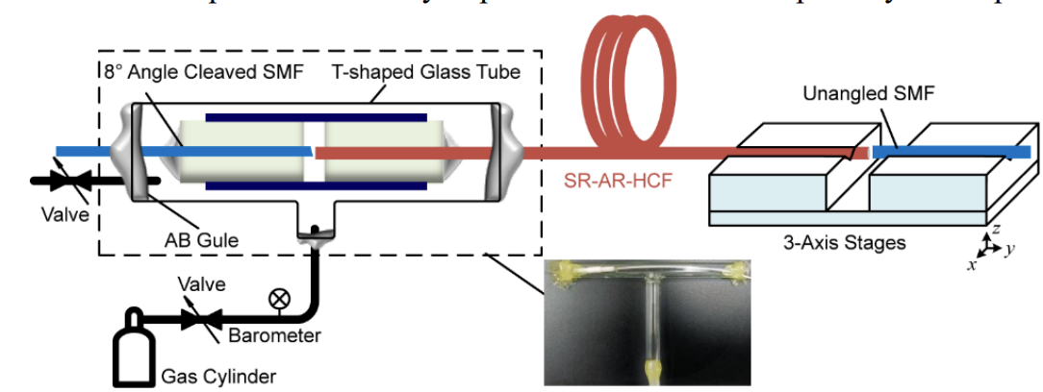
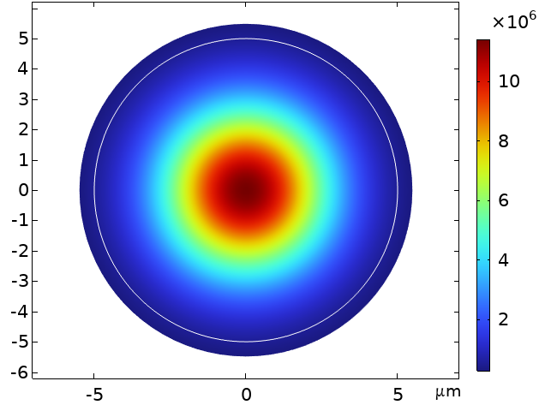
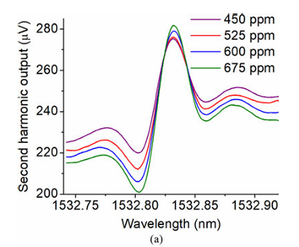
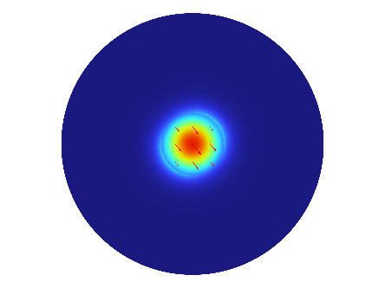
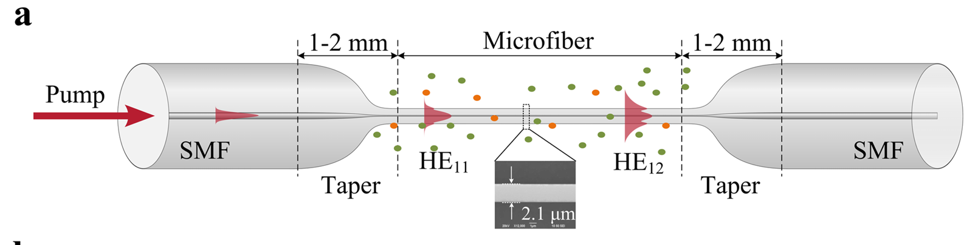
Background
Free space PTI
Gaussian light field
(a)
d₀ ~100 μm
Appl. Phys. Lett., 2025, 126.
Hollow core fiber PTI
Mode field of AR-HCF
d₀ ~10 μm
Nat. Commun, 2020, 11, 847
Nano fiber PTI
Evanescent field of NF
Background photothermal signal affects detection!
7
d₀ ~1 μm
7
J. Lightwave Technol., 2017, 35, 24
LaserPhotonicsRev.2023,17,2200972
7

Slide 8

THANKS FOR ATTENTION！

