Slide 1



Specialty Fiber
Photothermal Spectroscopy
for Trace Gas Detection
Sixiang Ran
2025.10.11

Slide 2

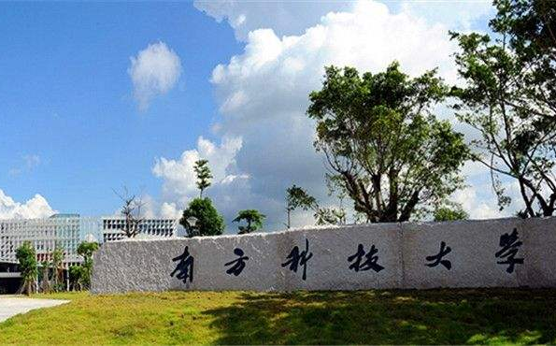
Content
Background
Methodology
Recent progress
Conclusion
1
2
3
4
2

Slide 3
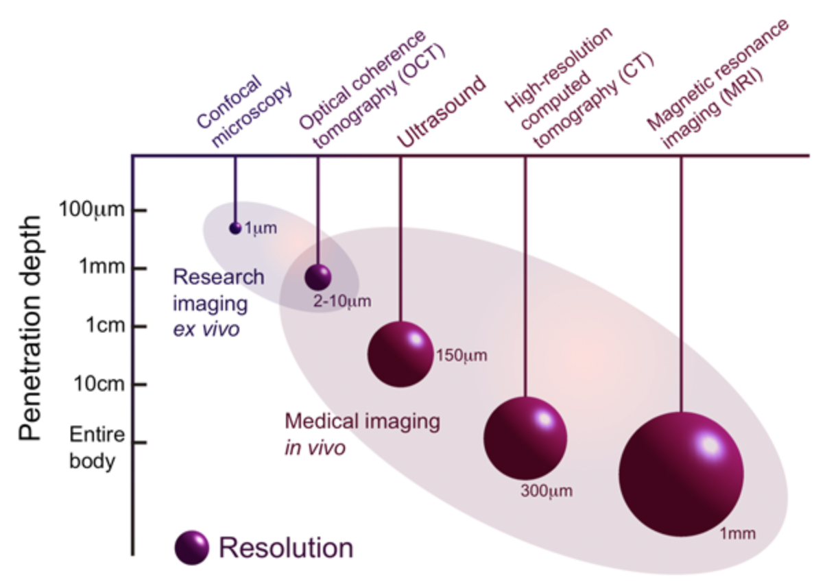
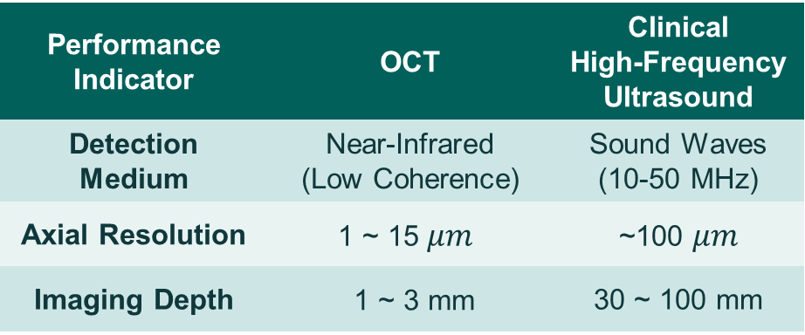
Spatial Resolution
OCT(Optical Coherence Tomography) vs. Ultrasound
OCT, often referred to as "optical ultrasound“, strikes a perfect balance between resolution and depth of penetration.
Performance Indicator | OCT | Clinical High-Frequency Ultrasound
Detection Medium | Near-Infrared (Low Coherence) | Sound Waves (10-50 MHz)
Axial Resolution | $$\text{1 \sim 15 }μm$$ | ~100 $μm$
Imaging Depth | 1 ~ 3 mm | 30 ~ 100 mm
High Resolution Imaging in Microscopy and Ophthalmology: New Frontiers in Biomedical Optics, edited by J. Roland, J. P. Rolland, and J. Jannick (Springer Nature, 2014).
3

Slide 4
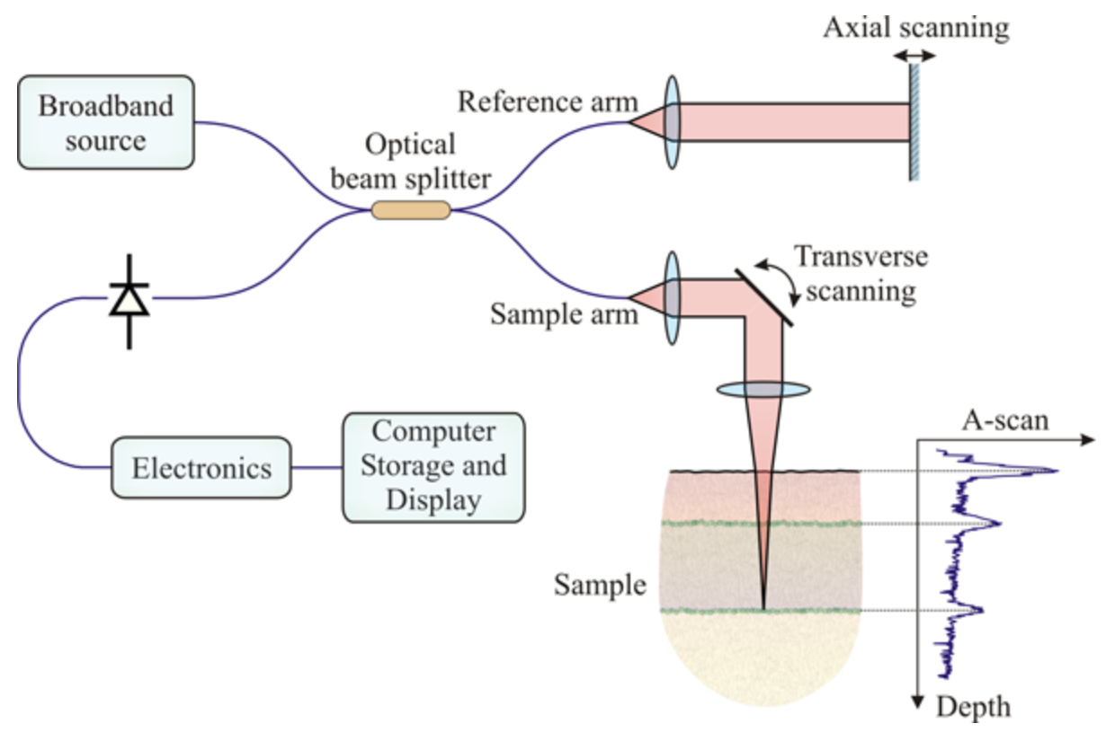


Spatial Resolution
OCT：Core Principle
Low-Coherence Interferometry
Axial Resolution
$$Δz=\frac{2\ln{2}}{π}\frac{λ_{0}^{2}}{Δλ}$$
(Wider bandwidth $Δλ→$ Higher resolution)
Advantages of Ultrafast Lasers:
According to the Fourier transform limit, a femtosecond pulse inherently possesses an extremely broad spectral bandwidth.
Low-coherence interferometry via a Michelson interferometer geometry
Interference occurs only when the optical path difference is strictly within the coherence length
4

Slide 5
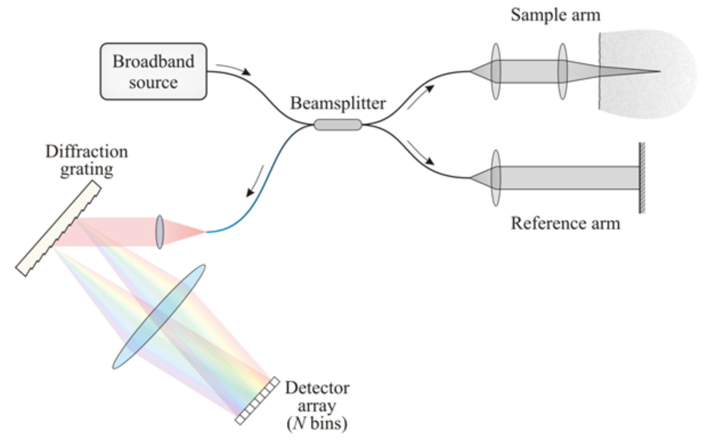
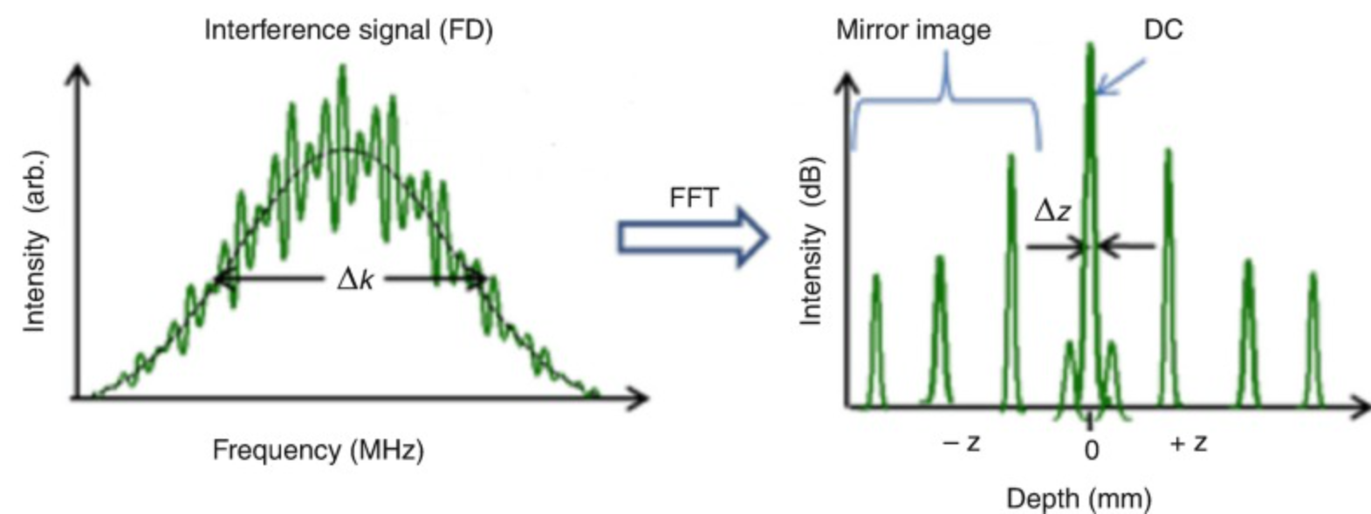
Spatial Resolution
OCT：Technical Evolution
SD-OCT：Spectral-Domain OCT
Coherent information from all depths is acquired in the frequency domain using a spectrometer
Eliminates mechanical reference arm scanning
Phase Stability
High Resolution Imaging in Microscopy and Ophthalmology: New Frontiers in Biomedical Optics, edited by J. Roland, J. P. Rolland, and J. Jannick (Springer Nature, 2014).
5

Slide 6
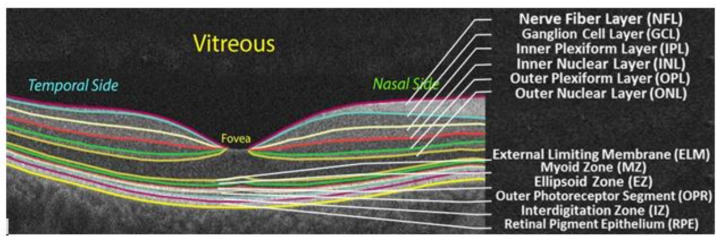
Spatial Resolution
OCT Applications：Structural imaging
Optical Biopsy of Retinal Layers
High-sensitivity resolution of stratified microstructures of the retina
using the ultra-broad spectrum of ultrafast lasers.
6

Slide 7
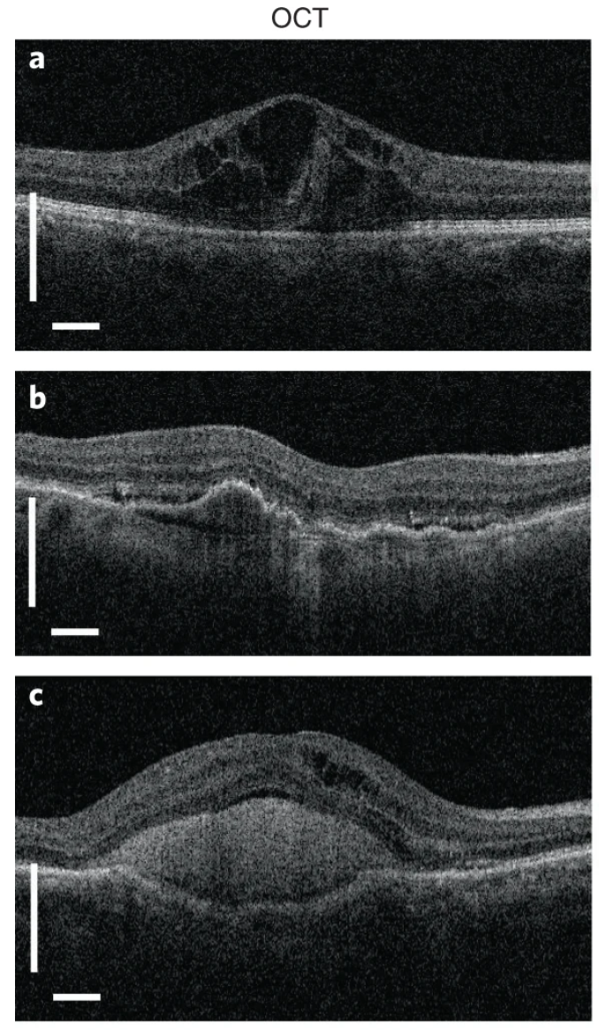
Spatial Resolution
OCT Applications：Structural imaging
Optical Biopsy of Retinal Layers
DME diagnosis: Real-time assessment of tissue fluid accumulation and cystic edema in areas such as the inner nuclear layer.
A patient with
diabetic macular edema
Drusen Identification: Precisely captures the minute bumps caused by the glass film light spot (Drusen) beneath the RPE layer.
A patient with choroidal neovascularization resulting from age-related macular degeneration (AMD)
Leakage monitoring: Observe the accumulation of subretinal high reflectivity material (SHRM), which is usually an important marker of choroidal neovascularization (CNV) and its activity.
A patient with neovascular
AMD with extensive subretinal hyperreflective material
7

Slide 8
Spatial Resolution
OCT Applications：Structural imaging
Optical Biopsy of Retinal Layers
DME diagnosis: Real-time assessment of tissue fluid accumulation and cystic edema in areas such as the inner nuclear layer.
A patient with
diabetic macular edema
Drusen Identification: Precisely captures the minute bumps caused by the glass film light spot (Drusen) beneath the RPE layer.
A patient with choroidal neovascularization resulting from age-related macular degeneration (AMD)
Leakage monitoring: Observe the accumulation of subretinal high reflectivity material (SHRM), which is usually an important marker of choroidal neovascularization (CNV) and its activity.
A patient with neovascular
AMD with extensive subretinal hyperreflective material
8

Slide 9
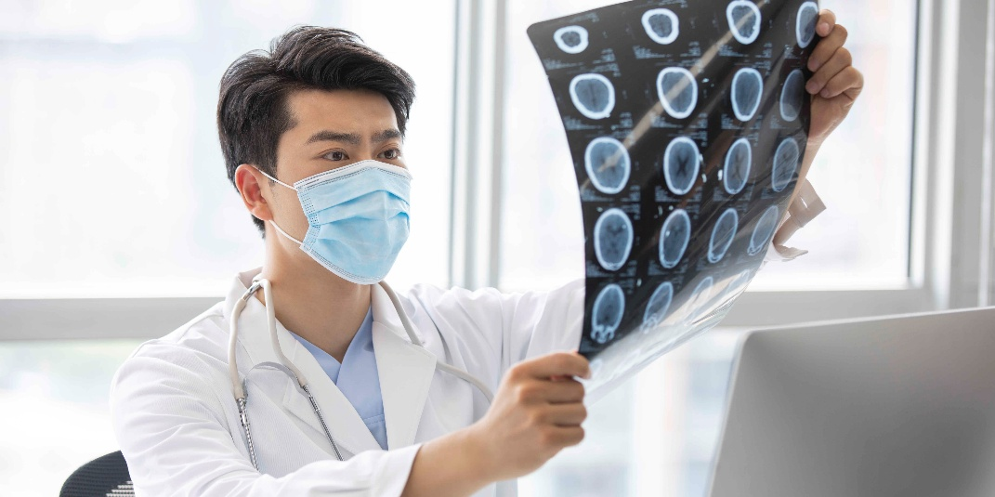
Conclusions
Diagnostic Science
Ultrafast laser technology is an important tool of modern label-free biomedical diagnostics.
Temporal Domain: Transient Dynamics
The Pump-Probe method turns spatial distance into high time resolution. It helps us capture the fast process of heat loss at the molecular level.
Spatial Domain: 3D Anatomy
OCT uses the features of ultrafast lasers to produce 3D images with extremely high resolution. Unlike traditional tools, it can show deep details clearly without touching the body.
Future
The combination of deep learning and functional OCT/Pump-Probe will provide a new imaging tool. It will further improve the quality of medical pictures and offer more help in clinical medicine.
9

Slide 10
References
[1] H.A. Haus, Mode-locking of lasers, IEEE Journal of Selected Topics in Quantum Electronics 6(6) (2000) 1173-1185.https://doi.org/10.1109/2944.902165
[2] A.H. Zewail, Femtochemistry: Atomic-Scale Dynamics of the Chemical Bond, The Journal of Physical Chemistry A 104(24) (2000) 5660-5694.https://doi.org/10.1021/jp001460h
[3] D. Huang, E.A. Swanson, C.P. Lin, J.S. Schuman, W.G. Stinson, W. Chang, M.R. Hee, T. Flotte, K. Gregory, C.A. Puliafito, J.G. Fujimoto, Optical Coherence Tomography, Science 254(5035) (1991) 1178-1181.https://doi.org/doi:10.1126/science.1957169
[4] I.R. Piletic, T.E. Matthews, W.S. Warren, Probing Near-Infrared Photorelaxation Pathways in Eumelanins and Pheomelanins, The Journal of Physical Chemistry A 114(43) (2010) 11483-11491.https://doi.org/10.1021/jp103608d
[5] W. Min, S. Lu, S. Chong, R. Roy, G.R. Holtom, X.S. Xie, Imaging chromophores with undetectable fluorescence by stimulated emission microscopy, Nature 461(7267) (2009) 1105-1109.https://doi.org/10.1038/nature08438
[6] T.E. Matthews, I.R. Piletic, M.A. Selim, M.J. Simpson, W.S. Warren, Pump-probe imaging differentiates melanoma from melanocytic nevi, Sci Transl Med 3(71) (2011) 71ra15.https://doi.org/10.1126/scitranslmed.3001604
[7] N. Nishizawa, Wideband ultrafast fiber laser sources for OCT and metrology, Journal of Physics B: Atomic, Molecular and Optical Physics 49(18) (2016) 182003.https://doi.org/10.1088/0953-4075/49/18/182003
[8] P. Chen, Z. Long, Q. Cheng, M. Song, W. Wang, R. Liu, Z. Zhang, K. Xia, Z. Yang, L. Qian, S. Bai, X. Wang, P. Yang, P. Xu, E.S. Yousef, R. Wang, On-Chip Supercontinuum Generation Pumped by Short Wavelength Fiber Lasers, Photonics, 2024, p. 440.10.3390/photonics11050440.
10

Slide 11

THANKS FOR ATTENTION！

