Slide 1
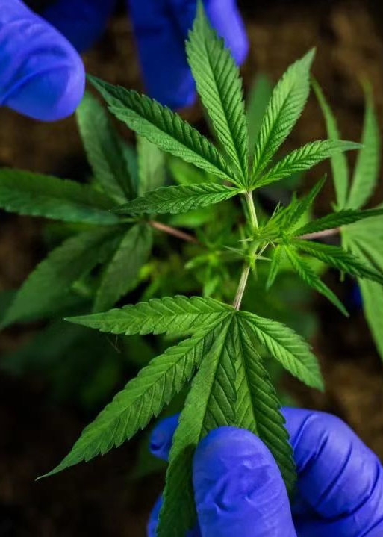
Legalizing Recreational Cannabis Promotes Economic Growth, Reduces Crime, and Enhances Public Health
SOSTech
12310824
12310825
12311512
12311520

Slide 2

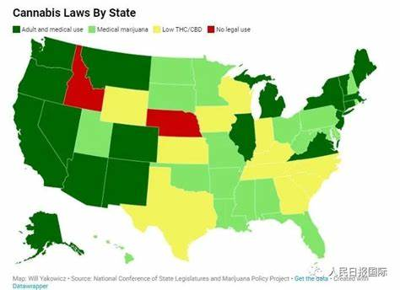
Background
Cannabis consumption is illegal globally.
Becoming legalised in USA (2014)
Becoming legalised in Canada (2018)
(Yimer,2025)

Slide 3
overview
Legalizing Recreational Cannabis is beneficial:
Reduction in crime rates
Economic growth
Public health outcome improvements
Counter agrument

Slide 4
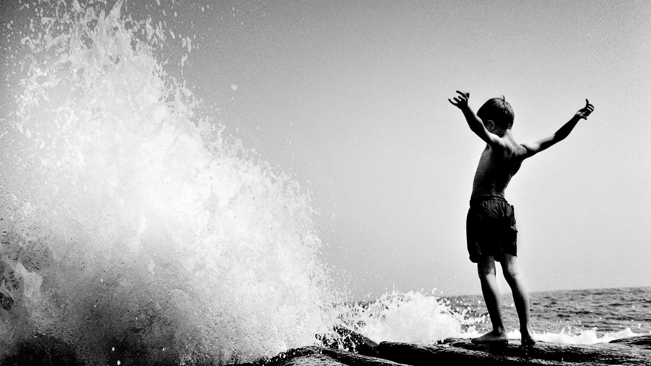
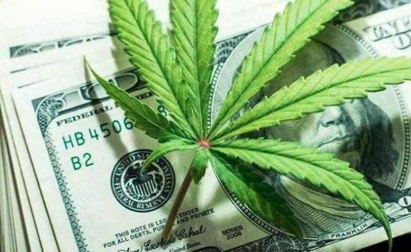
Reduction in crime rates
◈cannabis-related crimes:
76.3% decline in adult arrest rates
◈crimes not directly related to cannabis:
overall 12.5% reduction in violent crimes

Slide 5
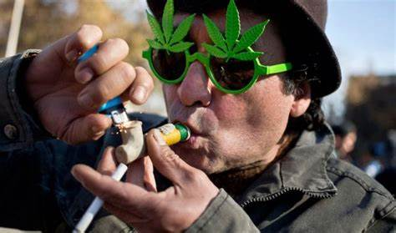
Reduction in crime rates
Analysis:
legal channels and behaviors
legal and regulated cannabis supply sources established

Slide 6



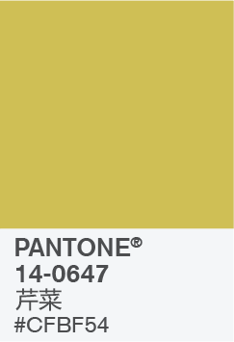


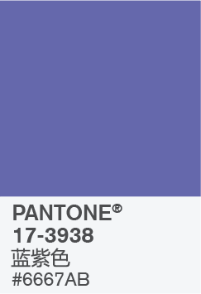

源泉

Slide 7
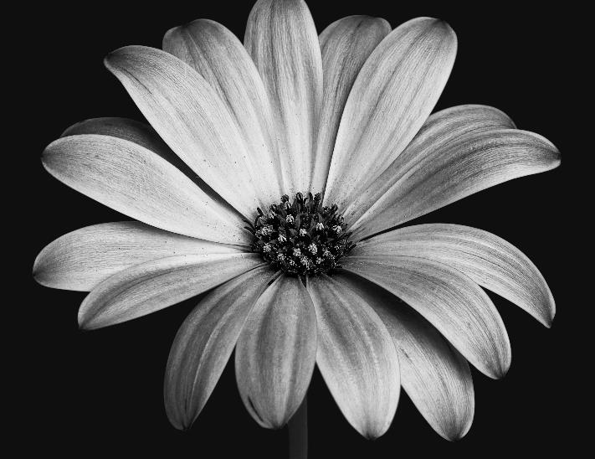
源泉
如果您想要融合自然融合的色调，以突出绿色的兼容性以及这些美味微妙和滋养色调的“有益健康”特性，请使用此调色板。

Slide 8


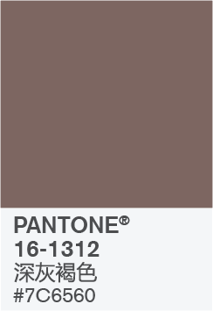



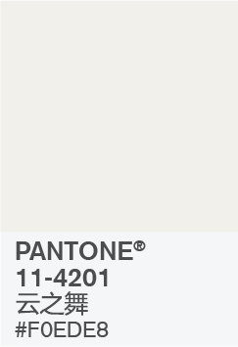
节目的明星

Slide 9
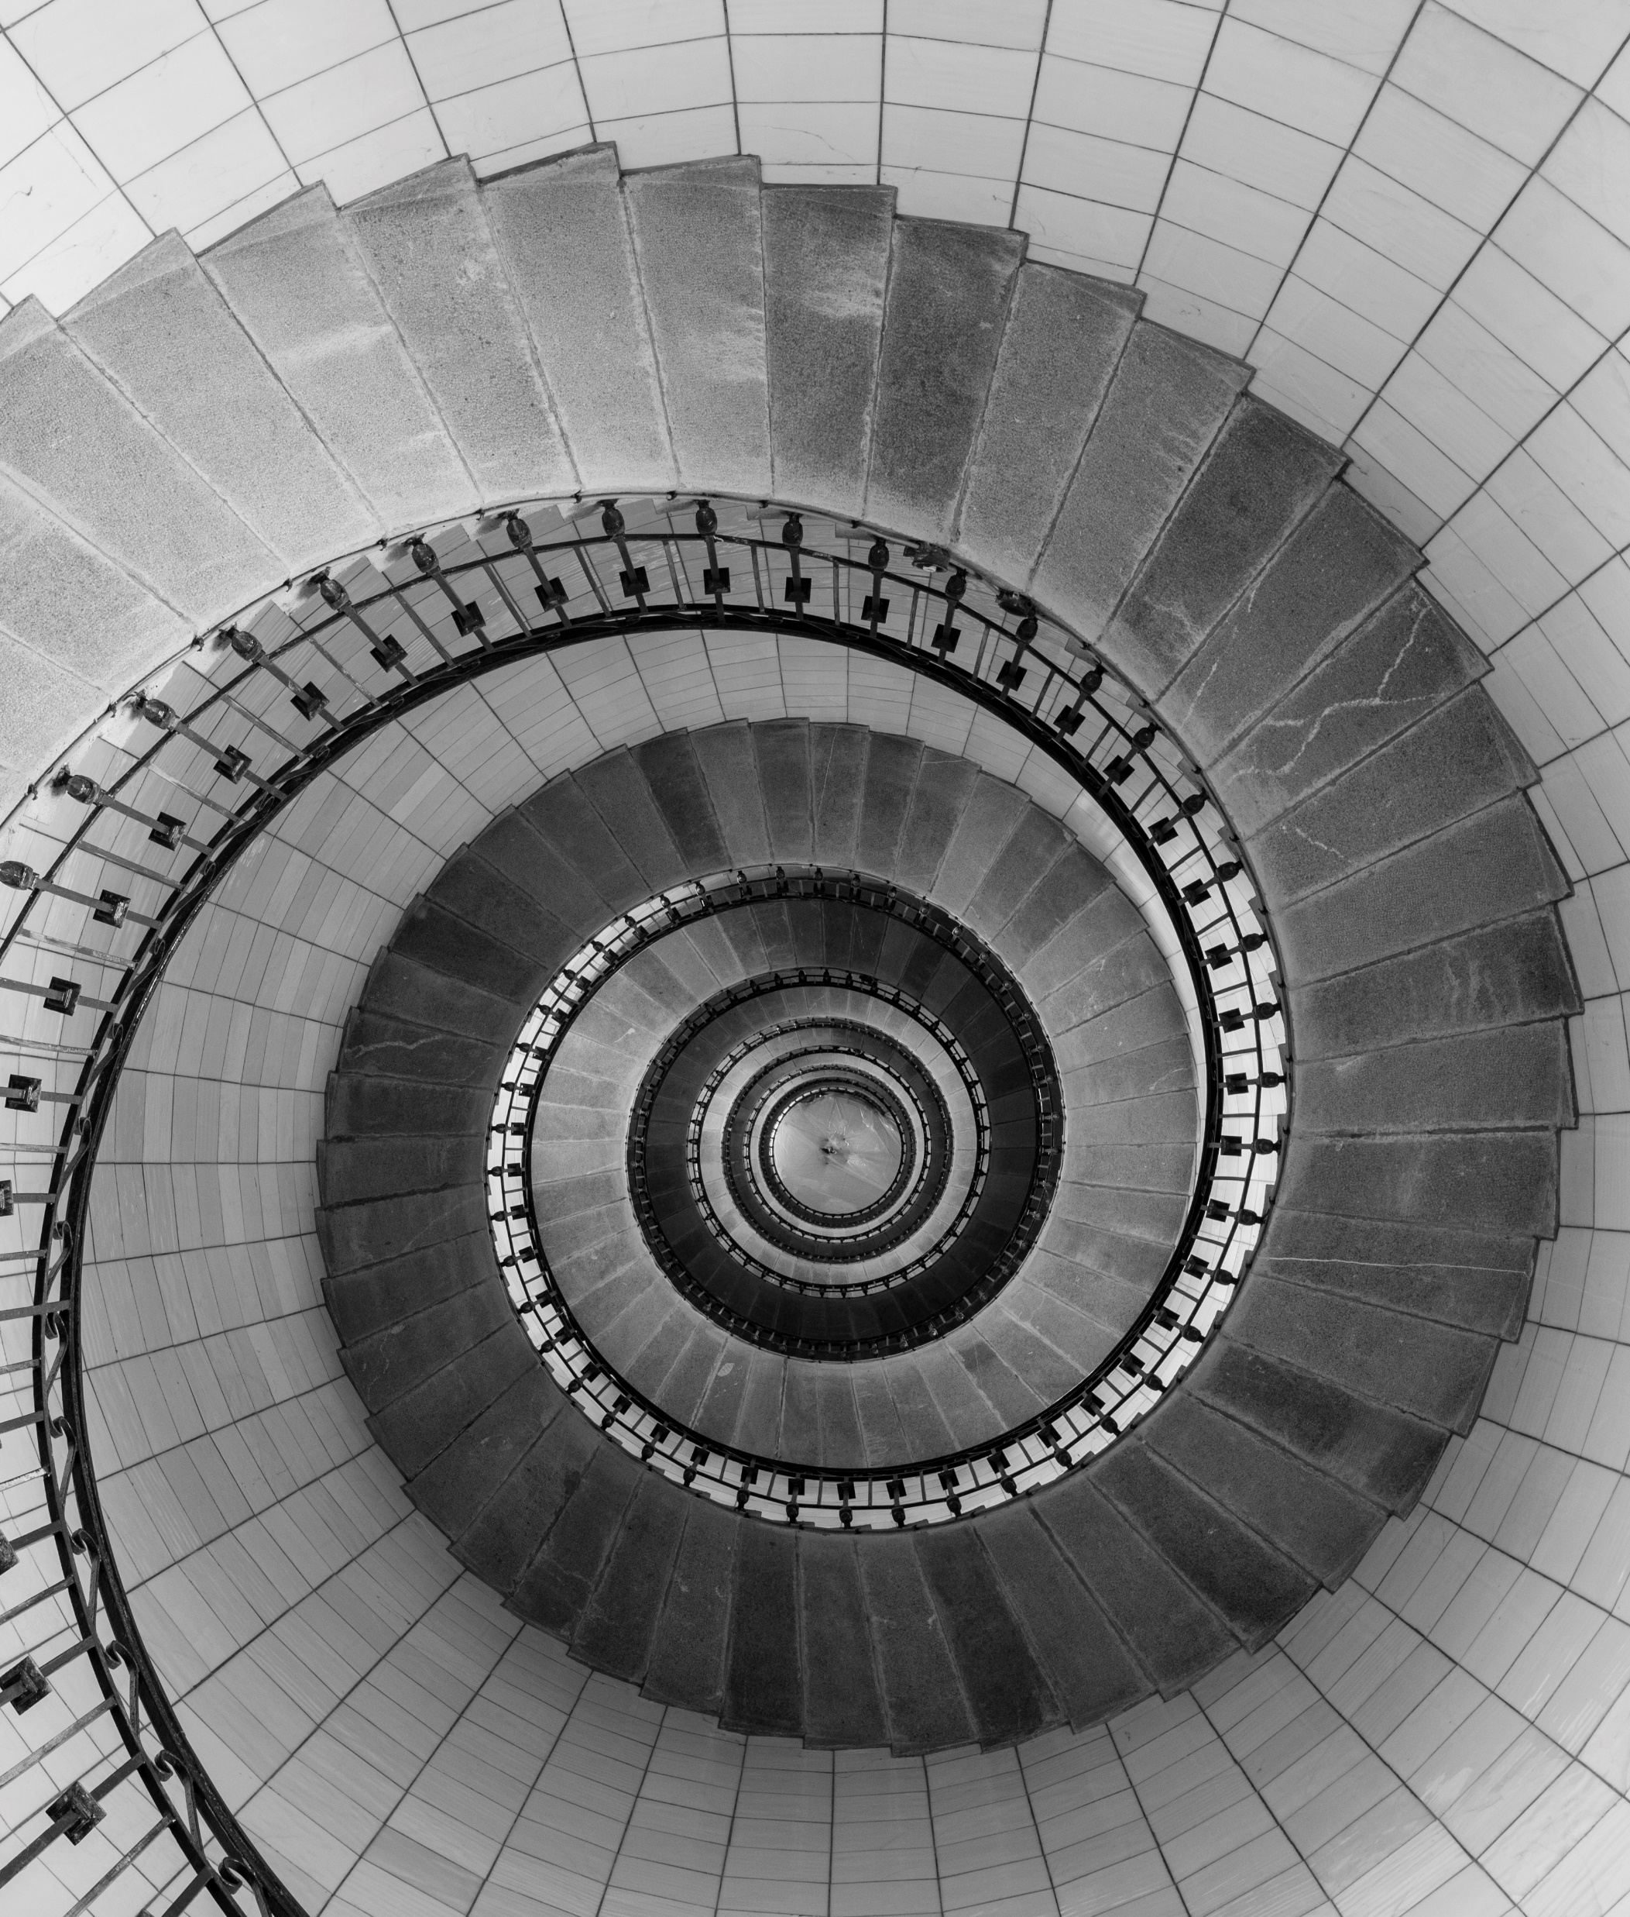

节目的明星
当你希望以更加优雅的方式呈现内容，该调色板中 Pantone 长春花蓝的动感属性宛如节目的明星一般耀眼。该调色板主打经典和中性元素，低调的风格传达出隽永成熟的格调。

Slide 10
Counter agrument
1 Black Markets Persistence
2 Crime Rate Debate
3 Social Concerns
4 Long-term Uncertainties

Slide 11
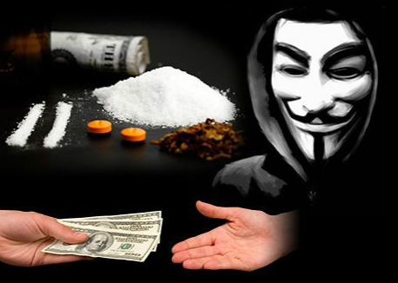
Black market persistence
Legal make
cannabis
40%-60%
more expensive
(Kilmer et al.,2013; CDOR,2023)
CDOR: Colorado Department of Revenue

Slide 12
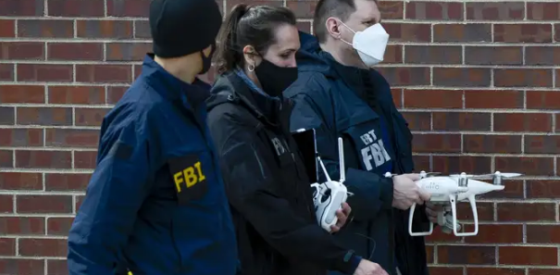
Crime Rate debate
From legal states
TO
Illegal states
(UNODC, 2020)
UNODC: United Nations Office on Drugs and Crime

Slide 13
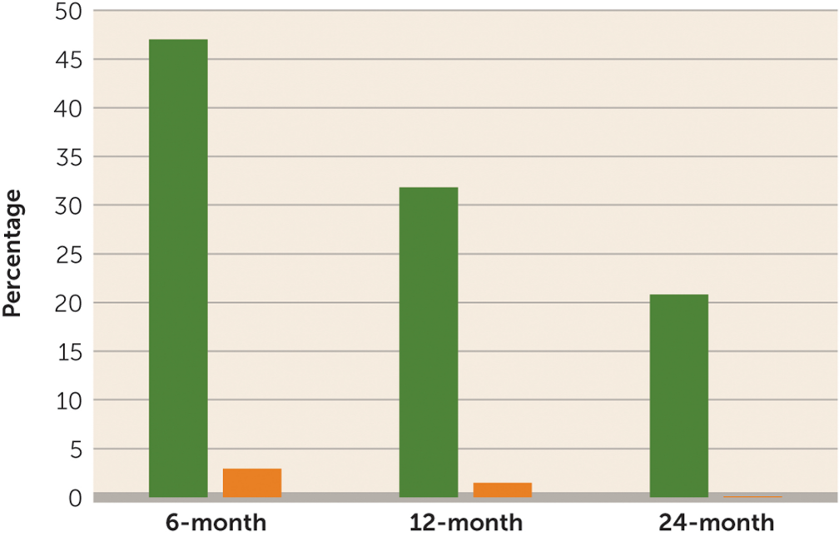
Social concerns
Green: low-income people
Orange: rich people
Low-income addicted
2.3 times than
rich people
(Williams et al, 2023)

Slide 14
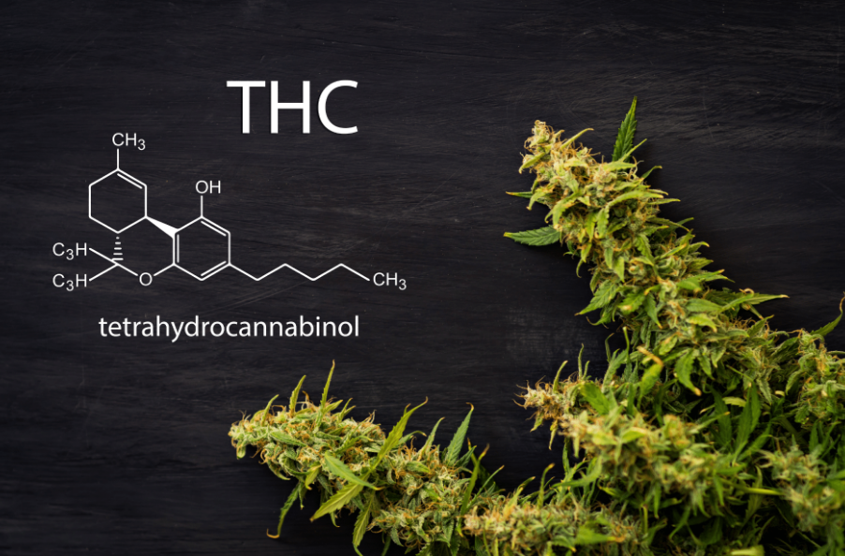
Long-term uncertainties
Sell products
(over 75% THC)
(Barry et al., 2022; NIH, 2023)
NIH: National Institutes of Health

Slide 15
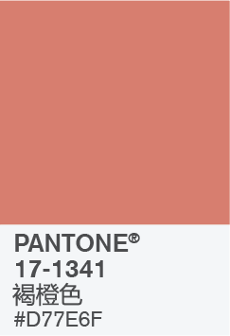

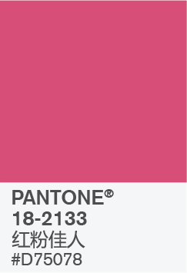
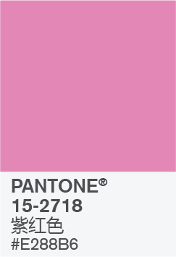
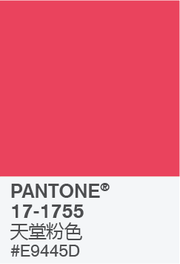


开心

Slide 16
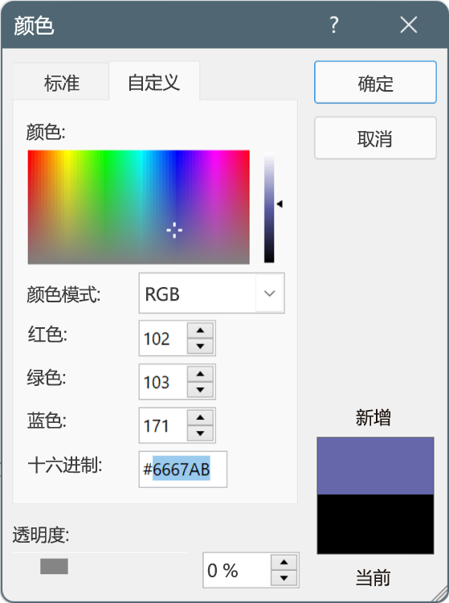
在 PowerPoint 演示文稿中使用这些颜色
选择形状或文本框边框。执行此操作时，将显示“形状格式”选项卡。
在“形状格式”选项卡上，选择“形状填充”>“其他填充颜色”。
在“颜色”框中，选择“自定义”选项卡。
输入要使用的颜色的十六进制值。
提示：若要更改多个形状或文本框，请单击第一个形状或文本框，然后在单击其他形状或文本框时长按 Ctrl。

Slide 17
Counter agrument
1 Black Markets Persistence
2 Crime Rate Debate
3 Social Concerns
4 Long-term Uncertainties

Slide 18
节目的明星
当你希望以更加优雅的方式呈现内容，该调色板中 Pantone 长春花蓝的动感属性宛如节目的明星一般耀眼。该调色板主打经典和中性元素，低调的风格传达出隽永成熟的格调。

Slide 19
节目的明星
当你希望以更加优雅的方式呈现内容，该调色板中 Pantone 长春花蓝的动感属性宛如节目的明星一般耀眼。该调色板主打经典和中性元素，低调的风格传达出隽永成熟的格调。

