Slide 1
Notes
Assignment
2.10
2.11
2.22 (b) (e)
2.25
2.28 (a) (c) (e) (g)
Tutorial questions (Week 6)
Basic Problems with Answers 2.20
Basic Problems 2.29
Advanced Problems 2.40, 2.43, 2.47

Slide 2
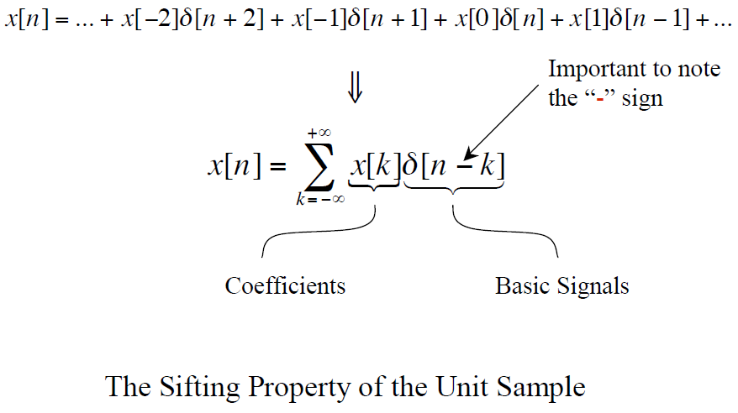
That is ...
Chapter 2 Review

Slide 3
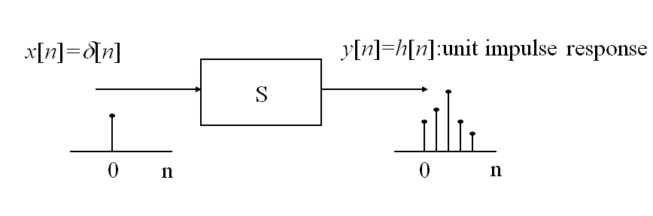
Unit Impulse Response
Chapter 2 Review
Example: y[n]=x[n]+2x[n-1]+4x[n-2]
What is unit impulse response?

Slide 4
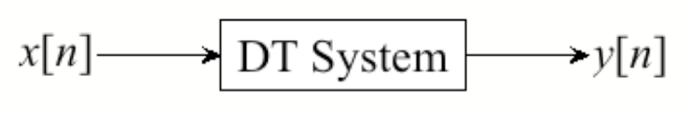
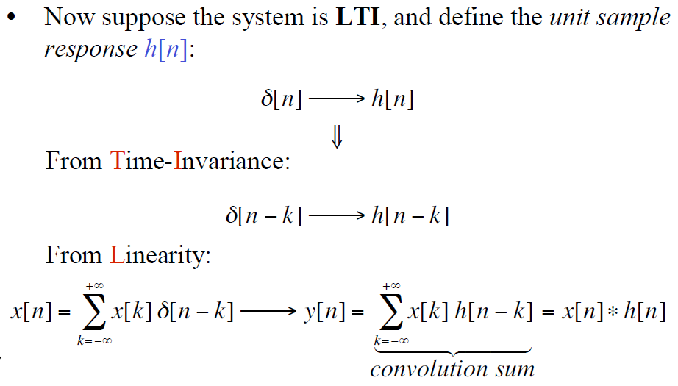
Response of DT LTI Systems
Chapter 2 Review
impulse
The output for an input signal is the superposition of a series of “shifted, scaled unit impulse response”

Slide 5
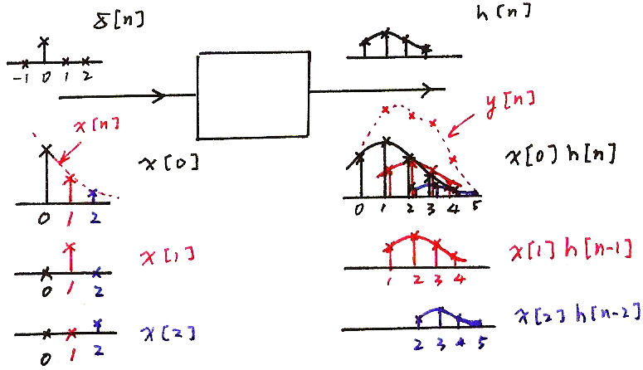
Chapter 2 Review
Input/Output Relation
DT LTI
system

Slide 6
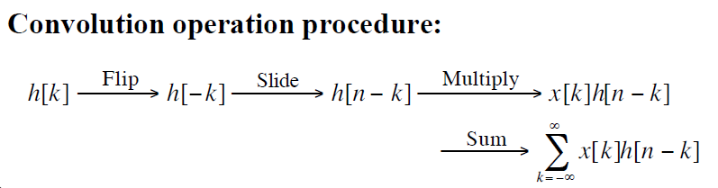
Chapter 2 Review
A different way to visualize the convolution sum
looked at on the index k
input signal
Contribution to the output signal at time n
flipped version of h[k] located at k = n
F S M S

Slide 7
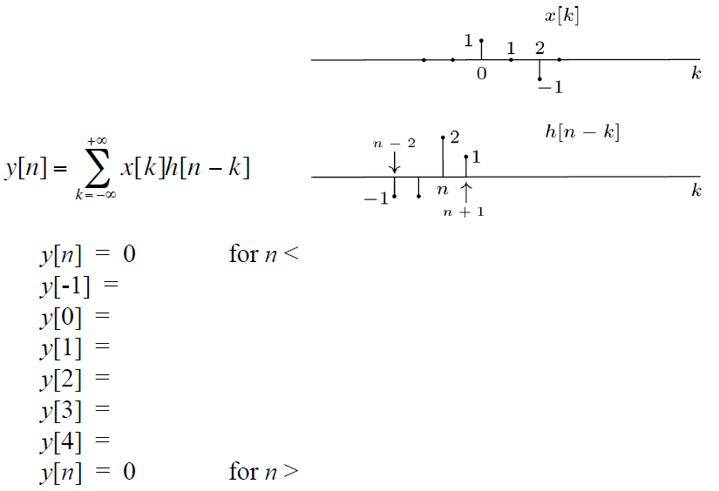
Calculating Successive Values: Shift, Multiply, Sum
Class practice

Slide 8
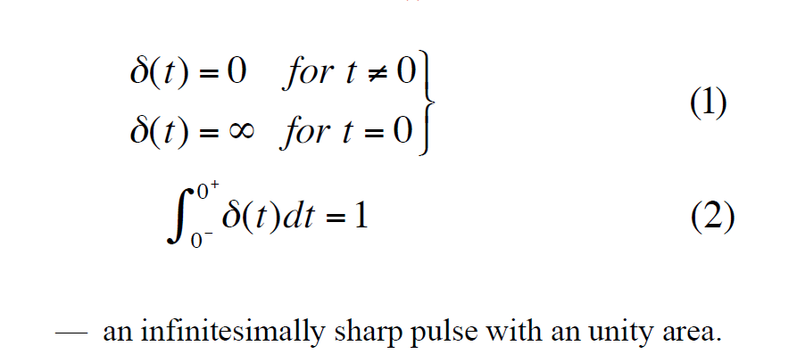
The Unit-impulse function δ(t)

Slide 9
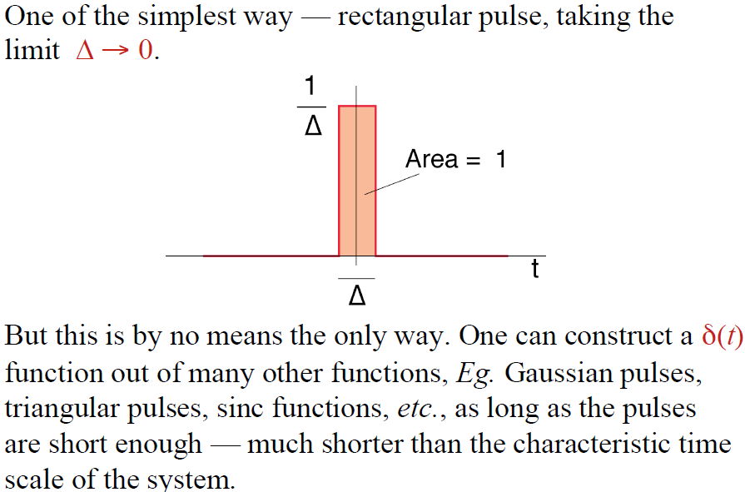
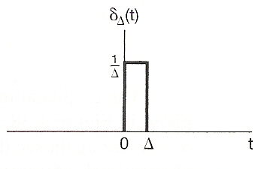
Construction of the Unit-impulse function δ(t)
Area=1

Slide 10
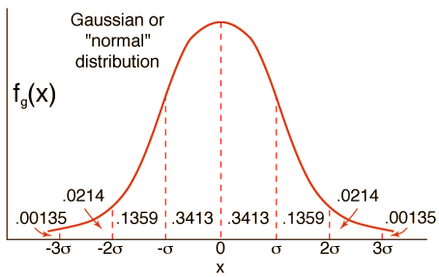
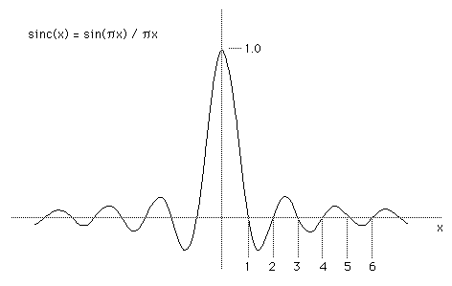
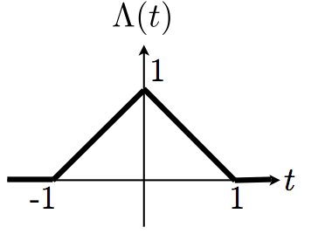

Slide 11
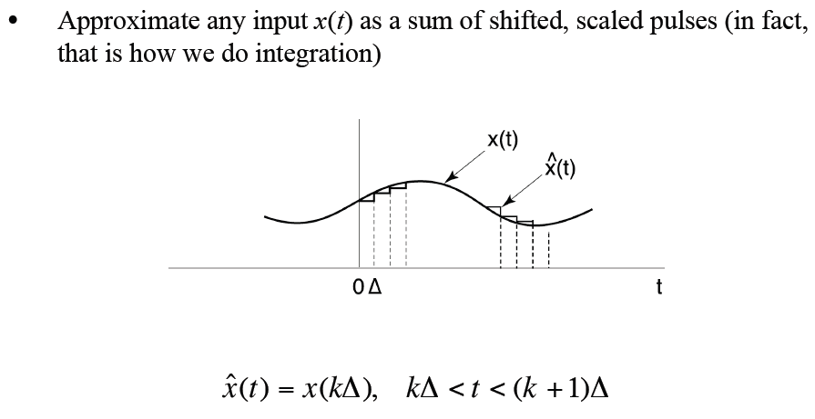
Representation of CT Signals

Slide 12
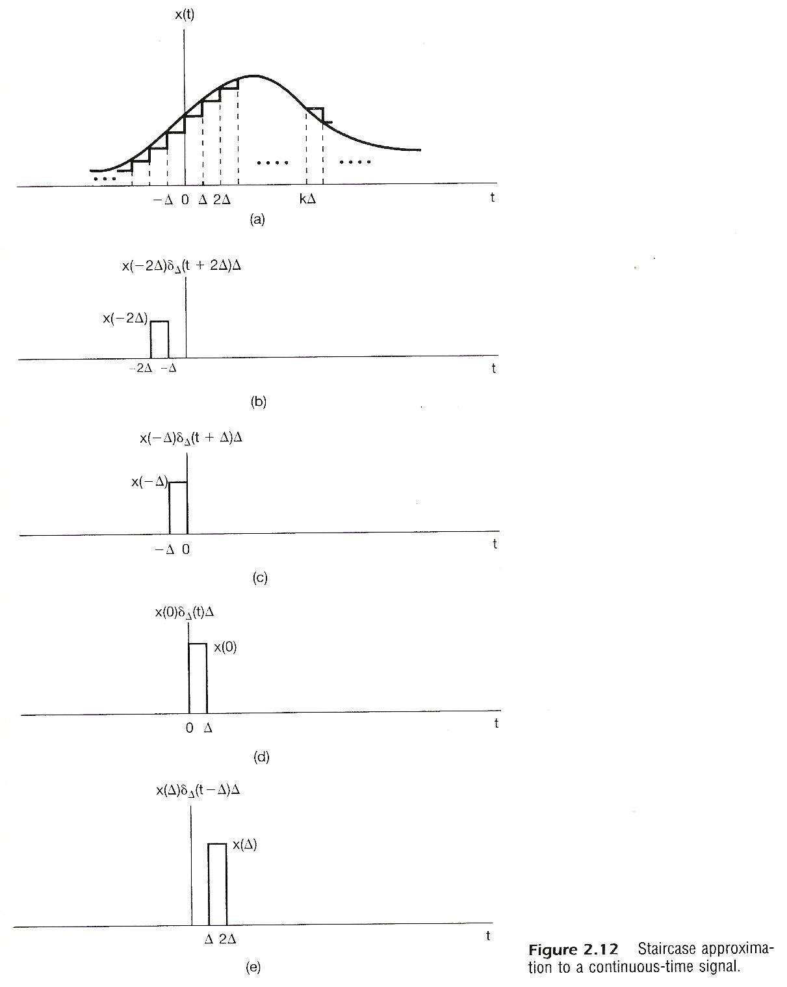

Slide 13
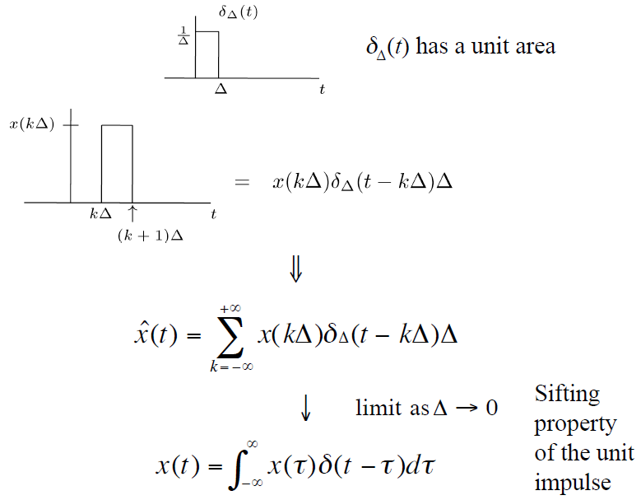
Representation of CT Signals (cont.)
?

Slide 14
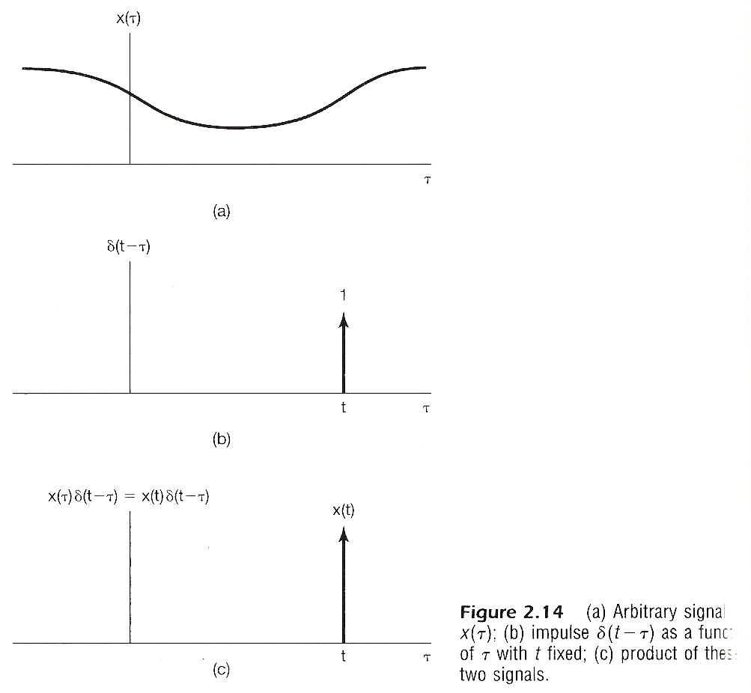
Recall, we have
, as a function of τ with t fixed.
A function of τ with t fixed

Slide 15
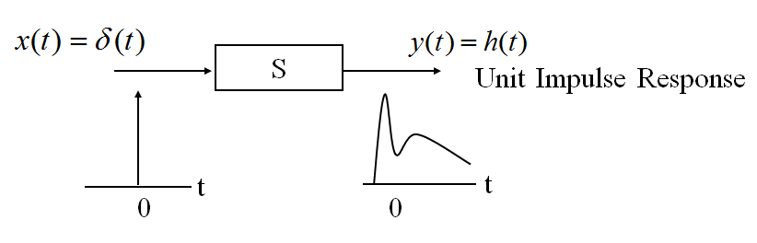
Unit Impulse Response

Slide 16
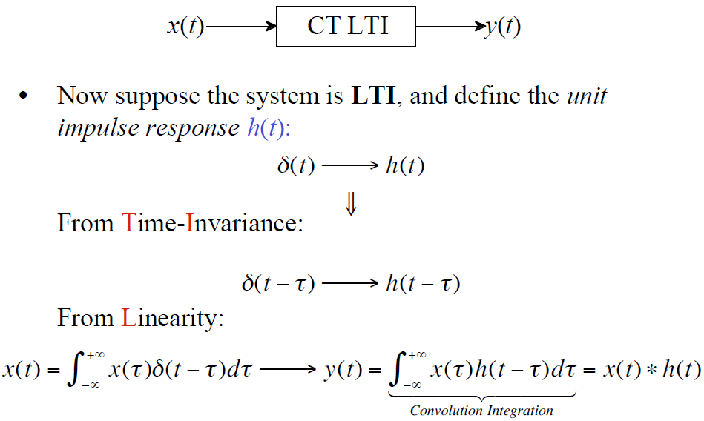
Response of a CT LTI System

Slide 17
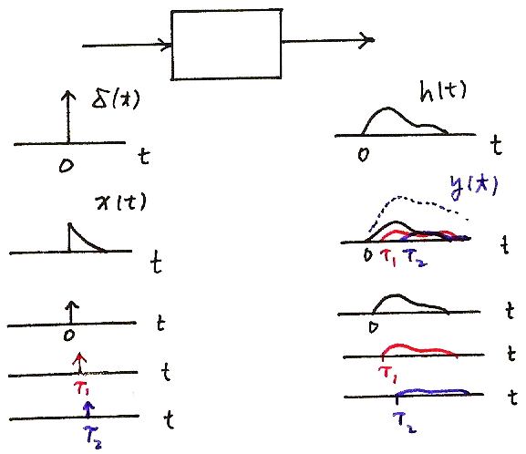
Response of a CT LTI System (cont.)
x(t)
y(t)
CT LTI

Slide 18

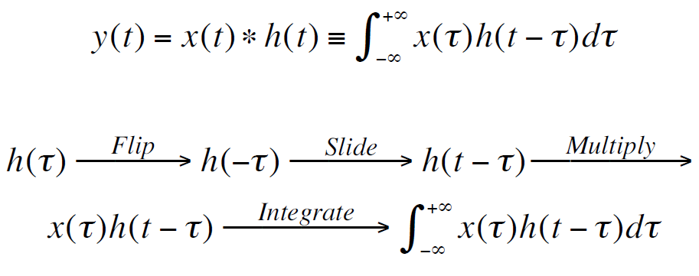
Operation of CT Convolution
Convolution Integral
Convolution Sum
A different way to understand the convolution integral
y(t) is a weighted integral of the input, where the
weight on x(τ) is h(t - τ)

Slide 19
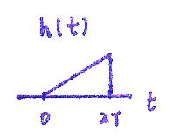
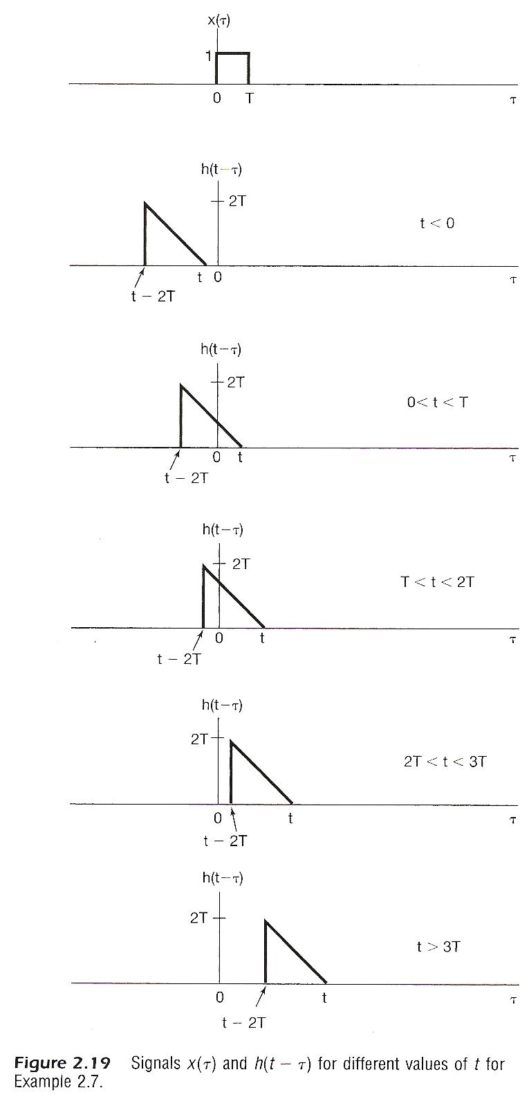

flip,
slide
$$−2T$$
0
h(-t)
……

Slide 20
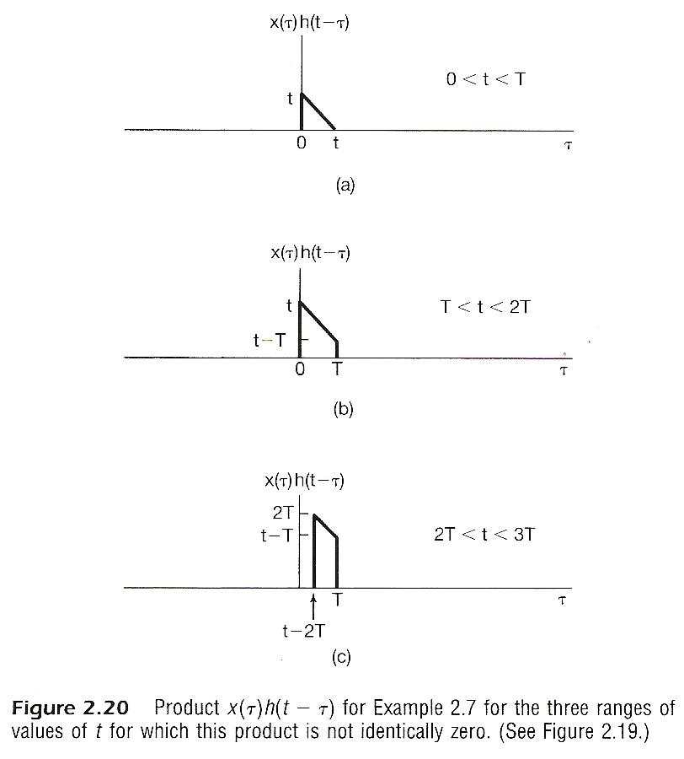
multiply

Slide 21
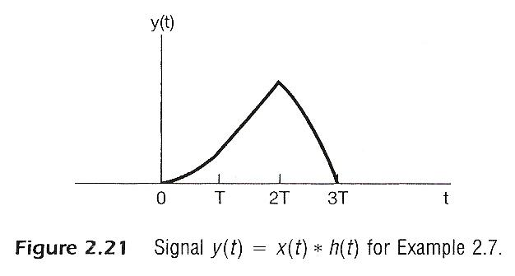
integrate

Slide 22
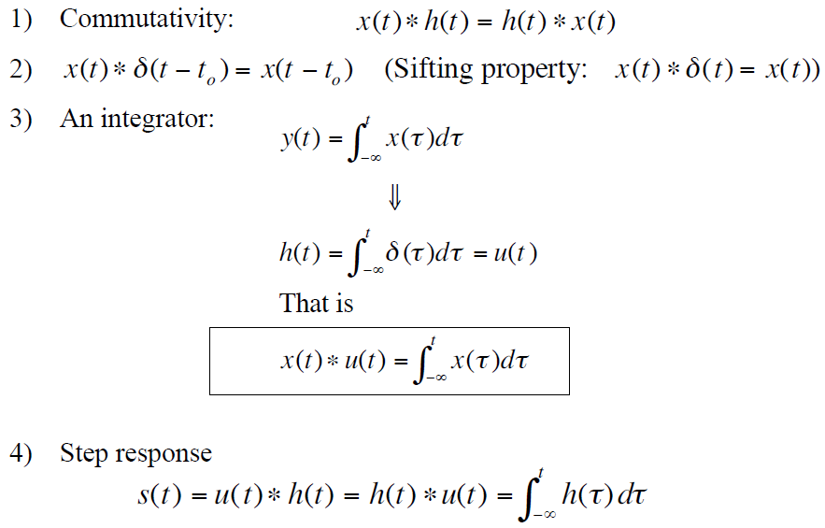
Property: Commutative
The role of input signal and unit impulse response is interchangeable, giving the same output signal
x(t)
h(t)
h(t)
x(t)

Slide 23
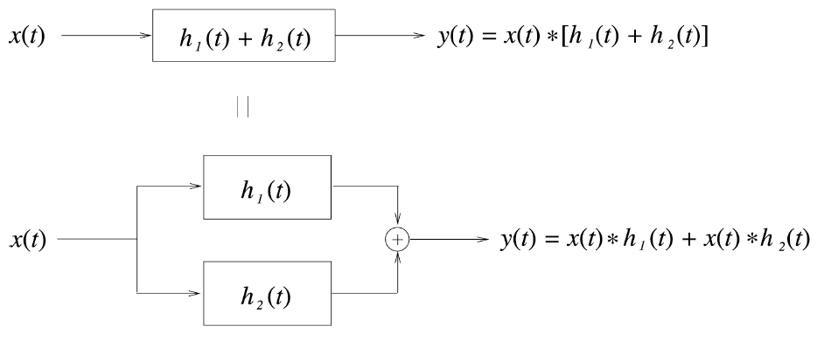
Property: Distributive

Slide 24
Property: Distributive (Cont.)
Problem 2.22 (b)
x(t)
0
2
5

Slide 25
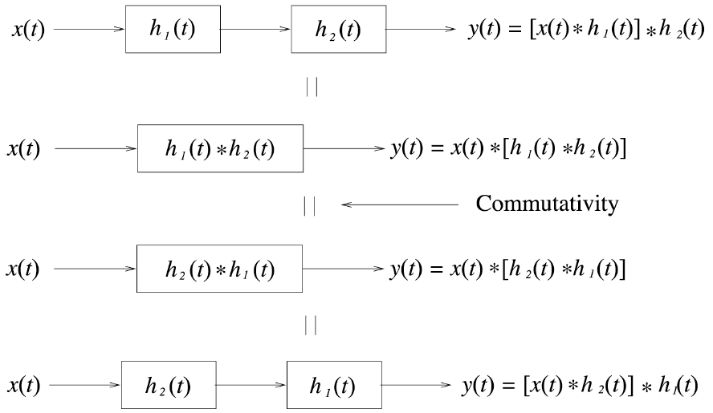
Properties: Associative
Cascade of two systems gives an unit impulse response which is the convolution of the unit impulse responses of the two individual systems
The behavior of a cascade of two systems is independent of the order in which the two systems are cascaded

Slide 26
Properties: Associative (Cont.)
The order in which non-linear systems are cascaded cannot be changed.
e.g.
y=2x
y=x²
y=x²
y=2x

Slide 27
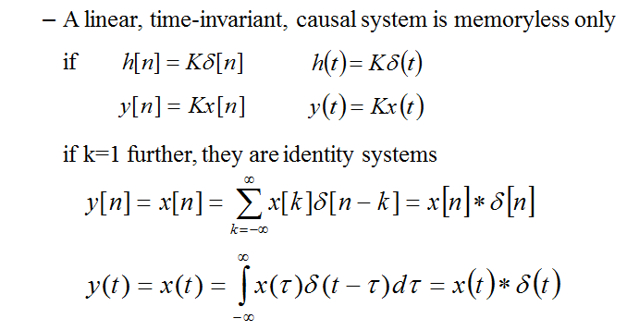
Property: Memory/Memoryless

Slide 28
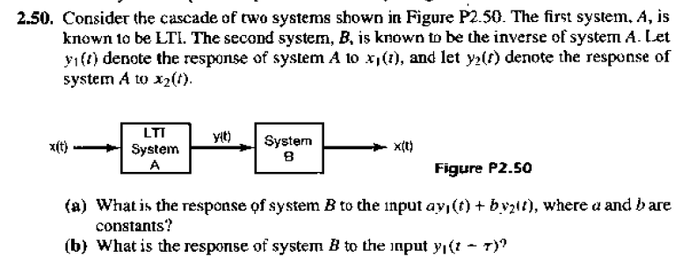
Property: Invertibility

Slide 29
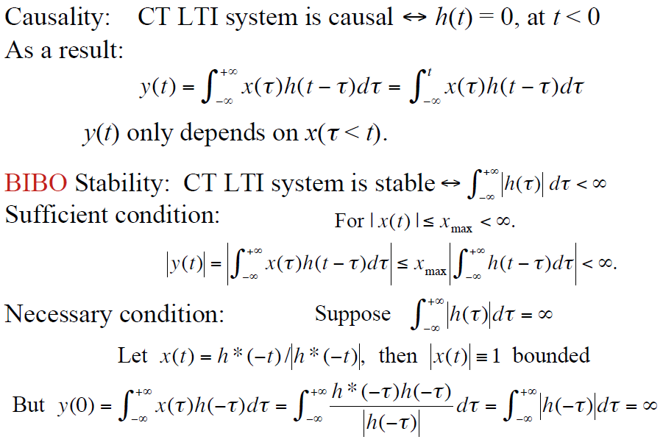
Property: Causality
This is because that the input unit impulse function δ(t)=0 at t<0
t – τ ≥ 0, or τ ≤ t

Slide 30
Property: Stability

Slide 31
Property: Unit Step Response
unit step function → unit step response
x(t)=δ(t)
h(t)
h(t): unit impulse response
x(t)=u(t)
h(t)
s(t): unit step response
The relation between unit step function and unit impulse function

Slide 32
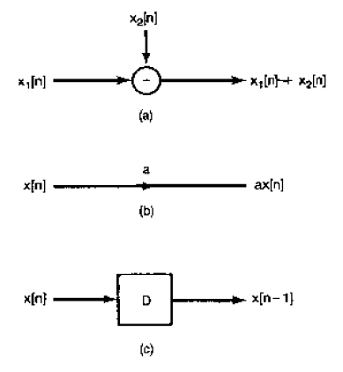
Block diagram representation of 1-st order system
Problem 2.38
y[n]=
+
y[n]=
How about
y[n]=

Slide 33
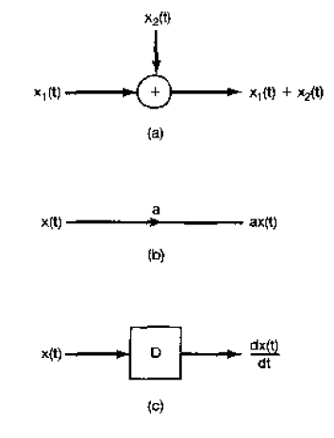

Class practice
Problem 2.39
t

Slide 34
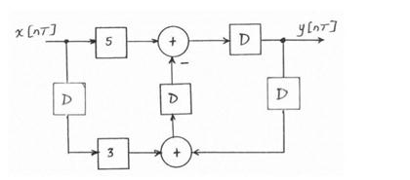
From block diagram to difference equation
Class practice
x[n]
y[n]

Slide 35
More about δ(t): Operational Definition
A function can be defined by
what it is at each value of the independent variable, or
what it does under some mathematical operation (such as an integral or a convolution), or how it behaves with a system, or some mathematical constraints: Singularity Function

Slide 36
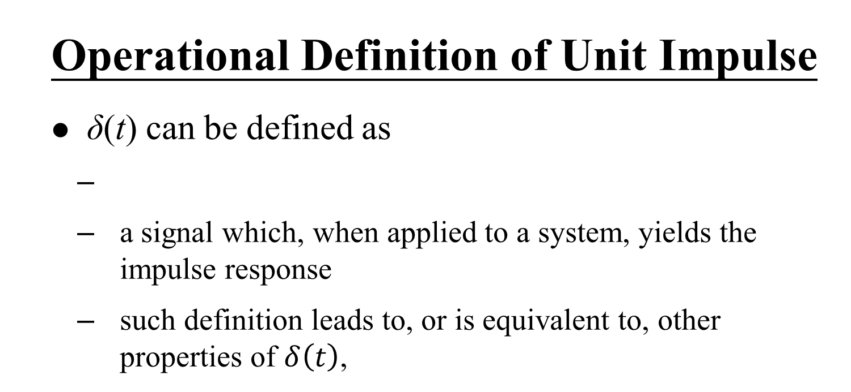
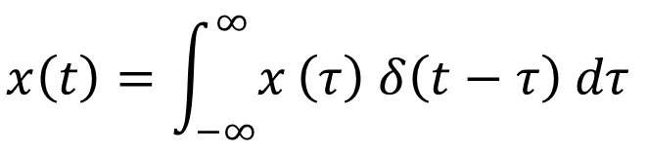
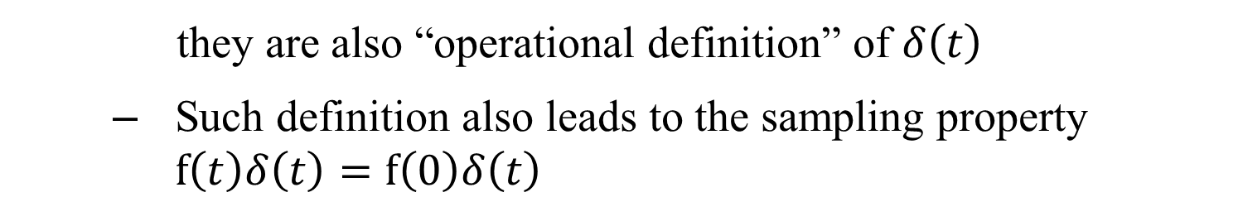

Slide 37
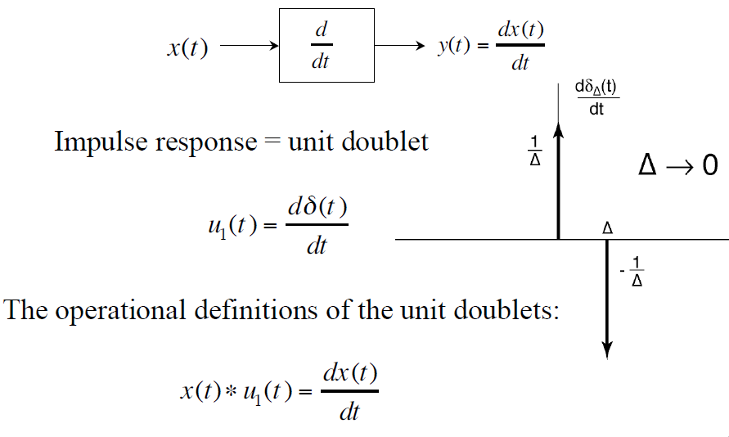
The Unit Doublet — Differentiator

Slide 38
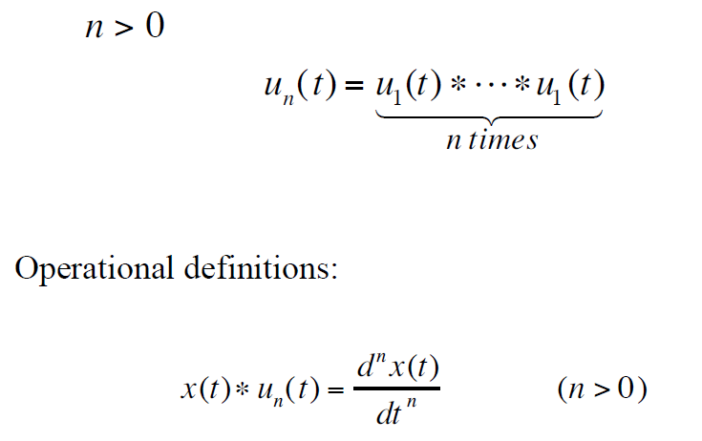
Triplets and beyond!

Slide 39
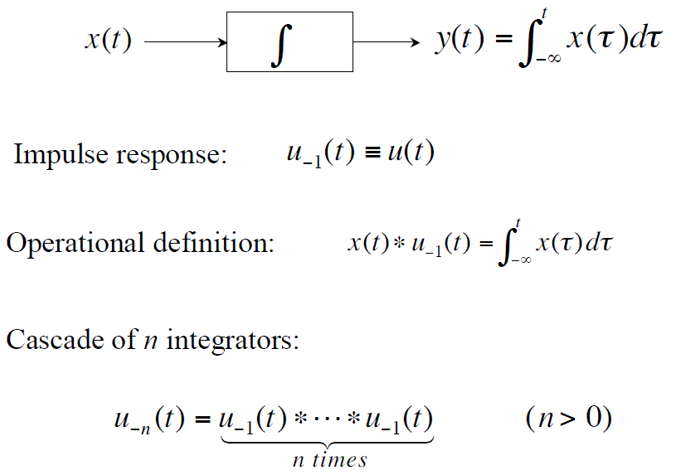
Integrators

Slide 40
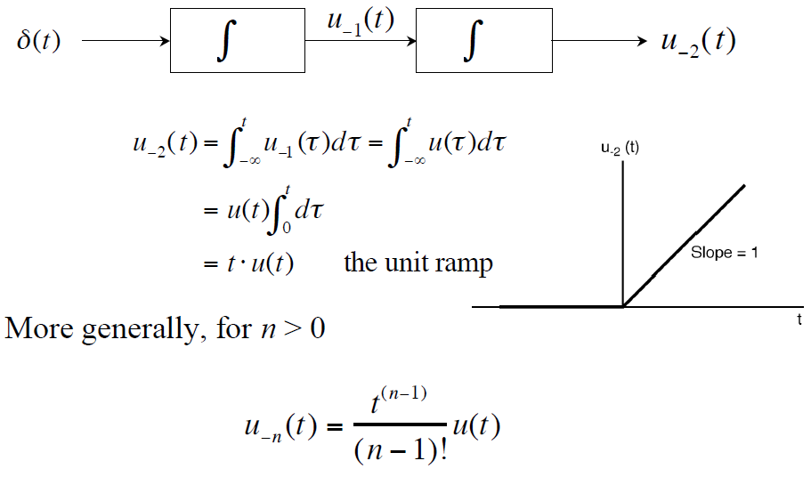
Integrators (Cont.)

Slide 41
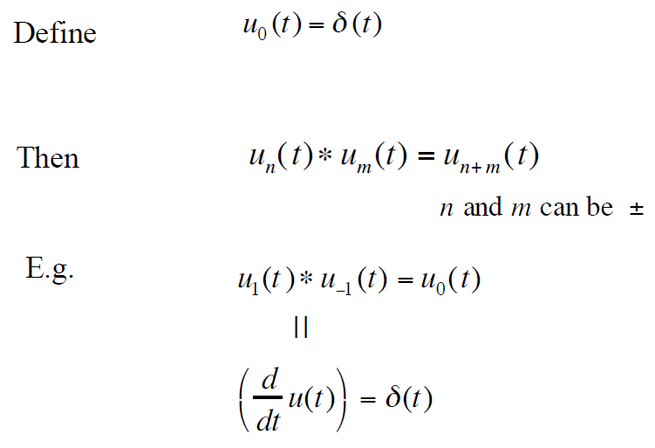
Notation

Slide 42
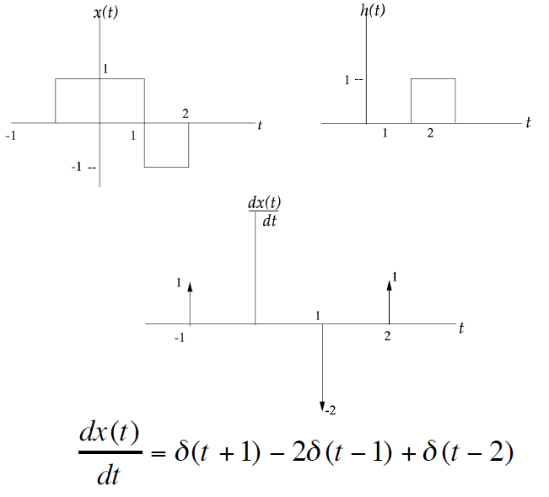
Example: Calculating x(t)∗h(t)

Slide 43
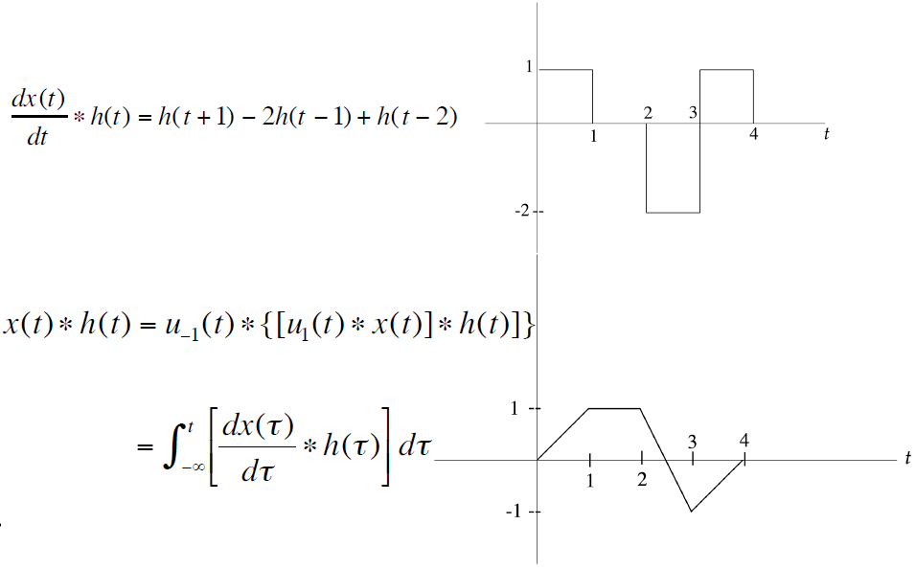
Example (Cont.)

Slide 44
Summary
How to represent a CT signal with approximation of DT signals
Calculation of CT convolution
Block diagram representation of a LTI system
Operational definition of unit impulse function

