Slide 1

EE104 Fundamentals of Electric Circuits (Supplementary)
Jun MA | 马俊
E-mail: maj3@sustech.edu.cn
南方科技大学-工学院-电子与电气工程系-PN Lab

Slide 2

1. A rotating rod (a)
A complex number that is used to represent a sinusoidal voltage or current is called a phasor.
A useful way to think of a cosine wave is as the projection of a rotating rod onto the horizontal axis.
For a unit-length rod, the projection has length cos θ.
If the rod is rotating at a speed of f revolutions per second, then θ increases uniformly with time: θ = 2πft.
Therefore the projection is cos(2πft) or cos(ωt).
$$θ$$

Slide 3
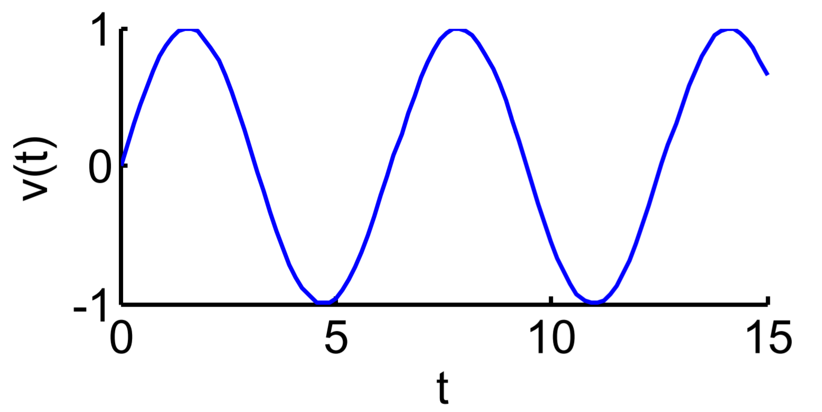
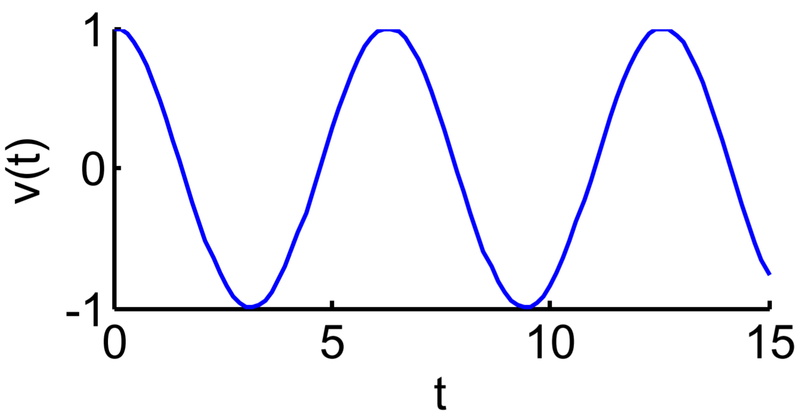
1. A rotating rod (b)
Based on the rotating rod model, the only difference between cos and sin is the starting position of the rod.
sin(2πft) lags cos(2πft) by π/2, because it peaks at ¼ of a cycle.
v₁(t) = cos(2πft)
v₂(t) = sin(2πft)
v₂(t) = cos(2πft – π/2)

Slide 4


2. Phasors 1 (a)
1. If the rod has length A and starts at an angle φ then the projection onto the horizontal axis is
Acos(ωt + φ) = Acosφ cos(ωt) – Asinφ sin(ωt)
Lex X = A cosφ and Y = A sinφ
Acos(ωt + φ) = Xcos(ωt) – Ysin(ωt)
2. At t = 0, the tip of the rod has coordinates
(X, Y) = (Acosφ, Asinφ)
3. If plane is a complex plane, the complex number X + jY corresponding to the tip of the rod at t = 0 is called a phasor.
4. The magnitude of the phasor, $A=\sqrt{x^{2}+y^{2}}$, gives the amplitude (peak value) of the sine wave.
5. The argument of the phasor, φ, gives the phase shift relative to the cos(ωt).
$$\text{φ}$$

Slide 5
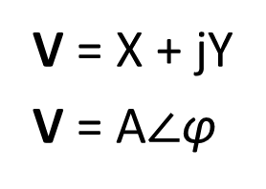
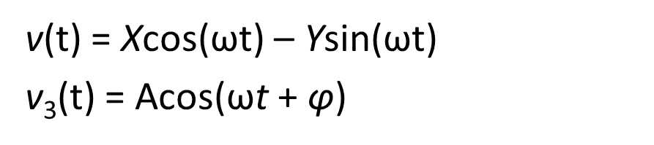
2. Phasors 1 (c)
Phasor domain
Time domain
V₁ = 1, f = 50 Hz
v₁(t) = cos(ωt)
V₂ = –j, f = 50 Hz
v₂(t) = sin(ωt)
V = X + jY
V = A$∠\text{φ}$
v(t) = Xcos(ωt) – Ysin(ωt)
v₃(t) = Acos(ωt + $\text{φ}$)
A phasor represents an entire waveform (encompassing all time) as a single complex number. We assume the frequency, f, is known.
A phasor does not vary with time.

Slide 6
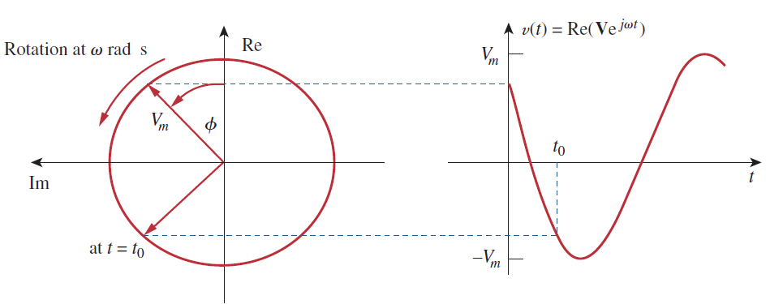
3. phasors 1 (d)
At a certain time t:
$$f\left(t\right)= Ve^{jωt}=V_{m}e^{jθ}e^{jωt}=V_{m}e^{j(ωt+θ)}$$
$$⇒Ve^{jωt}= V_{m}\cos\left(ωt+θ\right)+{jV}_{m}\sin\left(ωt+θ\right)⇒Re(Ve^{jωt})=V_{m}\cos\left(ωt+θ\right)$$
At time goes by

Slide 7
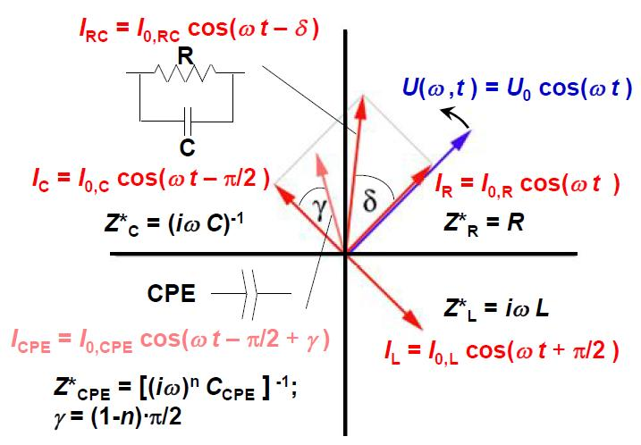
3. phasors 2 (a)

Slide 8
3. phasors 2 (a)
Vectors 向量
Phasors 相量
y
Im
ω
0
x
0
Re
Vectors are stationary and pointing toward a point on a plane
Phasors is a complex number, and “a vector rotating at a certain frequency ω on a complex plane”.

Slide 9


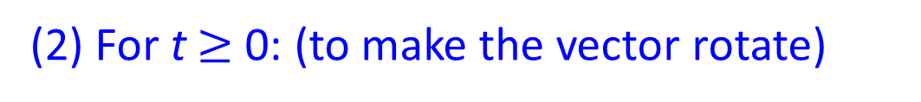


3. phasors 2 (b)
Phasors 相量
(1) At t = 0: (to define the vector)
Im
ω
$$V=a+jb=V_{m}\cos{θ}+jV_{m}\sin{θ}$$
$$V=V_{m}∠θ$$
$$V=V_{m}e^{jθ}$$
$$θ$$
(2) For t $≥$ 0: (to make the vector rotate)
0
Re
Phasors is vector rotating at a certain frequency ω on the complex plane.
$$f\left(t\right)= Ve^{jωt}=V_{m}e^{jθ}e^{jωt}$$
$$Don^{′}t forget that e^{jφ} is a rotating factor$$

Slide 10
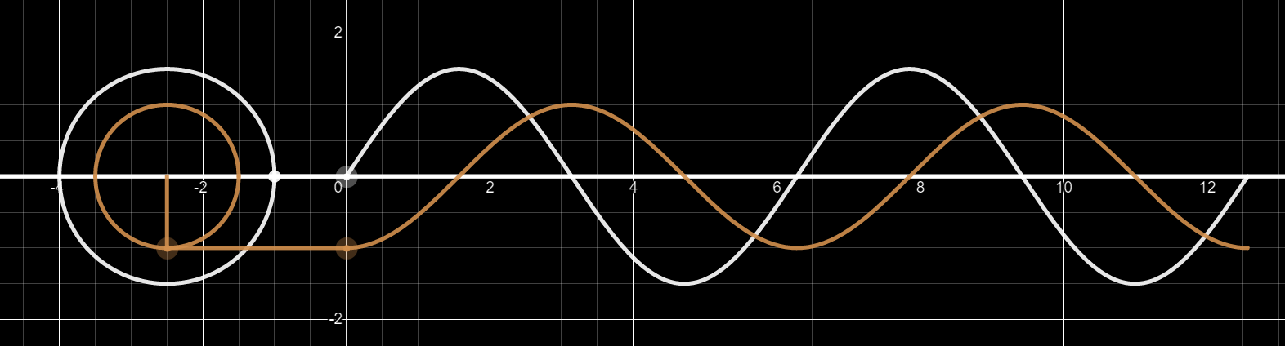
3. phasors 2 (d)
Time domain, the same frequency
v₁(t) = 1.5sin(t)
v₂(t) = -cos(t)
To calculate in time domain:
v (t) = v₁(t) + v₂(t) = 1.5sin(t) – cos(t)

Slide 11
3. phasors 2 (e)
Phasor domain
Time domain

Slide 12
3. phasors 2 (f)
Phasor domain
Time domain
V₁e^{-jwt}
v₁(t) = 1.5sin(t)
v₂(t) = -cos(t)
V₂e^{-jwt}
v₁(t) ⇒ V₁e^{jωt} v₂(t) ⇒ V₂e^{jωt}

Slide 13
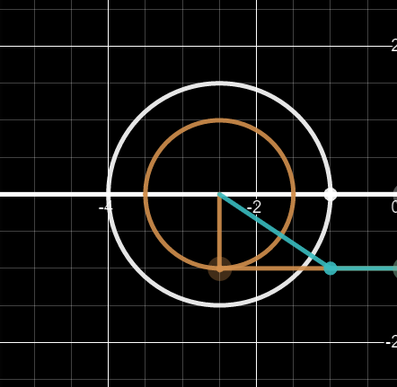
3. phasors 2 (g)
Phasor domain
Im
V₁
V₂
Re
V
Ve^{jωt} = (V₁ + V₂)e^{jωt} ⇒ V = V₁ + V₂

Slide 14
3. phasors 2 (h)
Phasor domain
Time domain
v (t) = Re[Ve^{jωt}] = Re[(V₁ + V₂)e^{jωt}]

Slide 15
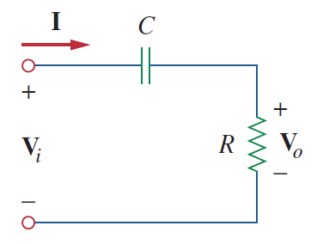
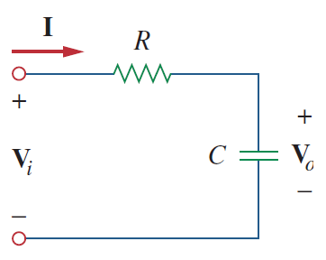









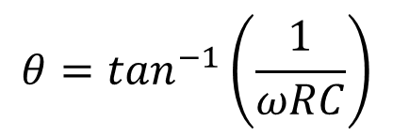
3. phasors 2 (i)
Positive phase shifter
Negative phase shifter
Im
Im
V_{o} = V_{R}
V_{R}
I
I
$$ωRC$$
$$ωRC$$
$$θ$$
Re
$$\sqrt{1+{(ωRC)}^{2}}$$
Re
$$\sqrt{1+{(ωRC)}^{2}}$$
$$θ$$
$$θ=\tan^{−1}\left(\frac{1}{ωRC}\right)$$
$$1$$
$$1$$
V_{i}
$$θ={−tan}^{−1}\left(ωRC\right)$$
V_{i}
V_{C}
V_{C} = V_{o}

