Slide 1
Part I the merit of GaN vertical power device
Part II Vertical GaN Process
Part Ⅲ: The way to improve the performance of GaN vertical power device
Part IV: Future Development of Vertical GaN Devices
Presenter: He Yanning

Slide 2

INTRODUCTION: ICNS-15
Five Research Achievements from the GaN Research Group at Shenzhen Pinghu Laboratory Showcased
The ICNS, fully known as the International Conference on Nitride Semiconductors, is one of the most important academic conferences and exhibition events in the field of III-nitride semiconductors.
Held biennially since 1995, the conference focuses on cutting-edge research in materials science, device development, and applications of III-V nitride semiconductors such as gallium nitride (GaN).
It provides a global platform for researchers, scientists, and engineers to exchange ideas, covering the full innovation chain from crystal growth, doping, and heterostructures to optoelectronic devices (e.g., LEDs and lasers) and power electronic devices (e.g., HEMTs).

Slide 3
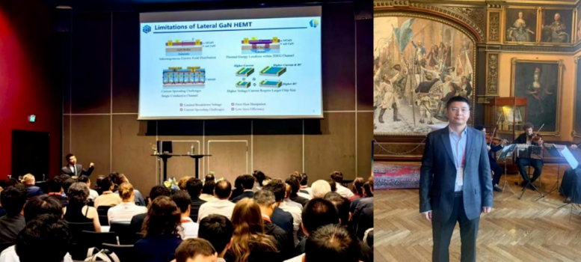
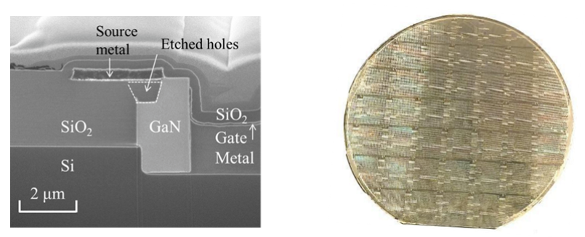
INTRODUCTION: vGaN HEMT
On July 10, 2025, Dr. Li Zilan, founder of Guangdong ZIENER, attended the 15th International Conference on Nitride Semiconductors (ICNS-15).
The presentation highlighted the team’s original breakthroughs in silicon-based vertical GaN power devices (vertical GaN HEMTs) and their promising application prospects.
Achieve a world-first by directly epitaxially growing a vertical two-dimensional electron gas channel on a silicon substrate.
In terms of process integration, the team achieved a fully vertical electrode layout, which can significantly enhance device heat dissipation efficiency.
Supported by an advanced process platform, this innovative technology exhibits excellent manufacturability for high-volume production.
x-SEM structure

Slide 4
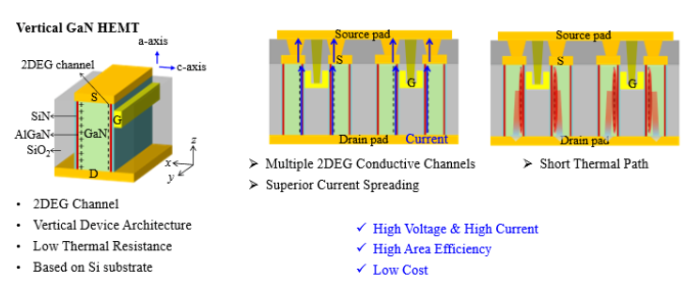
INTRODUCTION: vGaN HEMT Technology
Vertical GaN HEMT Power Device Technology

Slide 5
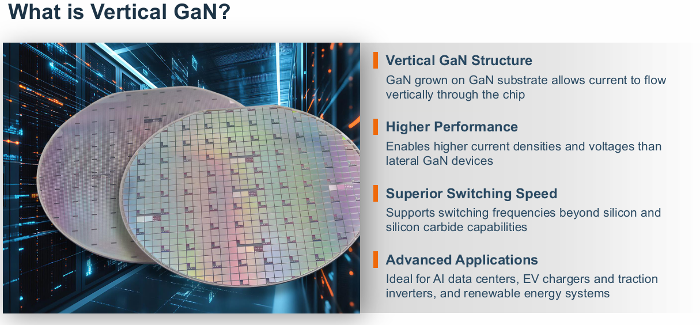
OVERVIEW: What is vGaN

Slide 6
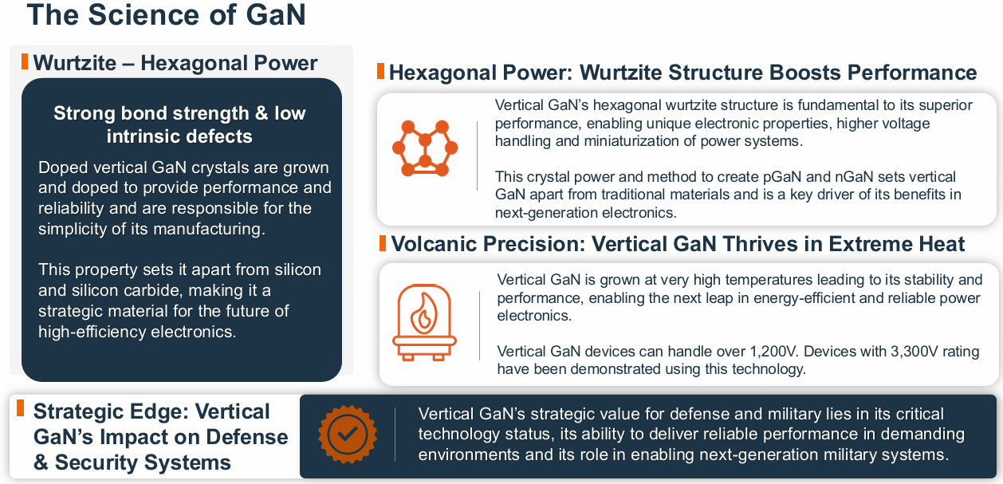
OVERVIEW: Science of vGaN

Slide 7
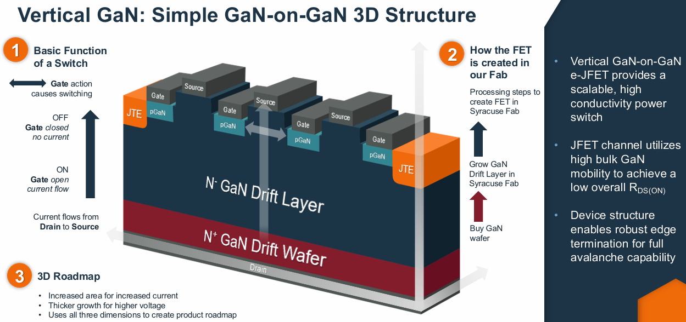
OVERVIEW: Simple vGaN Structure

Slide 8
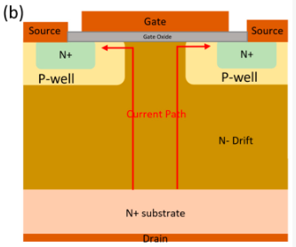
OVERVIEW: vGaN Property
Vertical GaN Properties
Current flows vertically from the bottom to the top surface
Don’t have a 2DEG drain drift region near the surface
Augment the thickness of the N-drift layer
Ability to exhibit avalanche breakdown
Langpoklakpam C, Liu A-C, Hsiao Y-K, Lin C-H, Kuo H-C. Vertical GaN MOSFET Power Devices. Micromachines. 2023; 14(10):1937. https://doi.org/10.3390/mi14101937

Slide 9
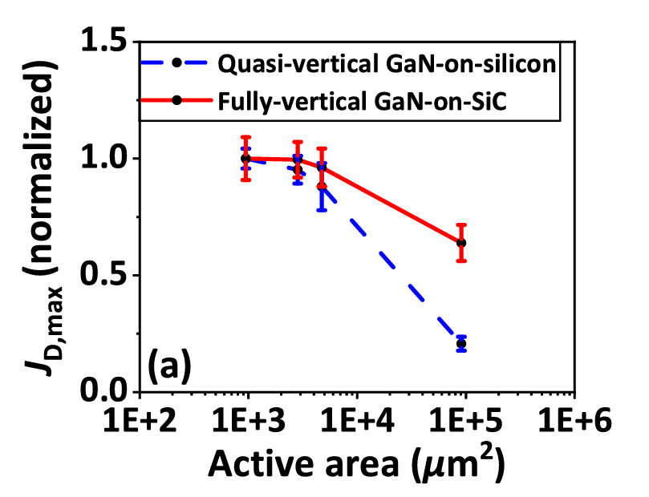
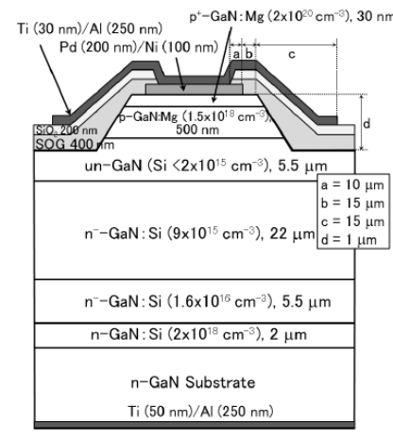
OVERVIEW: Vertical Current
Vertical Current Flow Path
Higher Current Density
Carry current through the full thickness of the drift region instead of a thin surface channel
Fully vs. Quasi (Inside vs. Surface)
Reduced current crowding effect allowing more effective scaling of current with the device area
Short current conduction path
This vertical path reduces series resistance, and enables higher current density, allowing the device to sustain higher breakdown voltage without increasing chip area.
Langpoklakpam C, Liu A-C, Hsiao Y-K, Lin C-H, Kuo H-C. Vertical GaN MOSFET Power Devices. Micromachines. 2023; 14(10):1937. https://doi.org/10.3390/mi14101937
Li, J., Zhu, R., Ming Wong, K., & May Lau, K. (2025). Fully-Vertical GaN-on-SiC Trench MOSFETs. IEEE Electron Device Letters, 46(2), 282–285. https://doi.org/10.1109/led.2024.3520200
‌

Slide 10

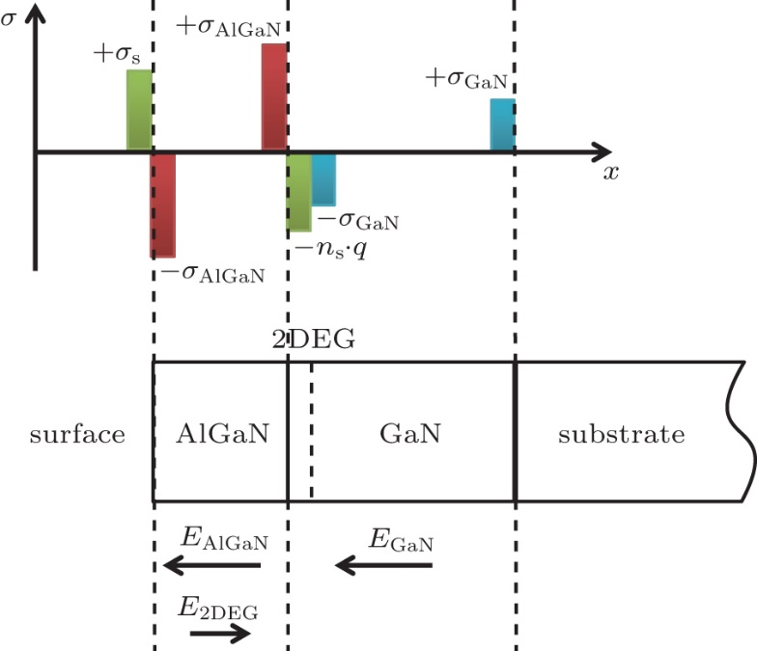
OVERVIEW: Reliability
No 2DEG drain drift region near the surface
2DEG sensitive
Traps, surface states, dynamic R_ON
Augment the thickness of the N-drift layer
A low-doped or unintentionally doped GaN epitaxial layer.
This makes the breakdown voltage independent of the lateral size of device.
Less degradation in dynamic R_ON
Due to trapped impurity charges or
bulk traps resulting from lattice mismatch
Ability to exhibit avalanche breakdown
Even distribution of the electric field within the device can mitigate the effects of current collapse by countering the influence of surface states, slowing down the collapse
High reliability
Electric field and current do not concentrate near the surface
This improves stability, reliability, and allows true avalanche behavior
Langpoklakpam C, Liu A-C, Hsiao Y-K, Lin C-H, Kuo H-C. Vertical GaN MOSFET Power Devices. Micromachines. 2023; 14(10):1937. https://doi.org/10.3390/mi14101937

Slide 11
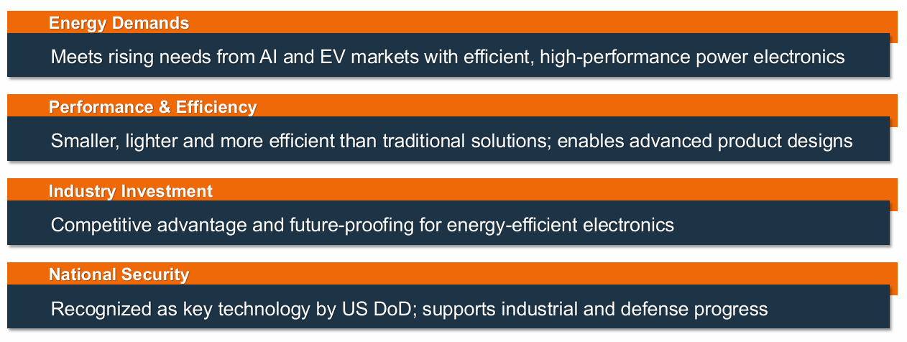
OVERVIEW: Advantages

Slide 12
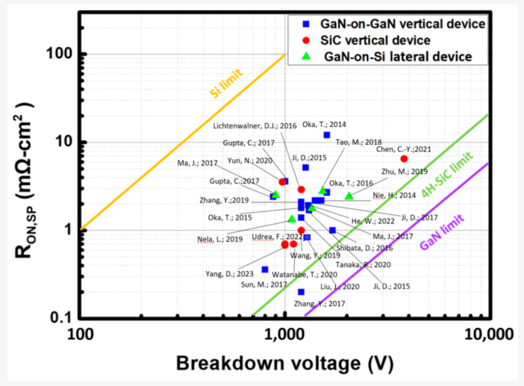
COMPARISON
Lateral GaN (Si)：
limited performance, with high RON at high voltage and low efficiency.
SiC：
mature and reliable, close to the material limit, suitable for 1–3 kV high-voltage applications.
Vertical GaN：
great potential, with RON close to SiC but still below the GaN theoretical limit.
Langpoklakpam C, Liu A-C, Hsiao Y-K, Lin C-H, Kuo H-C. Vertical GaN MOSFET Power Devices. Micromachines. 2023; 14(10):1937. https://doi.org/10.3390/mi14101937

Slide 13
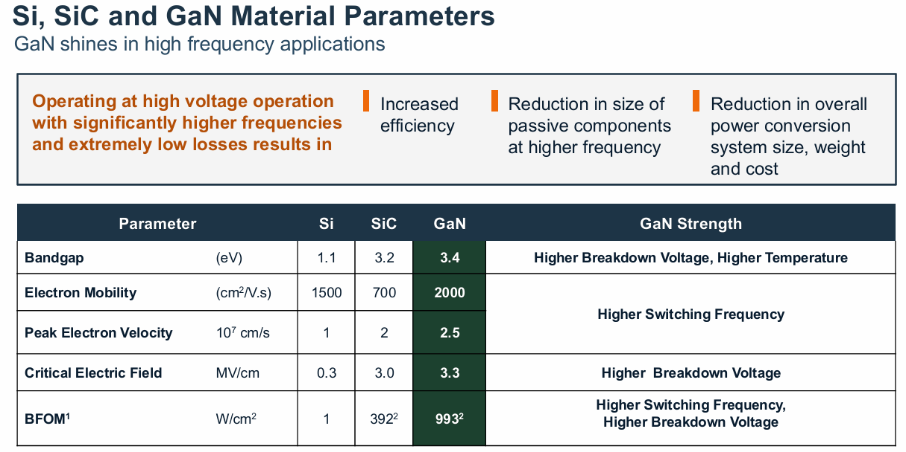
COMPARISON: Si/SiC

Slide 14
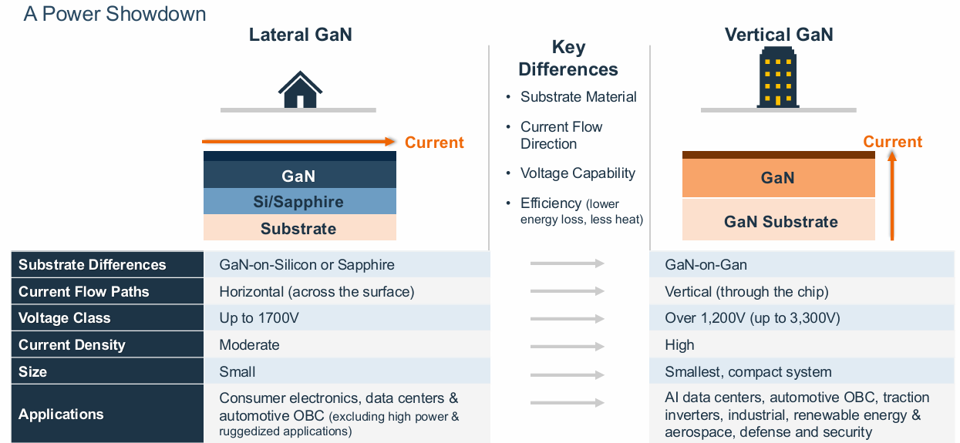
COMPARISON: Lateral GaN

Slide 15
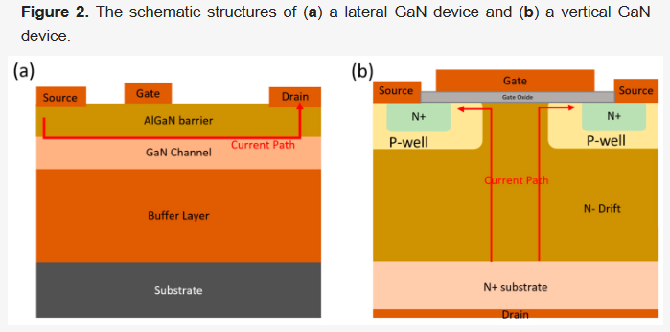
COMPARISON: KEY Difference
Lateral GaN
Because the electric field is concentrated near the surface, it will face premature breakdown when voltage increases
Vertical GaN
Since it spread the electric field across a thick GaN drift layer, allowing them to reach several kilovolts.
The key difference is the current direction
Lateral GaN conducts along the wafer surface (good for low-voltage);
Vertical GaN conducts through the substrate (suitable for high-voltage, high-current);
Vertical GaN offers higher breakdown voltage, lower on-resistance, higher power density, and better heat dissipation;
Therefore, vertical GaN is more suitable for high-voltage applications like power grids or industrial converters.

Slide 16


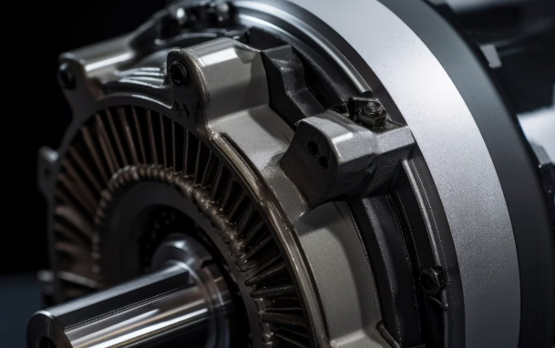
SUMMARY
Uniform Bulk Electric Field
Exhibit Avalanche Breakdown
Vertical Current Flow Path
Support High Voltage and High Current
Wide-bandgap semiconductor
High electron mobility and excellent thermal properties
Make GaN Suitable for High-Power and High-Frequency applications
PV Inverters
Data Center Power Delivery
Industrial Motor Drives
Vertical GaN Devices, the most promising technologies for next-generation power electronics

Slide 17
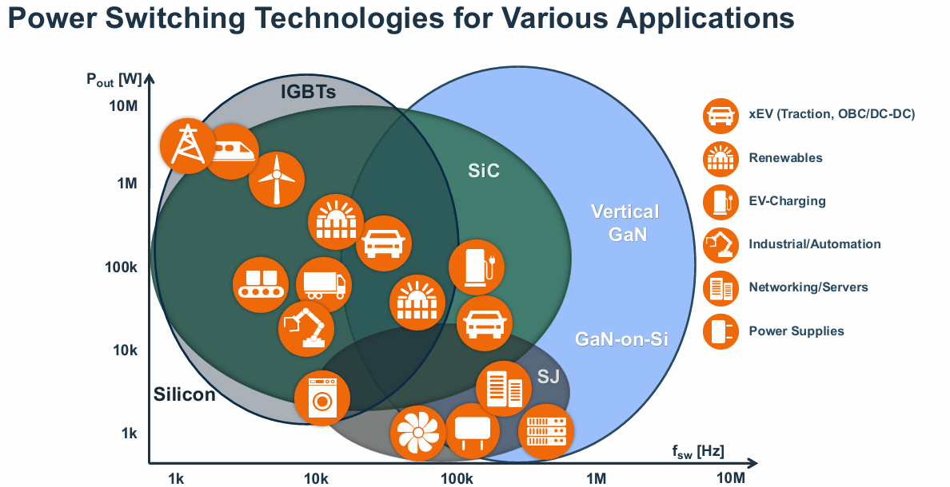
APPLICATIONS

Slide 18

APPLICATIONS

Slide 19

APPLICATIONS

Slide 20
FUTURE DEVELOPMENT
GaN on GaN:
Using a GaN substrate to fabricate GaN devices, offering better thermal performance and higher voltage tolerance, ideal for high-power and high-frequency applications
GaN on Si:
Integrating GaN devices on a silicon (Si) substrate, combining GaN's high efficiency with silicon's mature manufacturing process, reducing costs and enabling large-scale production
Optical Trigger:
The proposed device was benchmarked against other optical power switches, highlighting its potential in future low-cost, all optical, high-voltage power modules with reduced EMI susceptibility and circuit complexity.
Wrap-Around Gate:
The wrap-around-gate GaN trench CAVETs achieve strong channel control, low leakage, and high breakdown voltage. By tuning groove spacing, both normally-on and normally-off devices are realized, reaching up to 984 V and low specific on-resistance with scalable multi-finger high-current operation.

Slide 21

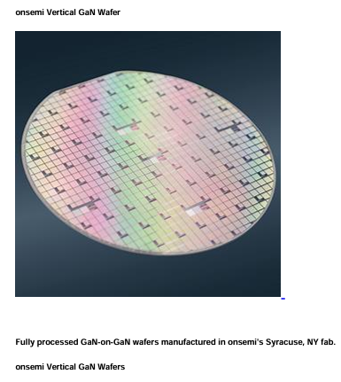
FUTURE DEVELOPMENT: GaN on GaN
From Motorola
2016 acquire Fairchild
ONSEMI is a core enabler of global automotive and industrial power and sensing technologies
October 30, 2025
ONSEMI launched 700V/1200V power-semiconductor devices now sampling with early customers;
Targets AI data-centers and EVs, slashes passive-component (caps, inductors) volume, enables 48 V backplane ultra-dense power;
Mass production slated for 2026; market share expected to ramp rapidly;
2025.10
Application wins
3× power-density boost;
ideal for EV on-board chargers (OBC) and solar inverters;
Challenges
high-cost native GaN substrates;
thermal conductivity still trails SiC;

Slide 22
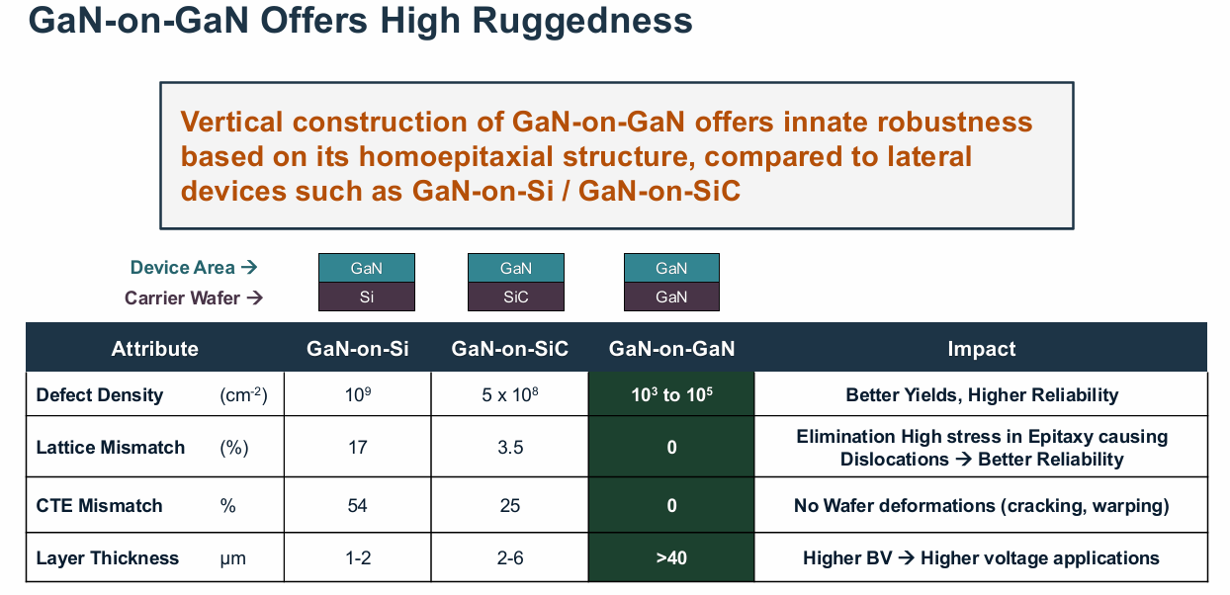
FUTURE DEVELOPMENT: GaN on GaN

Slide 23


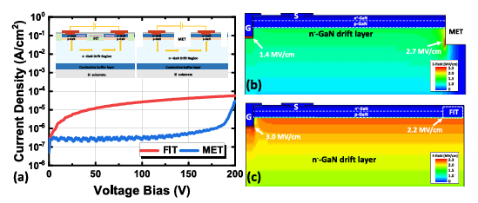
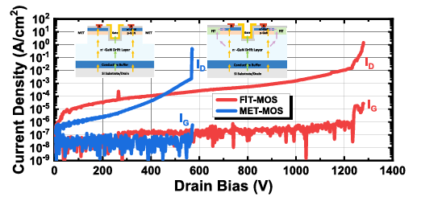
FUTURE DEVELOPMENT: GaN on Si
2025.09
Huawei and Shandong University jointly reported FIT-MOS that employs a fluorine-ion-implanted termination (FIT) structure
FIT(Fluorine-ion-implanted)
carries negative fixed charge,
forming a high-resistivity zone that naturally isolates the MOSFET devices
REPLACE
MET(Mesa-etched termination)
electric-field crowding effect at the mesa edges
567
1277
Y. Ma et al., "1200 V Fully-Vertical GaN-on-Si Power MOSFETs," in IEEE Electron Device Letters, vol. 46, no. 9, pp. 1513-1516, Sept. 2025, doi: 10.1109/LED.2025.3586947.

Slide 24
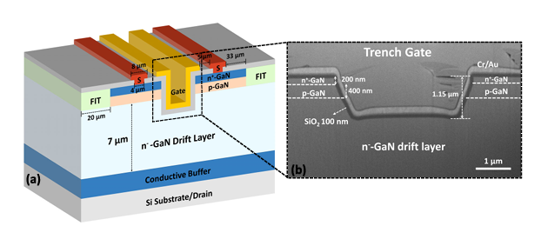
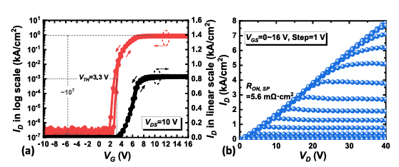
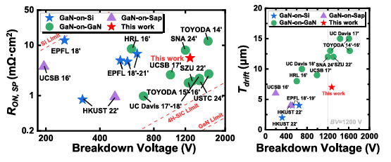
FUTURE DEVELOPMENT: GaN on Si
The breakdown voltage (BV) has been increased from
567 V in the MET-MOS to 1277 V in the FIT-MOS
In addition, the FIT-MOS exhibits
a threshold voltage (Vth) of 3.3 V；
an ON/OFF ratio of 10⁷；
a specific on-resistance (Ron,sp) of 5.6 mΩ·cm²；
an on-state current density of 8 kA/cm²；
The fluorine-ion-implanted termination (FIT) technology opens up broad prospects for the application of vertical GaN trench MOSFETs in kilovolt-class power systems.
Y. Ma et al., "1200 V Fully-Vertical GaN-on-Si Power MOSFETs," in IEEE Electron Device Letters, vol. 46, no. 9, pp. 1513-1516, Sept. 2025, doi: 10.1109/LED.2025.3586947.

Slide 25
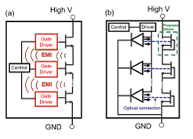
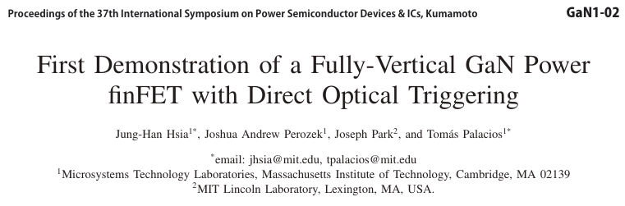
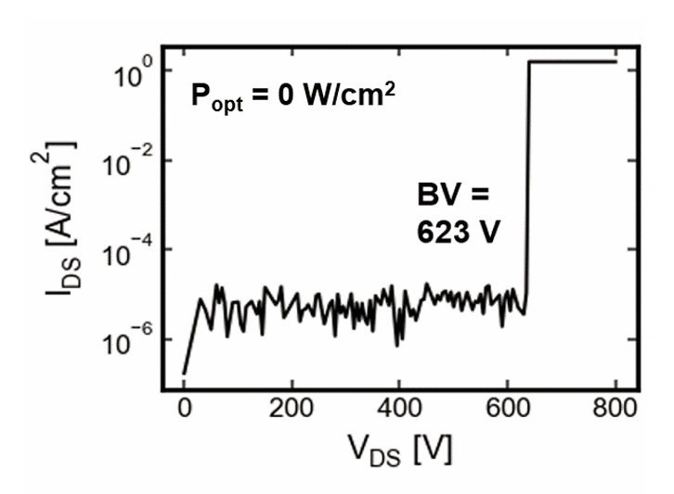
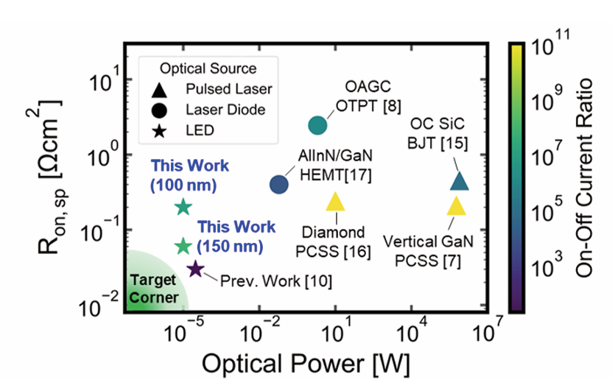
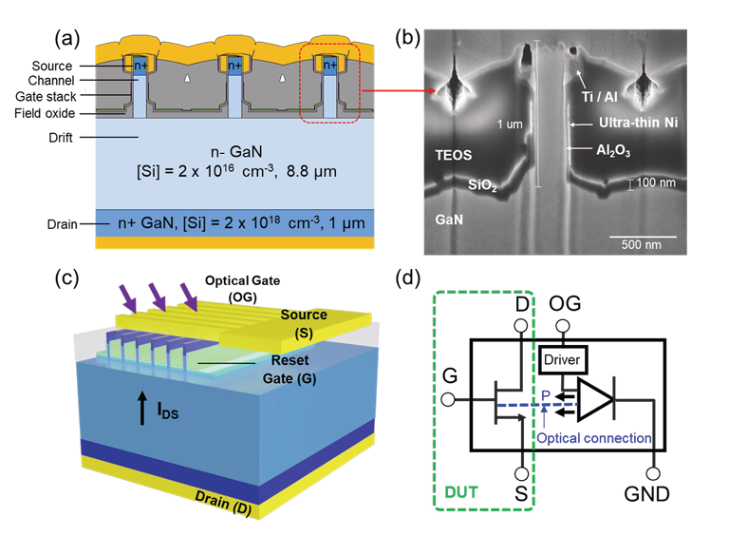
FUTURE DEVELOPMENT: Optcial Trigger
Tradition
2024.05
Optical Trigger
breakdown
Against other power switches
Structure
J. -H. Hsia, J. A. Perozek and T. Palacios, "First Demonstration of Optically-Controlled Vertical GaN finFET for Power Applications," in IEEE Electron Device Letters, vol. 45, no. 5, pp. 774-777, May 2024, doi: 10.1109/LED.2024.3375856.

Slide 26
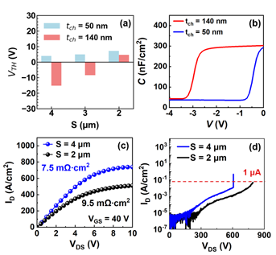
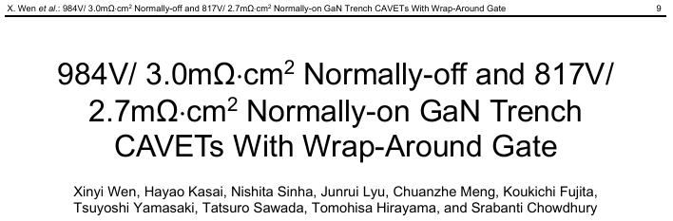
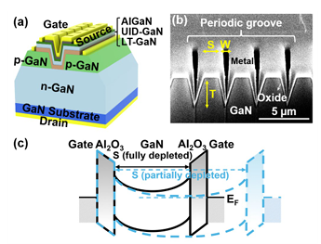
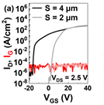
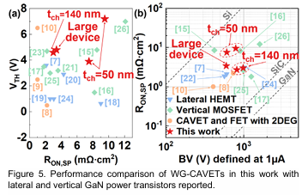
FUTURE DEVELOPMENT: Wrap-Around Gate
2025.07
S=4μm, on
S=2μm, off
X. Wen et al., "984V/ 3.0mΩ⋅cm2 Normally-off and 817V/ 2.7mΩ⋅cm2 Normally-on GaN Trench CAVETs With Wrap-Around Gate," in IEEE Electron Device Letters, doi: 10.1109/LED.2025.3631862.

Slide 27
REFERENCE
[1] Langpoklakpam C, Liu A-C, Hsiao Y-K, Lin C-H, Kuo H-C. Vertical GaN MOSFET Power Devices. Micromachines. 2023; 14(10):1937. https://doi.org/10.3390/mi14101937
[2] Li, J., Zhu, R., Ming Wong, K., & May Lau, K. (2025). Fully-Vertical GaN-on-SiC Trench MOSFETs. IEEE Electron Device Letters, 46(2), 282–285. https://doi.org/10.1109/led.2024.3520200
[3] Y. Ma et al., "1200 V Fully-Vertical GaN-on-Si Power MOSFETs," in IEEE Electron Device Letters, vol. 46, no. 9, pp. 1513-1516, Sept. 2025, doi: 10.1109/LED.2025.3586947.
[4] J. -H. Hsia, J. A. Perozek and T. Palacios, "First Demonstration of Optically-Controlled Vertical GaN finFET for Power Applications," in IEEE Electron Device Letters, vol. 45, no. 5, pp. 774-777, May 2024, doi: 10.1109/LED.2024.3375856.
[5] X. Wen et al., "984V/ 3.0mΩ⋅cm2 Normally-off and 817V/ 2.7mΩ⋅cm2 Normally-on GaN Trench CAVETs With Wrap-Around Gate," in IEEE Electron Device Letters, doi: 10.1109/LED.2025.3631862.

Slide 28
THANK YOU

