Slide 1






iFixFlakies: A Framework for Automatically Fixing
Order-Dependent Flaky Tests
August Shi, Wing Lam, Reed Oei, Tao Xie, Darko Marinov
ESEC/FSE 2019
Tallinn, Estonia
8/29/2019
CNS-1513939
CNS-1564274
CNS-1646305
CNS-1740916
CCF-1763788
CCF-1816615
OAC-1839010

Slide 2
Order-Dependent (OD) Flaky Tests
Cannot always have same order
JUnit tests ran in different order after upgrading Java 6 to 7^{1,2,3}
Code Under Test
Regression testing techniques
(prioritization, selection, etc)
can lead to different orders
test₀
test₀
test₀
test₁
test₂
test₂
test₂
test₁
test₁
…
…
…
test_{n}
test_{n}
test_{n}
¹http://intellijava.blogspot.com/2012/05/junit-and-java-7.html
²http://www.java-allandsundry.com/2013/01/
³https://coderanch.com/t/600985/engineering/Maintaining-order-JUnit-tests-JDK

Slide 3
Example 1 (from WildFly)
public class WritableServiceBasedNamingStoreTestCase {
@Test public void testBind() throws Exception {
final Name name = new CompositeName(“test”);
final Object value = new Object();
...
assertEquals(value, store.lookup(name));
}
@Test public void testPermissions() throws Exception {
...
final String name = “a/b”;
final Object value = new Object();
...
store.bind(new CompositeName(name), value);
...
}
}
State-Setter
Makes brittle pass if run before
State-setter has a fix!
Brittle
Fails if run before state-setter
testBind
testPermissions
How to Fix?
testPermissions
testBind
Notes:
<DEFINE “FIX”>
…While this seems to be a relatively simple case where we can directly fix with the relevant state-setter, there is a more complicated case

Slide 4
Example 2 (from ElasticJob)
public class ShutdownListenerManagerTest {
@Test public void assertIsShutdownAlready() {
shutdownListenerManager.new InstanceShutdownStatusJobListener()
dataChanged((“/test_job/instances/127.0.0.1 @ - @0”, ...));
verify(schedulerFacade, times(0)).shutdownInstance();
}
@Test public void assertRemoveLocalInstancePath() {
JobRegistry.getInstance().registerJob(“test_job”, …);
shutdownListenerManager.new InstanceShutdownStatusJobListener().
dataChanged((“/test_job/instances/127.0.0.1 @ - @0”, ...));
verify(schedulerFacade).shutdownInstance();
}
}
Victim
Fails if run after polluter
Polluter
Makes victim fail if run before
assertIsShutdownAlready
assertRemoveLocalInstancePath
How to Fix?
assertRemoveLocalInstancePath
assertIsShutdownAlready

Slide 5
A Fix is also in the Test Suite!
Cleaner
Makes victim pass when run between
polluter and victim
public class FailoverServiceTest {
@Test public void assertGetFailoverItems() {
JobRegistry.getInstance().registerJob(“test_job”, ...);
when(jobNodeStorage.getJobNodeChildrenKeys(...)).thenReturn(...));
when(jobNodeStorage.isJobNodeExisted(...)).thenReturn(true);
when(jobNodeStorage.isJobNodeExisted(...)).thenReturn(true);
when(jobNodeStorage.isJobNodeExisted(...)).thenReturn(false);
when(jobNodeStorage.getJobNodeDataDirectly(...)).thenReturn(...);
when(jobNodeStorage.getJobNodeDataDirectly(...)).thenReturn(...);
assertThat(...);
verify(jobNodeStorage).getJobNodeChildrenKeys(...);
verify(jobNodeStorage).isJobNodeExisted(...);
verify(jobNodeStorage).isJobNodeExisted(...);
verify(jobNodeStorage).getJobNodeDataDirectly(...);
verify(jobNodeStorage).getJobNodeDataDirectly(...);
JobRegistry.getInstance().shutdown(“test_job”);
}
}
ShutdownListenerManagerTest.
assertRemoveLocalInstancePath
FailoverServiceTest.
assertGetFailoverItems
ShutdownListenerManagerTest.
assertIsShutdownAlready
ShutdownListenerManagerTest.
assertIsShutdownAlready
Notes:
<Practice animation sync up of arrow with speaking>

Slide 6
iFixFlakies
Test suites often already have logic for setting/resetting state for OD tests!
We can fix OD tests by using the code the test suites already have
iFixFlakies automates this process
https://sites.google.com/view/ifixflakies

Slide 7
iFixFlakies Overview
iFixFlakies
Passing Order
test₀
test₁
test₂
Failing Order
test₀
test₂
test₁
Patches
Notes:
<at least one of each order>

Slide 8
iFixFlakies Overview
iFixFlakies
Passing Order
Minimizer
Patcher
test₀
test₁
test₂
Failing Order
test₀
test₂
test₁
Patches

Slide 9
Minimizer Overview
Input: A passing order, a failing order
Determine OD test kind by running the OD test in isolation
    Passing means victim, failing means brittle
Find polluters from failing order, state-setters from passing order
Find cleaner for polluter/victim pairs
Output: Polluters/cleaners/state-setters

Slide 10
Minimizer Overview
Input: A passing order, a failing order
Determine OD test kind by running the OD test in isolation
    Passing means victim, failing means brittle
Find polluters from failing order, state-setters from passing order
Find cleaner for polluter/victim pairs
Output: Polluters/cleaners/state-setters

Slide 11
Minimizer (Determine OD Test Kind)
T₀
T₁
T₂
T₃
T₃
V

Slide 12
Minimizer (Find Polluter)
T₀
T₁
T₂
V
T₂
V
T₀
T₁
V
Polluter
P
V
T₁
Can be configured to find
multiple polluters

Slide 13
Minimizer (Find Cleaner)
T₀
P
T₂
V
T₄
All tests are candidate cleaners
Notes:
All tests are candidate cleaners to try, because it is very important to have them for iFixFlakies to work!

Slide 14
Minimizer (Find Cleaner)
T₀
P
T₂
V
T₄
P
T₀
V
P
P
V
P
T₂
V
Cleaner
P
V
V
P
C
V
T₄

Slide 15
Patcher Overview
Input: Polluters/cleaners/state-setters
Make copy of cleaner/state-setter as new helper method, to be minimized
    Also include setup/teardown code
Add call to helper method in OD test
Delta debug statements in helper method until OD test passes
Attempt to inline minimized statements into the OD test
Output: One patch per cleaner/state-setter

Slide 16
Patcher Example
public class FailoverServiceTest {
@Test public void assertGetFailoverItems() {
JobRegistry.getInstance().registerJob(“test_job”, ...);
when(jobNodeStorage.getJobNodeChildrenKeys(...)).thenReturn(...));
when(jobNodeStorage.isJobNodeExisted(...)).thenReturn(true);
when(jobNodeStorage.isJobNodeExisted(...)).thenReturn(true);
when(jobNodeStorage.isJobNodeExisted(...)).thenReturn(false);
when(jobNodeStorage.getJobNodeDataDirectly(...)).thenReturn(...);
when(jobNodeStorage.getJobNodeDataDirectly(...)).thenReturn(...);
assertThat(...);
verify(jobNodeStorage).getJobNodeChildrenKeys(...);
verify(jobNodeStorage).isJobNodeExisted(...);
verify(jobNodeStorage).isJobNodeExisted(...);
verify(jobNodeStorage).getJobNodeDataDirectly(...);
verify(jobNodeStorage).getJobNodeDataDirectly(...);
JobRegistry.getInstance().shutdown(“test_job”);
}
}

Slide 17
Patcher Example
public class FailoverServiceTest {
public void helper() {
JobRegistry.getInstance().registerJob(“test_job”, ...);
when(jobNodeStorage.getJobNodeChildrenKeys(...)).thenReturn(...));
when(jobNodeStorage.isJobNodeExisted(...)).thenReturn(true);
when(jobNodeStorage.isJobNodeExisted(...)).thenReturn(true);
when(jobNodeStorage.isJobNodeExisted(...)).thenReturn(false);
when(jobNodeStorage.getJobNodeDataDirectly(...)).thenReturn(...);
when(jobNodeStorage.getJobNodeDataDirectly(...)).thenReturn(...);
assertThat(...);
verify(jobNodeStorage).getJobNodeChildrenKeys(...);
verify(jobNodeStorage).isJobNodeExisted(...);
verify(jobNodeStorage).isJobNodeExisted(...);
verify(jobNodeStorage).getJobNodeDataDirectly(...);
verify(jobNodeStorage).getJobNodeDataDirectly(...);
JobRegistry.getInstance().shutdown(“test_job”);
}
}
Try to inline this statement
public class ShutdownListenerManagerTest {
@Test public void assertIsShutdownAlready() {
new FailoverServiceTest().helper();
...
}}
assertRemoveLocalInstancePath
public class ShutdownListenerManagerTest {
@Test public void assertIsShutdownAlready() {
JobRegistry.getInstance().shutdown(“test_job”);
...
}}
assertIsShutdownAlready
helper + assertIsShutdownAlready
helper + assertIsShutdownAlready
Notes:
<Not compiling is also reason for not accepting code in the middle>

Slide 18
Experimental Setup
OD tests taken from public dataset collected in our prior work¹
  10 projects, 110 OD tests
RQ1: Breakdown of kinds of OD tests?
RQ2: Characteristics of patches?
RQ3: Running time of iFixFlakies?
¹Lam et al., “iDFlakies: A Framework for Detecting and Partially Classifying Flaky Tests”. ICST 2019.

Slide 19
RQ1: Breakdowns
Project - Module | # OD Tests | # Victims | # Brittles | # Victims w/ Cleaners
alibaba/fastjson | 11 | 4 | 7 | 1
apache/incubator-dubbo - m1 | 4 | 4 | 0 | 4
- m2 | 4 | 3 | 1 | 3
- m3 | 1 | 1 | 0 | 1
- m4 | 3 | 3 | 0 | 0
apache/jackrabbit-oak | 2 | 1 | 1 | 0
apache/struts | 4 | 4 | 0 | 4
dropwizard/dropwizard | 1 | 1 | 0 | 1
elasticjob/elastic-job-lite | 6 | 6 | 0 | 5
jfree/jfreechart | 1 | 1 | 0 | 0
kevinsawicki/http-request | 28 | 28 | 0 | 28
undertow-io/undertow | 1 | 1 | 0 | 1
wildfly/wildfly | 44 | 43 | 1 | 0
Total/Average | 110 | 100 | 10 | 48
Over half can be automatically fixed!

Slide 20
RQ2: Patch Characteristics
 | # Patches | # Unique Patches
Average | 25.2 | 3.3
Many cleaners/state-setters result in the same patch
 | First Patch |  | All Patches
 | Avg. # Stmts | Avg. % Stmts from Original | Avg. # Stmts | Avg. % Stmts from Original
Average | 1.9 | 22.6% | 1.8 | 24.6%
Final patches are small parts of the original cleaner/state-setter test
(69.5% of patches consist of only one statement!)
First patch obtained is similar in size to all others
Recommendation: Only generate a handful of patches

Slide 21
RQ2: Patches as Pull Requests
Submitted pull requests for 56 of 58 OD tests
  2 of 58 already fixed before our work
Pull requests for 21 of 56 tests accepted so far
  Remaining pending, nothing rejected
A patch for a brittle in WildFly also fixed 43 victims that have no cleaners!

Slide 22
RQ3: Runtime of iFixFlakies
* = spent time determining no cleaners
Project - Module | Test suite time (s) | Avg. time to find first (s)
 |  | polluter | cleaner | state-setter | patch
alibaba/fastjson | 203 | 92 | *523 | 42 | 299
apache/incubator-dubbo - m1 | 8 | 22 | 52 | n/a | 294
- m2 | 206 | 143 | 178 | 21 | 130
- m3 | 1 | 2 | 4 | n/a | 395
- m4 | 3 | 19 | *104 | n/a | n/a
apache/jackrabbit-oak | 189 | 218 | *5,710 | 50 | 416
apache/struts | 4 | 13 | 11 | n/a | 411
dropwizard/dropwizard | 7 | 36 | 16 | n/a | 714
elasticjob/elastic-job-lite | 24 | 45 | *293 | n/a | 258
jfree/jfreechart | 22 | 16 | *1,695 | n/a | n/a
kevinsawicki/http-request | 2 | 15 | 5 | n/a | 56
undertow-io/undertow | 17 | 32 | 79 | n/a | 232
wildfly/wildfly | 3 | 21 | *114 | 19 | 463
Total/Average | 35 | 29 | 176 | 37 | 186

Slide 23
RQ3: Runtime of iFixFlakies (cont’d)
* = spent time determining no cleaners
Project - Module | Test suite time (s) | Avg. time to find all (s)
 |  | polluters | cleaners | state-setters | patches
alibaba/fastjson | 203 | 113 | *1,443 | 1,748 | 25,424
apache/incubator-dubbo - m1 | 8 | 48 | 465 | n/a | 2,473
- m2 | 206 | 389 | 7,089 | 39 | 54,856
- m3 | 1 | 2 | 25 | n/a | 572
- m4 | 3 | 19 | *104 | n/a | n/a
apache/jackrabbit-oak | 189 | 218 | *5,710 | 50 | 416
apache/struts | 4 | 13 | 159 | n/a | 14,478
dropwizard/dropwizard | 7 | 57 | 589 | n/a | 4,960
elasticjob/elastic-job-lite | 24 | 45 | *1,434 | n/a | 11,854
jfree/jfreechart | 22 | 16 | *1,695 | n/a | n/a
kevinsawicki/http-request | 2 | 15 | 227 | n/a | 56
undertow-io/undertow | 17 | 109 | 1,025 | n/a | 2,617
wildfly/wildfly | 3 | 21 | *114 | 186 | 4,749
Total/Average | 35 | 39 | 592 | 1,154 | 9,737
Recommendation: Do not spend time searching for all patches

Slide 24
Conclusions
Order-dependent (OD) tests can often be automatically fixed
  Test suites often have logic that can fix them!
iFixFlakies can automatically find and minimize the fixes for these tests
Automatically fixed 58 out of 110 OD tests
  Pull requests for 21 of 56 OD tests accepted, remaining are pending, nothing rejected
https://sites.google.com/view/ifixflakies
awshi2@illinois.edu

Slide 25
I will be on the job market!
August Shi
http://mir.cs.illinois.edu/awshi2/

Slide 26
BACKUP

Slide 27
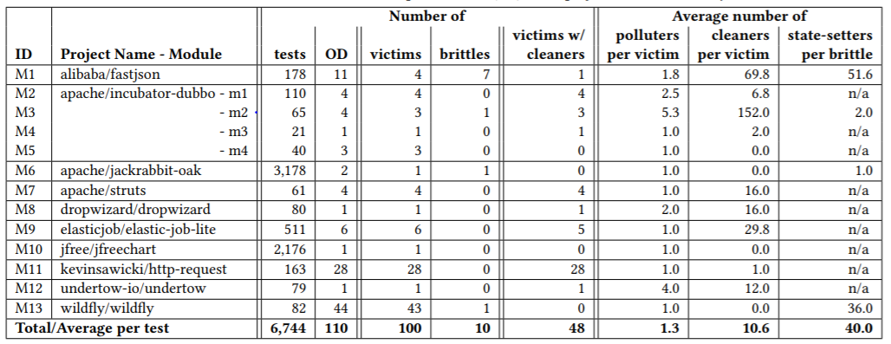
RQ1

Slide 28
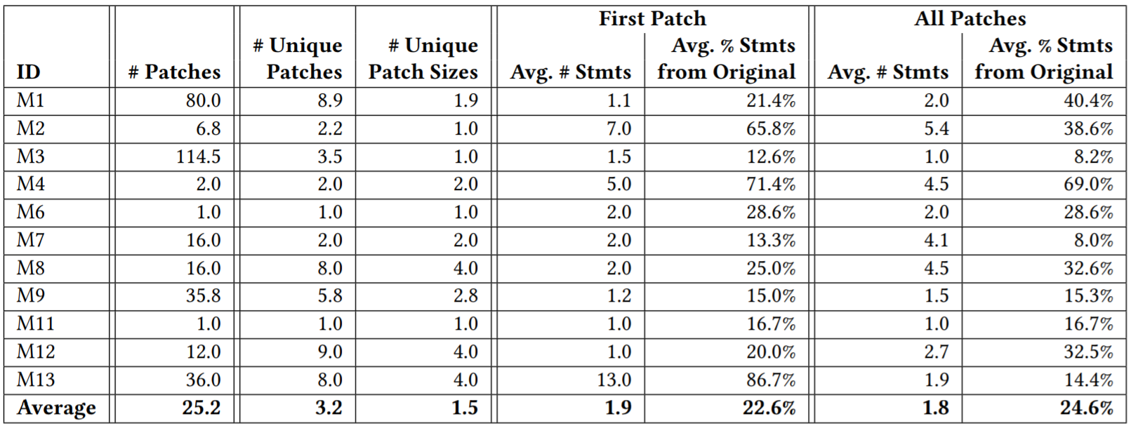
RQ2

Slide 29
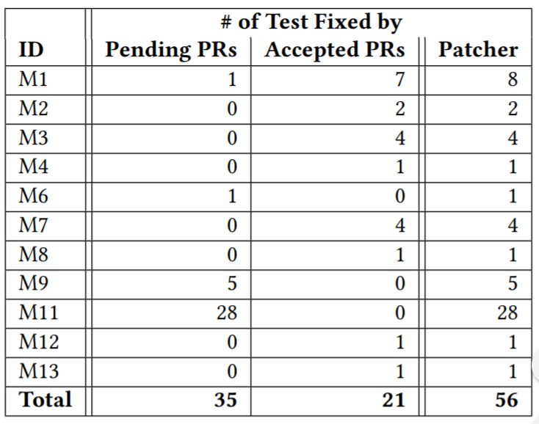
RQ2 cont.

Slide 30
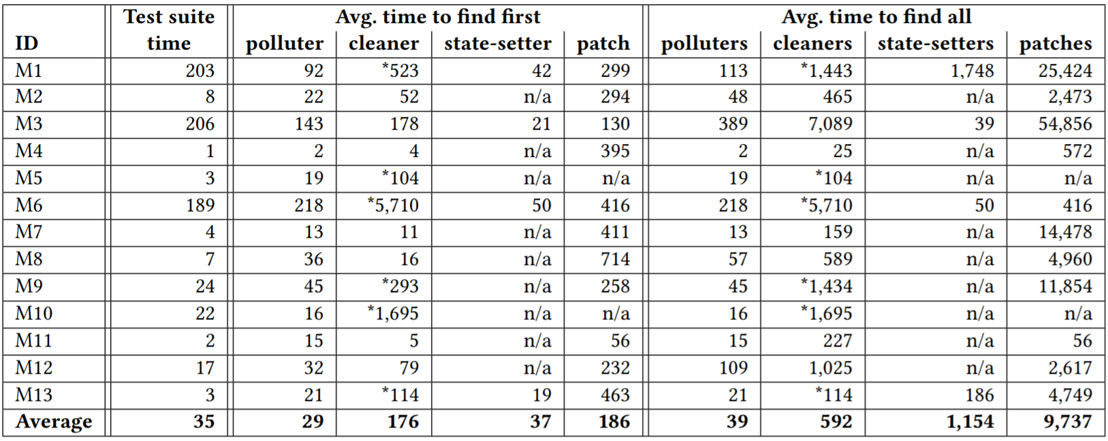
RQ3

