Slide 1






Understanding and Improving Regression Test Selection in Continuous Integration
August Shi, Peiyuan Zhao, Darko Marinov
Practical Experience Report
ISSRE 2019
Berlin, Germany
October 30, 2019
CCF-1421503 CNS-1646305 CNS-1740916
CCF-1763788 OAC-1839010

Slide 2




Continuous Integration
Build/test code from scratch
on fresh machine
Cloud-based
Version Control
CI Server
2
Fetch Changes
Build
Test
3
Pass/Fail
Commit Changes
Slow!
Travis CI
1
Fail
?
Facebook Buck
Google Tap
Microsoft CloudBuild
Pass
4
Release/Deploy
Developers

Slide 3
Regression Test Selection (RTS)
Tests
Tests
Code Under Test
v1733
T0
T1
T2
T3
…
TN
Code Under Test
v1734
T0
T1
T2
T3
…
TN
Change
Track dependencies between tests and code under test

Slide 4
Granularity of Dependencies
Class-level
vs
Module-level
(Academia)
(Industry)

Slide 5
Class-level RTS
Changed
Changed
C1
C4
C5
Conf
T1
T4
T5
C2
C3
Run
T2
T3
Academia
  Ekstazi, HyRTS, STARTS
Finer-grained selection (vs module-level)
Analysis can be somewhat slow (e.g., running instrumented code)
Can miss dependencies on non-code files
Run

Slide 6
Module-level RTS
M1
M3
Changed
Changed
C1
C4
C5
Conf
M2
T1
T4
T5
C2
C3
Run
Run
T2
T3
Industry
  Facebook Buck, Google Bazel, Microsoft CloudBuild
Coarse-grained selection (all tests in a module)
Faster analysis than class-level
Cannot miss to select affected tests (otherwise would not build)
Run
Run

Slide 7
How do Class- and Module-level RTS compare
in a cloud-based CI setting?
How do we improve them?

Slide 8
Our Work
Evaluate class- and module-level RTS in a cloud-based continuous integration system
Run representative tools
  Ekstazi: class-level RTS
  GIB: module-level RTS
  GIBstazi: hybrid class/module-level RTS
Measure tests selected and time to run
Measure failing tests selected

Slide 9
Travis CI: Cloud-based CI Service
Builds and tests code after every change
  Cloud-based: builds from scratch on fresh VM
Configured to build individual jobs
  Failing/erroring job can block push/merge
Fetch Changes
Build
Test
Pass/Fail

Slide 10
Travis CI Job Phases
Job
Need to incorporate RTS tools into this workflow
Error
Install cache
Error
before_install
install
mvn install -DskipTests=true
-Dmaven.javadoc.skip=true -B -V
Error
Download all third-party libraries
Compile code
Error
before_script
Fail
script
mvn test -B
Error
before_cache
Pass

Slide 11
RTS on Travis CI
Modify project to include RTS tool
Record number of tests run
Measure time to run job using RTS
}
Job
}
script
Test time
Total time

Slide 12
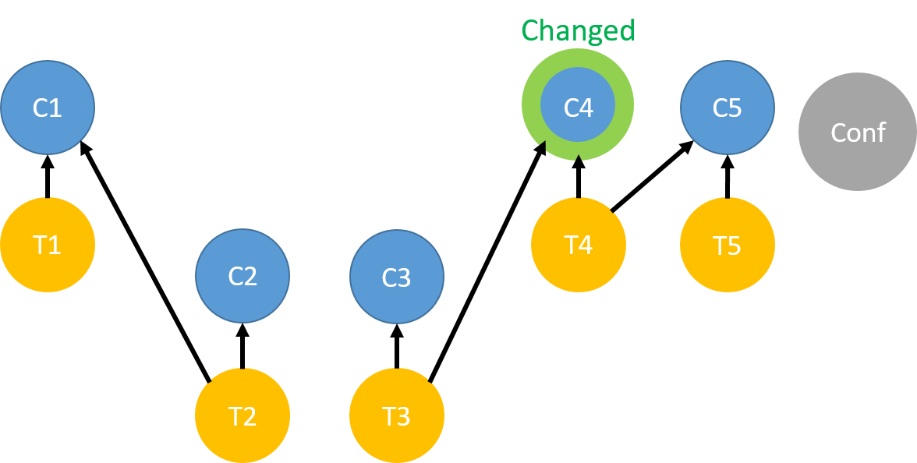
Ekstazi
Class-level RTS¹
  Run tests on instrumented code to track dependencies between tests and classes
  Save metadata in local .ekstazi/ directories
Compute changes from compiled classes
(checksum of classes)
Dependencies computed dynamically
¹http://www.ekstazi.org

Slide 13
Ekstazi on Travis CI
In cloud, need to preserve .ekstazi/ directories between all runs
Install cache
Copy in .ekstazi/ directories
before_install
Turn off Ekstazi
install
before_script
Turn on Ekstazi
script
before_cache
Collect .ekstazi/ directories

Slide 14
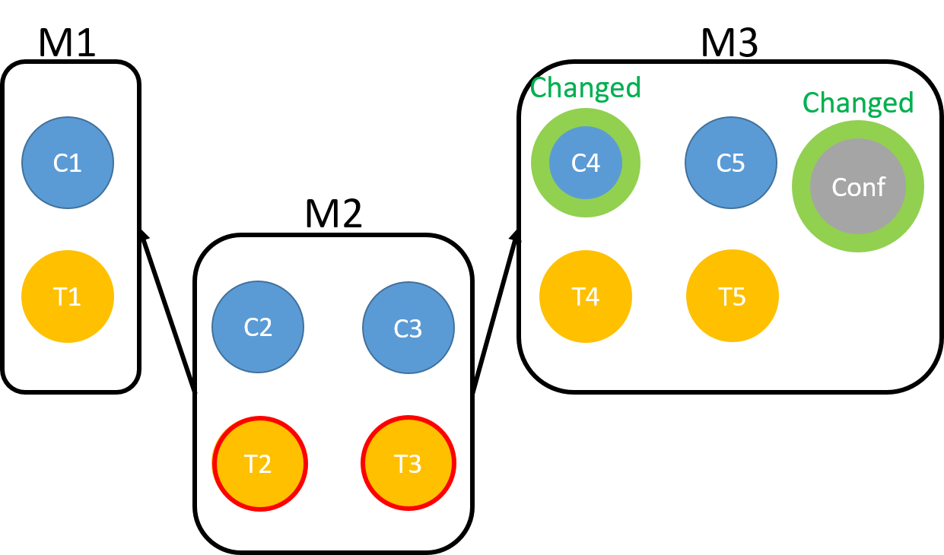
Gitflow Incremental Builder (GIB)
Module-level RTS¹
  Performs incremental module-based Maven builds, but can be used for RTS
Compute changes using git diff
Specified by developers in pom.xml build configuration file
¹https://github.com/vackosar/gitflow-incremental-builder

Slide 15
GIB on Travis CI
Install cache
before_install
Turn off GIB
install
before_script
Turn on GIB
script
before_cache

Slide 16
Preliminary: Basic GIB Ineffective
Almost always selecting all tests
  Selected all modules in 65% of the commits
  Selected >70% of all modules in all commits
Commits that only change documentation, e.g., README
Commits that change top-level pom.xml
  But only changed authors

Slide 17
GIB (modified)
Apply filters for changes to files to ignore
  README, *.txt, *.html, etc.
Ignore pom.xml change if no classpath change
Install cache
Copy in classpath file
before_install
Turn off GIB
install
before_script
Turn on GIB
script
before_cache
Collect classpath file

Slide 18
GIBstazi
Hybrid of Ekstazi and GIB¹
Goal:
  Safer than Ekstazi w.r.t. non-code files
  More precise than GIB in tests selected
Steps:
  Use GIB to determine affected modules
  Only run Ekstazi on affected modules
  If non-Java change, use regular GIB logic
¹https://github.com/august782/gitflow-incremental-builder

Slide 19
GIBstazi on Travis CI
Same modifications as Ekstazi and GIB on Travis CI
Install cache
Copy in .ekstazi/ directories and classpath file
before_install
Turn off GIBstazi
install
before_script
Turn on GIBstazi
script
before_cache
Collect .ekstazi/ directories and classpath file

Slide 20
Experimental Setup
Evaluate on 22 projects that use Travis CI
  Long-building projects with multiple modules
Replay 1377 past jobs on Travis CI with RetestAll and the 3 RTS tools
RQ1: What are the RTS % tests, % total time, % test time of RetestAll?
RQ2: How well does RTS select failing tests?

Slide 21
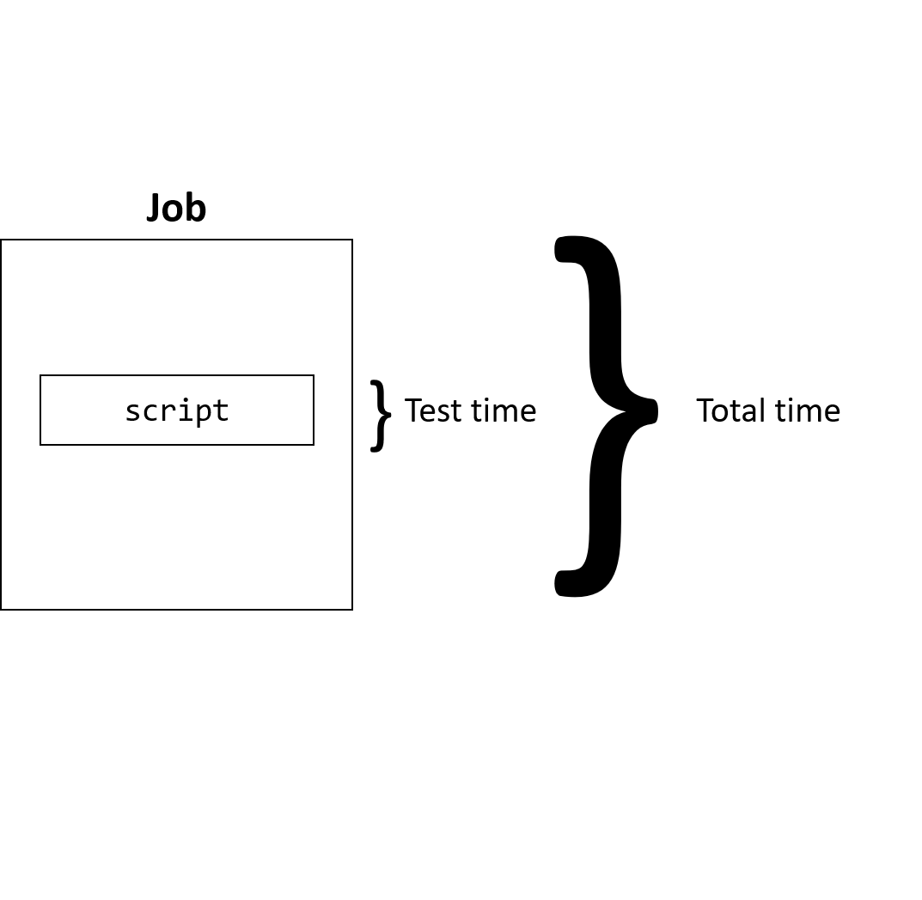
RQ1: Tests Selected/RTS Time
Compare RTS techniques against RetestAll
  Measure tests run and time of RetestAll job runs
% of RetestAll Tests Selected
% of RetestAll Test Time
  Only time in script phase
% of RetestAll Total Time
  End-to-end job time
Expectation: Ekstazi < GIBstazi < GIB

Slide 22
RQ1: Tests Selected/RTS Time
Ekstazi
Tests (%) | Test Time (%) | Total Time (%)
100.0 | 100.3 | 104.5
7.1 | 58.9 | 97.8
77.1 | 114.8 | 86.6
11.6 | 94.6 | 121.7
14.4 | 50.5 | 62.1
45.5 | 30.5 | 65.7
2.5 | 37.5 | 56.7
21.5 | 35.0 | 49.9
38.7 | 71.0 | 75.7
0.0 | 36.9 | 70.0
24.1 | 59.2 | 50.9
1.7 | 8.9 | 27.5
21.8 | 73.5 | 85.4
96.1 | 89.5 | 94.8
28.3 | 79.9 | 95.4
55.1 | 84.0 | 102.3
21.4 | 42.0 | 93.3
55.8 | 62.5 | 83.3
15.7 | 35.6 | 41.7
118.1 | 204.0 | 163.1
18.3 | 68.5 | 70.8
0.0 | 4.3 | 13.7
GIB
Tests (%) | Test Time (%) | Total Time (%)
100.0 | 94.6 | 102.9
24.4 | 39.1 | 78.3
29.3 | 33.7 | 43.4
57.3 | 61.4 | 74.4
94.0 | 97.5 | 97.9
58.2 | 58.5 | 68.3
17.5 | 29.8 | 80.4
10.4 | 16.0 | 33.7
100.0 | 86.9 | 101.4
100.0 | 109.9 | 115.3
91.1 | 94.1 | 83.1
21.9 | 36.9 | 47.1
44.8 | 57.3 | 71.7
126.3 | 610.1 | 111.4
47.9 | 58.9 | 81.8
22.0 | 26.8 | 47.5
32.9 | 46.3 | 102.7
100.0 | 97.5 | 98.1
78.1 | 76.0 | 78.9
68.0 | 80.0 | 80.8
47.0 | 62.3 | 64.1
27.9 | 32.7 | 37.1
GIBstazi
Tests (%) | Test Time (%) | Total Time (%)
100.0 | 84.7 | 92.8
24.4 | 40.4 | 70.3
29.3 | 44.0 | 58.9
29.1 | 55.7 | 80.9
85.6 | 97.6 | 99.3
41.3 | 53.7 | 73.8
13.7 | 31.5 | 79.1
10.3 | 16.9 | 35.4
59.0 | 75.6 | 97.2
100.0 | 154.4 | 131.7
26.5 | 58.9 | 45.0
11.2 | 14.4 | 33.2
10.2 | 34.8 | 62.3
146.5 | 138.7 | 123.4
25.1 | 60.8 | 81.5
16.7 | 25.7 | 49.8
32.5 | 54.2 | 102.9
56.1 | 61.6 | 69.2
15.7 | 26.9 | 34.3
69.8 | 109.0 | 88.7
37.4 | 64.8 | 67.0
0.0 | 1.8 | 10.9
ID
P1
P2
P3
P4
P5
P6
P7
P8
P9
P10
P11
P12
P13
P14
P15
P16
P17
P18
P19
P20
P21
P22
Selecting >100% Tests?!
GIBstazi is faster?!
AVG
35.2 | 65.5 | 77.9
59.1 | 86.6 | 77.3
42.8 | 59.4 | 72.2

Slide 23
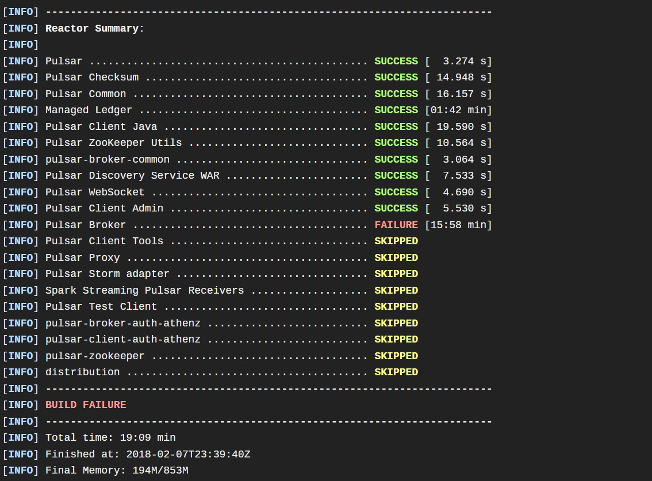
Why >100% Selection?!
RetestAll can fail early due to test failures
This is reality
but doesn’t help us answer the RQ…

Slide 24
RQ1: Tests Selected/RTS Time (Filtered)
ID | GIBstazi
 | Tests (%) | Total Time (%) | Test Time (%)
P1 | 100.0 | 99.2 | 97.2
P2 | 24.4 | 40.4 | 70.3
P4 | 29.1 | 55.7 | 80.9
P5 | 100.0 | 109.7 | 109.7
P6 | 43.6 | 56.1 | 74,4
P7 | 13.7 | 31.5 | 79.1
P8 | 10.4 | 16.9 | 35.5
P9 | 59.0 | 75.6 | 97.2
P10 | 100.0 | 154.4 | 131.7
P11 | 26.5 | 58.9 | 46.0
P12 | 7.7 | 13.0 | 29.6
P13 | 7.5 | 29.5 | 67.6
P15 | 26.0 | 63.7 | 91.0
P16 | 17.5 | 28.5 | 41.5
P17 | 31.8 | 53.7 | 102.7
P18 | 56.1 | 61.6 | 69.2
P19 | 100.0 | 99.3 | 99.9
P21 | 40.0 | 68.1 | 70.2
AVG | 44.1 | 62.0 | 77.4
Ekstazi
Tests (%) | Test Time (%) | Total Time (%)
100.0 | 101.1 | 97.0
7.1 | 58.9 | 97.8
11.6 | 94.6 | 121.7
16.6 | 49.8 | 60.6
44.6 | 25.8 | 62.0
2.5 | 37.5 | 56.7
21.7 | 35.1 | 50.1
38.7 | 71.0 | 75.7
0.0 | 36.9 | 70.0
24.1 | 59.2 | 50.9
0.8 | 4.6 | 21.6
25.1 | 49.8 | 73.0
5.8 | 69.4 | 93.9
55.8 | 87.6 | 94.0
20.8 | 41.7 | 93.4
55.8 | 62.5 | 83.3
100.0 | 100.9 | 101.4
19.5 | 62.7 | 65.2
GIB
Tests (%) | Test Time (%) | Total Time (%)
100.0 | 102.8 | 100.9
24.4 | 39.1 | 78.3
57.3 | 61.4 | 74.4
100.0 | 103.6 | 103.4
61.5 | 61.5 | 69.7
17.5 | 29.8 | 80.4
10.5 | 16.0 | 33.7
100.0 | 86.9 | 101.4
100.0 | 109.9 | 115.3
91.1 | 94.1 | 83.1
7.7 | 8.7 | 22.5
33.5 | 48.4 | 72.1
47.4 | 61.8 | 91.6
25.9 | 31.9 | 40.9
32.1 | 45.7 | 102.4
100.0 | 97.5 | 98.1
100.0 | 98.6 | 99.3
49.1 | 64.9 | 66.9
GIBstazi
Tests (%) | Test Time (%) | Total Time (%)
100.0 | 99.2 | 97.2
24.4 | 40.4 | 70.3
29.1 | 55.7 | 80.9
100.0 | 109.7 | 109.7
43.6 | 56.1 | 74,4
13.7 | 31.5 | 79.1
10.4 | 16.9 | 35.5
59.0 | 75.6 | 97.2
100.0 | 154.4 | 131.7
26.5 | 58.9 | 46.0
7.7 | 13.0 | 29.6
7.5 | 29.5 | 67.6
26.0 | 63.7 | 91.0
17.5 | 28.5 | 41.5
31.8 | 53.7 | 102.7
56.1 | 61.6 | 69.2
100.0 | 99.3 | 99.9
40.0 | 68.1 | 70.2
No Statistical Difference
AVG
30.6 | 58.3 | 76.0
58.8 | 64.6 | 79.7
44.1 | 62.0 | 77.4

Slide 25
Why is Ekstazi Running Slower?
Running more tests:
  Non-deterministic compilation -> seemingly more changes than developer intended
  Incomplete prior runs do not cache .ekstazi/
    Selecting based on old changes
  More in paper
Running longer:
  Instrumented runs are longer
  Overhead of analyzing unaffected modules

Slide 26
RQ2: Failing Tests
What percent of RetestAll failing tests do the RTS techniques select?
Three categories for failing tests:
  Selected
  Not Selected
  Unknown
    Early failures lead to later modules being skipped, so unknown if later test selected
Ideally, 0% for “Not Selected”
  Expectation: Ekstazi > GIBstazi = GIB

Slide 27

RQ2: Failing Tests Results
Ekstazi %
Sel. | Not Sel. | Unknown
0.0 | 100.0 | 0.0
50.0 | 50.0 | 0.0
0.0 | 100.0 | 0.0
20.0 | 70.0 | 10.0
100.0 | 0.0 | 0.0
57.1 | 42.9 | 0.0
20.0 | 60.0 | 20.0
0.0 | 14.3 | 85.7
0.0 | 100.0 | 0.0
84.6 | 0.0 | 15.4
50.0 | 50.0 | 0.0
GIB %
Sel. | Not Sel. | Unknown
100.0 | 0.0 | 0.0
50.0 | 50.0 | 0.0
0.0 | 100.0 | 0.0
70.0 | 30.0 | 0.0
100.0 | 0.0 | 0.0
71.4 | 28.6 | 0.0
0.0 | 100.0 | 0.0
0.0 | 100.0 | 0.0
0.0 | 100.0 | 0.0
53.9 | 46.2 | 0.0
100.0 | 0.0 | 0.0
GIBstazi %
Sel. | Not Sel. | Unknown
100.0 | 0.0 | 0.0
50.0 | 50.0 | 0.0
0.0 | 100.0 | 0.0
20.0 | 70.0 | 10.0
100.0 | 0.0 | 0.0
71.4 | 28.6 | 0.0
0.0 | 100.0 | 0.0
0.0 | 100.0 | 0.0
0.0 | 100.0 | 0.0
38.5 | 46.1 | 15.4
50.0 | 50.0 | 0.0
ID | # Failed Tests | GIB %
 |  | Sel. | Not Sel. | Unknown
P5 | 1 | 100.0 | 0.0 | 0.0
P6 | 2 | 50.0 | 50.0 | 0.0
P12 | 1 | 0.0 | 100.0 | 0.0
P13 | 10 | 70.0 | 30.0 | 0.0
P14 | 47 | 100.0 | 0.0 | 0.0
P15 | 7 | 71.4 | 28.6 | 0.0
P16 | 5 | 0.0 | 100.0 | 0.0
P17 | 7 | 0.0 | 100.0 | 0.0
P19 | 1 | 0.0 | 100.0 | 0.0
P20 | 13 | 53.9 | 46.2 | 0.0
P21 | 2 | 100.0 | 0.0 | 0.0
SUM/AVG
96
69.8 | 19.8 | 10.4
72.9 | 27.1 | 0.0
64.6 | 32.3 | 3.1
Are we missing bugs by using RTS?!

Slide 28
No, They’re Flaky!
Flaky tests: tests that can nondeterministically pass or fail on the same, unchanged code
All but one failing test confirmed as flaky after rerunning them
  All RTS techniques selected the one non-flaky test

Slide 29

RQ2: Failing Tests Results (revisited)
Ekstazi %
Sel. | Not Sel. | Unknown
0.0 | 100.0 | 0.0
50.0 | 50.0 | 0.0
0.0 | 100.0 | 0.0
20.0 | 70.0 | 10.0
100.0 | 0.0 | 0.0
57.1 | 42.9 | 0.0
20.0 | 60.0 | 20.0
0.0 | 14.3 | 85.7
0.0 | 100.0 | 0.0
84.6 | 0.0 | 15.4
50.0 | 50.0 | 0.0
GIB %
Sel. | Not Sel. | Unknown
100.0 | 0.0 | 0.0
50.0 | 50.0 | 0.0
0.0 | 100.0 | 0.0
70.0 | 30.0 | 0.0
100.0 | 0.0 | 0.0
71.4 | 28.6 | 0.0
0.0 | 100.0 | 0.0
0.0 | 100.0 | 0.0
0.0 | 100.0 | 0.0
53.9 | 46.2 | 0.0
100.0 | 0.0 | 0.0
GIBstazi %
Sel. | Not Sel. | Unknown
100.0 | 0.0 | 0.0
50.0 | 50.0 | 0.0
0.0 | 100.0 | 0.0
20.0 | 70.0 | 10.0
100.0 | 0.0 | 0.0
71.4 | 28.6 | 0.0
0.0 | 100.0 | 0.0
0.0 | 100.0 | 0.0
0.0 | 100.0 | 0.0
38.5 | 46.1 | 15.4
50.0 | 50.0 | 0.0
ID | # Failed Tests | GIB %
 |  | Sel. | Not Sel. | Unknown
P5 | 1 | 100.0 | 0.0 | 0.0
P6 | 2 | 50.0 | 50.0 | 0.0
P12 | 1 | 0.0 | 100.0 | 0.0
P13 | 10 | 70.0 | 30.0 | 0.0
P14 | 47 | 100.0 | 0.0 | 0.0
P15 | 7 | 71.4 | 28.6 | 0.0
P16 | 5 | 0.0 | 100.0 | 0.0
P17 | 7 | 0.0 | 100.0 | 0.0
P19 | 1 | 0.0 | 100.0 | 0.0
P20 | 13 | 53.9 | 46.2 | 0.0
P21 | 2 | 100.0 | 0.0 | 0.0
SUM/AVG
96
69.8 | 19.8 | 10.4
72.9 | 27.1 | 0.0
64.6 | 32.3 | 3.1

Slide 30
Conclusions
Evaluated different levels of RTS on Travis CI
All techniques performed relatively similar w.r.t. tests selected and time
  Class-level better in terms of (local) test time
  No statistical differences in total time
All techniques selected to run real failing tests
  All non-selected failing tests were flaky
  RTS is good at avoiding flaky failures!
awshi2@illinois.edu

